Slide 1
Cloudmesh
Gregor von Laszewski
laszewski@gmail.com
DIBBS meeting, Washington DC

Slide 2
Cloudmesh Client and Portal
Simplify access
Queueing Systems
Containers
IaaS
Parallelism
Task
Compute
Data
(GPU)
XSEDE
HPC
Clouds
Comet
Jetstream
Bridges

Slide 3
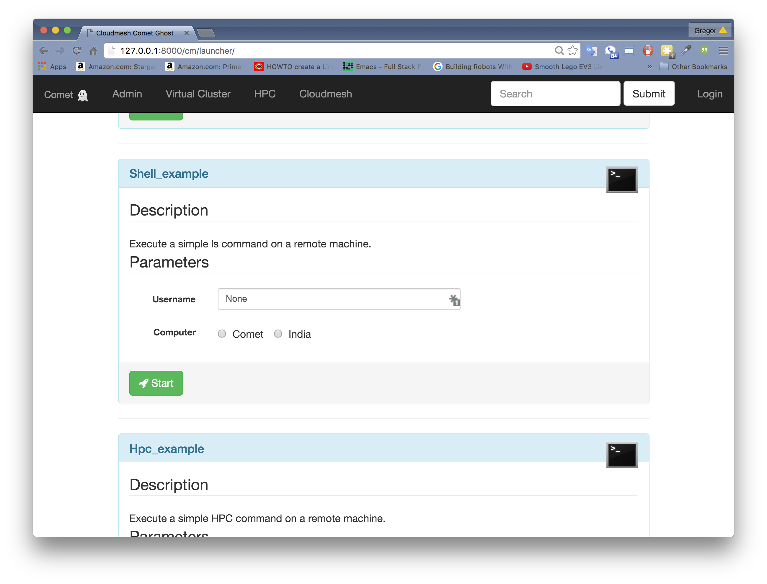
Cloudmesh Client and Portal
$ cm cm> register remote cm> default cloud=kilo cm> vm boot
Data Repository
Access
Command Shell & Line
API
REST
(PORTAL)
Compute
VMs, Containers, Batch
Choreography
Groups, Workflows, PaaS

Slide 4
Install
We recommend
python 2.7.10
pip 7.1.2
Will install on
Linux
OSX
Windows
pip install cloudmesh_client
Once we have finalized, we will work towards and there is need:
rpm, dpg, ..
dmg
exe

Slide 5
SHell
Shell
Command Line
$ cm
cm> register remote
cm> default cloud=kilo
cm> vm boot
Yes that is it! Defaults for images and flavors can be set
cm register remote
cm default cloud=kilo
cm vm boot
Integration of the cybera (Alberta, Canada)
took 5 minutes

Slide 6
PaaS Management
Virtual Cluster
Hadoop
$ cm cluster –n 10 –group=myCluster
$cm hadoop –n 10 –group=myHadoop

Slide 7
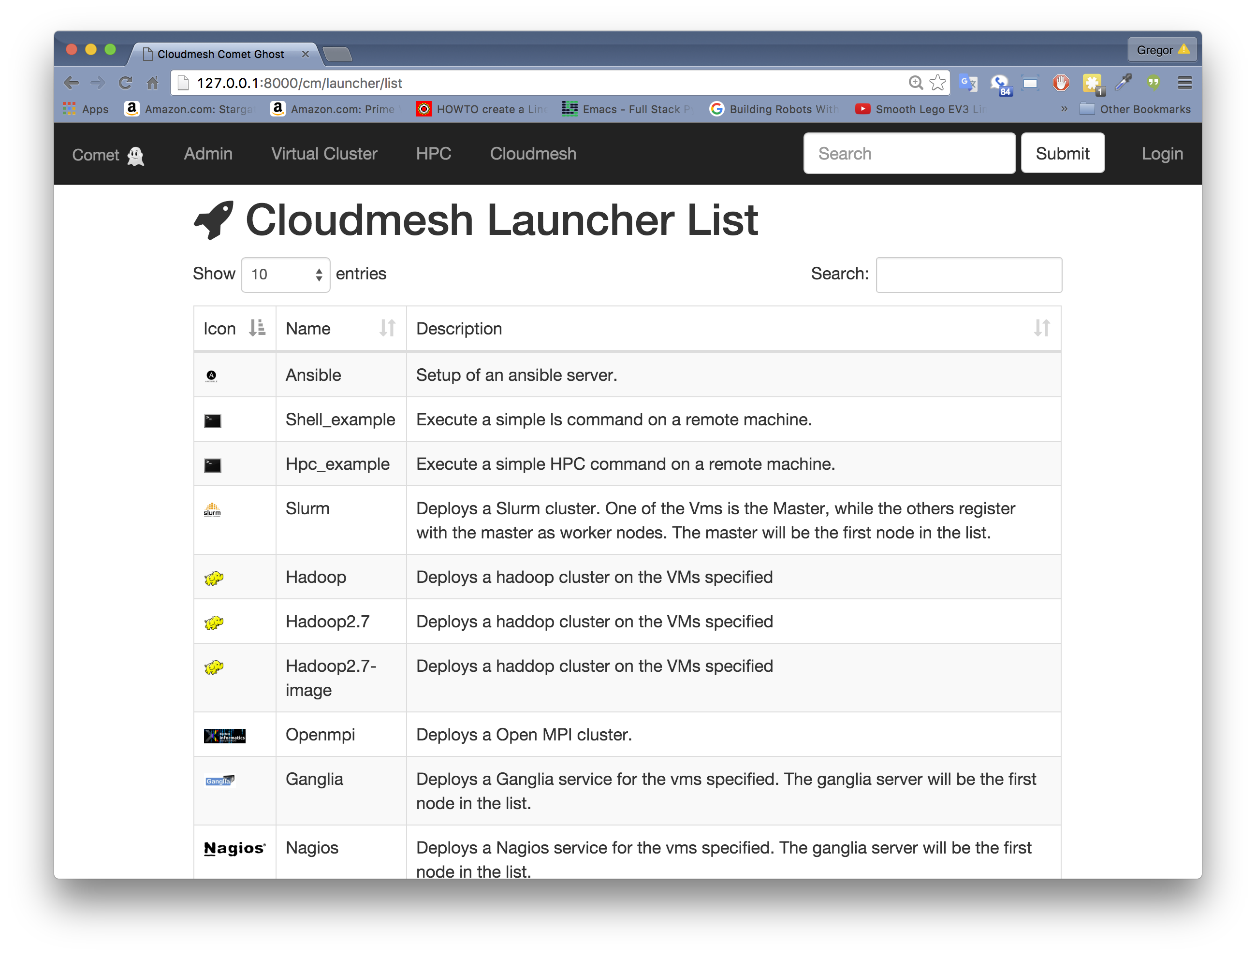
Launchers: commands via GUI
Specific Launch
List of Launchers

