Slide 1
Private Client
Graph
Reviewable family and trust relationships
from private-client source documents
FTEC5660 hackathon
17 October 2026
Draft for review
Draft for review. Evaluation and deployment approval remain pending.
1
Notes:
Project scope: docs/design/final-build-day.md. Synthetic material only. Deck figures must come from retained final Runs.

Slide 2
The source-review problem
Family and trust facts span notes, letters and later updates.
“Alice Chen confirmed that Bob Chen is a beneficiary of the Evergreen Family Trust.”
A graph makes connections visible. A solicitor still needs to inspect the words that support each relationship and distinguish a current appointment from an earlier one.
Case 01, synthetic attendance note
Project objective: produce inspectable proposed relationships for professional review.
Draft for review. Evaluation and deployment approval remain pending.
2
Notes:
Sources: GLOSSARY.md; PRODUCT.md; cases/case_01/source.txt. The quoted sentence is a synthetic fixture. No efficiency or market-size claim.

Slide 3
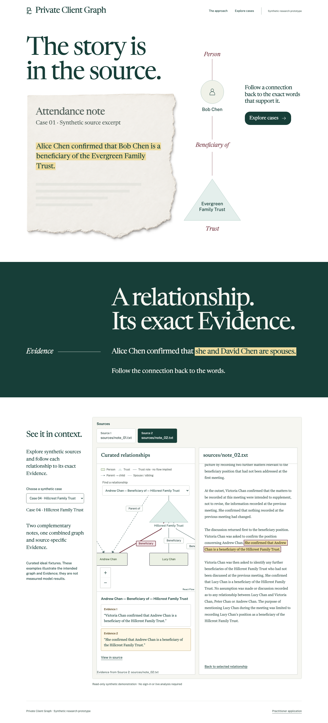
Evidence beside the relationship graph
Select a relationship, choose its Evidence and inspect the exact passage in the correct Source.
Practitioners review a saved proposal before confirming the whole graph as current Matter state.
Local public showcase. Curated synthetic Case 04.
Draft for review. Evaluation and deployment approval remain pending.
3
Notes:
Screenshot: local P6 deterministic browser run on 17 October 2026. Source: submission/assets/showcase-case-04.png. Curated ideal fixture, not a recorded model result or deployed build.

Slide 4
System architecture
Ordered Sources
Final PDF text
Extract
One full-context call
Resolve
No-resolution config
Construct
Deterministic validation
Model interprets semantics
Matter Proposal
Source-aware relational facts
Code validates identity, types, exact quotes, support and deduplication. PostgreSQL preserves Source attribution and aggregate integrity.
Accepted Matter
Whole-proposal confirmation
Draft for review. Evaluation and deployment approval remain pending.
4
Notes:
Sources: docs/CODE_STYLE.md; ADR0008; ADR0009; approved final-build-day design. Fixed Extract/Resolve/Construct topology. Application uses approved no-resolution configuration.

Slide 5
Source identity travels with Evidence
A quote carries an explicit Source ID. Repeated titles and repeated words do not identify the document.
Exact quote occurrence checks mechanical provenance. It does not prove that the passage entails the relationship.
note_01
Initial attendance note
Andrew Chan
beneficiary of
Hillcrest Family Trust
note_02
Follow-up attendance note
Exact-text validation checks occurrence. Professional review checks meaning.
One canonical relationship can retain support from both Sources.
Draft for review. Evaluation and deployment approval remain pending.
5
Notes:
Sources: canonical_state.py; models/source.py; models/sourced_evidence.py; cases/case_04/source_evidence.json. Title is display text, not source identity.

Slide 6
Explicit updates define the current trustee
1 September
David Ng is sole trustee
15 September
Rachel Lim is sole trustee
Replacement effective 10 September
The final current graph retains Rachel’s trustee edge and the five unchanged family and trust relationships.
The source documents retain the historical statement. The application adds no event store or historical-date selector.
Draft for review. Evaluation and deployment approval remain pending.
6
Notes:
Sources: cases/case_05/sources/note_01.txt and note_02.txt. Source-aware expected_state.json is an authored ideal. Dates refer to fictional events.

Slide 7
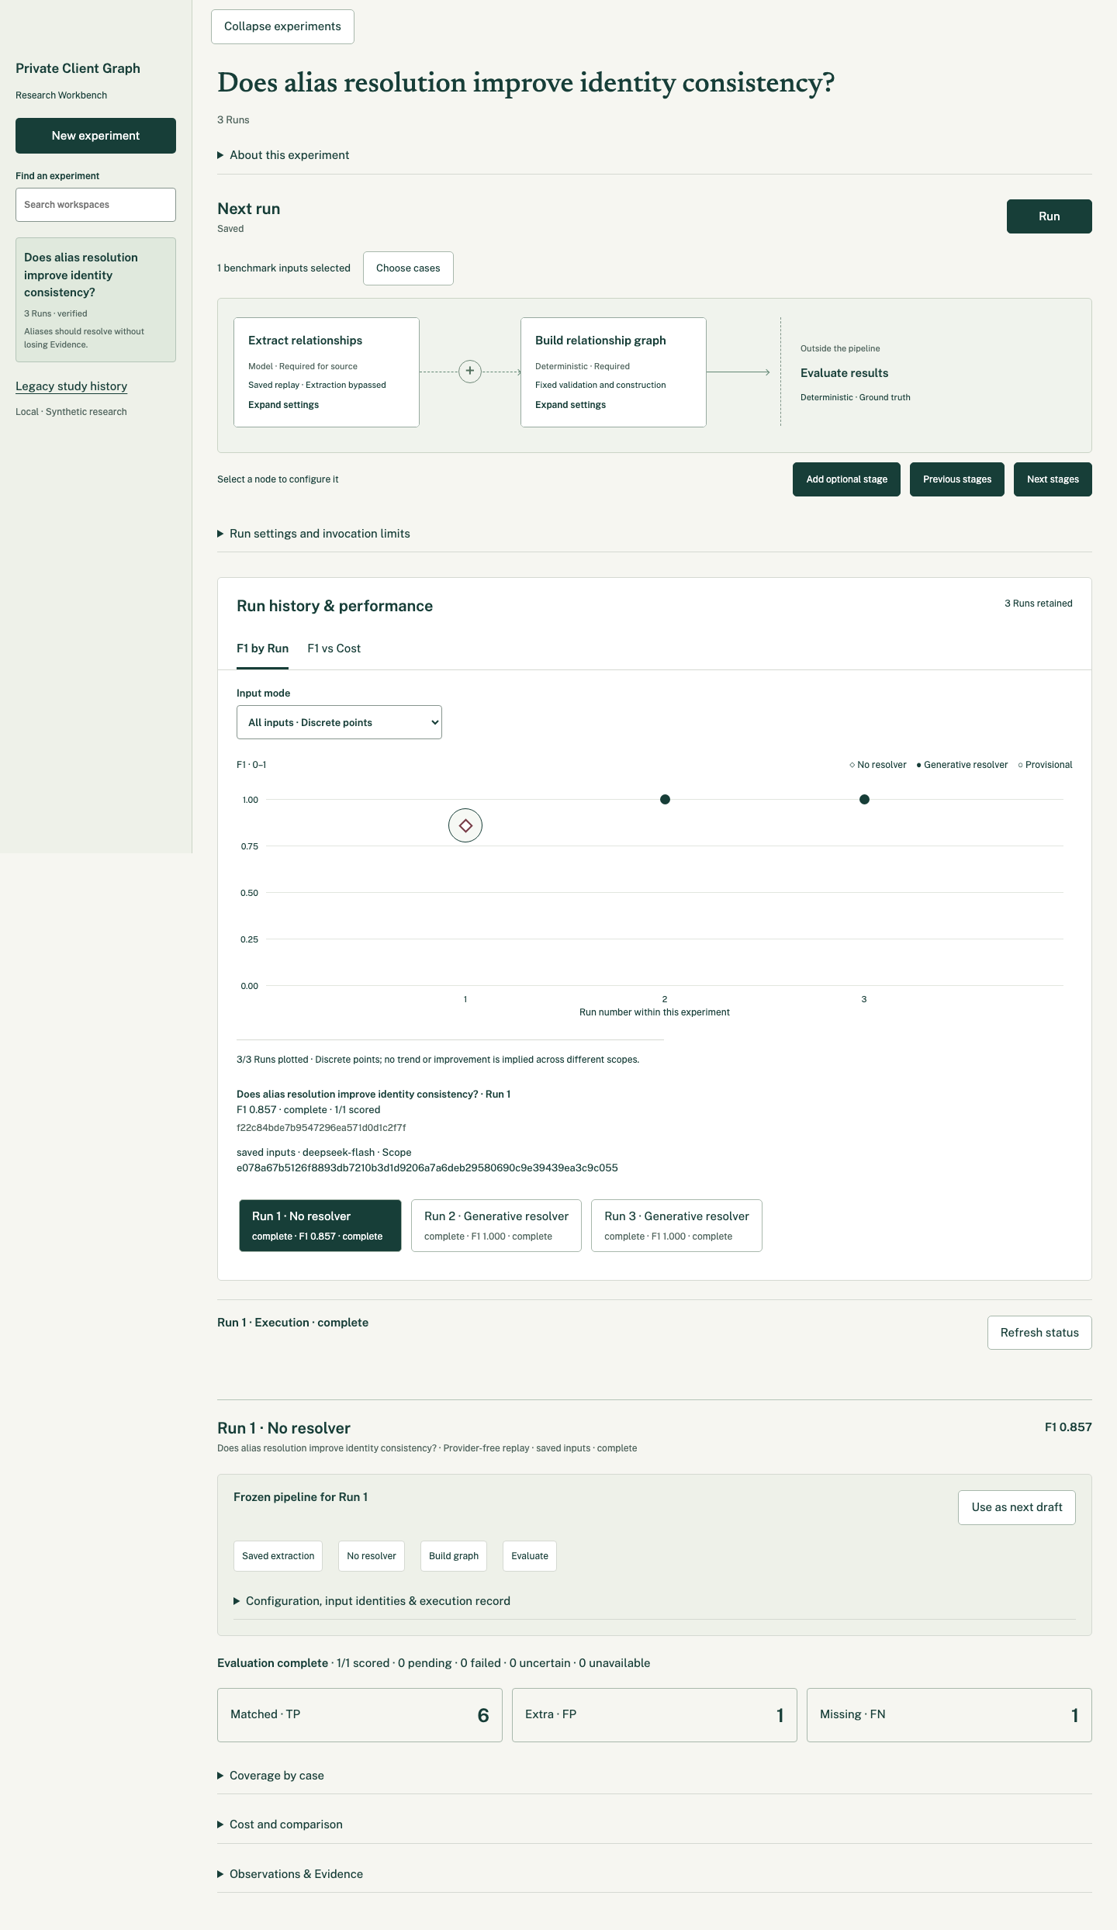
Research Workbench and evaluation
Five development cases exercise the chain. Ten separate synthetic cases form the proposed held-out benchmark.
A Run preserves inputs, configuration, extracted candidates, stage outcomes and deterministic evaluation artifacts.
Relationship P/R/F1 compare semantic edges. Approved-quote accuracy checks true-positive edges. Source attribution evaluates assessed Evidence items separately.
Current Workbench interface. Screenshot context appears in the asset manifest.
Draft for review. Evaluation and deployment approval remain pending.
7
Notes:
Sources: README.md Research Workbench; docs/design/final-build-day.md; research/final-day/validation. Deterministic tests substitute only the model boundary.

Slide 8
Held-out benchmark status
10 synthetic cases
39 current relationships
Independent fixture review covers exact Source attribution and supported current relationships. Benchmark approval and the frozen-chain evaluation remain pending.
No held-out precision, recall, F1 or provider cost is claimed in this draft.
Draft for review. Evaluation and deployment approval remain pending.
8
Notes:
No held-out Run has been supplied. This draft makes no final extraction-quality claim. Authored ideal fixtures do not measure model performance.

Slide 9
Findings and limitations
Limits of the current evidence
The held-out examples are small, explicit and synthetic. They test specific difficulties and offer limited evidence of robustness on practice documents.
Exact occurrence and approved-quote scoring cannot establish legal correctness. Curated examples demonstrate review behaviour, not extraction accuracy.
Synthetic material only. Text-layer PDFs only. Whole-proposal confirmation. Real client use needs a separate data-handling and tenancy design.
Draft for review. Evaluation and deployment approval remain pending.
9
Notes:
Sources: AGENTS.md; synthetic authoring workflow; independent case-review summaries; retained Run failures when supplied. Current authentication does not authorize real confidential client data.

Slide 10
Conclusion and demonstration
A bounded extraction system with inspectable Evidence and explicit professional confirmation
The next evidence should come from broader documents and practitioner feedback. Real-client ingestion requires a separately approved security and data design.
https://private-client-graph-production.up.railway.app
The public service currently has the earlier Case 01 demo. The reviewed multi-source build remains a local preview pending deployment approval.
Draft for review. Evaluation and deployment approval remain pending.
10
Notes:
Public deployment URL: https://private-client-graph-production.up.railway.app
Multi-source public deployment verified: false. Local screenshot assets demonstrate the reviewed P6 build. Current deployed service predates that build unless verification is supplied.

