Slide 1

Data Science
101

Slide 2

DATA SCIENCE 101
LEARNING OBJECTIVES
Explain the field of data science, defining common roles & trends.
Explore popular tools & resources to visualise, analyse & model data.
Recognise the types of problems that can be solved by data science.
Apply the data science workflow.
‣
‣
‣
‣
Create a custom learning plan to build your data science skills after
this workshop!
‣

Slide 3

DATA SCIENCE 101
PRE-WORK

Slide 4

PRE-WORK REVIEW
Bring a laptop with Anaconda installed. Scroll to your operating
system version and click on the install button for Anaconda with
Python 2.7.
‣
We will be using Jupyter Notebooks as the main IDE for the workshop.
If you have installed Anaconda, then you are ready to go!
‣

Slide 5

DATA SCIENCE 101
OPENING

Slide 6


WHO AM I?
Peter Goodin
What do I do : Lead Instructor – Data Science Immersive
What have I done : Ph.D Cognitive Neuroscience – Psychoneuroimmunology of Major Depressive Disorder, Consumer Neuroscience, Condom analysis.
What I’m interested in : Tech & machine learning for rehabilitation after brain damage
@peter_goodin
petergoodin

Slide 7
ABOUT YOU
Before we dive in, let’s talk a bit about you!
‣
Name
What brings you to GA?
‣
‣
Current activities
Your Goals
‣
‣
Fun fact about yourself!
‣

Slide 8
OUR EXPECTATIONS
You're ready to take charge of your learning experience.
‣
You're curious and excited about data science!
‣
You've installed Anaconda with Python 2.7.
‣

Slide 9
THE BIG PICTURE
What we’ll cover:
‣
‣
Why data science & what it can do for me?
Data science skills
Explore the Data Science Toolkit
Introduction to Algorithms
Basic and advanced data analysis
‣
‣
‣
‣

Slide 10
THE BIG PICTURE
Why data science matters:
‣
OECD ranks Australia’s numeracy skills in the lower 50% of countries surveyed
‣
Data science (programming, exploration, analysis, interpretation) is a sought-after skill in many industries
‣
Why it rocks:
‣
Data science opens up a door to a variety of opportunities
‣
Mix of creative and analytic skills required (never boring!)
‣
Learning for life
‣
Notes:
OECD - Organisation for Economic Co-operation and Development

Slide 11

INTRODUCTION
WHAT IS DATA SCIENCE AND WHAT CAN IT DO FOR ME?

Slide 12
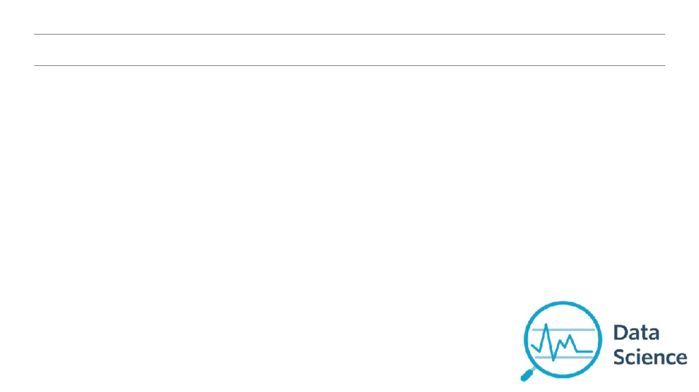
WHAT IS DATA SCIENCE?
THE skillset of the information age.
Data Science: A set of tools and techniques used to extract useful
information from data.
An interdisciplinary, problem-solving oriented subject.
‣
The application of scientific techniques to practical problems.
‣
A rapidly growing field.
‣
Notes:
Harvard Business Review - Sexiest job of the 21st century.

Slide 13
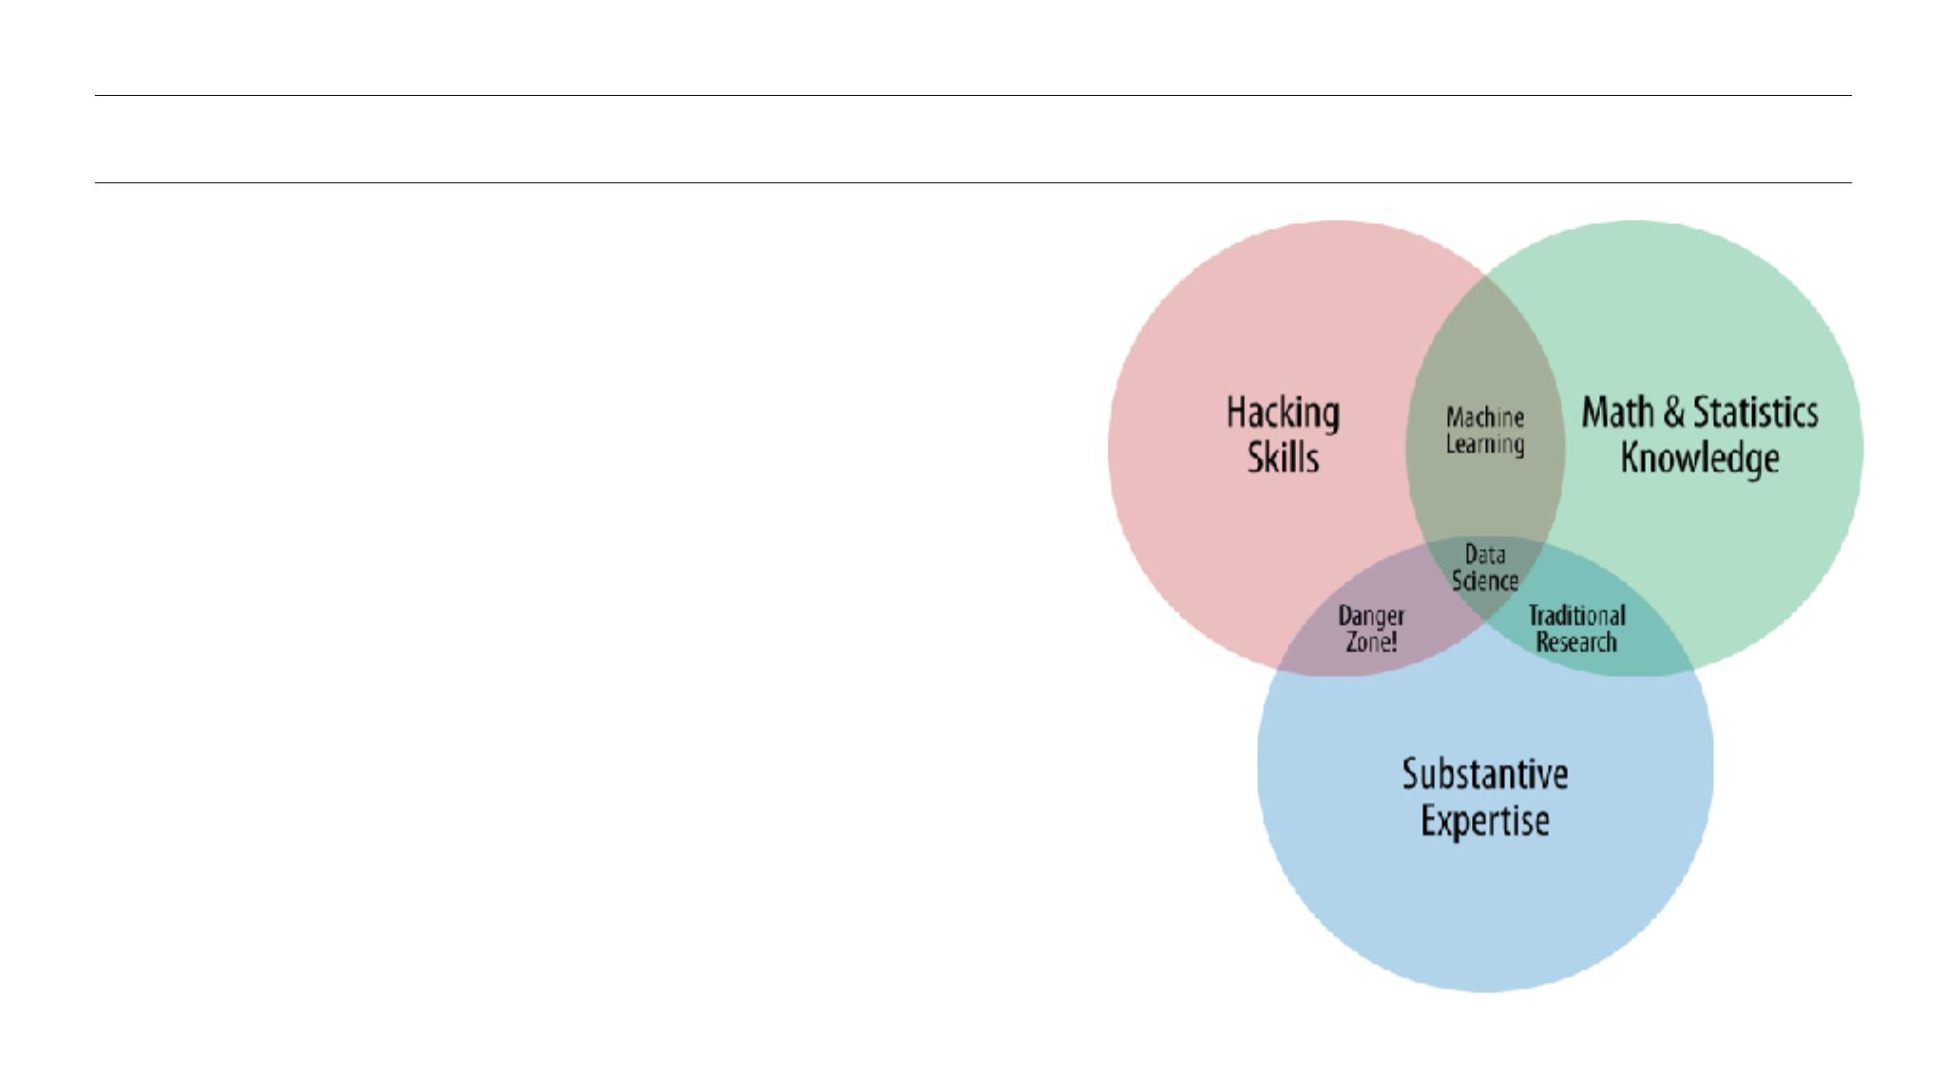
QUALITIES OF A DATA SCIENTIST
Programming skills
‣
Math and Statistics knowledge
‣
Business acumen
‣
Creativity & problem solving
‣
Plus: Communication skills
‣

Slide 14

YOUR TURN: QUALITIES OF A DATA SCIENTIST AND YOU
DIRECTIONS
Let's talk through the following questions together:
1.
2.
What do you think are the most important qualities for a data scientist?
Can you think of any other quality/skill we have not mentioned?
EXERCISE

Slide 15

WHAT CAN DATA SCIENCE DO FOR ME?
Ask better questions:
‣
What is required?
‣
How are results evaluated? (measures of success)
What do we currently know? (existing data)
What has happened? (descriptive analytics)
What will happen (if)? (predictive analytics)
What to do to achieve what we require? (insight)
‣
‣
‣
‣
‣
Define and test a hypothesis/run experiments.
‣

Slide 16
WHAT CAN DATA SCIENCE DO FOR ME?
Manipulate, sanitize, and wrangle data.
‣
Visualize data.
‣
Understand data relationships.
‣
Tell the machine how to learn from data.
‣
Create data products that deliver actionable insight.
‣
Tell relevant stories from data.
‣

Slide 17
DEMO
VISUALIZING THE DATA SCIENCE WORKFLOW

Slide 18
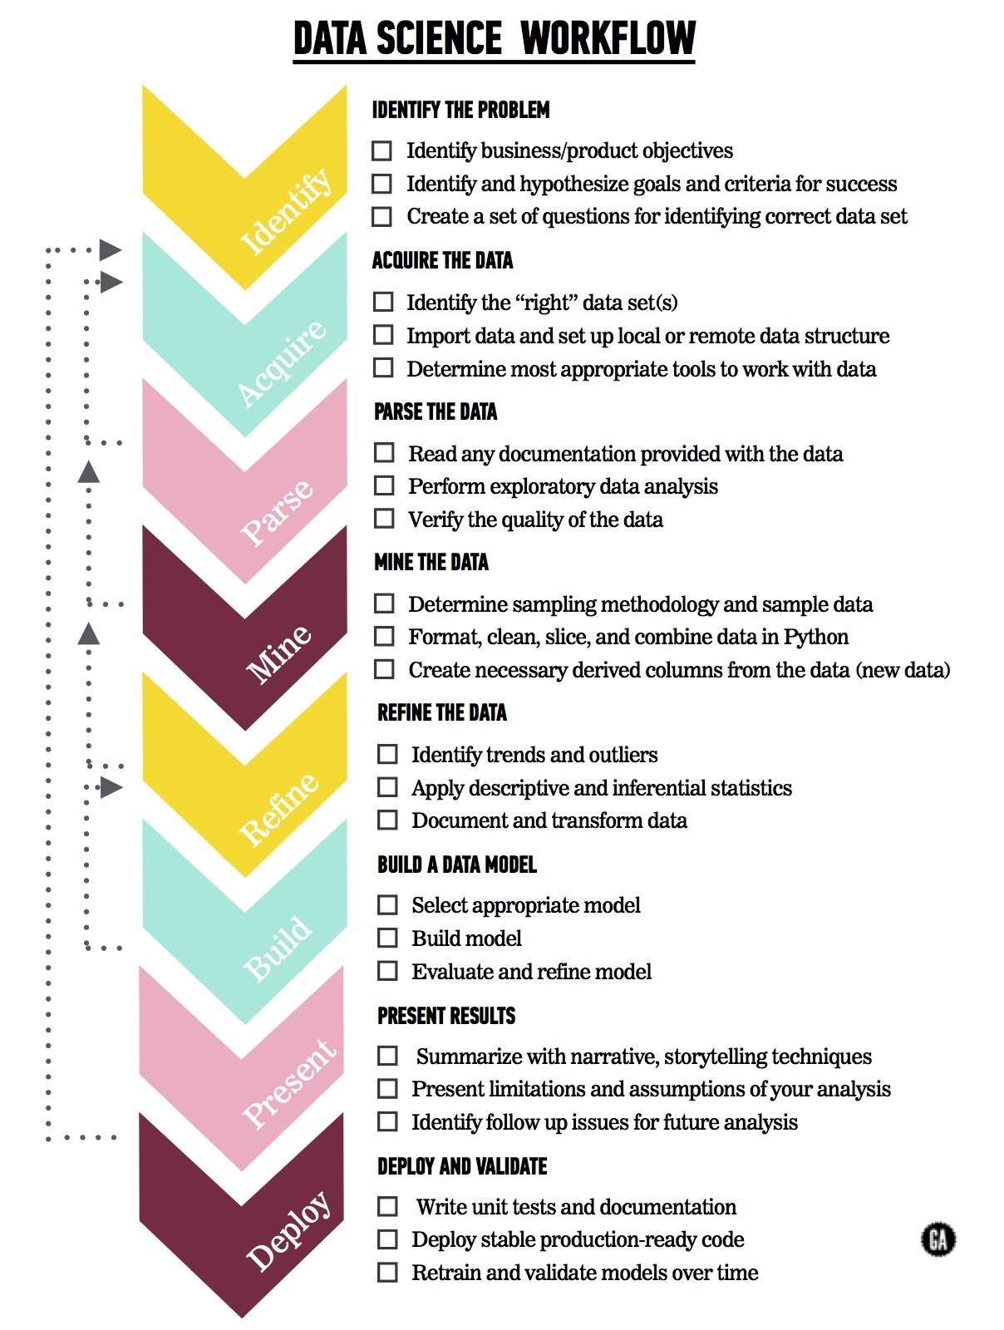
THE DATA SCIENCE WORKFLOW
MAIN PHASES
Identify the problem
‣
Acquire the data
‣
Parse the data
‣
Mine the data
‣
Refine the data
‣
Build a data model
‣
Present the results
‣
Notes:
Identify problem - Why go through the trouble of finding a solution if there’s no problem?
Acquire data - Databases, web scraping, surveys etc.
Parse data - Learn about the data: Where it came from, what it contains, make sure everything needed is included.
Mine the data - Clean, munge, create new.
Refine - Find patterns and outlier samples, explore dataset, make changes as needed.
Build a model - Select appropriate method, evaluate and refine output.
Present results - Plots, presentations, summaries.
Deploy and validate - Product development, model refinement.
NOT A STEPWISE PROCESS!

Slide 19
GUIDED PRACTICE
EXPLORING THE DATA SCIENCE TOOLKIT

Slide 20

WHY PYTHON?
Python is:
Great for rapid prototyping and full-stack commercial applications.
‣
A modern, elegant, object-oriented language.
‣
High level language, i.e., you can be more productive sooner.
‣
Well documented and has an established and growing community.
‣
Mature. In other words, Python has libraries that will help you with
a lot of different tasks!
‣
‣
Anaconda distribution comes with python, a large collection of libraries and
extra features to help you get to the analysis sooner!

Slide 21

PACKAGES
Libraries of code written to solve particular set of problems
‣
Can be installed with:conda install <package name>
‣
Ever used Excel? How would you like working with data
structured in a similar way, but without the irritation of
formatting, long formula, and better graphics?
‣
‣
Try pandas!
‣
Does your application require the use of advanced
mathematical functions or numerical operations with
arrays, vectors or matrices?
Try SciPy (scientific Python).
Try NumPy (numerical Python).
‣
‣

Slide 22
PACKAGES
Are you interested in using Python in a data science workflow and exploit the use of machine
learning in your applications
‣
Look no further than Scikit-learn.
‣
Are you tired of the boring-looking charts produced with Excel? Are you bored of looking for the
right menu to move a label in your plot?
‣
Take a look at the visuals offered by matplotlib & seaborn.
‣
Is your boss asking about significance testing and confidence intervals? Are you interested in
descriptive statistics, statistical tests, plotting functions, and result statistics?
‣
Well, statsmodels offers you that and more.
‣
All the data you require is available freely on the web but there is no download button and you
need to scrape the website?
‣
You can extract data from HTML using Beautiful soup.
‣

Slide 23
GUIDED BASIC ANALYSIS
ANALYSE SOME DATA!

Slide 24

INSTRUCTIONS (GITHUB)
‣
We recommend using a Jupyter notebook for this practice.
To get a hold of the starter code, you’ll need to download these materials.
Visit this page: https://github.com/petergoodin/ga_ds101
Click on the “Clone or Download” button, and click “Download ZIP”
Unzip the files downloaded in a known location in your file system
Open Jupyter: Open a terminal
In this guided
2.
3.
4.
‣
practice we are using
a sample dataset,
demonstrate how to
carry out descriptive
analytics using the
pandas library we
introduced above.
• Mac: Using spotlight search for "Terminal"
• Windows: Click the "Start" button and type "cmd"
In the terminal type: `jupyter notebook`
•
5.
6.
7.
Navigate to the folder where you have saved the files in step 3
Open the file iris_identify.ipynb
Let’s take a look at how data can help inform decisions

Slide 25

SCENARIO
FLOWERS AND MORE
You are a business intelligence manager at a fast moving startup that deals with flowers. Iris Mania is sweeping the world and certain species fetch upwards of $50,000 AU for a single flower!
‣
‣
A new iris has just been delivered. It’s species is not known and the resident florist is
on holidays (typical).
‣
The business has a sample data set with typical measures for
three species for iris flower.

Slide 26

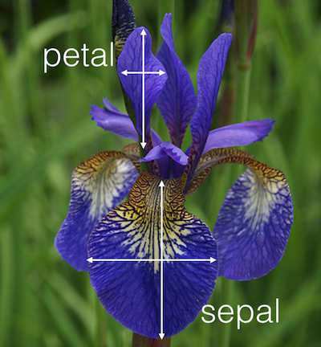
IRIS DATA SET
Famous data set collected and analysed by Ronald Fisher.
‣
‣
50 samples of 3 different flower species:
‣
Setosa (the valuable one)
‣
‣
Virginica
Varsicolor
‣
4 features:
‣
‣
Sepal: length and width
Petal: length and width
How could we use our existing data to identify it?

Slide 27
DATA SCIENCE 101
ANALYSIS TAKE AWAY
Notes:
Even simple methods such as means (central / typical value) and count frequencies can be useful in helping to make decisions.

Slide 28
INTRODUCTION
WHAT ARE ALGORITHMS
ANYWAY?

Slide 29
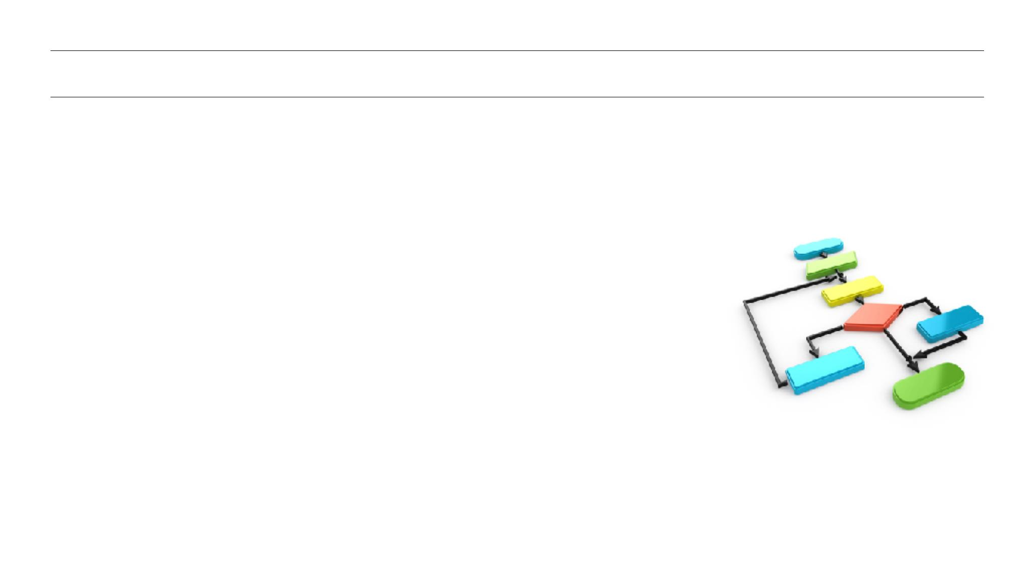
ALGORITHM
COMPUTER SCIENCE
Algorithms are a formal way of describing precisely
defined instructions.
‣
Computers are very good at carrying out series of
precisely defined instructions.
‣

Slide 30
ALGORITHM
A SET OF STEPS TO ACCOMPLISH A TASK
Would you put on your shoes before you put on your socks?
‣
What if you put on your jacket before you put on your jumper?
‣
Notes:
Underwear before or after pants (assuming you’re not a superhero…)

Slide 31
ALGORITHM
CRITERIA OF A GOOD ALGORITHM
An algorithm is an unambiguous description that makes clear what has to be
implemented.
‣
In a recipe, a step such as “Bake until done” is ambiguous because it doesn’t
explain what “done” means.
‣
In a computational algorithm, a step such as “Choose a large number” is vague:
what does “large” mean to a computer?
‣

Slide 32
ALGORITHM
CRITERIA OF A GOOD ALGORITHM
‣
An algorithm expects a defined set of inputs.
For example, it might require two numbers where both numbers are greater
than zero. Or it might require a word, or a list of zero or more numbers.
‣
‣
An algorithm produces a defined set of outputs.
It might output the larger of the two numbers, an all-uppercase version of a
word, or a sorted version of the list of numbers.
‣

Slide 33
ALGORITHM
CRITERIA OF A GOOD ALGORITHM
An algorithm should be guaranteed to terminate and produce a result, always
stopping after a finite time.
If an algorithm could potentially run forever, it wouldn’t be very useful because you
might never get an answer!

Slide 34
DEMO
ALGORITHMS
IN ACTION

Slide 35
THINKING LIKE AN ALGORITHM
LET US SEE HOW TO WRITE AN ALGORITHM
We will use Python to write our algorithm
‣
Example:
Problem: Given a list of positive numbers, return the largest number on the
list.
‣
Inputs: A list L of positive numbers.
‣
The list must contain at least one number.

Slide 36
THINKING LIKE AN ALGORITHM
WHAT IS THE OUTPUT
Output: A number n, which will be the largest number of the list.
‣

Slide 37
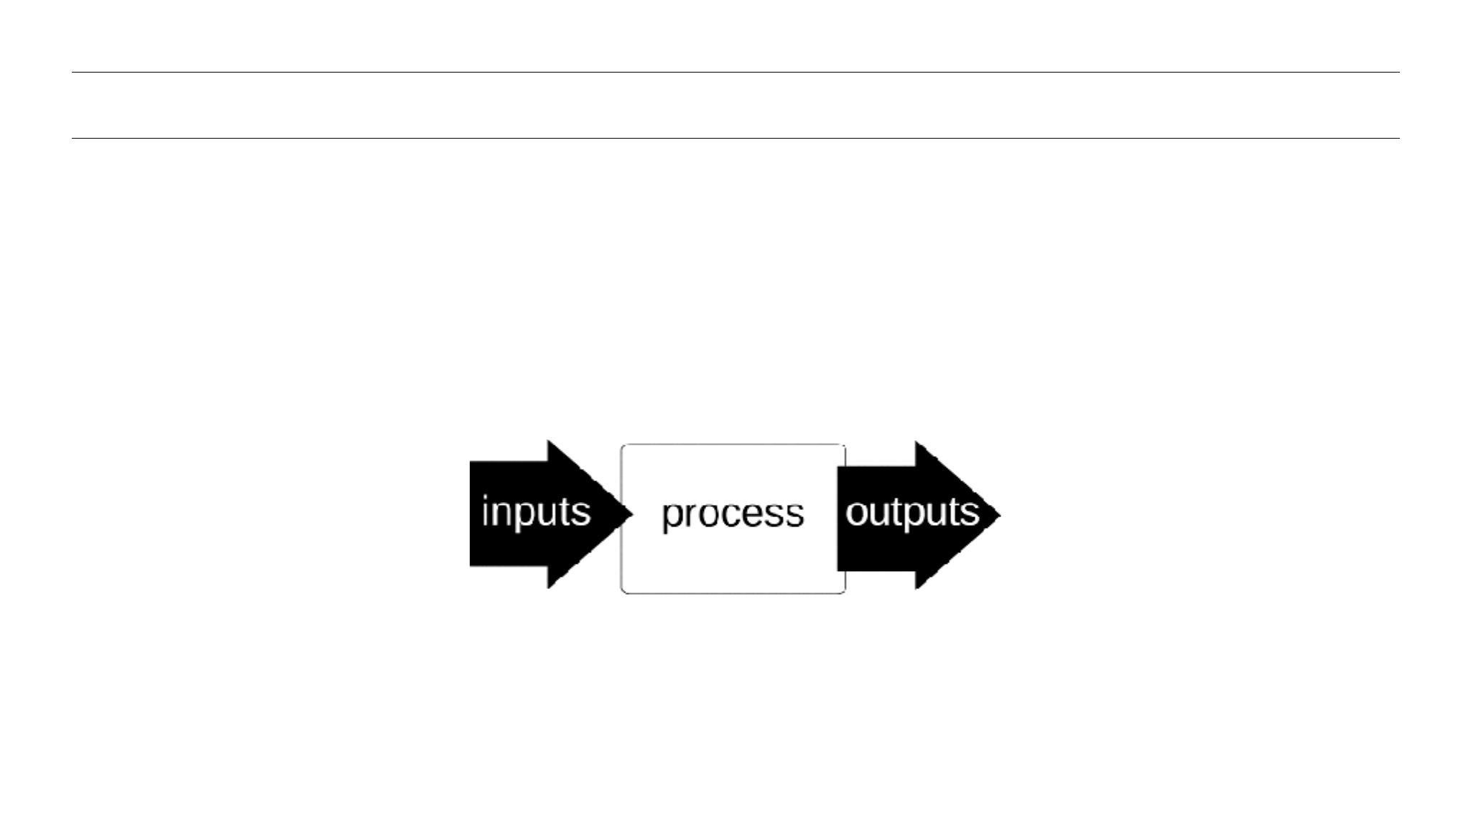
ALGORITHM
Notes:
Inputs > Do something > Outputs

Slide 38
THINKING LIKE AN ALGORITHM
WHAT IS THE OUTPUT
ALGORITHM
‣
1.
2.
Set the variable `max` to 0.
For each number `x` in the list `L`, compare it to `max`.
•
If `x` is larger, set `max` to `x`.
3.
`max` is now set to the largest number in the list.

Slide 39
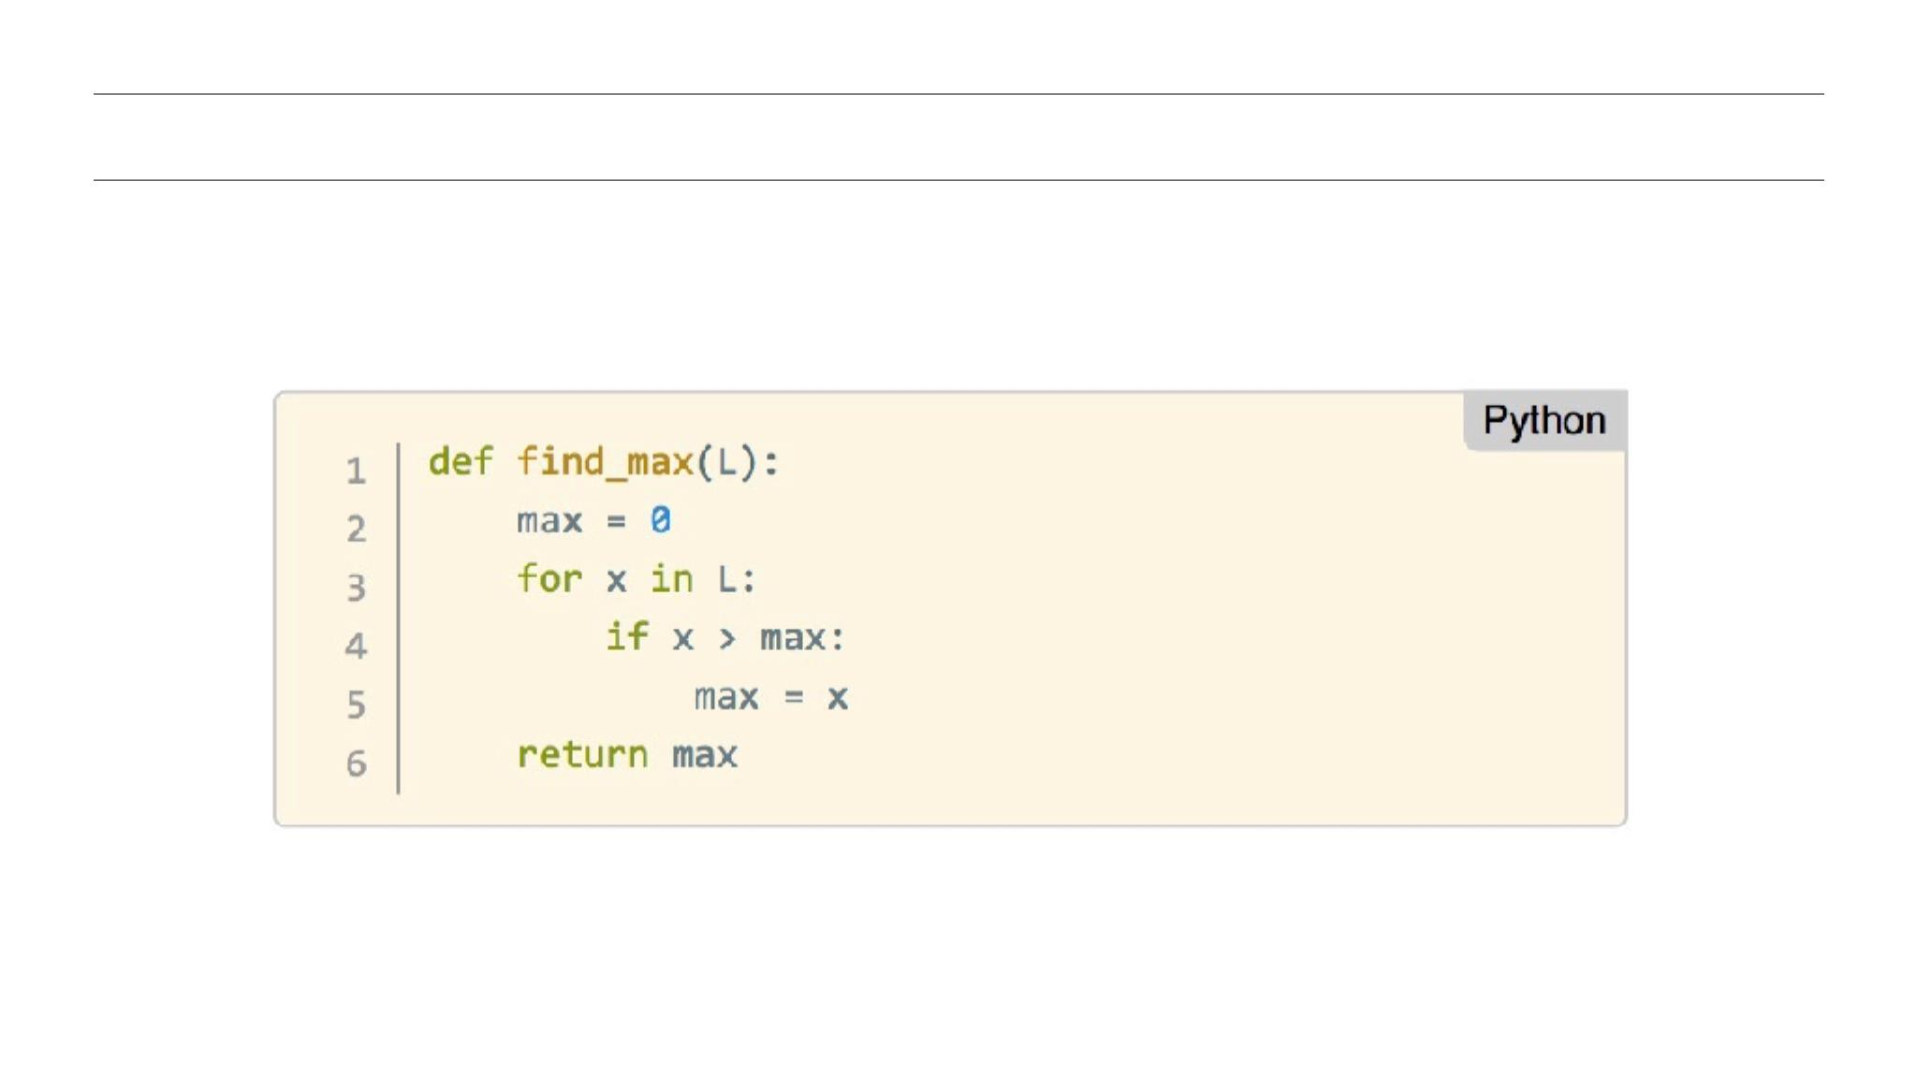
THINKING LIKE AN ALGORITHM
HERE IT IS IN PYTHON

Slide 40
ALGORITHMS IN THE CONTEXT OF MACHINE LEARNING
Machine learning is concerned with the construction and study of systems that can learn from data.
‣
The core of machine learning deals with supervised and and non-supervised problems.
‣
Supervised – Learn from labelled data (dog, cat, yes, no,
temperature Tuesday given previous examples of temperature)
Non-supervised – Learn without labels (some internal criteria)
‣
‣
Notes:
Why was I prattling on about algorithms? Because they’re the basis of machine learning.

Slide 41
SUPERVISED METHODS
Further distinction in supervised methods:
‣
‣
Classification:
Sort unknown data into classes (apple / orange, sale / no sale, healthy / sick)
based on previously seen data
‣
Prediction:
Predict an unknown value from data based on previously seen data (temperature, price, weight)

Slide 42
UNSUPERVISED METHODS
‣
Finding patterns in the data without previous examples
Clustering like with like (red things with red things, animals with animals,
‣
WAIT! ISN’T THAT LIKE CLASSIFICATION?!
‣ Nope! Classification uses previous data to base the decision.
Cluster makes it up as it goes along.

Slide 43
GUIDED ADVANCED ANALYSIS
ANALYSE SOME MORE DATA!

Slide 44
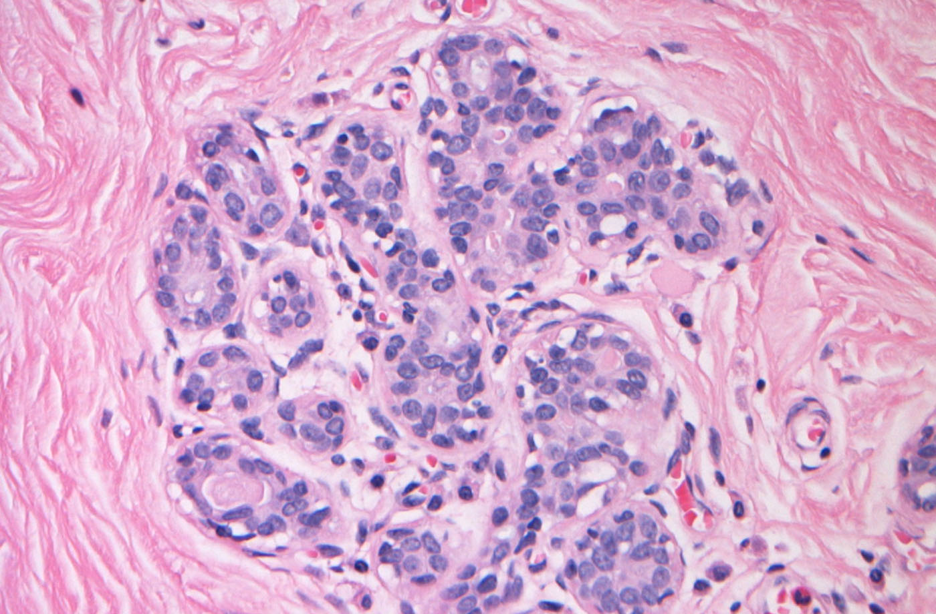
SCENARIO
GUIDED ADVANCED ANALYSIS
ANALYSE SOME DATA!
AGAIN!
CANCER CLASSIFICATION
Using measures from biopsied breast tissue, is it possible to classify non-cancerous (benign) and cancerous (metastatic) cases?
‣

Slide 45
Wisconsin Diagnostic Breast Cancer
‣
596 samples and two categories:
‣
Benign (357)
‣
Metastatic (212)
‣
30 features (Derived from 10 initial measurements)
‣
How accurately can non-cancerous and cancerous
cases be identified?
‣
Does one algorithm perform better than another?

Slide 46
INSTRUCTIONS
From the materials:
Open a terminal and reopen `jupyter notebook`
Navigate to the folder downloaded from
https://github.com/petergoodin/ga_ds101
1.
2.
‣
In this final guided practise we will apply
basic transformations
and two different algorithms to determine
whether cancerous
tissue has spread or not.
Open the file cancer_classify.ipynb
3.
Lets see how algorithms can be used to help save lives.
4.

Slide 47
DATA SCIENCE 101
ANALYSIS TAKE AWAY
Notes:
Algorithms allow for extremely accurate predictions to be made from data.
Not perfect.

Slide 48
DATA SCIENCE 101
CONCLUSION
Notes:
Data science is a powerful set of skills that allows for deeper inferences to be drawn using data.
Essential skill in a data driven world.

Slide 49
REVIEW & RECAP
In this workshop, we've covered the following topics:
‣
Why data science?
‣
What can data science do for me?
‣
What is the data science workflow?
‣
How to analyze and visualize data using Python
‣
Define the role of algorithms and their relationship with machine
learning
‣
Demonstrate how these concepts can be applied to make
predictions
‣

Slide 50
TAKEAWAYS
LEARNING PLAN
Evaluate your data science skills! How confident are you with:
•
•
•
•
•
Programming skills (Python or R)
Knowledgeable in algebra and statistics (analyzing and modeling data)
Business acumen (how to work with stakeholders)
Industry expertise (for the type of field you're working within)
Communication skills (visualize data, tell stories)

Slide 51
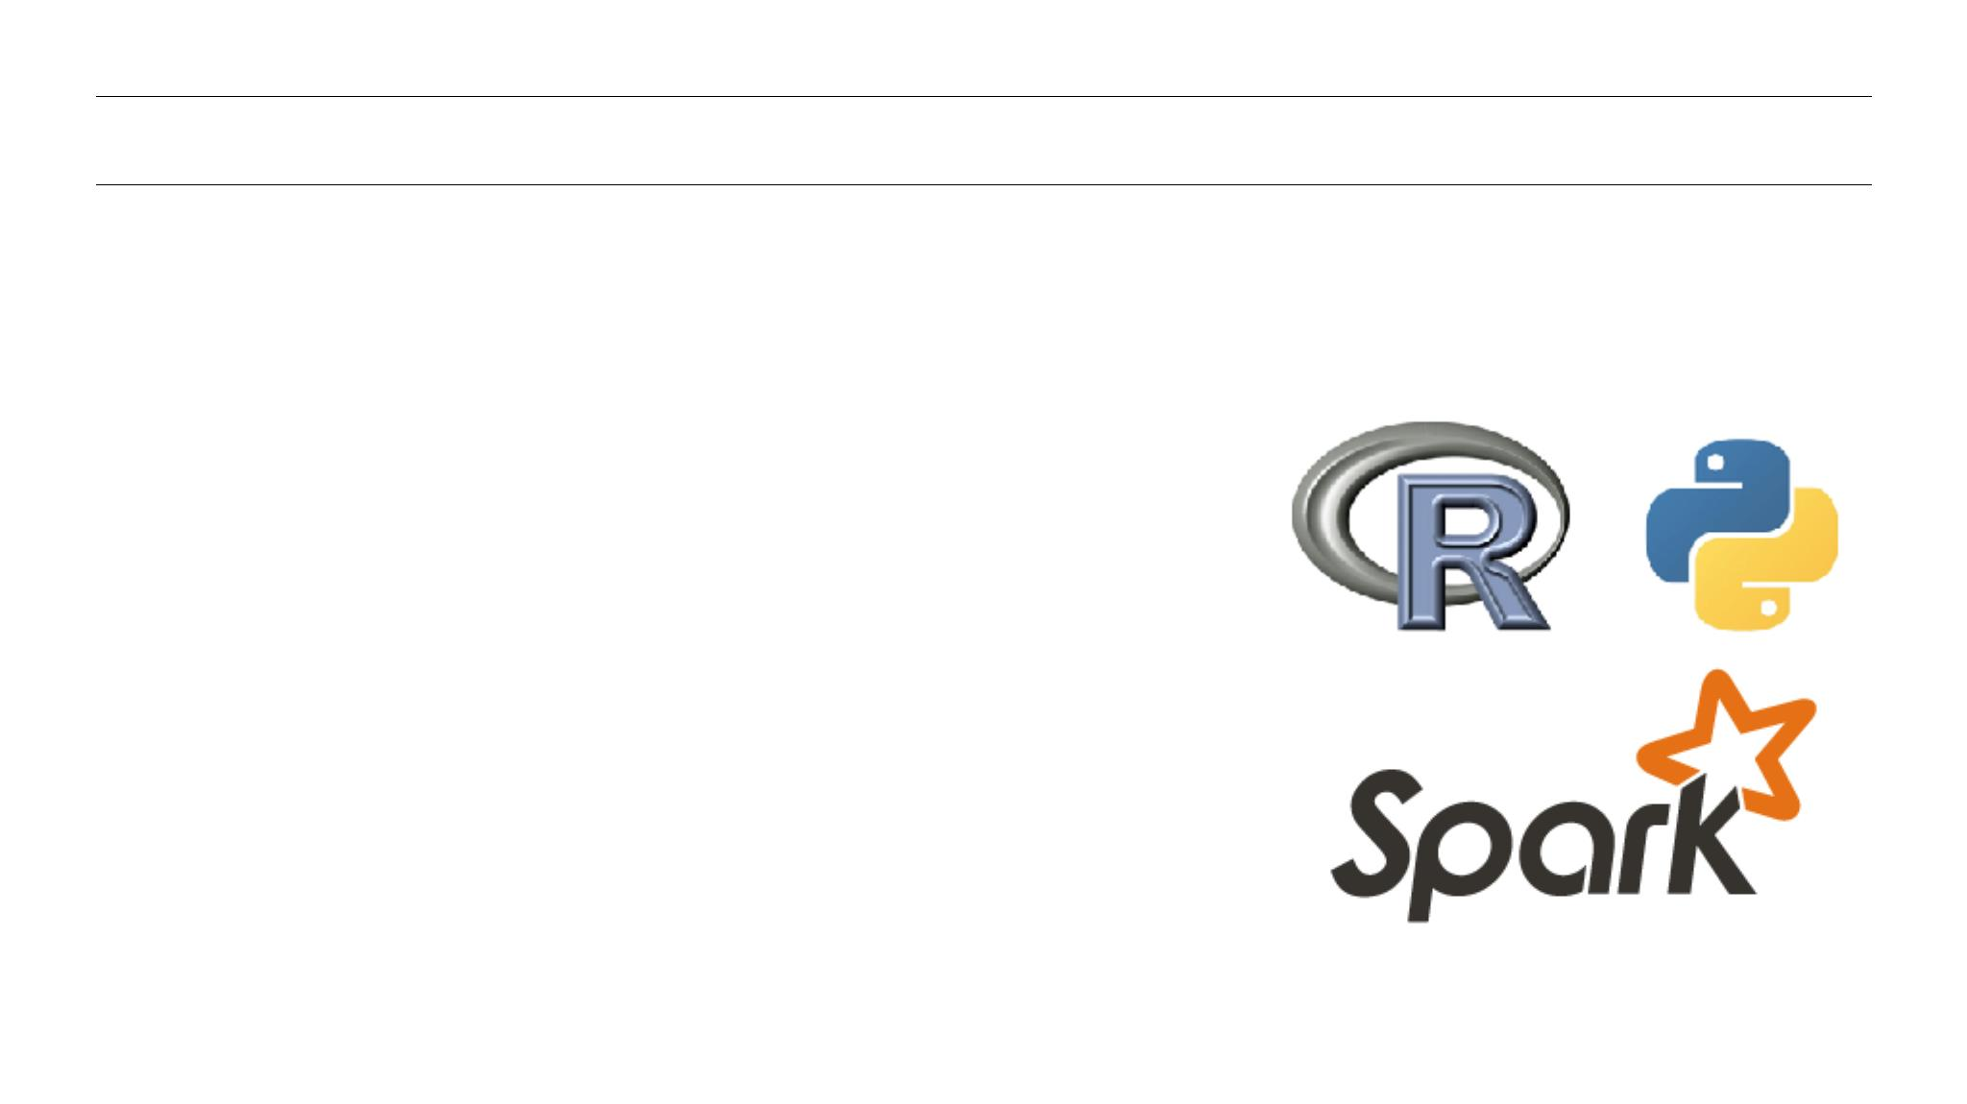
TAKEAWAYS
WHAT SHOULD YOU DO NEXT?
Want to be a better programmer?
Work on these:
Continue learning Python syntax on sites
like Codecademy or Code School.
‣
‣
‣
Already know R? Work on comparing the two.
Interested in other frameworks? Try Spark!

Slide 52

TAKEAWAYS
WHAT SHOULD YOU DO NEXT?
Want to brush-up on your math and statistics skills?
Have a look at these:
‣
Pattern Recognition and Machine Learning, C. Bishop
‣
Data Science and Analytics with Python, J Rogel-Salazar
‣
An Introduction to Statistical Learning with Applications in R (free PDF)
‣
Elements of Statistical Learning (free PDF)

Slide 53
TAKEAWAYS
WHAT SHOULD YOU DO NEXT?
Concerned about business acumen & communication skills?
Have a look at these:
Data Science for Business, F. Provost and T. Fawcett
‣
Storytelling with Data: A Data Visualization Guide for Business Professionals,
C. Nussbaumer Knaflic
‣

Slide 54
TAKEAWAYS
WANT MORE?
General Assembly offers courses in data science!
Check out our:
‣
Part-time Data Science Course
‣
Data Science Immersive Course

Slide 55

DATA SCIENCE 101
ADDITIONAL RESOURCES

Slide 56
DATA SCIENCE 101
BOOKS
Data Analysis with Open Source Tools, P. K. Jannert
Data Science for Business, F. Provost and T. Fawcett
Pattern Recognition and Machine Learning, C. Bishop
Data Science and Analytics with Python, J Rogel-Salazar
An Introduction to Statistical Learning with Applications in R (free PDF)
Elements of Statistical Learning (free PDF)
Mining of Massive Datasets (free PDF)
Think Stats (free PDF or HTML)

Slide 57
DATA SCIENCE 101
MOOCS
‣Andrew Ng’s Machine Learning Class on Coursera
‣MIT’s Artificial Intelligence course
‣Johns Hopkins' Data Analysis Methods
‣Cal Tech’s Learning from Data course

Slide 58
DATA SCIENCE 101
AGGREGATORS
‣DataTau: Like Hacker News, but for data
‣MachineLearning on reddit: Very active subreddit
‣Quora’s Machine Learning section: Lots of interesting Q&A
‣Quora’s Data Science topic FAQ
‣KDnuggets: Data mining news, jobs, classes and more

Slide 59
DATA SCIENCE 101
SOCIAL
Hillary Mason (@hmason): Data Scientist in Residence at Accel and Scientist Emeritus
‣
at bitly.
Dj Patil (@dpatil): VP of Product at RelateIQ.
‣
‣
Jeff Hammerbacher (@hackingdata): Founder and Chief Scientist at Cloudera and
Assistant Professor at the Icahn School of Medicine at Mount Sinai.
J Rogel-Salazar (@quantum_tunnel): Data scientist at IBM and GA instructor
‣
‣
Peter Skomoroch (@peteskomoroch): Equity Partner at Data Collective, former Principal
Data Scientist at LinkedIn.
Drew Conway (@drewconway): Head of Data at Project Florida
‣

Slide 60

DATA SCIENCE 101
Q&A

Slide 61

DATA SCIENCE 101
EXIT TICKETS
DON’T FORGET TO FILL OUT YOUR EXIT TICKET

Slide 62
DATA SCIENCE 101
THANKS FOR COMING!

