Slide 1

Programming One (csc7050)
Aidan McGowan
OOP
classes, properties, methods and accessors

Slide 2
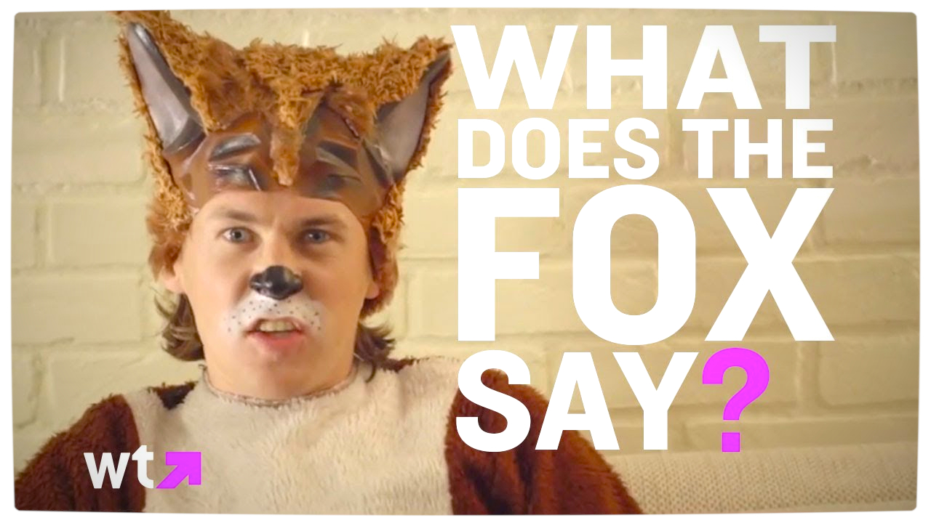
Notes:
http://www.youtube.com/watch?v=jofNR_WkoCE

Slide 3

Using OOP - code this !
Dog goes WOOF
Cat goes MEOW
Bird goes TWEET
Mouse goes SQUEAK
But there's one sound that no one knows...
WHAT DOES THE FOX SAY?
Ring-ding-ding-ding-dingeringeding!
Ring-ding-ding-ding-dingeringeding!
Ring-ding-ding-ding-dingeringeding!
Big BLUE eyes
POINTY nose
TINY paws
your fur is RED
WHAT DOES THE FOX SAY?
Ring-ding-ding-ding-dingeringeding!
Ring-ding-ding-ding-dingeringeding!
Ring-ding-ding-ding-dingeringeding!

Slide 4
Design of program
Create an Animal class
Animal
name : String noise : String eyeColour : String noseType : String pawSize : String furColour : String
+ makeNoise ()

Slide 5

RunLyrics class
Create a class named RunLyrics.java
In the Main method … create the Dog, Cat, Bird, Mouse and Fox objects from the Animal class then using the setter methods add the appropriate details e.g.

Slide 6

RunLyrics class
Now output the lyrics to screen using the appropriate animal objects and methods (getters and methods)

