Slide 1

Scooby Doo and the Scary Software Stack
By Old Man Withers
Notes:
Some days I think this is what we’ve arrived at

Slide 2
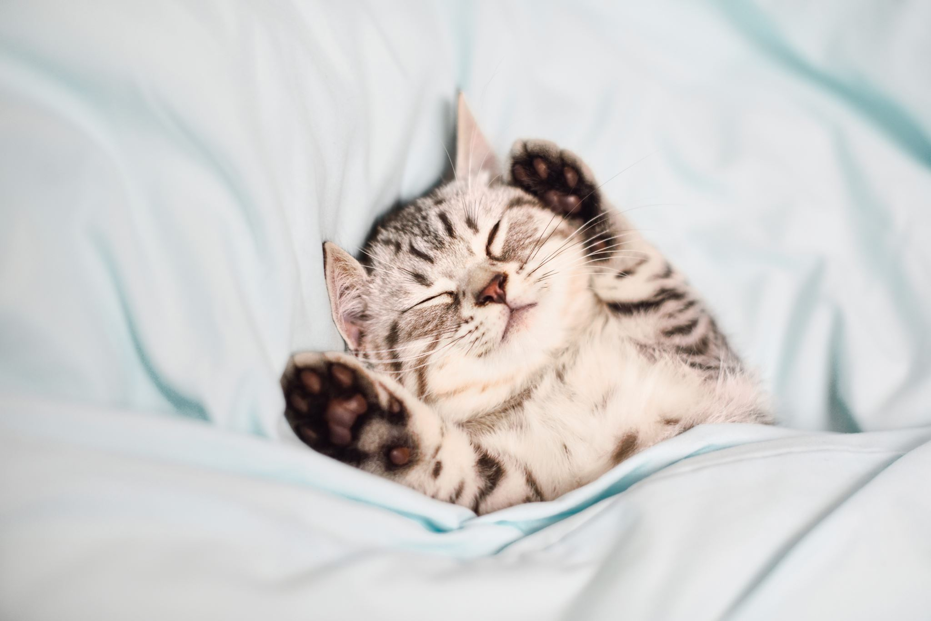
Docker and Kubernetes - lets make this less scary
Notes:
We’ve been on this journey for over 3 years.
We’ve levelled up a lot, across a wide range of tech
We’ve tried a huge amount of tech – kept some, thrown others out
I think we’ve made a huge amount of progress. But in other ways we’ve stagnated. I’m seeing the same mistakes
Docker login – docker cred helpers and docker
Pull policies – lack of under standing of k8s architecture
Debugging images – people not fulling under
Debugging helm failures -
Debugging call failures – lack of understanding of kube dns and ingress controllers.
In some of these areas I really feel the limiter is a lack of understanding of how the tech works
So I thought it was time for a refresher, and a history lesson and some of the behindology
I’ve been fortunate enough to get in on the ground floor of some of this tech. So today, I want to get you guys to run a bunch of commands and for us to talk about them, and use this to try and level up our understanding of containers and Kubernetes. Then I’m going to walk through some aspects of our pipelines and you can see how this tech fits in to the pipelines
The company goal here is to make fireteams more self sufficient. There IS too much for everyone to be an expert in everything. But If one person can level up in this space within each team they’ll gradually raise that teams understanding. I think that’s the key to scaling our delivery.

Slide 3
Now I’m just regurgitating….
Container Security – Liz Rice
Cgroups, namespaces, and beyond: what are containers made from? – Jerome Petazzoni
Container runtimes – Ian Lewis
The almighty pause container – Ian Lewis
Kubernetes Components

Slide 4
Agenda
Build and run a container
Understand how containers work by running linux commands inside containers
Understand image building
Understand container runtimes
Augment our container to mount data
Understand why you’d chose Kubernetes
Augment our chart to use a PVC

Slide 5
Prep 0
Notes:
Clone the repo
Start docker

Slide 6
What is a container ?
Its Not a VM….
Its Not just a process ...
It’s not a docker spec ….
Its Not an image file or an image manifest
It’s a VM with a shared kernel ? …

Slide 7
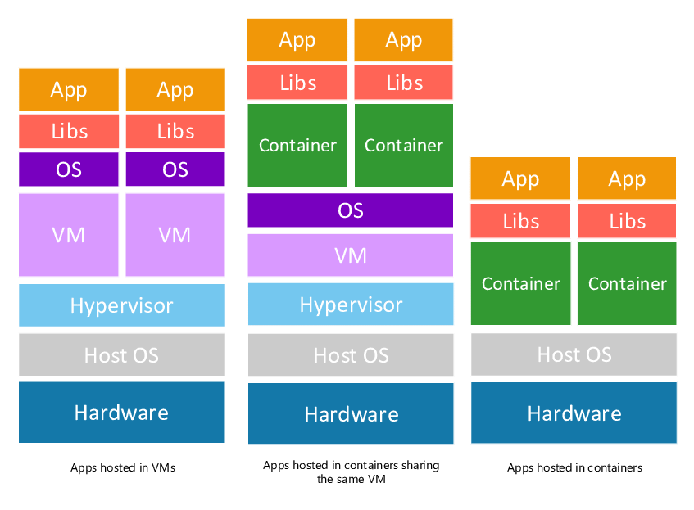
You may have seen
Notes:
Whats a hypervisor ?
https://www.vmware.com/topics/glossary/content/hypervisor.html
https://docs.microsoft.com/en-us/windows-server/administration/performance-tuning/role/hyper-v-server/architecture

Slide 8
Images & Dive 1
Notes:
Ok – so lets build a container
Why Distroless and Debian selection
One package manager
Rapidly updated security vulnerabilities
No musl (alpine)
Images aren’t a docker thing – see https://opencontainers.org/

Slide 9
Namespaces & Shell commands 2
Notes:
So, we need to explore linux a little bit
So, lets do some docker and explore our containers

Slide 10
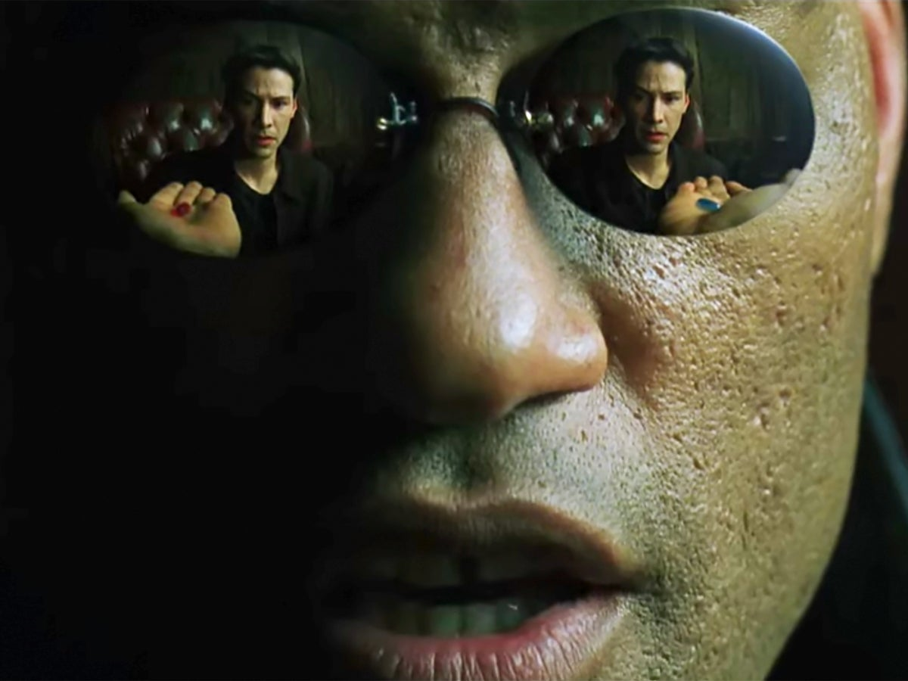
It had to happen….
Notes:
Cgroups, namespaces, and beyond: what are containers made from? – Jerome Petazzoni
Introduction to cgroups and namespaces 2:00 – 5:18
Different namespaces - 24:46 – 27:25
Understand what getting a shell in a container is
“A container is a process that’s not sharing ! (the default namespace) – Alister Shipman
How can we think of it docker, images and containers together
dockerfile is the sourcecode (it’s a specific language)
image is the compiled binary, but the files as well, and the image manifest
container is the running process - but docker run does a bit more

Slide 11
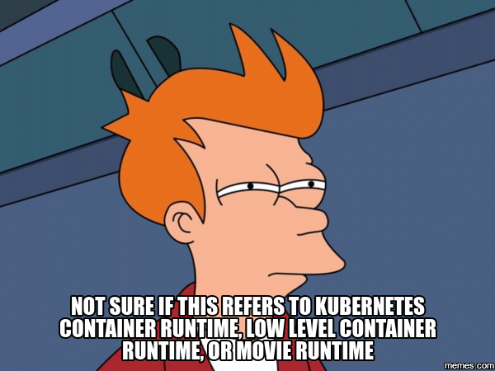
So, what the hell is docker then ?

Slide 12
Docker was released in 2013 and solved many of the problems that developers had running containers end-to-end. It had all these things:
A container image format
A method for building container images (Dockerfile/docker build)
A way to manage container images (docker images, docker rm, etc.)
A way to manage instances of containers (docker ps, docker rm , etc.)
A way to share container images (docker push/pull)
A way to run containers (docker run)
Notes:
https://www.ianlewis.org/en/container-runtimes-part-1-introduction-container-r

Slide 13
Containers Runtimes & Docker 3
Notes:
Ok – so we know what a container is now, and we’ve built some, inspected some images, how would we build one ?
Practically building containers
Well we will use docker, but I stress this is only one way !
We’ve used 3 here – docker, kaniko and jib
Ok – docker commands to run it – observe link between commands and namespaces e.g pid namespace

Slide 14
Container Monitoring and Pods 4
Notes:
Monitoring pods – the building blocks
The almighty pause container https://www.ianlewis.org/en/almighty-pause-container
“In Kubernetes, the pause container serves as the "parent container" for all of the containers in your pod. The pause container has two core responsibilities. First, it serves as the basis of Linux namespace sharing in the pod. And second, with PID (process ID) namespace sharing enabled, it serves as PID 1 for each pod and reaps zombie processes”
Ok – so we can monitor a container,
Paying it forward – you’re going to have to deal with these kinds of problems – monitoring, HA and deployment, scaling, config management. So the space will have some intrinsic complexity
https://kubernetes.io/docs/concepts/overview/what-is-kubernetes/#why-you-need-kubernetes-and-what-can-it-do
https://kubernetes.io/docs/concepts/overview/what-is-kubernetes/
https://kubernetes.io/docs/reference/kubernetes-api/
After that
Lets just run some Kubernetes commands and have a look round k9s – explore the Kubernetes api and api server
Explore .kubeconfig – auth, user etc
Explore relationship to docker config, image pull, kubelet etc

