Slide 1
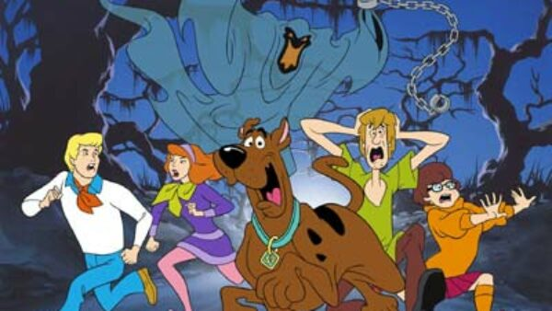
Scooby Doo and the Scary Software Stack
By Old Man Withers
Notes:
Some days I think this is what we’ve arrived at

Slide 2

Docker and Kubernetes - lets make this less scary

Slide 3
Now I’m just regurgitating….
Container Security – Liz Rice
Cgroups, namespaces, and beyond: what are containers made from? – Jerome Petazzoni
Container runtimes – Ian Lewis
The almighty pause container – Ian Lewis
Kubernetes Components

Slide 4
Agenda
Build and run a container
Investigate and Illuminate what containers are
Understand image building
Understand container runtimes
Augment our container to mount data
Understand the step to k8s and why you’d chose it

Slide 5
Prep 0
Notes:
Clone the repo
Start docker

Slide 6
What is a container ?
Its Not a VM….
Its Not just a process ...
It’s not a docker spec ….
Its Not an image file or an image manifest
It’s a VM with a shared kernel ? …
Notes:
Cgroups, namespaces, and beyond: what are containers made from? – Jerome Petazzoni
Introduction to cgroups and namespaces 2:00 – 5:18
Different namespaces - 24:46 – 27:25
Understand what getting a shell in a container is
“A container is a process that’s not sharing ! (the default namespace) – Alister Shipman
How can we think of it docker, images and containers together
dockerfile is the sourcecode (it’s a specific language)
image is the compiled binary, but the files as well, and the image manifest
container is the running process - but docker run does a bit more

Slide 7
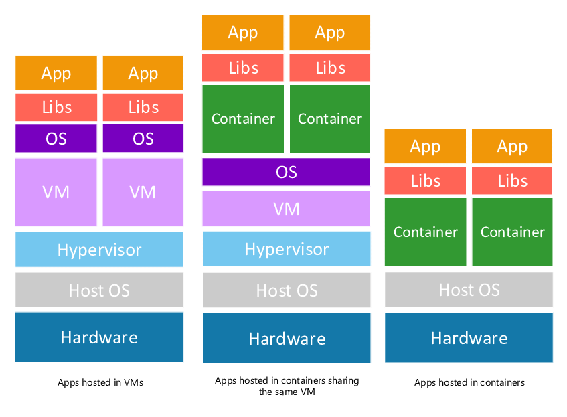
You may have seen
Notes:
Whats a hypervisor ?
https://www.vmware.com/topics/glossary/content/hypervisor.html
https://docs.microsoft.com/en-us/windows-server/administration/performance-tuning/role/hyper-v-server/architecture

Slide 8
Test Drive 1
Notes:
Ok – so lets build a container
Why Distroless and Debian selection
One package manager
Rapidly updated security vulnerabilities
No musl (alpine)
Images aren’t a docker thing – see https://opencontainers.org/

Slide 9
Images & Dive 2
Notes:
Ok – so lets build a container
Why Distroless and Debian selection
One package manager
Rapidly updated security vulnerabilities
No musl (alpine)
Images aren’t a docker thing – see https://opencontainers.org/

Slide 10
Namespaces & Shell commands 3
Notes:
So, we need to explore linux a little bit
So, lets do some docker and explore our containers

Slide 11
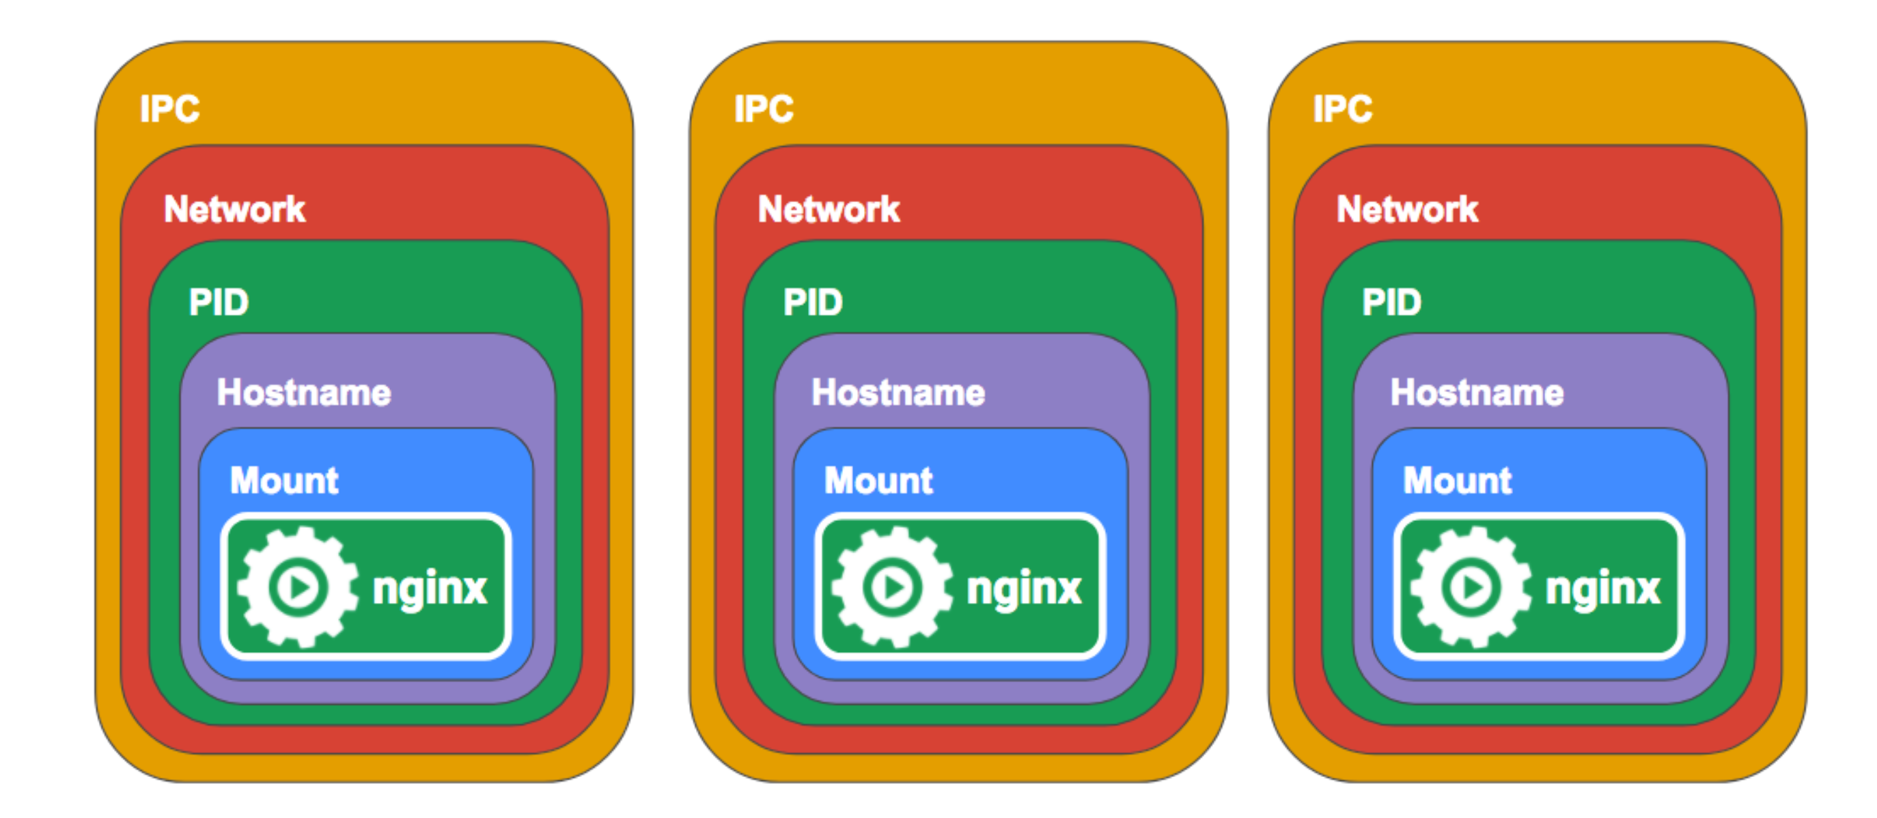
Notes:
So, we need to explore linux a little bit
So, lets do some docker and explore our containers

Slide 12
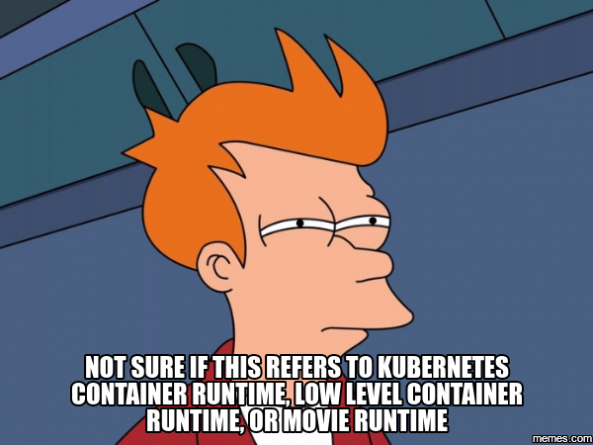
So, what the hell is docker then ?

Slide 13
Docker was released in 2013 and solved many of the problems that developers had running containers end-to-end. It had all these things:
A container image format
A method for building container images (Dockerfile/docker build)
A way to manage container images (docker images, docker rm, etc.)
A way to manage instances of containers (docker ps, docker rm , etc.)
A way to share container images (docker push/pull)
A way to run containers (docker run)
Notes:
https://www.ianlewis.org/en/container-runtimes-part-1-introduction-container-r

Slide 14
Containers Runtimes & Docker 4
Notes:
Ok – so we know what a container is now, and we’ve built some, inspected some images, how would we build one ?
Practically building containers
Well we will use docker, but I stress this is only one way !
We’ve used 3 here – docker, kaniko and jib
Ok – docker commands to run it – observe link between commands and namespaces e.g pid namespace

Slide 15
Container Monitoring, Pods and Kubernetes 5
Notes:
Monitoring pods – the building blocks
The almighty pause container https://www.ianlewis.org/en/almighty-pause-container
“In Kubernetes, the pause container serves as the "parent container" for all of the containers in your pod. The pause container has two core responsibilities. First, it serves as the basis of Linux namespace sharing in the pod. And second, with PID (process ID) namespace sharing enabled, it serves as PID 1 for each pod and reaps zombie processes”
Ok – so we can monitor a container,
Paying it forward – you’re going to have to deal with these kinds of problems – monitoring, HA and deployment, scaling, config management. So the space will have some intrinsic complexity
https://kubernetes.io/docs/concepts/overview/what-is-kubernetes/#why-you-need-kubernetes-and-what-can-it-do
https://kubernetes.io/docs/concepts/overview/what-is-kubernetes/
https://kubernetes.io/docs/reference/kubernetes-api/
After that
Lets just run some Kubernetes commands and have a look round k9s – explore the Kubernetes api and api server
Explore .kubeconfig – auth, user etc
Explore relationship to docker config, image pull, kubelet etc

Slide 16
Back to the rock 6
Notes:
Lets look at dockerfiles again

