Slide 1
Architectures For Big Data
Prof. Andrea Condorelli
2021-2022
Davide D’Ascenzo, Alice Schiavone

Slide 2


I have this awesome idea using this tool!
If you can make it real, I will give you a lot of money!

Slide 3


Meet the team
github.com/aliswh/lastfm
Davide D’Ascenzo
Solution Architect
Alice Schiavone
Developer

Slide 4
About the Architecture
ABSTRACT VIEW
LastFM Reader
READ
Batch Job
WRITE
Cloud Storage
READ
Spark

Slide 5
About the Architecture
SYSTEM VIEW
Google Colaboratory
Google Cloud
LastFM
Intel Xeon 2.20GHz
12GB RAM
60GB SSD
Google Cloud Storage
Spark

Slide 6
About the Architecture
DATA VIEW
PyLastSource
Source
LastFM
get()
BatchWriter
Writer
GoogleStorageJson
DataLake
write()
write()
Google Cloud Storage
read()
PySparkReader
Reader
delete()
read()
Spark

Slide 7
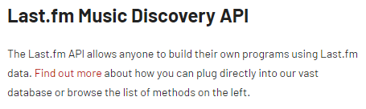
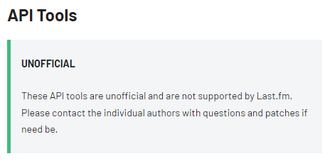

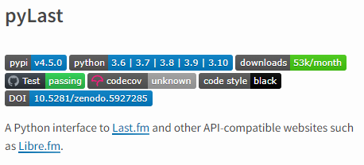
About the APIs
Instead of the standard LastFM APIs we used the PyLast Python interface to LastFM, so it was easier to deal with.
The library is not officially built and maintained by LastFM but is listed on their documentation website.

Slide 8
Ask no more!
You want User Features? We have User Features!

Slide 9

What we got on the menu:
Greatest Hits
Greatest Hits for today, yesterday, last week and last month
Greatest Hits for today, yesterday, last week and last month per genre
Listening sessions
Extract listening sessions from users:
list of concatenated songs with a play events +-10 sec after the actual song completed
Know statistics about these sessions:
average number of tracks
average session per user
session lengths

Slide 10
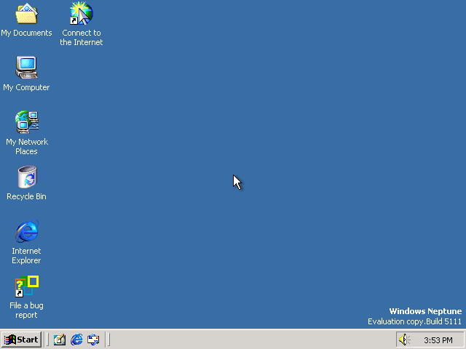
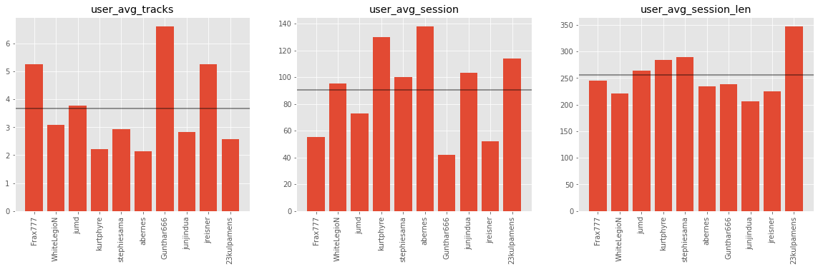
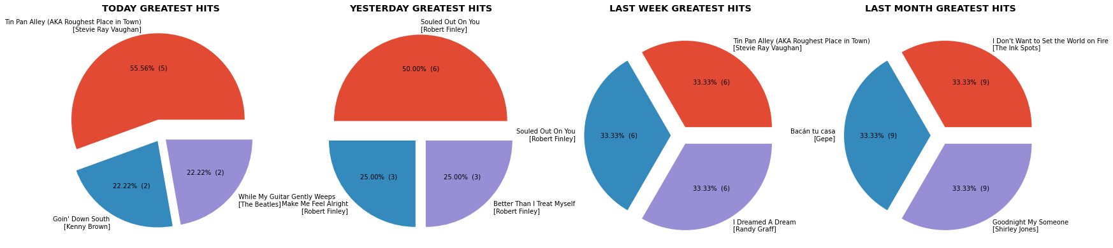

Slide 11
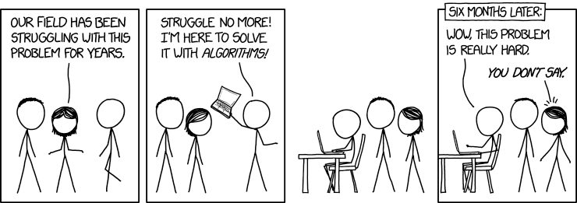
Problem(s and their) solving

Slide 12
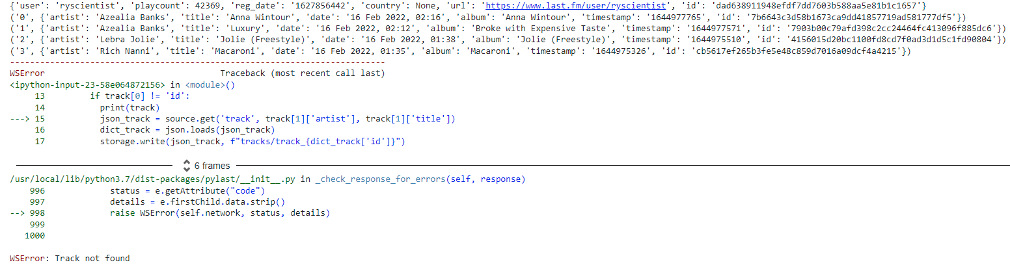

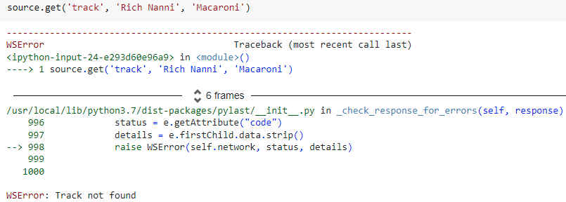
MISSING TRACKS!
Run on 16 Feb at 19.50

Slide 13
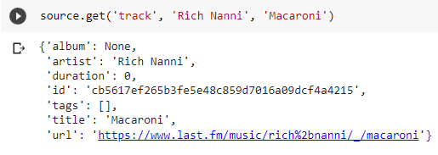
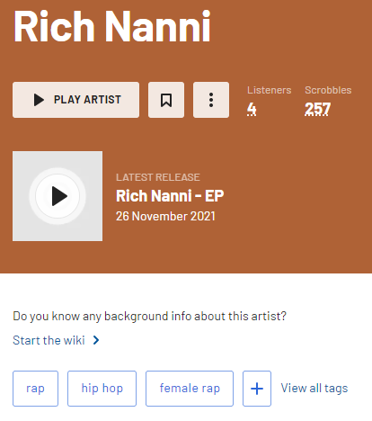
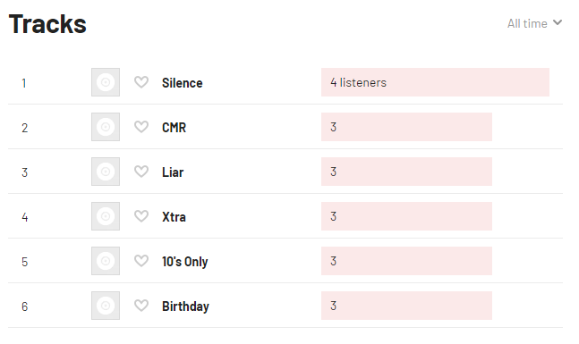
HOW?
Solution
Easy!
Now let’s get to the fun part.

Slide 14
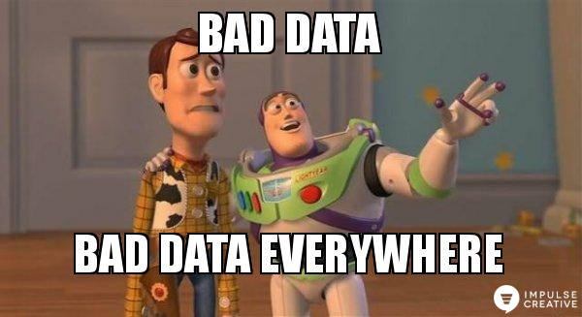
Missing durations!
Problem: missing duration for some tracks
Fix:
Take max duration from the tracks by that artist in the listening session to fill missing values.
Duration from top tracks
Default value: average of all values for the tracks listened by that user in the recent tracks

Slide 15
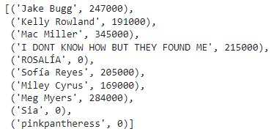
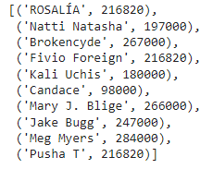

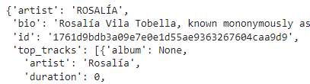
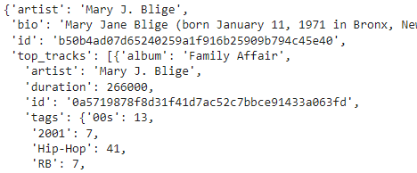
recent_tracks
1
3
Artist’s top tracks
2

Slide 16

These features will make me rich!
Take all the company money to make it happen!

Slide 17
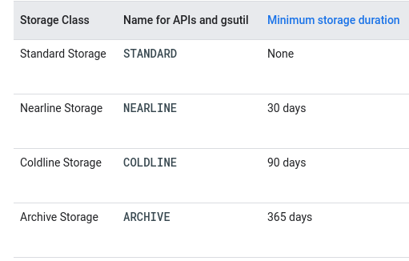
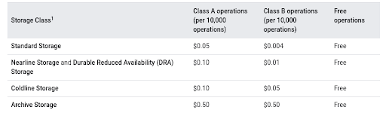
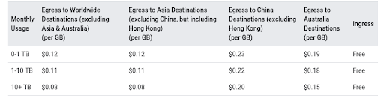
Price to pay!
Standard Storage
Standard Storage is best for data that is frequently accessed and/or stored for only brief periods of time.
Standard Storage is priced at $0.020 per GB per Month.
Operations
Operation charges apply when you perform operations within Cloud Storage. An operation is an action that makes changes to or retrieves information about resources such as buckets and objects in Cloud Storage.
Operations are divided into three categories: Class A, Class B, and free. Billing rates are per 10,000 operations.
Network
Egress represents data sent from Cloud Storage in HTTP responses. Data or metadata read from a Cloud Storage bucket is an example of egress.
Ingress represents data sent to Cloud Storage in HTTP requests. Data or metadata written to a Cloud Storage bucket is an example of ingress.
Source: https://www.easydeploy.io/blog/google-cloud-storage-price/

Slide 18
Total for Simple Pricing Example: $2.61
Storage usage pattern in a given month:
50 GB of standard data storage, from the first day to the end of the billing month.
10 GB of network egress (Americas and EMEA). (Ingress is free.)
10,000 total PUT/POST, GET bucket (list), GET service requests, Class A operations.
10,000 total GET object and HEAD requests, Class B operations.
Bill for the month:
50 GB standard storage at $0.026/per GB:
$1.30
10 GB of network egress at $0.12/per GB:
$1.20
10,000 Class A operations at $0.01/per 1,000 operations:
$0.10
10,000 Class B operations at $0.01/per 10,000 operations:
$0.01

Slide 19

We don’t actually need all your money!
WOW!
Then put it in production, I’ll see you later!

