Slide 1
Multi-Lingual SER by SAE
Audio Pattern Recognition - Prof. Stavros Ntalampiras
Alice Schiavone

Slide 2

Speech Emotion Recognition
“Emotion recognition is the process of identifying human emotion. People vary widely in their accuracy at recognizing the emotions of others.”
from wikipedia.org/wiki/Emotion_recognition
What about emotion recognition of speaker from different languages?

Slide 3
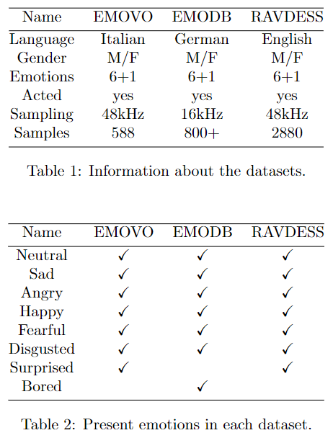
😐😢😠 The Data 😀😨😒
For this study, we chose to work on the 6+1 Big Emotions of:
Italian (EMOVO)
German (EMODB)
English (RAVDESS)
The challenges:
Inconsistent emotions
Different way of speaking
Different way of expressing emotions
Different acquisition methods for different languages
all the SER problems!

Slide 4
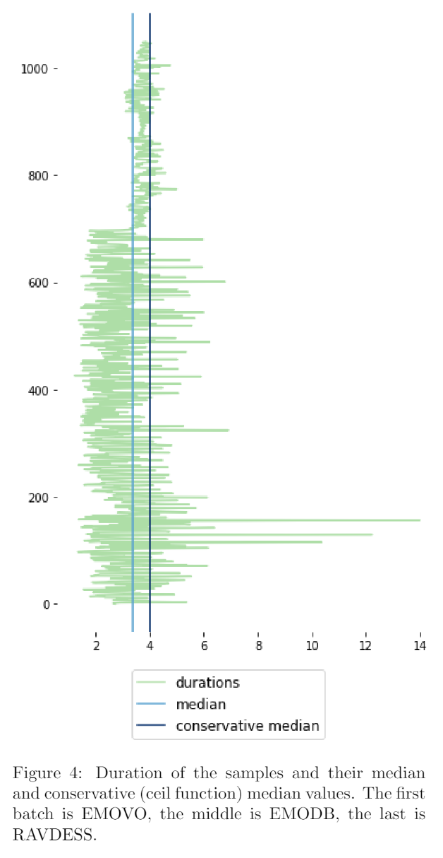
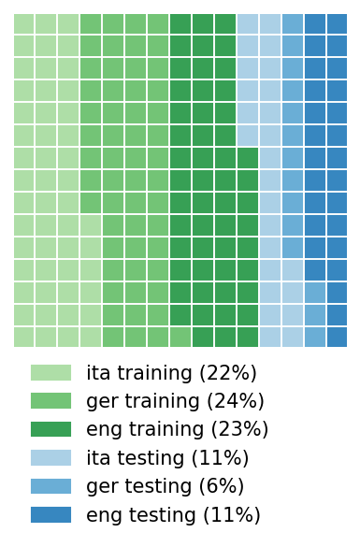
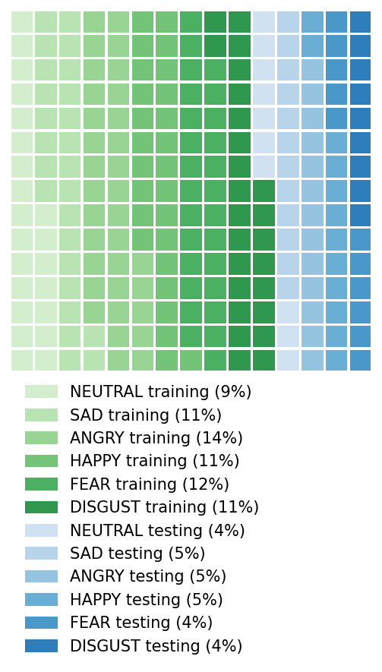
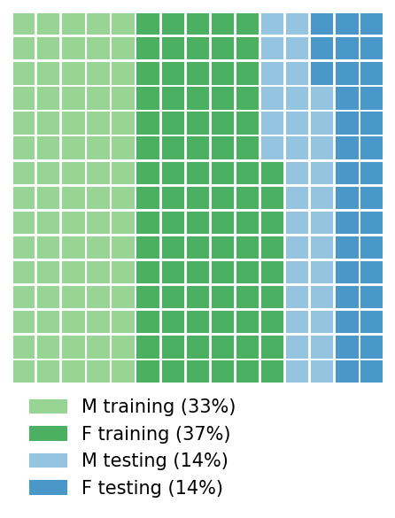
The Data: is it balanced?

Slide 5
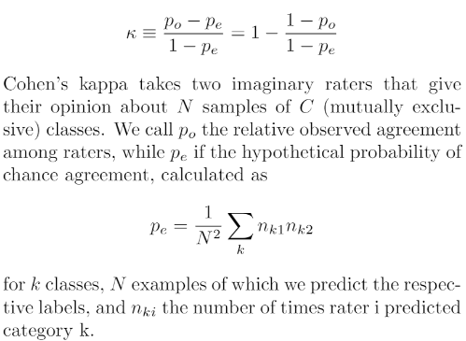
Models
Metrics
On features
On latent vector
On all languages
Dense NN
Convolutional NN
Stacked Convolutional Autoencoder
SVM
MLP
CNN
CNN on features
CNN on encoded signal + features
Confusion Matrix
For implementation details: github.com/aliswh/ser_ae/blob/main/Emo_CNN_AE.pdf

Slide 6
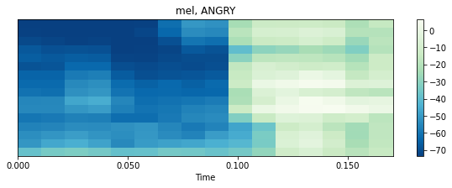

Preprocessing
Features
Downsampling
Segmentation
Scaling
Training and Testing Split
Log Mel-Spectrogram
MFCCs
Chroma
Centroid
Neutral, F, Italian : 48kHz → 8kHz x 2

Slide 7
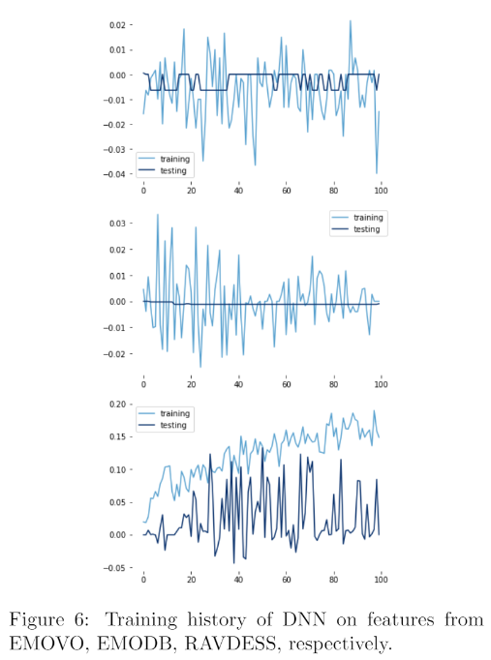
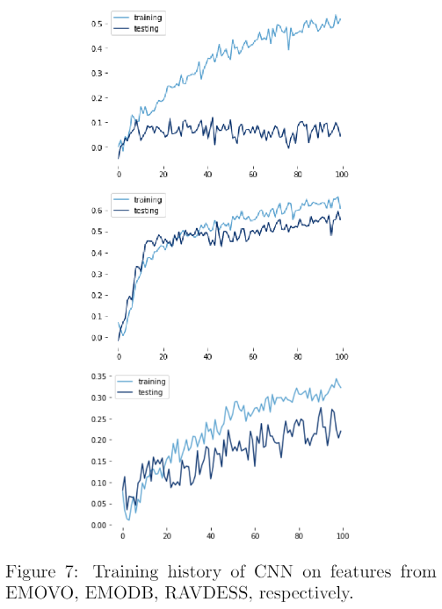
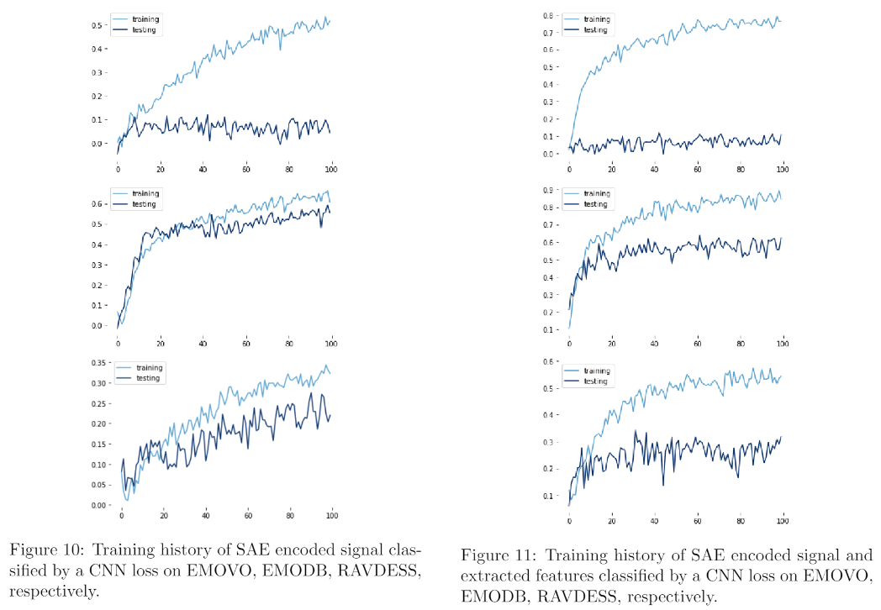
Training

Slide 8
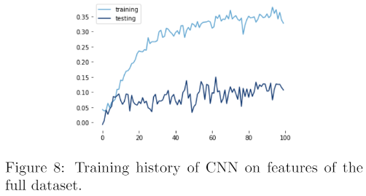
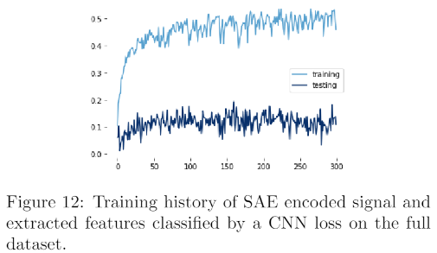
Comparison between CNN on features (base line) vs CNN on features and encoded signal (proposed model).

Slide 9
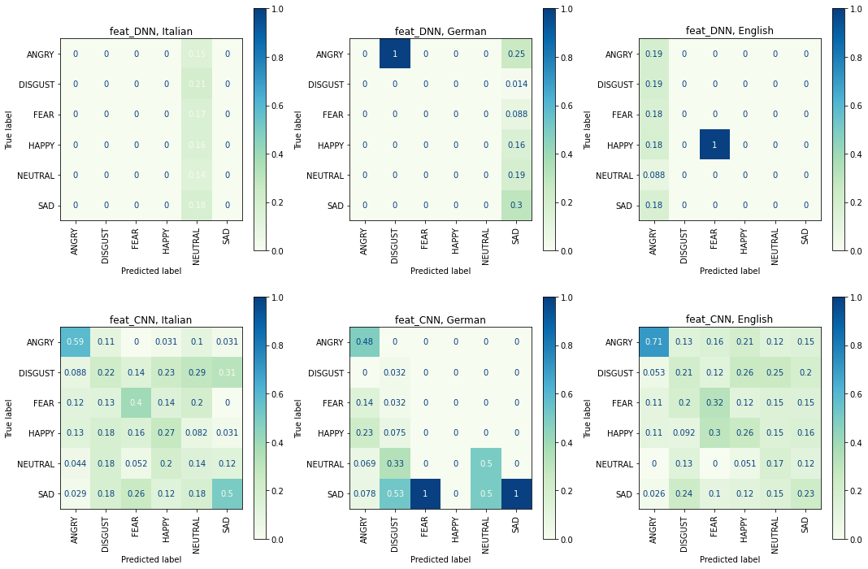
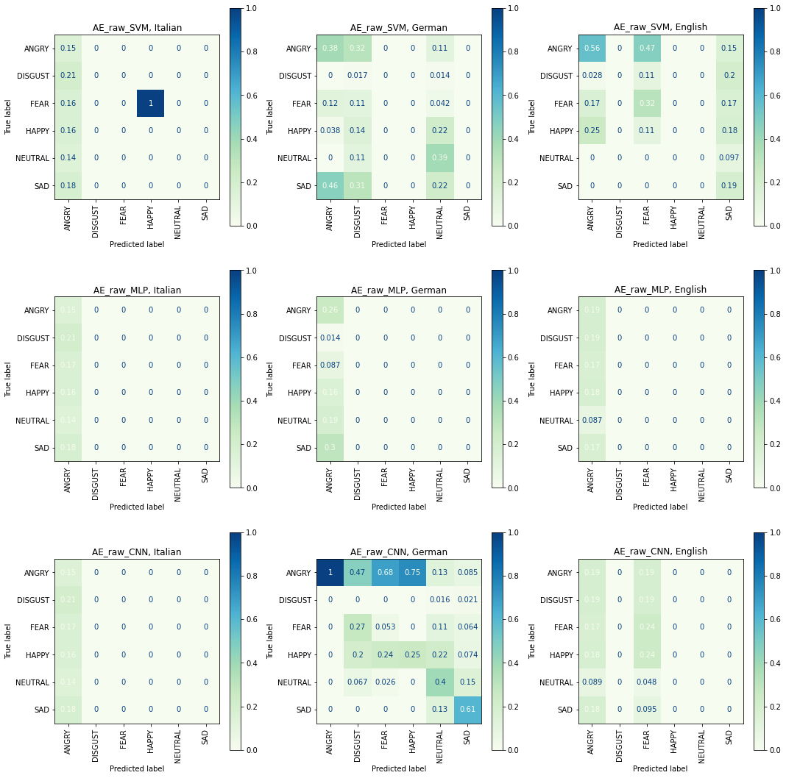
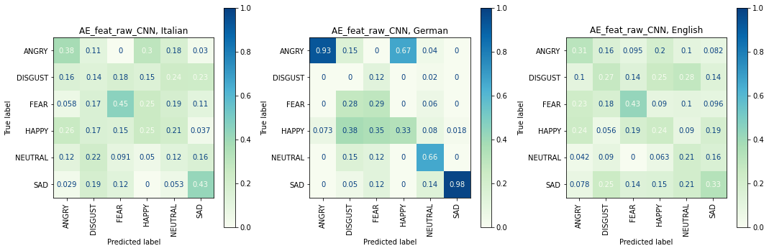

Slide 10
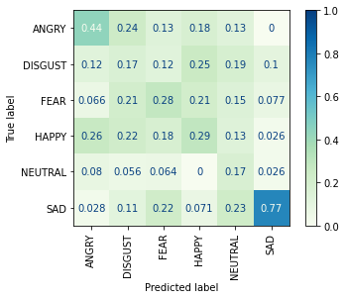
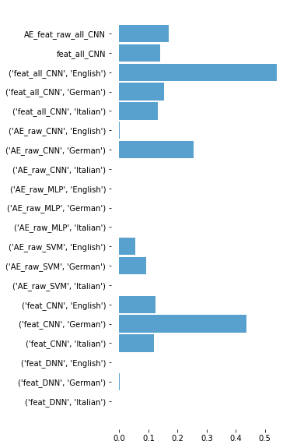
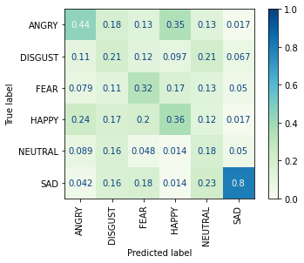
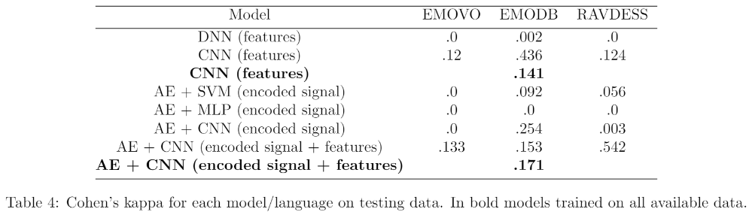

Slide 11
Further research
More preprocessing
More evaluation metrics
Recurrent NNs
Better Data
Can we normalize the data better?
Are the extracted features enough/right?
How to measure the performance of something we humans struggle to do?
NN such as LSTM are the standard for SER. How to get the most efficient results?
For more interesting results:
i.e. family of languages tailored training

Slide 12

The End.
Thank you!

