Slide 1
NYC Housing Prediction
Ali Syed, Arsenii Vasilev, William Dang, Javier Vargas, Sarah Pun

Slide 2
Project Proposal
Predict and analyze deficiencies that are present in housing in New York City by clustering similar deficiencies that will reveal systematic issues that plays a larger role
We aim to use the age of the building, number of units, household income, etc.. to help us identify possible patterns that may correlate with the the housing deficiencies or quality of the buildings

Slide 3
Data Collection
This data is from 2021 New York City Housing and Vacancy Survey Microdata provided by the United States Census Bureau
This dataset includes information about residential demographics (relationship, age, gender, income, marital status), and and housing information with economic data which is what we are interested in.
10 deficiencies
  Leaks
  Mold
  Elevator Broken
  Rodents Unit
  Rodent Build
  Toilet Broken
  Wall Holes
  Floor Holes
  Peelpaint
  Peelpaint Large
15.5k units

Slide 4
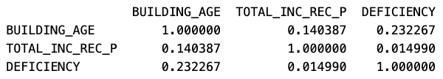
Hypothesis #1
Older buildings and those in low-income neighborhoods are more likely to experience deficiencies in their housing
Correlation between BUILDING_AGE and DEFICIENCY: positive correlation means older buildings are slightly more likely to have deficiencies
Correlation between TOTAL_INC_REC_P and DEFICIENCY: weak positive correlation means to have little to no relationship with deficiencies; factors other than household income may play a significant role
Correlation between BUILDING_AGE and TOTAL_INC_REC_P: weak positive correlation means older buildings might be associated with slightly higher income levels

Slide 5
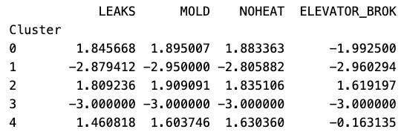
Hypothesis #2
Clusters of similar deficiencies will reveal systematic issues that play a larger role (lack of maintenance and the age of the building)
Cluster 0: General poor maintenance across all issues.
Cluster 1 and 4: Represents well-maintained housing units.
Cluster 2: Heating and structural issues dominate.
Cluster 3: moderate issues suggest a transitional state where preventative maintenance could prevent further decline.

Slide 6

Hypothesis #3
Older buildings and those in low-income neighborhoods are more likely to experience deficiencies in their housing
BUILDING_AGE is the most significant factor and that indicates the household income does not play the largest role in being associated with deficiencies

Slide 7
K-Means Clustering (Random Forest Model)
Used to identify patterns and group housing units based on deficiency-related features
Shows the top 10 features and highlights the key factors units based on the deficiencies
Silhouette Score: 0.566
Deficiency column is highly imbalance
  1 (deficiency): 11,703 units
  0 (no deficiency): 765 units
6.5% of homes in New York do not have any present deficiencies

Slide 8
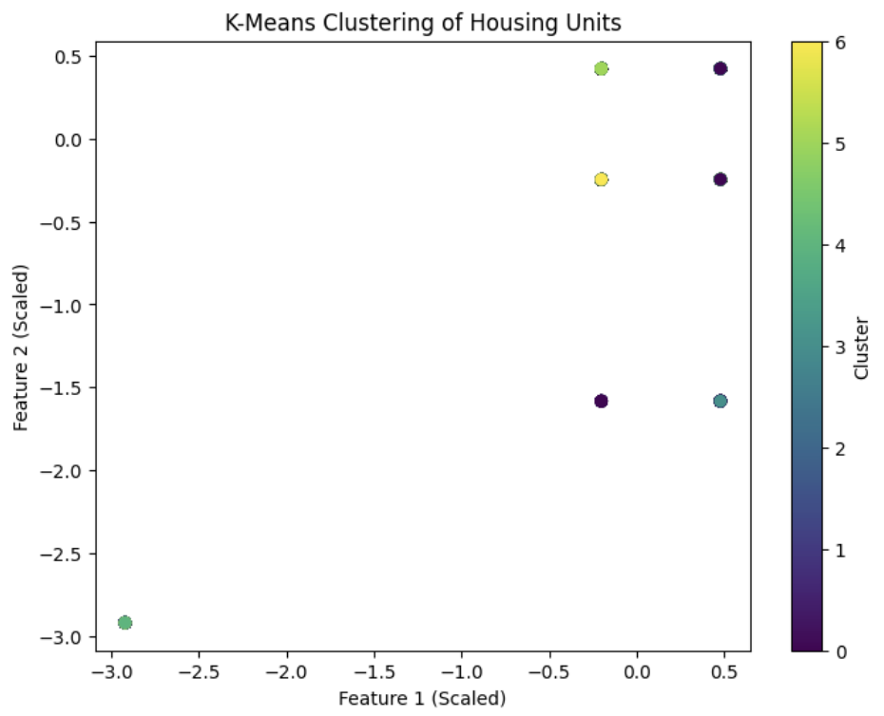
K-Means Clustering (Random Forest Model)

Slide 9
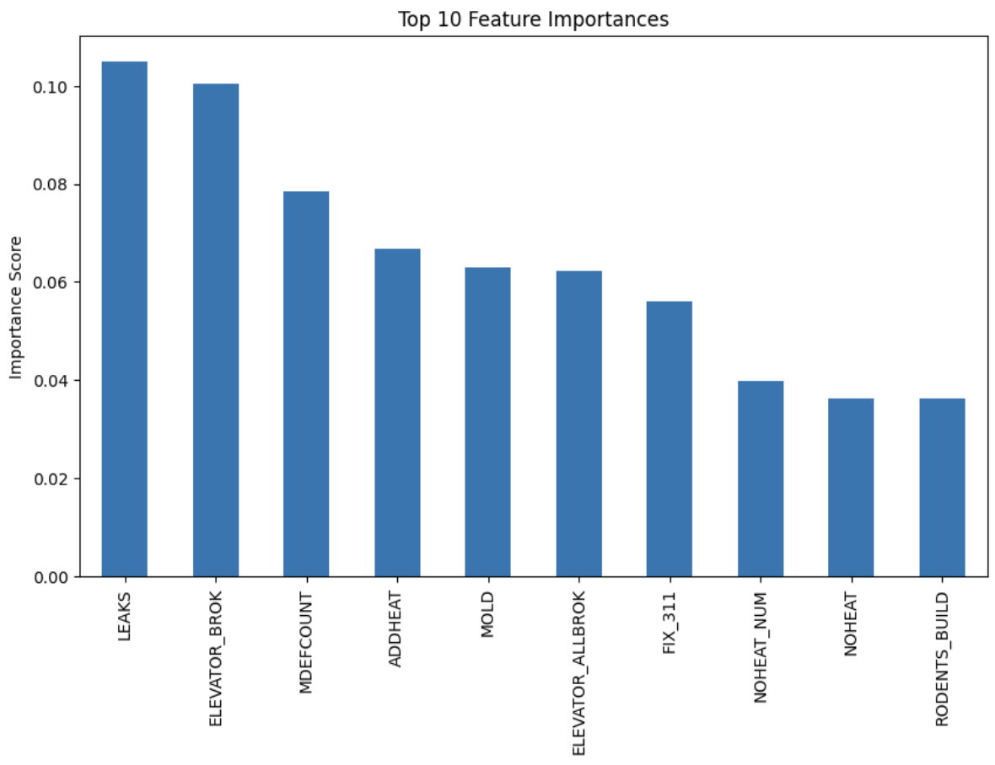
Top 10 Feature Importances

Slide 10
K-Means Clustering (Principal Component Analysis)
5 clusters are used to distinct groups of housing units with the 10 shared deficiency profiles
Shows which deficiencies are most common in each group
Silhouette Score: 0.590
5 Clusters
  #0: units with the most severe deficiencies across all features
  #1: Potential anomalies or misclassifications due to extreme negative values,
  #2: Units with mild deficiencies (indicating housing issues)
  #3: Units with moderate deficiencies (related to toilet and paint issues)
  #4: Units with balanced deficiencies (with paint and mold being the most prominent issues)

Slide 11
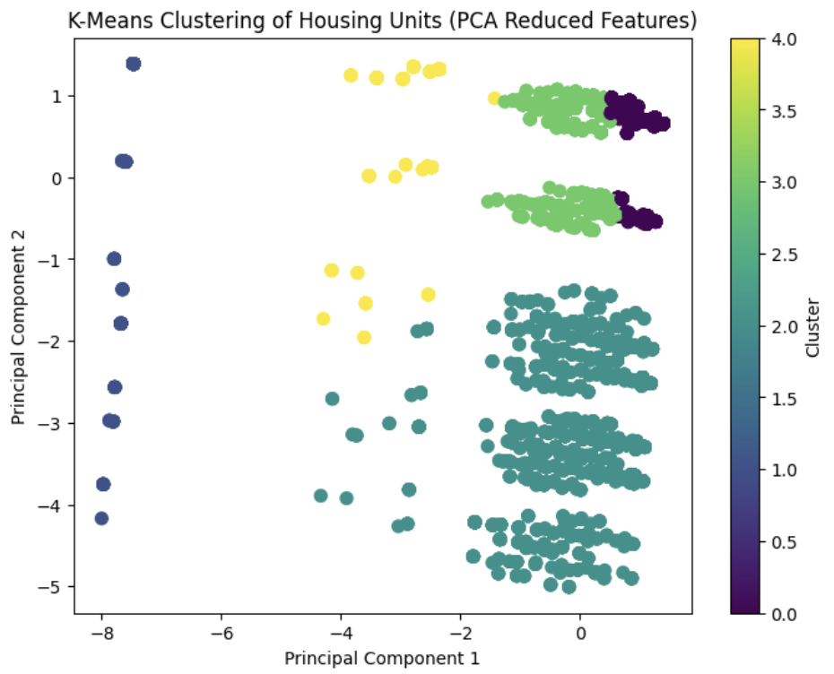
K-Means Clustering (Principal Component Analysis)

Slide 12
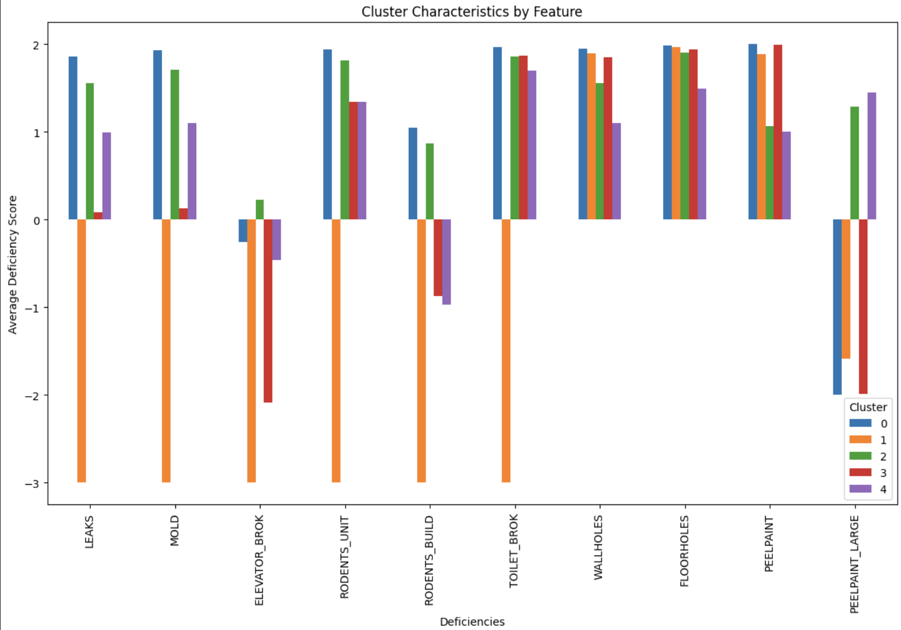
Cluster Characteristics by Feature

Slide 13
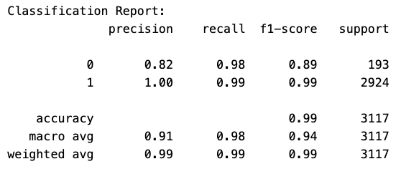
Model Validation
Precision:
Class 0 (ND): 0.82
Class 1 (D): 1.00
Recall:
Class 0 (ND): 0.98
Class 1 (D): 0.99
F1-Score:
Class 0 (ND): 0.89
Class 1 (D): 0.99
Overall Accuracy: 99%

Slide 14
Model Validation
Precision:
  Class 0 (ND): 0.82
  Class 1 (D): 1.00
Recall:
  Class 0 (ND): 0.98
  Class 1 (D): 0.99
F1-Score:
  Class 0 (ND): 0.89
  Class 1 (D): 0.99
Overall Accuracy: 99% of the units are correctly classified as having or not having deficiencies
Training ROC-AUC: 1.00, indicates that the model perfectly distinguishes between units with and without deficiencies
Confusion Matrix: shows that the model has a low number of false positives and false negatives so it is effective at predicting deficiencies.
True Positives = 2882 (units with deficiencies correctly identified)
True Negatives = 189 (units without deficiencies correctly identified)
False Positives = 4 (units incorrectly classified as having deficiencies)
False Negatives = 42 (units with deficiencies incorrectly classified as having no deficiencies)

Slide 15
Conclusion
Our analysis tells us that building age and household income are key predictors of housing deficiencies.
Musty conditions, mold, and lack of heat are the top three factors influencing deficiencies.
K-Means Clustering revealed patterns of systematic maintenance issues in older buildings and low-income neighborhoods.
Principal Component Analysis (PCA) reduced the data into two principal components, identifying five clusters of housing units with distinct deficiency profiles.

Slide 16
Question #1
What does the positive correlation between BUILDING_AGE and DEFICIENCY means?

Slide 17
Question #2
What does the Random Forest Model do to help us collect data?

Slide 18
Question #3
What are the two predictors of housing deficiencies?

Slide 19
Thank you
Ali Syed, Arsenii Vasilev, William Dang, Javier Vargas, Sarah Pun

