Slide 1
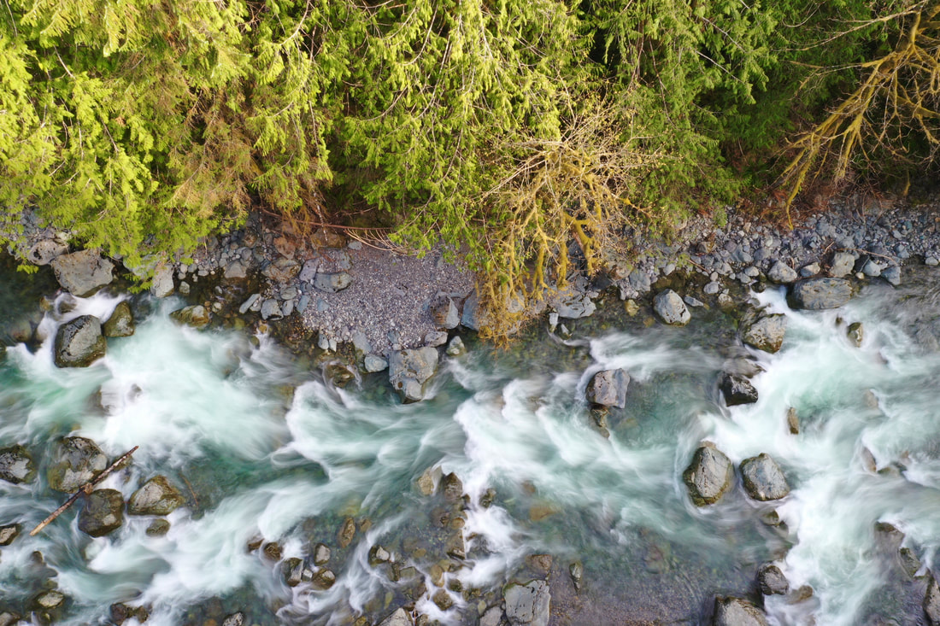
Streamflow prediction using Long Short-Term Memory (LSTM) Network
Group 20
Habtamu Tamiru
Nischal Karki
Ali Takallou

Slide 2
Contents
Introduction
Results
0 1
0 2
Methodology
0 3
Future works
0 4

Slide 3
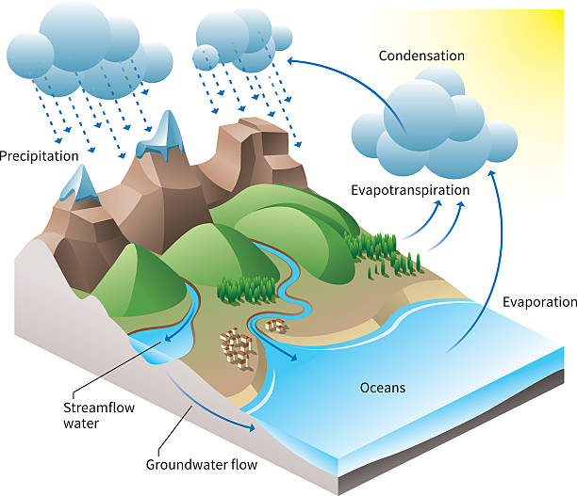
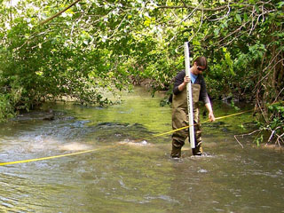
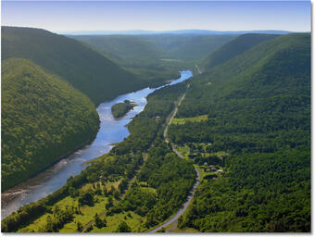
Introduction
Stream flow, or discharge, is the volume of water that moves in either natural or artificial channels over a chosen point and a fixed period.
Streamflow information is required to know the overall hydrologic processes related to water resources management, flood prediction, drought monitoring and other ecohydrological studies.
Streamflow measurement is also essential for assessing the availability of water resources necessary for hydroelectric power generation and estimating water supply demand for a city.

Slide 4
Introduction

Slide 5
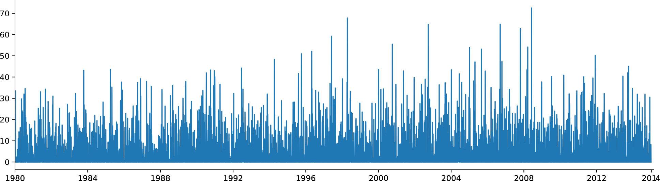
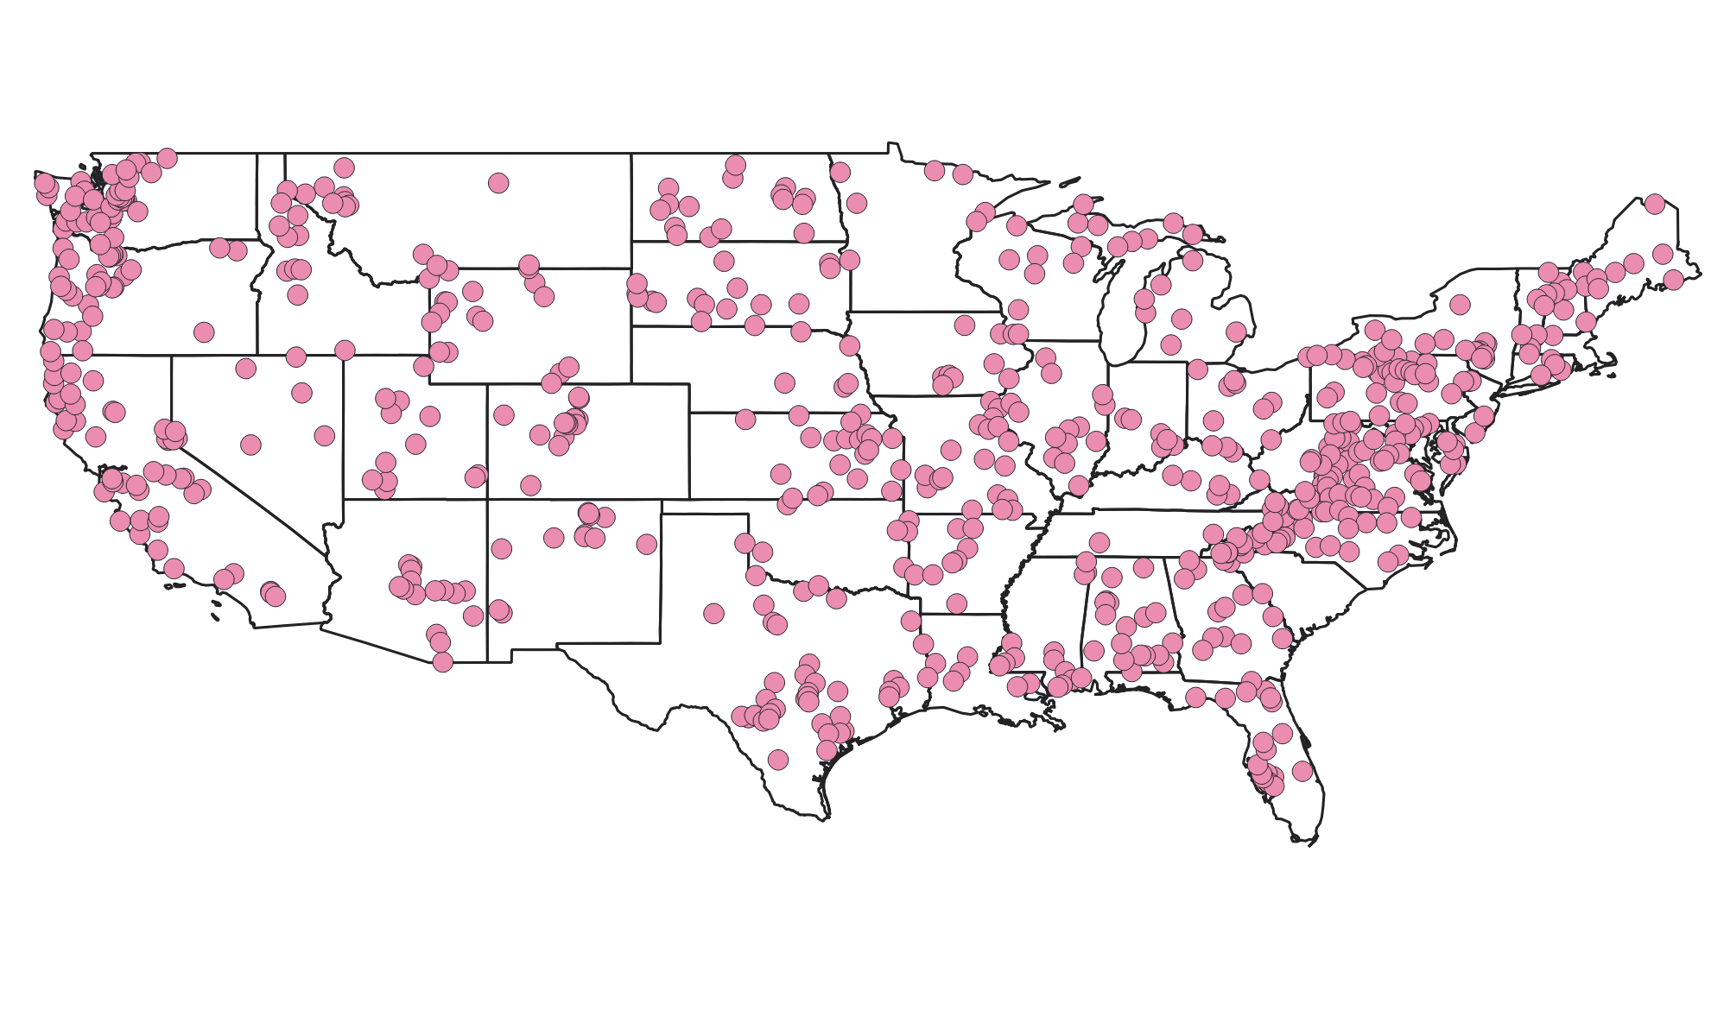
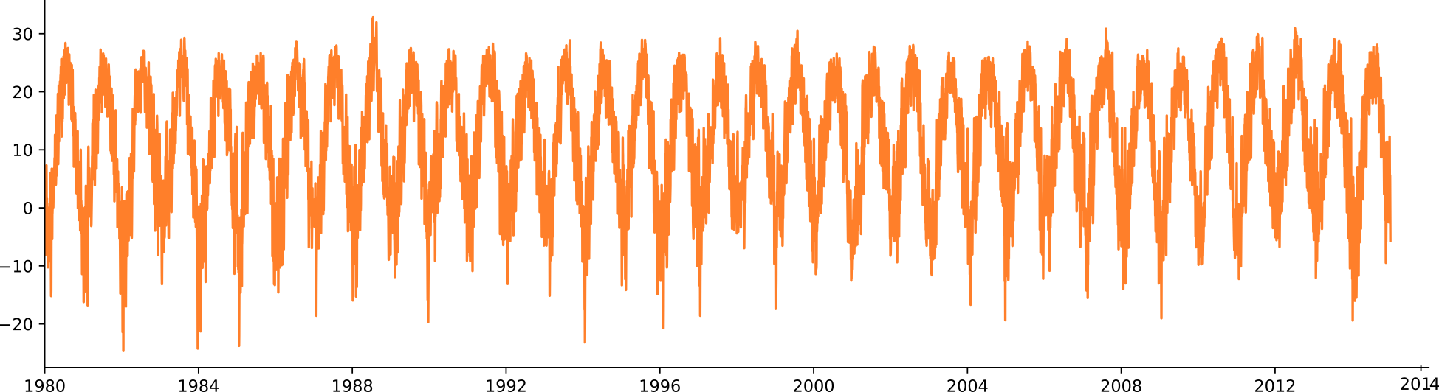
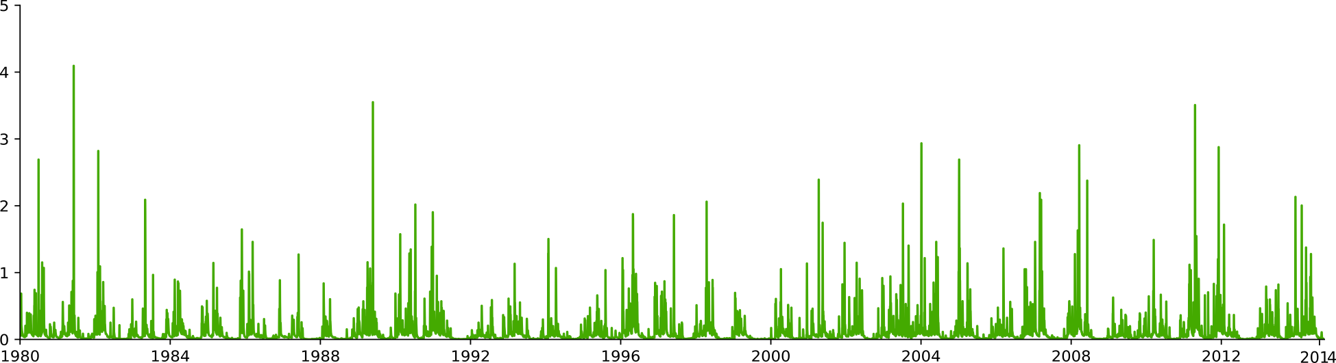
Methodology: Data
Precipitation
CAMELS: Catchment Attributes and Meteorology for Large-sample Studies (Addor et.al, 2017)
Temperature
Elevation, Slope, Landcover, Soil properties,…
671 basins across CONUS (531 used in this project)
Dynamic features (5):
- Daily meteorologic timeseries data from 1980-2014
Streamflow
Static features (27):
- Elevation, Slope, Landcover, Soil properties,…

Slide 6
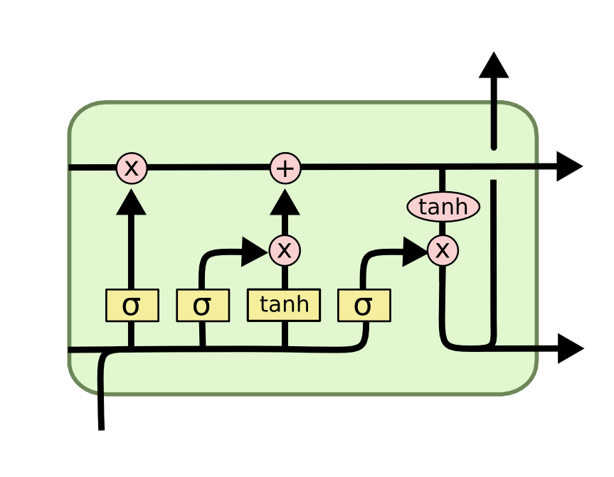
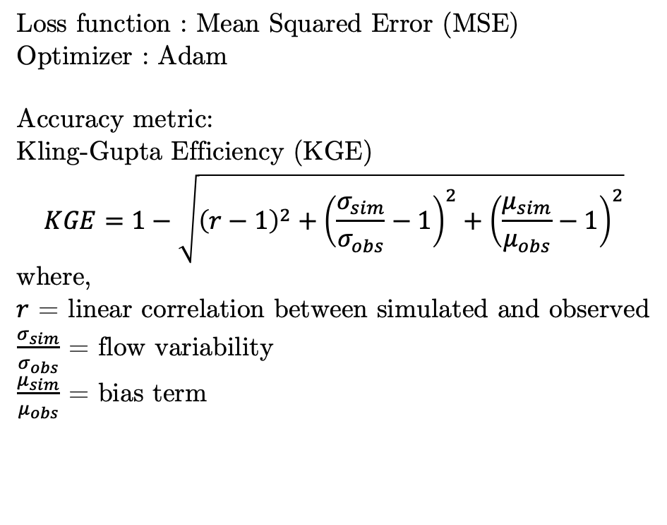
Methodology: Model architecture
LSTM layer
128 hidden size
Sequence length = 270 days
Dropout layer
p=0.4
Linear layer
1 output node
Loss function : Mean Squared Error (MSE)
Optimizer : Adam
Accuracy metric: Kling-Gupta Efficiency (KGE)
$$KGE=1−\sqrt{{\left(r−1\right)}^{2}+{\left(\frac{σ_{sim}}{σ_{obs}}−1\right)}^{2}+{\left(\frac{μ_{sim}}{μ_{obs}}−1\right)}^{2}}$$
where,
$r$ = linear correlation between simulated and observed
$\frac{σ_{sim}}{σ_{obs}}$ = flow variability
$\frac{μ_{sim}}{μ_{obs}}$ = bias term

Slide 7
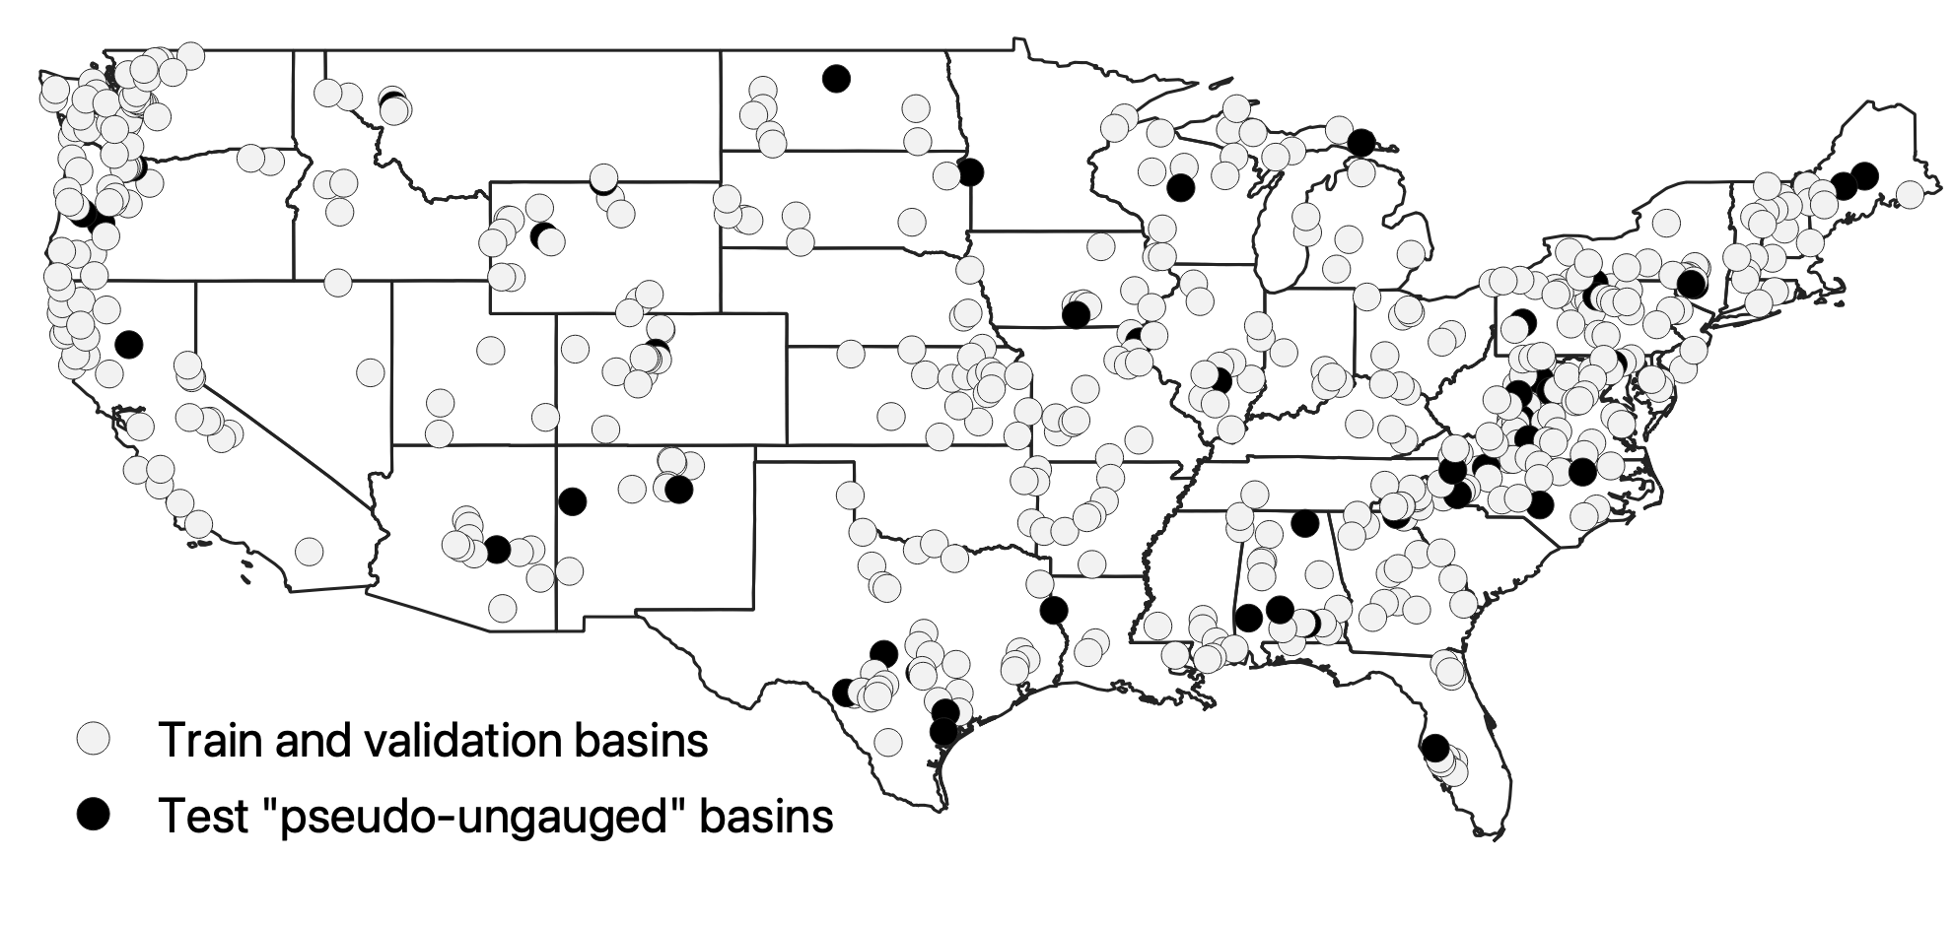
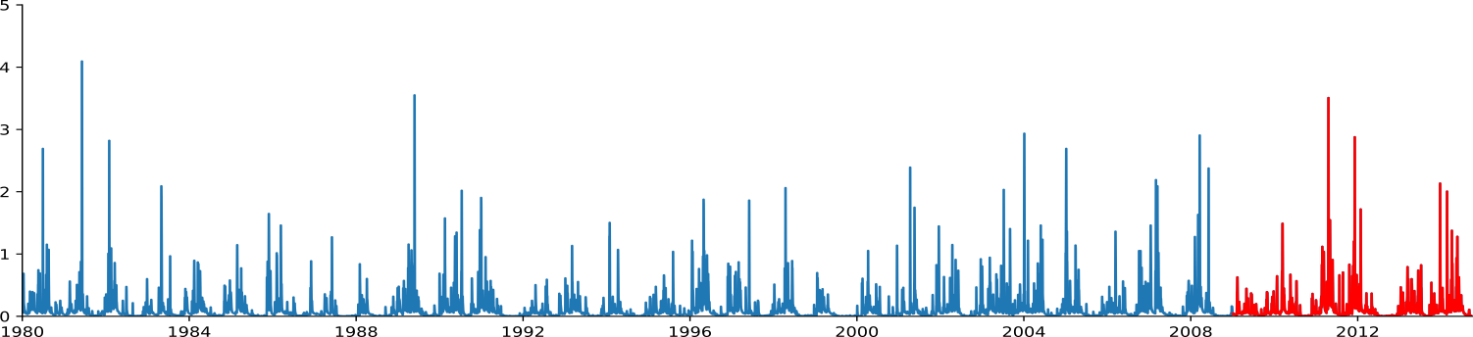
Methodology: Data split
Train and validation set:
480/531 basins
Train period: 1980-2008
Validation period: 2009-2014
Test set:
51/531 basins
Test period: 1980-2014
“Pseudo-ungauged” basins
Training period
Validation period

Slide 8
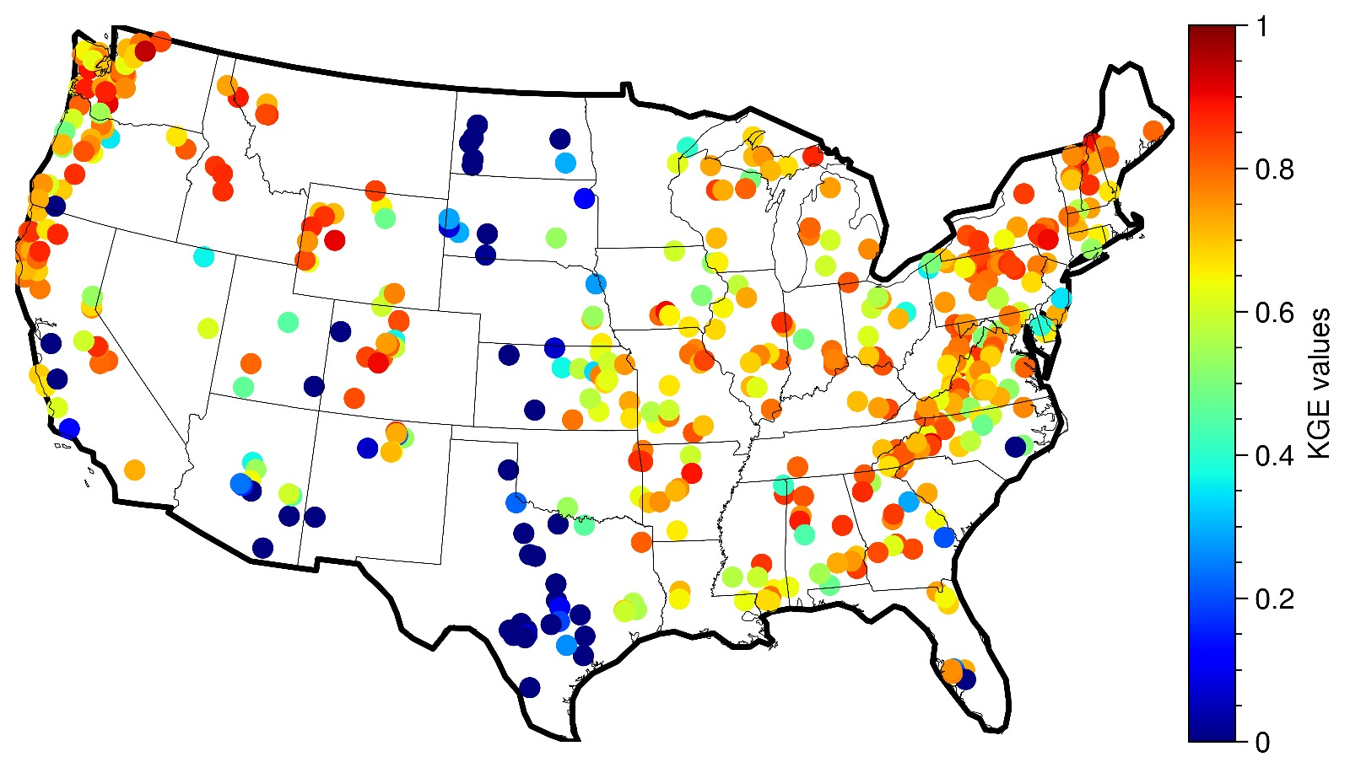
Results: Performance in validation period

Slide 9
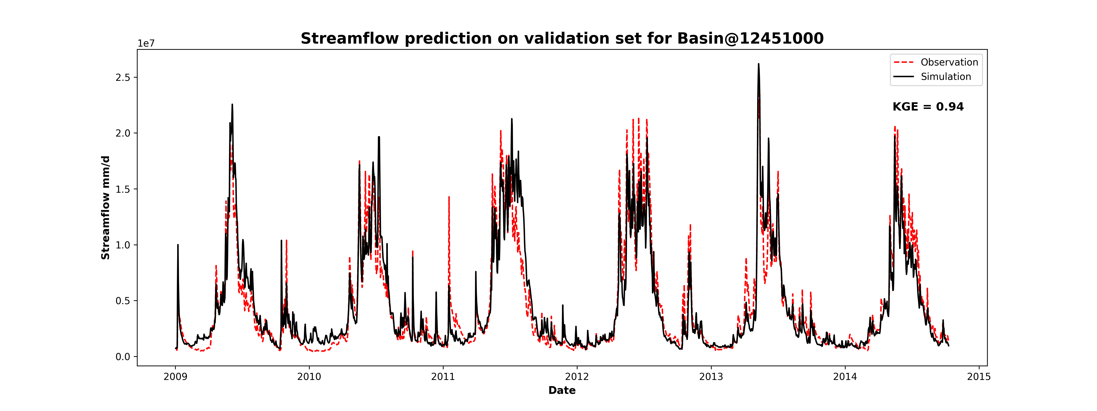
Results: Performance in validation period

Slide 10
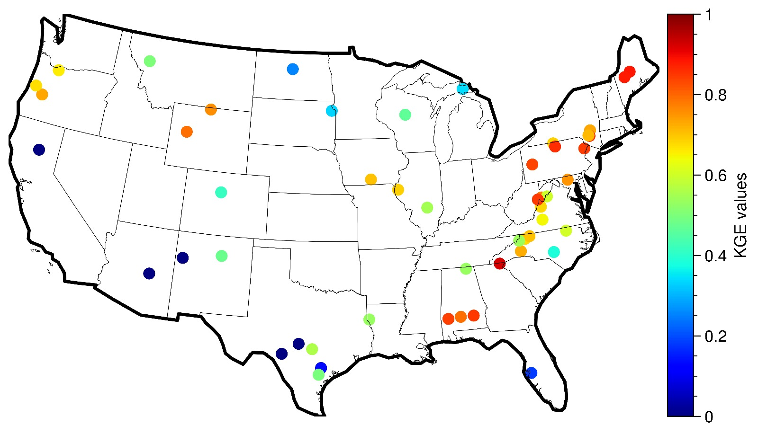
Results: Performance in ungauged basins

Slide 11
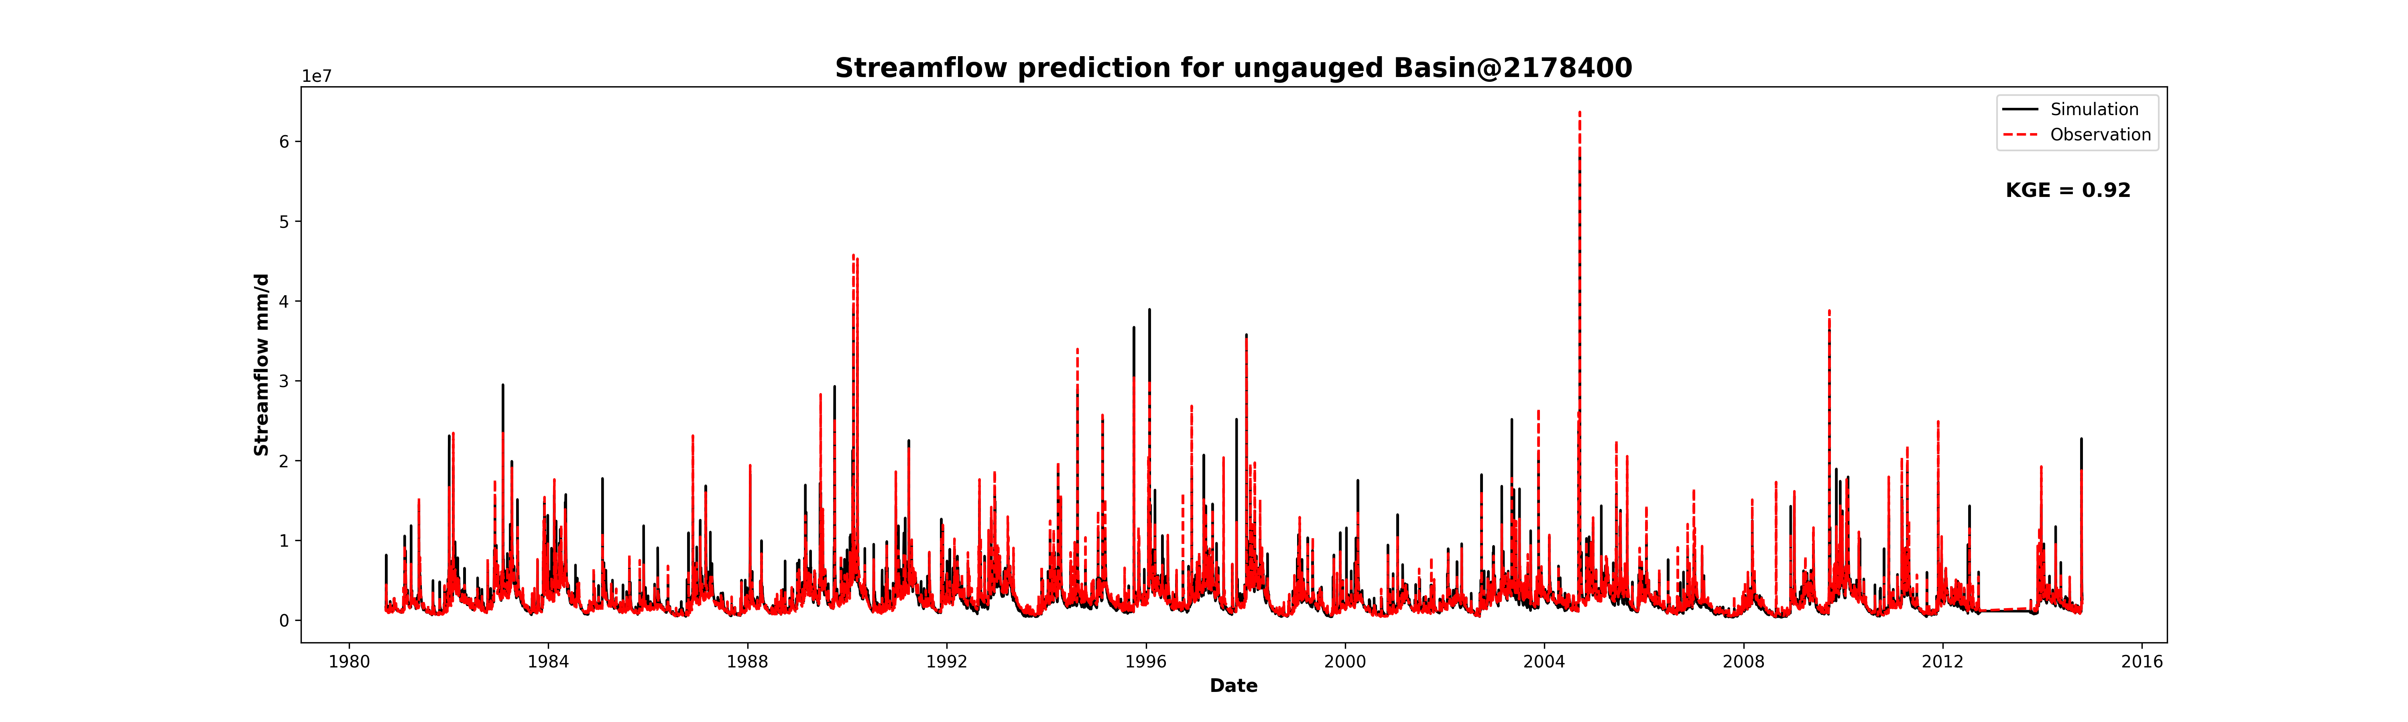
Results: Performance in ungauged basins

Slide 12
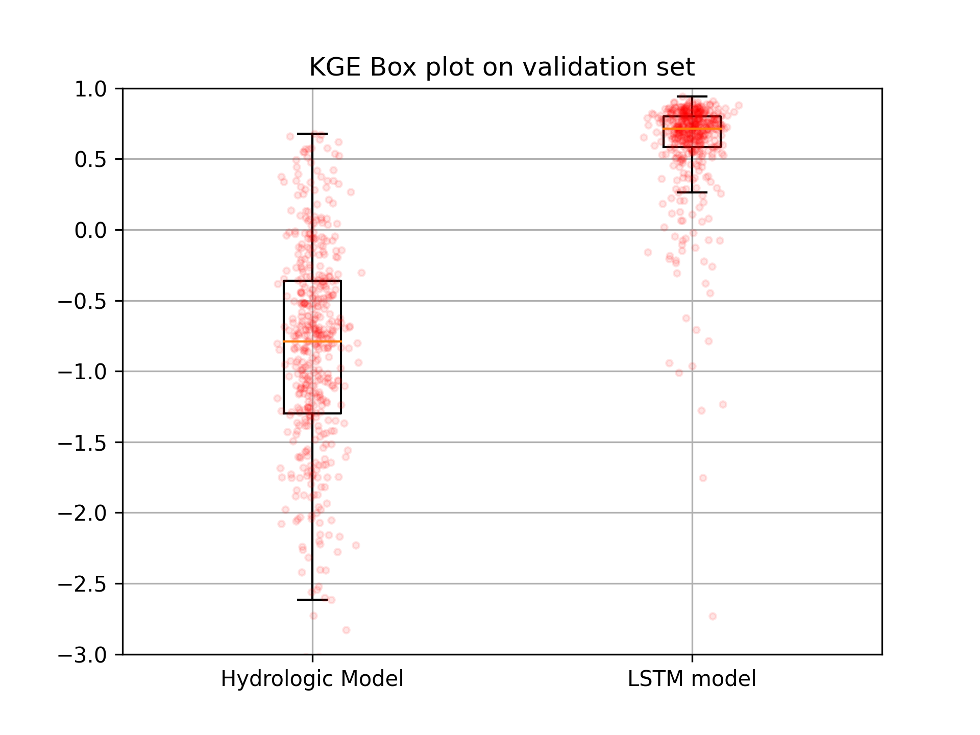
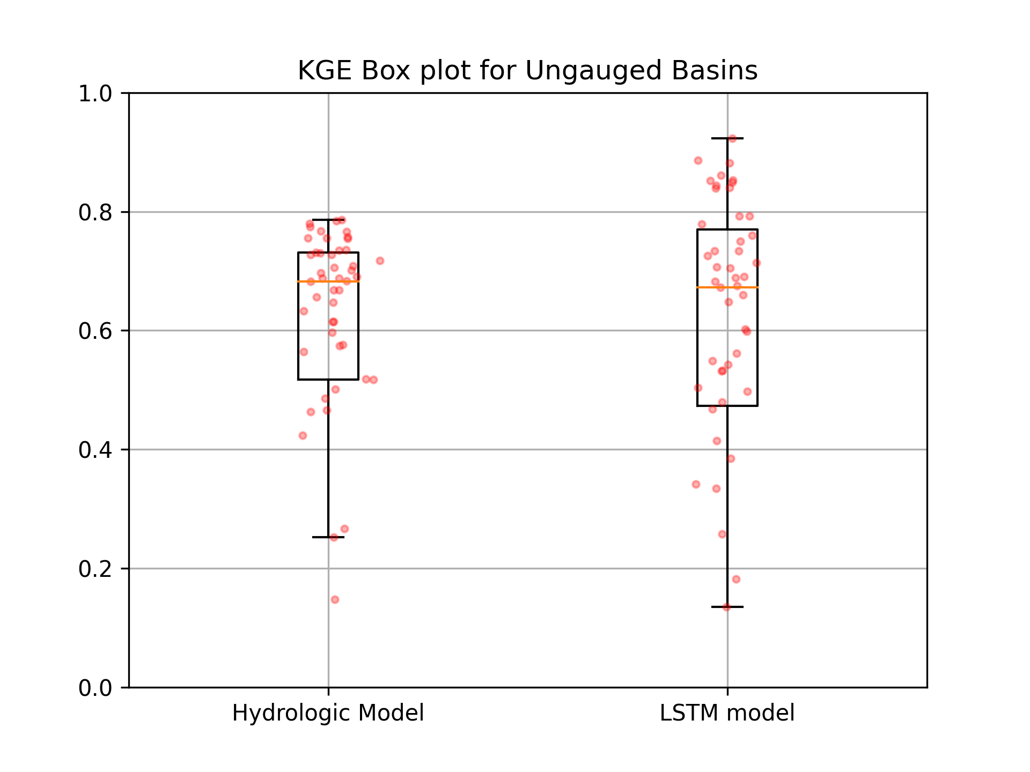
Results: Comparison with hydrological model

Slide 13
THANK YOU
QUESTIONS ???

