Slide 2
Why Android OS is The Most Popular Mobile OS in The World ?

Slide 3
1.Android OS is Open Sources
2.Android OS has Millions Applications and Games
3.Android OS is Multiplatform

Slide 4
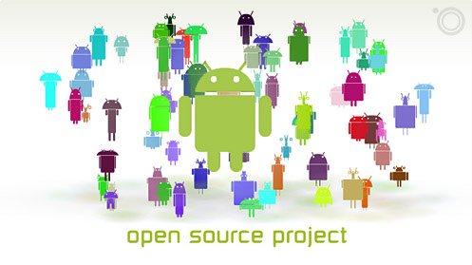
1.Android OS is Open Sources

Slide 5
Based on Linux OS
Apache License 2.0

Slide 6

2.Android OS has Millions Applications and Games

Slide 8
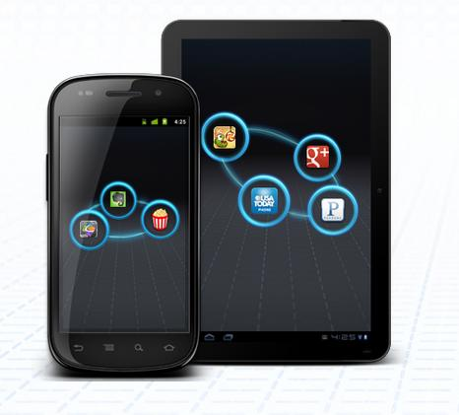
3.Android OS is Multiplatform

Slide 9
Android OS on Smartphone
Android on PC
Android OS on Smart TV
Android OS on Tablet
Android OS on Camera Device
Android OS on Smart Cars

Slide 10
Thank You...
Have a nice day

