Slide 1

CS212: Object-Oriented Programming
Polymorphism
Instructor: Hirra Anwar

Slide 2
Objectives
In this chapter you will learn:
The concept of polymorphism.
To use overridden methods to effect polymorphism.
To distinguish between abstract and concrete classes.
To declare abstract methods to create abstract classes.
How polymorphism makes systems extensible and maintainable.
To determine an object's type at execution time.

Slide 3
Introduction
Polymorphism
Enables “programming in the general”
The same invocation can produce “many forms” of results

Slide 4
Polymorphism
Polymorphism allows a single variable to refer to objects from different subclasses in the same inheritance hierarchy
For example, if Cat and Dog are subclasses of Pet, then the following statements are valid:
Pet myPet;
myPet = new Dog();
...
myPet = new Cat();

Slide 5
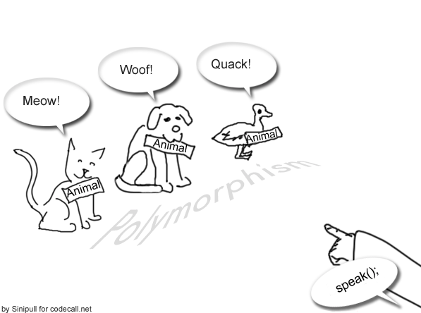
Polymorphism

Slide 6
Polymorphism, cont.
When a program invokes a method through a superclass variable, the correct subclass version of the method is called, based on the type of the reference stored in the superclass variable
The same method name and signature can cause different actions to occur, depending on the type of object on which the method is invoked
Facilitates adding new classes to a system with minimal modifications to the system’s code

Slide 7
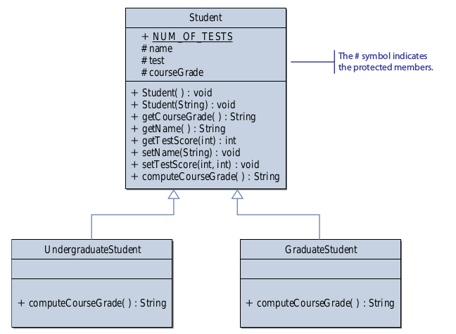
Example

Slide 8
Creating the roster Array
We can maintain our class roster using an array,
combining objects from the Student, UndergraduateStudent and GraduateStudent classes.
Student roster = new Student[40];
...
roster[0] = new GraduateStudent();
roster[1] = new UndergraduateStudent();
roster[2] = new UndergraduateStudent();
...

Slide 9
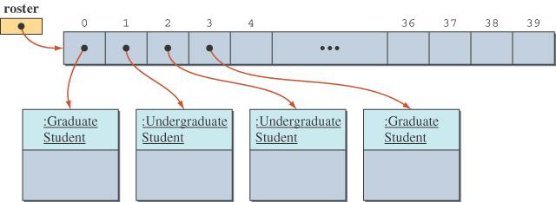
State of the roster Array
The roster array with elements referring to instances of GraduateStudent or UndergraduateStudent classes.

Slide 10
Sample Polymorphic Message
To compute the course grade using the roster array, we execute
for (int i = 0; i < numberOfStudents; i++) {
roster[i].computeCourseGrade();
}
If roster[i] refers to a GraduateStudent, then the computeCourseGrade method of the GraduateStudent class is executed.
If roster[i] refers to an UndergraduateStudent, then the computeCourseGrade method of the UndergraduateStudent class is executed.

Slide 11
The instanceof Operator
The instanceof operator can help us learn the class of an object.
The following code counts the number of undergraduate students.
int undergradCount = 0;
for (int i = 0; i < numberOfStudents; i++) {
if ( roster[i] instanceof UndergraduateStudent ){
undergradCount++;
}
}

Slide 12
Remarks
Polymorphism enables programmers to deal in generalities and let the execution-time environment handle the specifics.
Programmers can command objects to behave in manners appropriate to those objects, without knowing the types of the objects (as long as the objects belong to the same inheritance hierarchy).
Polymorphism promotes extensibility.
Software that invokes polymorphic behavior is independent of the object types to which messages are sent.
New object types that can respond to existing method calls can be incorporated into a system without requiring modification of the base system.
Only client code that instantiates new objects must be modified to accommodate new types.

Slide 13
Demonstrating Polymorphic Behavior
A superclass reference can be aimed at a subclass object.
This is possible because a subclass object is a superclass object as well.
When invoking a method from that reference, the type of the actual referenced object, not the type of the reference, determines which method is called.
A subclass reference can be aimed at a superclass object only if the object is downcasted.

Slide 14
// Assigning superclass and subclass references to superclass and
// subclass variables.
public class PolymorphismTest
{
public static void main( String args[] )
{
// assign superclass reference to superclass variable
CommissionEmployee3 commissionEmployee = new CommissionEmployee3(
"Sue", "Jones", "222-22-2222", 10000, .06 );
// assign subclass reference to subclass variable
BasePlusCommissionEmployee4 basePlusCommissionEmployee =
new BasePlusCommissionEmployee4(
"Bob", "Lewis", "333-33-3333", 5000, .04, 300 );
// invoke toString on superclass object using superclass variable
System.out.printf( "%s %s:\n\n%s\n\n",
"Call CommissionEmployee3's toString with superclass reference ",
"to superclass object", commissionEmployee.toString() );
Typical reference assignments

Slide 15
Assign the reference to a basePlusCommissionEmployee object to a CommissionEmployee3 variable
// invoke toString on subclass object using subclass variable
System.out.printf( "%s %s:\n\n%s\n\n",
"Call BasePlusCommissionEmployee4's toString with subclass",
"reference to subclass object",
basePlusCommissionEmployee.toString() );
// invoke toString on subclass object using superclass variable
CommissionEmployee3 commissionEmployee2 = basePlusCommissionEmployee;
System.out.printf( "%s %s:\n\n%s\n",
"Call BasePlusCommissionEmployee4's toString with superclass",
"reference to subclass object", commissionEmployee2.toString() );
} // end main
} // end class PolymorphismTest
Polymorphically call basePlusCommissionEmployee’s toString method

Slide 16
Call CommissionEmployee3's toString with superclass reference to superclass object:
commission employee: Sue Jones
social security number: 222-22-2222
gross sales: 10000.00
commission rate: 0.06
Call BasePlusCommissionEmployee4's toString with subclass reference to subclass object:
base-salaried commission employee: Bob Lewis
social security number: 333-33-3333
gross sales: 5000.00
commission rate: 0.04
base salary: 300.00
Call BasePlusCommissionEmployee4's toString with superclass reference to subclass object:
base-salaried commission employee: Bob Lewis
social security number: 333-33-3333
gross sales: 5000.00
commission rate: 0.04
base salary: 300.00

Slide 17
ABSTRACT CLASS

Slide 18
Abstract Classes and Methods
Classes that are too general to create real objects
Used only as abstract superclasses for concrete subclasses and to declare reference variables
Many inheritance hierarchies have abstract superclasses occupying the top few levels
Abstract classes cannot be instantiated

Slide 19
Example: Abstract Classes
public abstract class LivingThing {
public void breath(){
System.out.println("Living Thing breathing..."); }
public void eat(){
System.out.println("Living Thing eating..."); }
public abstract void walk();
}
public class Human extends LivingThing {
public void walk(){
System.out.println("Human walks..."); }
}

Slide 20
Abstract Classes
A class must be declared abstract if any of the following condition is true
The class has one or more abstract methods
The class inherits one or more abstract methods for which it does not provide implementation
The class declares that it implements an interface but does not provide implementation for every method of that interface
An abstract class cannot be instantiated
Abstract classes defer the implementation to subclasses
The subclass must provide the implementation of the abstract method or declare itself to be abstract in which case the implementation is deferred once again
You can declare a variable of an abstract class

Slide 21
superclass of abstract class may be concrete
A subclass can be abstract even if its superclass is concrete. For example, the Object class is concrete, but its subclasses, such as GeometricObject, may be abstract.
21
21

Slide 22
Employee hierarchy UML class diagram.

Slide 23
EMPLOYEE CLASS
Class Employee
Data members (Firstname, Lastname, SSN)
Earnings()
toString()

Slide 24
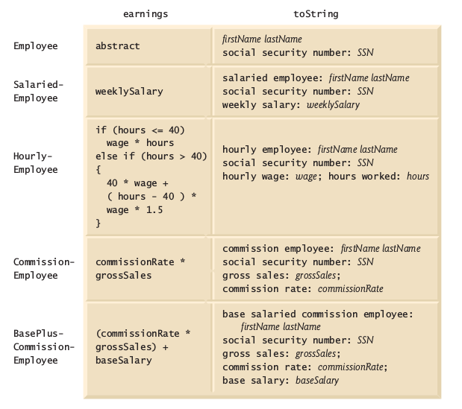
Polymorphic interface for the Employee hierarchy classes.

Slide 25
Creating Abstract Superclass Employee
abstract superclass Employee
earnings method is declared abstract
No implementation can be given for earnings in the Employee abstract class
An array of Employee variables will store references to subclass objects
earnings method calls from these variables will call the appropriate version of the earnings method

Slide 26
Employee.java (1 of 3)
// Employee abstract superclass.
public abstract class Employee
{
private String firstName;
private String lastName;
private String socialSecurityNumber;
// three-argument constructor
public Employee( String first, String last, String ssn )
{
firstName = first;
lastName = last;
socialSecurityNumber = ssn;
} // end three-argument Employee constructor
Declare abstract class Employee
Attributes common to all employees

Slide 27
Employee.java (2 of 3)
// set first name
public void setFirstName( String first )
{
firstName = first;
} // end method setFirstName
// return first name
public String getFirstName()
{
return firstName;
} // end method getFirstName
// set last name
public void setLastName( String last ) {
lastName = last;
} // end method setLastName
// return last name
public String getLastName()
{
return lastName;
} // end method getLastName

Slide 28
Employee.java (3 of 3)
// set social security number
public void setSocialSecurityNumber( String ssn )
{
socialSecurityNumber = ssn; // should validate
} // end method setSocialSecurityNumber
// return social security number
public String getSocialSecurityNumber()
{
return socialSecurityNumber;
} // end method getSocialSecurityNumber
// return String representation of Employee object
public String toString()
{
return String.format( "%s %s\nsocial security number: %s",
getFirstName(), getLastName(), getSocialSecurityNumber() );
} // end method toString
// abstract method overridden by subclasses
public abstract double earnings(); // no implementation here
} // end abstract class Employee
abstract method earnings has no implementation

Slide 29
SalariedEmployee.java (1 of 2)
Class SalariedEmployee extends class Employee
// SalariedEmployee class extends Employee.
public class SalariedEmployee extends Employee
{
private double weeklySalary;
// four-argument constructor
public SalariedEmployee(String first, String last, String ssn, double salary )
{
super( first, last, ssn ); // pass to Employee constructor
setWeeklySalary( salary ); // validate and store salary
} // end four-argument SalariedEmployee constructor
// set salary
public void setWeeklySalary( double salary )
{
weeklySalary = salary < 0.0 ? 0.0 : salary;
} // end method setWeeklySalary
Call superclass constructor
Call setWeeklySalary method
Validate and set weekly salary value

Slide 30
SalariedEmployee.java (2 of 2)
// return salary
public double getWeeklySalary()
{
return weeklySalary;
} // end method getWeeklySalary
// calculate earnings; override abstract method earnings in Employee
public double earnings()
{
return getWeeklySalary();
} // end method earnings
// return String representation of SalariedEmployee object
public String toString()
{
return String.format( "salaried employee: %s\n%s: $%,.2f",
super.toString(), "weekly salary", getWeeklySalary() );
} // end method toString
} // end class SalariedEmployee
Override earnings method so SalariedEmployee can be concrete
Override toString method
Call superclass's version of toString

Slide 31
HourlyEmployee.java (1 of 2)
Class HourlyEmployee extends class Employee
// HourlyEmployee class extends Employee.
public class HourlyEmployee extends Employee
{
private double wage; // wage per hour
private double hours; // hours worked for week
// five-argument constructor
public HourlyEmployee( String first, String last, String ssn,
double hourlyWage, double hoursWorked )
{
super( first, last, ssn );
setWage( hourlyWage ); // validate hourly wage
setHours( hoursWorked ); // validate hours worked
} // end five-argument HourlyEmployee constructor
// set wage
public void setWage( double hourlyWage )
{
wage = ( hourlyWage < 0.0 ) ? 0.0 : hourlyWage;
} // end method setWage
// return wage
public double getWage()
{
return wage;
} // end method getWage
Call superclass constructor
Validate and set hourly wage value

Slide 32
HourlyEmployee.java (2 of 2)
// set hours worked
public void setHours( double hoursWorked )
{
hours = ( ( hoursWorked >= 0.0 ) && ( hoursWorked <= 168.0 ) ) ?
hoursWorked : 0.0;
} // end method setHours
// return hours worked
public double getHours()
{
return hours;
} // end method getHours
// calculate earnings; override abstract method earnings in Employee
public double earnings()
{
if ( getHours() <= 40 ) // no overtime
return getWage() * getHours();
else
return 40 * getWage() + ( gethours() - 40 ) * getWage() * 1.5;
} // end method earnings
// return String representation of HourlyEmployee object
public String toString()
{
return String.format( "hourly employee: %s\n%s: $%,.2f; %s: %,.2f",
super.toString(), "hourly wage", getWage(),
"hours worked", getHours() );
} // end method toString
} // end class HourlyEmployee
Validate and set hours worked value
Override earnings method so HourlyEmployee can be concrete
Override toString method
Call superclass's toString method

Slide 33
CommissionEmployee.java (1 of 3)
// CommissionEmployee class extends Employee.
public class CommissionEmployee extends Employee
{
private double grossSales; // gross weekly sales
private double commissionRate; // commission percentage
// five-argument constructor
public CommissionEmployee( String first, String last, String ssn,
double sales, double rate )
{
super( first, last, ssn );
setGrossSales( sales );
setCommissionRate( rate );
} // end five-argument CommissionEmployee constructor
// set commission rate
public void setCommissionRate( double rate )
{
commissionRate = ( rate > 0.0 && rate < 1.0 ) ? rate : 0.0;
} // end method setCommissionRate
Class CommissionEmployee extends class Employee
Call superclass constructor
Validate and set commission rate value

Slide 34
CommissionEmployee.java (2 of 3)
// return commission rate
public double getCommissionRate()
{
return commissionRate;
} // end method getCommissionRate
// set gross sales amount
public void setGrossSales( double sales )
{
grossSales = ( sales < 0.0 ) ? 0.0 : sales;
} // end method setGrossSales
// return gross sales amount
public double getGrossSales()
{
return grossSales;
} // end method getGrossSales
Validate and set the gross sales value

Slide 35
CommissionEmployee.java (3 of 3)
// calc. earnings; override abstract method earnings in Employee
public double earnings()
{
return getCommissionRate() * getGrossSales();
} // end method earnings
// return String representation of CommissionEmployee object
public String toString()
{
return String.format( "%s: %s\n%s: $%,.2f; %s: %.2f",
"commission employee", super.toString(),
"gross sales", getGrossSales(),
"commission rate", getCommissionRate() );
} // end method toString
} // end class CommissionEmployee
Override earnings method so CommissionEmployee can be concrete
Override toString method
Call superclass's toString method

Slide 36
BasePlusCommissionEmployee.java (1 of 2)
public class BasePlusCommissionEmployee extends CommissionEmployee
{
private double baseSalary; // base salary per week
// six-argument constructor
public BasePlusCommissionEmployee( String first, String last,
String ssn, double sales, double rate, double salary )
{
super( first, last, ssn, sales, rate );
setBaseSalary( salary ); // validate and store base salary
} // end six-argument BasePlusCommissionEmployee constructor
// set base salary
public void setBaseSalary( double salary )
{
baseSalary = ( salary < 0.0 ) ? 0.0 : salary; // non-negative
} // end method setBaseSalary
Class BasePlusCommissionEmployee extends class CommissionEmployee
Call superclass constructor
Validate and set base salary value

Slide 37
BasePlusCommissionEmployee.java (2 of 2)
// return base salary
public double getBaseSalary()
{
return baseSalary;
} // end method getBaseSalary
// calc. earnings;override method earnings in CommissionEmployee
public double earnings()
{
return getBaseSalary() + super.earnings();
} // end method earnings
// return String representation of BasePlusCommissionEmployee object
public String toString()
{
return String.format( "%s %s; %s: $%,.2f",
"base-salaried", super.toString(),
"base salary", getBaseSalary() );
} // end method toString
} // end class BasePlusCommissionEmployee
Override earnings method
Call superclass's earnings method
Override toString method
Call superclass's toString method

Slide 38
PayrollSystemTest.java (1 of 5)
// Employee hierarchy test program.
public class PayrollSystemTest
{
public static void main( String args[] )
{
// create subclass objects
SalariedEmployee salariedEmployee =
new SalariedEmployee(
"John", "Smith", "111-11-1111", 800.00 );
HourlyEmployee hourlyEmployee =
new HourlyEmployee(
"Karen", "Price", "222-22-2222", 16.75, 40 );
CommissionEmployee commissionEmployee =
new CommissionEmployee(
"Sue", "Jones", "333-33-3333", 10000, .06 );
BasePlusCommissionEmployee basePlusCommissionEmployee =
new BasePlusCommissionEmployee(
"Bob", "Lewis", "444-44-4444", 5000, .04, 300 );
System.out.println( "Employees processed individually:\n" );

Slide 39
PayrollSystemTest.java (2 of 5)
System.out.printf( "%s\n%s: $%,.2f\n\n",
salariedEmployee, "earned", salariedEmployee.earnings() );
System.out.printf( "%s\n%s: $%,.2f\n\n",
hourlyEmployee, "earned", hourlyEmployee.earnings() );
System.out.printf( "%s\n%s: $%,.2f\n\n",
commissionEmployee, "earned", commissionEmployee.earnings() );
System.out.printf( "%s\n%s: $%,.2f\n\n",
basePlusCommissionEmployee,
"earned", basePlusCommissionEmployee.earnings() );
// create four-element Employee array
Employee employees[] = new Employee[ 4 ];
// initialize array with Employees
employees[ 0 ] = salariedEmployee;
employees[ 1 ] = hourlyEmployee;
employees[ 2 ] = commissionEmployee;
employees[ 3 ] = basePlusCommissionEmployee;
System.out.println( "Employees processed polymorphically:\n" );
// generically process each element in array employees
for ( Employee currentEmployee : employees )
{
System.out.println( currentEmployee ); // invokes toString
Assigning subclass objects to supercalss variables
Implicitly and polymorphically call toString

Slide 40
PayrollSystemTest.java (3 of 5)
If the currentEmployee variable points to a BasePlusCommissionEmployee object
// determine whether element is a BasePlusCommissionEmployee
if ( currentEmployee instanceof BasePlusCommissionEmployee )
{
// downcast Employee reference to
// BasePlusCommissionEmployee reference
BasePlusCommissionEmployee employee =
( BasePlusCommissionEmployee ) currentEmployee;
double oldBaseSalary = employee.getBaseSalary();
employee.setBaseSalary( 1.10 * oldBaseSalary );
System.out.printf(
"new base salary with 10%% increase is: $%,.2f\n",
employee.getBaseSalary() );
} // end if
System.out.printf(
"earned $%,.2f\n\n", currentEmployee.earnings() );
} // end for
// get type name of each object in employees array
for ( int j = 0; j < employees.length; j++ )
System.out.printf( "Employee %d is a %s\n", j,
employees[ j ].getClass().getName() );
} // end main
} // end class PayrollSystemTest
Downcast currentEmployee to a BasePlusCommissionEmployee reference
Give BasePlusCommissionEmployees a 10% base salary bonus
Polymorphically call earnings method
Call getClass and getName methods to display each Employee subclass object's class name

Slide 41
PayrollSystemTest.java (4 of 5)
Employees processed individually:
salaried employee: John Smith
social security number: 111-11-1111
weekly salary: $800.00
earned: $800.00
hourly employee: Karen Price
social security number: 222-22-2222
hourly wage: $16.75;
hours worked: 40.00
earned: $670.00
commission employee: Sue Jones
social security number: 333-33-3333
gross sales: $10,000.00;
commission rate: 0.06
earned: $600.00
base-salaried commission employee: Bob Lewis
social security number: 444-44-4444
gross sales: $5,000.00;
commission rate: 0.04;
base salary: $300.00
earned: $500.00

Slide 42
PayrollSystemTest.java (5 of 5)
Employees processed polymorphically:
salaried employee: John Smith
social security number: 111-11-1111
weekly salary: $800.00
earned $800.00
hourly employee: Karen Price
social security number: 222-22-2222
hourly wage: $16.75; hours worked: 40.00
earned $670.00
commission employee: Sue Jones
social security number: 333-33-3333
gross sales: $10,000.00; commission rate: 0.06
earned $600.00
base-salaried commission employee: Bob Lewis
social security number: 444-44-4444
gross sales: $5,000.00; commission rate: 0.04; base salary: $300.00
new base salary with 10% increase is: $330.00
earned $530.00
Employee 0 is a SalariedEmployee
Employee 1 is a HourlyEmployee
Employee 2 is a CommissionEmployee
Employee 3 is a BasePlusCommissionEmployee
Same results as when the employees were processed individually
Base salary is increased by 10%
Each employee's type is displayed

Slide 43
Demonstrating Polymorphic Processing, Operator instanceof and Downcasting
Dynamic binding
Also known as late binding
Calls to overridden methods are resolved at execution time, based on the type of object referenced
instanceof operator
Determines whether an object is an instance of a certain type

Slide 44
Remarks
Assigning a superclass variable to a subclass variable (without an explicit cast) is a compilation error.
If at execution time the reference of a subclass object has been assigned to a variable of one of its direct or indirect superclasses, it is acceptable to cast the reference stored in that superclass variable back to a reference of the subclass type.
Before performing such a cast, use the instanceof operator to ensure that the object is indeed an object of an appropriate subclass type.

Slide 45
Demonstrating Polymorphic Processing, Operator instanceof and Downcasting (Cont.)
Downcasting
Convert a reference to a superclass to a reference to a subclass
Allowed only if the object has an is-a relationship with the subclass
getClass method
Inherited from Object
Returns an object of type Class
getName method of class Class
Returns the class's name

Slide 46
Summary of the Allowed Assignments Between Superclass and Subclass Variables
Superclass and subclass assignment rules
Assigning a superclass reference to a superclass variable is straightforward
Assigning a subclass reference to a subclass variable is straightforward
Assigning a subclass reference to a superclass variable is safe because of the is-a relationship
Referring to subclass-only members through superclass variables is a compilation error
Assigning a superclass reference to a subclass variable is a compilation error
Downcasting can get around this error

Slide 47
final Methods and Classes
final methods
Cannot be overridden in a subclass
private and static methods are implicitly final
final methods are resolved at compile time, this is known as static binding
Compilers can optimize by inlining the code
final classes
Cannot be extended by a subclass
All methods in a final class are implicitly final

Slide 48
Questions/Answers &
Discussion

