Slide 1

LEAFMARK
PME PROJECT ASSIGNMENT PRESENTATION
SIR SARFARAZ NATHA

Slide 2
Team Members
Muhammad Ali (2020-SE-161)
Zainab Attaria (2020-SE-185)

Slide 3
COMPANY NAME
LeafMark

Slide 4
INTRODUCTION
We being the software students, came up with the idea that Flyers and Leaflets distribution services should be easily accessible through an online platform. To invent a solution for this idea, we decided to establish a company where anyone who wants to promote their business, to do any advertisement of their products can contact us through our online platform and our company will provide the workers who will go lane to lane, home to home and will distribute the client’s designed leaflets.

Slide 5
PITCH
The main idea behind our business is that Flyers and Leaflets distribution services should be easily accessible through an online platform.
To invent a solution for this idea, we decided to establish a company where anyone who wants to promote their business, to do any advertisement of their products can contact us through our online platform and our company will provide the workers who will go lane to lane, home to home and will distribute the client’s designed leaflets.
How it will work : we will create a website where the client can login and can make an order for his leaflet/brocher/pamphlet/flyer distribution.
The client can send his flyers in hard copy to our company and our company will hire workers to distribute those flyers.

Slide 6
PITCH
The client can also send the softcopy of his flyer/leaflet and we will print it out as per the client’s defined quantity and then our workers will distribute it.
We will track the distributor workers for their performance and distribution progress.
The client can also track the progress of their distribution order and see where the workers are distributing his leaflets/flyers at the current moment.
Our regional managers will generate proper progress reports about the client’s order and it will be shown to client on his order page so that we can build trust with our clients.

Slide 7
PITCH
How it will benefit us with business prospect: We will take orders from clients and hire the workers. Pay the workers as per their performance and time delivery while the rest of the order package will be our profit.
Our company will also be good at providing jobs to common man with no professional experience as this job doesn’t need any top-tier qualification set.
Also, when our web portal will be popular to run among the businesses, we will get a lot of PR advertisements for our website. We can earn through clients too and also through our website.

Slide 8
What We Do?
We are the students of Software Engineering ( Sir Syed University Of Engineering & Technology ), and we are here today to talk to you about our company LeafMark. How we are planning to implement our idea into online service and how it will benefit the startups, small business and youth of Pakistan.

Slide 9
Our Targets
To make it easier for individual businesses to promote their business and products.
To make advertisements and promotions easier for the small business owners and startups.
To make the manual marketing easier for people with less man power.
To modernize the manual leaflet distribution marketing.
To enable the business owners to track their marketing progress through our online platform.

Slide 10
Our Achievements
We are trying to bring together all the components of this manual distribution system into an online platform. Our biggest achievement is to promote small businesses and startups.

Slide 11
Profit & Loss
Every business has two aspects, profit and loss. If you get profit through your business, you must be ready to face the loss too. Not necessary of-course, but losses may occur in a business and an entrepreneur should remain emotionally and financially stable to get over the loss and come up stronger with profits.

Slide 12
Financials
Our financial plans contain a very less investment strategy and higher profit. All we have to do is build a very powerful ERP system for our business and promote it. Further we will take orders from clients and hire the workers. Pay the workers as per their performance and time delivery while the rest of the order package will be our profit. We can also earn through our website by taking PR advertisements for our website.

Slide 13
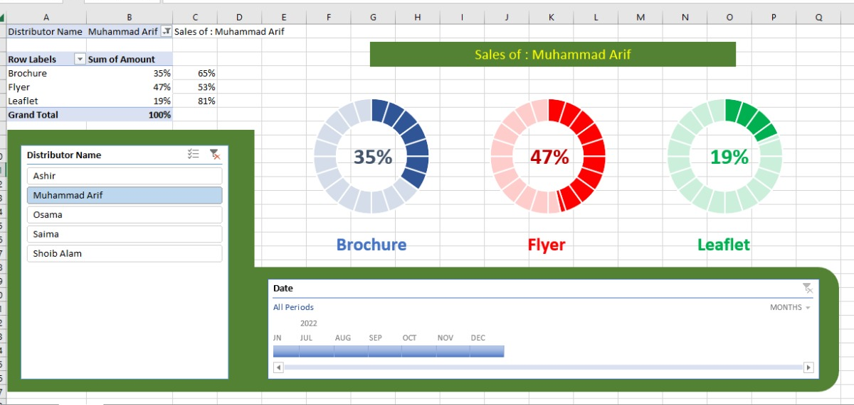
Sales Dashboard

Slide 14
Our Goals
Our main goal is that our idea will reach all over the Pakistan so we can be successful in our idea to promote small businesses and startups.

Slide 15
“Thank you”

