Slide 1
Capstone Project Presentation
Subject: ITSS Software Development
Group 3
Trinh Thu Hai Nguyen Huy Hoang Bui Thanh Tung

Slide 2
Member Contribution
Trinh Thu Hai: 25% RentBikeController, Subsystem, CreditCard
Nguyen Huy Hoang: 38% ReturnBikeController, ViewRentalController, Rental, Payment
Bui Thanh Tung: 37% ViewDockController, Bike, Station, Screens

Slide 3
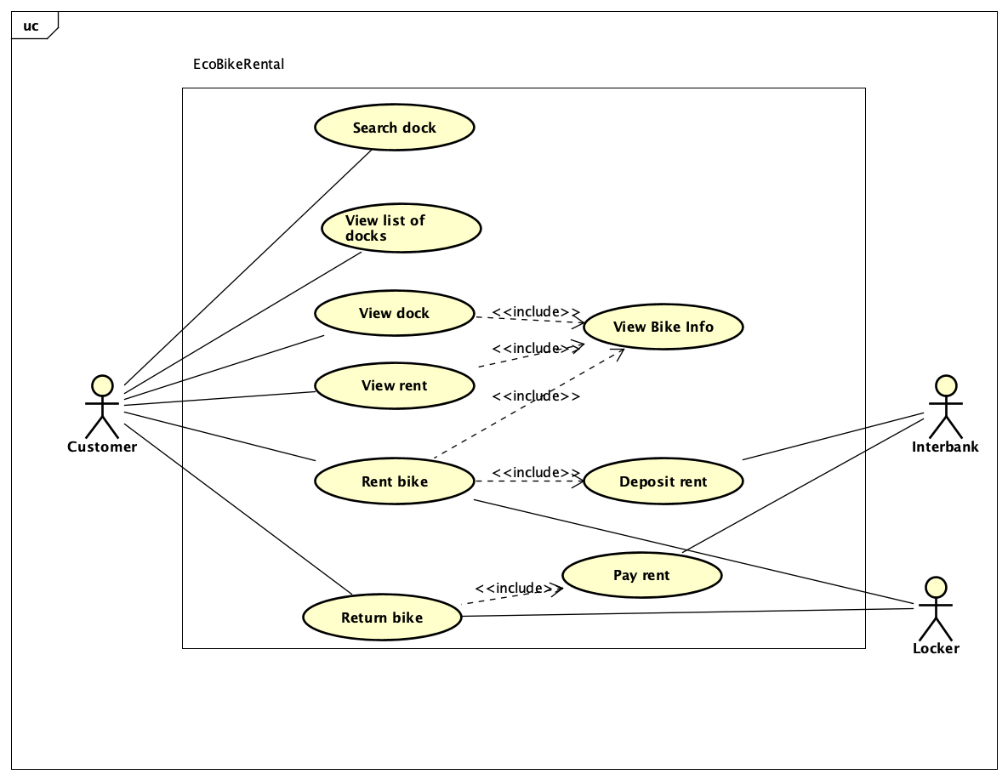
Use Case Diagram

Slide 4
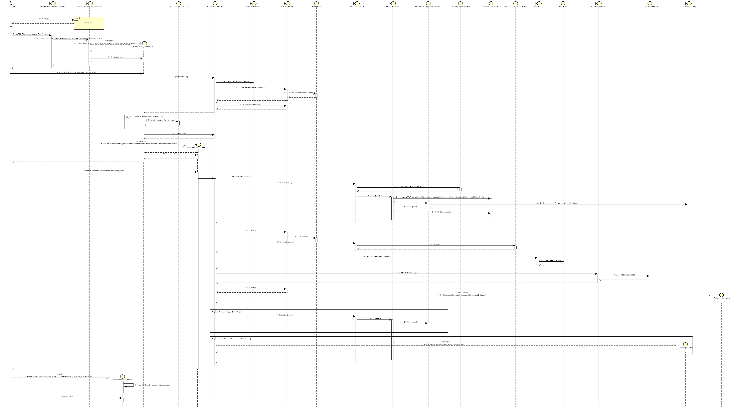
Interaction Diagram (Rent Bike Use case)

Slide 5
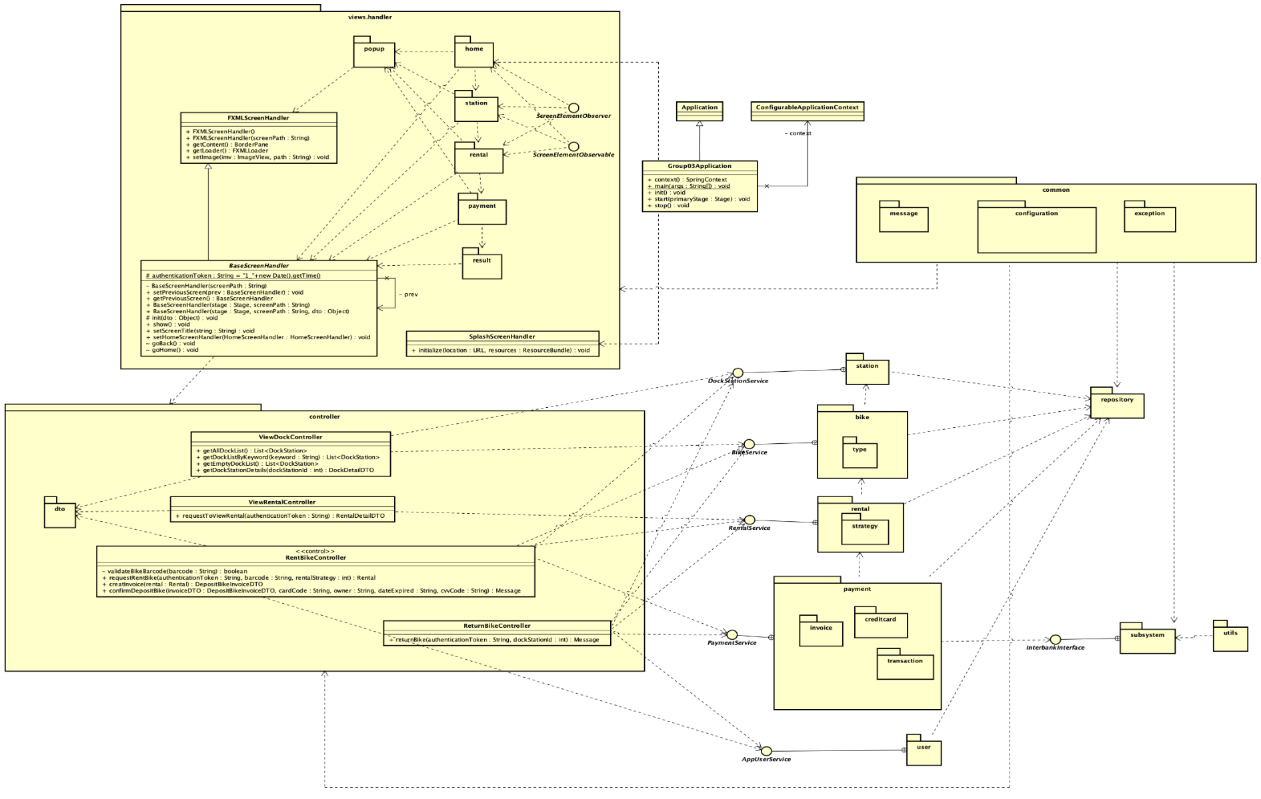
Class Diagram

Slide 6
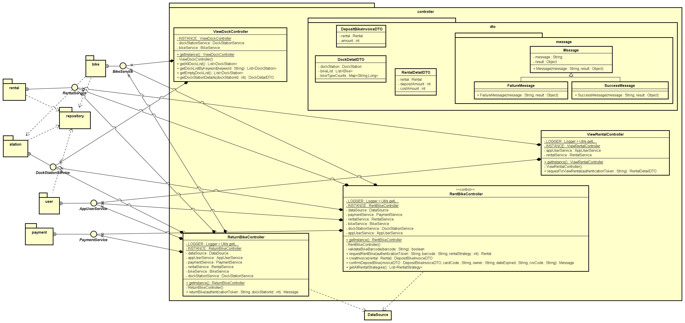
Class Diagram (Controller)

Slide 7
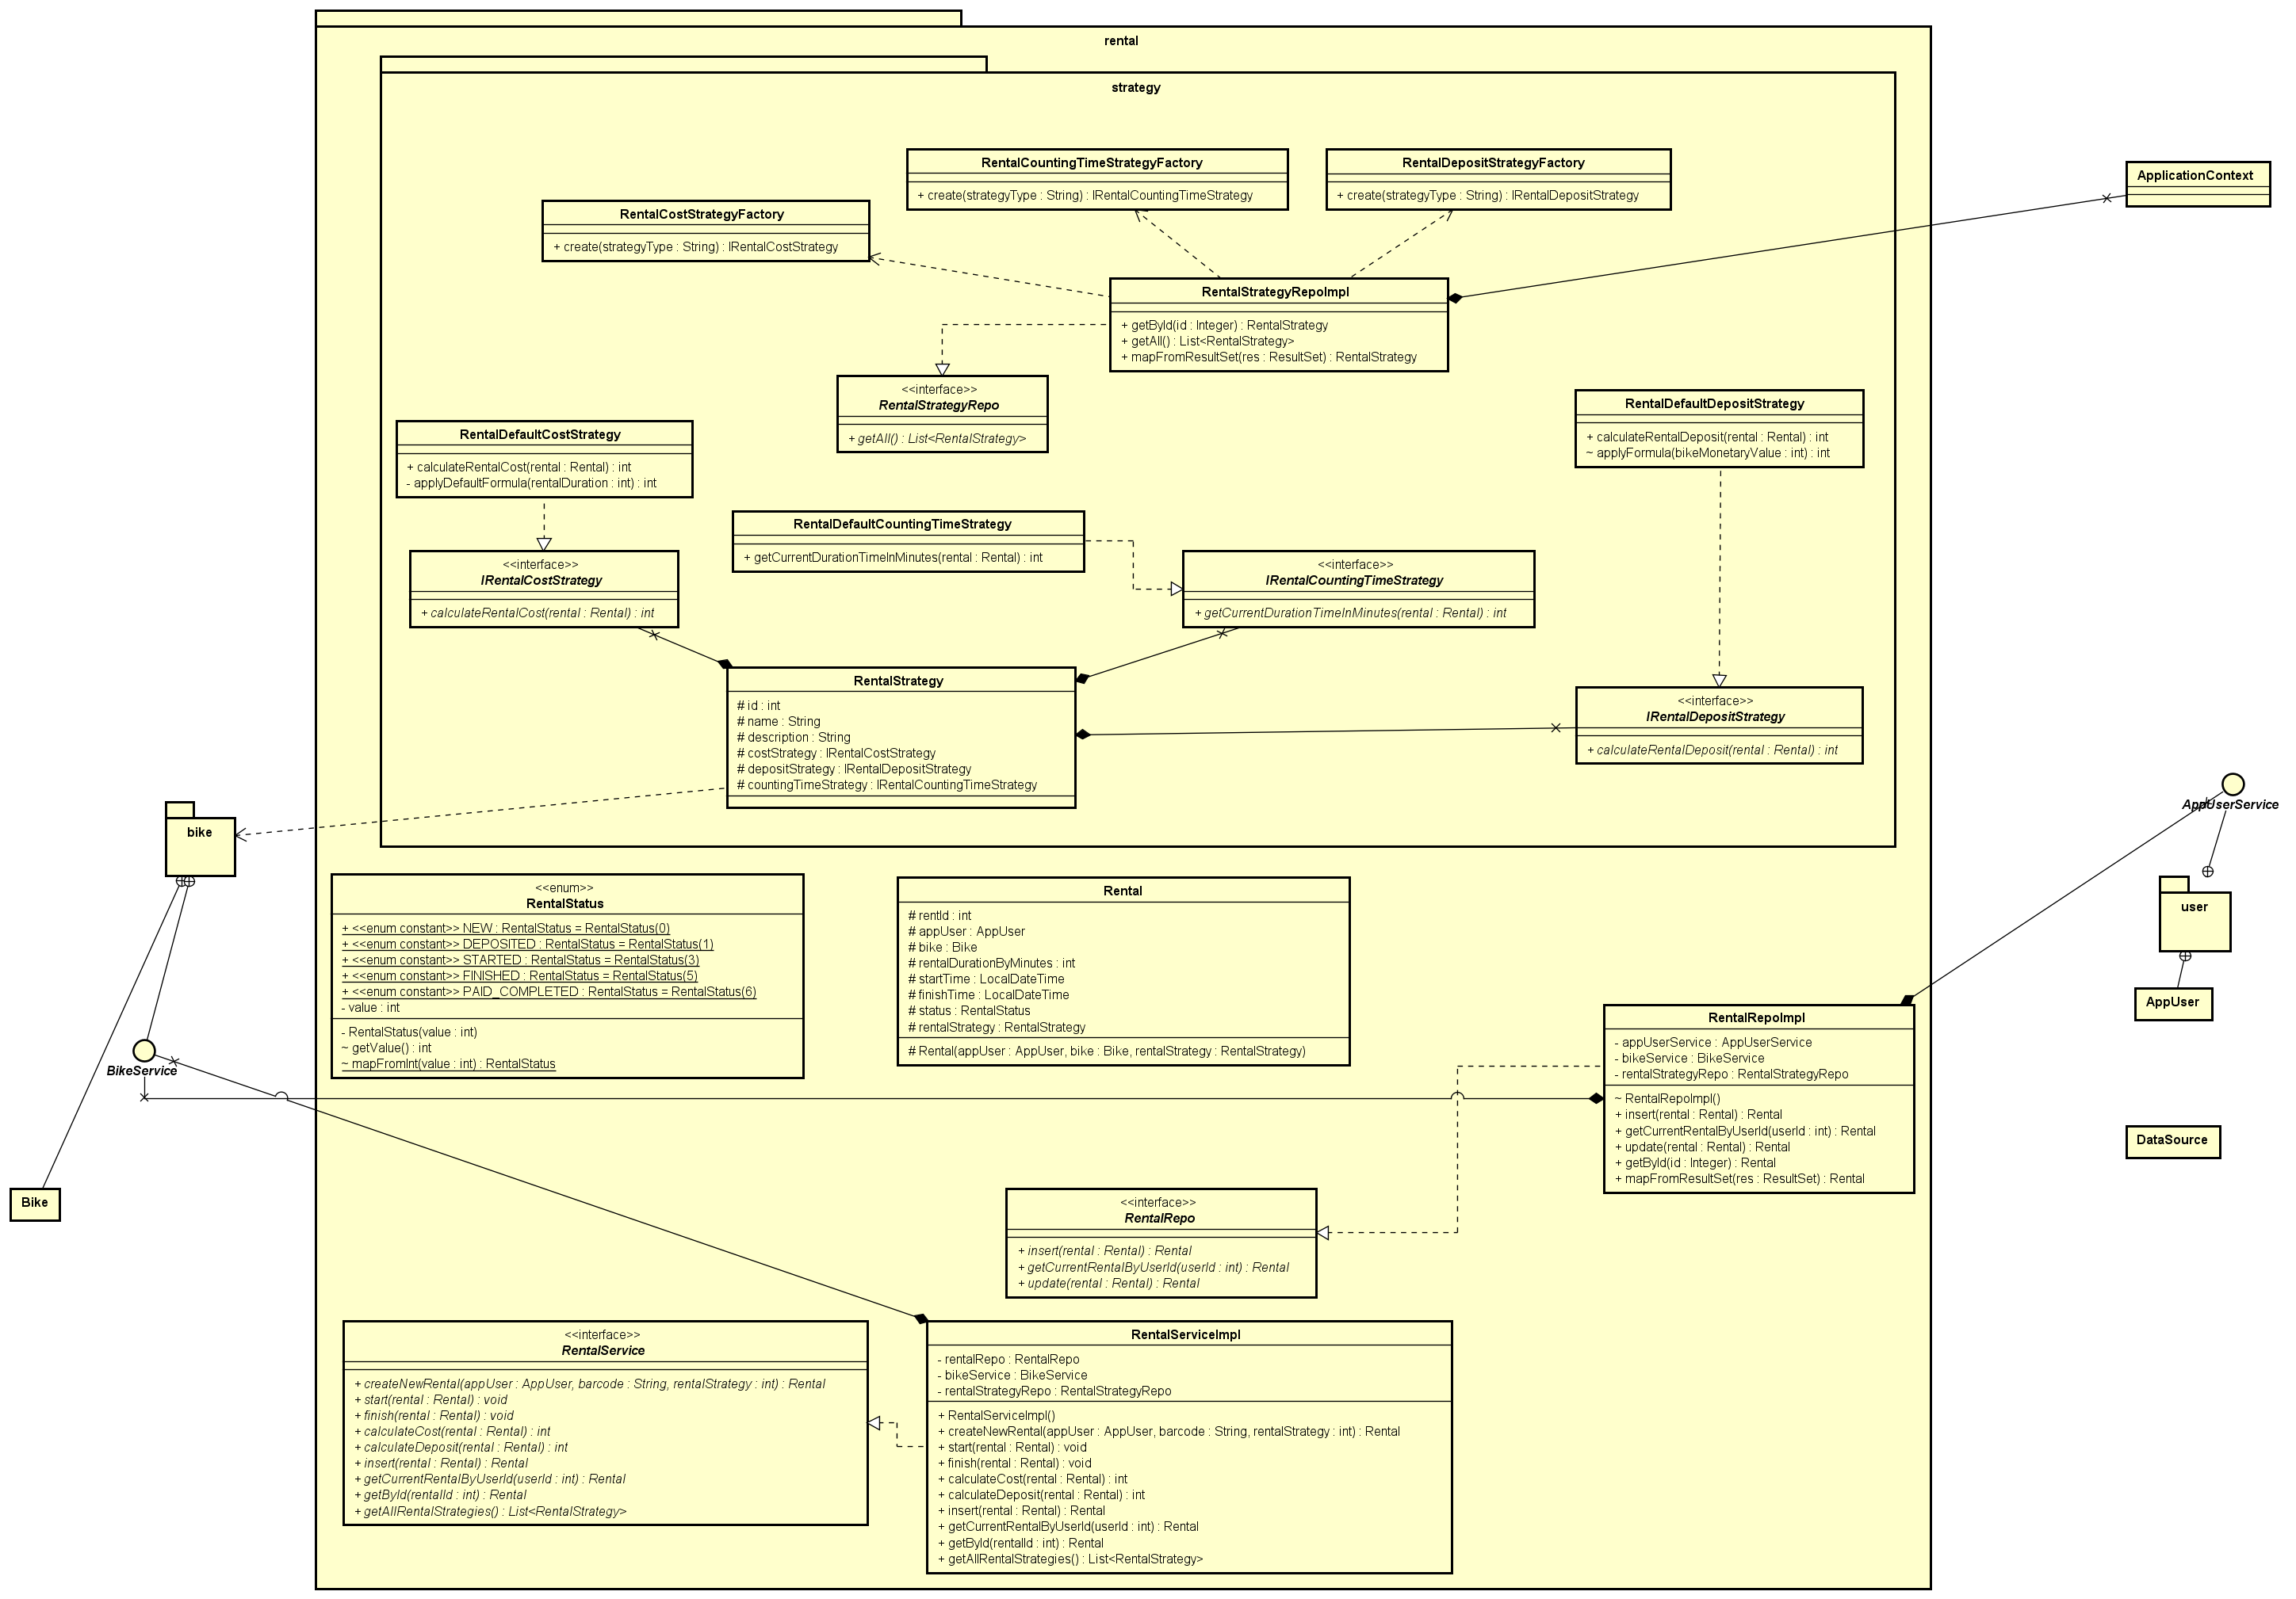
Class Diagram(Rental)

Slide 8
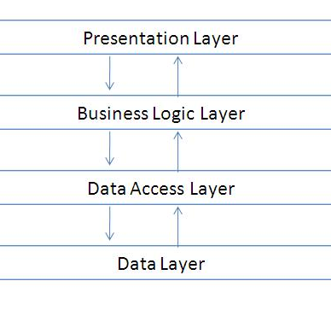
Design Considerations
Multi-tier architecture

Slide 9
Design Considerations
SOLID principles
Applying new requirements, SOLID principles are held
Coupling and Cohesion
Coupling: Mostly data coupling
Cohesion: Mostly sequential and temporal

Slide 10
Design Considerations
Design Patterns
Singleton | Controllers, DataSource | Repository | Database Access
Factory | Rental Strategy Factory | Data Transfer Object | From Controller To Screen Handler
Strategy | Rental Strategy | Observer | Screen and List Item
Facade | Services | Template Method | Base Screen Handler setup

Slide 11
Demo

Slide 12
Thank you for listening!

