Slide 1
Introduction to Computers & Programming Language
Module 1: Basic of Java Programming Language
Unit 1

Slide 2
Module 1 - Unit 1 Objectives
Identify the different types of programming languages.
Examine high-level programming languages
Discover what a compiler is and what it does
Observe how a Java program is processed
Recognize the importance of Java and other leading programming languages.
Learn a typical Java program development environment.
Setup an IDE Java development environment step-by-step.

Slide 3
1.1 Computers & Programming Languages
Computer programs (software) are designed specifically for each task
Software (i.e., the instructions you write) controls hardware (i.e., computers).
Programs Guide computer through orderly sets of actions specified by computer programmers
Software is created with programming languages
Java is an example of a programming language
Java is one of the world’s most widely used computer programming languages.

Slide 4
1.1 Elements of a Computer System
Computer is a device capable of performing computations & making logical decisions
Computers can perform calculations and make logical decisions phenomenally faster than human beings can.
Today’s personal computers can perform billions of calculations in one second—more than a human can perform in a lifetime.
Supercomputers are already performing thousands of trillions (quadrillions) of instructions per second!
Computers process data under the control of sequences of instructions called computer programs.
A computer has two components: Hardware & Software

Slide 5
1.1 Software Programs
These software programs guide the computer through ordered actions specified by people called computer programmers.
You’ll learn a key programming methodology that’s enhancing programmer productivity, thereby reducing software development costs – object-oriented programming.

Slide 6
1.1 Hardware Components of a Computer
Computers can be envisioned as divided into six logical units or sections.
Input unit
Output unit
Memory unit
Arithmetic and logic unit (ALU)
Central processing unit (CPU)
Secondary storage unit

Slide 7
1.1 Input Devices
Devices that feed data and computer programs into computers
"Receiving" section of computer
Obtains data from input devices
Example
Keyboard
Mouse
Disk
Scanner

Slide 8
1.1 Output Devices
Devices that the computer uses to display results
“Shipping” section of computer
Makes info available outside the computer
Puts processed info on various output devices
Example
Screens,
paper printouts,
speakers

Slide 9
1.1 Input /Output Devices

Slide 10
1.1 Main Memory
Rapid access, low capacity “warehouse”
Retains information entered through input unit
Retains info that has already been processed until can be sent to output unit
Often called memory, primary memory, or random access memory (RAM)
When power is turned off, everything in main memory is lost

Slide 11
1.1 Arithmetic and Logic Unit
“Manufacturing” section of computer
Performs calculations (addition, subtraction, multiplication and division)
Contains decision mechanisms and can make comparisons

Slide 12
1.1 Central Processing Unit (CPU)
“Administrative” section of computer
Coordinates and supervises other sections
The CPU
tells the input unit when information should be read into the memory unit,
tells the ALU when information from the memory unit should be used in calculation
and tells the output unit when to send information from the memory unit to certain output devices

Slide 13
1.1 Secondary Storage Unit
Provides permanent storage for information
Long-term, high-capacity “warehouse”
Stores programs or data not currently being used by other units on secondary storage devices (like discs)
Takes longer to access than primary memory
Examples:
Hard disks
Flash memory
CD-ROMs
Tapes

Slide 14
1.1 Central Processing Unit and Main Memory

Slide 15
1.2 Types of Programming Languages
Programmers write instructions in various programming languages, some directly understandable by computers and others requiring intermediate translation steps.
These may be divided into three general types:
Machine languages
Assembly languages
High-level languages

Slide 16
1.2 Machine Languages
Any computer can directly understand only its own machine language, defined by its hardware design.
Generally consist of strings of numbers (a sequence of 0s and 1s)
A bit is a binary digit, 0 or 1
A byte is a sequence of eight bits
Example: Adding overtime pay to base pay and storing the result in gross pay
+1300042774
+1400593419
+1200274027

Slide 17
1.2 Assembly Languages
English-like abbreviations that represent elementary operations formed the basis of assembly languages.
Translator program called assembler converts assembly language instructions into machine language.
In assembly language, an instruction is an easy-to-remember form called a mnemonic
Example: Adding overtime pay to base pay and storing the result in gross pay
LOAD BASEPAY
ADD OVERPAY
STORE GROSSPAY

Slide 18
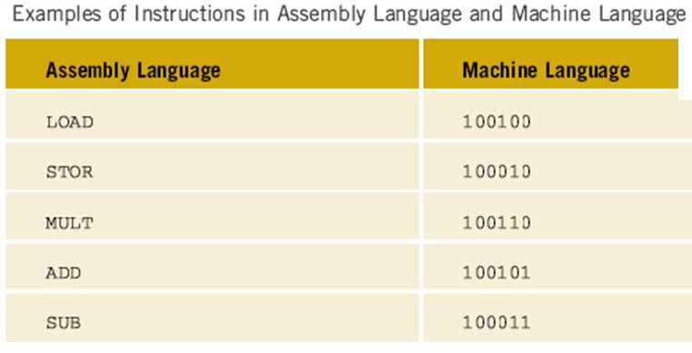
1.2 Instructions in Assembly and Machine Language

Slide 19
1.2 High-Level Languages
Single statements accomplish substantial tasks.
Compilers convert high-level language programs into machine language.
Allow you to write instructions that look almost like everyday English and contain commonly used mathematical notations.
A payroll program written in a high-level language might contain a single statement such as
grossPay = basePay + overTimePay
Adding overtime pay to base pay and storing the result in gross pay

Slide 20
1.2 High-Level Programming Languages
High-level languages make programming easier
Closer to spoken languages
Examples
Basic (Visual Basic)
C# (C Sharp)
COBOL
C++
Java

Slide 21
1.3 Java Language
For many organizations, the preferred language for meeting their enterprise programming needs is Java.
Java is also widely used for implementing Internet-based applications and software for devices that communicate over a network.
According to Oracle, 97% of enterprise desktops, 89% of PC desktops, three billion devices and 100% of all Blu-ray Disc™ players run Java, and there are over 9 million Java developers. (http://www.oracle.com/technetwork/articles/java/javaone12review-1863742.html)

Slide 22
1.3 What is Java technology and why do I need it?
Java is a programming language and computing platform first released by Sun Microsystems in 1995.
There are lots of applications and websites that will not work unless you have Java installed, and more are created every day.
Java is fast, secure, and reliable.
From laptops to datacenters, game consoles to scientific supercomputers, cell phones to the Internet.
Java is everywhere!

Slide 23
1.3 Java Standard Edition
Java Standard Edition (Java SE) contains the capabilities needed to develop desktop and server applications.
Prior to Java SE 8, Java supported three programming paradigms—procedural programming, object-oriented programming and generic programming. Java SE 8 adds functional programming.

Slide 24
1.3 Java Enterprise Edition
Java is used in such a broad spectrum of applications that it has two other editions.
The Java Enterprise Edition (Java EE) is geared toward developing large-scale, distributed networking applications and web-based applications.

Slide 25
1.3 Java Micro Edition
a subset of Java SE.
geared toward developing applications for resource-constrained embedded devices, such as
Smartwatches
MP3 players
television set-top boxes
smart meters (for monitoring electric energy usage)
and more.

Slide 26
1.5 Difference Between Compiler and Interpreter
Compiler and interpreter, both basically serve the same purpose.
They convert one level of language to another level.
A compiler converts the high level instructions into machine language
Interpreter converts the high level instruction into some intermediate form and after that, the instruction is executed.
Compiling a high-level language program into machine language can take considerable computer time.

Slide 27
1.6 Java Editors
Linux editors: vi and emacs.
Windows provides Notepad.
OSX provides TextEdit.
Many freeware and shareware editors available online:
Notepad++ (www.notepad-plus-plus.org)
EditPlus (www.editplus.com)
TextPad (www.textpad.com)
jEdit (www.jedit.org)

Slide 28
1.6 Java Integrated development environments (IDEs)
Provide tools that support the software development process, such as editors, debuggers for locating logic errors (errors that cause programs to execute incorrectly) and more.
Popular Java IDEs
Eclipse (www.eclipse.org)
NetBeans (www.netbeans.org)
IntelliJ IDEA (www.jetbrains.com)

Slide 29
1.7 A Typical Java Development Environment
Normally there are five phases
edit
compile
load
verify
execute.

Slide 30
1.7 Phase 1: Editing
Phase 1 consists of editing a file with an editor program
Using the editor, you type a Java program (source code).
Make any necessary corrections.
Save the program.
Java source code files are given a name ending with the .java extension indicating that the file contains Java source code.

Slide 31
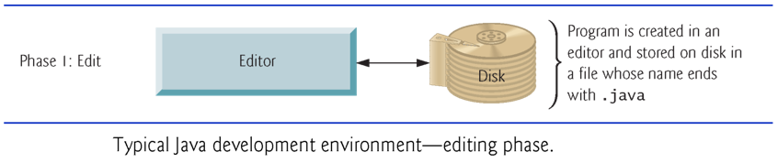
1.7 Java Editing Phase

Slide 32
1.7 Phase 2: Compiling
Phase 2: Compiling a Java Program into Bytecodes
Use the command javac (the Java compiler) to compile a program. For example, to compile a program called Welcome.java, you’d type
javac Welcome.java
If the program compiles, the compiler produces a .class file called Welcome.class that contains the compiled version.

Slide 33
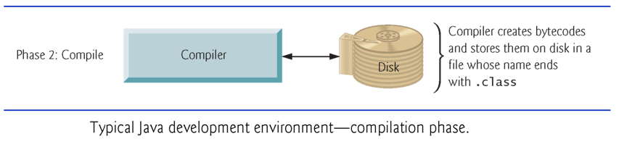
1.7 Java Compilation Phase

Slide 34
1.7 Java Virtual Machine (JVM)
Java compiler translates Java source code into bytecodes that represent the tasks to execute.
The Java Virtual Machine (JVM)—a part of the JDK and the foundation of the Java platform—executes bytecodes.
Virtual machine (VM)—a software application that simulates a computer
Hides the underlying operating system and hardware from the programs that interact with it.
If the same VM is implemented on many computer platforms, applications written for that type of VM can be used on all those platforms.

Slide 35
1.7 Java Bytecode
Bytecode instructions are platform independent
The same bytecode instructions can execute on any platform containing a JVM that understands the version of Java in which the bytecode instructions were compiled.
The JVM is invoked by the java command. For example, to execute a Java application called Welcome, you’d type the command
java Welcome

Slide 36
1.7 Phase 3: Loading
Phase 3: Loading a Program into Memory
The JVM places the program in memory to execute it – this is known as loading.
Class loader takes the .class files containing the program’s bytecodes and transfers them to primary memory.
Also loads any of the .class files provided by Java that your program uses.
The .class files can be loaded from a disk on your system or over a network.

Slide 37
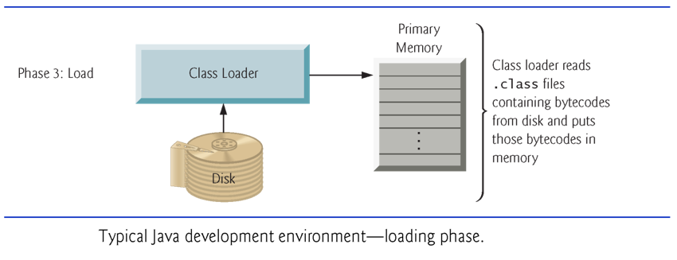
1.7 Java Loading Phase

Slide 38
1.7 Phase 4: Bytecode Verification
As the classes are loaded, the bytecode verifier examines their bytecodes
Ensures that they’re valid and do not violate Java’s security restrictions.
Java enforces strong security to make sure that Java programs arriving over the network do not damage your files or your system (as computer viruses and worms might).

Slide 39
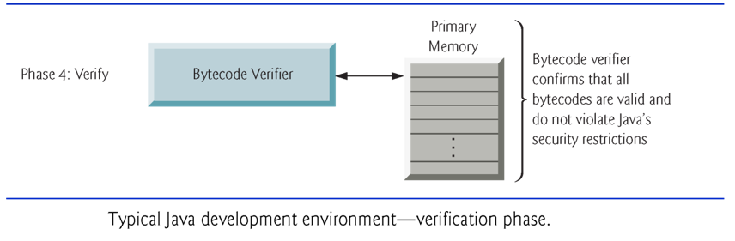
1.7 Java Verification Phase

Slide 40
1.7 Phase 5: Execution
The JVM executes the program’s bytecodes.
JVMs typically execute bytecodes using a combination of interpretation and so-called just-in-time (JIT) compilation.
Analyzes the bytecodes as they’re interpreted
A just-in-time (JIT) compiler—such as Oracle’s Java HotSpot compiler—translates the bytecodes into the underlying computer’s machine language.

Slide 41
1.7 Two Compilation Phases
When the JVM encounters these compiled parts again, the faster machine-language code executes.
Java programs go through two compilation phases
One in which source code is translated into bytecodes (for portability across JVMs on different computer platforms) and
A second in which, during execution, the bytecodes are translated into machine language for the actual computer on which the program executes.

Slide 42
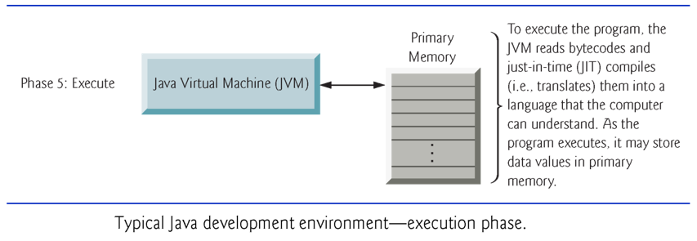
1.7 Java Execution Phase

