Slide 1
Basic Elements of Java
Module 1: Basic of Java Programming Language
Unit 2

Slide 2
Module 1 - Unit 2 Objectives
Become familiar with the basic components of a Java program
Explore primitive data types
Discover how to use arithmetic and other operators
Learn what an assignment statement is and what it does
Learn how to import packages and why they are necessary
Examine ways to input data and output results
CCCS 300 Programming Techniques 1

Slide 3
The Basics of a Java Program
CCCS 300 Programming Techniques 1
Java program: collection of classes
There is a main method in every Java application program
Token: smallest individual unit of a program

Slide 4
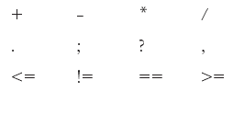
Special Symbols
CCCS 300 Programming Techniques 1

Slide 5
Reserved Words (Keywords)
int
float
double
char
void
public
static
throws
return
CCCS 300 Programming Techniques 1

Slide 6
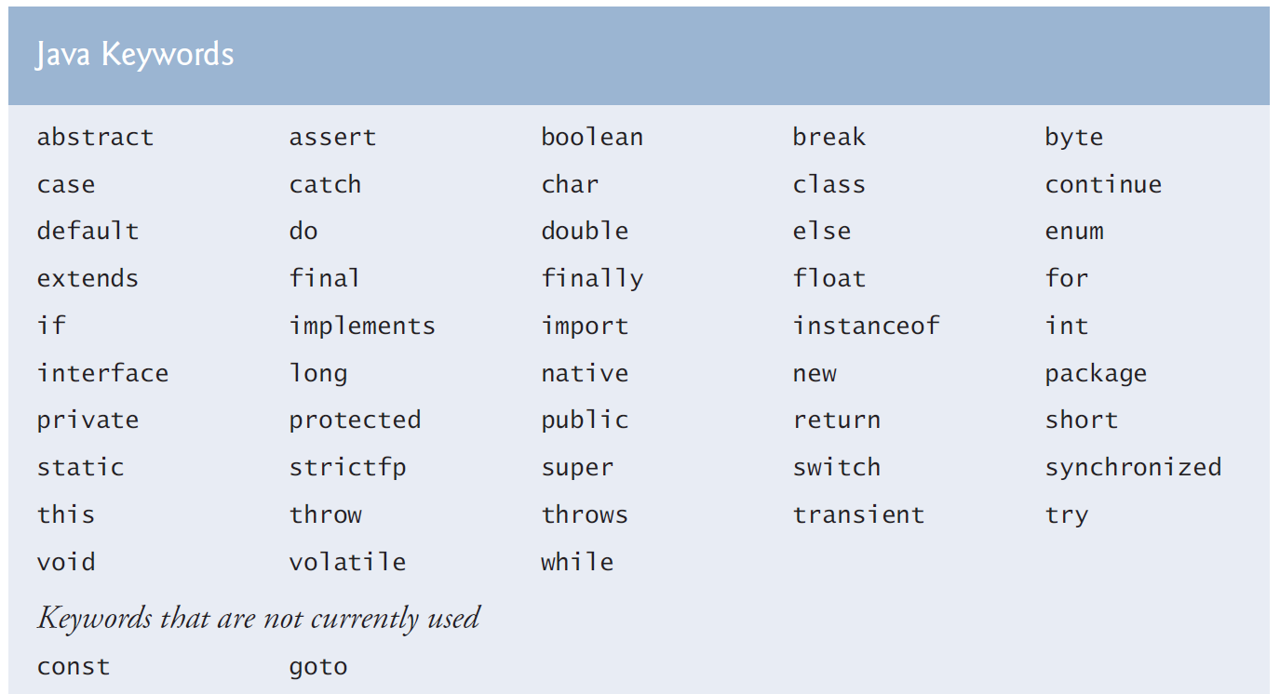
Java Reserved Keywords
CCCS 300 Programming Techniques 1

Slide 7
Java Identifiers
Names of things
Consist of:
Letters
Digits
The underscore character (_)
The dollar sign ($)
Must begin with a letter, underscore, or the dollar sign
CCCS 300 Programming Techniques 1

Slide 8
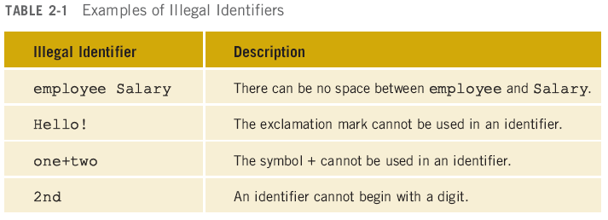
Illegal Identifiers
CCCS 300 Programming Techniques 1

Slide 9
Data Types
Data type: set of values together with a set of operations
CCCS 300 Programming Techniques 1

Slide 10
Primitive Data Types
Integral, which is a data type that deals with integers, or numbers without a decimal part (and characters)
Floating-point, which is a data type that deals with decimal numbers
Boolean, which is a data type that deals with logical values
CCCS 300 Programming Techniques 1

Slide 11
Integral Data Types
char
byte
short
int
long
CCCS 300 Programming Techniques 1

Slide 12
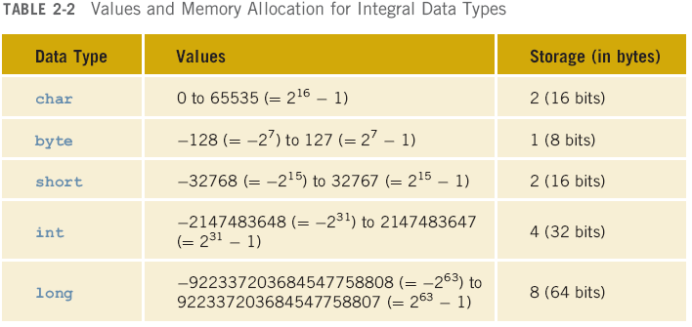
Values and Memory Allocation for Integral Data Types

Slide 13
Primitive Data Types
Floating-point data types
float: precision = 6 or 7
double: precision = 15
boolean: two values
true
false

Slide 14
Literals (Constants)
Integer literals, integer constants, or integers: 23 and -67
Floating-point literals, floating-point constants, floating-point numbers: 12.34 and 25.60
Character literals, character constants, or characters: 'a' and '5'
CCCS 300 Programming Techniques 1

Slide 15
Arithmetic Operators and Operator Precedence
Five arithmetic operators
+ addition
- subtraction
* multiplication
/ division
% mod (modulus)
Unary operator: operator that has one operand
Binary operator: operator that has two operands
CCCS 300 Programming Techniques 1

Slide 16
Order of Precedence
1. * / % (same precedence)
2. + - (same precedence)
Operators in 1 have a higher precedence than operators in 2
When operators have the same level of precedence, operations are performed from left to right
CCCS 300 Programming Techniques 1

Slide 17
Expressions
Integral expressions
Floating-point or decimal expressions
Mixed expressions
CCCS 300 Programming Techniques 1

Slide 18
Integral Expressions
All operands are integers
Examples
2 + 3 * 5
3 + x – y / 7
x + 2 * (y – z) + 18
CCCS 300 Programming Techniques 1

Slide 19
Floating-Point Expressions
All operands are floating-point numbers
Examples
12.8 * 17.5 – 34.50
x * 10.5 + y - 16.2
CCCS 300 Programming Techniques 1

Slide 20
Mixed Expressions
Operands of different types
Examples
2 + 3.5
6 / 4 + 3.9
Integer operands yield an integer result; floating-point numbers yield floating-point results
If both types of operands are present, the result is a floating-point number
Precedence rules are followed
CCCS 300 Programming Techniques 1

Slide 21
Type Conversion (Casting)
Used to avoid implicit type coercion
Syntax
(dataTypeName) expression
Expression evaluated first, then type converted to dataTypeName
Examples
(int)(7.9 + 6.7) = 14
(int)(7.9) + (int)(6.7) = 13
CCCS 300 Programming Techniques 1

Slide 22
The class String
Used to manipulate strings
Sequence of zero or more characters
Enclosed in double quotation marks
Null or empty strings have no characters
Numeric strings consist of integers or decimal numbers
Length is the number of characters in a string
CCCS 300 Programming Techniques 1

Slide 23
Strings and the Operator +
Operator + can be used to concatenate two strings or a string and a numeric value or character
Example 2-10
"The sum = " + 12 + 26
- After this statement executes, the string assigned to str is:
"The sum = 1226";
CCCS 300 Programming Techniques 1

Slide 24
Strings and the Operator + (continued)
Consider the following statement:
"The sum = " + (12 + 26)
In this statement, because of the parentheses, you first evaluate num1 + num2
Because num1 and num2 are both int variables, num1 + num2 = 12 + 26 = 38
After this statement executes, the string assigned to str is:
"The sum = 38";
CCCS 300 Programming Techniques 1

Slide 25
Input
Named constant
Cannot be changed during program execution
Declared by using the reserved word final
Initialized when it is declared
Example 2-11
final double CENTIMETERS_PER_INCH = 2.54;
final int NO_OF_STUDENTS = 20;
final char BLANK = ' ';
final double PAY_RATE = 15.75;
CCCS 300 Programming Techniques 1

Slide 26
Input (continued)
Variable (name, value, data type, size)
Content may change during program execution
Must be declared before it can be used
May not be automatically initialized
If new value is assigned, old one is destroyed
Value can only be changed by an assignment statement or an input (read) statement
Example 2-12
double amountDue;
int counter;
char ch;
int num1, num2;
CCCS 300 Programming Techniques 1

Slide 27
Input (continued)
The assignment statement
variable = expression;
Example 2-13
int num1;
int num2;
double sale;
char first;
String str;
num1 = 4;
num2 = 4 * 5 - 11;
sale = 0.02 * 1000;
first = 'D';
str = "It is a sunny day.";
CCCS 300 Programming Techniques 1

Slide 28
Input (continued)
Example 2-14
num1 = 18;
num1 = num1 + 27;
num2 = num1;
num3 = num2 / 5;
num3 = num3 / 4;
CCCS 300 Programming Techniques 1

Slide 29
Input (continued)
CCCS 300 Programming Techniques 1

Slide 30
Input (continued)
CCCS 300 Programming Techniques 1

Slide 31
Input (continued)
Standard input stream object: System.in
Input numeric data to program
Separate by blanks, lines, or tabs
To read data:
Create an input stream object of the class Scanner
Use the methods such as next, nextLine, nextInt, and nextDouble
CCCS 300 Programming Techniques 1

Slide 32
Input (continued)
static Scanner console = new Scanner(System.in);
Example 2-16
static Scanner console = new Scanner(System.in);
int feet;
int inches;
Suppose the input is 23 7
feet = console.nextInt(); //Line 1
inches = console.nextInt(); //Line 2
CCCS 300 Programming Techniques 1

Slide 33
Increment and Decrement Operators
++ increments the value of its operand by 1
-- decrements the value of its operand by 1
Syntax
Pre-increment: ++variable
Post-increment: variable++
Pre-decrement: --variable
Post-decrement: variable--
CCCS 300 Programming Techniques 1

Slide 34
Output
Standard output object: System.out
Methods
print
println
Syntax
System.out.print(stringExp);
System.out.println(stringExp);
System.out.println();
CCCS 300 Programming Techniques 1

Slide 35
Commonly Used Escape Sequences
CCCS 300 Programming Techniques 1

Slide 36
Packages, Classes, Methods, and the import Statement
Package: collection of related classes
Class: consists of methods
Method: designed to accomplish a specific task
CCCS 300 Programming Techniques 1

Slide 37
import Statement
Used to import the components of a package into a program
Reserved word
import java.io.*;
Imports the (components of the) package java.io into the program
Primitive data types and the class String
Part of the Java language
Don’t need to be imported
CCCS 300 Programming Techniques 1

Slide 38
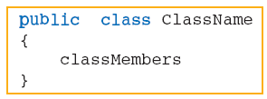
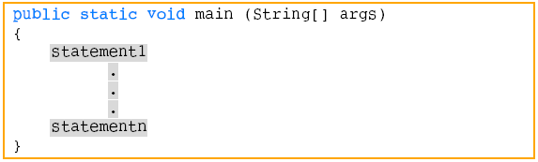
Creating a Java Application Program
Syntax of a class
Syntax of the main method
CCCS 300 Programming Techniques 1

Slide 39
Debugging: Understanding and Fixing Syntax Errors
When you type a program, typos and unintentional syntax errors are likely to occur
Therefore, when you compile a program, the compiler will identify the syntax error
CCCS 300 Programming Techniques 1

Slide 40
ProgramNum1 Contains Syntax Errors
CCCS 300 Programming Techniques 1

Slide 41
Compiler Result
The compiler produces the following errors:
ProgramNum.java:9: ';' expected
int num
^
ProgramNum.java:16: reached end of file while parsing
}
^
2 errors
CCCS 300 Programming Techniques 1

Slide 42
Program After Correcting These Errors
CCCS 300 Programming Techniques 1

Slide 43
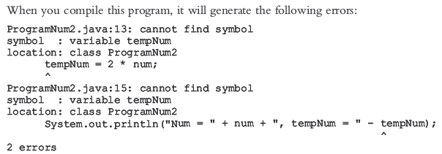
Compiler Generates The Following Errors
CCCS 300 Programming Techniques 1

Slide 44
Operator minus (–) cannot be applied to strings
CCCS 300 Programming Techniques 1

Slide 45
Compiler Generates The Following Errors
CCCS 300 Programming Techniques 1

Slide 46
After Correcting The Error
CCCS 300 Programming Techniques 1

Slide 47
Programming Style and Form
CCCS 300 Programming Techniques 1
Know common syntax errors and rules
Use blanks appropriately
Semicolon: statement terminator
Important to have well-documented code
Good practice to follow traditional rules for naming identifiers

Slide 48
Avoiding Bugs: Consistent, Proper Formatting and Code Walkthrough
Java is a free-format language in the sense that programming instructions need not be typed in specific columns
As you will discover, consistent and proper formatting will make it easier to develop, debug, and maintain programs
Throughout the course, you will see consistent and predictable use of blanks, tabs, and newline characters to separate the elements of a program
When you write programs, unintentional typos and errors are unavoidable
The Java compiler will find the syntax rules and give some hints how to correct them; however, the compiler may not find logical (semantic) errors
CCCS 300 Programming Techniques 1

Slide 49
Avoiding Bugs: Consistent, Proper Formatting and Code Walk-Through (continued)
Typically, programmers try to find and fix these problems themselves by walking carefully through their programs
Sometimes after multiple readings, a programmer may not be able to find the bug because the programmer may overlook the piece of the code that contains the bug and therefore may seek outside help
If your program is properly formatted and you have used good names for identifiers, the person reading your program will have an easier time reading and debugging the program
CCCS 300 Programming Techniques 1

Slide 50
Explain What Your Program Intended To Do
Before you seek outside help, you should be prepared to explain what your program intended to do and answer questions raised by the person reading your program
The examination of your program by yourself, by another person, or a group of persons is a walk-through; a walk-through is helpful for all phases of the software development process
CCCS 300 Programming Techniques 1

Slide 51
More on Assignment Statements
variable = variable * (expression);
is equivalent to
variable *= expression;
Similarly,
variable = variable + (expression);
is equivalent to
variable += expression;
CCCS 300 Programming Techniques 1

Slide 52
Programming Examples
Convert Length program
Input: length in feet and inches
Output: equivalent length in centimeters
Make Change program
Input: change in cents
Output: equivalent change in half-dollars, quarters, dimes, nickels, and pennies
CCCS 300 Programming Techniques 1

Slide 53
Unit Summary
Basic elements of a Java program include:
The main method
Reserved words
Special symbols
Identifiers
Data types
Expressions
Input
Output
Statements
CCCS 300 Programming Techniques 1

Slide 54
Unit Summary (continued)
To create a Java application, it is important to understand:
Syntax rules
Semantic rules
How to manipulate strings and numbers
How to declare variables and named constants
How to receive input and display output
Good programming style and form
CCCS 300 Programming Techniques 1

