Slide 1
Control Statements - Repetition Statements
Module 2: Java Control Structures
Unit 2

Slide 2
Module 2 - Unit 2 Objectives
Examine relational, logical and increment and decrement operators.
Use Java while repetition statement
Learn the essentials of counter-controlled repetition
Develop algorithm for solving a problem
Understand pseudocode algorithm with counter-controlled repetition
Implement counter-controlled repetition
Use sentinel-controlled repetition (indefinite repetition)
Develop the pseudocode algorithm with indefinite repetition
Implement sentinel-controlled repetition
CCCS 300 Programming Techniques 1

Slide 3
Control Structures
Three methods of processing a program
In sequence
Branching (Selection)
Looping (Repetition)
Branch: altering the flow of program execution by making a selection or choice
Loop: altering the flow of program execution by repetition of statement(s)

Slide 4
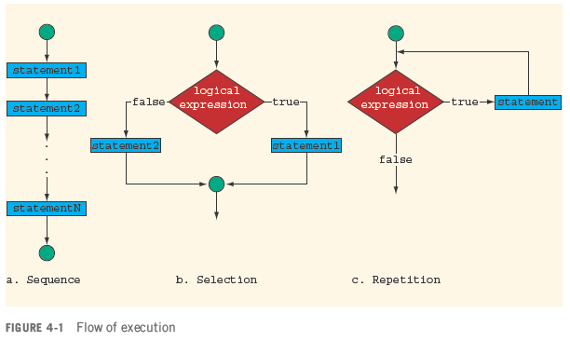
Flow of Execution

Slide 5
Relational Operators
Relational (comparison) operator
Allows you to make comparisons in a program
Binary operator
Condition is represented by a logical expression in Java
Logical expression: expression that has a value of either true or false

Slide 6
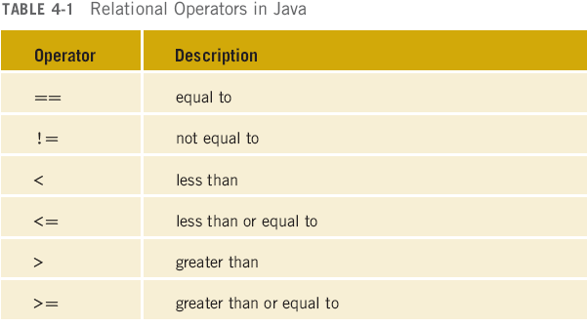
Relational Operators in Java

Slide 7
Relational Operators and Primitive Data Types
Can be used with integral and floating-point data types
Can be used with the char data type
Unicode collating sequence

Slide 8
8

Slide 9
9

Slide 10
Relational Operators & Unicode Collating Sequence

Slide 11
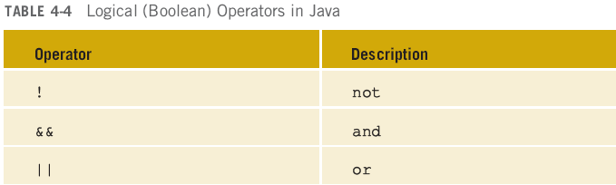
Logical (Boolean) Operators

Slide 12
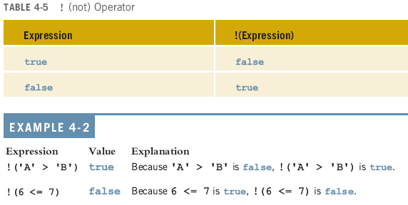
Not Operator (!)

Slide 13
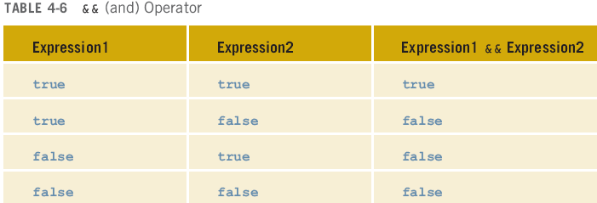
And Operators (&&)

Slide 14
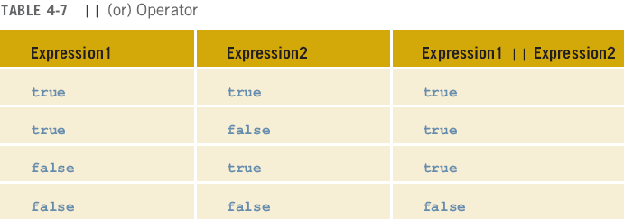
Or Operators (||)

Slide 15
Precedence of Operators

Slide 16
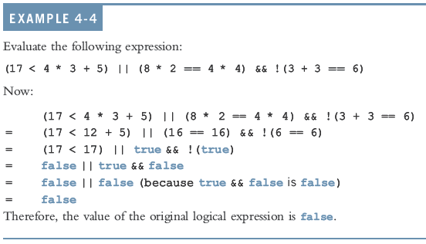
Precedence of Operators (Example)
16

Slide 17
17

Slide 18
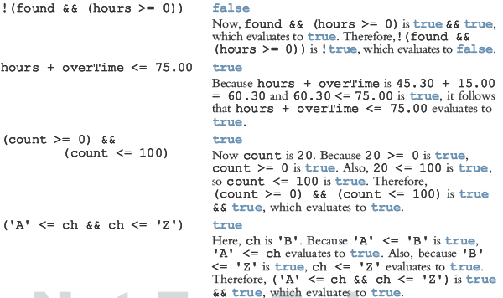
Example 4-5

Slide 19
while Repetition Statement
Repetition statement—repeats an action while a condition remains true.
Pseudocode
While there are more items on my shopping list Purchase next item and cross it off my list
The repetition statement’s body may be a single statement or a block.
Eventually, the condition will become false. At this point, the repetition terminates, and the first statement after the repetition statement executes.

Slide 20
Essentials of Counter-Controlled Repetition
Counter-controlled repetition requires
a control variable (or loop counter)
the initial value of the control variable
the increment by which the control variable is modified each time through the loop (also known as each iteration of the loop)
the loop-continuation condition that determines if looping should continue.

Slide 21
while Repetition Statement (Diagram)
The UML activity diagram in Fig. 4.6 illustrates the flow of control in the preceding while statement.
The UML represents both the merge symbol and the decision symbol as diamonds.
The merge symbol joins two flows of activity into one.
The decision and merge symbols can be distinguished by the number of “incoming” and “outgoing” transition arrows.
A decision symbol has one transition arrow pointing to the diamond and two or more pointing out from it to indicate possible transitions from that point. Each transition arrow pointing out of a decision symbol has a guard condition next to it.
A merge symbol has two or more transition arrows pointing to the diamond and only one pointing from the diamond, to indicate multiple activity flows merging to continue the activity. None of the transition arrows associated with a merge symbol has a guard condition.

Slide 22
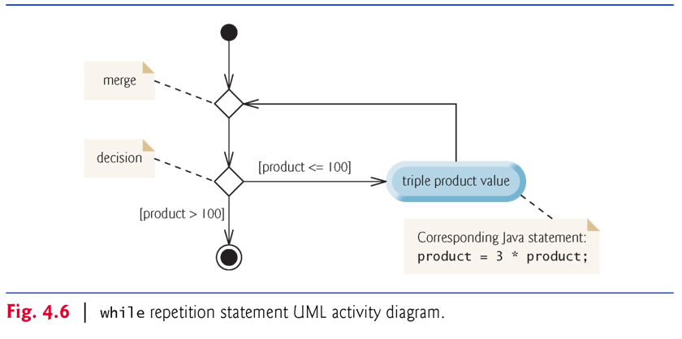
while Repetition Statement Activity Diagram

Slide 23
Formulating Algorithms: Counter-Controlled Repetition
A class of ten students took a quiz. The grades (integers in the range 0-100) for this quiz are available to you. Determine the class average on the quiz.
The class average is equal to the sum of the grades divided by the number of students.
The algorithm for solving this problem on a computer must input each grade, keep track of the total of all grades input, perform the averaging calculation and print the result.

Slide 24
Pseudocode Algorithms with Counter-Controlled Repetition
Use counter-controlled repetition to input the grades one at a time.
A variable called a counter (or control variable) controls the number of times a set of statements will execute.
Counter-controlled repetition is often called definite repetition, because the number of repetitions is known before the loop begins executing.

Slide 25
Software Engineering Observation
Experience has shown that the most difficult part of solving a problem on a computer is
developing the algorithm for the solution. Once a correct algorithm has been specified,
producing a working Java program from it is usually straightforward.

Slide 26
Formulating Algorithms: Counter-Controlled Repetition (Example)
A total is a variable used to accumulate the sum of several values.
A counter is a variable used to count.
Variables used to store totals are normally initialized to zero before being used in a program.

Slide 27
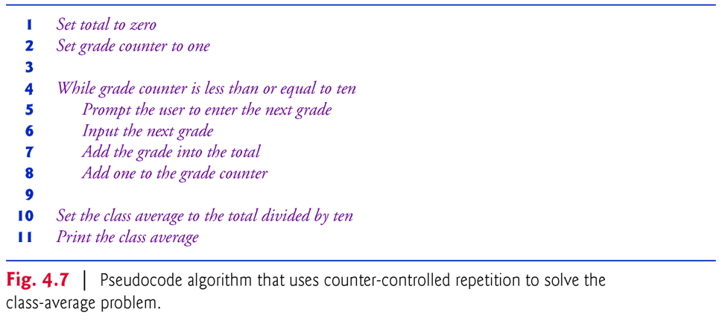
Pseudocode Algorithm that Uses Counter-Controlled Repetition

Slide 28
Local Variables in Method main
Variables declared in a method body are local variables and can be used only from the line of their declaration to the closing right brace of the method declaration.
A local variable’s declaration must appear before the variable is used in that method.
A local variable cannot be accessed outside the method in which it’s declared.

Slide 29
Common Programming Errors
Using the value of a local variable before it’s initialized results in a compilation error. All local variables must be initialized before their values are used in expressions.
Initialize each total and counter, either in its declaration or in an assignment statement.
Totals are normally initialized to 0. Counters are normally initialized to 0 or 1, depending on how they’re used.

Slide 30
Notes on Integer Division and Truncation
Dividing two integers results in integer division—any fractional part of the calculation is truncated (i.e., lost).
Assuming that integer division rounds (rather than truncates) can lead to incorrect results.
For example, 7 ÷ 4, which yields 1.75 in conventional arithmetic, truncates to 1 in integer arithmetic, rather than rounding to 2.

Slide 31
A Note About Arithmetic Overflow
In the following statement
total = total + grade; // add grade to total
added each grade entered by the user to the total.
Even this simple statement has a potential problem—adding the integers could result in a value that’s too large to store in an int variable.
This is known as arithmetic overflow and causes undefined behavior, which can lead to unintended results.

Slide 32
Maximum and Minimum Values (int variable)
The maximum and minimum values that can be stored in an int variable are represented by the constants MIN_VALUE and MAX_VALUE, respectively, which are defined in class Integer.
There are similar constants for the other integral types and for floating-point types.
Each primitive type has a corresponding class type in package java.lang.

Slide 33
A Deeper Look at Receiving User Input
Any time a program receives input from the user, various problems might occur. For example,
int grade = input.nextInt(); // input next grade
we assume that the user will enter an integer grade in the range 0 to 100.
However, the person entering a grade could enter an integer less than 0, an integer greater than 100, an integer outside the range of values that can be stored in an int variable, a number containing a decimal point or a value containing letters or special symbols that’s not even an integer.

Slide 34
Ensuring valid inputs
To ensure that inputs are valid, industrial-strength programs must test for all possible erroneous cases.
A program that inputs grades should validate the grades by using range checking to ensure that hey are values from 0 to 100.
You can then ask the user to reenter any value that’s out of range.
If a program requires inputs from a specific set of values (e.g., non-sequential product codes), you can ensure that each input matches a value in the set.

Slide 35
Formulating Algorithms: Sentinel-Controlled Repetition
Develop a class-averaging program that processes grades for an arbitrary number of students each time it is run.
Sentinel-controlled repetition is often called indefinite repetition because the number of repetitions is not known before the loop begins executing.
A special value called a sentinel value (also called a signal value, a dummy value or a flag value) can be used to indicate “end of data entry.”
A sentinel value must be chosen that cannot be confused with an acceptable input value.

Slide 36
Developing the Pseudocode Algorithm : Sentinel-Controlled Repetition
Top-down, stepwise refinement
Begin with a pseudocode representation of the top—a single statement that conveys the overall function of the program:
Determine the class average for the quiz
The top is a complete representation of a program. Rarely conveys sufficient detail from which to write a Java program.

Slide 37
Proceeding to the First Refinement
Divide the top into a series of smaller tasks and list these in the order in which they’ll be performed.
First refinement:
Initialize variables Input, sum and count the quiz grades Calculate and print the class average
This refinement uses only the sequence structure—the steps listed should execute in order, one after the other.

Slide 38
Software Engineering Observation
Many programs can be divided logically into four phases:
A declaration phase where variables are declared
An initialization phase that initializes the variables;
A processing phase that inputs data values and adjusts program variables accordingly; and
A termination phase that calculates and outputs the final results.

Slide 39
Proceeding to the Second Refinement
Second refinement: commit to specific variables.
The pseudocode statement
Initialize variables
can be refined as follows:
Initialize total to zero
Initialize counter to zero

Slide 40
Formulating Algorithms: Sentinel-Controlled Repetition (Cont.)
The pseudocode statement
Input, sum and count the quiz grades
requires repetition to successively input each grade.
We do not know in advance how many grades will be entered, so we’ll use sentinel-controlled repetition.

Slide 41
Second Refinement of the Preceding Pseudocode
The second refinement of the preceding pseudocode statement is then
Prompt the user to enter the first grade Input the first grade (possibly the sentinel)
While the user has not yet entered the sentinel Add this grade into the running total Add one to the grade counter Prompt the user to enter the next grade Input the next grade (possibly the sentinel)

Slide 42
Formulating Algorithms: (Termination Phase)
The pseudocode statement
Calculate and print the class average
can be refined as follows:
If the counter is not equal to zero Set the average to the total divided by the counter Print the average else Print “No grades were entered”
Test for the possibility of division by zero—a logic error that, if undetected, would cause the program to fail or produce invalid output.

Slide 43
Error-Prevention Tip
When performing division (/) or remainder (%) calculations in which the right operand could be zero, test for this and handle it (e.g., display an error message) rather than allowing the error to occur.

Slide 44
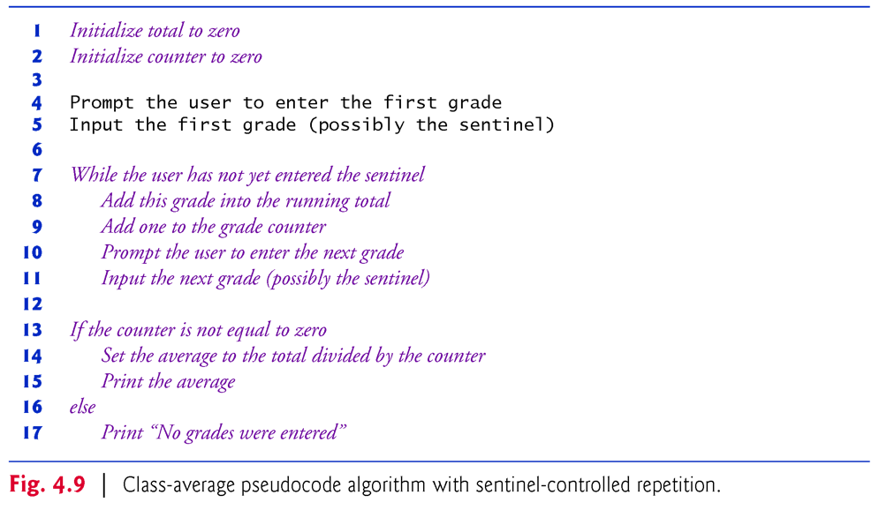
Class-Average Pseudocode Algorithm with Sentinel-Controlled Repetition

Slide 45
Software Engineering Observation
Some programmers do not use program development tools like pseudocode. They feel that their ultimate goal is to solve the problem on a computer and that writing pseudocode merely delays the production of final outputs. Although this may work for simple and familiar problems, it can lead to serious errors and delays in large, complex projects.

Slide 46
Program Logic for Sentinel-Controlled Repetition vs. Counter-Controlled Repetition
Program logic for sentinel-controlled repetition
Reads the first value before reaching the while.
This value determines whether the program’s flow of control should enter the body of the while. If the condition of the while is false, the user entered the sentinel value, so the body of the while does not execute (for example, no grades were entered).
If the condition is true, the body begins execution and processes the input.
Then the loop body inputs the next value from the user before the end of the loop.

