Slide 1
Control Statements – Repetition Structures
Module 2 – Java Control Structure
Unit 4

Slide 2
Module 2 - Unit 2 Objectives
Use for and do…while repetition structures
Understand multiple selection using switch selection statement
Use the break and continue program statements to alter the flow of control

Slide 3
The Basics of a Java Program
CCCS 300 Programming Techniques 1
Java program: collection of classes
There is a main method in every Java application program
Token: smallest individual unit of a program

Slide 4
5.2 Essentials of Counter-Controlled Repetition
Counter-controlled repetition requires
a control variable (or loop counter)
the initial value of the control variable
the increment by which the control variable is modified each time through the loop (also known as each iteration of the loop)
the loop-continuation condition that determines if looping should continue.

Slide 5
5.3 for Repetition Statement
for repetition statement
Specifies the counter-controlled-repetition details in a single line of code.
When the for statement begins executing, the control variable is declared and initialized.
Next, the program checks the loop-continuation condition, which is between the two required semicolons.
If the condition initially is true, the body statement executes.
After executing the loop’s body, the program increments the control variable in the increment expression, which appears to the right of the second semicolon.
Then the loop-continuation test is performed again to determine whether the program should continue with the next iteration of the loop.
A common logic error with counter-controlled repetition is an off-by-one error.

Slide 6
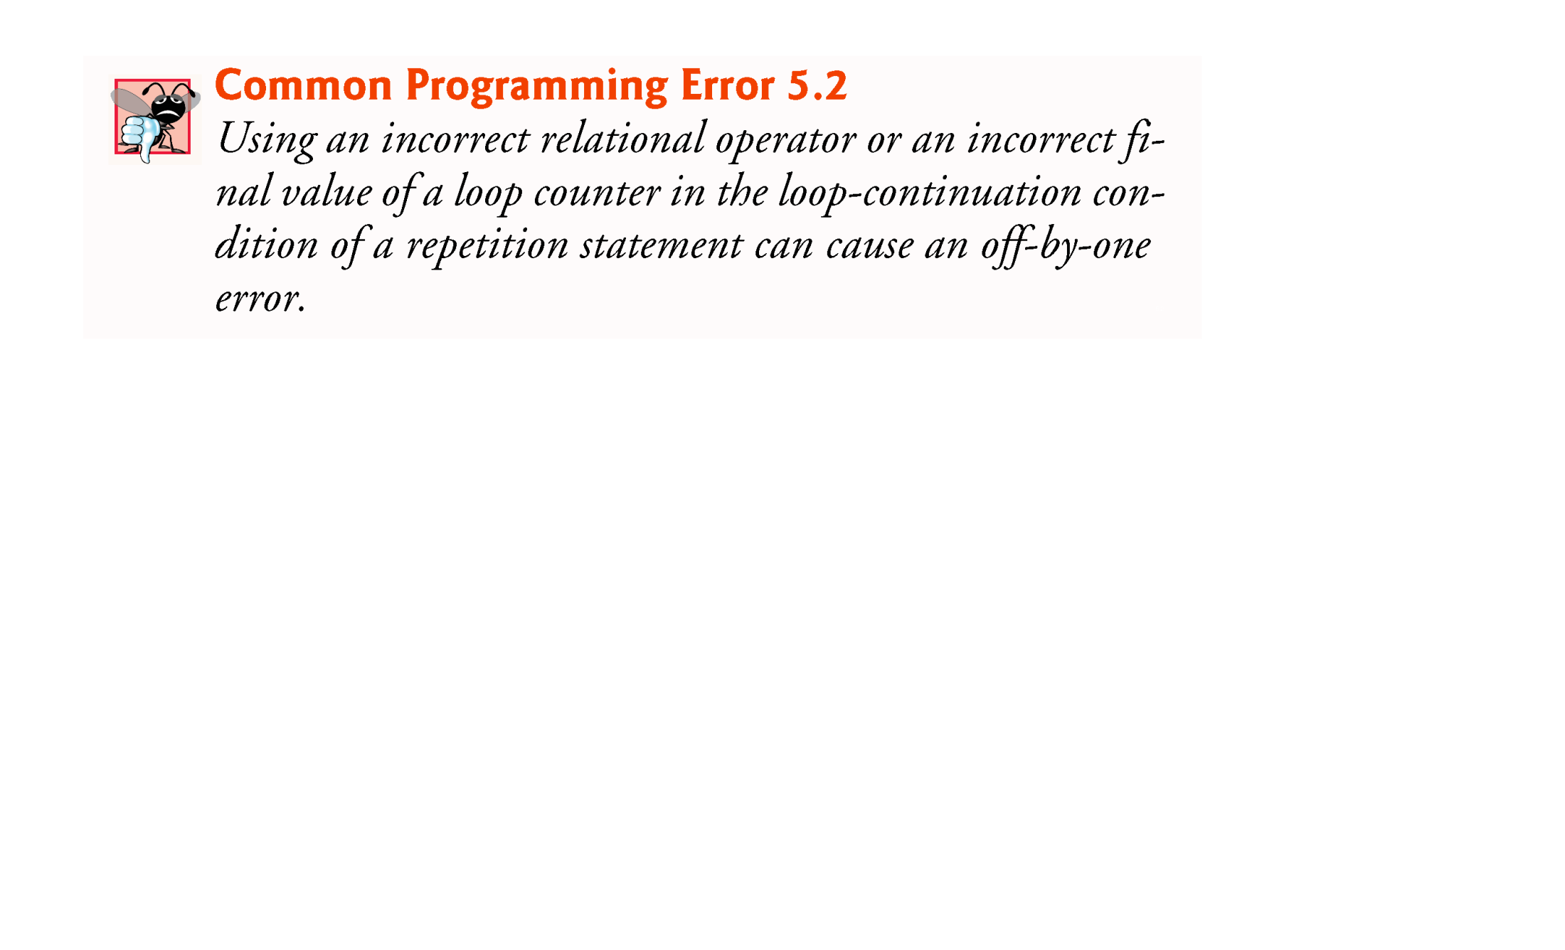

Slide 7
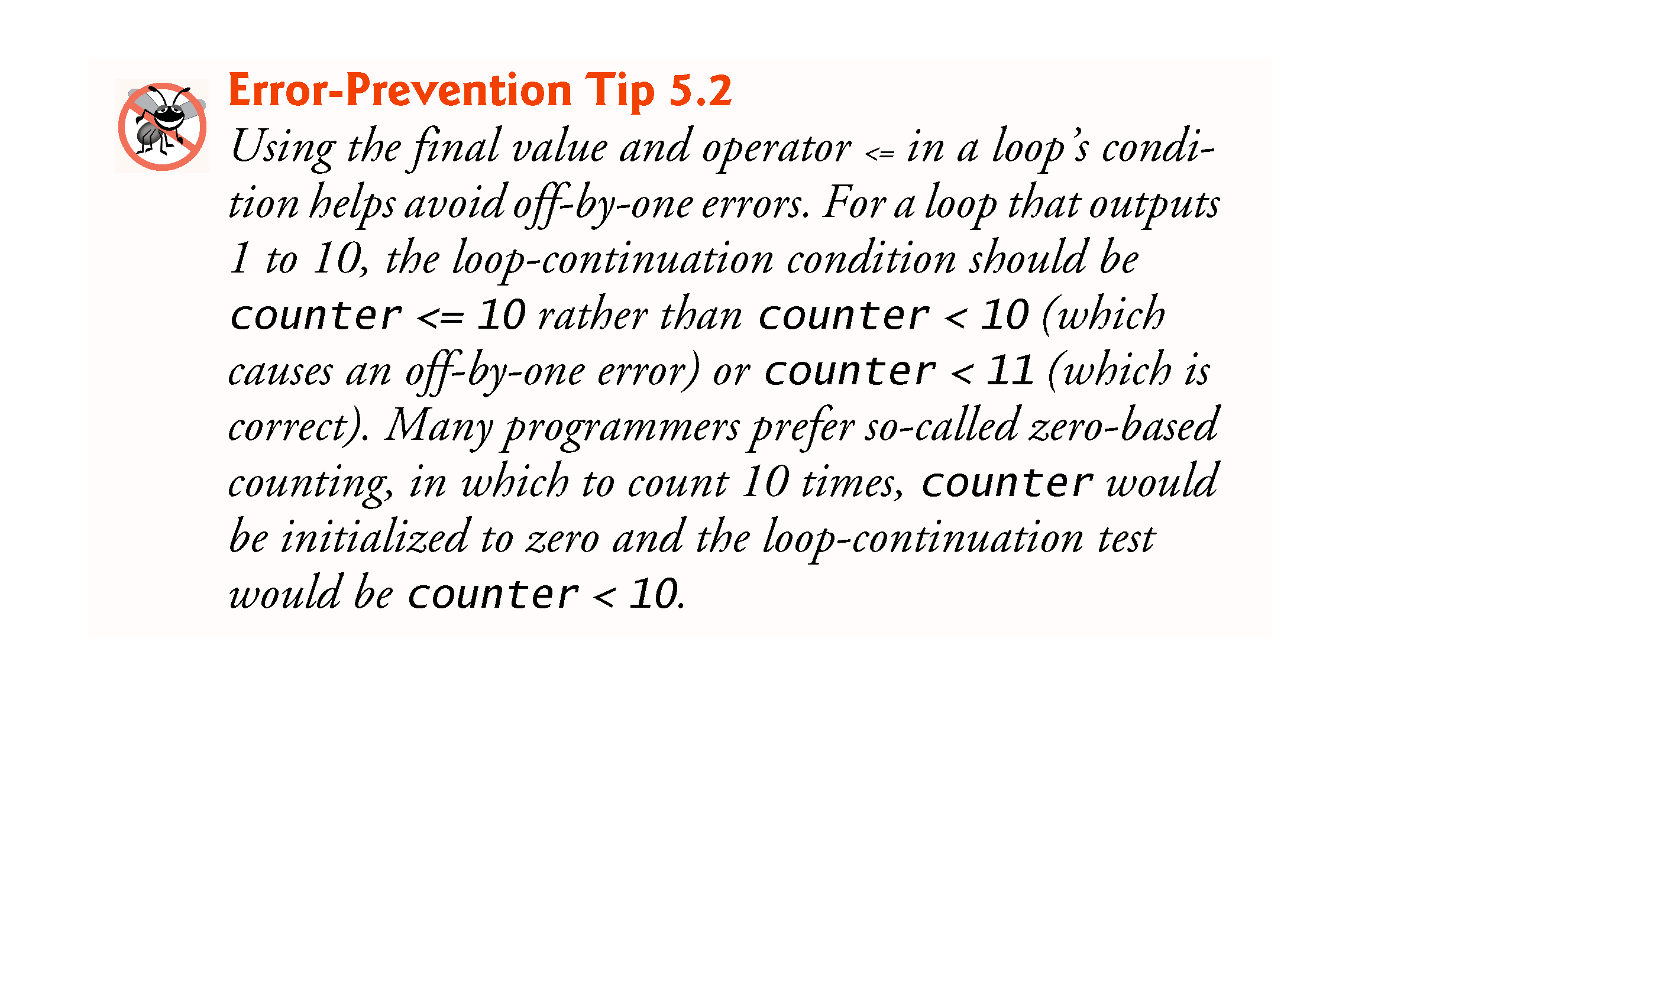

Slide 8
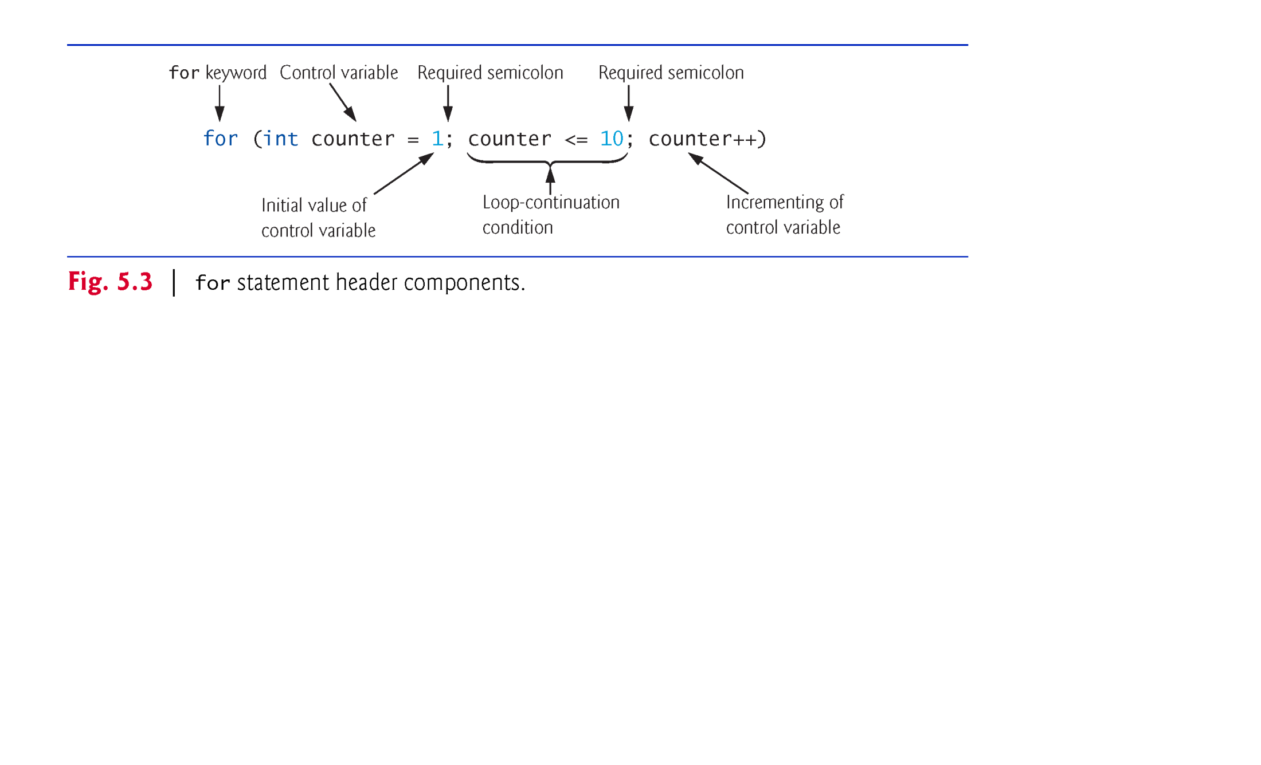

Slide 9
5.3 for Repetition Statement (Cont.)
The general format of the for statement is
for (initialization; loopContinuationCondition; increment) statement
the initialization expression names the loop’s control variable and optionally provides its initial value
loopContinuationCondition determines whether the loop should continue executing
increment modifies the control variable’s value, so that the loop-continuation condition eventually becomes false.
The two semicolons in the for header are required.

Slide 10
5.3 for Repetition Statement (Cont.)
The for statement often can be represented with an equivalent while statement as follows:
initialization;
while (loopContinuationCondition) { statement increment; }
Typically, for statements are used for counter-controlled repetition and while statements for sentinel-controlled repetition.
If the initialization expression in the for header declares the control variable, the control variable can be used only in that for statement.

Slide 11
5.3 for Repetition Statement (Cont.)
A variable’s scope defines where it can be used in a program.
A local variable can be used only in the method that declares it and only from the point of declaration through the end of the method.

Slide 12


Slide 13
5.3 for Repetition Statement (Cont.)
All three expressions in a for header are optional.
If the loopContinuationCondition is omitted, the condition is always true, thus creating an infinite loop.
You might omit the initialization expression if the program initializes the control variable before the loop.
You might omit the increment if the program calculates it with statements in the loop’s body or if no increment is needed.
The increment expression in a for acts as if it were a standalone statement at the end of the for’s body, so
counter = counter + 1 counter += 1 ++counter counter++
are equivalent increment expressions in a for statement.

Slide 14
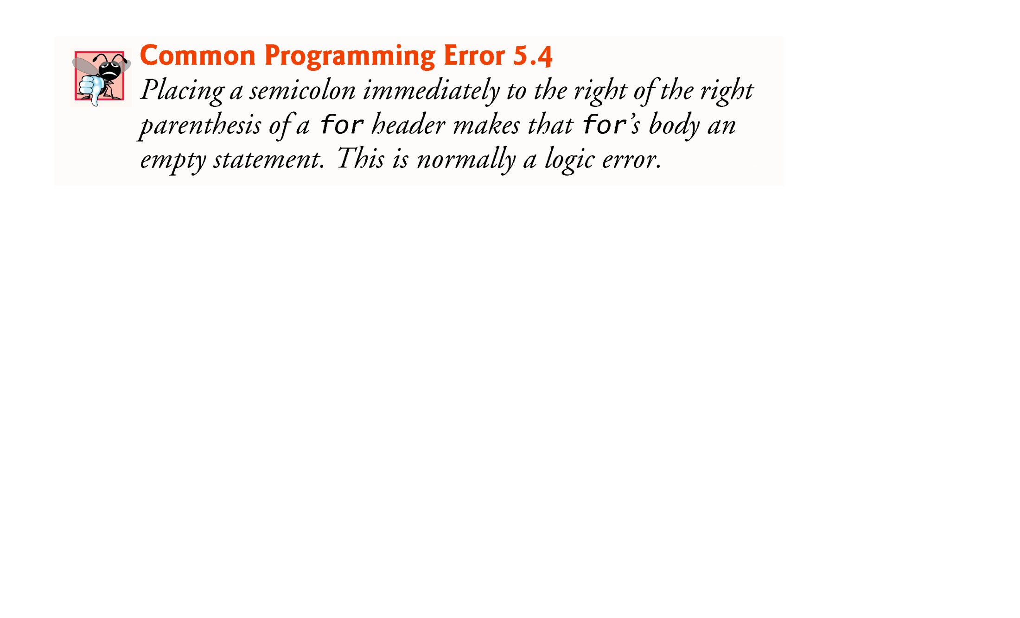

Slide 15
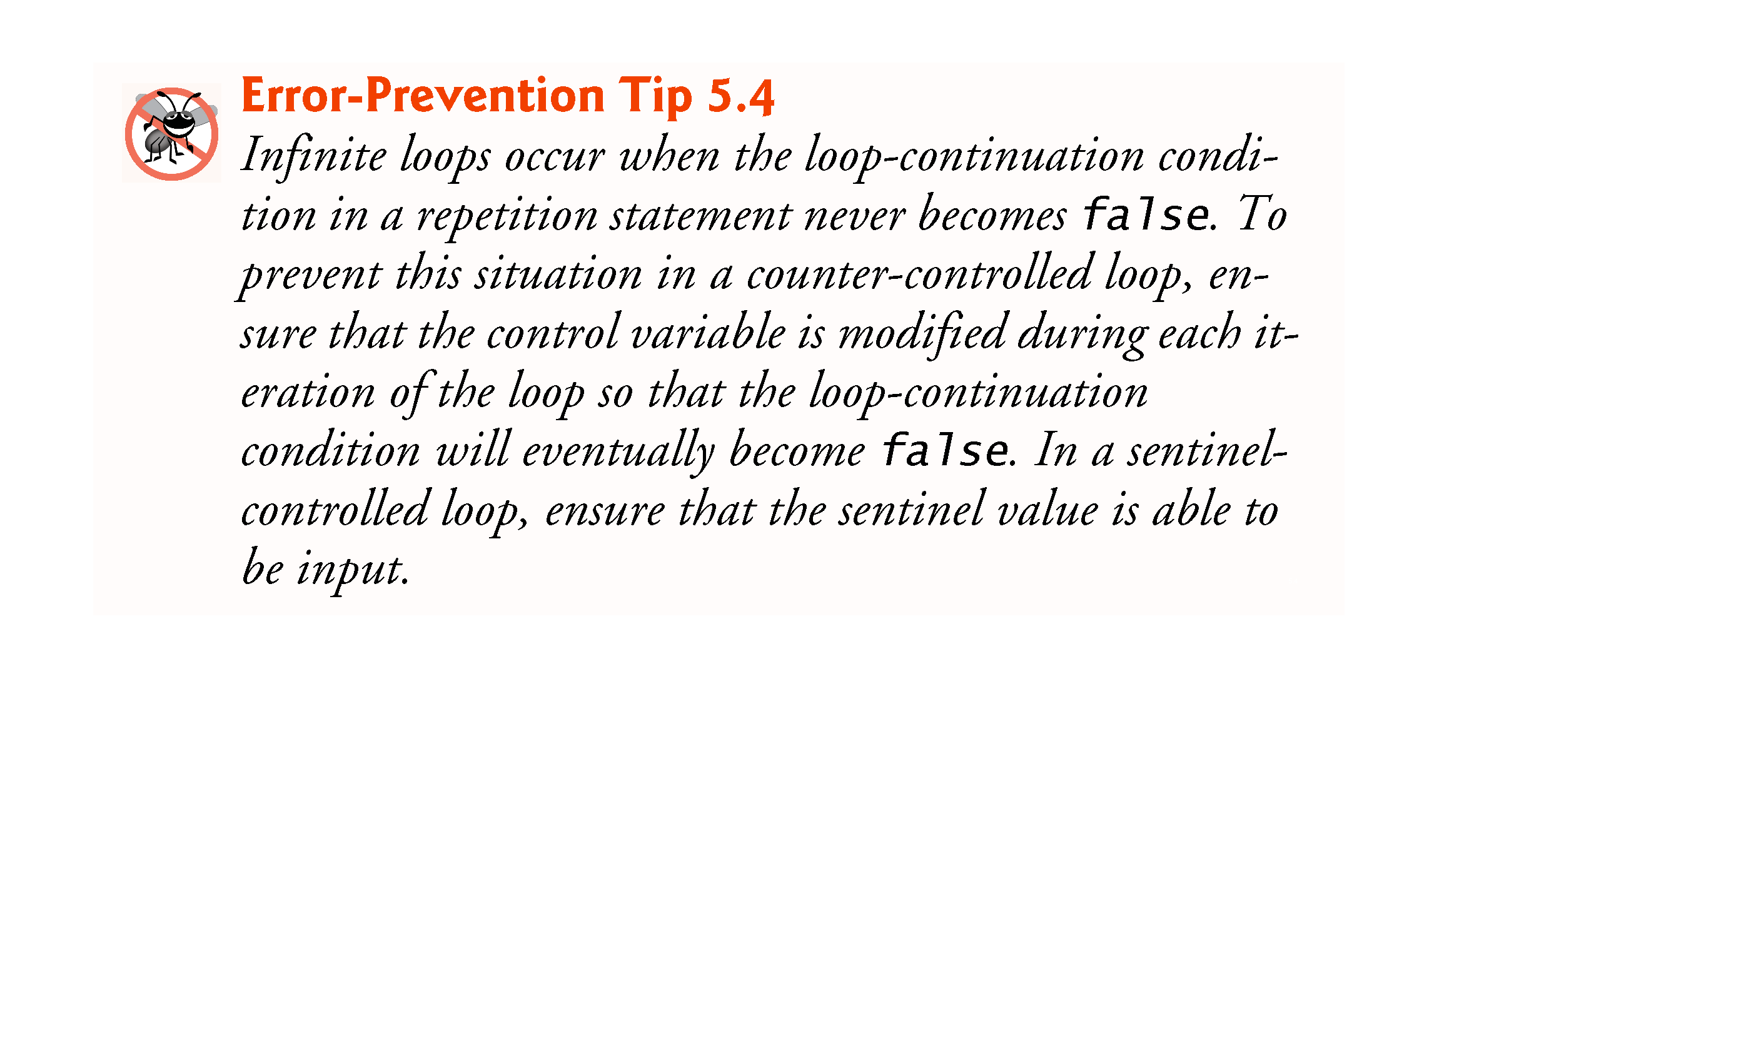

Slide 16
5.3 for Repetition Statement (Cont.)
The initialization, loop-continuation condition and increment can contain arithmetic expressions.
For example, assume that x = 2 and y = 10. If x and y are not modified in the body of the loop, the statement
for (int j = x; j <= 4 * x * y; j += y / x)
is equivalent to the statement
for (int j = 2; j <= 80; j += 5)
The increment of a for statement may be negative, in which case it’s a decrement, and the loop counts downward.

Slide 17


Slide 18
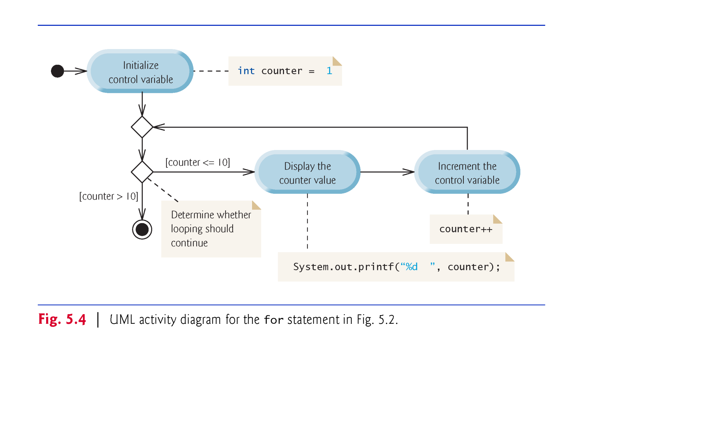

Slide 19
5.4 Examples Using the for Statement
a)Vary the control variable from 1 to 100 in increments of 1.
for (int i = 1; i <= 100; i++)
b)Vary the control variable from 100 to 1 in decrements of 1.
for (int i = 100; i >= 1; i--)
c)Vary the control variable from 7 to 77 in increments of 7.
for (int i = 7; i <= 77; i += 7)

Slide 20
5.4 Examples Using the for Statement (Cont.)
d)Vary the control variable from 20 to 2 in decrements of 2.
for (int i = 20; i >= 2; i -= 2)
e)Vary the control variable over the values 2, 5, 8, 11, 14, 17, 20.
for (int i = 2; i <= 20; i += 3)
f)Vary the control variable over the values 99, 88, 77, 66, 55, 44, 33, 22, 11, 0.
for (int i = 99; i >= 0; i -= 11)

Slide 21
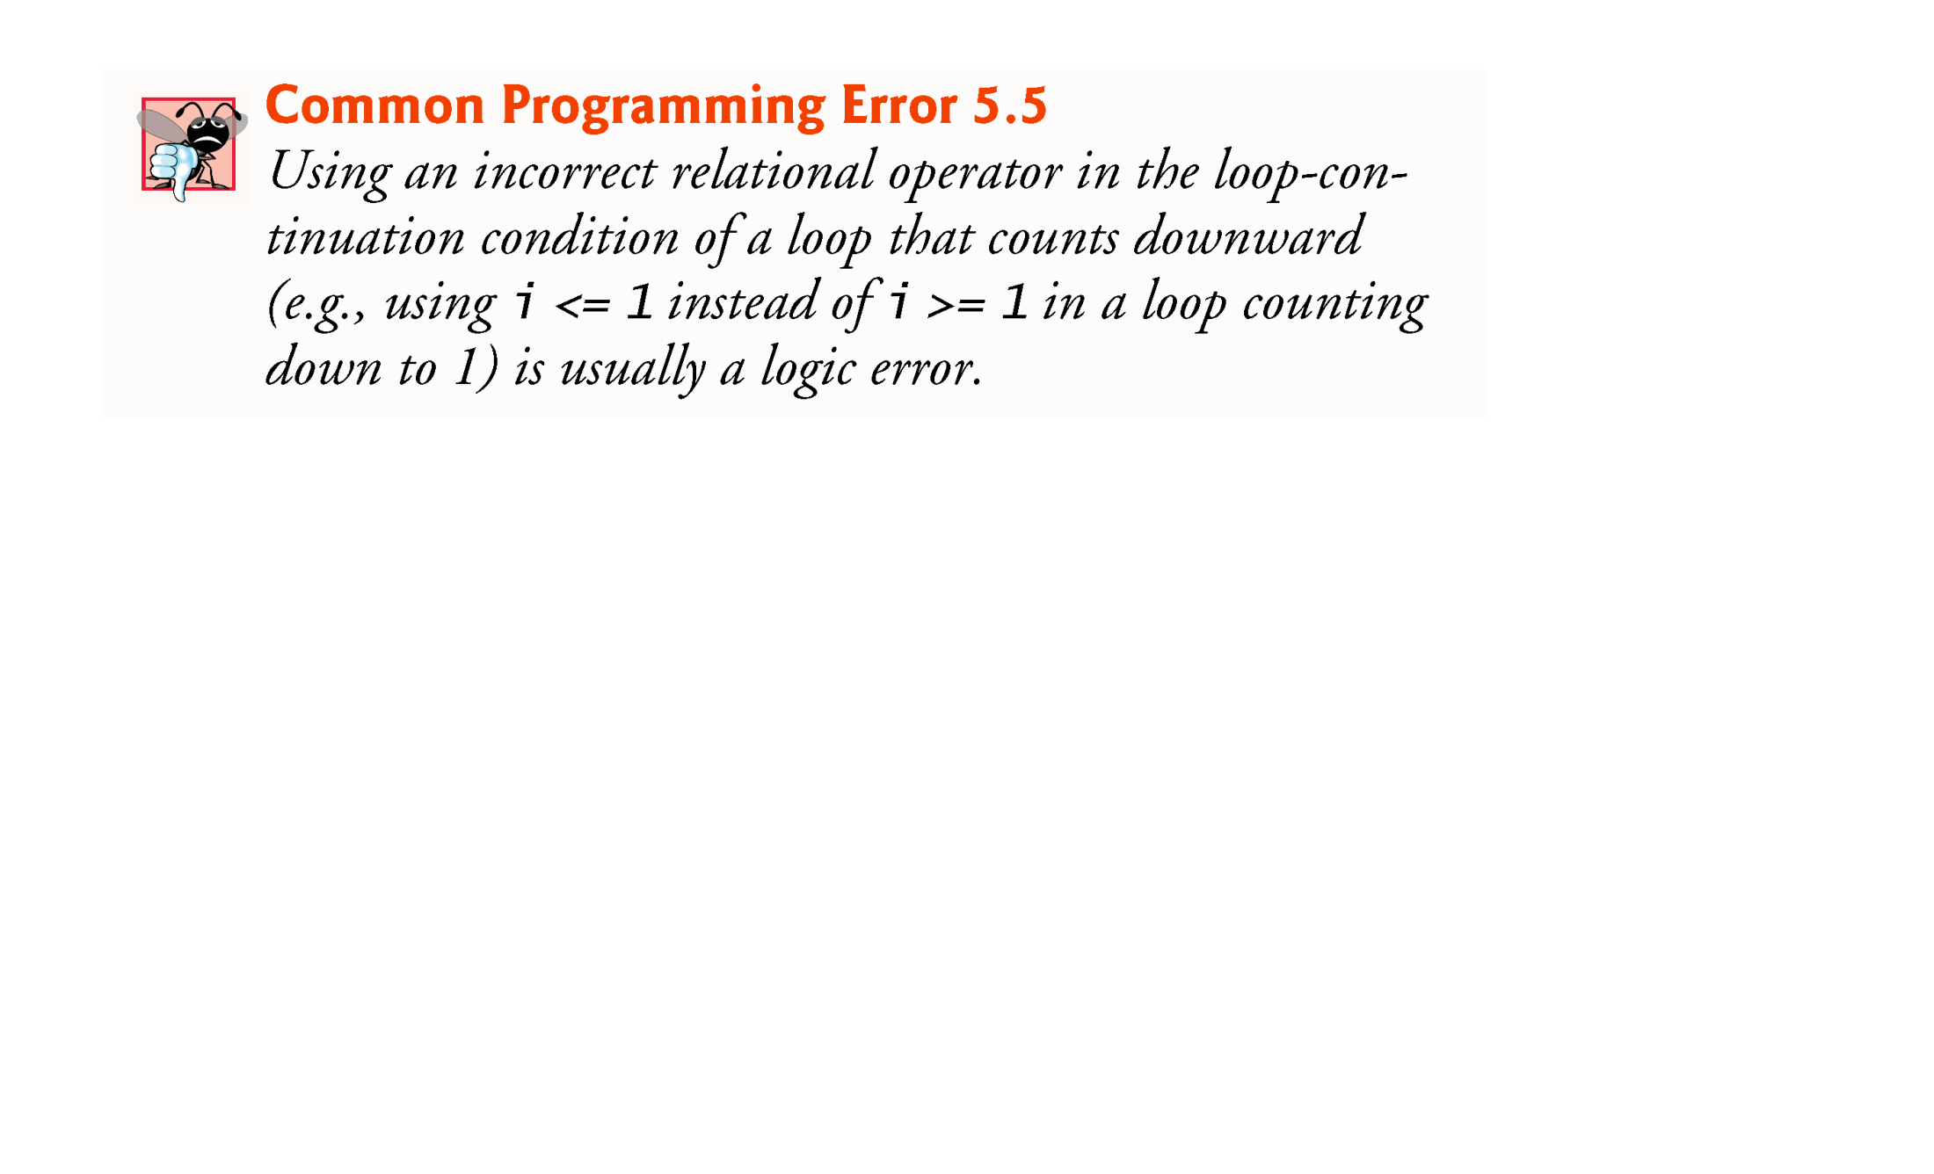

Slide 22
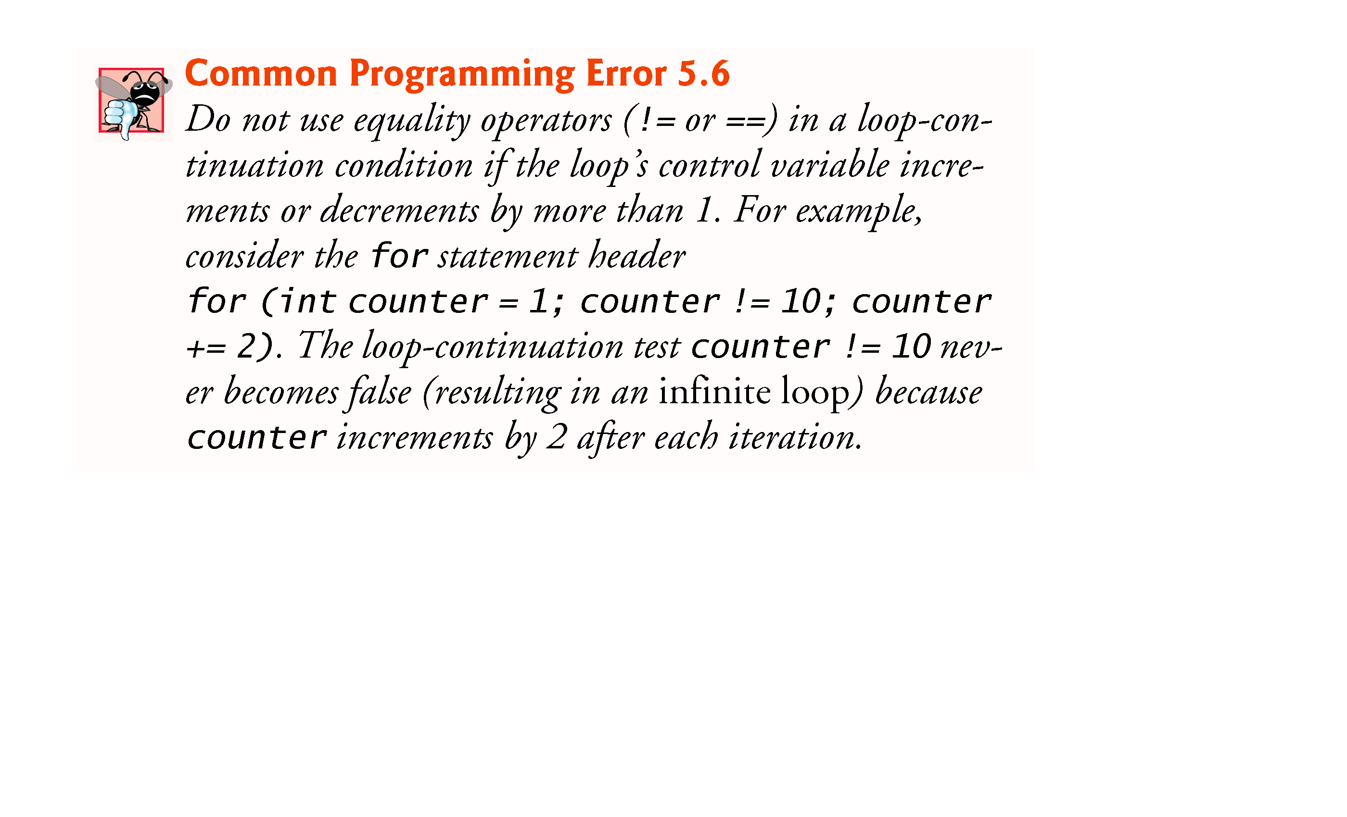

Slide 23
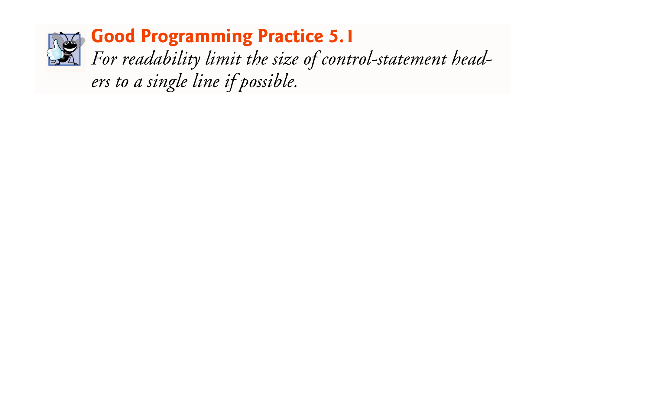

Slide 24
5.4 Examples Using the for Statement (Cont.)
Compound interest application
A person invests $1,000 in a savings account yielding 5% interest. Assuming that all the interest is left on deposit, calculate and print the amount of money in the account at the end of each year for 10 years. Use the following formula to determine the amounts:
a = p (1 + r)^{n}
where
p is the original amount invested (i.e., the principal) r is the annual interest rate (e.g., use 0.05 for 5%) n is the number of years a is the amount on deposit at the end of the nth year.

Slide 25
5.4 Examples Using the for Statement (Cont.)
The solution to this problem (Fig. 5.6) involves a loop that performs the indicated calculation for each of the 10 years the money remains on deposit.
Java treats floating-point constants like 1000.0 and 0.05 as type double.
Java treats whole-number constants like 7 and -22 as type int.

Slide 26
5.4 Examples Using the for Statement (Cont.)
In the format specifier %20s, the integer 20 between the % and the conversion character s indicates that the value output should be displayed with a field width of 20—that is, printf displays the value with at least 20 character positions.
If the value to be output is less than 20 character positions wide, the value is right justified in the field by default.
If the year value to be output were more thanhas more characters than the field width, the field width would be extended to the right to accommodate the entire value.
To indicate that values should be output left justified, precede the field width with the minus sign (–) formatting flag (e.g., %-20s).

Slide 27
5.4 Examples Using the for Statement (Cont.)
Classes provide methods that perform common tasks on objects.
Most methods must be called on a specific object.
Someclasses also provide methods that perform common tasks and do not require you to first create objects of those classes. These are called static methods.
Java does not include an exponentiation operator—Math class static method pow can be used for raising a value to a power.
You can call a static method by specifying the class name followed by a dot (.) and the method name, as in
ClassName.methodName(arguments)
Math.pow(x, y) calculates the value of x raised to the y^{th} power. The method receives two double arguments and returns a double value.

Slide 28
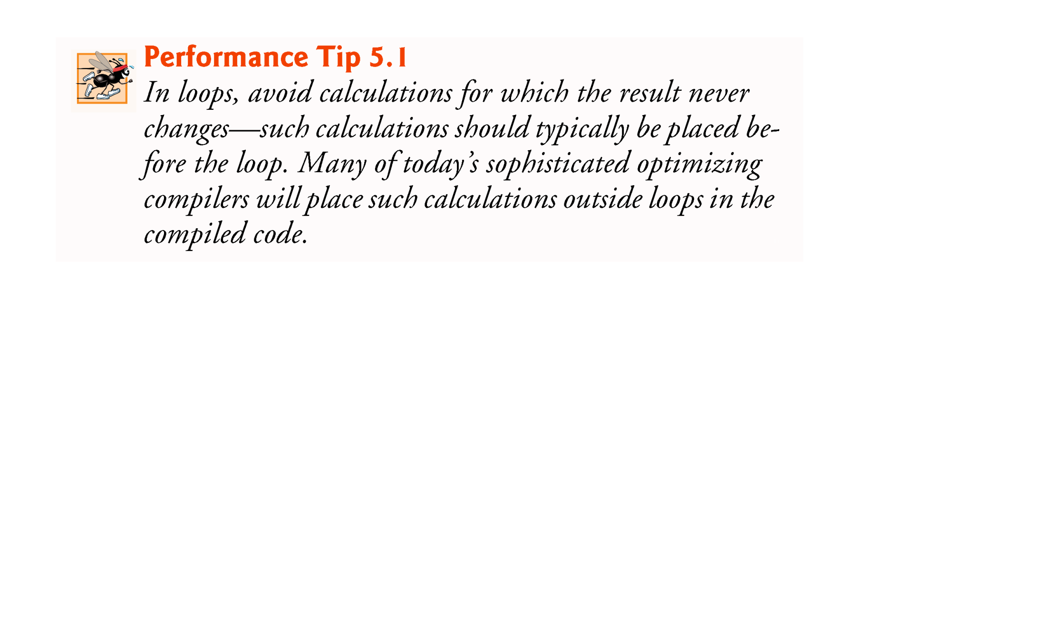

Slide 29
5.4 Examples Using the for Statement (Cont.)
In the format specifier %,20.2f, the comma (,) formatting flag indicates that the floating-point value should be output with a grouping separator.
Separator is specific to the user’s locale (i.e., country).
In the United States, the number will be output using commas to separate every three digits and a decimal point to separate the fractional part of the number, as in 1,234.45.
The number 20 in the format specification indicates that the value should be output right justified in a field width of 20 characters.
The .2 specifies the formatted number’s precision—in this case, the number is rounded to the nearest hundredth and output with two digits to the right of the decimal point.

Slide 30
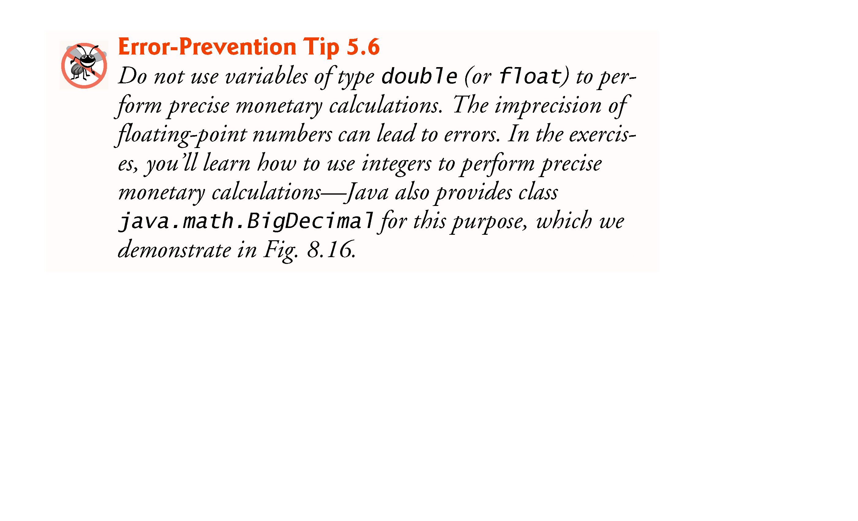

Slide 31
5.5 do…while Repetition Statement
The do…while repetition statement is similar to the while statement.
In the while, the program tests the loop-continuation condition at the beginning of the loop, before executing the loop’s body; if the condition is false, the body never executes.
The do…while statement tests the loop-continuation condition after executing the loop’s body; therefore, the body always executes at least once.
When a do…while statement terminates, execution continues with the next statement in sequence.

Slide 32
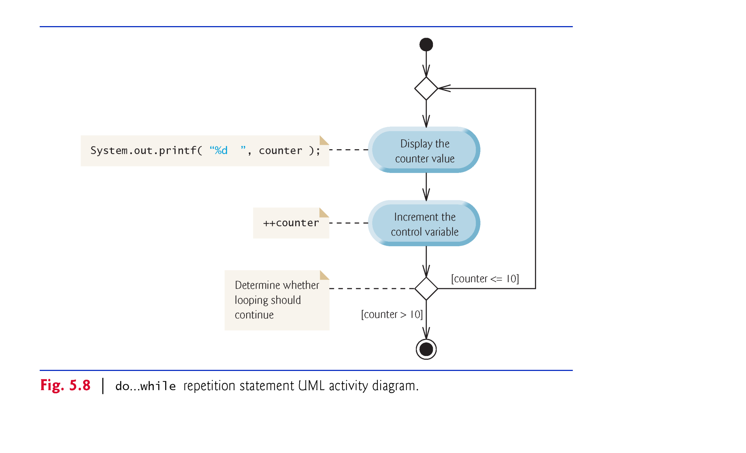
5.5 do…while Repetition Statement (Cont.)
The diagram makes it clear that the loop-continuation condition is not evaluated until after the loop performs the action state at least once.

Slide 33
5.5 do…while Repetition Statement (Cont.)
Braces are not required in the do…while repetition statement if there’s only one statement in the body.
Most programmers include the braces, to avoid confusion between the while and do…while statements.
Thus, the do…while statement with one body statement is usually written as follows:
do { statement } while (condition);

Slide 34
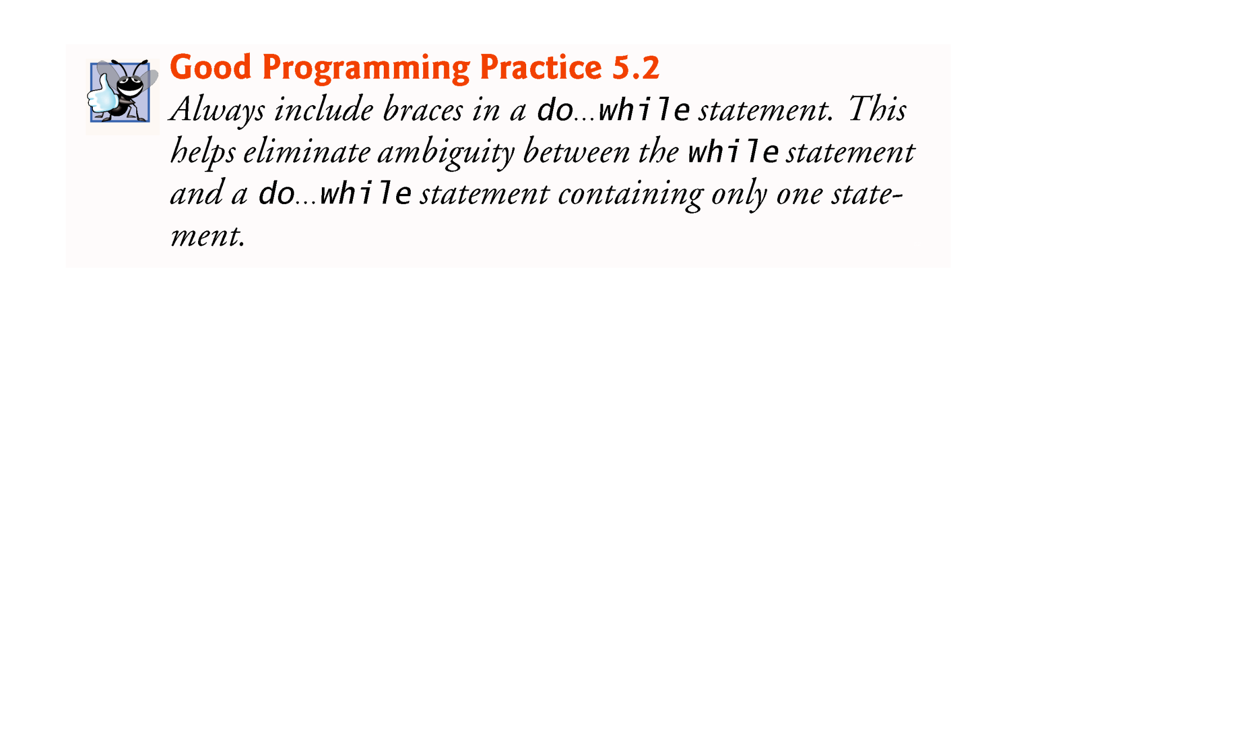

Slide 35
5.6 switch Multiple-Selection Statement
switch multiple-selection statement performs different actions based on the possible values of a constant integral expression of type byte, short, int or char.

Slide 36
5.6 switch Multiple-Selection Statement (Cont.)
The switch statement consists of a block that contains a sequence of case labels and an optional default case.
The program evaluates the controlling expression in the parentheses following keyword switch.
The program compares the controlling expression’s value (which must evaluate to an integral value of type byte, char, short or int, or to a String) with each case label.
If a match occurs, the program executes that case’s statements.
The break statement causes program control to proceed with the first statement after the switch.

Slide 37
5.6 switch Multiple-Selection Statement (Cont.)
switch does not provide a mechanism for testing ranges of values—every value must be listed in a separate case label.
Note that each case can have multiple statements.
switch differs from other control statements in that it does not require braces around multiple statements in a case.
Without break, the statements for a matching case and subsequent cases execute until a break or the end of the switch is encountered. This is called “falling through.”
If no match occurs between the controlling expression’s value and a case label, the default case executes.
If no match occurs and there is no default case, program control simply continues with the first statement after the switch.

Slide 38
5.6 switch Multiple-Selection Statement (Cont.)
Most switch statements use a break in each case to terminate the switch statement after processing the case.
The break statement is not required for the switch’s last case (or the optional default case, when it appears last), because execution continues with the next statement after the switch.
Forgetting a break statement when one is needed in a switch is a logical error
In a switch statement, ensure that you test for all possible values of the controlling expressions

Slide 39
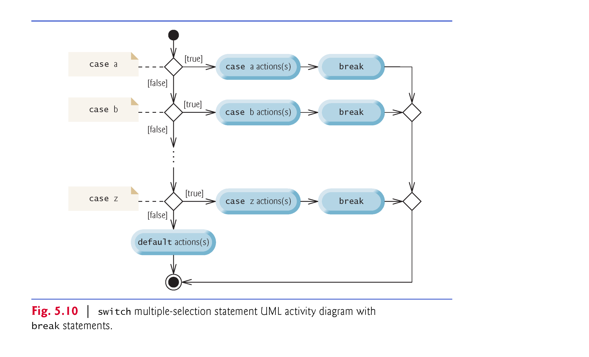

Slide 40
5.6 switch Multiple-Selection Statement (Cont.)
When using the switch statement, remember that each case must contain a constant integral expression.
An integer constant is simply an integer value.
In addition, you can use character constants—specific characters in single quotes, such as 'A', '7' or '$'—which represent the integer values of characters.
The expression in each case can also be a constant variable—a variable that contains a value which does not change for the entire program. Such a variable is declared with keyword final.
Java has a feature called enum types—enum type constants can also be used in case labels.

Slide 41
5.8 break and continue Statements
The break statement, when executed in a while, for, do…while or switch, causes immediate exit from that statement.
Execution continues with the first statement after the control statement.
Common uses of the break statement are to escape early from a loop or to skip the remainder of a switch.

Slide 42
5.8 break and continue Statements (Cont.)
The continue statement, when executed in a while, for or do…while, skips the remaining statements in the loop body and proceeds with the next iteration of the loop.
In while and do…while statements, the program evaluates the loop-continuation test immediately after the continue statement executes.
In a for statement, the increment expression executes, then the program evaluates the loop-continuation test.

Slide 43
5.9 Logical Operators
Java’s logical operators enable you to form more complex conditions by combining simple conditions.
The logical operators are
&& (conditional AND)
|| (conditional OR)
& (boolean logical AND)
| (boolean logical inclusive OR)
^ (boolean logical exclusive OR)
! (logical NOT).
[Note: The &, | and ^ operators are also bitwise operators when they are applied to integral operands.]

Slide 44
5.9 Logical Operators (Cont.)
The & (conditional AND) operator ensures that two conditions are both true before choosing a certain path of execution.
The table in Fig. 5.15 summarizes the && operator. The table shows all four possible combinations of false and true values for expression1 and expression2.
Such tables are called truth tables. Java evaluates to false or true all expressions that include relational operators, equality operators or logical operators.

Slide 45
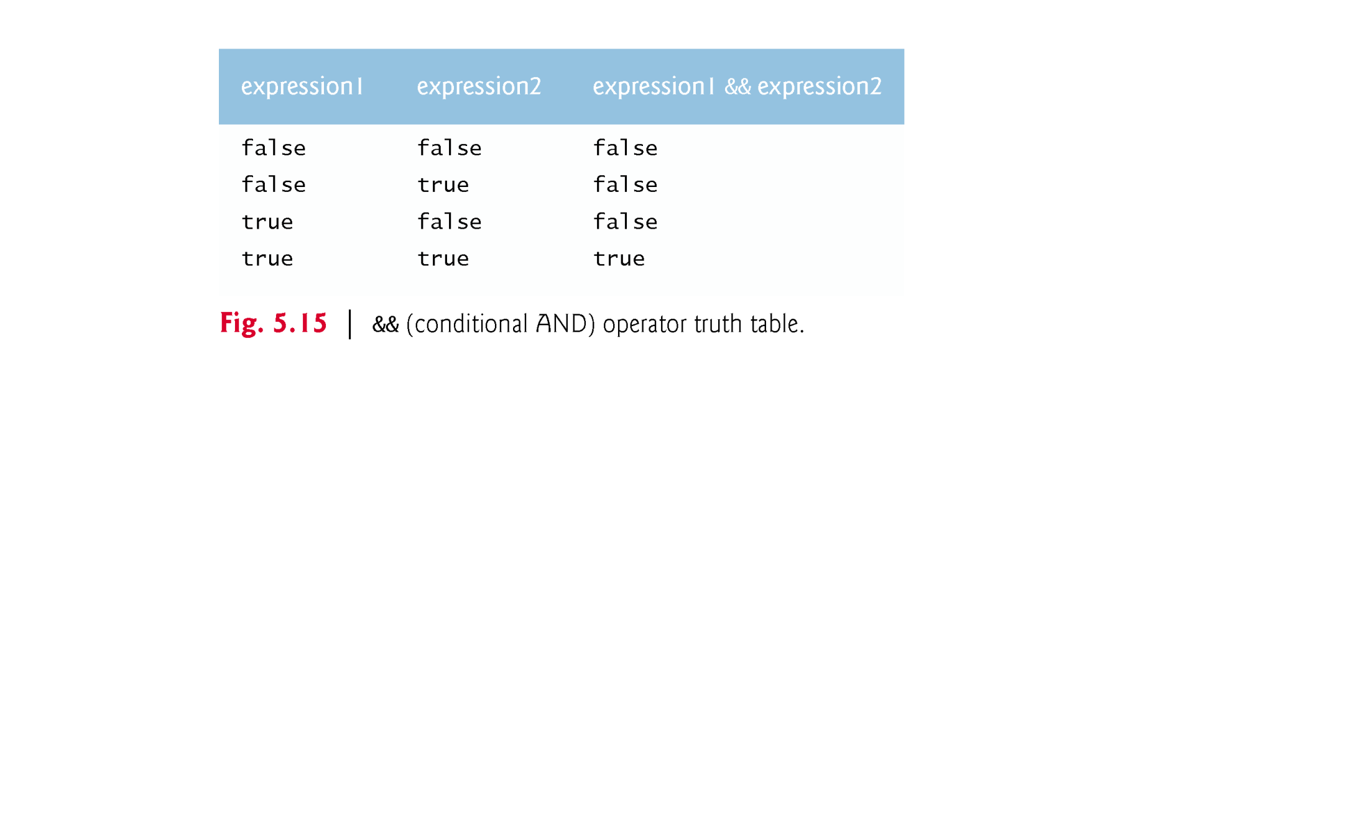

Slide 46
5.9 Logical Operators (Cont.)
The || (conditional OR) operator ensures that either or both of two conditions are true before choosing a certain path of execution.
Figure 5.16 is a truth table for operator conditional OR (||).
Operator && has a higher precedence than operator ||.
Both operators associate from left to right.

Slide 47
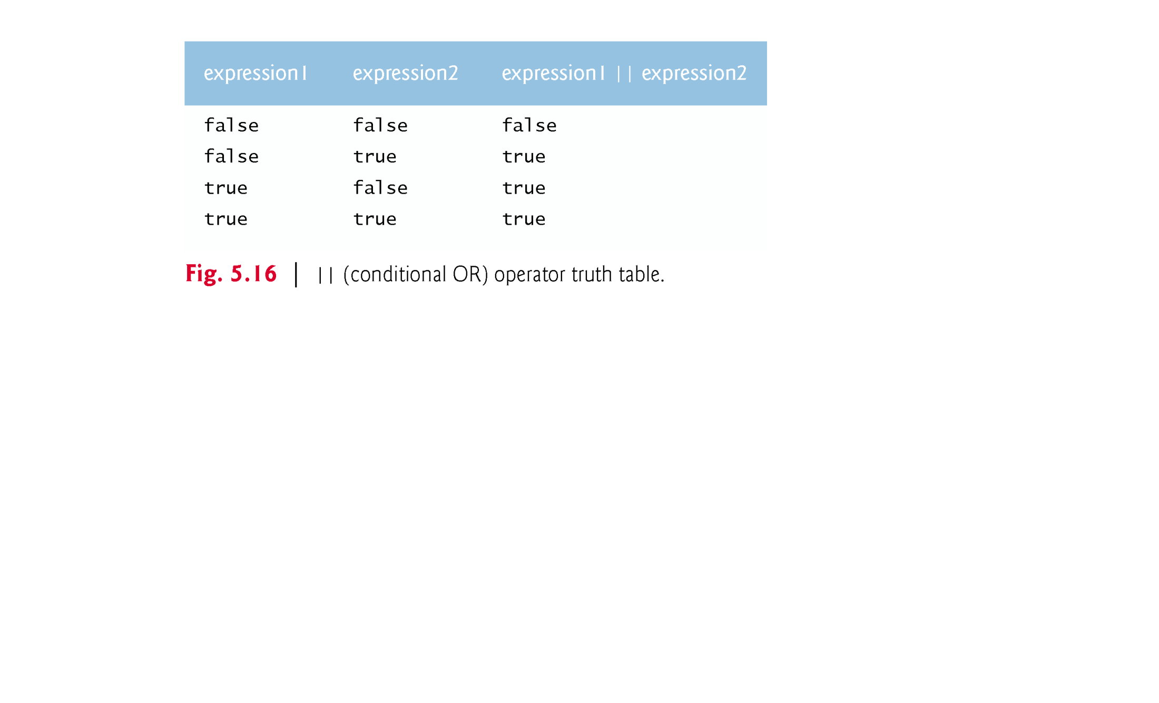

Slide 48
5.9 Logical Operators (Cont.)
The parts of an expression containing && or || operators are evaluated only until it’s known whether the condition is true or false. T
This feature of conditional AND and conditional OR expressions is called short-circuit evaluation.

Slide 49
5.9 Logical Operators (Cont.)
The boolean logical AND (&) and boolean logical inclusive OR (|) operators are identical to the && and || operators, except that the & and | operators always evaluate both of their operands (i.e., they do not perform short-circuit evaluation).
This is useful if the right operand has a required side effect—a modification of a variable’s value.

Slide 50
5.9 Logical Operators (Cont.)
A simple condition containing the boolean logical exclusive OR (^) operator is true if and only if one of its operands is true and the other is false.
If both are true or both are false, the entire condition is false.
Figure 5.17 is a truth table for the boolean logical exclusive OR operator (^).
This operator is guaranteed to evaluate both of its operands.

Slide 51
5.9 Logical Operators (Cont.)
The ! (logical NOT, also called logical negation or logical complement) operator “reverses” the meaning of a condition.
The logical negation operator is a unary operator that has only one condition as an operand.
The logical negation operator is placed before a condition to choose a path of execution if the original condition (without the logical negation operator) is false.
In most cases, you can avoid using logical negation by expressing the condition differently with an appropriate relational or equality operator.
Figure 5.18 is a truth table for the logical negation operator.

Slide 52
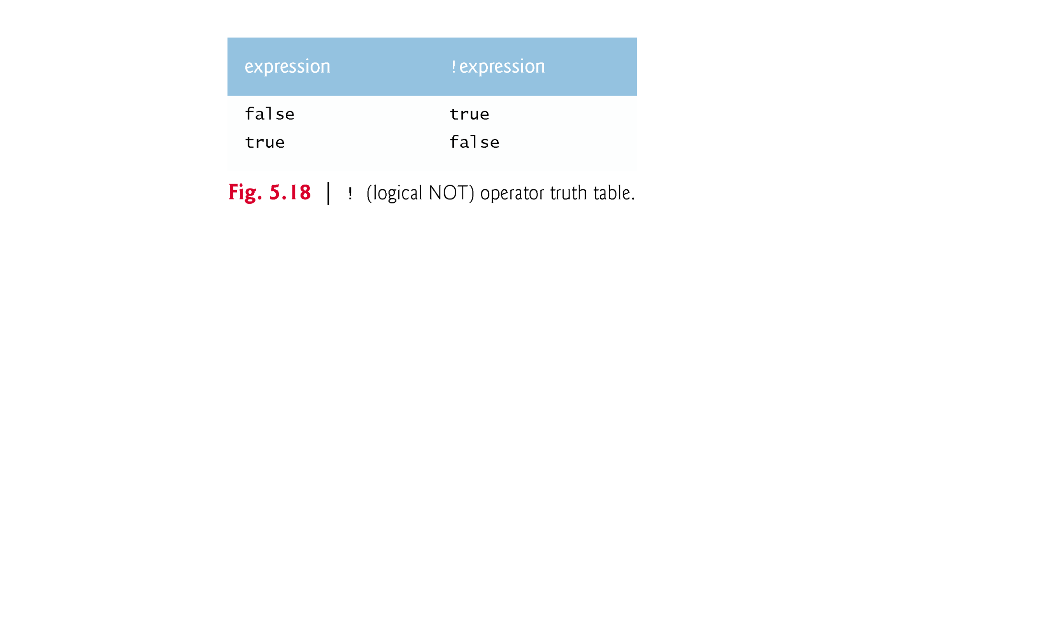

Slide 53
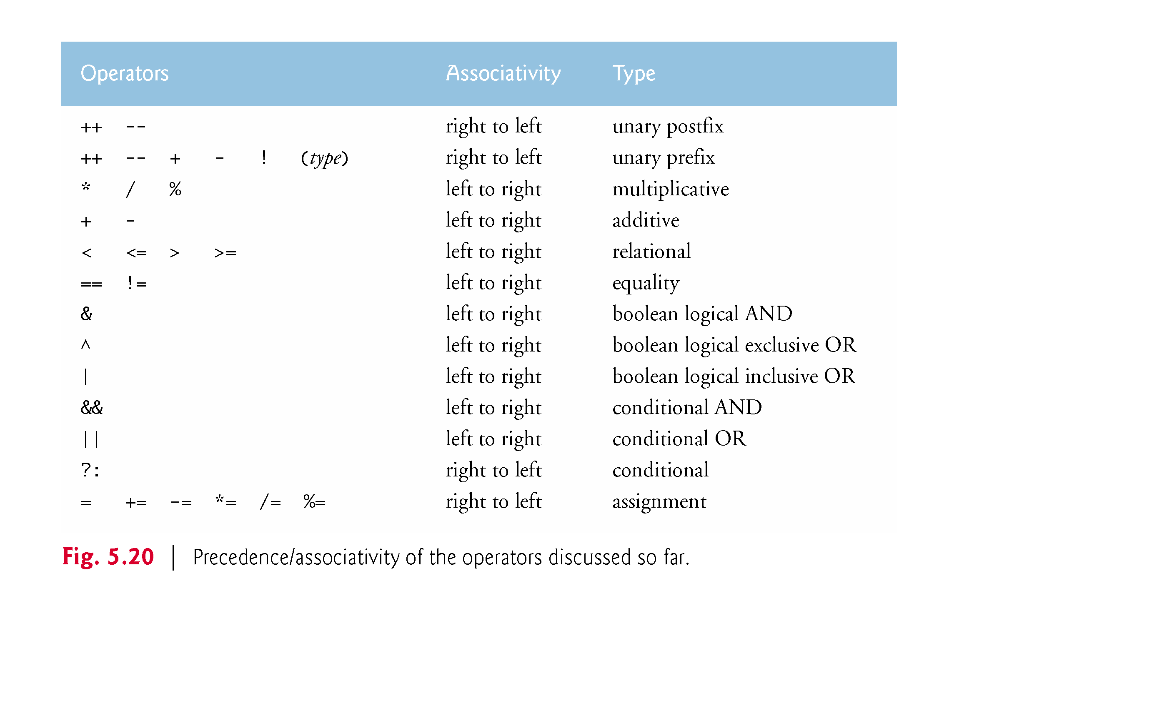

Slide 54
5.10 Structured Programming Summary
Java includes only single-entry/single-exit control statements—there is only one way to enter and only one way to exit each control statement.
Connecting control statements in sequence to form structured programs is simple. The final state of one control statement is connected to the initial state of the next—that is, the control statements are placed one after another in a program in sequence. We call this control-statement stacking.
The rules for forming structured programs also allow for control statements to be nested.

Slide 55
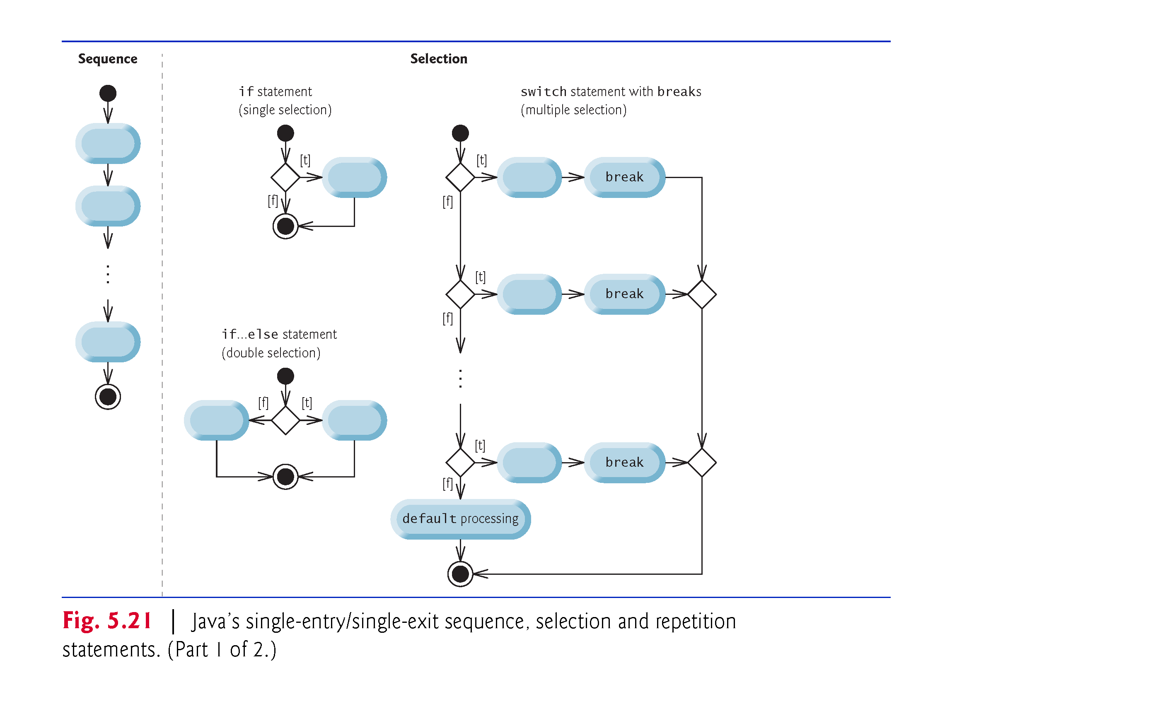

Slide 56
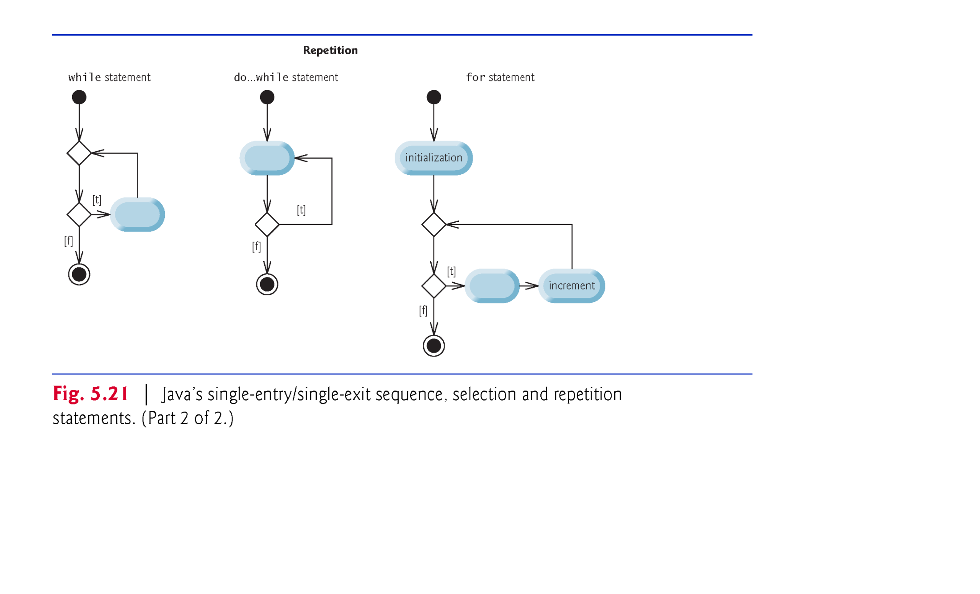

Slide 57
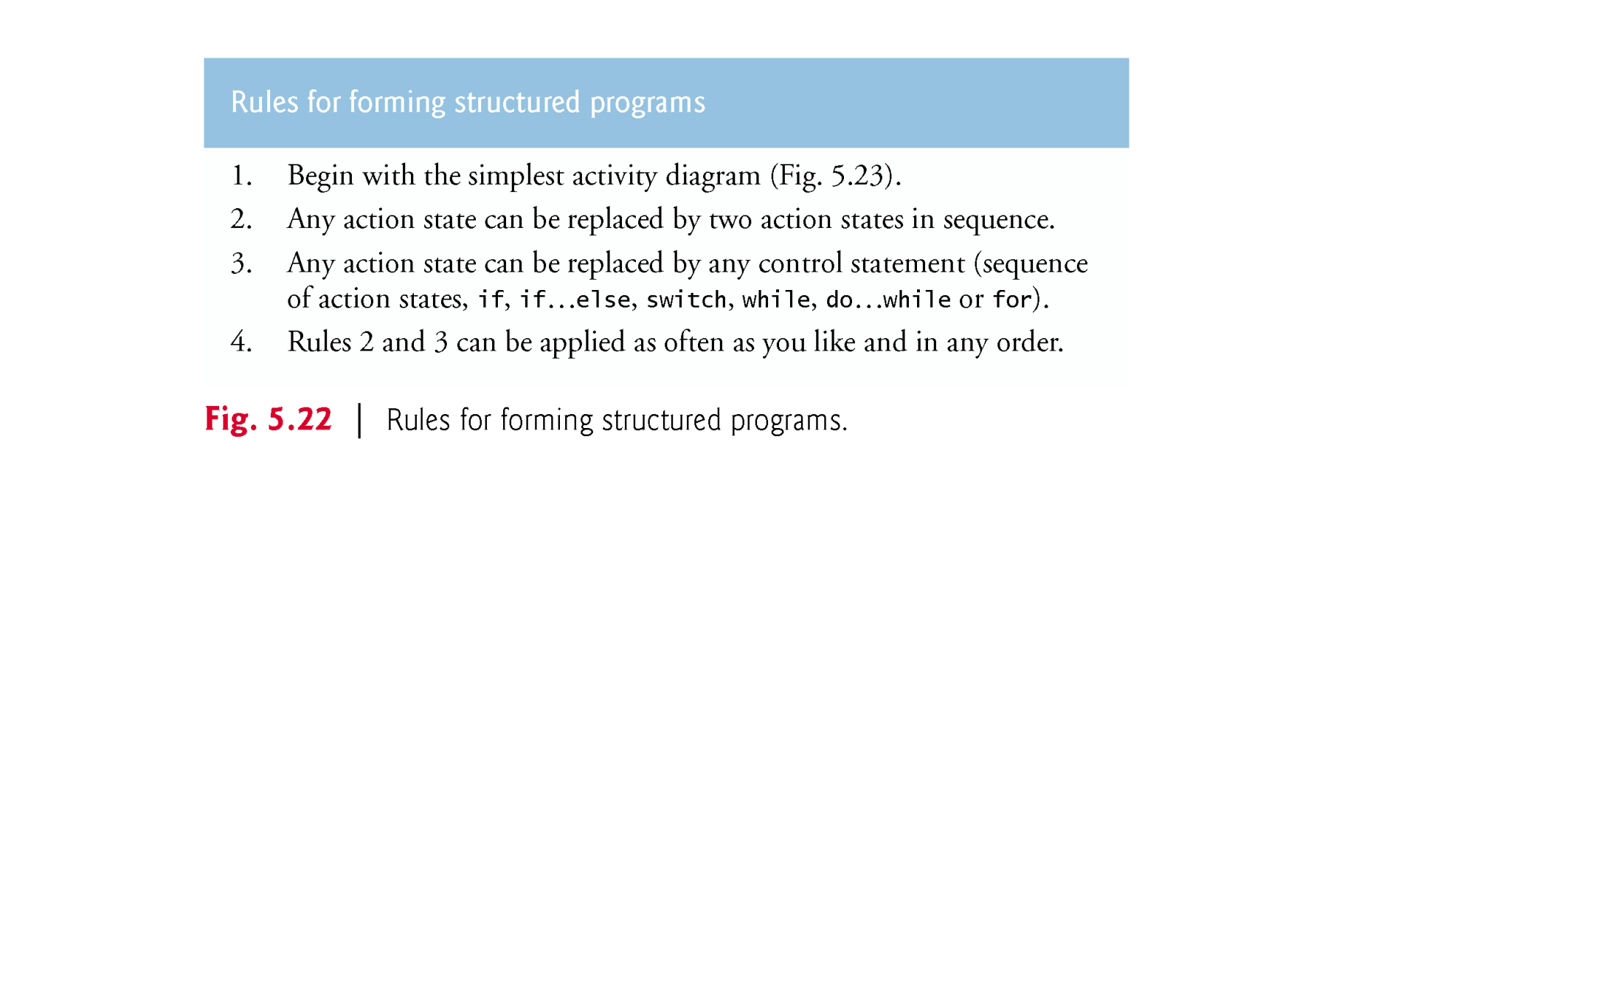

Slide 58
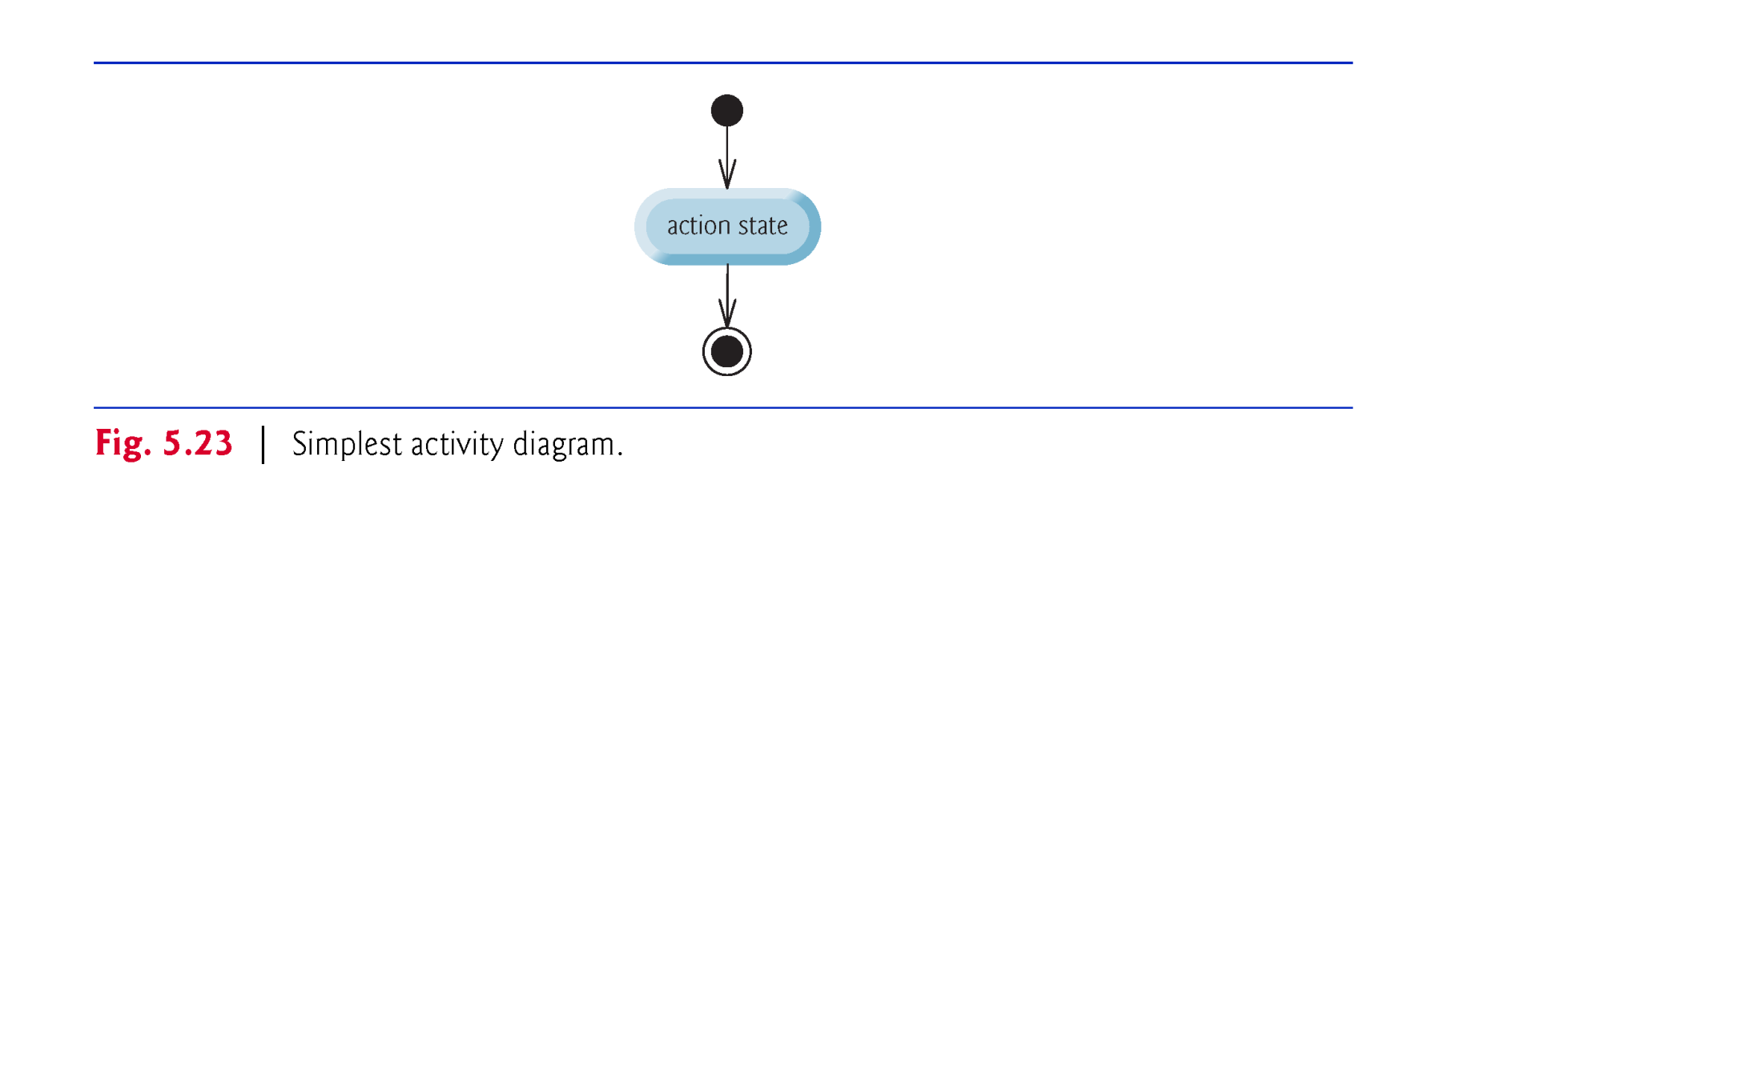

Slide 59
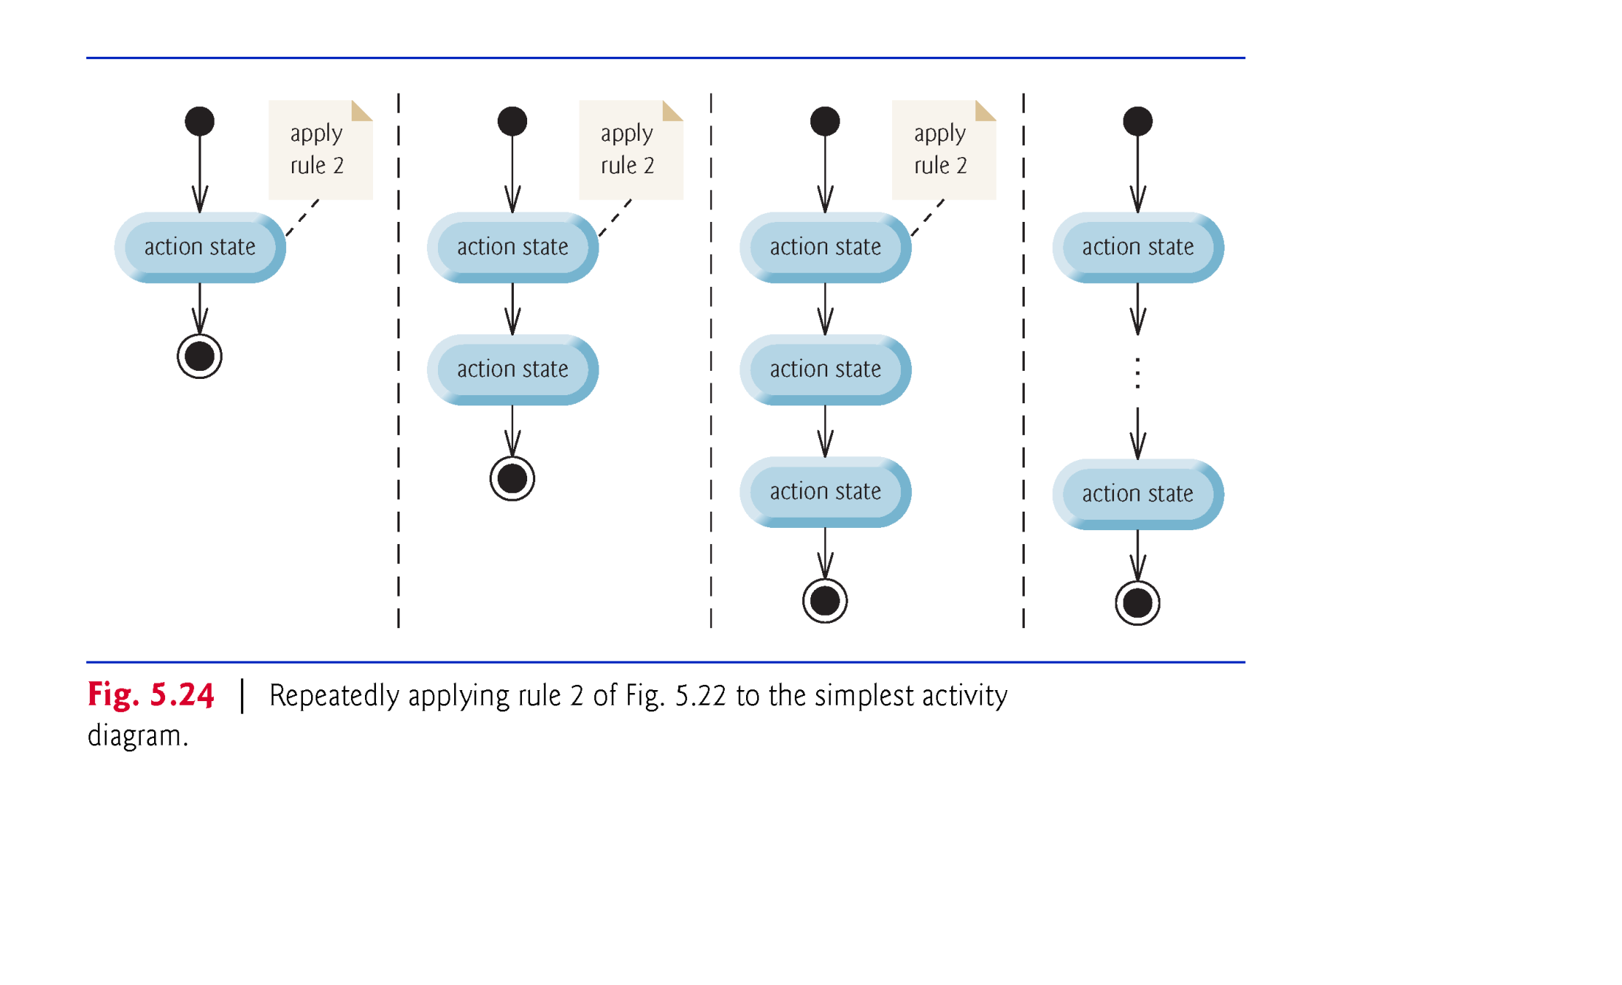

Slide 60
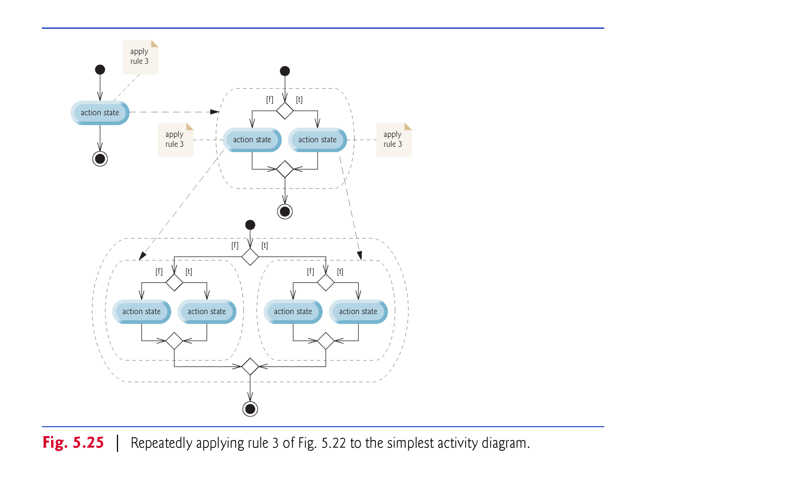

Slide 61
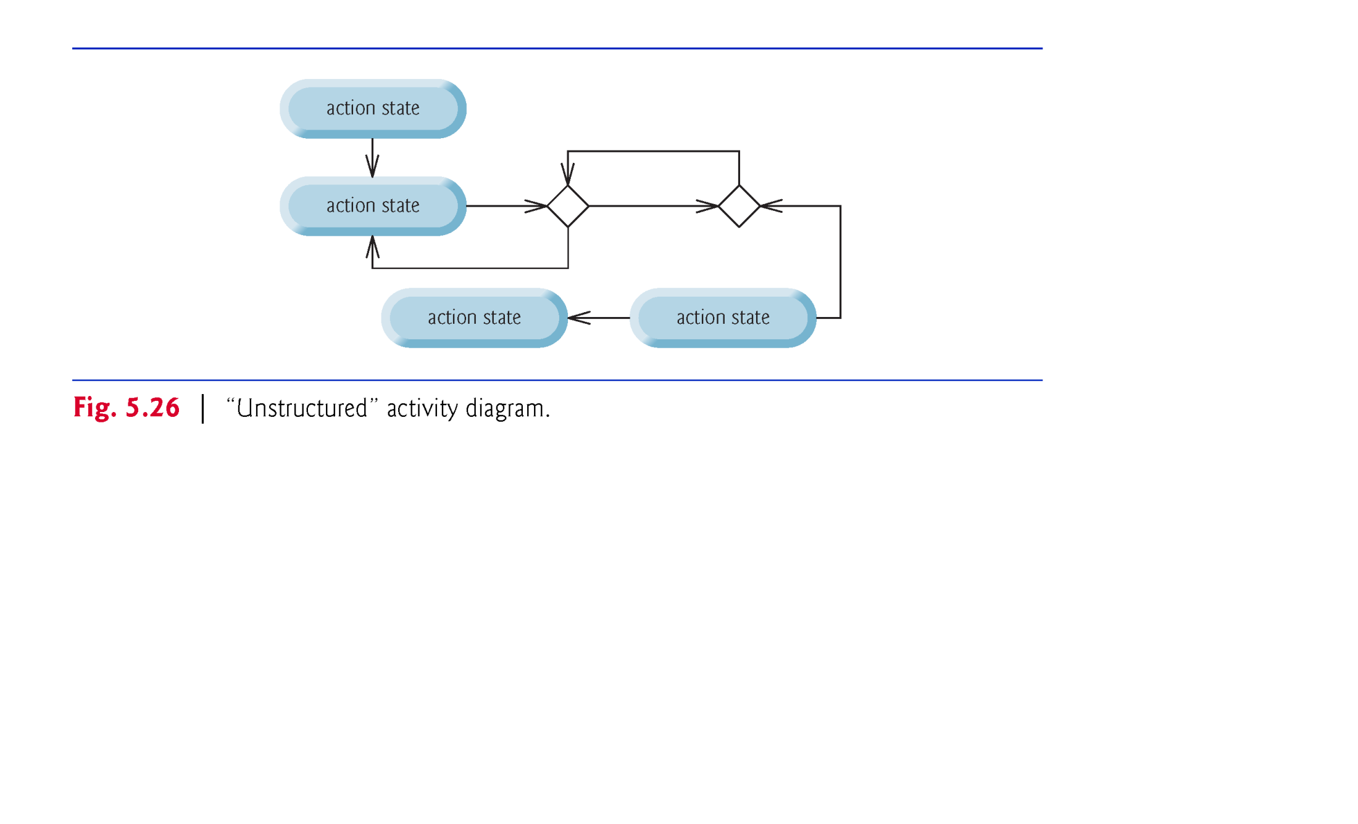

Slide 62
5.10 Structured Programming Summary (Cont.)
Structured programming promotes simplicity.
Bohm and Jacopini: Only three forms of control are needed to implement an algorithm:
sequence
selection
repetition
The sequence structure is trivial. Simply list the statements to execute in the order in which they should execute.

Slide 63
5.10 Structured Programming Summary (Cont.)
Selection is implemented in one of three ways:
if statement (single selection)
if…else statement (double selection)
switch statement (multiple selection)
The simple if statement is sufficient to provide any form of selection—everything that can be done with the if…else statement and the switch statement can be implemented by combining if statements.

Slide 64
5.10 Structured Programming Summary (Cont.)
Repetition is implemented in one of three ways:
while statement
do…while statement
for statement
The while statement is sufficient to provide any form of repetition. Everything that can be done with do…while and for can be done with the while statement.

Slide 65
5.10 Structured Programming Summary (Cont.)
Combining these results illustrates that any form of control ever needed in a Java program can be expressed in terms of
sequence
if statement (selection)
while statement (repetition)
and that these can be combined in only two ways—stacking and nesting.

