Slide 1
Programming Fundamentals – Arrays
Module 3: Java Arrays
Unit 2

Slide 2
Module 3 - Unit 2 Objectives
Learn about arrays
Explore how to declare and manipulate data into arrays
Understand the meaning of “array index out of bounds”
Become familiar with the restrictions on array processing
Discover how to pass an array as a parameter to a method

Slide 3
Array Definition
Definition: structured data type with a fixed number of elements
Elements of an array are also called components of the array
Every element is of the same type
Elements are accessed using their relative positions in the array

Slide 4
Arrays Declaration & Initialization
The general form to declare a one-dimensional array is:
dataType[] arrayName; //Line 1
where dataType is the element type
The general syntax to instantiate an array object is:
arrayName = new dataType[intExp];
where intExp is any expression that evaluates to a positive integer. Also, the value of intExp specifies the number of elements in the array.
You can combine the statements in Lines 1 and 2 into one statement as follows:
dataType[] arrayName = new dataType[intExp];

Slide 5
Accessing Array Elements
The general form (syntax) used to access an array element is:
arrayName[indexExp]
where indexExp, called the index, is an expression whose value is a nonnegative integer less than the size of the array
In Java, [] is an operator called the array subscripting operator.

Slide 6
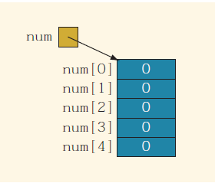
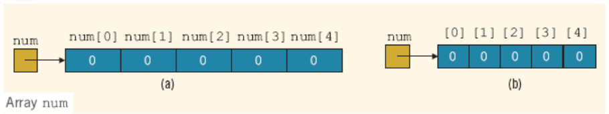
Declaring & Creating Array Consisting of 5 Elements
int[] num = new int[5];
declares and creates the array num consisting of 5 elements.
Each element is of type int.
The elements are accessed as num[0], num[1], num[2], num[3], and num[4].

Slide 7
Accessing Array Elements
The general form (syntax) used to access an array element is:
arrayName[indexExp]
where indexExp, called the index, is an expression whose value is a nonnegative integer less than the size of the array.
In Java, [] is an operator called the array subscripting operator
int[] list = new int[10];

Slide 8
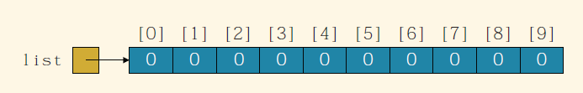
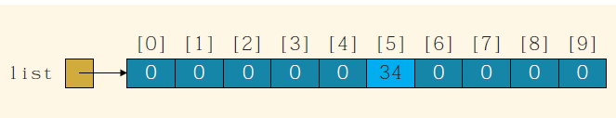
Accessing Array Elements (2)
Consider the following statement:
int[] list = new int[10];
The assignment statement:
list[5] = 34;
stores 34 into list[5], which is the sixth element of the array list

Slide 9
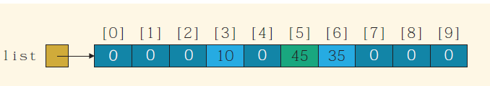
Array List After Assignment Element Values
consider the following statements:
list[3] = 10;
list[6] = 35;
list[5] = list[3] + list[6];
The first statement stores 10 into list[3], the second statement stores 35 into list[6], and the third statement adds the contents of list[3] and list[6] and stores the result into list[5]

Slide 10
Declare a named constant as Array Argument List
You can also declare arrays as follows:
final int ARRAY_SIZE = 10;
int[] list = new int[ARRAY_SIZE];
That is, you can first declare a named constant of an integral type, such as int, and then use the value of the named constant to specify the size of the array.

Slide 11
Specifying Array Size during Program Execution
During program execution, you can first prompt the user to specify the size of the array and then instantiate the object.
int arraySize; //Line 1
System.out.print("Enter the size of the array: "); //Line 2
arraySize = console.nextInt(); //Line 3
System.out.println(); //Line 4
int[] list = new int[arraySize]; //Line 5

Slide 12
Array Initialization during Declaration
the following Java statement declares an array, sales, of five elements and initializes those elements to specific values:
double[] sales = {12.25, 32.50, 16.90, 23, 45.68};
The initializer list contains values, called initial values, that are placed between braces and separated by commas
sales[0]= 12.25, sales[1]= 32.50, sales[2]= 16.90, sales[3]= 23.00, and sales[4]= 45.68

Slide 13
Array Initialization during Declaration (2)
When declaring and initializing arrays, the size of the array is determined by the number of initial values within the braces
If an array is declared and initialized simultaneously, we do not use the operator new to instantiate the array object

Slide 14
Arrays and the Instance Variable length
Associated with each array that has been instantiated, there is a public (final) instance variable length
The variable length contains the size of the array
The variable length can be directly accessed in a program using the array name and the dot operator
int[] list = {10, 20, 30, 40, 50, 60};
This statement creates the array list of six elements and initializes the elements using the values given. Here, list.length is 6.

Slide 15
Arrays and the Instance Variable length (2)
This statement creates the array list of six components and initializes the components using the values given
Here list.length is 6
int[] numList = new int[10];
This statement creates the array numList of 10 components and initializes each component to 0
Because the number of elements of numList is 10, the value of numList.length is 10.

Slide 16
Arrays and the Instance Variable length (3)
The value of numList.length is 10
numList[0] = 5;
numList[1] = 10;
numList[2] = 15;
numList[3] = 20;
These statements store 5, 10, 15, and 20, respectively, in the first four components of numList
You can store the number of filled elements, that is, the actual number of elements, in the array in a variable, say numOfElement
It is a common practice for a program to keep track of the number of filled elements in an array

Slide 17
Array Size
Once an array is instantiated, its size remains fixed. In other words, if you have instantiated an array of 5 elements, the number of elements of the array remains 5.
If you need to increase the size of the array, then you must instantiate another array of the desired size and copy the data stored in the first array into the new array.

Slide 18
Operations Performed on an Array
Some basic operations performed on a one-dimensional array are
initializing the array,
reading data into the array,
storing output data in the array, and
finding the largest and/ or smallest element in the array Loops used to step through elements in array and perform operations
double[] sales = new double[10];
int index;
double largestSale, sum, average;
for (int index = 0; index < sales.length; index++) {
sales[index] = 10.00;
}

Slide 19
Processing An Arrays
int[] list = new int[100]; //list is an array of size 100
The following for loop steps through each element of the array list, starting at the first element of list:
for (int count = 0; count < list.length; count++) //process list[count]
The following statements read 100 numbers from the keyboard and store the numbers into list:
for (int count = 0; count < list.length; count++) {
list[count] = console.nextInt();
}
The following for loop outputs the elements of list:
for (int count = 0; count < list.length; count++) {
System.out.print(list[count] + " ");
}

Slide 20
Array Index Out of Bounds
In Java, if an array index goes out of bounds during program execution, it throws an ArrayIndexOutOfBoundsException exception. If the program does not handle this exception, the program terminates with an appropriate error message.
Array in bounds if:
0 <= index <= arraySize – 1
If index < 0 or index > arraySize:
ArrayIndexOutOfBoundsException exception is thrown
Base address: memory location of first component in array

Slide 21
Declaring Arrays as Formal Parameters to Methods
Just like other data types, you can declare arrays as formal parameters to methods. A general syntax to declare an array as a formal parameter is:
dataType[] arrayName
public static void arraysAsFormalParameter(int[] listA, double[] listB, int num) {
//...
}
int[] intList = new int[10];
double[] doubleNumList = new double[15];
int number;
The following statement calls the method with actual parameters intList, doubleNumList, and number
arraysAsFormalParameter(intList, doubleNumList, number);

Slide 22
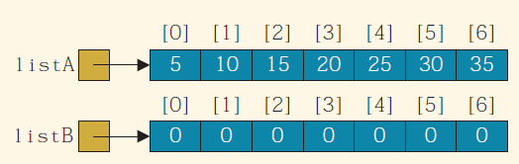
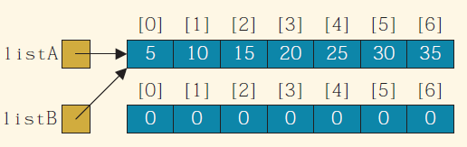
The Assignment Operators and Arrays
Consider the following statements:
int[] listA = {5, 10, 15, 20, 25, 30, 35}; //Line 1
int[] listB = new int[listA.length]; //Line 2
You can use the assignment operator to assign listA to listB and the relational operators to compare listA with listB. However, the results obtained might not be what you expect.
listB = listA;
Because listA is a reference variable, its value is a reference, that is, a memory address. Therefore, the preceding statement copies the value of listA into listB, and so after this statement executes, both listA and listB refer to the same array. this is called the shallow copying of data.

Slide 23
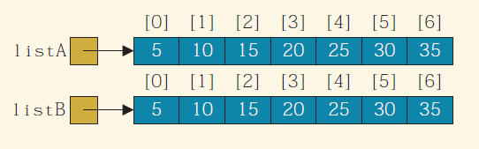
The Assignment Operators and Arrays (2)
To copy the elements of listA into the corresponding elements of listB, you need to provide an element-by-element copy, as shown by the following loop:
for (int index = 0; index < listA.length; index++)
listB[index] = listA[index];
After this statement executes, listA and listB each refers to its own array and the elements of listA are copied into the corresponding elements of listB. This is called the deep copying of data.

Slide 24
Relational Operators and Arrays
if (listA == listB)...
The expression listA == listB determines if the values of listA and listB are the same and thus determines whether listA and listB refer to the same array
To determine whether listA and listB contain the same elements, you need to compare them component by component
You can write a method that returns true if two int arrays contain the same elements

Slide 25
Arrays as Parameter Methods
Just like other objects, arrays can be passed as parameters to methods. The following method takes as an argument any int array and outputs the data stored in each element:
public static void printArray(int[] list) {
for (int index = 0; index < list.length; index++)
System.out.print(list[index] + " ");
}
in addition to declaring an array as a formal parameter, we declare another formal parameter specifying the number of valid elements in the array, as in the following method:
public static void printArray(int[] list, int numOfElements)
{
for (int index = 0; index < numOfElements; index++)
System.out.print(list[index] + " ");
}

Slide 26
Searching an Array for a Specific Item
Searching a list for a given item is one of the most common operations performed on a list.
The search algorithm is called the sequential search or linear search.
As the name implies, you search the array sequentially starting from the first array element.
You compare searchItem with the elements in the array (the list) and continue the search until either you find the item or no more data is left in the list to compare with searchItem.
Suppose that you want to determine whether 27 is in the list
First you compare 27 with list[0]
Because list[0] ≠ 27, you then compare 27 with list[1]
Because list[1] ≠ 27, you compare 27 with list[2]; because list[2] = 27, the search stops
This search is successful

Slide 27

Searching an Array for a Specific Item
Suppose that you want to determine whether 27 is in the list
First you compare 27 with list[0]
Because list[0] ≠ 27, you then compare 27 with list[1]
Because list[1] ≠ 27, you compare 27 with list[2]; because list[2] = 27, the search stops
This search is successful

Slide 28
Searching an Array for a Specific Item (2)
Let’s now search for 10
Search starts at the first element in the list, that is, at list[0]
This time, the search item, which is 10, is compared with every item in the list; eventually, no more data is left in the list to compare with the search item; this is an unsuccessful search

Slide 29
Array Sequential search Method
public static int seqSearch(int[] list, int listLength, int searchItem) {
int loc;
boolean found = false;
loc = 0;
while (loc < listLength && !found) {
if (list[loc] == searchItem)
found = true;
else
loc++;
}
if (found) {
return loc;
}
else
return -1;
}

Slide 30
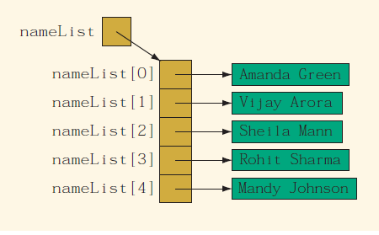
Array of String Objects
String[] nameList = new String[5];
nameList[0] = "Amanda Green";
nameList[1] = "Vijay Arora";
nameList[2] = "Sheila Mann";
nameList[3] = "Rohit Sharma";
nameList[4] = "Mandy Johnson";

Slide 31
Arrays and Variable Length Parameter List
Java provides a variable length formal parameter (list). The syntax to declare a variable length formal parameter (list) is:
dataType ... Identifier
where dataType is the name of a type.
This statement declares numList to be a variable length formal parameter. In fact, numList is an array wherein each element is of type double, and the number of elements in list depends on the number of arguments passed to numList.

Slide 32
Arrays and Variable Length Parameter List (2)

Slide 33
foreach Loop
One way to process the elements of an array one-by-one, starting at the first element, is to use an index variable, initialized to 0, and a loop.
For example, to process the elements of an array, list, you can use a for loop, such as the following:
for (int index; index < list.length; index++)
The syntax to use this for loop to process the elements of an array is:
for (dataType identifier : arrayName) {
statements
}
identifier is a variable, and the data type of identifier is the same as the data type of the array components

Slide 34
foreach loop (2)
sum = 0;
for (double num : list)
sum = sum + num;
The for statement in Line 2 is read: for each num in list
The identifier num is initialized to list[0]
In the next iteration, the value of num is list[1], and so on
for (double num : numList)
{
if (max < num)
max = num;
}

Slide 35
Unit Summary
Arrays
Definition
Uses
Declaring arrays
Instantiating arrays
Processing arrays
Entire array
Row processing
Column processing
Common operations and methods performed on arrays
Manipulating data in arrays

