Slide 1
Small Store System Presentation
An application for who needs to manage his business systematically in a simple, applied and smart way
By: Ali Torabi , Behnaz Afshar

Slide 2
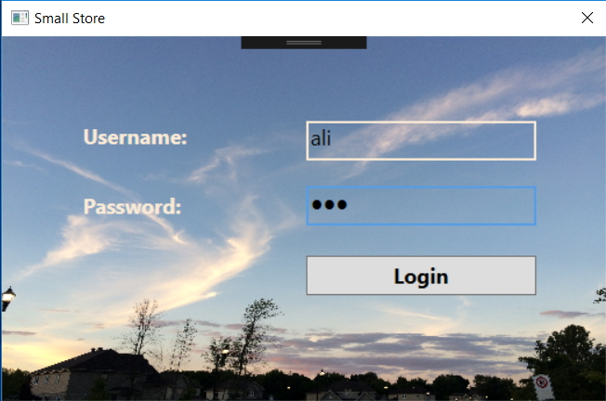
Login page

Slide 3
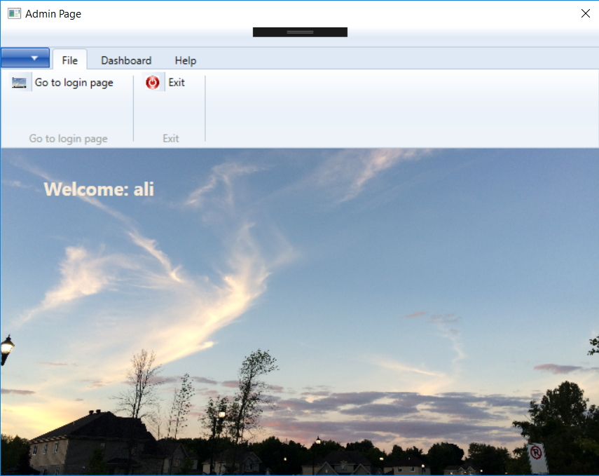
Admin - File

Slide 4
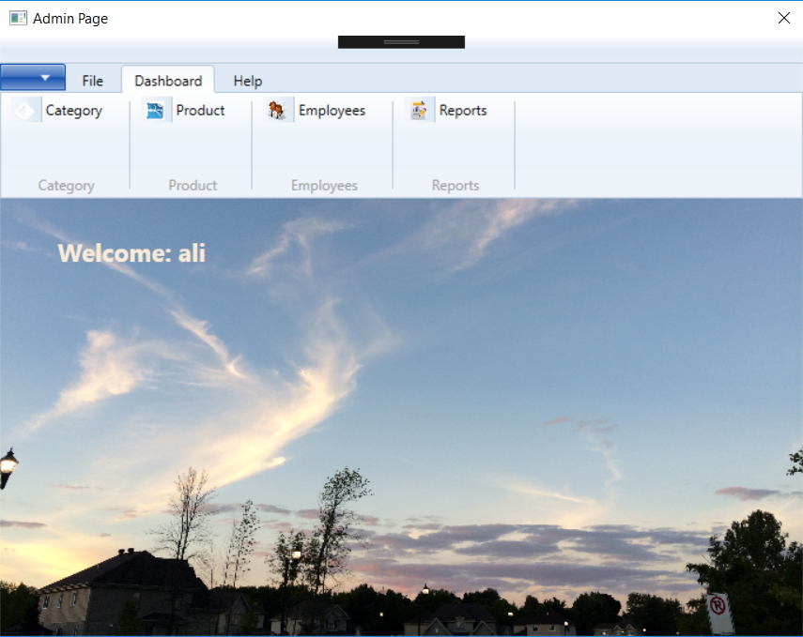
Admin - Dashboard

Slide 5
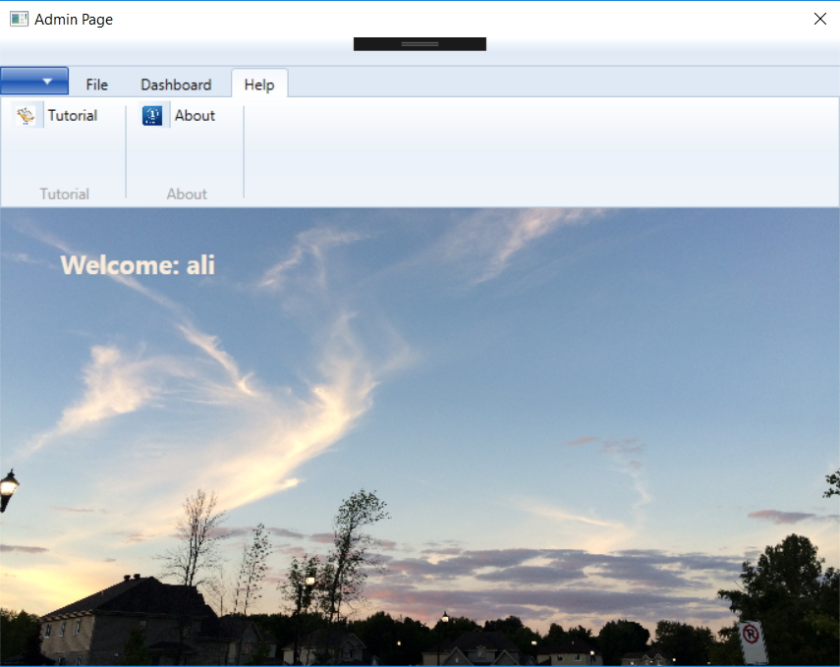
Admin - Help

Slide 6
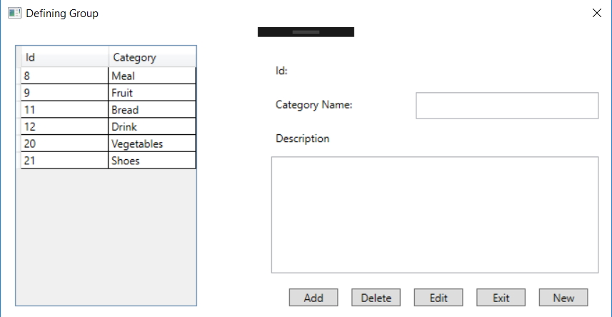
Dashboard - Category

Slide 7
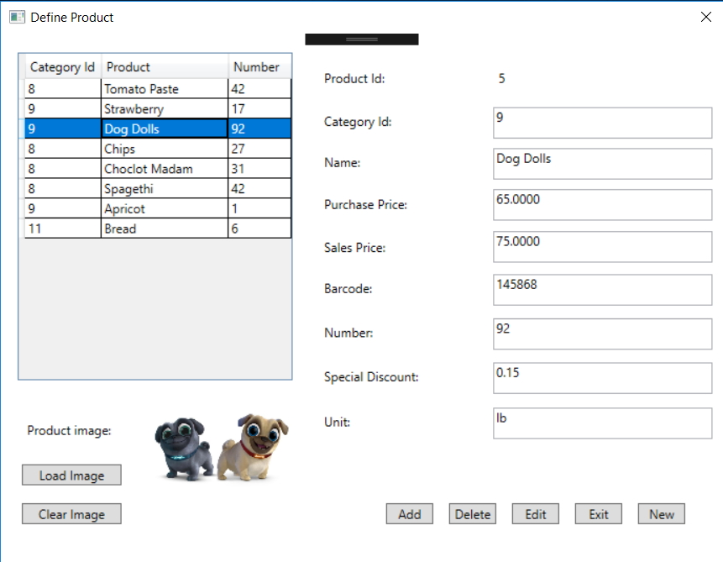
Dashboard - Products

Slide 8
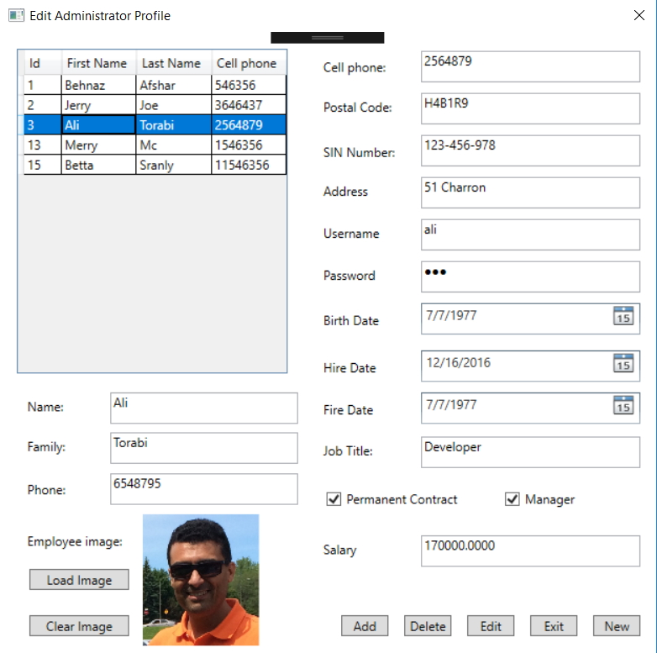
Dashboard - Employee

Slide 9
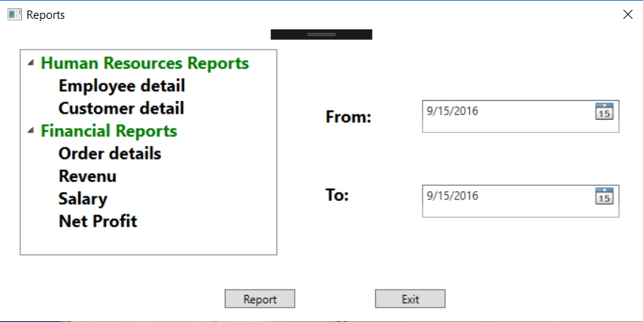
Dashboard - Report

Slide 10
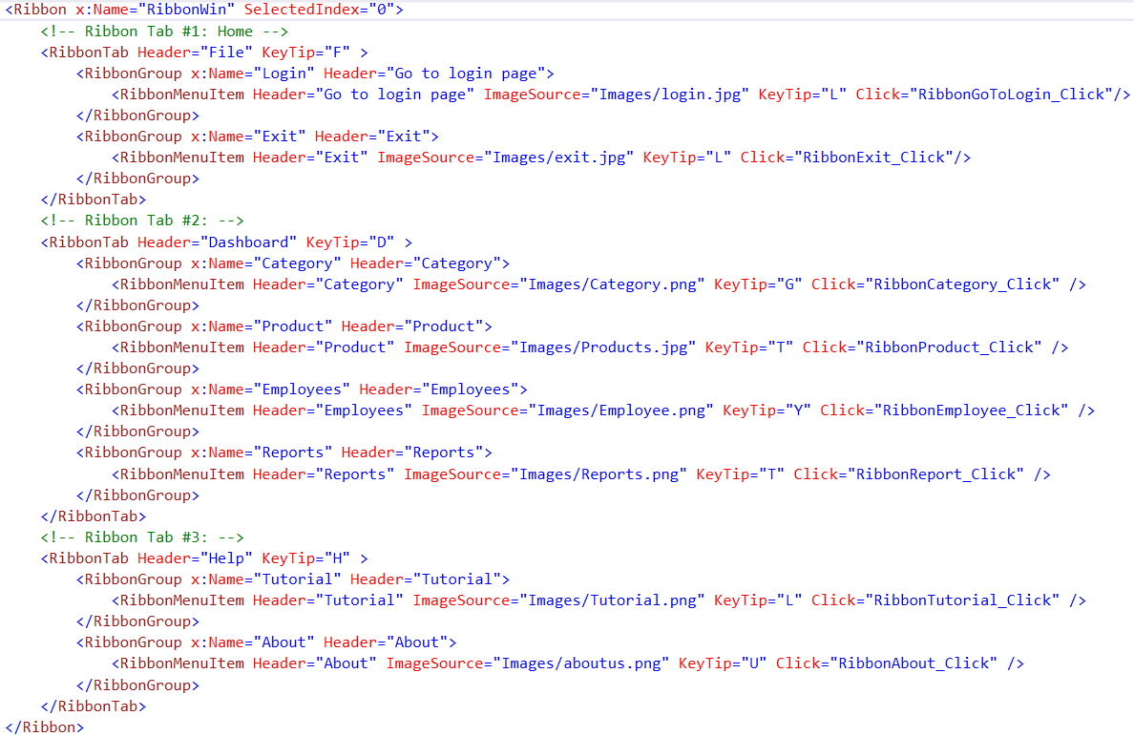
Ribbon challenge

Slide 11
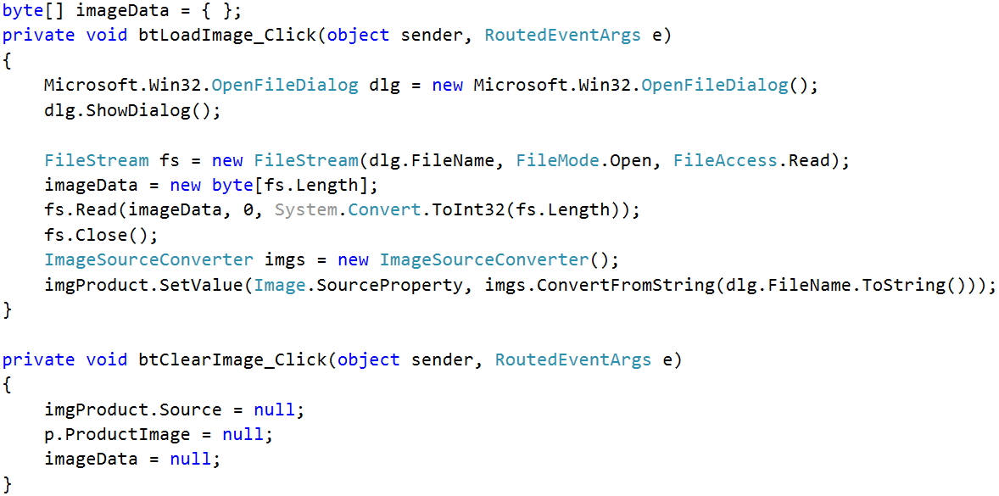
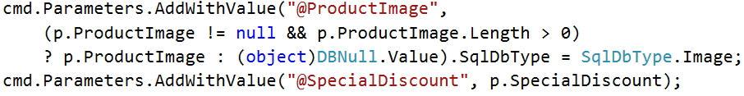
Images & Database challenge

Slide 12
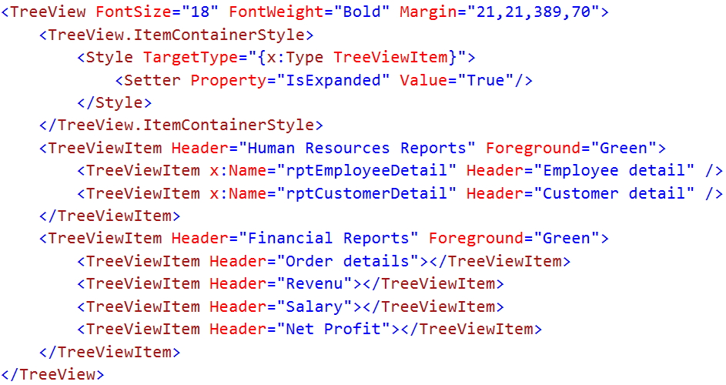
Treeview challenge

Slide 13
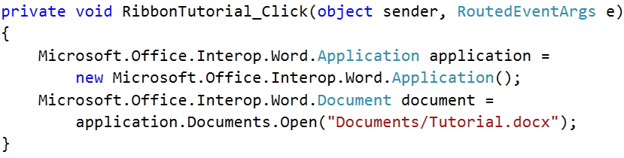
Open a Word or Excel document challenge
We don't have the necessary .dll file to use Microsoft.Office components, so first of all we need to add the dll file:
On the Project menu, click Add Reference.
On the COM tab, locate Microsoft Word or Excel Object Library, and then Select it on the COM tab.
Click OK in the Add References dialog box to accept your selections.
Add the following chunk of code to open the Word document.

Slide 14
For the future
Completing report
Adding a window for about page
Making more powerful search for Order page
Adding Barcode
Making more powerful field checking

