Slide 1
Small Store System Presentation
An application for who needs to manage his business systematically in a simple, applied and smart way
By: Ali Torabi , Behnaz A.Afshar

Slide 2
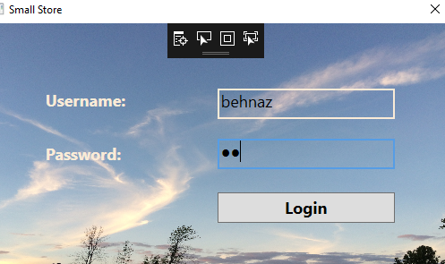
Login page for all employees

Slide 3
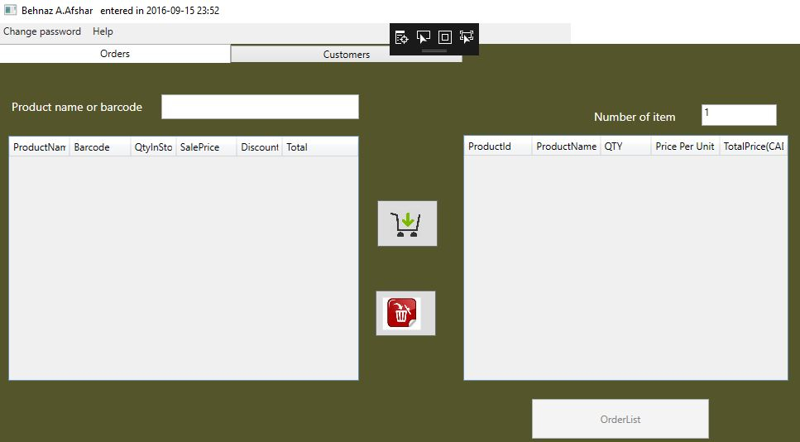
Cashier Form

Slide 4
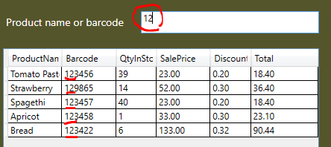
Find product with barcode

Slide 5
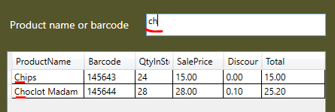
Find product with product name

Slide 6
Main issues in Cashier Side
Calculated values(columns) in Datagrids that don’t exist in DB(in tables)
Db Transaction for submitting customer Order and receipt
Pdf-printing for receipt and reports

Slide 7
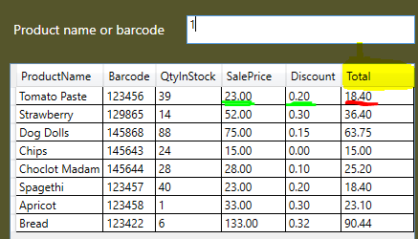
Daily price (Update price)- Calculated column

Slide 8

Price based on quantity of items- Calculated column

Slide 9
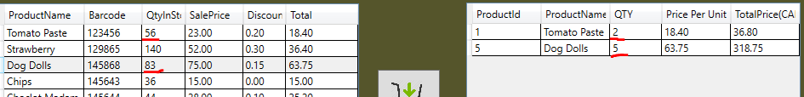
Transfer data between datagrids
Data just add/delete between Ordergrid and Productgrid (just in view) but no change is not happened in tables for real data
All verification about Qty of items in stack and Qty for order items Is considered

Slide 10
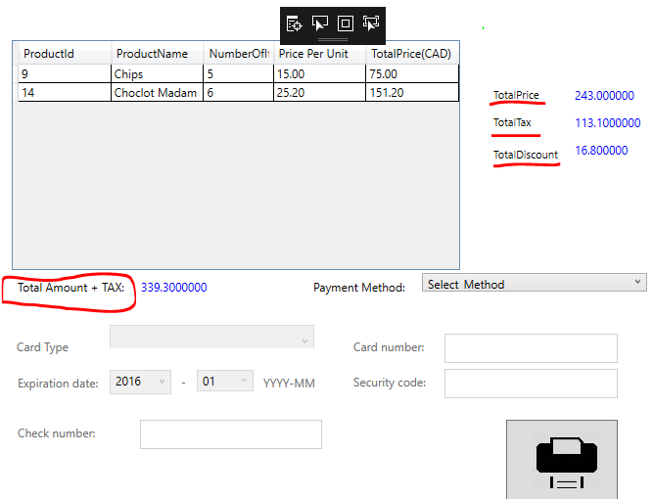
Payment Form
Until now the shopping is not happened after press submit button and view pdf bill if is not any error or exception all data registered in database(shopping happened)

Slide 11
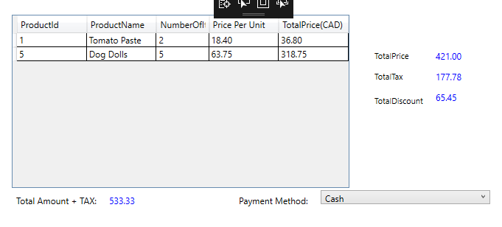
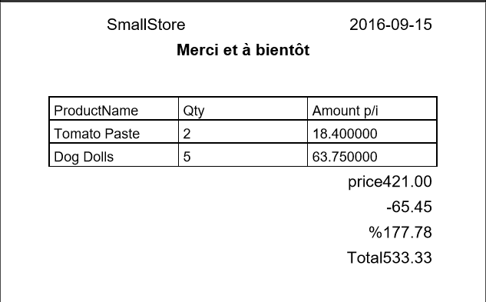
Payment form
Receipt (pdf file)

Slide 12
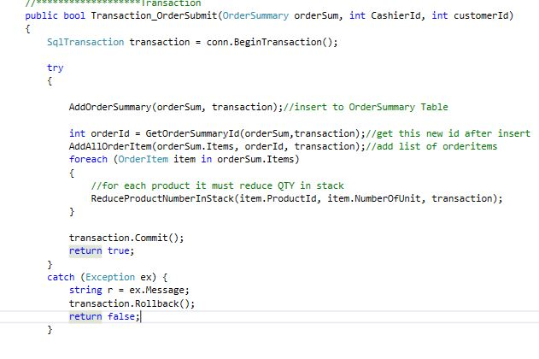
Transaction steps for submit order

Slide 13




