Slide 1
Small Store System Presentation
An application for who needs to manage his business systematically in a simple, applied and smart way
By: Ali Torabi , Behnaz Afshar

Slide 2
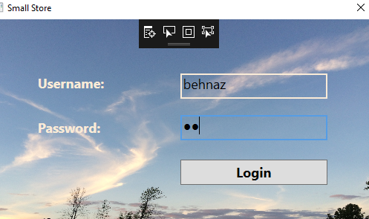
Login page for all employees

Slide 3
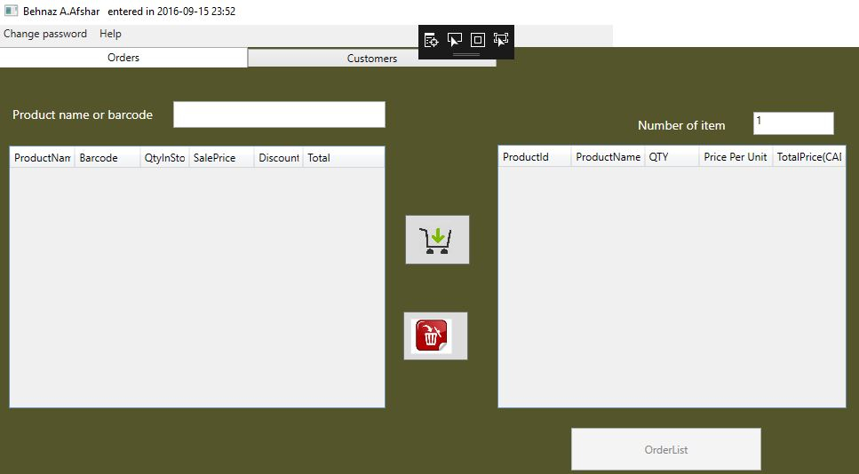
Cashier Form

Slide 4
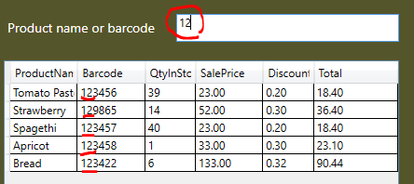
Find product with barcode

Slide 5
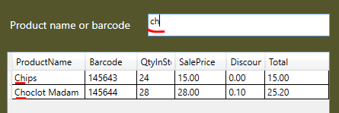
Find product with product name

Slide 6
Main issues in Cashier Side
Calculated values(columns) in Datagrids that don’t exist in DB(in tables)
Db Transaction for submitting customer Order and receipt
Pdf-printing for receipt and reports

Slide 7
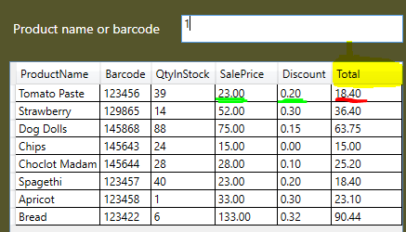
Daily price (Update price)

Slide 8

Price based on quantity of items

Slide 9
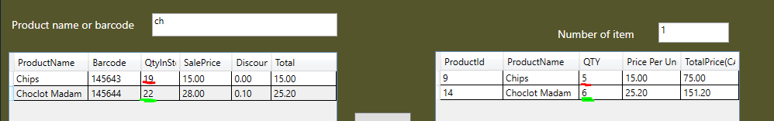
Transfer data between datagrids
Data just add/delete between Ordergrid and Product grid but no change is not happened in tables for real data

