Slide 1
Small Store System Presentation
An application for who needs to manage his business systematically in a simple, applied and smart way
By: Ali Torabi , Behnaz Afshar

Slide 2
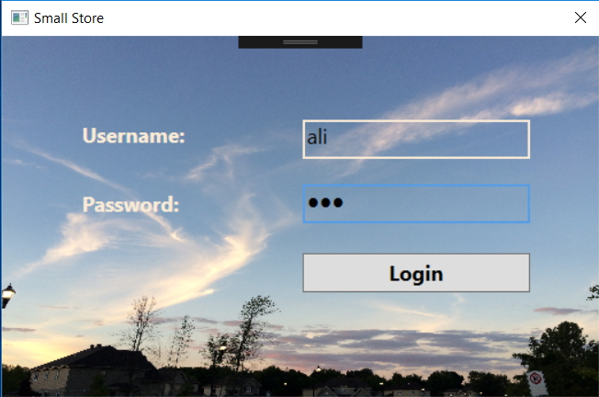
Login page

Slide 3
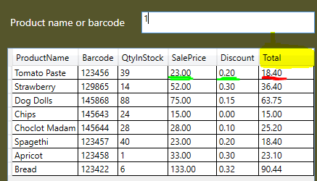

Slide 4
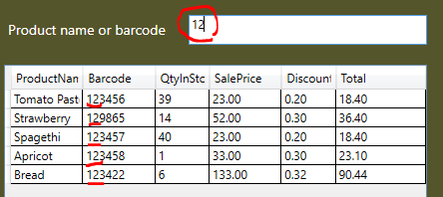

Slide 5
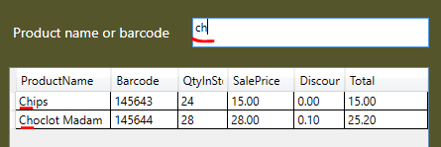

Slide 6
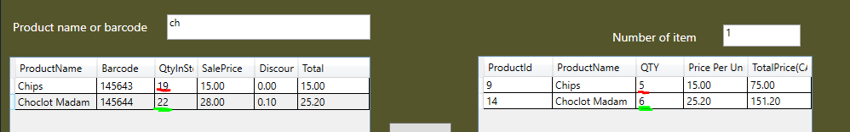

Slide 7


Slide 8
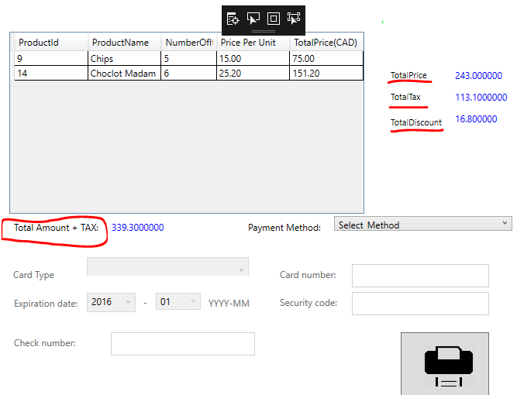

Slide 9
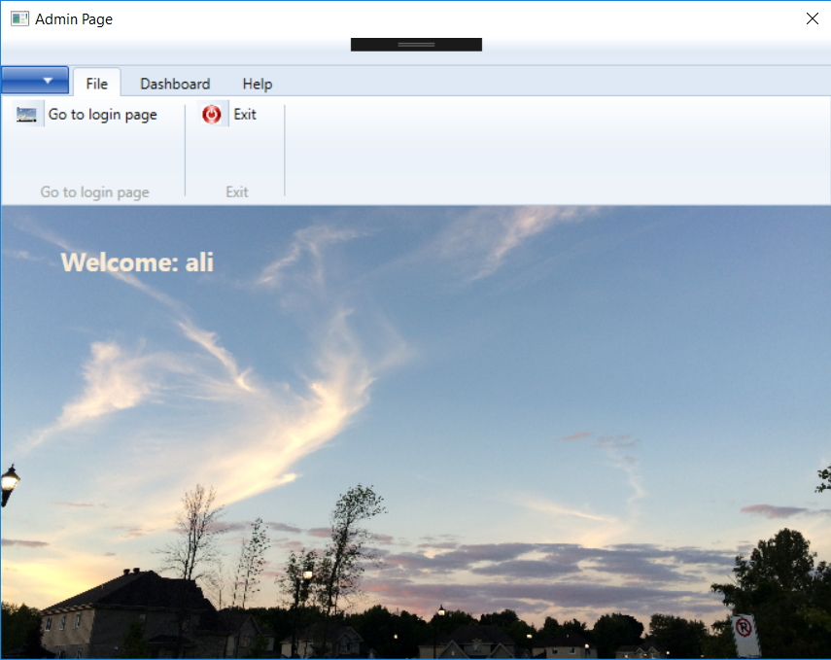
Admin - File

Slide 10
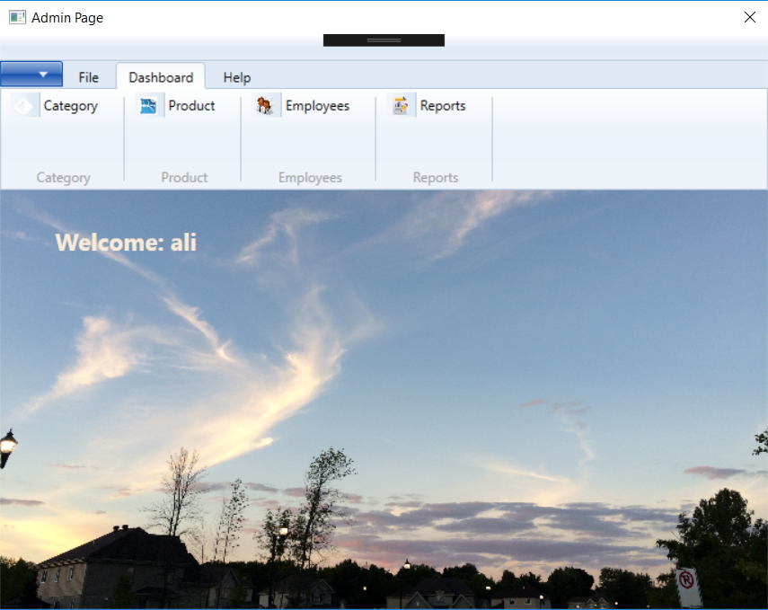
Admin - Dashboard

Slide 11
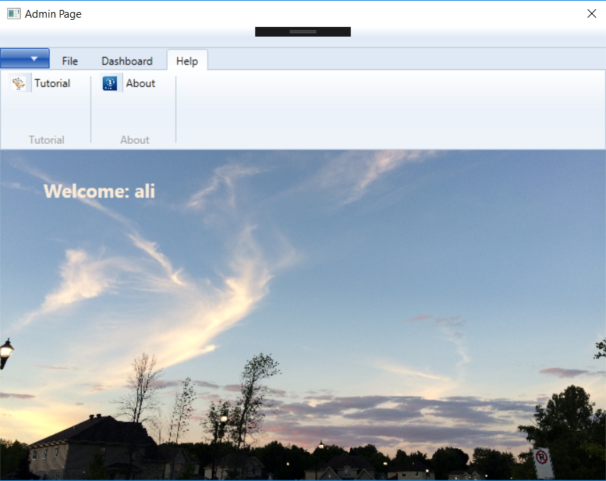
Admin - Help

Slide 12
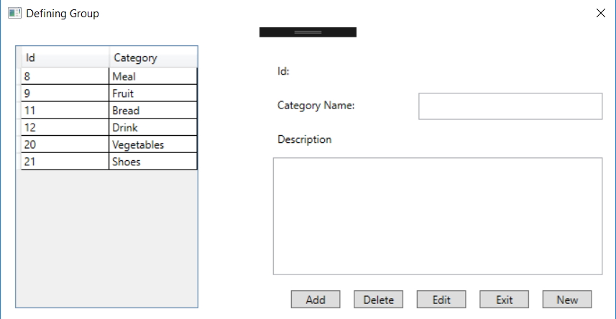
Dashboard - Category

Slide 13
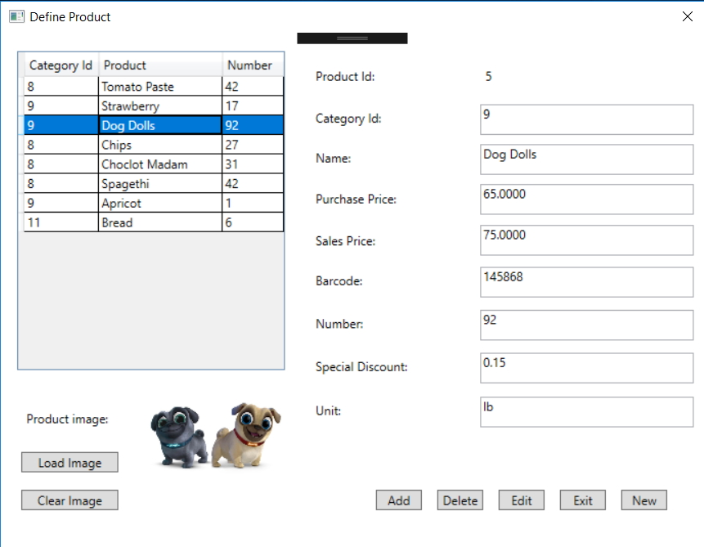
Dashboard - Products

