Slide 1
Small Store System
An application for who needs to manage his business in a simple, applied and smart way
By: Ali Torabi , Behnaz A.Afshar

Slide 2
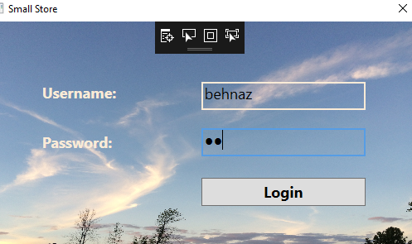
Login page for all employees

Slide 3
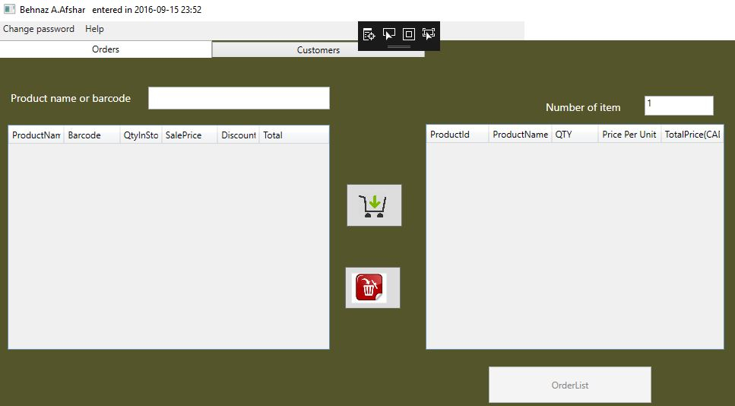
Cashier Form

Slide 4
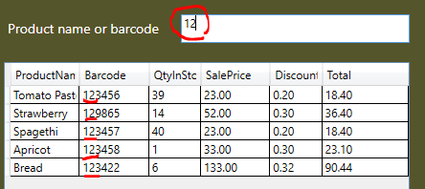
Find product with barcode

Slide 5
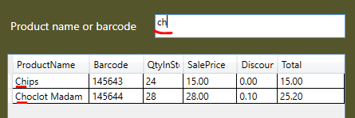
Find product with product name

Slide 6
Main issues in Cashier Side
Calculated values(columns) in Data grids that don’t exist in DB(in tables)
Db Transaction for submitting customer Order and receipt
Pdf-printing for receipt and reports

Slide 7
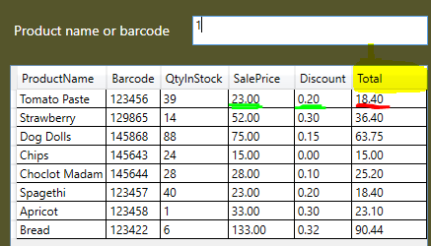
Daily price (Update price)- Calculated column

Slide 8

Price based on quantity of items- Calculated column

Slide 9
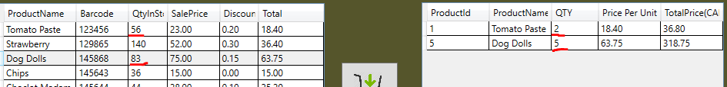
Transfer data between datagrids
Data just add/delete between Order grid and Product grid (just in view) but no change is not happened in tables for real data
All verification about Qty of items in stack and Qty for order items Is considered

Slide 10
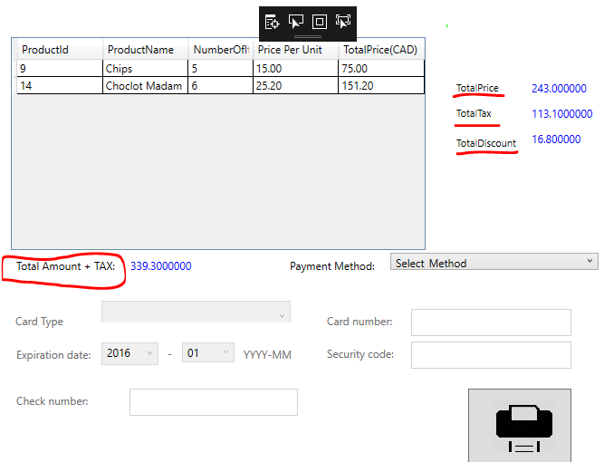
Payment Form
Until now the shopping is not happened after press submit button and view pdf bill if is not any error or exception all data registered in database(shopping happened)

Slide 11
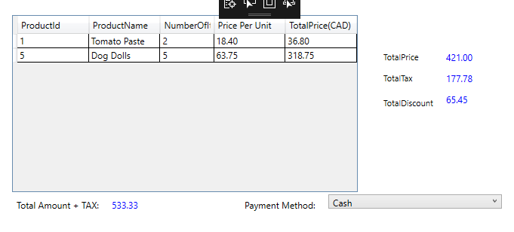
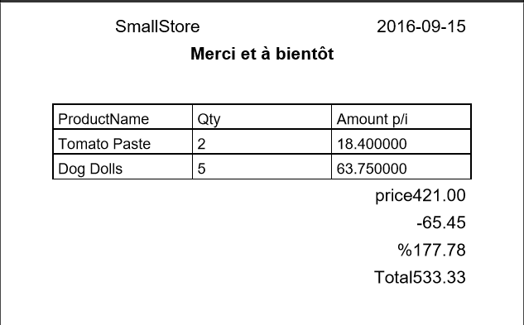
Payment form
Receipt (pdf file)

Slide 12
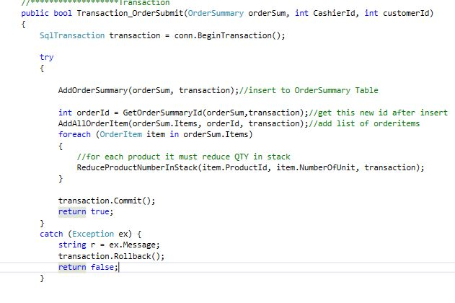
Transaction steps for submit order

Slide 13




Slide 14
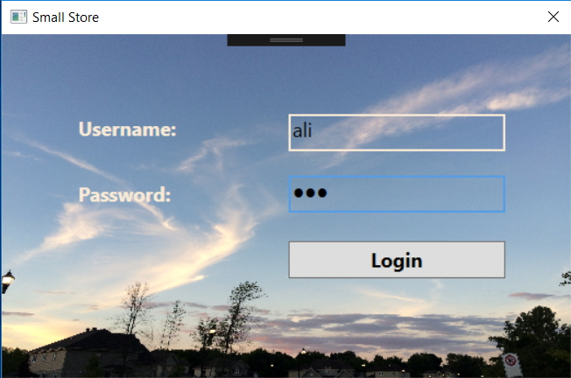
Login page

Slide 15
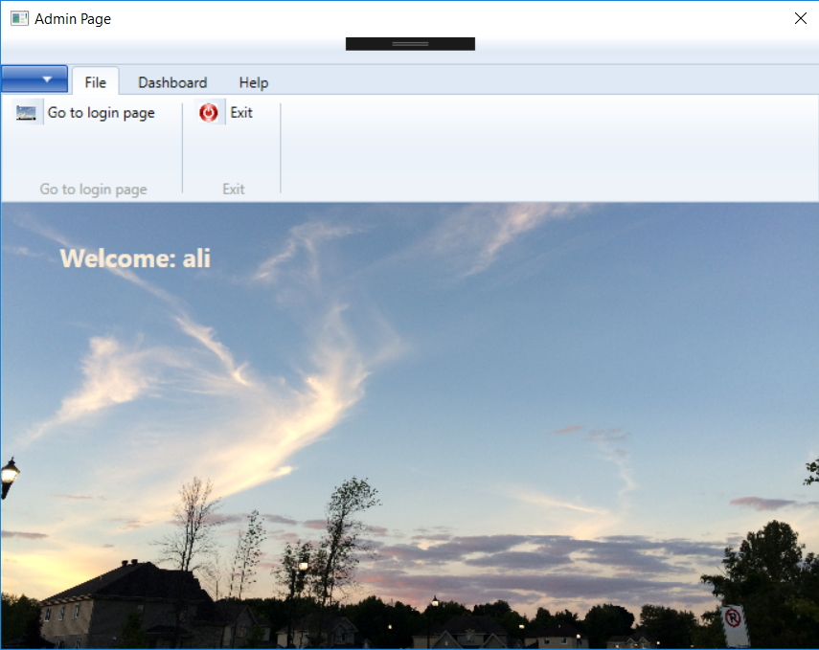
Admin - File

Slide 16
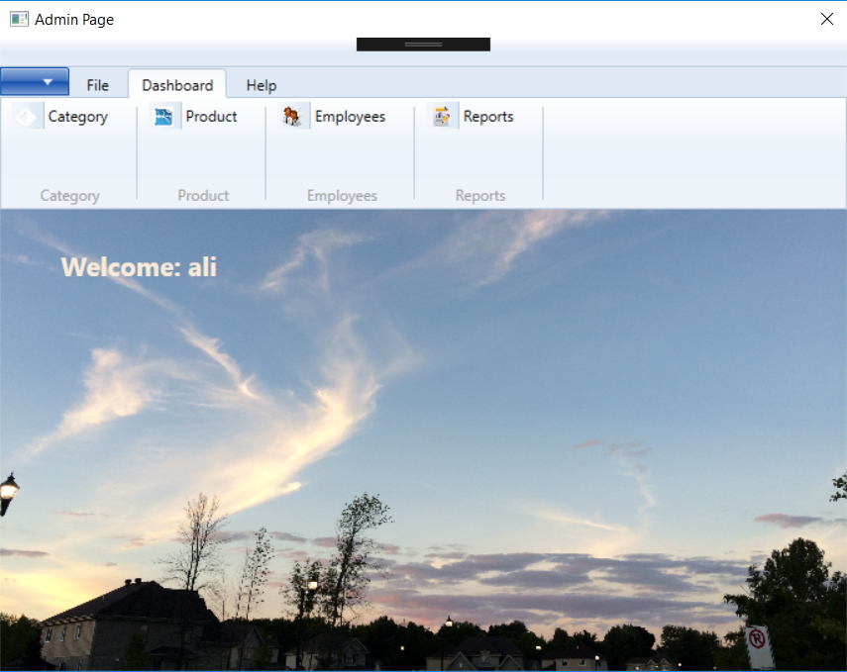
Admin - Dashboard

Slide 17
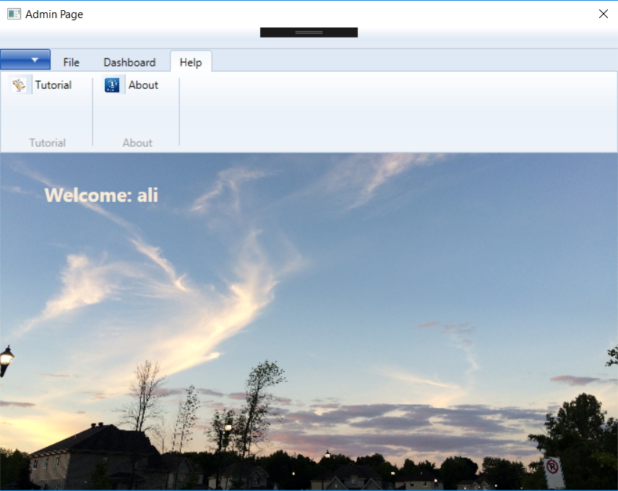
Admin - Help

Slide 18
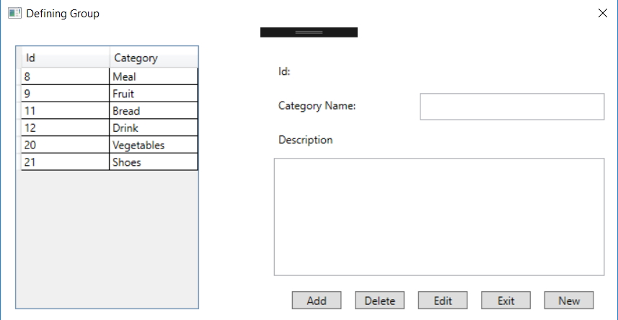
Dashboard - Category

Slide 19
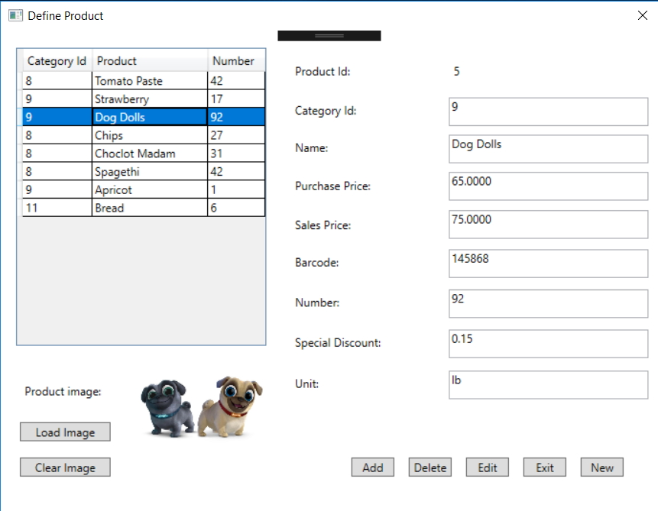
Dashboard - Products

Slide 20
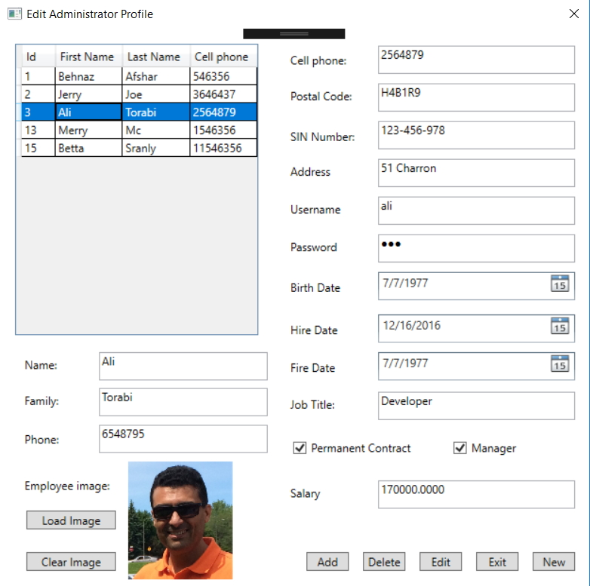
Dashboard - Employee

Slide 21
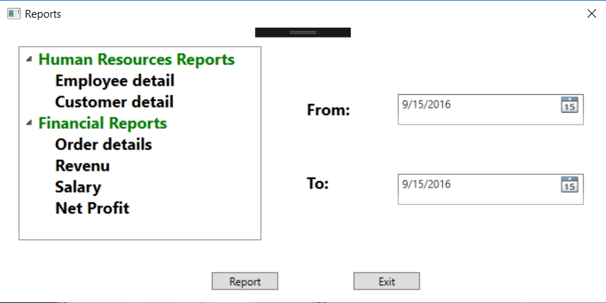
Dashboard - Report

Slide 22
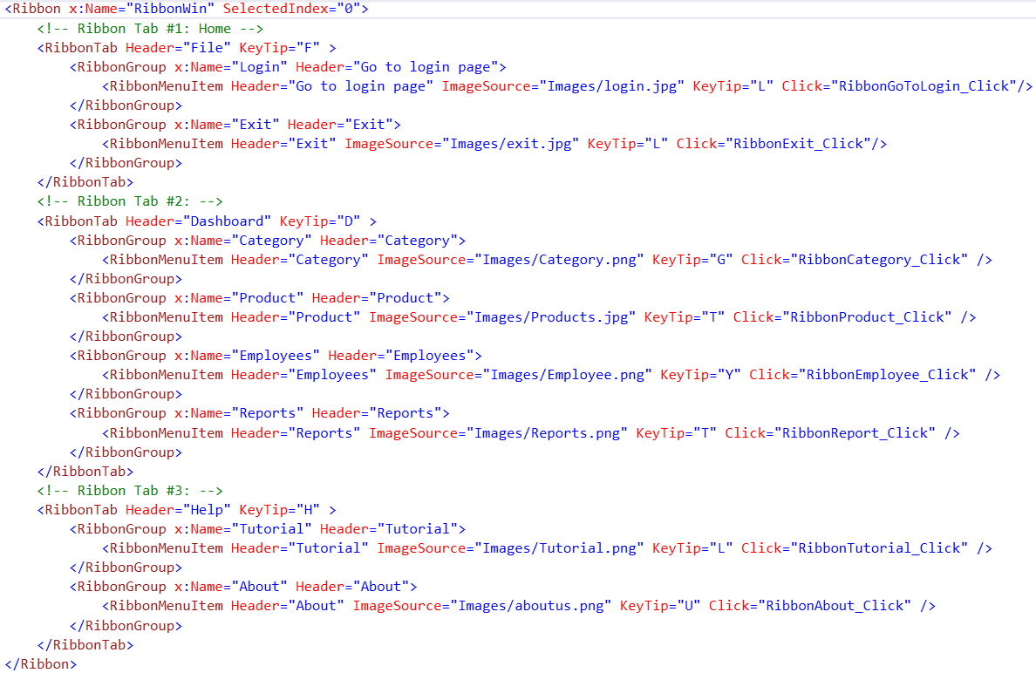
Ribbon challenge

Slide 23
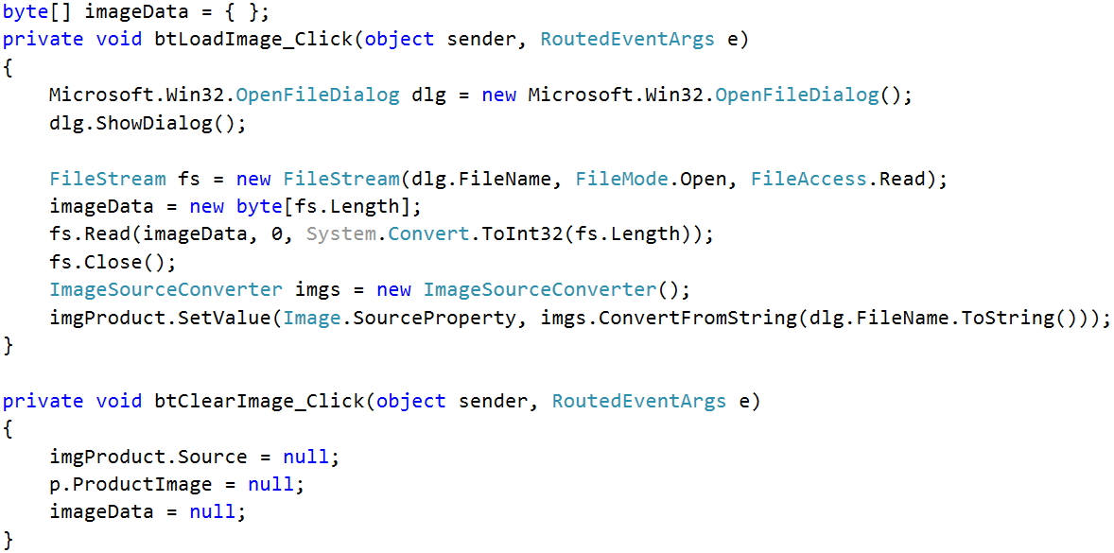
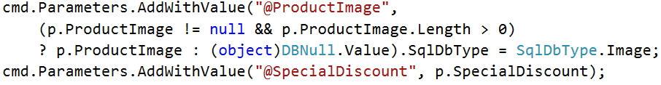
Images & Database challenge

Slide 24
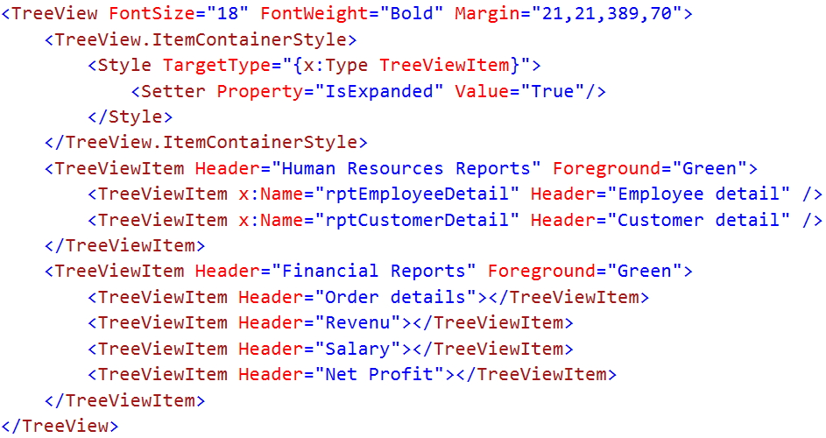
Treeview challenge

Slide 25
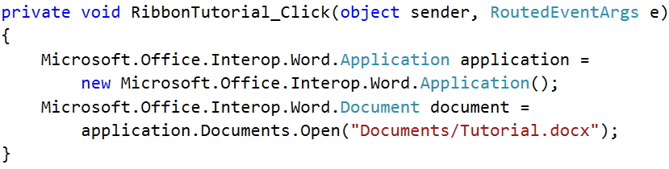
Open a Word or Excel document challenge
We don't have the necessary .dll file to use Microsoft.Office components, so first of all we need to add the dll file:
On the Project menu, click Add Reference.
On the COM tab, locate Microsoft Word or Excel Object Library, and then Select it on the COM tab.
Click OK in the Add References dialog box to accept your selections.
Add the following chunk of code to open the Word document.

Slide 26
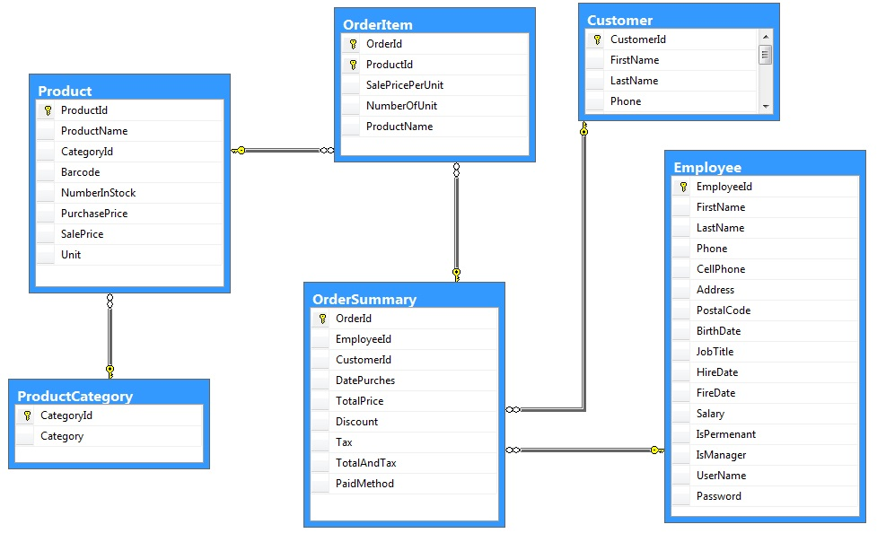
Data Model

Slide 27
For the future
Completing report (such as financial, HR, …)
Adding a window for about page
Making more powerful search for Order page
Adding Barcode
Making more powerful field checking

