Slide 1
Small Store System Presentation
An application for who needs to manage his business systematically in a simple, applied and smart way
By: Ali Torabi , Behnaz Afshar

Slide 2
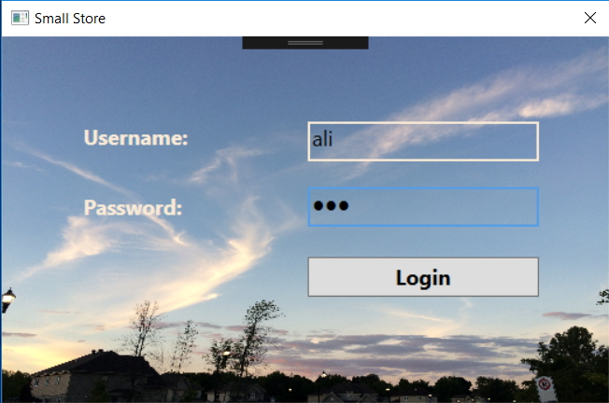
Login page

Slide 3
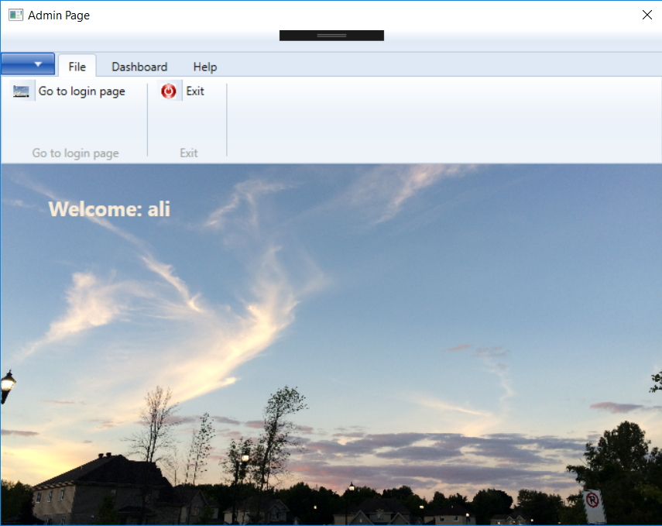
Admin - File

Slide 4
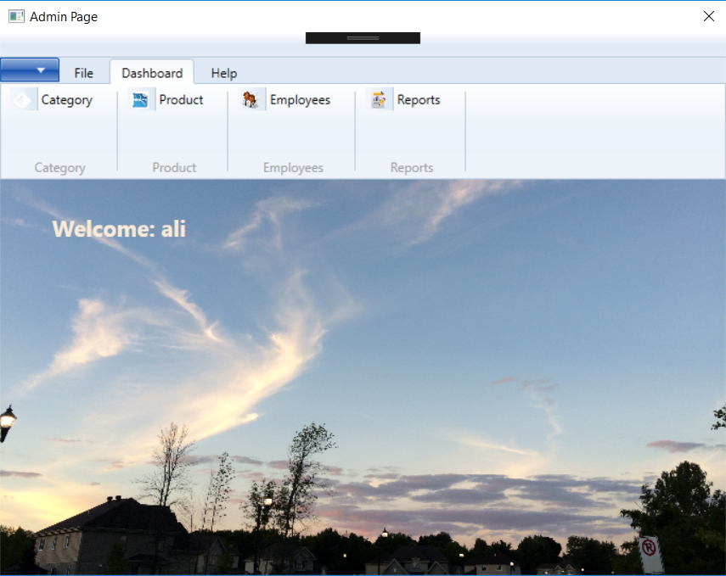
Admin - Dashboard

Slide 5
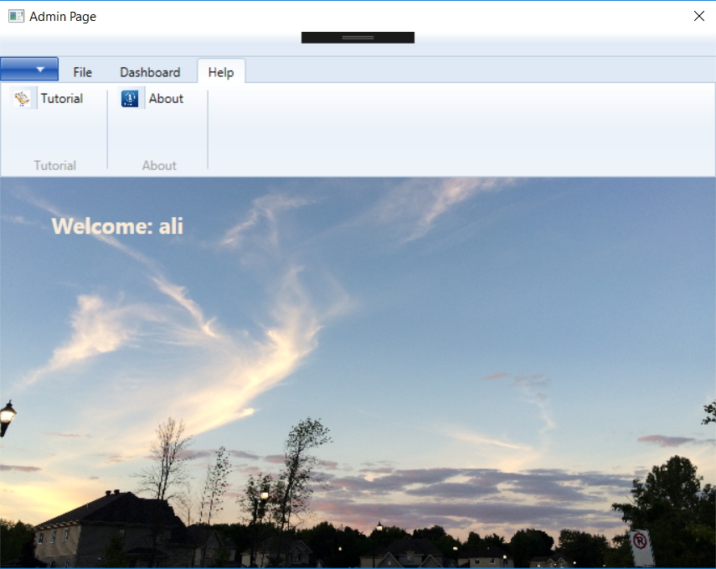
Admin - Help

Slide 6
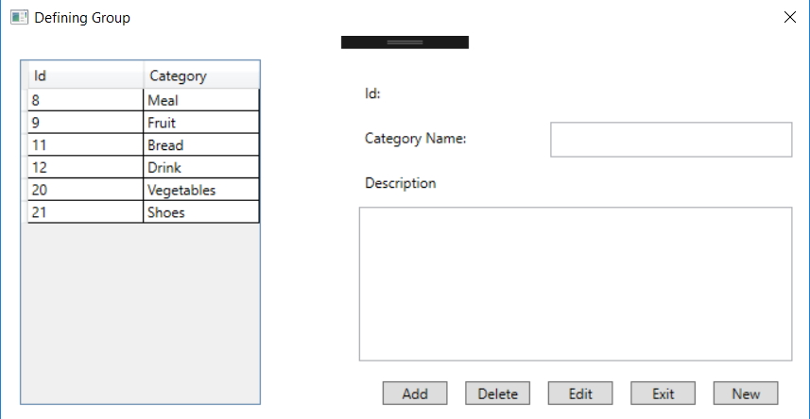
Dashboard - Category

Slide 7
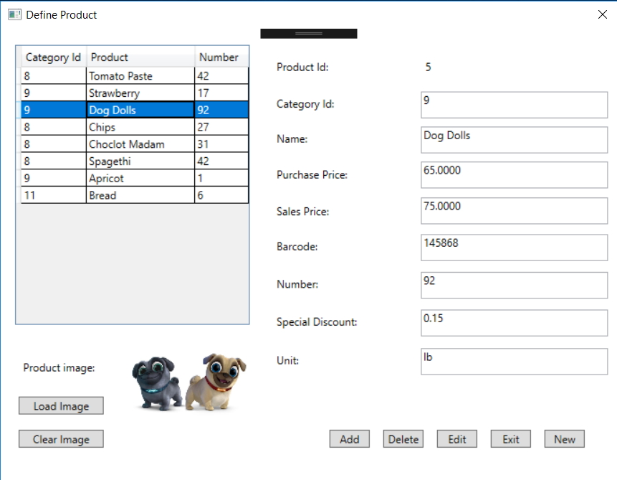
Dashboard - Products

