Slide 1
Best Bid
An auction web site for the sellers who needs to sell their products or services with the highest price in a very simple way
By: Ali Torabi , Behnaz A.Afshar

Slide 2
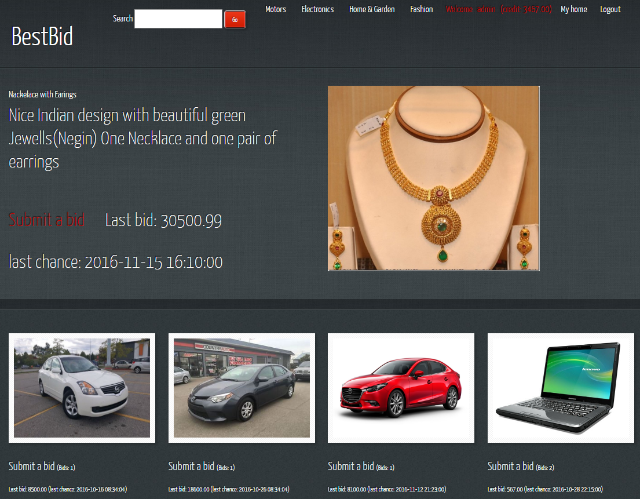
BestBid Home page

Slide 3
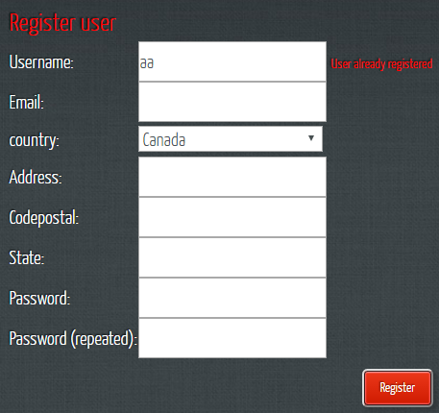
Bestbid registration

Slide 4
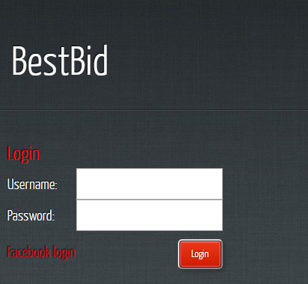
You can login with your Bestbid account or by your Facebook account

Slide 5
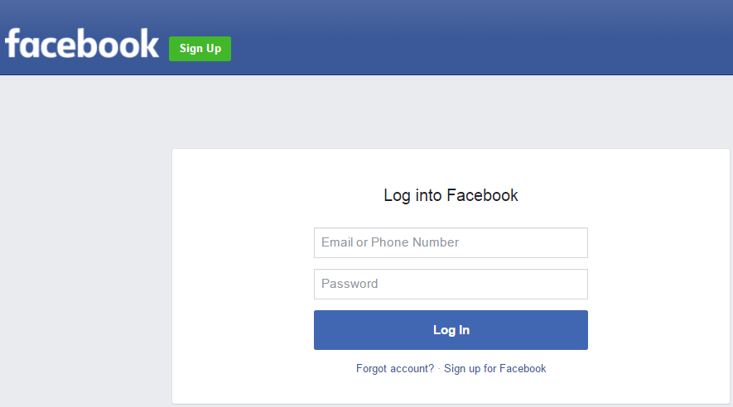
login with Facebook account

Slide 6
Successful login

Slide 7
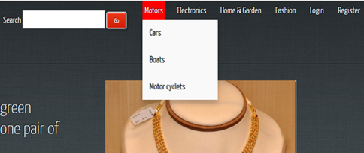
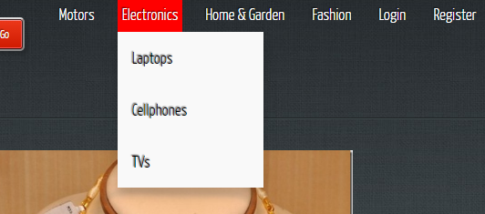
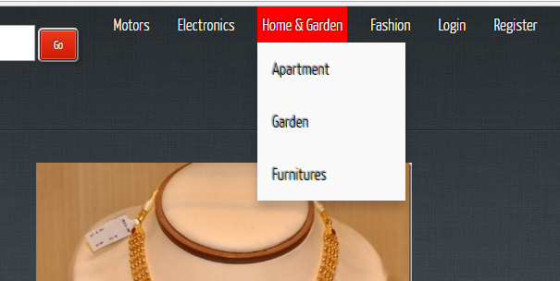
Dynamic categories and sub categories

Slide 8
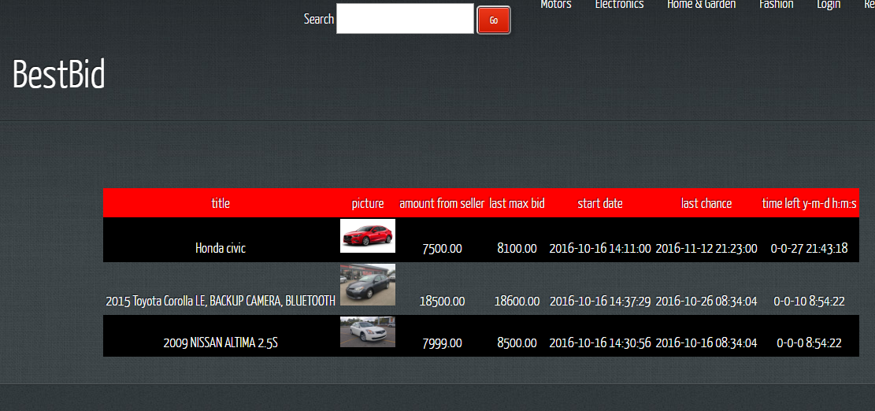
List of items in the same category
Last bid
Count Down

Slide 9

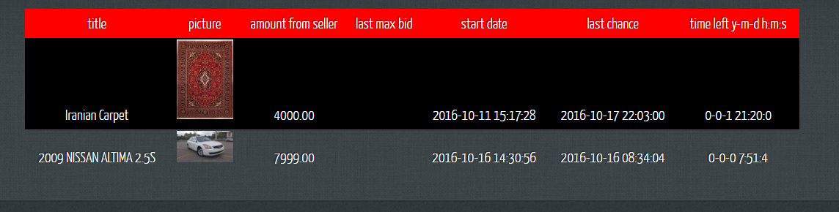
Search item
Search text

Slide 10
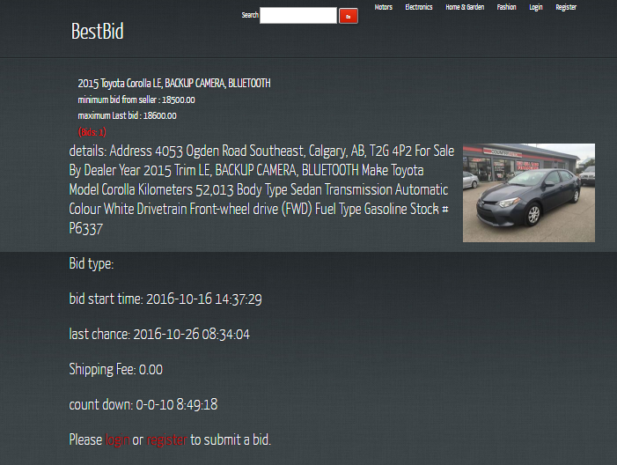
View the item and bid
Must login or register

Slide 11
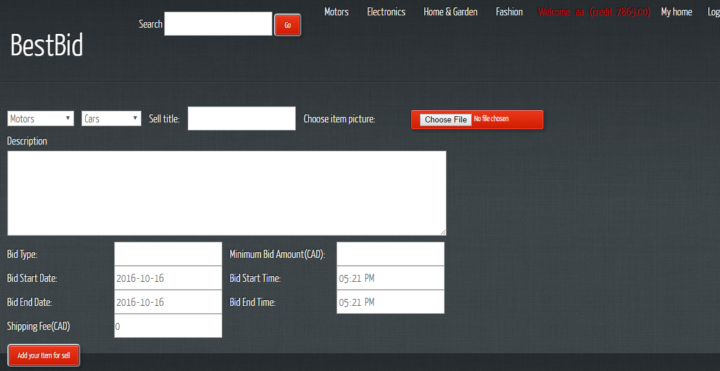
Add item for sell(only logged users can)

Slide 12
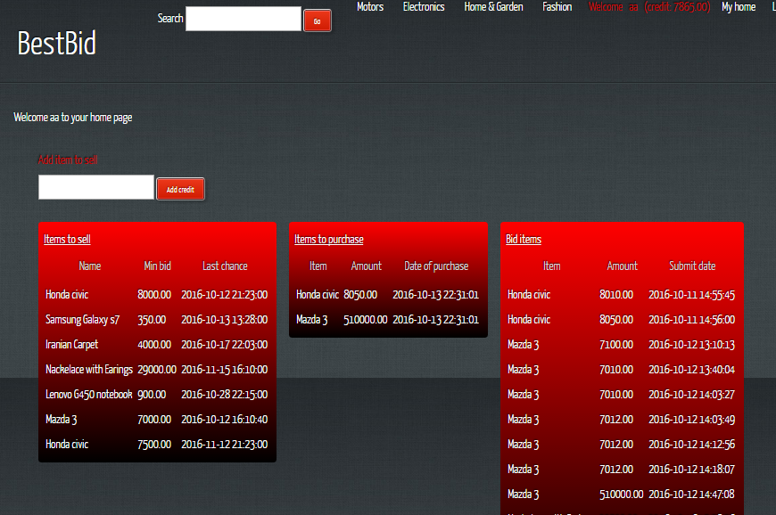
User Home Page

Slide 13
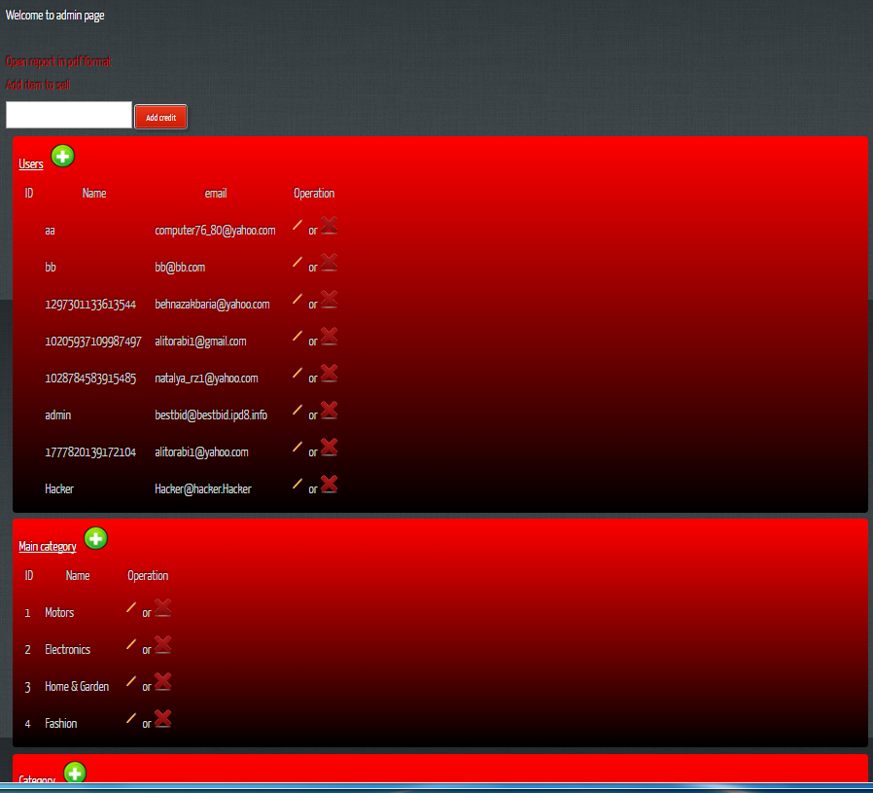
Admin Page
Add , Edit and Delete
- categories
- users
Reports and print in pdf format

Slide 14
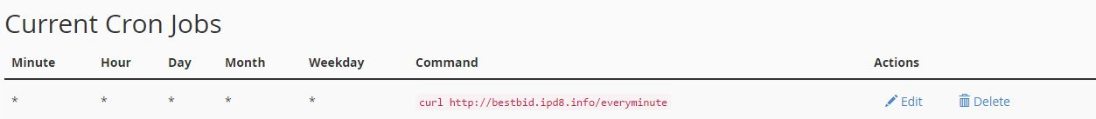
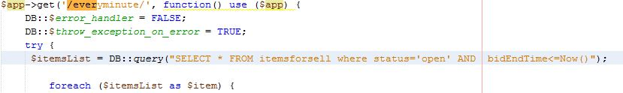
Schedule in server
--Transaction
If there are bids for item
---send email to buyer who win bid and send email to seller that he/she can sell own item
--update status='sold‘ in itemsforsell table and add to purchases table
//decrease amount of credit buyer and add this amount to credit of seller
Else
--update 'status='notReachedToSell‘
--- send email to user(seller) “You can’t sell your item”

Slide 15
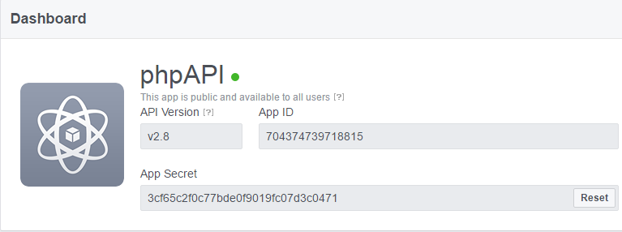
Facebook login challenge 1- create a Facebook API

Slide 16
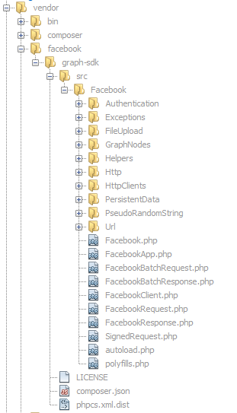
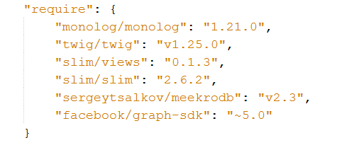
Facebook login challenge 2- composer.json

Slide 17
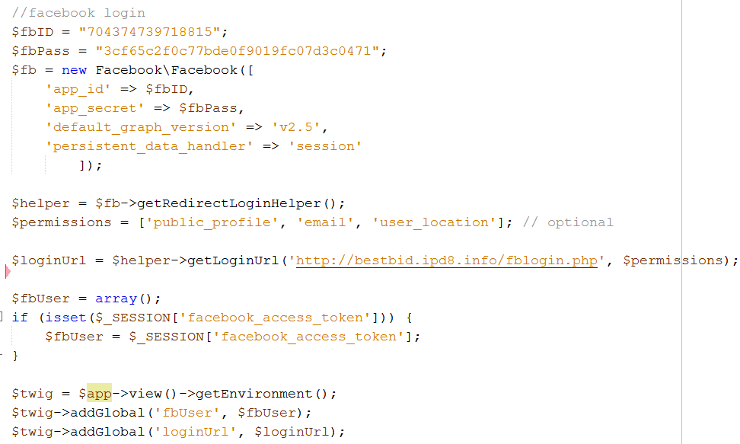
Facebook login challenge 3- index.php

Slide 18
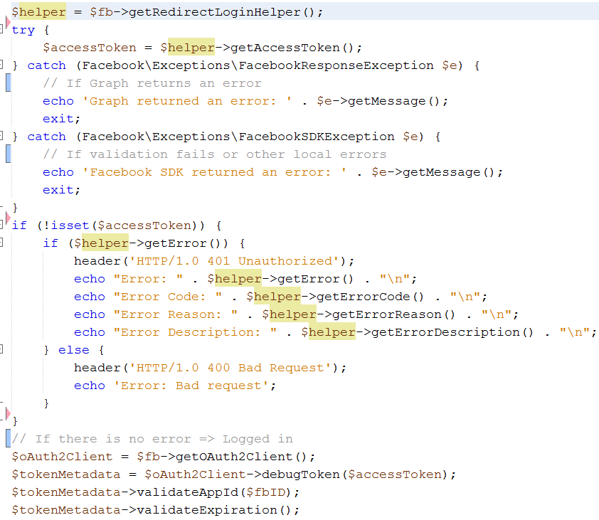
Facebook login challenge 4-1 fblogin.php

Slide 19
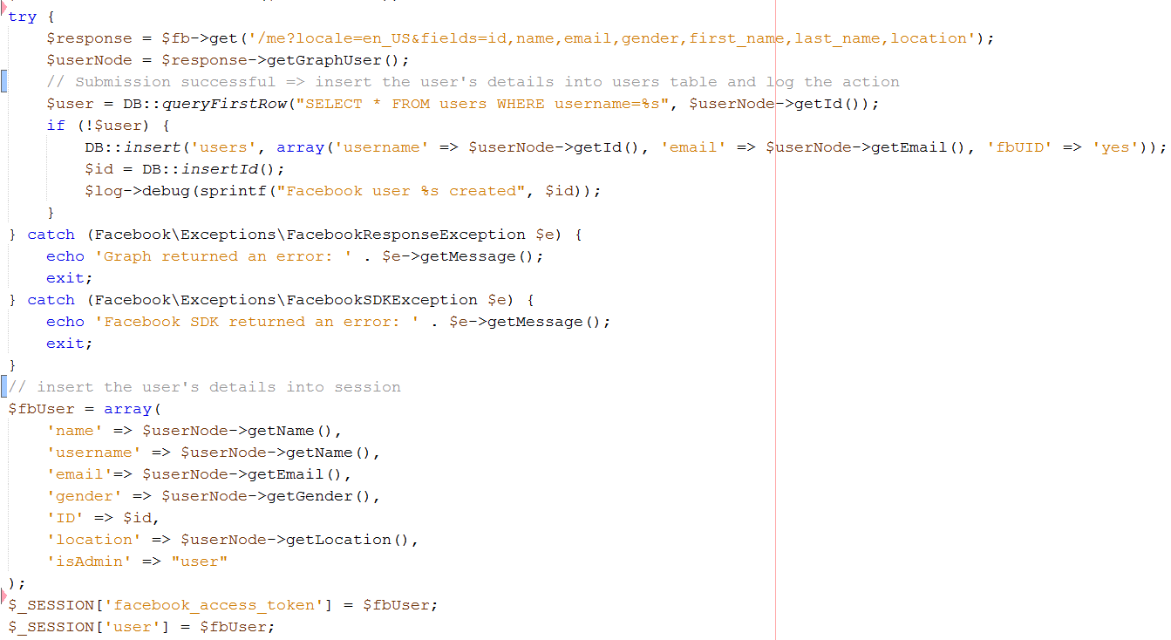
Facebook login challenge 4-2 fblogin.php

Slide 20
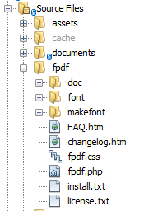
To make and open pdf file challenge:
1- download fpdf library from http://www.fpdf.org/
And include it in the root of your project

Slide 21
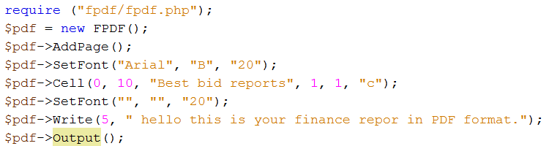
To make and open pdf file challenge:
2- create a pdf generator php file as:

Slide 22
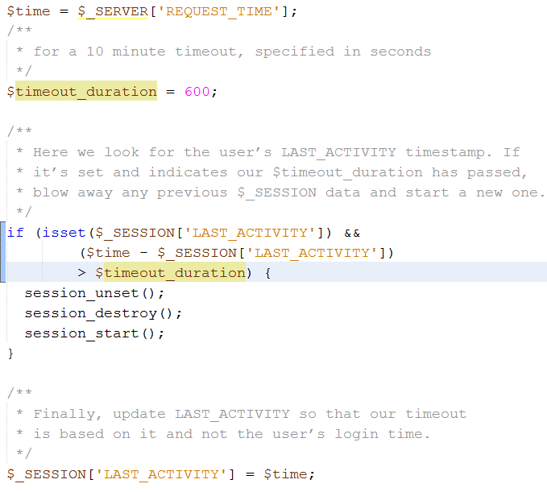

Session timeout challenge

Slide 23
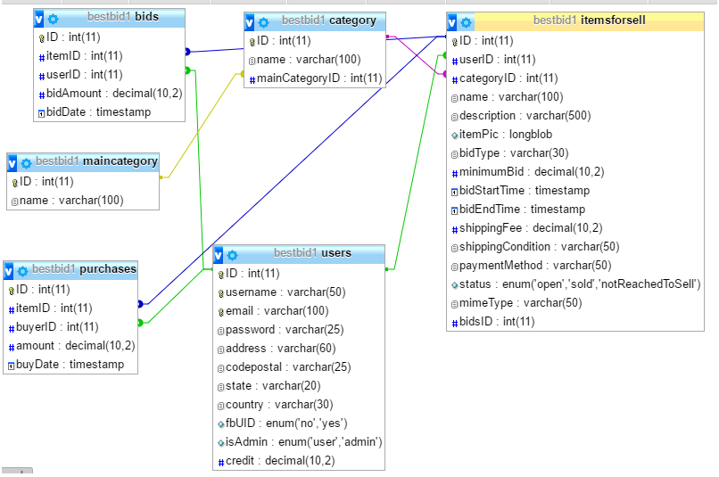
Database

Slide 24
For the future
Adding VISA and PayPal API functionality
Adding Twitter API in order to login with twitter account
Adding sitemap, contact us, about us, … pages
Making more powerful search engine

