Slide 1
Best Bid
An auction web site for the sellers who needs to sell their products or services with the highest price in a very simple way
By: Ali Torabi , Behnaz A.Afshar

Slide 2
Techopedia explain of Online Auction
Online auctions mirror traditional auctions and usually involve multiple bidder participation. In both scenarios, bidders and sellers buy and sell tangible and intangible products and services. Starting bids are low but increase at steady rates to meet market demand and item popularity. The time span of an online auction ranges from one to 10 days for items offered 24/7 worldwide. Online auctions are a widely accepted business model for the following reasons:
No fixed time constraint
Flexible time limits
No geographical limitations
Offers highly intensive social interactions
Includes a large numbers of sellers and bidders, which encourages a high-volume online business
Online auctions include business to business (B2B), business to consumer (B2C), and consumer to consumer (C2C) auctions. Ebay is the best example of an auction site that uses all three methodologies. The online auction business model continues to evolve according to market needs. Examples include eBay, WebStore, OnlineAuction and Overstock. Ebay and other providers encourage legitimate bidding activity through bidder block lists. EBay also offers Dutch auctions for large inventories, where auction bidders pay according to an item's highest sale price. Like other online services and activities, online auctions can attract stolen or pirated products.

Slide 3
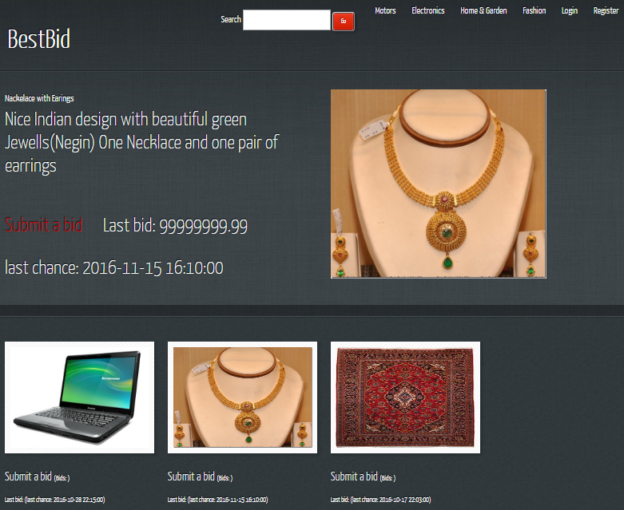
BestBid Home page

Slide 4
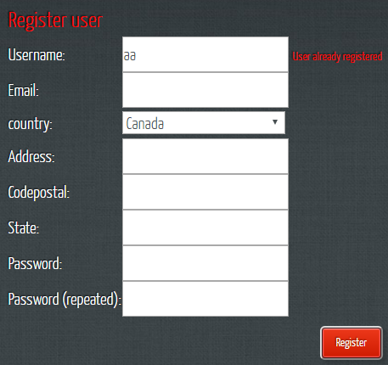
Bestbid registration

Slide 5
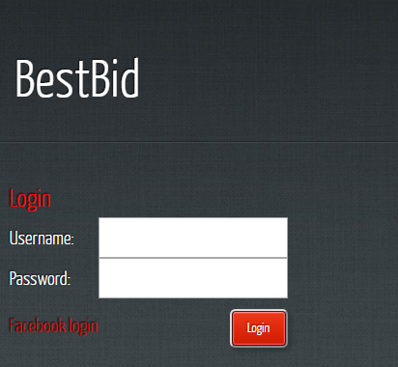
You can login with your Bestbid account or by your Facebook account

Slide 6
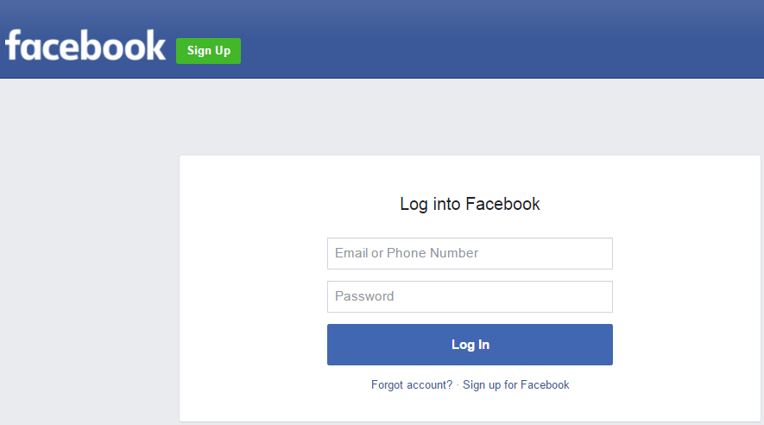
login with Facebook account

Slide 7
Successful login

Slide 8
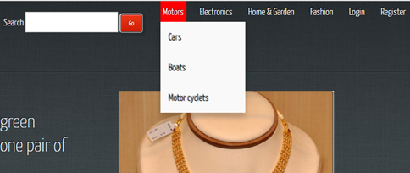
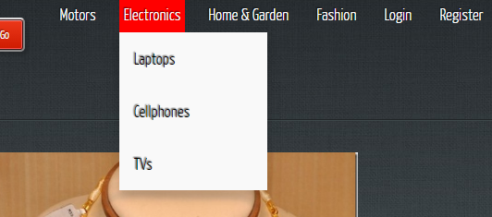
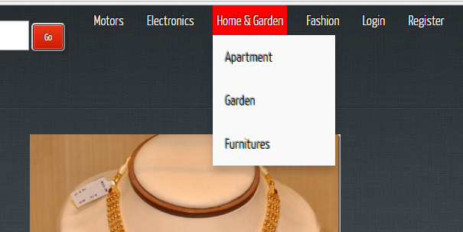
Dynamic categories and sub categories

Slide 9
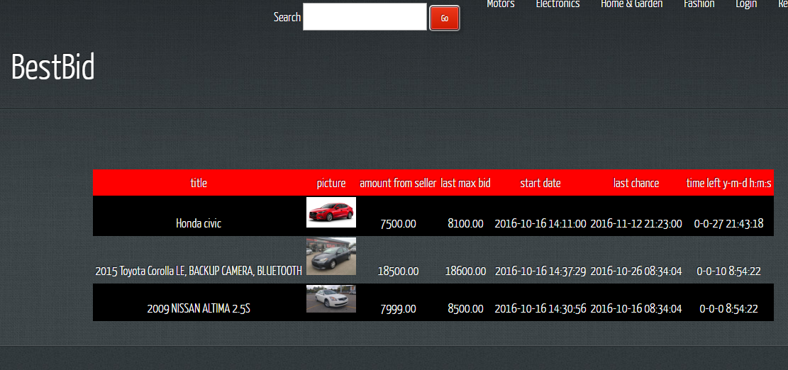
List of items in the same category
Last bid
Count Down

Slide 10

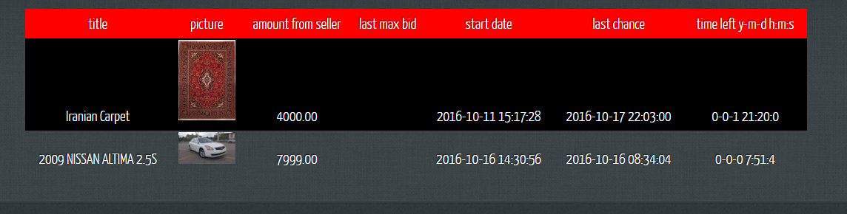
Search item
Search text

Slide 11
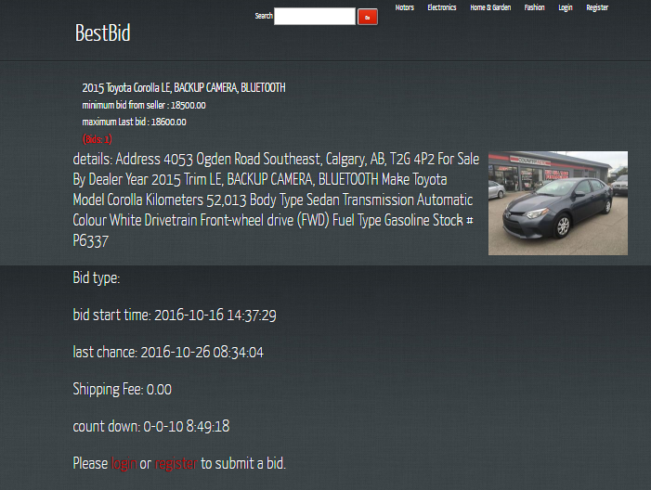
View the item and bid
Must login or register

Slide 12
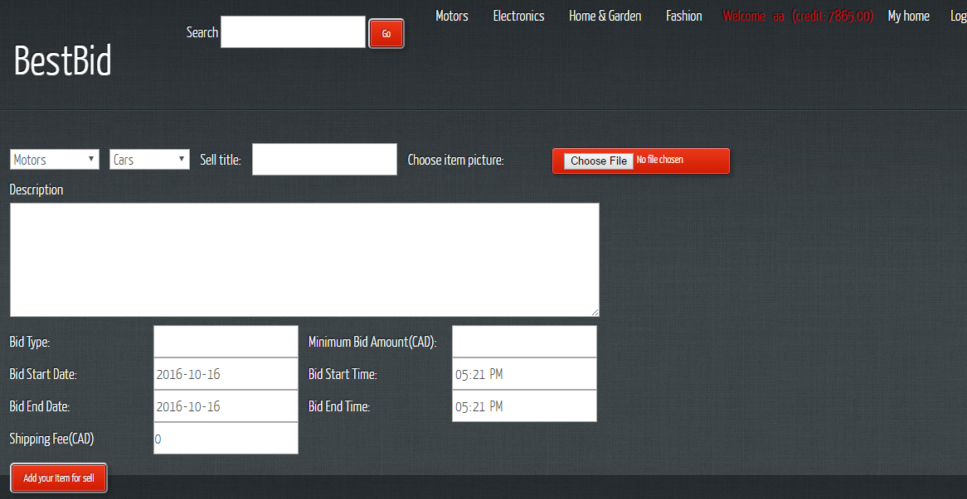
Add item for sell(only logged users can)

Slide 13
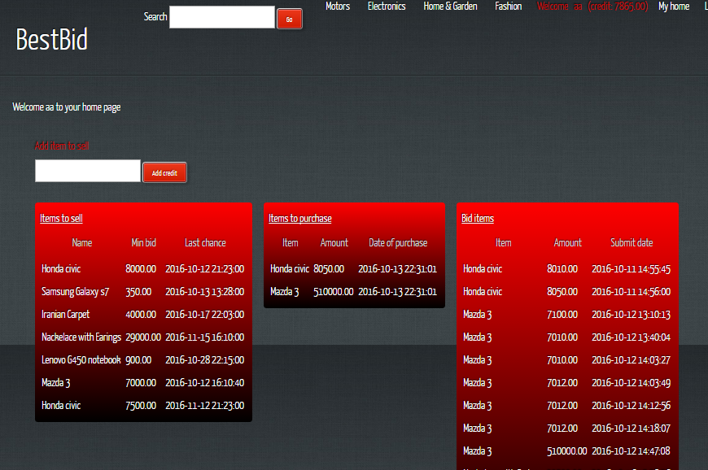
User Home Page

Slide 14
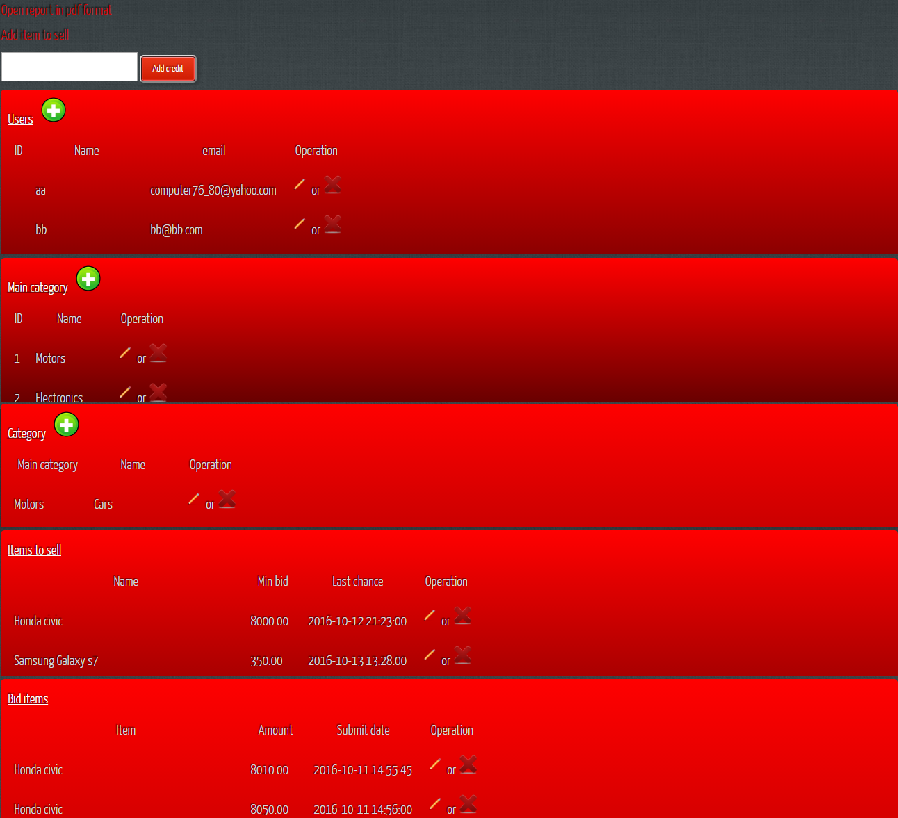
Admin Page
Add , Edit and Delete
- categories
- users
Reports and print in pdf format

Slide 15
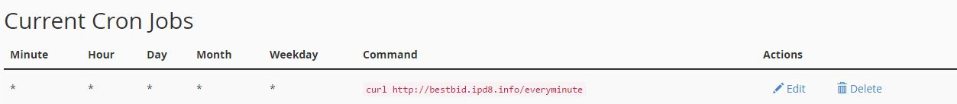
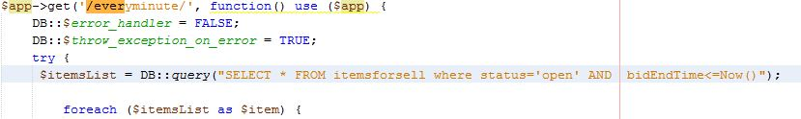
Schedule in server
--Transaction
If there are bids for item
---send email to buyer who win bid and send email to seller that he/she can sell own item
--update status='sold‘ in itemsforsell table and add to purchases table
//decrease amount of credit buyer and add this amount to credit of seller
Else
--update 'status='notReachedToSell‘
--- send email to user(seller) “You can’t sell your item”

Slide 16
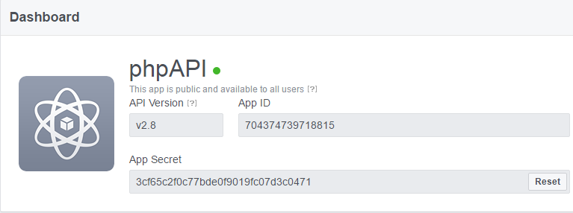
Facebook login challenge 1- create a Facebook API

Slide 17
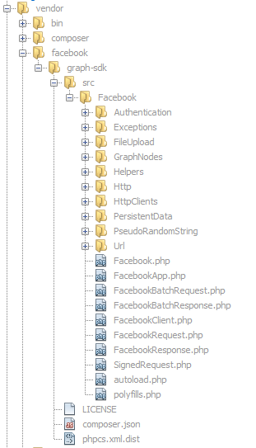
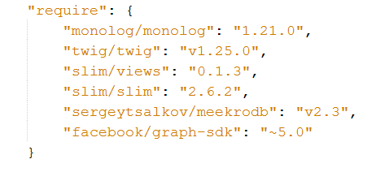
Facebook login challenge 2- composer.json

Slide 18
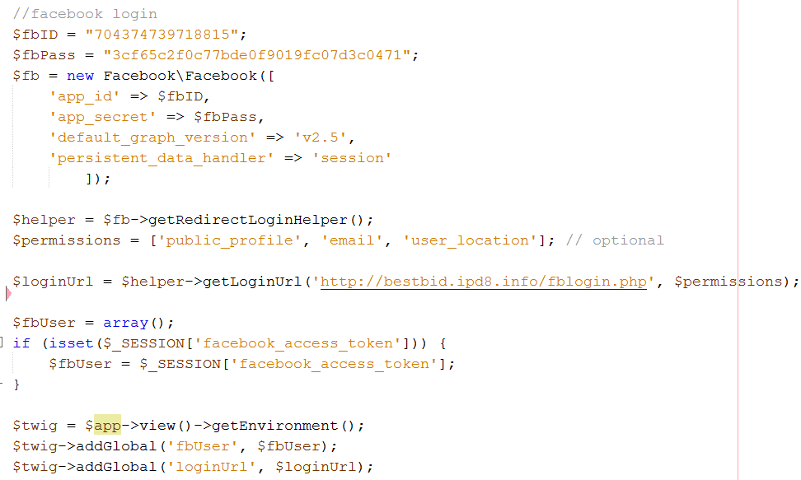
Facebook login challenge 3- index.php

Slide 19
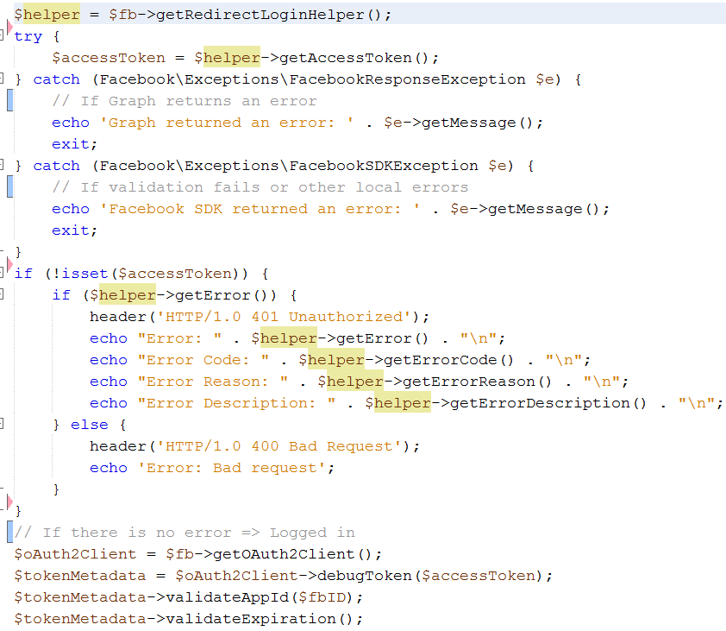
Facebook login challenge 4-1 fblogin.php

Slide 20
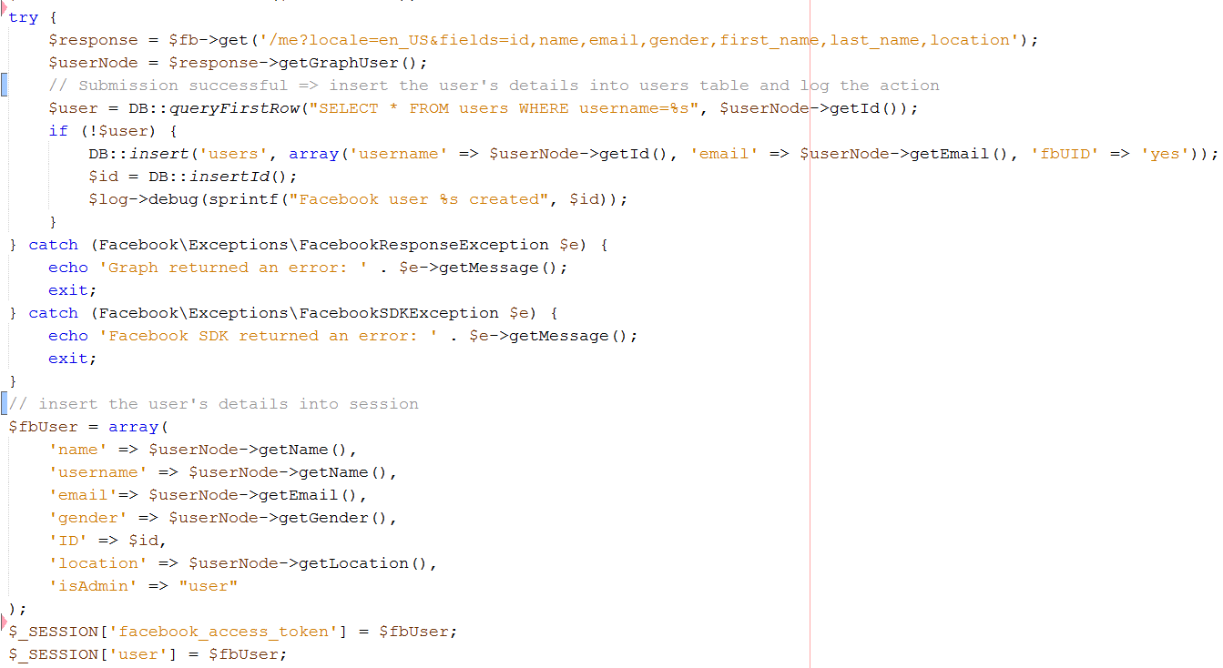
Facebook login challenge 4-2 fblogin.php

Slide 21
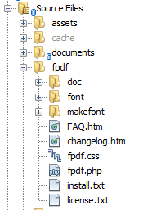
To make and open pdf file challenge:
1- download fpdf library from http://www.fpdf.org/
And include it in the root of your project

Slide 22
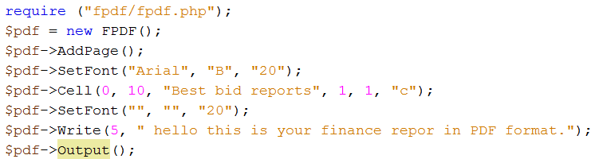
To make and open pdf file challenge:
2- create a pdf generator php file as:

Slide 23
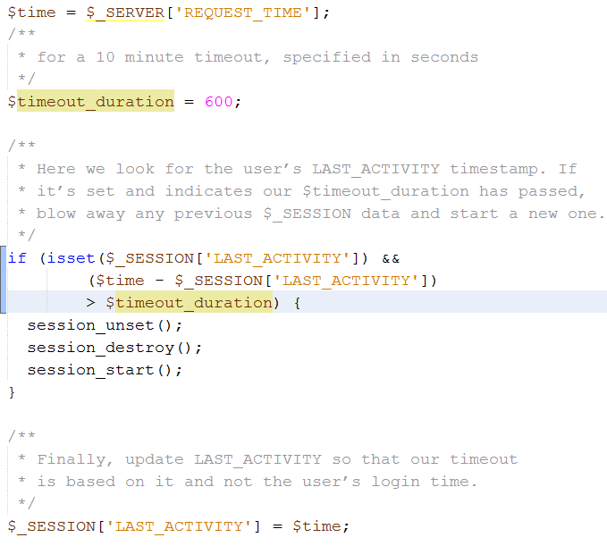

Session timeout challenge

Slide 24
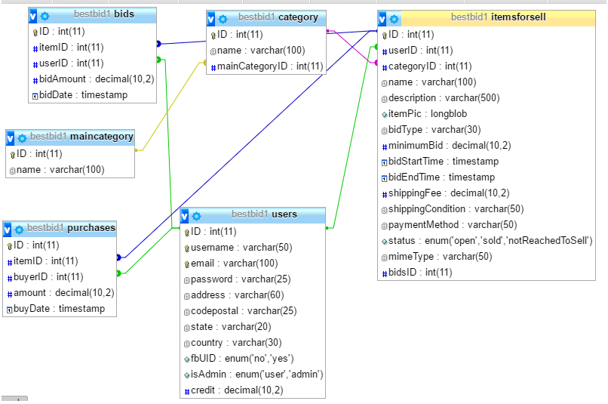
Database

Slide 25
For the future
Adding VISA and PayPal API functionality
Adding Twitter API in order to login with twitter account
Adding sitemap, contact us, about us, … pages
Making more powerful search engine

