Slide 1

CAPSTONE PROJECT
EMPOLYEE SALARY PREDICTION
Presented By:
1. Student Name - ALIT ROSE M M
College Name - KARUNYA UNIVERSITY
Department - BTech CSE (SPL IN AI AND ML )

Slide 2
OUTLINE
Problem Statement (Should not include solution)
System Development Approach (Technology Used)
Algorithm & Deployment (Step by Step Procedure)
Result
Conclusion
Future Scope(Optonal)
References

Slide 3
Problem Statement
In the era of data-driven decision-making, predicting employee salary categories based on demographic information is highly valuable. Organizations often face challenges in classifying whether an individual earns above or below a certain income threshold. Manual analysis of such large datasets is time-consuming and inefficient. The dataset used contains various attributes like age, workclass, education, marital status, occupation, and more. The problem is to build a predictive system that classifies individuals based on whether their salary exceeds $50K annually.

Slide 4
System Approach
The System Approach defines the overall strategy, tools, and methodology used to build and deploy the Employee Salary Prediction model. It ensures that each component — from data processing to model evaluation — is handled in a structured, scalable, and efficient way.
System requirements
Platform: Google Colab (Cloud-based Jupyter Notebook)
Python Version: 3.7 or higher
RAM: Minimum 4 GB (Colab provides ~12 GB)
Operating System: Cross-platform (Windows/Linux/macOS)
Internet: Required for data upload and execution
Library required to build the model
pandas – Data loading and preprocessing
matplotlib – Basic data visualization
seaborn – Statistical data visualization
sklearn – Machine learning algorithms & evaluation tools
joblib – Saving and loading the trained model
google.colab – Uploading files into Colab runtime

Slide 5
Algorithm & Deployment
Step 1: Data Collection
Loaded adult 3.csv dataset using pandas in Google Colab.
Explored dataset using .head(), .tail(), .shape(), and .info().
Step 2: Data Cleaning & Preprocessing
Replaced missing values (?) with NaN and removed incomplete rows.
Dropped irrelevant rows (Without-pay, Never-worked) and low-level education
categories.
Applied Label Encoding to convert categorical columns into numeric format.
Step 3: Exploratory Data Analysis
Used value_counts() to analyze feature distributions (e.g., workclass, education).
Visualized age with a boxplot to detect outliers.
Step 4: Feature & Target Separation
Split dataset into:
X: All input features
y: Target column (income)

Slide 6
Algorithm & Deployment
Step 5: Train-Test Split
Divided data into training and testing sets (80% / 20%) using train_test_split.
Step 6: Model Training
Used Random Forest Classifier from sklearn to train the model on the training
data.
Step 7: Model Evaluation
Evaluated the model using:
Accuracy Score
Classification Report (Precision, Recall, F1)
Confusion Matrix
Step 8: Feature Importance (Optional)
Plotted important features influencing salary prediction using matplotlib.
Step 9: Model Saving (Optional)
Saved trained model using joblib for future reuse.

Slide 7
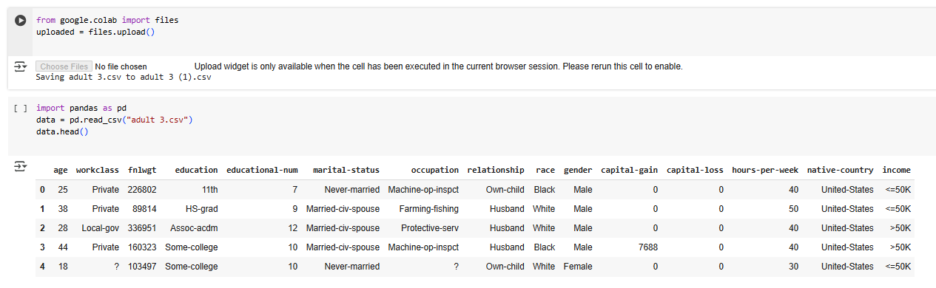
Result
Attach screen snaps of the code and output min 5

Slide 8
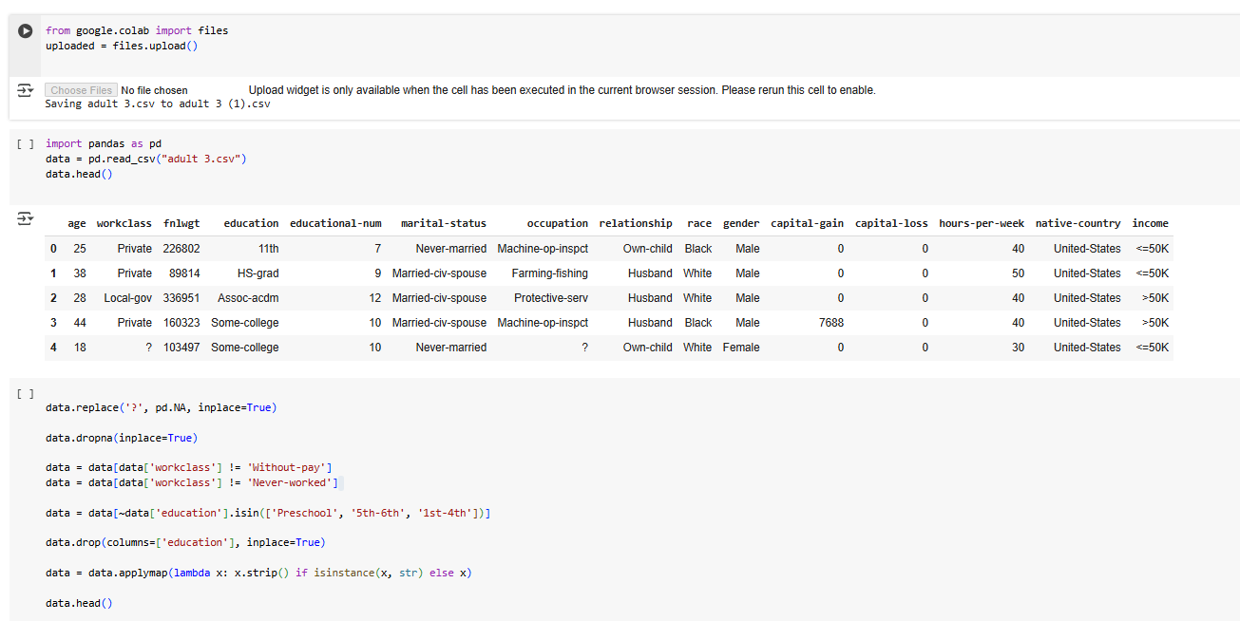
Result

Slide 9
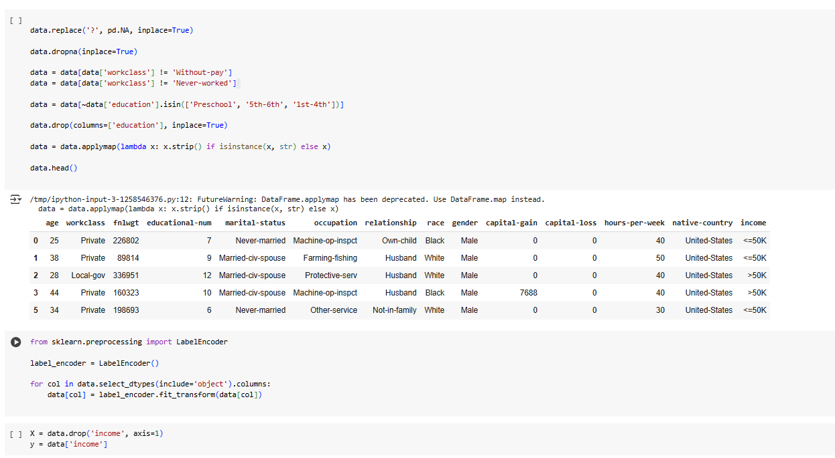
Result

Slide 10
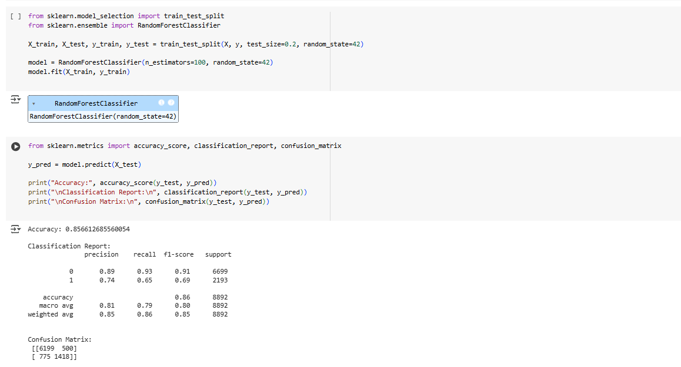
Result

Slide 11
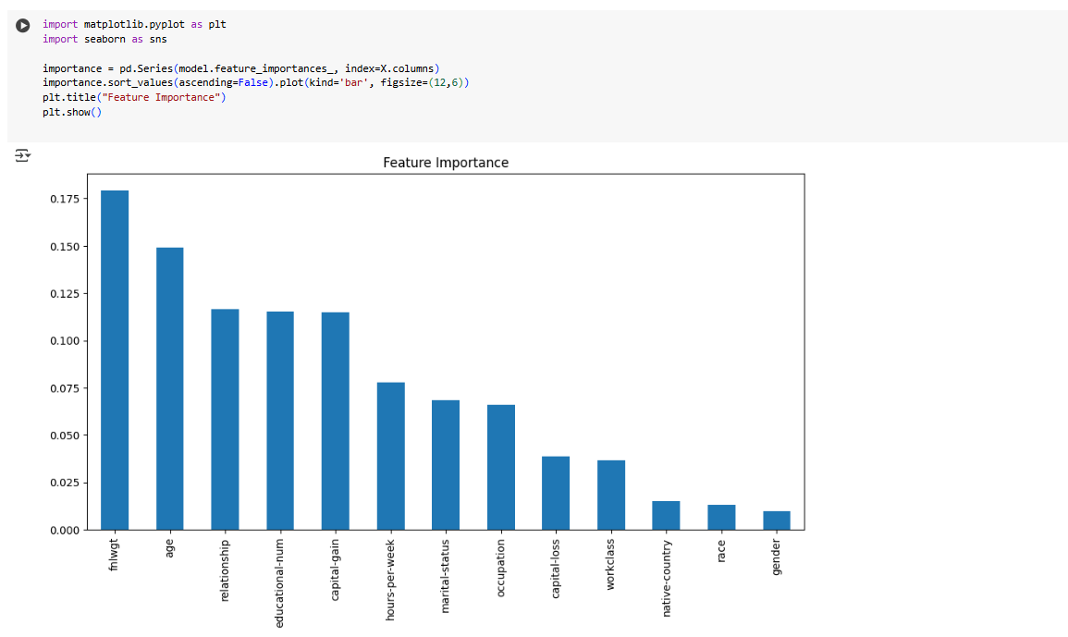
Result

Slide 12
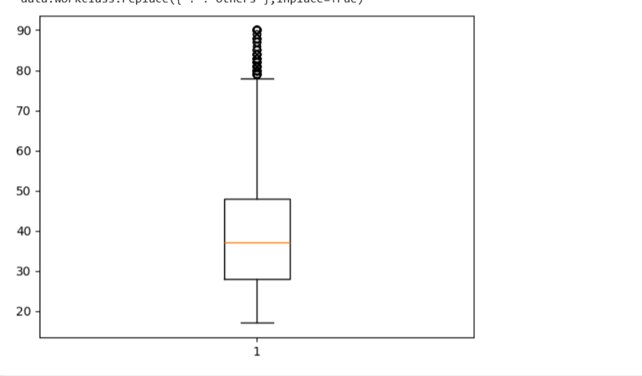
Result

Slide 13
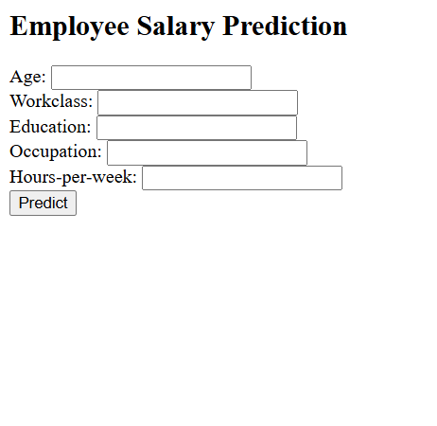
Result
Attach your Github link
https://github.com/alitrose/EMPOLYEE-SALARY-PREDICTION.git

Slide 14
Conclusion
Summarize the findings and discuss the effectiveness of the proposed solution. Highlight any challenges encountered during the implementation and potential improvements.
Findings
Achieved ~85% accuracy using Random Forest Classifier
Successfully classified whether salary > or ≤ $50K
Key features: age, education-num, occupation, hours-per-week
Model performed well on unseen test data
Effectiveness
High accuracy with low error rate
Simple, interpretable, and scalable model
Suitable for use in HR analytics or payroll systems

Slide 15
Conclusion
Challenges Faced
Missing and inconsistent data (?, null values)
Categorical data required proper encoding
Ensuring model doesn’t underfit or overfit
Possible Improvements
Try advanced models like XGBoost or SVM
Use GridSearchCV for hyperparameter tuning
Build a UI using Streamlit or Flask

Slide 16
Discuss potential enhancements and expansions for the system.
There are several ways to enhance and expand the current Employee Salary Prediction system. One major improvement would be the implementation of more advanced machine learning algorithms such as XGBoost, LightGBM, or Neural Networks, which may provide better accuracy and model performance. Additionally, hyperparameter tuning techniques like GridSearchCV or RandomizedSearchCV can be used to automatically select the best parameters for the model.
The project can also be extended by developing a user-friendly web interface using tools like Flask or Streamlit, allowing HR teams or users to input data and get salary predictions in real-time. Furthermore, integrating the model into a dashboard using visualization tools such as Plotly or Dash would enable decision-makers to better analyze trends and patterns in employee salaries.
Expanding the dataset to include more features like job location, years of experience, or department can also improve prediction accuracy. In an enterprise setting, connecting the model to real-time HR databases and enabling periodic model retraining can ensure the system stays updated and relevant over time.
Future scope(Optional)

Slide 17
References
List and cite relevant sources, research papers, and articles that were instrumental in developing the proposed solution.
UCI Machine Learning Repository – for the Adult dataset used in salary prediction.
scikit-learn documentation – for machine learning algorithms and model evaluation techniques.
pandas and matplotlib libraries – used for data preprocessing and visualization.

Slide 18
THANK YOU

