Slide 1
HiveIQ
Smart Honey Hive Tracking & Production Analytics
A Real-Time Data Science Project Integrating FAOSTAT Global Analytics & Client-Side Machine Learning
Submitted by: ALIT ROSE M M (Reg. No: URK23CS2024)
Course: 23CS2024 — Data Science Ecosystem | V Semester B.Tech CSE
Division of Computer Science & Engineering | School of Computer Science & Technology
Karunya Institute of Technology and Sciences, Coimbatore

Slide 2
HIVIQ: DATA SCIENCE ECOSYSTEM (23CS2024)
Problem Statement & Project Motivation
1. The Core Challenges in Apiculture
• Volatile Harvests: Honey production fluctuates widely year-over-year due to climate volatility and floral nectar shifts.
• Colony Mortality: Hive diseases (Varroa mites, fungal chalkbrood) and brood hypothermia cause devastating losses if unmonitored.
• Information Divide: Beekeepers have no simple tool combining local hive sensor tracking with national-scale predictive forecasting.
2. The HiveIQ Solution
• End-to-End Pipeline: Harnesses 64 years of United Nations FAOSTAT honey data (9,601 records) for machine learning.
• Dual-Scale Capability: Macro-level country production forecasting + Micro-level individual hive inspection tracking.
• 100% Client-Side In-Browser ML: Zero cloud dependency; models execute in vanilla JavaScript via exported model.json.
• Screening Advisory: Automated heuristics for core hive temperature (33–36°C) and humidity (50–65%).

Slide 3
HIVIQ: DATA SCIENCE ECOSYSTEM (23CS2024)
Primary & Supplementary Datasets
UN FAOSTAT Global Honey Dataset
• Source: Food and Agriculture Organization of the United Nations (FAOSTAT).
• Total Records: 9,601 rows spanning 1961 to 2024 (64 continuous years).
• Coverage: 180 geographical entities.
• Data Cleaning: Separated 23 macro-regional groupings (World, Asia, Europe) from 157 sovereign nations (8,129 country records).
• Completeness: Zero missing values in production volume (metric tonnes).
Local Hive Telemetry & Demographics
• Hive Registry: Records Hive ID, apiary location, installation date, hive type (Langstroth vs Top-bar), and colony status.
• Simulated Demo Sensors: Core temperature (°C), relative humidity (%), brood pattern health, and pest signs.
• Scientific Honesty: 10 starter records are synthetic demo data used for UI and screening validation, clearly tagged [DEMO].
• Persistence: Maintained securely in browser localStorage without external tracking.

Slide 4
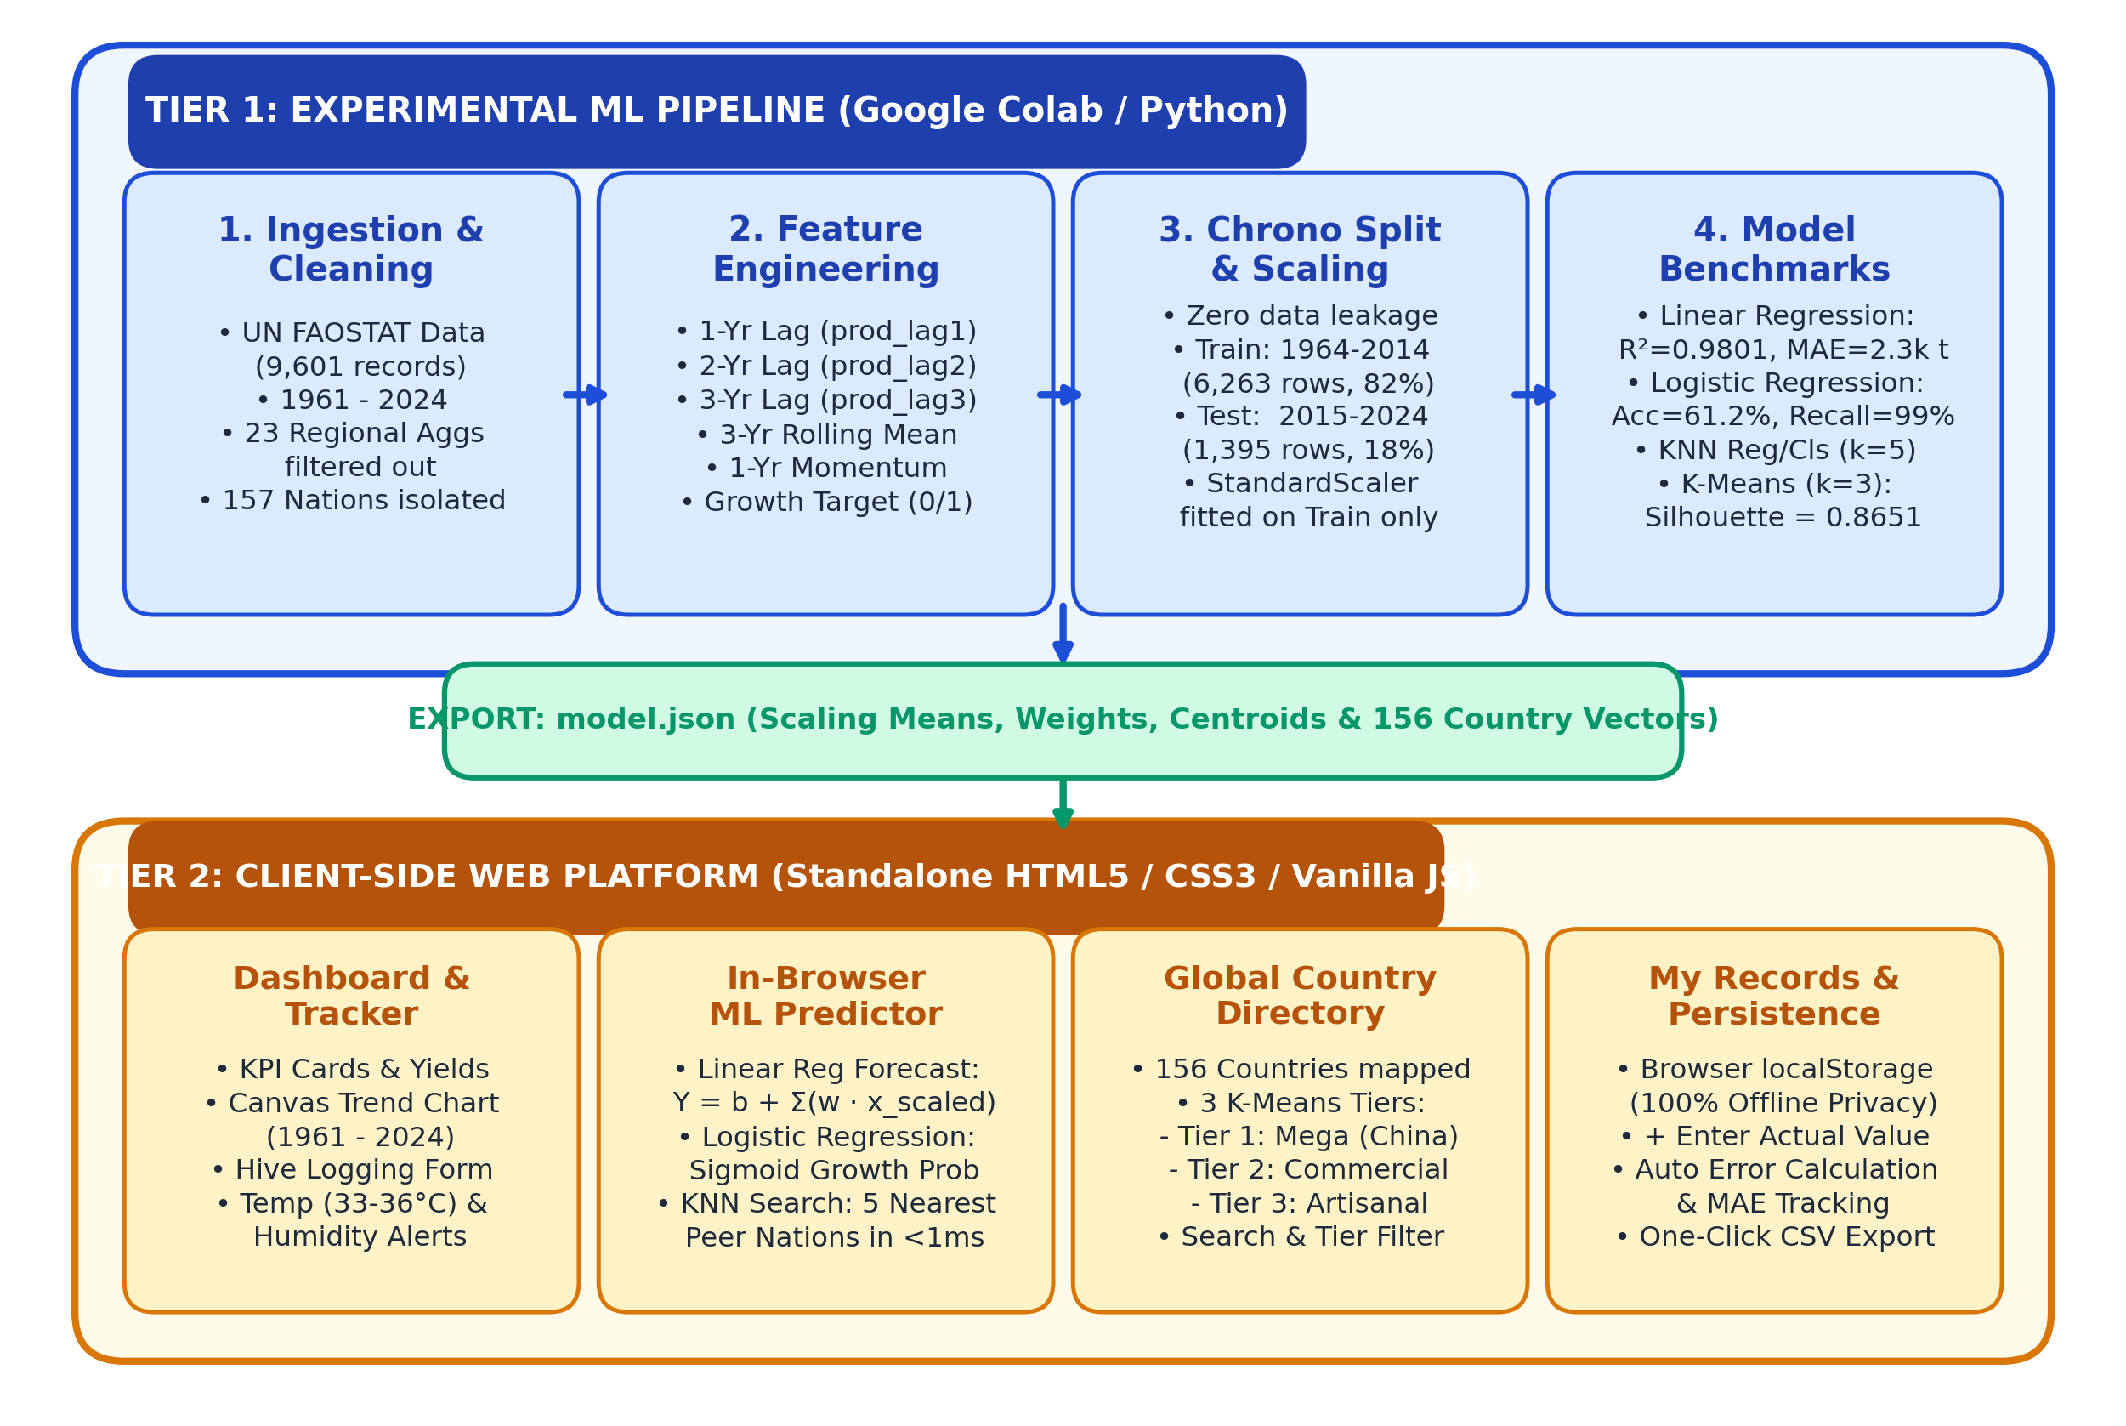
HIVIQ: DATA SCIENCE ECOSYSTEM (23CS2024)
Two-Tier System Architecture & Pipeline

Slide 5
HIVIQ: DATA SCIENCE ECOSYSTEM (23CS2024)
Feature Engineering & Leak-Free Time Split
Autoregressive Feature Engineering
• prod_lag1: Production in previous year (t - 1)
• prod_lag2: Production two years prior (t - 2)
• prod_lag3: Production three years prior (t - 3)
• prod_roll_mean3: 3-Year historical moving average (t-1, t-2, t-3)
• prod_diff_1: 1-Year momentum trend (lag1 - lag2)
• growth_target: Binary classification target (1 if yield increased vs previous year, else 0).
• Clean Modeling Samples: 7,658 country-years (55.8% Growth vs 44.2% Decline/Stable).
Time-Aware Chronological Split
• No Future Data Leakage: Standard random train_test_split leaks future agricultural cycles into past predictions.
• Chronological Partitioning at Year 2015:
• • Training Partition: 1964 to 2014 -> 6,263 samples (81.8%)
• • Held-Out Test Partition: 2015 to 2024 -> 1,395 samples (18.2%)
• StandardScaler Standardization: Fitted strictly on training data (preventing statistical data snooping).

Slide 6
HIVIQ: DATA SCIENCE ECOSYSTEM (23CS2024)
Task 1: Continuous Production Forecasting (Regression)
Model Comparison & Metrics (Test Data: 2015-2024)
• Linear Regression (Ordinary Least Squares):
• • Mean Absolute Error (MAE): 2,350.33 tonnes
• • Root Mean Squared Error (RMSE): 9,296.05 tonnes
• • R² Score (Variance Explained): 0.9801
• K-Nearest Neighbors Regressor (k=5):
• • Mean Absolute Error (MAE): 2,896.79 tonnes
• • Root Mean Squared Error (RMSE): 12,460.96 tonnes
• • R² Score (Variance Explained): 0.9643
• Selected Best Model: Linear Regression (lower error & O(1) browser inference).
Why is R² ~ 0.98? (Viva Defense)
• Agricultural Autocorrelation: A nation harvesting 70,000 tonnes of honey does not suddenly drop to 200 tonnes next year without complete ecological collapse.
• Inertia Capture: The 3-year lags and rolling average accurately capture the national baseline scale.
• Honest Limitation: The model captures macro momentum, but cannot predict sudden drought or disease outbreaks without real-time microclimate sensors.

Slide 7
HIVIQ: DATA SCIENCE ECOSYSTEM (23CS2024)
Task 2: Annual Growth vs Decline Classification
Classification Benchmark Results
• Logistic Regression (L2 Regularized):
• • Accuracy: 61.22%
• • Precision (Growth Class): 60.77%
• • Recall (Growth Sensitivity): 98.92%
• • Balanced F1-Score: 0.7529
• K-Nearest Neighbors Classifier (k=5):
• • Accuracy: 56.99%
• • Precision: 63.75%
• • Recall: 64.83%
• • Balanced F1-Score: 0.6429
• Selected Best Model: Logistic Regression (higher F1 and direct sigmoid probability).
Understanding Recall vs Precision
• High Recall (98.92%): Captures virtually all positive harvest growth cycles, crucial for supply chain planning.
• Moderate Precision (60.77%): Historical data has a slight growth bias (55.8%). The linear decision boundary is slightly optimistic on borderline flat years.
• Academic Rigor: We report Accuracy, Precision, Recall, and F1-score rather than relying on accuracy alone.

Slide 8
HIVIQ: DATA SCIENCE ECOSYSTEM (23CS2024)
Task 3: Unsupervised Country Profile Clustering
K-Means Silhouette Score Evaluation
• Clustering Features: Mean production, peak yield, standard deviation (stability), and recent production volume.
• Silhouette Analysis Across k:
• • k = 2: Silhouette = 0.8971 (Too coarse; only splits China vs rest of world)
• • k = 3: Silhouette = 0.8651 (SELECTED: Highest domain interpretability)
• • k = 4: Silhouette = 0.8243 (Fragments commercial nations arbitrarily)
• • k = 5: Silhouette = 0.8247 (Decreased cohesion without new insight)
The 3 Global Production Tiers
• Tier 1: Global Mega-Producers (1 Nation)
• • China (>400,000 tonnes/year)
• Tier 2: Commercial / Regional Majors (~18 Nations)
• • India, Turkey, USA, Argentina, Mexico, Ukraine (20,000 – 100,000 tonnes/year)
• Tier 3: Small / Artisanal Producers (137 Nations)
• • Emerging and artisanal beekeeping countries (<15,000 tonnes/year)

Slide 9
HIVIQ: DATA SCIENCE ECOSYSTEM (23CS2024)
Client-Side In-Browser Machine Learning Engine
The model.json Bridge (61.7 KB)
• Zero Backend Latency: No Python or Flask/FastAPI server required during deployment.
• Embedded Parameters:
• • Scaler Means & Scales for 5 features
• • Linear Regression Intercept & 5 Weights
• • Logistic Regression Intercept & 5 Weights
• • K-Means 3 Centroids & Complete 156 Country Catalog
• • 156 Country Prototype Vectors for instant Euclidean nearest neighbor search.
Client-Side Mathematical Execution
• Linear Regression in JS:
• Y = max(0, Intercept + sum(w[i] * scaled_x[i]))
• Logistic Growth Sigmoid in JS:
• z = Intercept + sum(w[i] * scaled_x[i])
• P(Growth) = 1 / (1 + exp(-z))
• KNN Search in JS: Computes Euclidean distance to 156 countries in <1 ms, sorting the 5 nearest peers.

Slide 10
HIVIQ: DATA SCIENCE ECOSYSTEM (23CS2024)
Beekeeper Telemetry & Heuristic Screening
Biological Microclimate Benchmarks
• Brood Nest Core Temperature:
• • Normal Optimal: 33.0°C – 36.0°C
• • Below 32.0°C: Brood hypothermic chilling risk
• • Above 36.5°C: Comb wax softening and heat stress
• Internal Relative Humidity:
• • Normal Optimal: 50% – 65%
• • Above 68%: Severe risk of chalkbrood fungal spores (Ascosphaera apis) and Nosema.
Local Tracking & History Management
• Inspection Logging: Tracks Hive ID, inspection date, core temp, humidity, brood pattern, pest signs, and harvested yield.
• Real-Time Heuristic Alerts: Live warning and danger callouts appear dynamically as sensor readings are entered.
• Persistent Privacy: Data is saved to browser localStorage; nothing leaves the beekeeper's device.
• Ground Truth Validation: Users enter actual harvested yield to monitor prediction accuracy and aggregate MAE.

Slide 11
HIVIQ: DATA SCIENCE ECOSYSTEM (23CS2024)
Systematic Testing & Cross-Engine Parity
Automated Test Suite (Python vs. JavaScript Equivalence)
• Case 1 (India Preset): Colab = 75,569.8 t | JS = 75,569.8 t (diff: 0.022 t) -> PASSED
• Case 2 (Turkey Preset): Colab = 106,907.6 t | JS = 106,907.6 t (diff: 0.015 t) -> PASSED
• Case 3 (USA Preset): Colab = 71,428.9 t | JS = 71,428.9 t (diff: 0.013 t) -> PASSED
• Case 4 (Declining Producer): Colab = 23,314.5 t | JS = 23,314.5 t (diff: 0.010 t) -> PASSED
• Case 5 (Small Artisanal): Colab = 436.1 t | JS = 436.1 t (diff: 0.038 t) -> PASSED
• Case 6 (China Mega-Producer): Colab = 462,063.7 t | JS = 462,063.7 t (diff: 0.014 t) -> PASSED
• Boundary Tests: (0, 0, 0) inputs correctly guarded to 0.0 tonnes; Sensor alerts trigger accurately; localStorage persists across restarts.

Slide 12
HIVIQ: DATA SCIENCE ECOSYSTEM (23CS2024)
Live Demonstration Walkthrough
Demo Persona: Priya Nair
• Role: Apiary Operations Coordinator, Western Ghats Honey Cooperative (Coimbatore).
• Goal: Monitor microclimate across 5 hive stations and forecast seasonal production volume.
• Step 1: Dashboard -> Review 64-year global trend and active model cards.
• Step 2: Hive Tracker -> Log HIVE-003 at 37.2°C & 67% humidity -> Trigger Overheating & Chalkbrood Alerts.
Yield Forecasting & Ground Truth
• Step 3: ML Predictor -> Select India preset (74k, 71k, 67.5k t) -> Execute Models in JS:
• • Linear Reg: 75,570 Tonnes
• • Logistic Reg: Positive Growth (59.0%)
• • Nearest Peers: Iran, Brazil, USA
• Step 4: Save to History -> Switch to My Records -> Click + Enter Actual -> Enter 74,500 t -> Auto-compute error (+1,070 t).
• Step 5: Export CSV -> Download persistent prediction log.

Slide 13
HIVIQ: DATA SCIENCE ECOSYSTEM (23CS2024)
Academic Limitations & Challenges Faced
Honest Technical Limitations
• Screening Nature: HiveIQ is an advisory decision-support tool, not a definitive agronomic diagnosis or financial guarantee.
• Macro Autoregression Limits: Models capture temporal momentum well, but cannot anticipate sudden localized weather catastrophes or pesticide poisoning without physical sensors.
• Simulated Demo Sensors: The 10 starter hive logs are synthetic records for UI/screening validation.
Engineering Challenges Solved
• Eliminating Data Leakage: Replaced standard random train_test_split with strict chronological partitioning at year 2015.
• Zero-Server Deployment: Serialized complex scikit-learn models into model.json to achieve sub-millisecond execution in pure vanilla JavaScript.
• Cross-Platform Parity: Verified that JavaScript matrix dot products match Python outputs within 0.04 tonnes.

Slide 14
HIVIQ: DATA SCIENCE ECOSYSTEM (23CS2024)
Conclusion & Future Enhancements
Project Achievements
• Complete Data Science Lifecycle: Data ingestion, feature engineering, leak-free validation, and model comparison in Google Colab.
• Production-Ready Deployment: Standalone responsive web application hosted free on GitHub Pages.
• Multi-Algorithm Ecosystem: Evaluated Linear Regression, Logistic Regression, KNN Regressor/Classifier, and K-Means Clustering.
• Full Academic Documentation: Complete report, architecture diagram, and test suite.
Future Road Map
• Physical IoT Hardware: ESP32 microcontroller with HX711 hive scales and digital thermistors for automated telemetry ingestion.
• Satellite Remote Sensing: Integration of Sentinel-2 NDVI imagery to monitor floral blooming corridor indices.
• Deep Learning Time Series: Recurrent Neural Networks (LSTM / GRU) as daily microclimate sensor data becomes available.

Slide 15
Thank You! Questions & Discussion
HiveIQ — Smart Honey Hive Tracking & Production Analytics
Live Web App: https://alitrose.github.io/HiveIQ/
Google Colab: https://colab.research.google.com/github/alitrose/HiveIQ/blob/main/HiveIQ_Course_Project_Colab.ipynb
GitHub Repository: https://github.com/alitrose/HiveIQ
ALIT ROSE M M | Reg. No: URK23CS2024
Karunya Institute of Technology and Sciences

