Slide 1


Azimuthal barrier evaluation based on XSI tool
An Interpretable Deep Learning Framework for Cement Channeling Detection in Sonic Logging
A Case Study in Model Development and Diagnostic Analysis using Wavelet Transforms and Grad-CAM
Jun Xiao，Qizhi Bi，Hua Wang，Yunjia Ji,
UESTC acoustic information intelligent perception and imaging team
November 18, 2025
Notes:
Good morning and good evening, everyone. My name is Xiao Jun, and I am a second-year graduate student advised by Professor Wang Hua. It's my pleasure to present the results of my work.
The topic of my presentation is **An Interpretable Deep Learning Framework for Cement Channeling Detection in Sonic Logging*, with the subtitle: **A Case Study in Model Development and Diagnostic Analysis using Wavelet Transforms and Grad-CAM**.

Slide 2
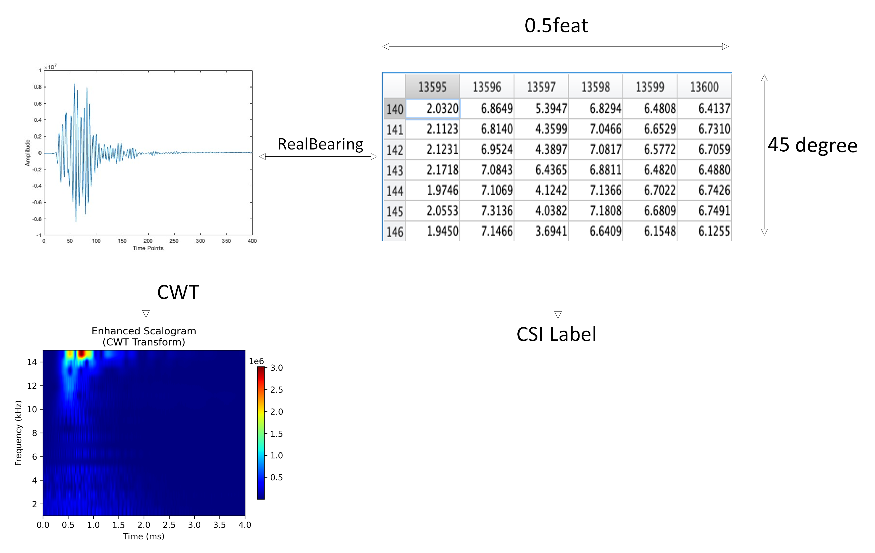
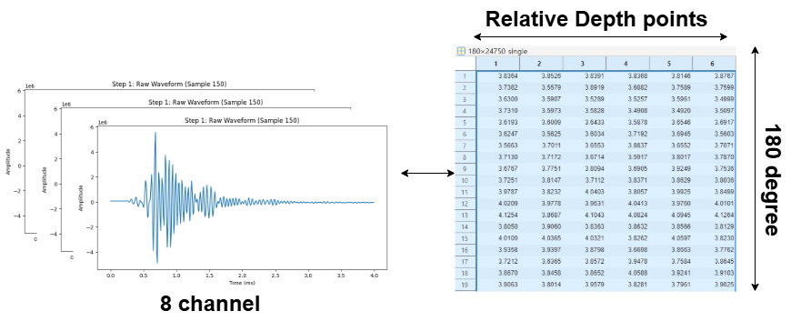
Review | Model | Correspondence | Problem
Proj1 | SE-ResNet |  | Miss match in azimuth
Proj2 | EfficientNetV2B0 |  | Discard all azimuth information
Improvement | Model | Method | Results
Proj1 | SE-ResNet & GradientBoostingRegressor | Using GradientBoostingRegressor to fit the ɛ-function (epsilon function) derived from eccentricity effects, in order to cleanse the waveforms and produce clean waveforms. | The model is able to learn, but its performance is very poor.
 | Hybrid Input SE-ResNet | Feeding the normalized eccentricity metadata as another input channel to the model, allowing the model to learn the relationship between the waveforms and the eccentricity metadata on its own. | Themodel is unable to learn any effective features.
Proj2 | EfficientNetV2B0 | FFT & The Severity(Zc) = max(0, 2.5 - Zc) transformation | The model performance is good, with a high degree of task completion.
Notes:
Today's presentation is divided into three parts. The first part is a review of past work, the second part analyzes the existing problems and proposes solutions, and the third part presents the improvements.
Here, I will briefly show the work that needs to be reviewed and the corresponding improvements made to that past work.
In all of this work, the most critical aspect is how to match the correspondence between ultrasonic and sonic data. How to maximize the use of ultrasonic data, correctly utilize sonic data, and define the relationship between the two is a very important topic.
In the presentation before last, which used the SE-ResNet model, I relied on Relative Bearing data to precisely match the sonic and ultrasonic data with a 45-degree azimuthal resolution. However, the problem was that the Relative Bearing data is unreliable in non-eccentered zones.
In the last presentation, which used the EfficientNetV2B0 model, I ended up discarding all angular azimuth information and only retained depth information. This ultimately achieved a relatively ideal result, but the obvious problem was the lack of azimuthal resolution.
Therefore, improvements were made to both efforts. For the SE-ResNet model project, data from the eccentered interval was used because the Relative Bearing data is more reliable in that zone, but the results were all poor. For the EfficientNetV2B0 model project, an FFT was applied to the ultrasonic data in the azimuthal direction, retaining structural information while discarding positional information. The final result was relatively ideal.

Slide 3
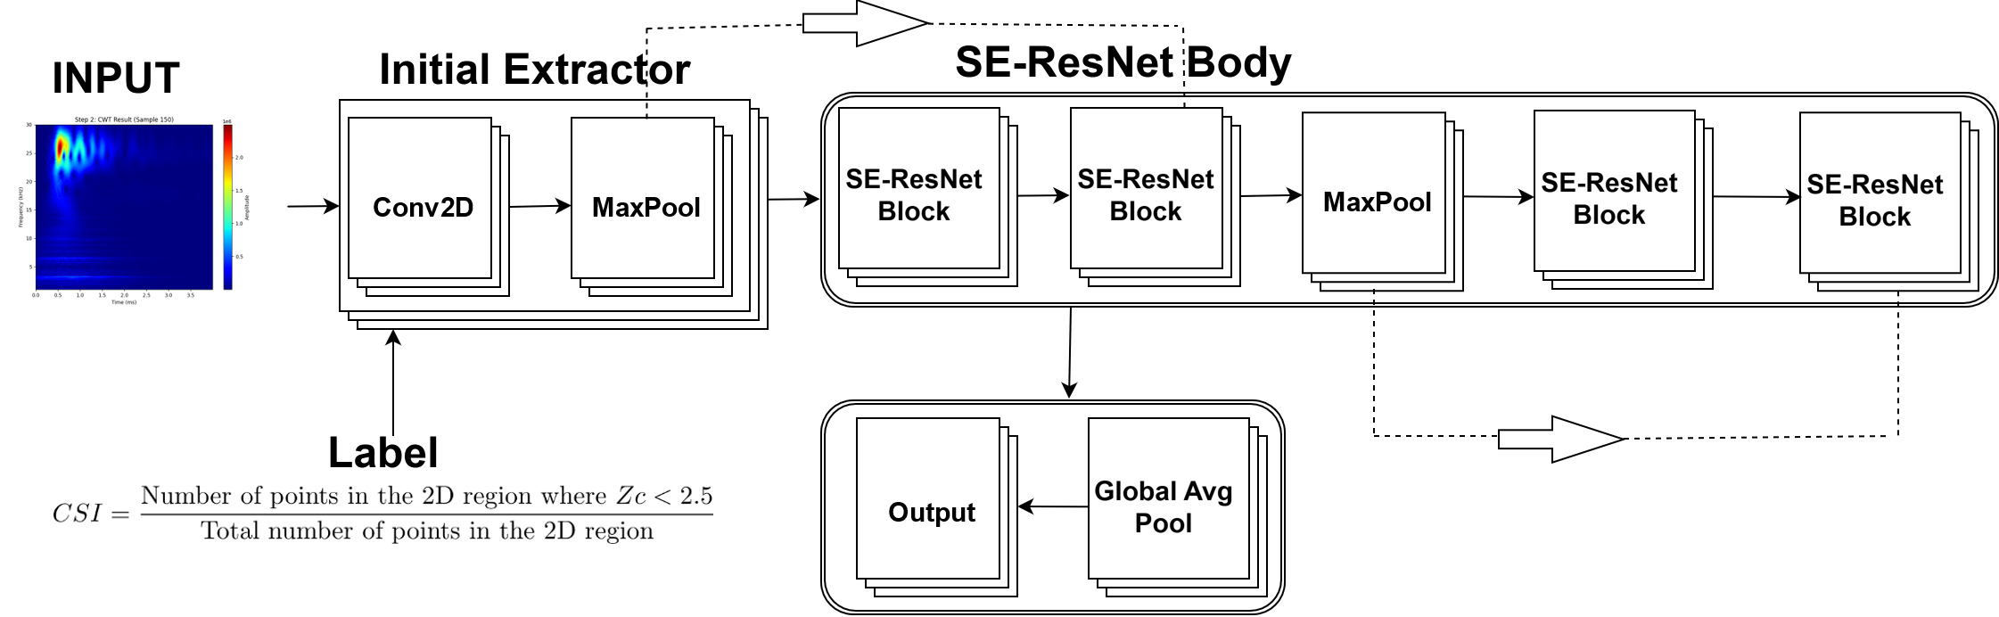
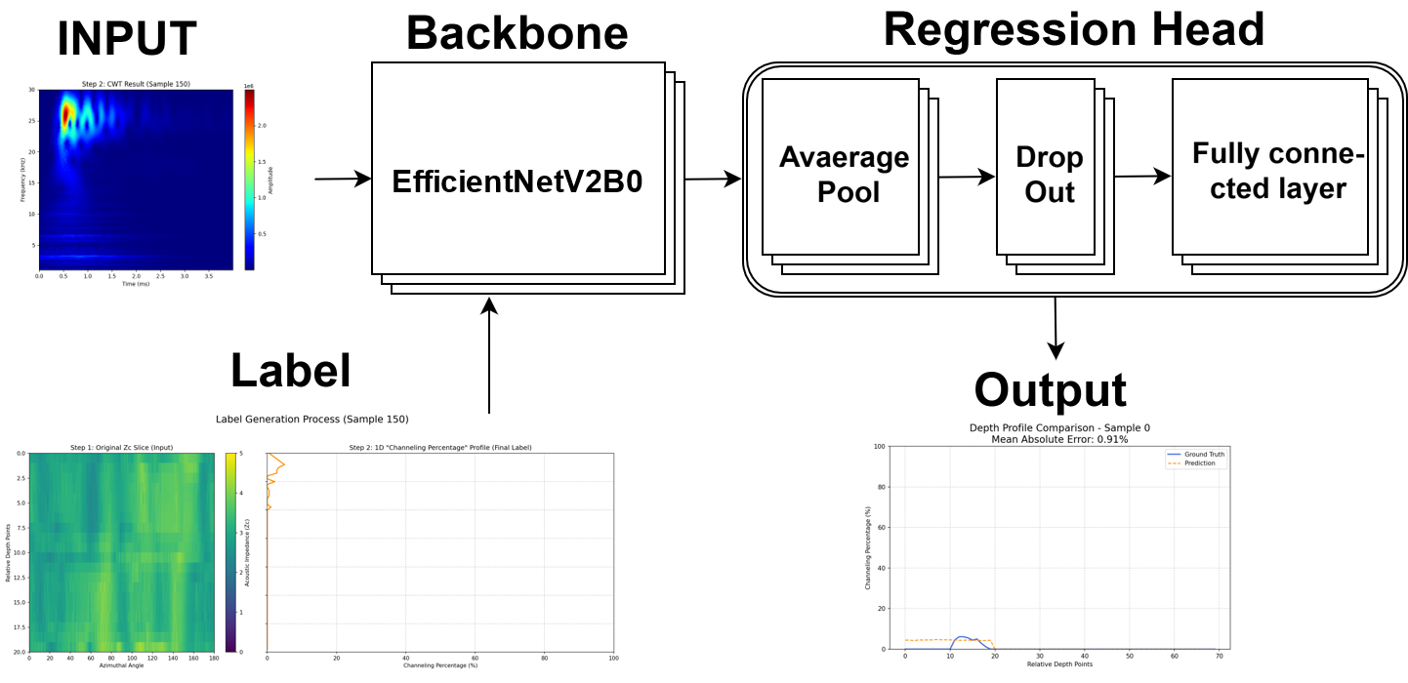
Review
CSI & SE-ResNet
1D percentage label & EfficientNet
Azimuth mismatch issue：In non-eccentered zones, the Relative Bearing data is unreliable.
All azimuth information is lost.
Notes:
In the presentation before last, using the SE-ResNet model, I defined the geological information reflected by a waveform (from one of the 8 azimuthally distributed receivers of an array at a specific depth point) as a 2D area spanning ±0.25 feet vertically and 45 degrees circumferentially/ˌsɝː.kəm.fərˈen.ʃəl/. Therefore, for the corresponding ultrasonic information, I sampled an identical 2D area and calculated a CSI value as the label. However, in the non-eccentered depth interval, the Relative Bearing value is unreliable, leading to an azimuth mismatch issue, which made the conclusions unreliable.
In the last presentation, using the EfficientNetV2B0 model, I defined the geological information reflected by the 8 waveforms from the 8 azimuthally distributed receivers as a 2D area covering the entire reception depth range and 360 degrees. The resulting match discarded all azimuthal information, retaining only depth resolution.

Slide 4
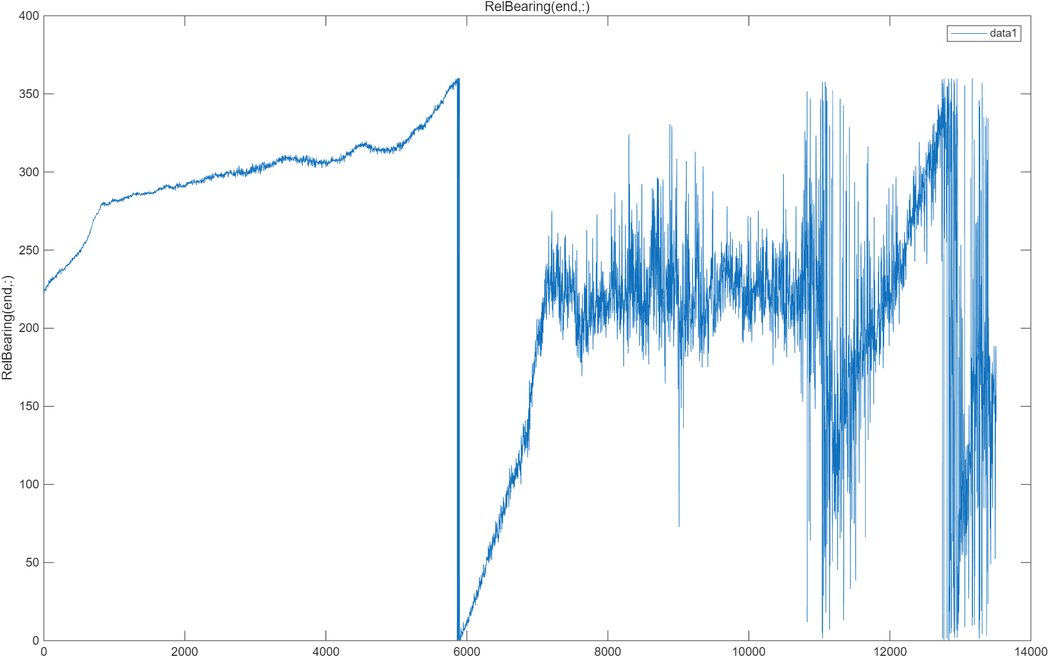
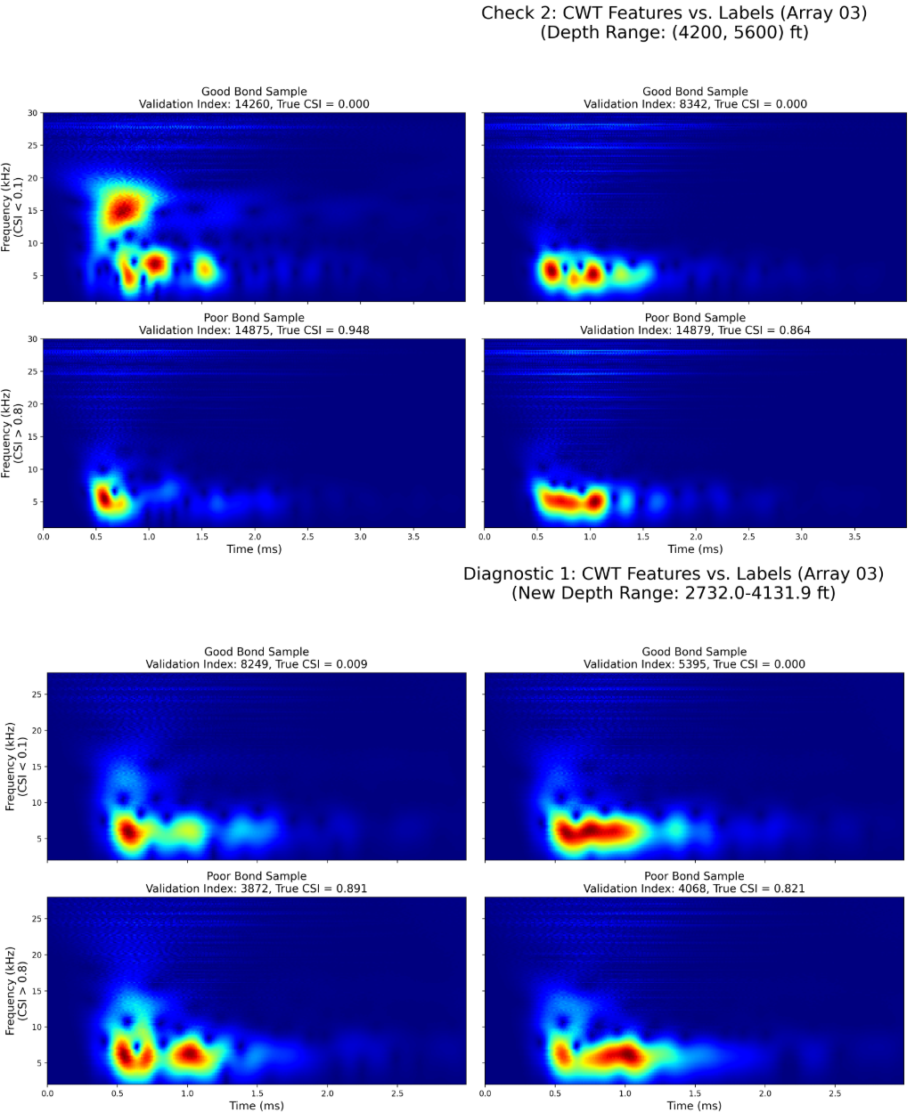
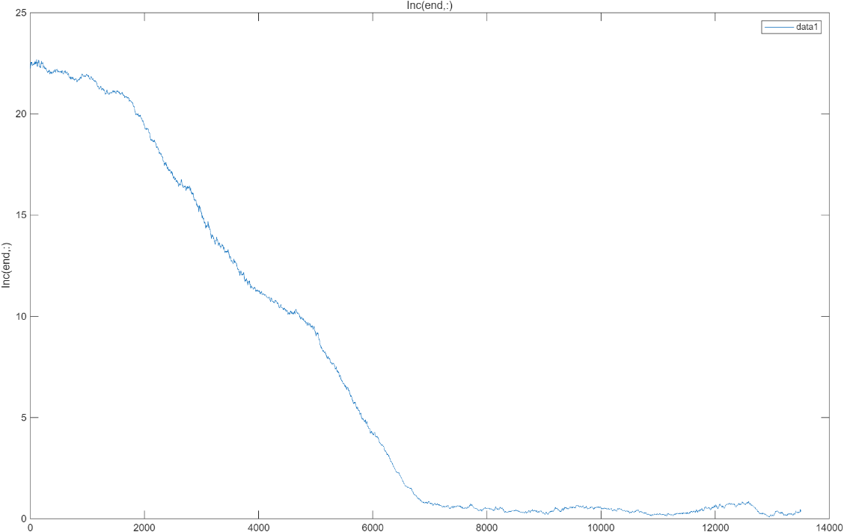
Problems
Relative Bearing
 | Eccentricity Condition | Non-Eccentricity Condition
Feature Information | Contaminated | Good
Relative Bearing | Good | Unreliable
Inc
Notes:
This page provides a specific demonstration of the problems mentioned earlier.
A contradictory situation can be observed: in the eccentered zone, the Rb data is reliable, but the waveform is affected; in the non-eccentered zone, the Rb data is unreliable, but the waveform is good. We can see from the CWT scalograms that in the eccentric zone, there is no obvious difference between the 'Good Bond' and 'Very Poor Bond' cases.

Slide 5
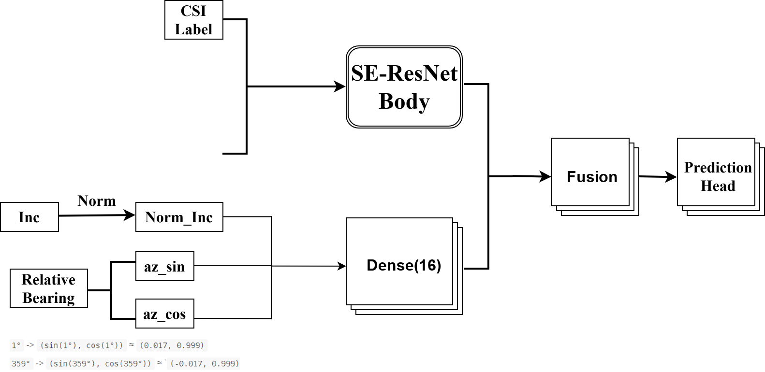
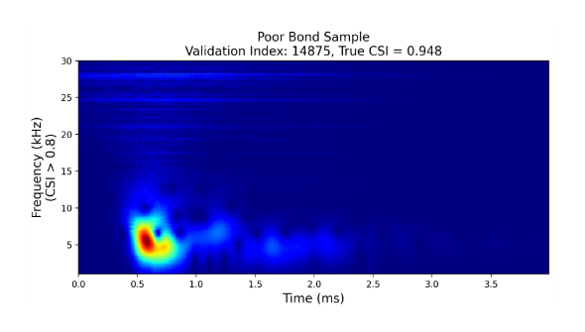
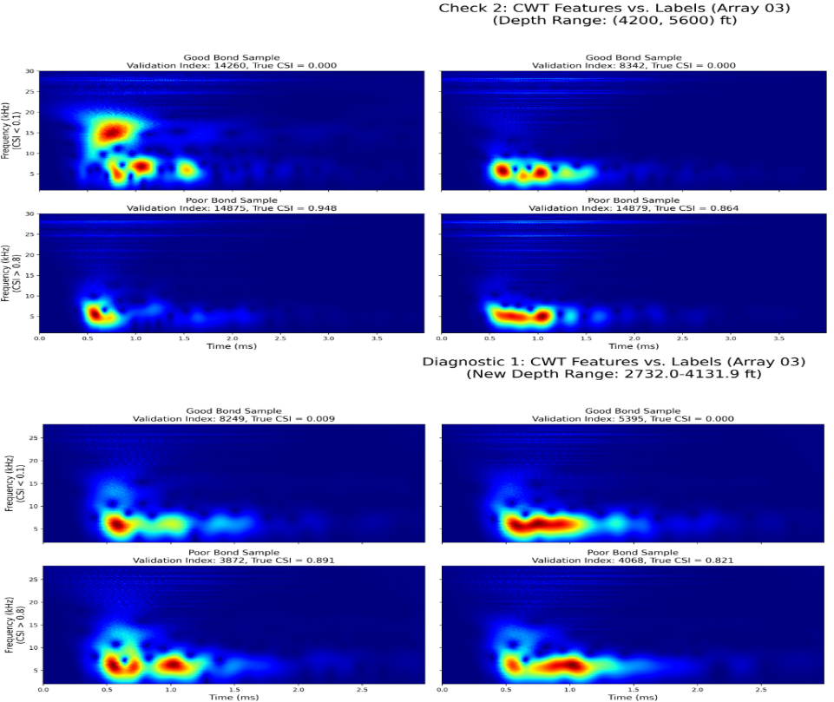
Given that in the 4200-5600 ft depth range, we simultaneously have 'bad' CWT features and 'good' metadata clues, can we then build a smarter dual-input model that learns on its own how to use the 'good' metadata to 'decouple' or 'correct' the 'bad' CWT features?
Eccentricity Condition
Hybrid Input Model
Model fails to learn anything
Notes:
First, let's look at the first improvement: the dual-channel, hybrid-input model.
Given that in the 4200-5600 ft depth range, we simultaneously have 'bad' CWT features and 'good' metadata clues, can we then build a smarter dual-input model that learns on its own how to use the 'good' metadata to 'decouple' or 'correct' the 'bad' CWT features?
Azimuth is a cyclical (ˈsiklək(ə)l ) datum (ˈdadəm). Physically, 359° and 1° are very close (only 2° apart).
However, if we just feed the numbers [359, 1] into the model, the model will think they are distinctly different and far apart (359 - 1 = 358). The model cannot understand that 359 'wraps around' back to 0.
By converting an angle $\theta$ into sin(theta) and cos(theta), we are mapping this 1D 'ring' onto a 2D 'circle'. Now, in the new (x, y) coordinate system, the points 1° and 359° become mathematically very close.
The first input channel is the standard CWT scalogram, and the second input channel is a series of metadata. The features extracted from both branches are then fused before being passed to the output head for prediction.
However, the final model failed to learn any effective information; the model was unable to learn anything useful from the 'bad' CWT input features.

Slide 6
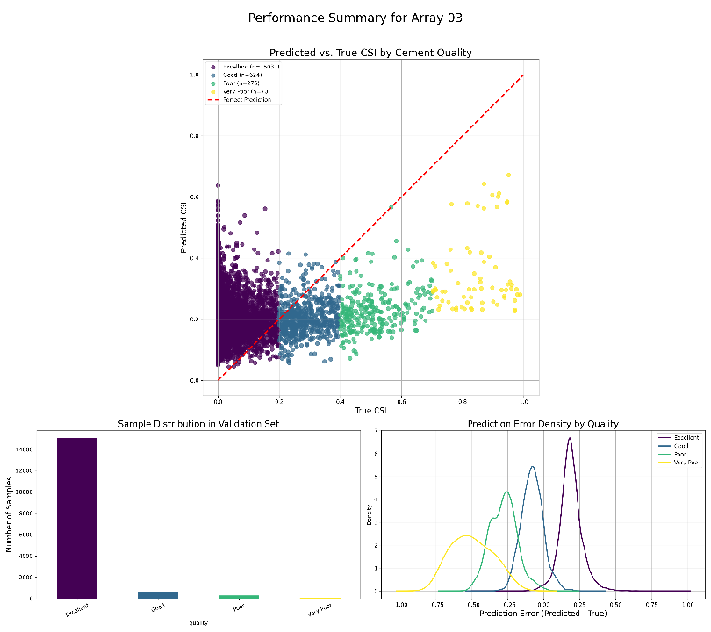
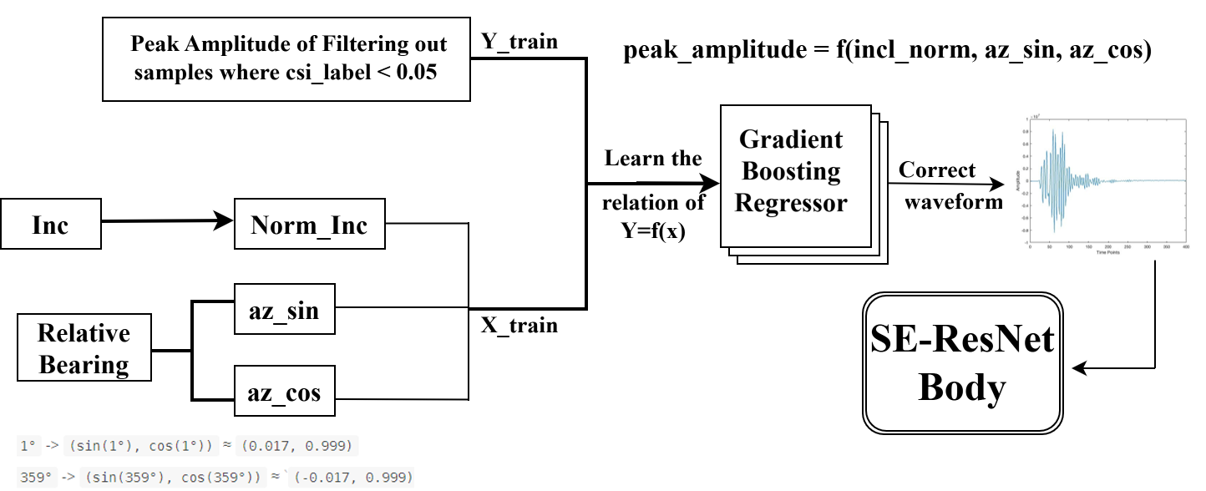
Eccentricity Condition
Eccentricity pre-correction
We no longer rely on the model to 'guess'. Instead, during the preprocessing stage, we first use the 'good' metadata to build an eccentricity correction model. We use this model to 'cleanse' the 'bad' waveform data, and finally, we feed only the 'clean' CWT features into a simple, single-input model.
The model is able to learn, but its performance is very poor.
This proves that our correction model itself is not sophisticated enough (or 'is insufficient') and cannot completely 'wash away' (or 'remove') all of the contamination.
Notes:
Next is the second improvement: the eccentricity pre-correction model.
We no longer rely on the model to 'guess'. Instead, during the preprocessing stage, we first use the 'good' metadata to build an eccentricity correction model. We use this model to 'cleanse' the 'bad' waveform data, and finally, we feed only the 'clean' CWT features into a simple, single-input model.
We extract the waveform peak amplitude from all 'perfect bond' samples (CSI < 0.05) as one input, and the previously extracted metadata as another input. We then let the machine learning model, GradientBoostingRegressor, fit the $\epsilon$-function (epsilon function) caused by the eccentricity effects, and use this $\epsilon$-function to correct all other waveforms.
The model is able to learn, but its performance is very poor. This proves that our correction model itself is not sophisticated enough (or 'is insufficient') and cannot completely 'wash away' (or 'remove') all of the contamination.

Slide 7
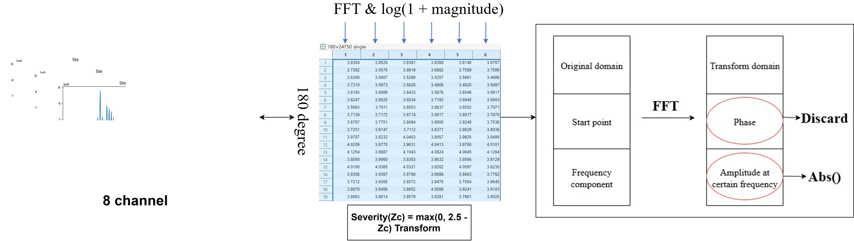
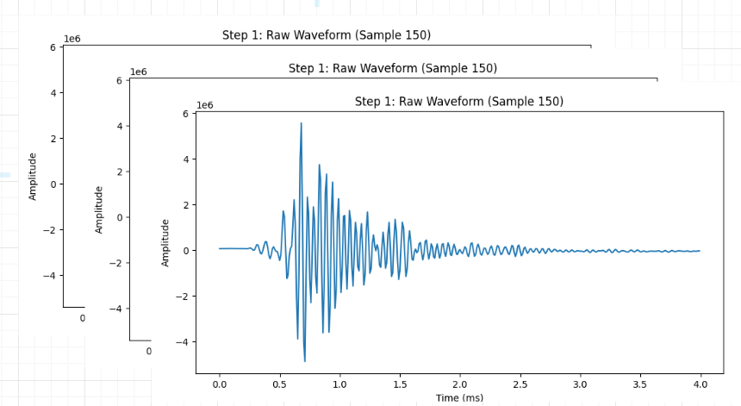
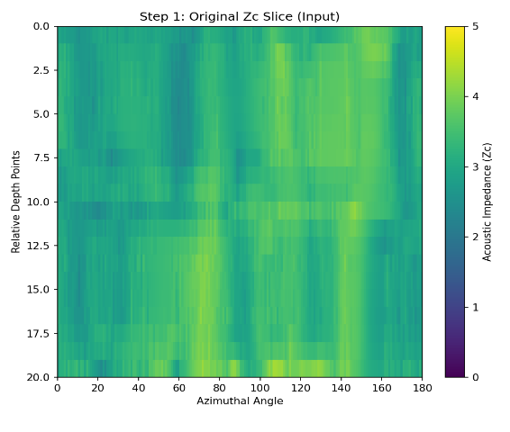

Non Eccentricity
Preprocess
Notes:
For the project in the non-eccentered zone, the following preprocessing improvements were made first.
For the 2D slice corresponding to the 8 azimuthally distributed receivers (covering 360 degrees) and their corresponding send-receive depth interval, we first apply the severity transformation to the ultrasonic data: points with acoustic impedance (Zc) greater than 2.5 are uniformly set to 0, while values less than 2.5, like 2.3, become 0.2 (i.e., Severity(Zc) = max(0, 2.5 - Zc)).
Afterward, we apply an FFT to the ultrasonic data in the azimuthal direction to get the FFT coefficients and then apply a log transform to them.
Finally, we keep the magnitude and discard the phase information; that is, we retain the structural information in the azimuth while discarding the positional information.
The resulting FFT labels are shown in the figure below. The vertical axis is depth, and the horizontal axis is the FFT coefficients.

Slide 8
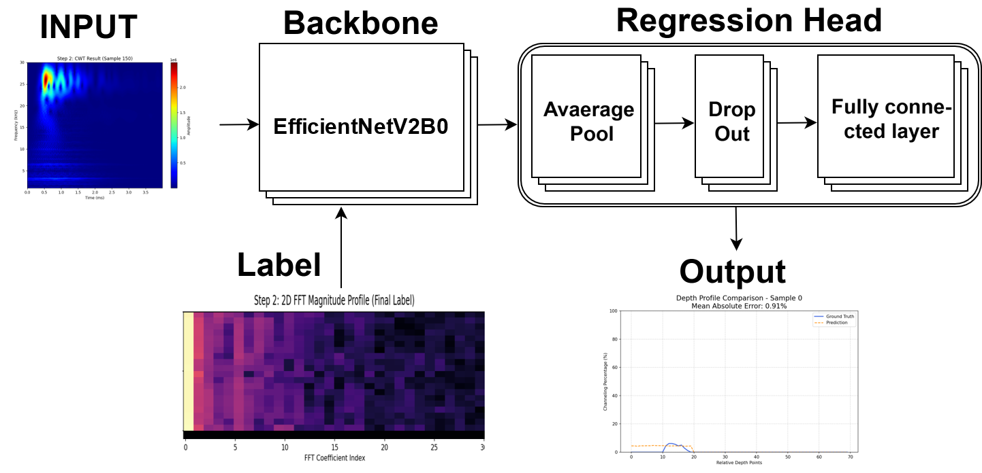
Non Eccentricity
Modeling
Notes:
Then, the CWT scalograms (as input) and the FFT-transformed labels (as target) are fed into the EfficientNet model used in the last presentation, which, after a regression head, outputs the corresponding prediction.

Slide 9
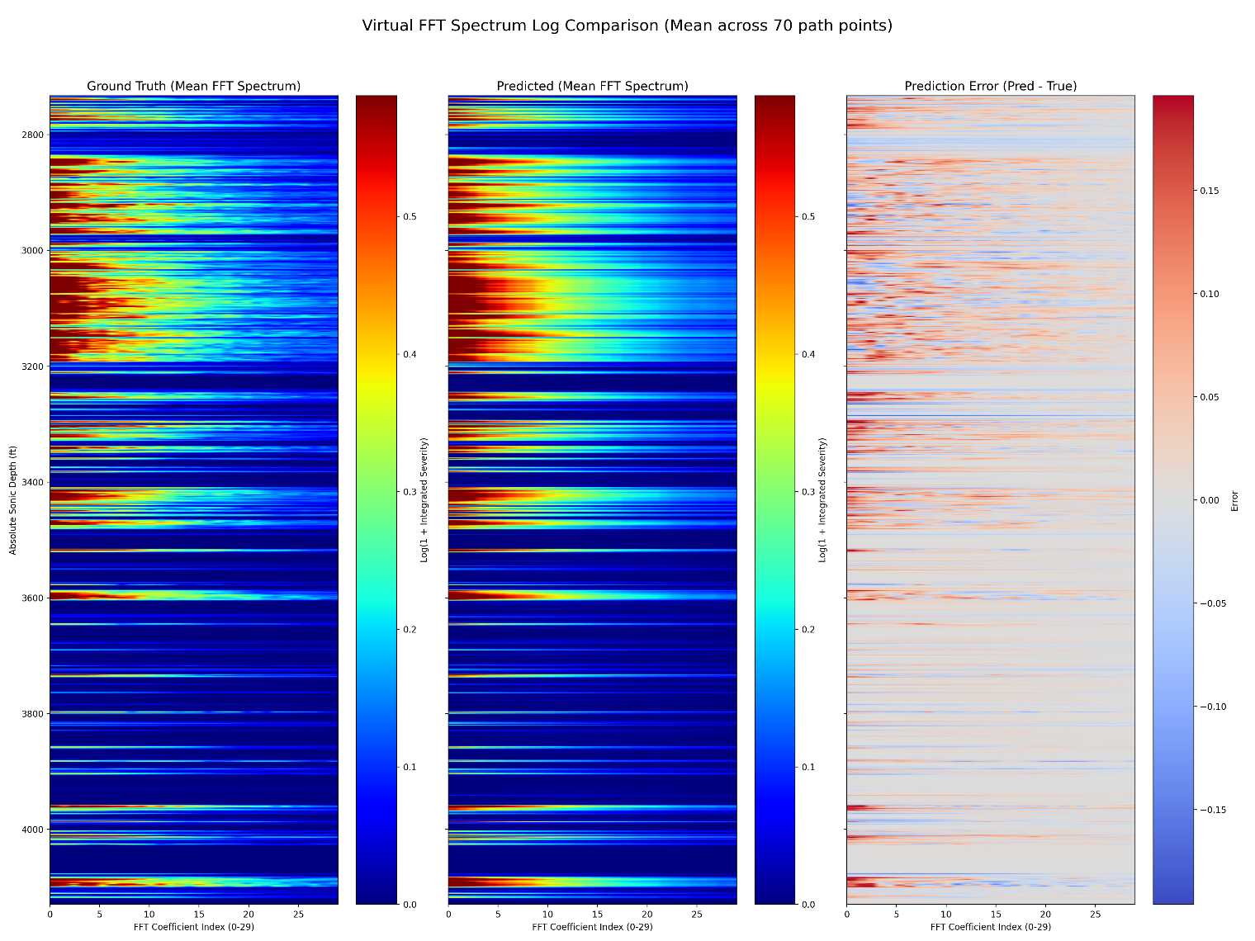
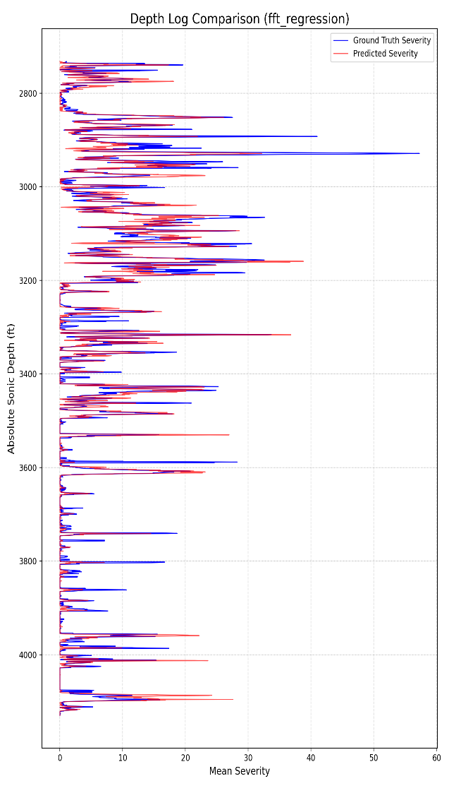
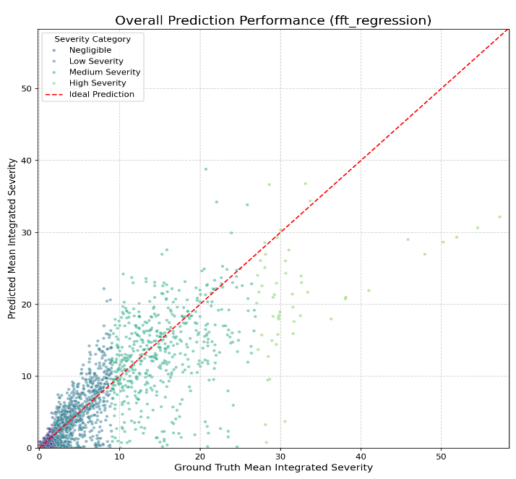
Non Eccentricity
Results
The model's prediction performance is good for good cement bonding; however, the worse the cementing condition, the worse the model's prediction performance.
s
Notes:
The first chart is a scatter plot evaluating the overall model performance. As you can see, the result is as before: the model's prediction performance is good for good cement bonding; however, the worse the cementing condition, the worse the model's prediction performance.
The second chart is a curve plot of the average severity vs. depth. The blue curve is the ground truth, and the red curve is the prediction. It can be seen that the result is quite good, providing a relatively close prediction in most intervals.
The third chart shows, from left to right, the FFT coefficient maps for the ground truth, the prediction, and the difference between the two (error).

Slide 10
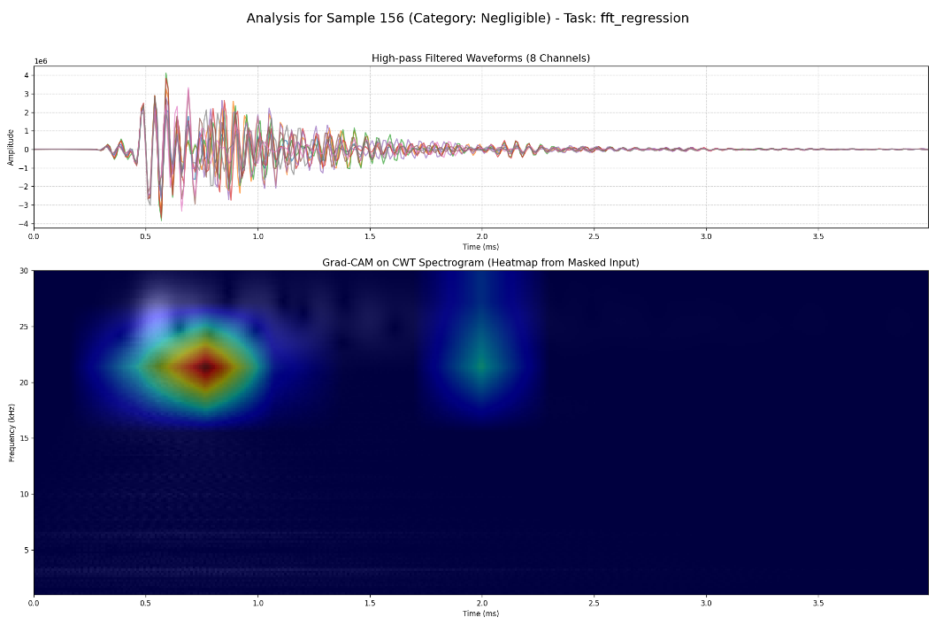
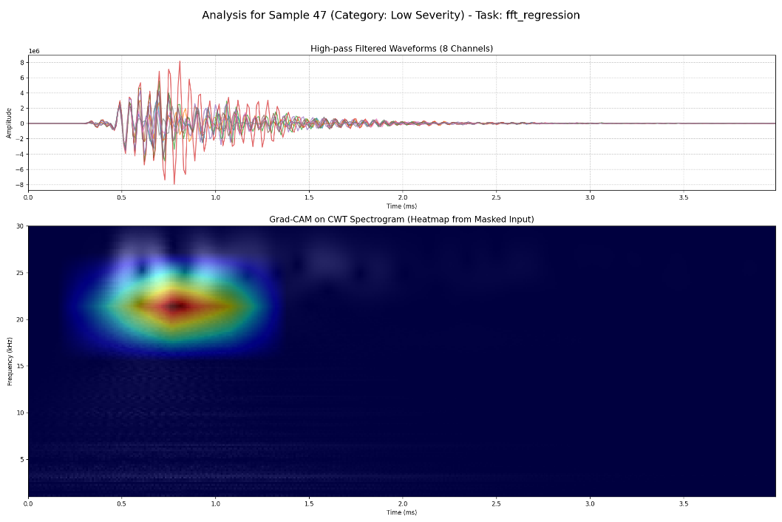
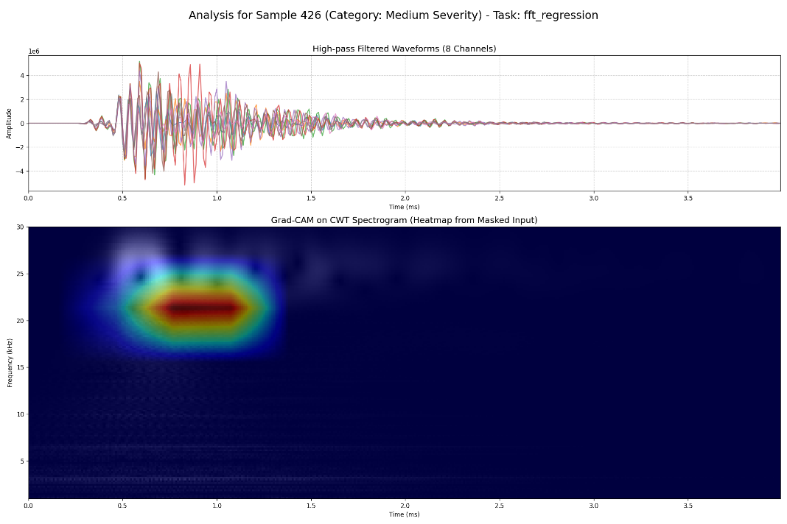
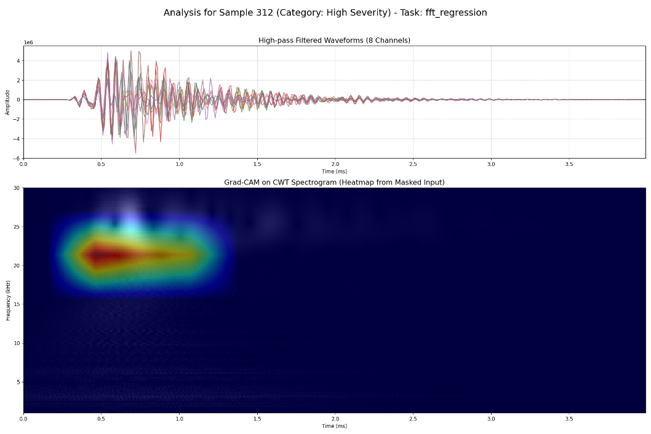
Non Eccentricity
Results
s
This time, regardless of the cementing condition, the model's high-attention regions are consistently located on the time-frequency features between 0.5ms-1ms and 20-23kHz. We can apply high-resolution filtering to individual samples based on their specific high-attention regions, in order to observe which wave is critical for the model's channeling assessment.
Notes:
This time, regardless of the cementing condition, the model's high-attention regions are consistently located on the time-frequency features between 0.5ms-1ms and 20-23kHz. As a next step, we can apply high-resolution filtering to individual samples based on their specific high-attention regions, in order to observe which wave is critical for the model's channeling assessment.

Slide 11
Thanks for your listening
Notes:
Thank you all for your time. Any questions?

