Slide 1
Expense Tracker
Ben Landen, Adam Delaney, Nathan Bullock and Andrew Littleton

Slide 2
Our Mission/What we aim to do
We are a small development team working to develop database driven web applications
Our mission is to develop quality applications to help make user’s lives easier and more organized
Our primary application is the Expense Tracker Web Application

Slide 3
Our Purpose
We wanted to solve the problem people face of keeping track of the money they spend
The goal for our users is to help decide how much they should spend on different things each month or in any given time period.
Expense Tracker allows users to monitor expenses by type and budget by expense

Slide 4
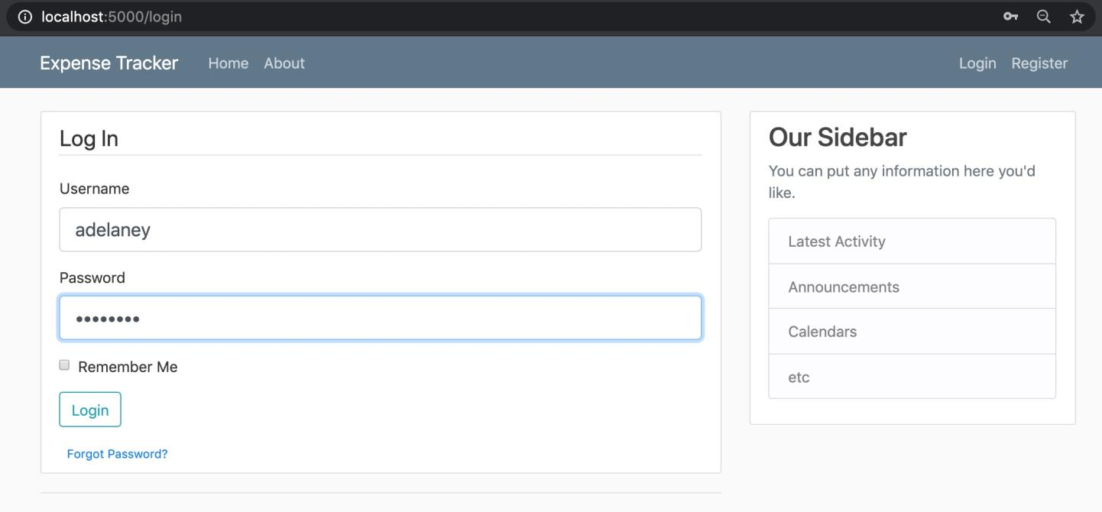
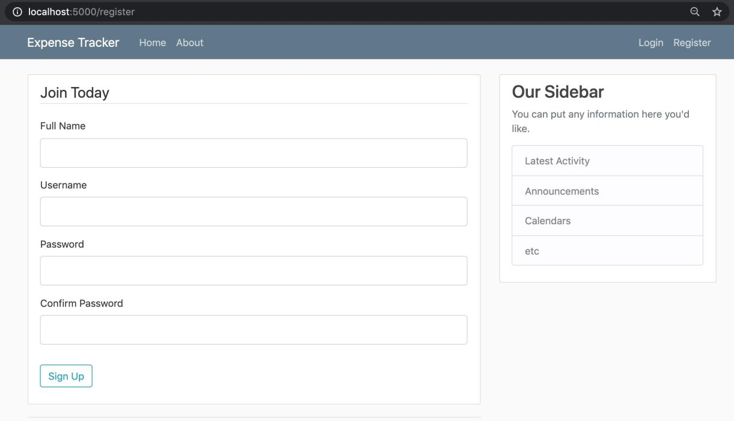
Who are our Users?
Our primary user groups are those who would like to manage their spending practices
Can belong to any group of people looking to manage spending
College students
Parents
Anyone
Access control is governed by user authentication involving a username/password

Slide 5
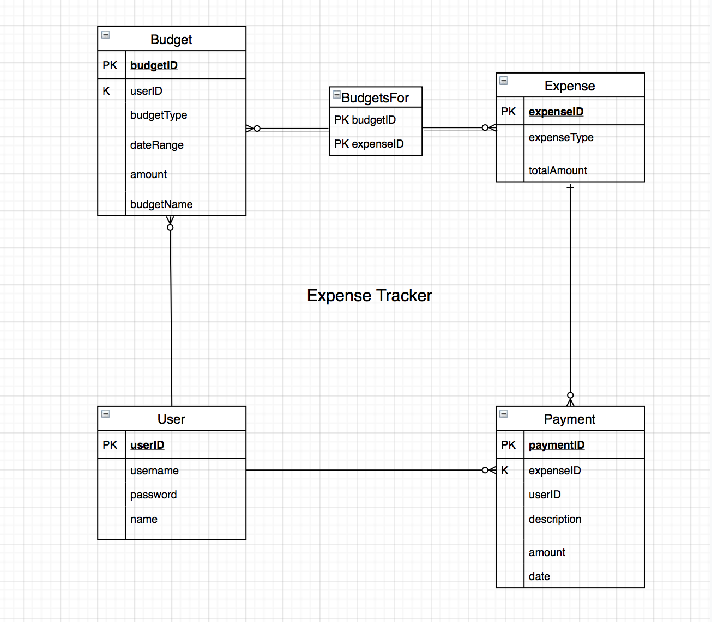
Our ERD
Users can make many payments and budgets
Budgets can have many expenses
Expenses can have many budgets
Expenses can have many payments made towards it
Each Payment must made towards an expense

Slide 6
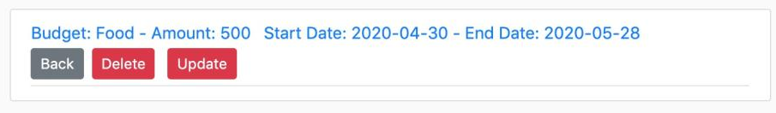
How to use our product
The Home Page is where the user will land upon opening the application
From here they will see the payments made in descending order by date
The Top Navigation bar will take the user to the pages to add Expenses, Budgets, or Payments
Each Payment can be made towards an Expense and Budgets can be made regarding expenses
Payments, Budgets, and Expenses can be updated or deleted from their individual selection controls

Slide 7
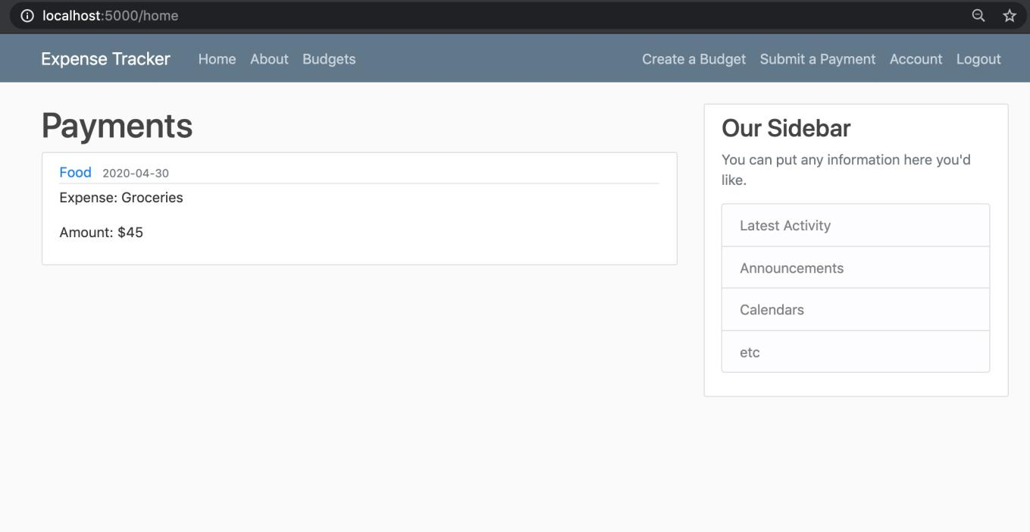
Home Page
Default Landing Page

Slide 8
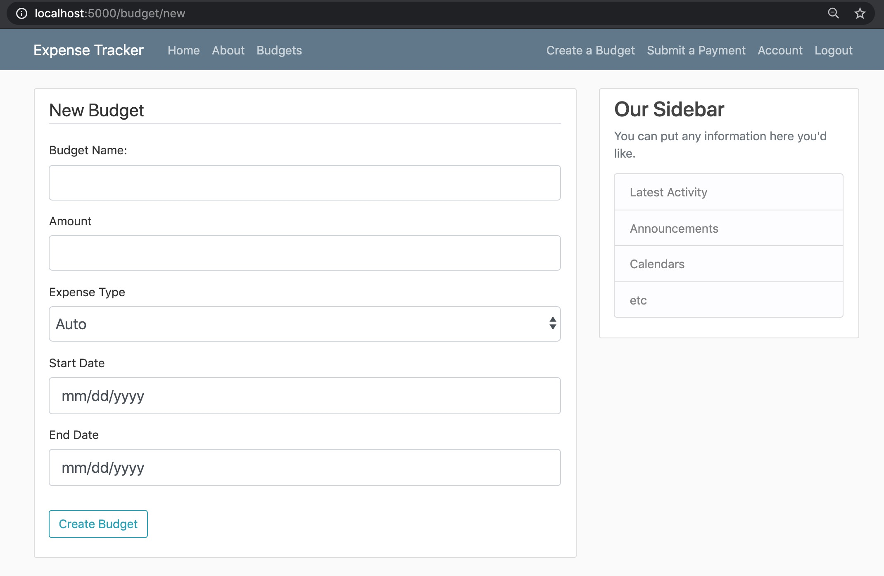
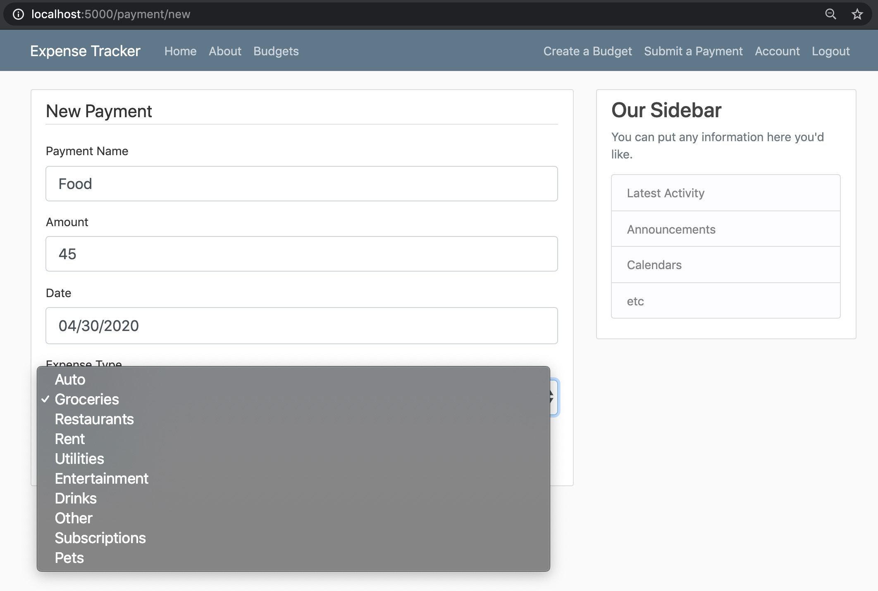
Creation
Empty Budget Creation Window
Filled Payment Creation Window with Dropdown

Slide 9
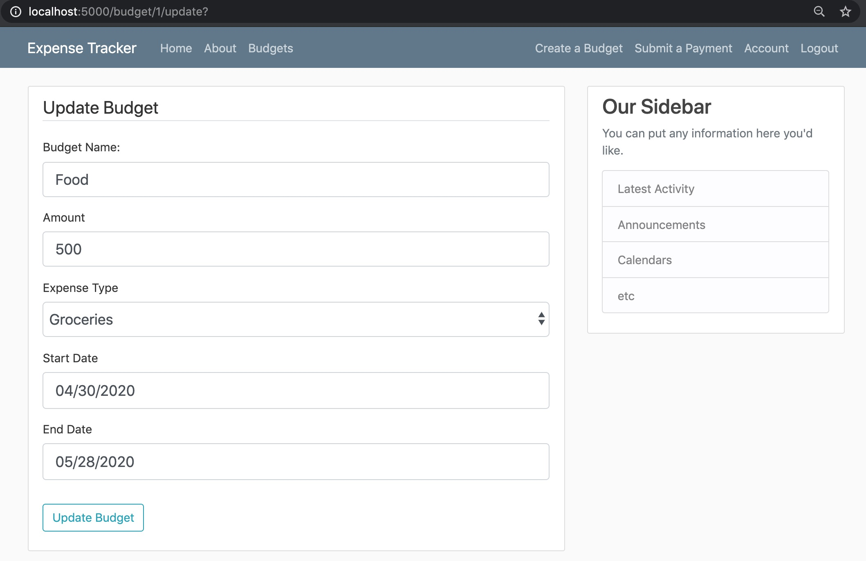
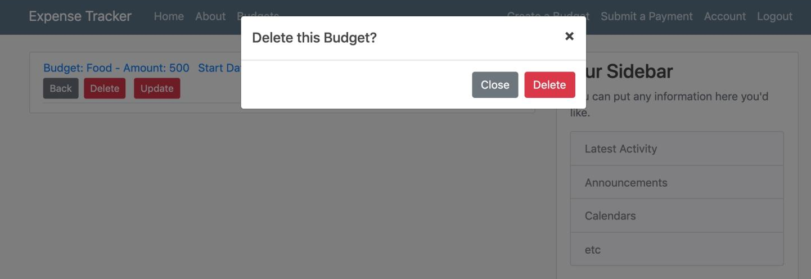
Modification and Deletion
Deletion Confirmation
Budget Update Window

Slide 10
How we used CRUD in our project
Create:
Payments, Expenses, and Budgets can be created by the user
Read
For each user, their personal Payments, Expenses, and Budgets are read from the database and made viewable through the web app
Update:
Users are given the ability to modify any of the Payments, Budgets, and Expenses they have created
Delete
Users are given the ability to delete any of the Payments, Budgets, and Expenses they have created

Slide 11
How our program satisfies our Mission
Our Expense Tracker provides users the ability to keep track of their different kinds of expenses and budget each one accordingly or not at all
Users will better be able to manage spending if they are able to keep track of it through our application.

