Slide 1
Opening New Turkish Restaurants in Bucharest
By Abraham Liu
IBM Data Science Professional Certificate

Slide 2
Business Problem
Bucharest is the capital and cultural, industrial, and financial center of the country of Romania with a population of over 2 million people.
Because Bucharest is such a cultural city, opening new Turkish restaurants is an interesting proposition, as it may be very profitable. With this idea, I want to see where in Bucharest should a Turkish restaurant open up.

Slide 3
Data Sources
I extracted data for the neighborhoods of Bucharest from Wikipedia.
In order to get the geographical coordinates of the neighborhoods, I will be using the python geocoder library.
I will use the Foursquare API venue explore method to get venues of the given neighborhoods of Bucharest.
I will also use the Foursquare API venues method to get ranks and likes of restaurants by given venue id.

Slide 4
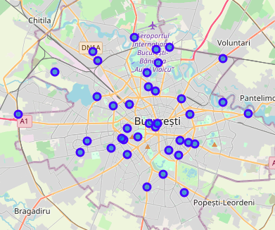
Methodology
I extracted the neighborhood data from Wikipedia and put blue dots on a map of Bucharest to see the center of each neighborhoods. There are a total of 40 neighborhoods in Bucharest.

Slide 5
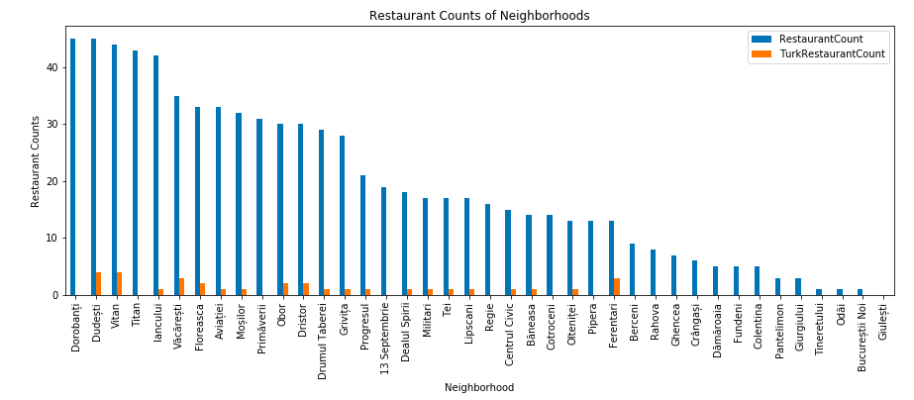
Methodology
Through the use of Foursquare API, I got venues 1km around the center of each neighborhood with a limit of 100 venues. I merged venue data with the neighborhood data.
I filtered all restaurants and Turkish restaurants. We can see from a histogram of restaurants that 20 neighborhoods do not have any Turkish restaurants.

Slide 6
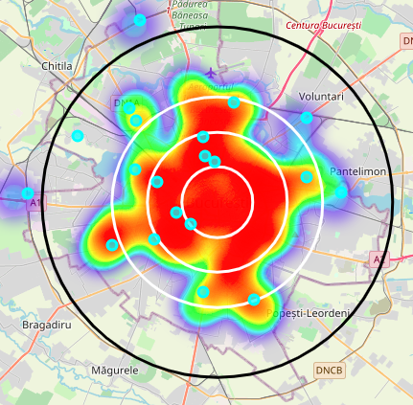
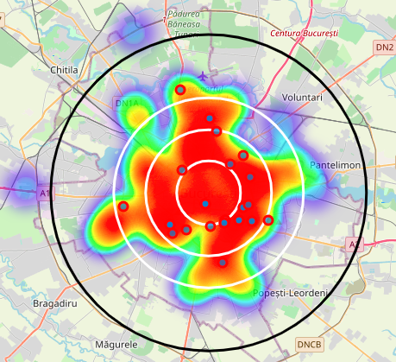
Methodology
With red markers, I superimposed Turkish restaurants on the first heatmap.
With blue markers, I superimposed Turkish restaurants with a rating of less than 7 on the first heatmap.
With cyan markers, I superimposed neighborhoods with no Turkish restaurants on the second heatmap.

Slide 7
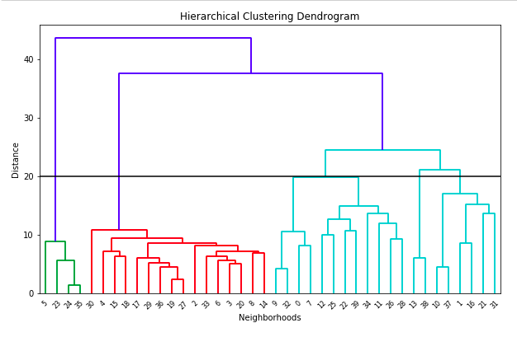
Methodology (Clustering)
I used Agglomerative Clustering to cluster neighborhood according to the count of venue categories in each neighborhood. According to the graph, it allowed me to divide the neighborhoods into 6 different clusters (cut off distance at 20, the horizontal black line).

Slide 8
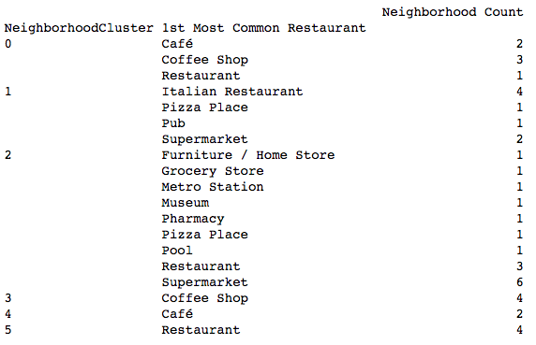
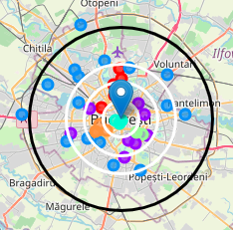
Methodology (Clustering)
Agglomerative Clustering gave me 6 different clusters:
Cluster 0 (Red): Café, Italian Restaurant, Pub
Cluster 1 (Purple): Café, Pub
Cluster 2 (Blue): Grocery Store, Plaza
Cluster 3 (Cyan): Café, Hotel
Cluster 4 (Green): Café, Lounge
Cluster 5 (Orange): Plaza, Bistro, Supermarket

Slide 9
Results
Turkish restaurant count in Bucharest is 4.25%
Total Number of Restaurants: 494
Total Number of Turkish Restaurants: 21
From the bar chart, we can see:
Dorobanți is the neighborhood with the most restaurants.
Dorobanți has many restaurants, but no Turkish restaurants.
Bucureștii Noi, Giulești, and Odăi are the neighborhoods with the least amount of restaurants.
20 neighborhoods do not have any Turkish restaurants. We can probably choose one of these neighborhoods to open a Turkish restaurants in.
From the heat maps, we can see:
There are too many restaurants 4km from the center of Bucharest.
There are enough restaurants between 4-6km from the center of Bucharest.
After 6km from the center of Bucharest, there are not many restaurants.
All Turkish restaurants are about 2-4km from the center of Bucharest with them in the South, North, and East parts of Bucharest.
There are no Turkish restaurants in West and North West Bucharest.
Some Turkish ratings do not have good ratings. This suggests that people do not prefer Turkish restaurants and new restaurants should not be opened near them.

Slide 10
Discussion
Cluster 2 suffers from a lack of restaurants. We can think about adding a Turkish restaurant in Cluster 2, in particular on the West side of Bucharest.
Cluster 0 has a preference for Italian restaurants, suggesting that Turkish restaurants would not be successful in Cluster 0, with the exception of one location, which might work.
Cluster 1, 2, and 3 are full of restaurants, as shown with the heatmap.

Slide 11
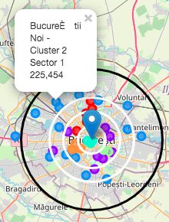
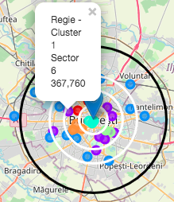
Conclusion (Part 1)
I chose Regie since the west part of Bucharest has no Turkish restaurants and Regie is also very close to the center. Regie is also in a Cluster that seems to be very open to a variety of restaurants.
I chose Bucureștii Noi because, like Regie, it is in the west part of Bucharest which has not Turkish restaurants. Considering the lack of restaurants 6km from the center, this is a good option to open one in this area.

Slide 12
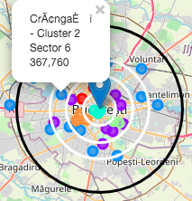
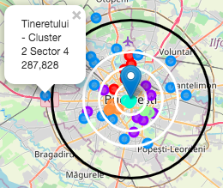
Conclusion (Part 2)
I chose Crângași because like Bucureștii Noi and Regie, it is in the west part of Bucharest which has not Turkish restaurants. I chose this Sector specifically because of the large population. With a large population, it can support multiple restaurants and a diverse choice of restaurants is a great business choice.
I chose Tineretului because it is very isolated and has no Turkish restaurants. Because of its isolated nature, this neighborhood does not have many restaurants and it should open a Turkish restaurant.

Slide 13
Thank You!

