Slide 1
Integrating Cancer Mutations, Gene Expression &
Neoantigen Prediction in Colorectal Cancer
TCGA-COAD | Project 130
[Group Member 1] • [Group Member 2] 2026-07-20
Somatic mutations → expression → mutant peptides → HLA binding → candidate neoantigens
Notes:
Colorectal cancer via TCGA-COAD. Core pipeline builds mutation, expression and integrated matrices; advanced component predicts mutant peptides and their neoantigen potential.

Slide 2
Project overview & objectives
Dataset
One cancer type (colorectal / TCGA-COAD); build an integrated somatic-mutation + expression dataset.
Core
Mutation-by-sample matrix, gene-by-sample TPM matrix, and an integrated matrix with a cancer-level expression summary.
Advanced
Translate coding mutations into mutant peptides; predict HLA binding and neoantigen potential.
Rigour
Fully reproducible from numbered scripts; exact software versions and access dates; tab-delimited outputs.
Notes:
State the two deliverable tiers: core (80 pts) and advanced (20 pts), and the reproducibility rules.

Slide 3
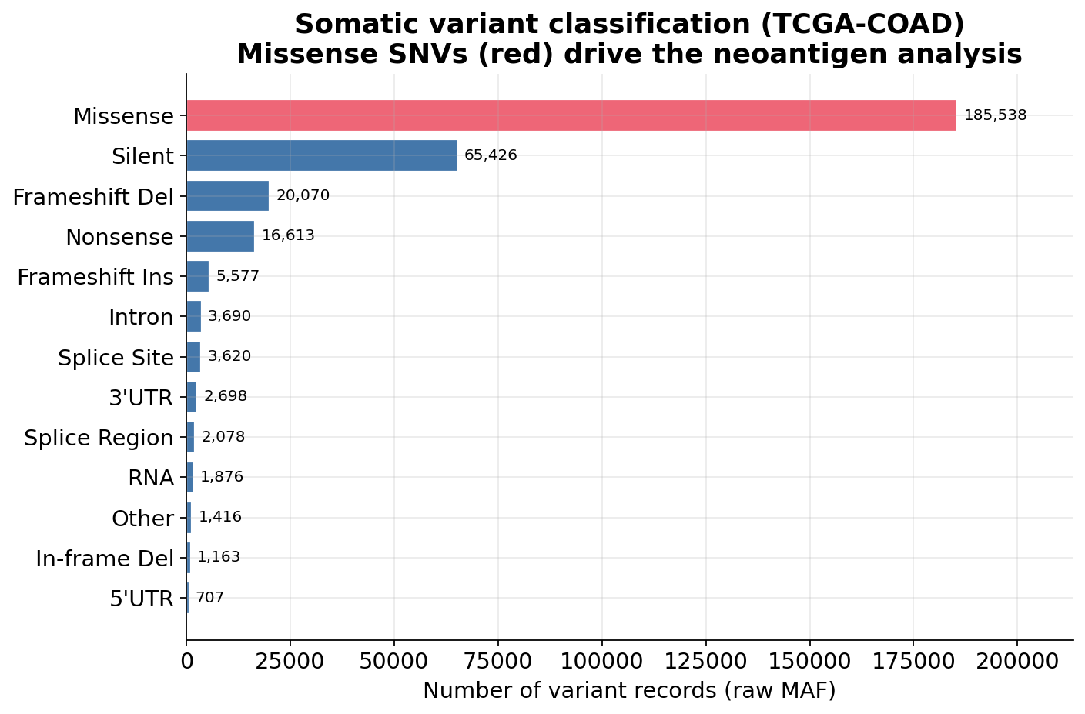
Dataset selection: colorectal cancer
TCGA-COAD chosen: large, well-characterised colorectal cohort with a high neoantigen burden.
Somatic mutations from the GDC project-level Masked Somatic Mutation MAF (GRCh38).
Core analysis filtered to protein-coding, PASS, missense single-nucleotide variants.
Missense SNVs (red) are the substrate for the neoantigen analysis.
Somatic variant classes in the raw TCGA-COAD MAF
Notes:
Why colorectal: KRAS/TP53/APC/PIK3CA drivers, MSI subset with high neoantigen load. Filtering rationale from Section 4.

Slide 4
Data sources & provenance
Dataset | Source | Identifier / assembly | Access
Somatic mutations (MAF) | NCI GDC — TCGA-COAD | Masked Somatic Mutation, GRCh38 (gdc-client manifest) | Open
RNA-seq expression | cBioPortal — coadread_tcga_pan_can_atlas_2018 | data_mrna_seq_v2_rsem.txt (RSEM, HiSeq RNASeqV2) | Open
Reference proteome | UniProt | Reviewed human proteome UP000005640 | Open
All downloads accessed 2026-07-20. Assembly is GRCh38/hg38 throughout — no coordinate mixing (Rule 5).
RNA-seq (not microarray). RSEM values are converted to TPM (documented) — never mislabelled (Rule 6).
Notes:
Emphasise open access, exact files, download dates, single assembly.

Slide 5
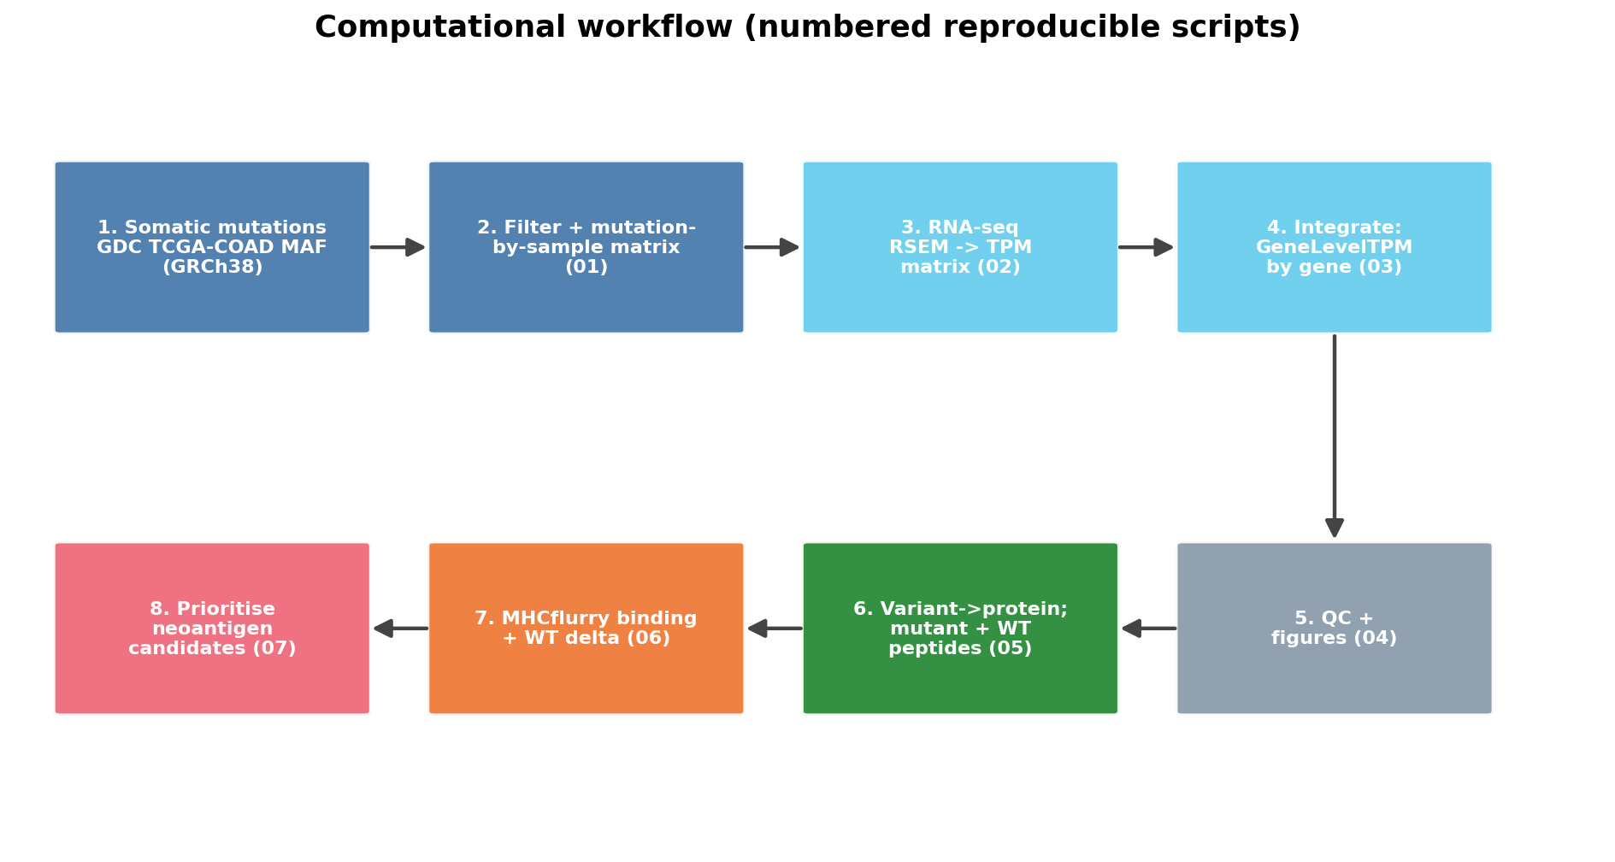
Computational workflow
Eight numbered, reproducible scripts (01–07) from MAF + RNA-seq to prioritised neoantigens.
Notes:
Walk left-to-right, top row = core, bottom row = advanced. Each box is one script.

Slide 6
Part I — Core pipeline
Mutation matrix · TPM matrix · integration · quality control

Slide 7
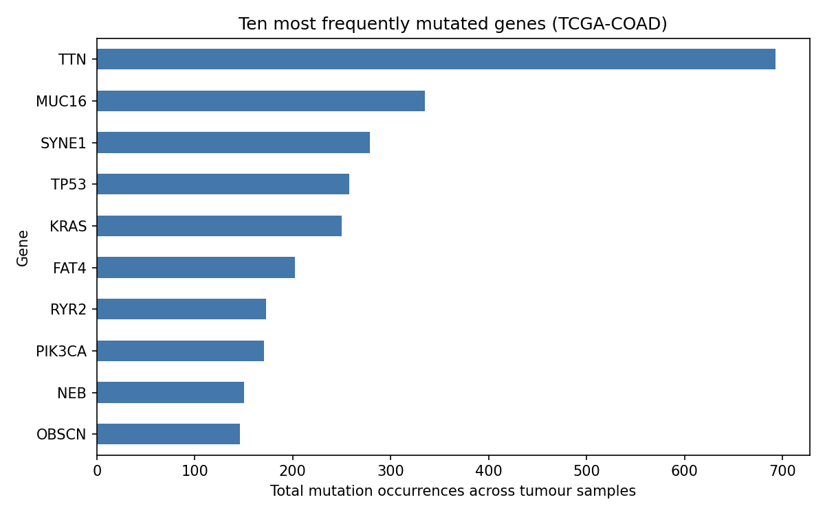
1
Somatic mutation processing
Sections 4–5 • script 01_build_mutation_matrix.py
Filter to protein-coding, PASS, nonsynonymous missense SNVs.
Collapse tumour barcodes to TCGA sample level.
Binary mutation-by-sample matrix; one row per distinct mutation (HGVS).
# Section 4 filters (all GRCh38)
keep = ((df.BIOTYPE == "protein_coding") &
df.GDC_FILTER.isin(["", "PASS"]) &
(df.Variant_Classification ==
"Missense_Mutation") &
(df.Variant_Type == "SNP"))
# distinct mutation = Gene + HGVSc + HGVSp
# value = 1 if present in sample else 0
Top mutated genes — TP53/KRAS/PIK3CA drivers recovered
Notes:
310,472 raw → 184,574 filtered → 153,996 distinct mutations × 586 samples.

Slide 8
Deliverable 01 — mutation-by-sample matrix
Gene_Name | Mutation | AminoAcid_Change | TCGA-…-01 | TCGA-…-02 | TCGA-…-03
KRAS | c.35G>A | p.G12D | 0 | 1 | 0
KRAS | c.35G>T | p.G12V | 0 | 0 | 1
BRAF | c.1919T>A | p.V640E | 0 | 0 | 0
TP53 | c.743G>A | p.R248Q | 1 | 0 | 1
153,996 distinct mutations × 586 tumour samples. Multiple mutations in a gene are separate rows (Section 5).
Notes:
Values strictly 0/1; HGVS notation; tab-delimited (Rule 1).

Slide 9
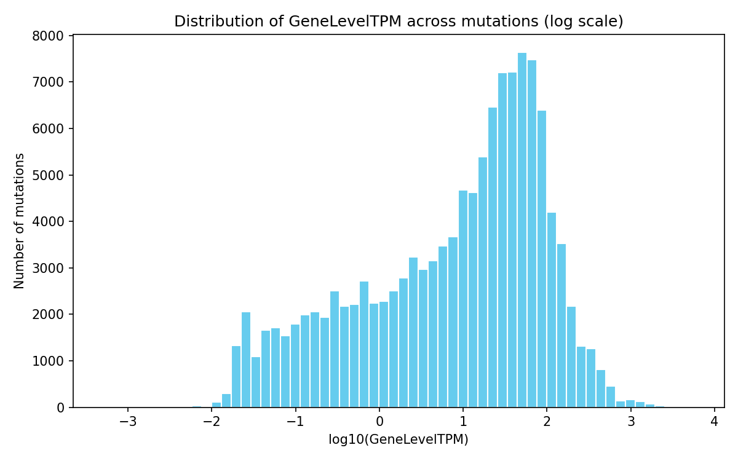
2
Expression: RSEM → TPM
Section 6 • script 02_build_expression_matrix.py
Why convert? RSEM sample sums ≈ 1.8×10⁷, so values are NOT TPM. Rescaling each sample to 1×10⁶ yields true TPM (Rule 6).
# RSEM -> TPM: rescale each sample to 1e6
col_totals = expr.sum(axis=0, skipna=True)
tpm = expr.divide(col_totals, axis=1) * 1e6
assert np.allclose(tpm.sum(axis=0), 1e6)
# duplicated gene symbols summed -> one row
20,511 genes × 592 tumour samples · 5.64% missing → NA (never 0)
Distribution of GeneLevelTPM (log scale)
Notes:
Emphasise the honest RSEM→TPM conversion. Every sample column sums to exactly 1e6.

Slide 10
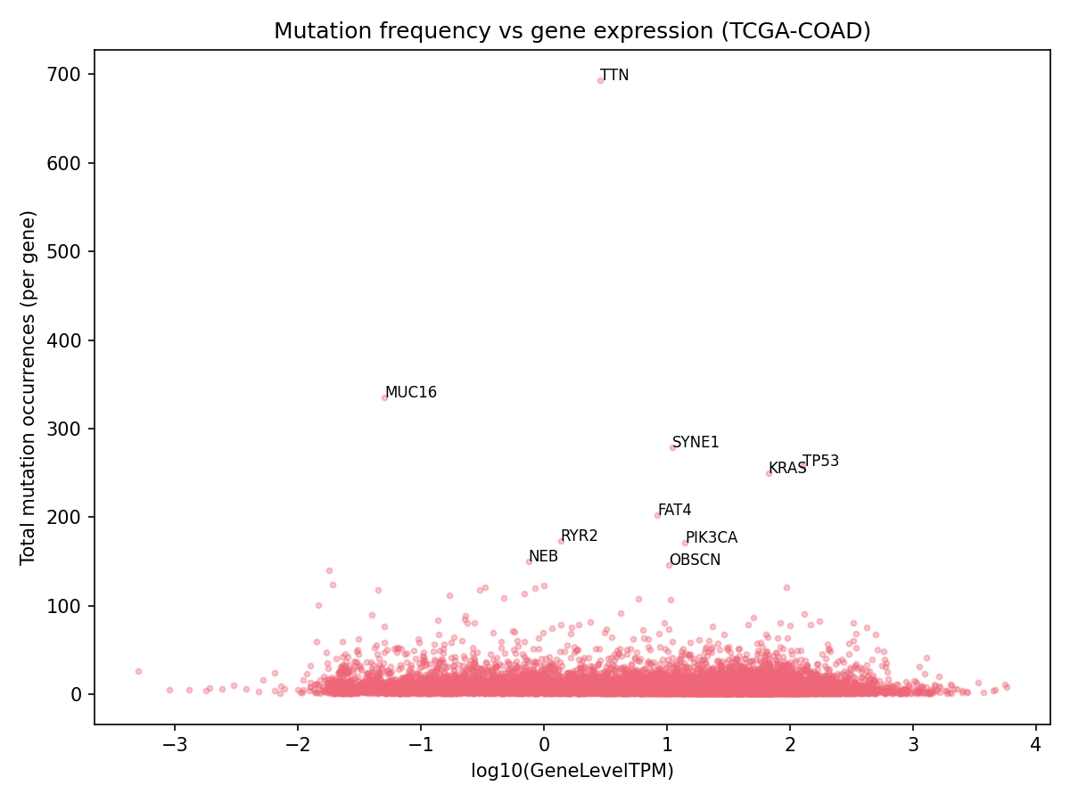
3
Integration of mutations & expression
Section 7 • script 03_integrate_datasets.py
Mutation and expression cohorts differ → summarise expression per gene.
GeneLevelTPM = median TPM across tumour samples (robust to outliers).
Merge by gene; genes absent from expression → NA (never 0).
# GeneLevelTPM = median TPM across samples
gene_level = (tpm.set_index("GeneName")
.median(axis=1, skipna=True))
# merge into mutation matrix by gene symbol
Mutation frequency vs gene expression per gene
Notes:
Deliverable 03 keeps per-sample mutation columns + GeneLevelTPM.

Slide 11
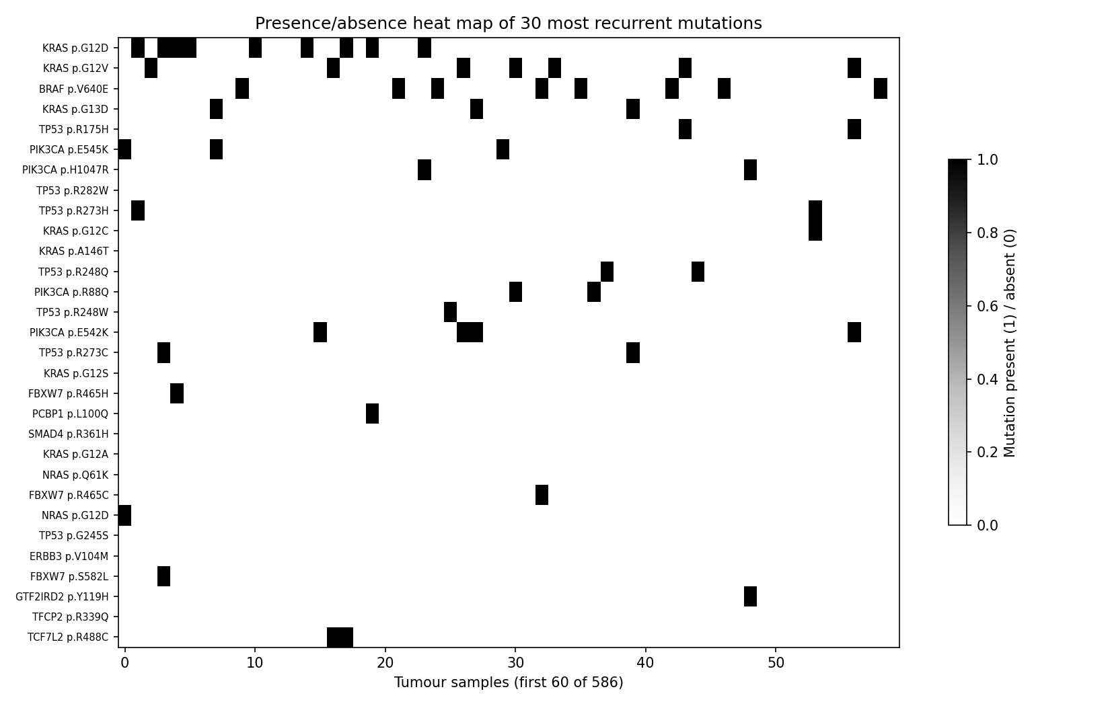
Quality control (Section 8)
310,472
153,996
raw MAF records
distinct mutations
586 / 592
5.64%
mutation / expr samples
missing expression
Consistent Hugo symbols · GRCh38 throughout · counts before/after filtering reported.
Recurrent mutations across tumour samples
Notes:
Four required QC figures produced; two shown here and on prior slides.

Slide 12
Part II — Neoantigens
mutant peptides · HLA binding · immunogenicity · prioritisation

Slide 13
4
Variant → protein → peptides
Sections 9–10 • script 05_annotate_and_generate_peptides.py
Map each missense mutation to its VEP-canonical transcript & protein.
Generate all mutation-containing 9-mers (MHC-I) and 15-mers (MHC-II) + wild-type.
Verify reference AA vs reference protein; 1-based mutation position.
Worked example — KRAS G12D
Reference protein: …LVVVGAGGVGKS…
Mutant protein: …LVVVDAGGVGKS…
9-mer mutant:
VVGADGVGK
9-mer wild-t: VVGAGGVGK
Matches the assignment's worked example exactly.
def windows(seq, m, L): # m = 1-based pos
for start in range(max(1, m-L+1),
min(len(seq)-L+1, m)+1):
yield seq[start-1:start-1+L], m-start+1
# KRAS p.G12D -> mutant VVGADGVGK (MutPos 5)
# -> wild-t VVGAGGVGK
Notes:
145,612 mutations annotated; 6,873,140 peptides; 2,964 excluded for ref-AA mismatch (audited).

Slide 14
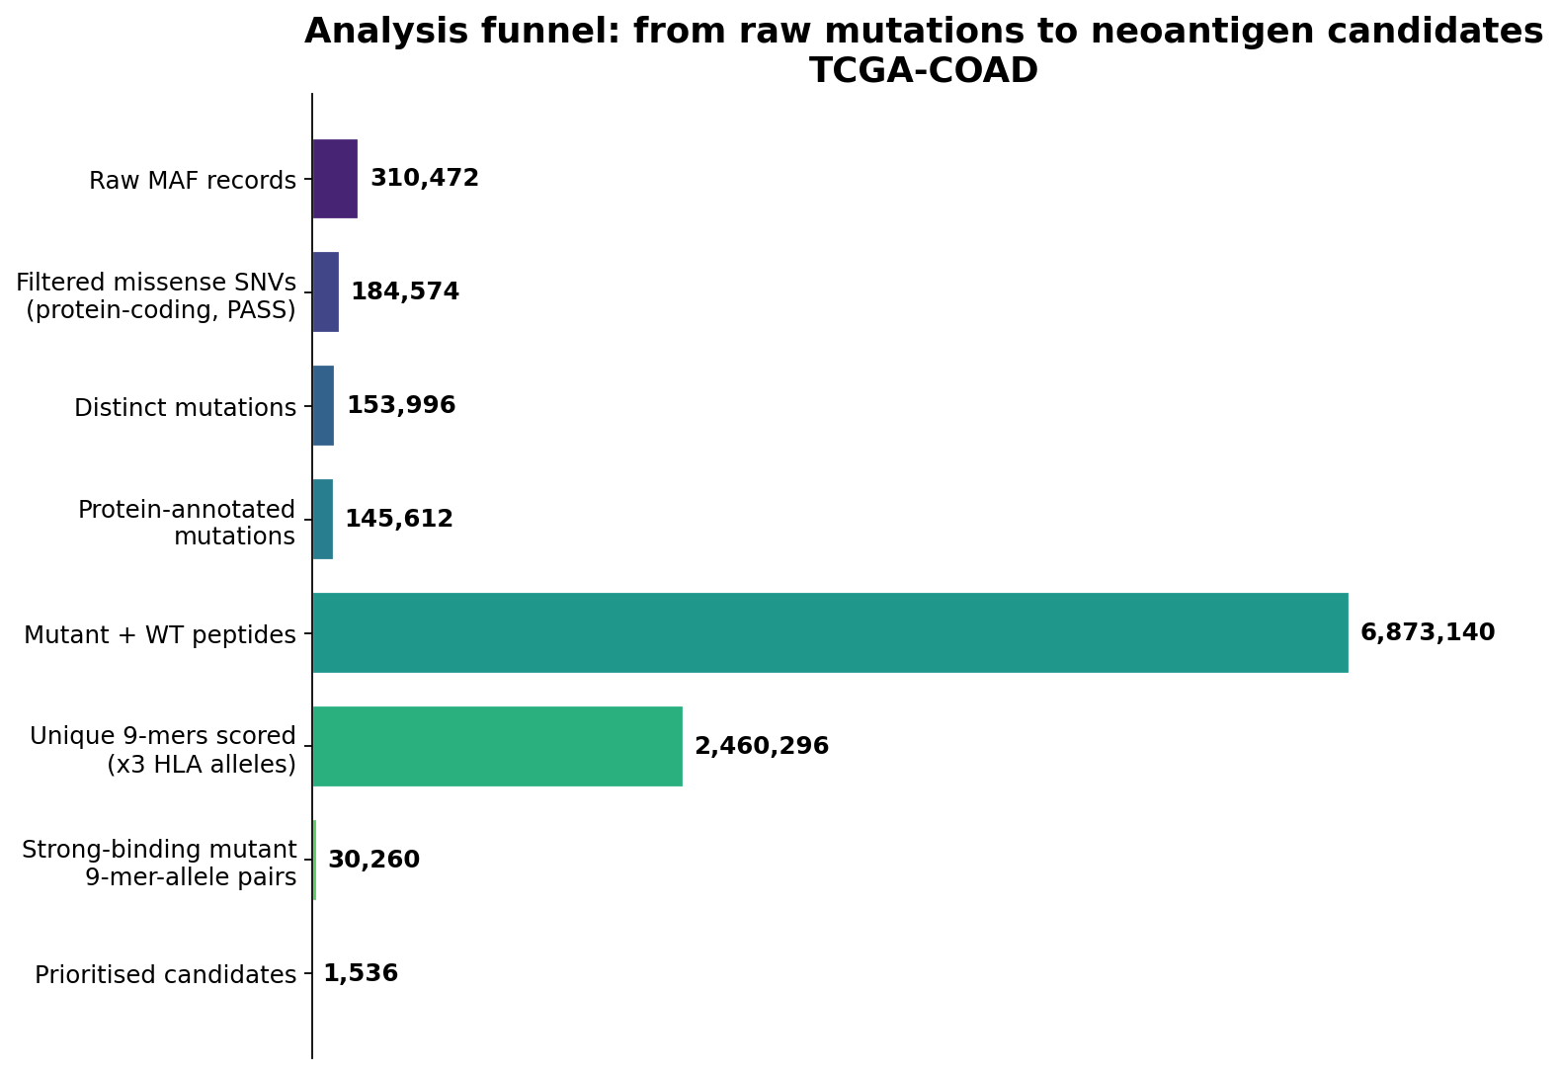
From mutations to candidates — scale
Notes:
Funnel shows the peptide explosion (6.87M) narrowing to 1,536 prioritised candidates.

Slide 15
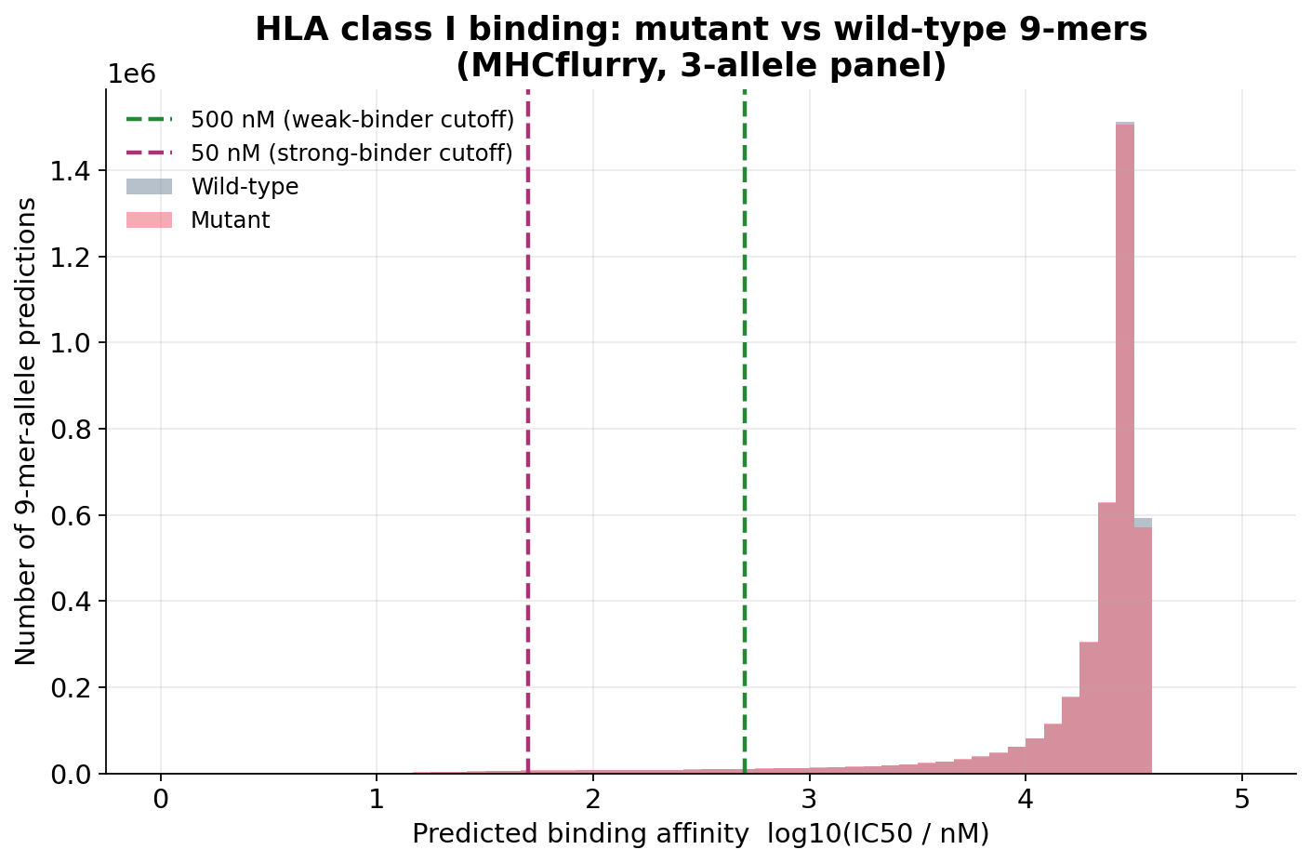
5
HLA selection & MHC binding
Sections 11–12 • script 06_predict_neoantigens.py
Option A fixed HLA-I panel: A*02:01, A*01:01, A*03:01.
MHCflurry 2.2.1 presentation predictor: affinity, %rank, presentation score.
Binder class: Strong <50 nM, Weak <500 nM. Class-II 15-mers reserved for NetMHCIIpan.
r = predictor.predict(
peptides=uniq, alleles=[allele],
include_affinity_percentile=True)
# every score carries its HLA allele (Rule 7)
# missing tool outputs -> NA, never 0
Mutant vs wild-type 9-mer binding, with 50/500 nM cutoffs
Notes:
2.46M unique 9-mers × 3 alleles. Present binding vs presentation vs immunogenicity distinction next.

Slide 16
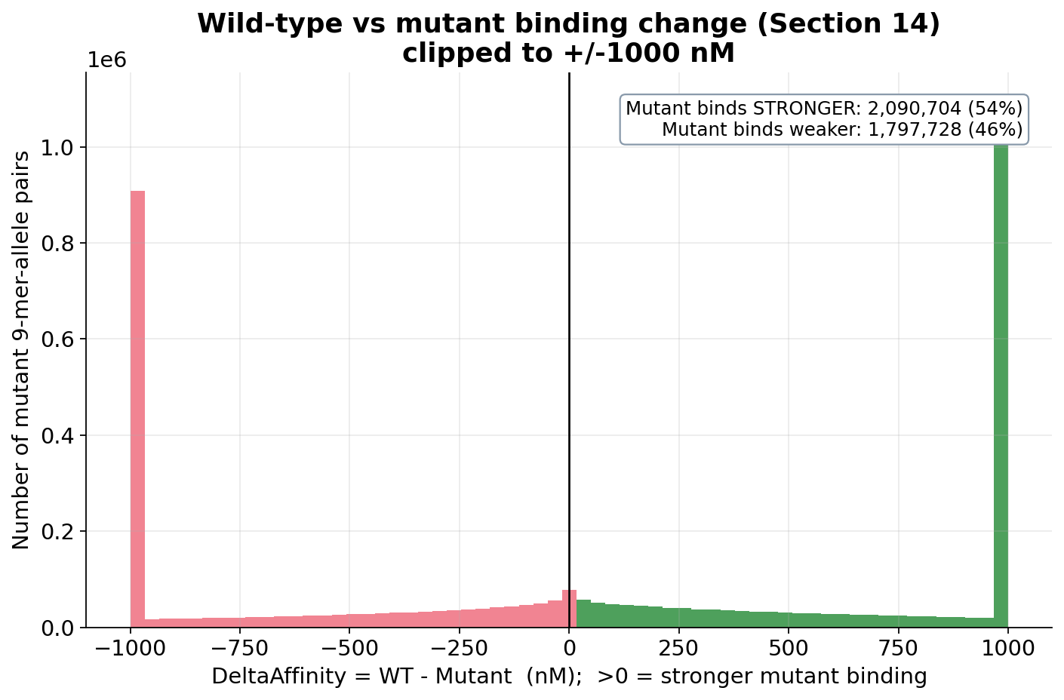
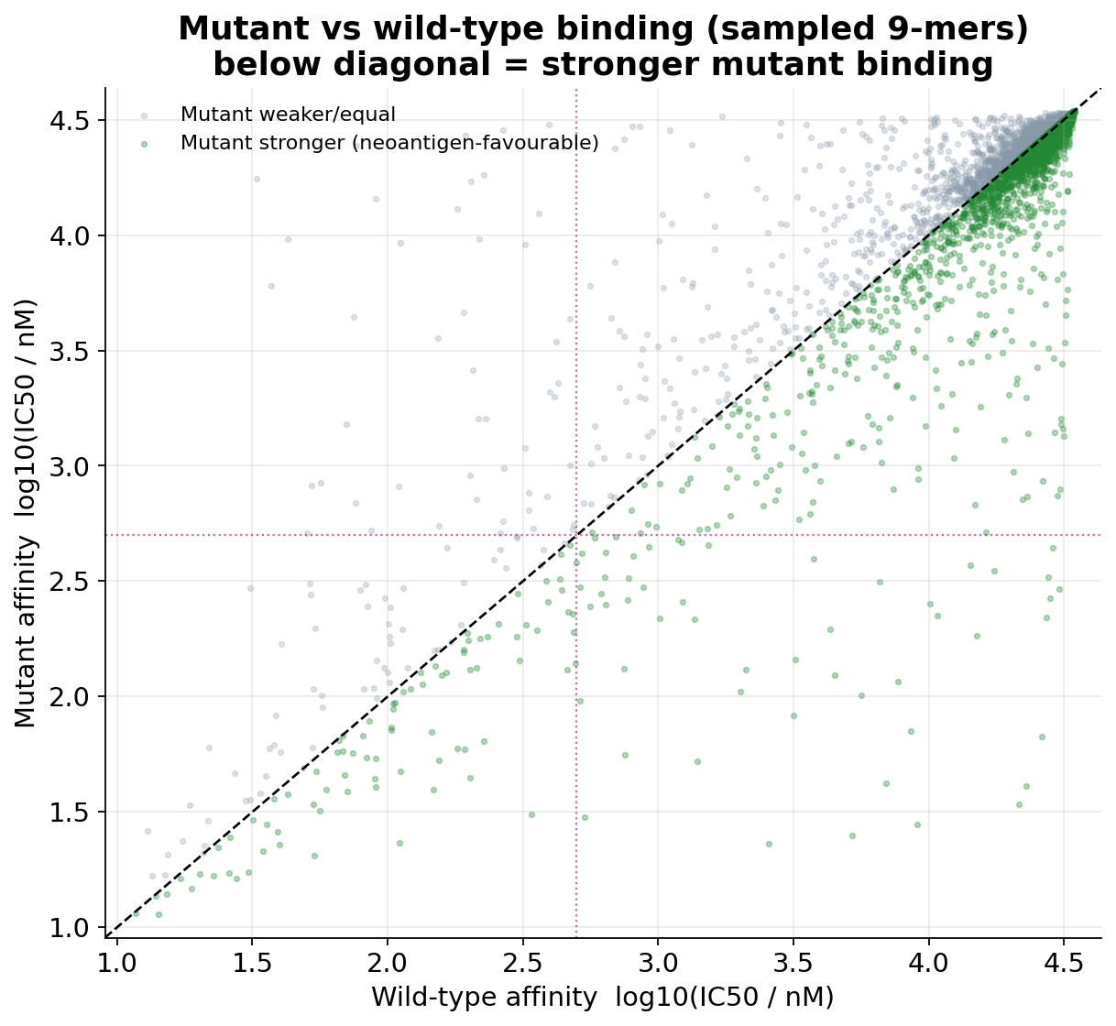
Wild-type vs mutant comparison (Section 14)
ΔAffinity = WT − Mutant. 54% of mutant 9-mers bind more strongly than wild-type (below the diagonal, right).
Notes:
Positive delta / below-diagonal = neoantigen-favourable. This is the core selection signal.

Slide 17
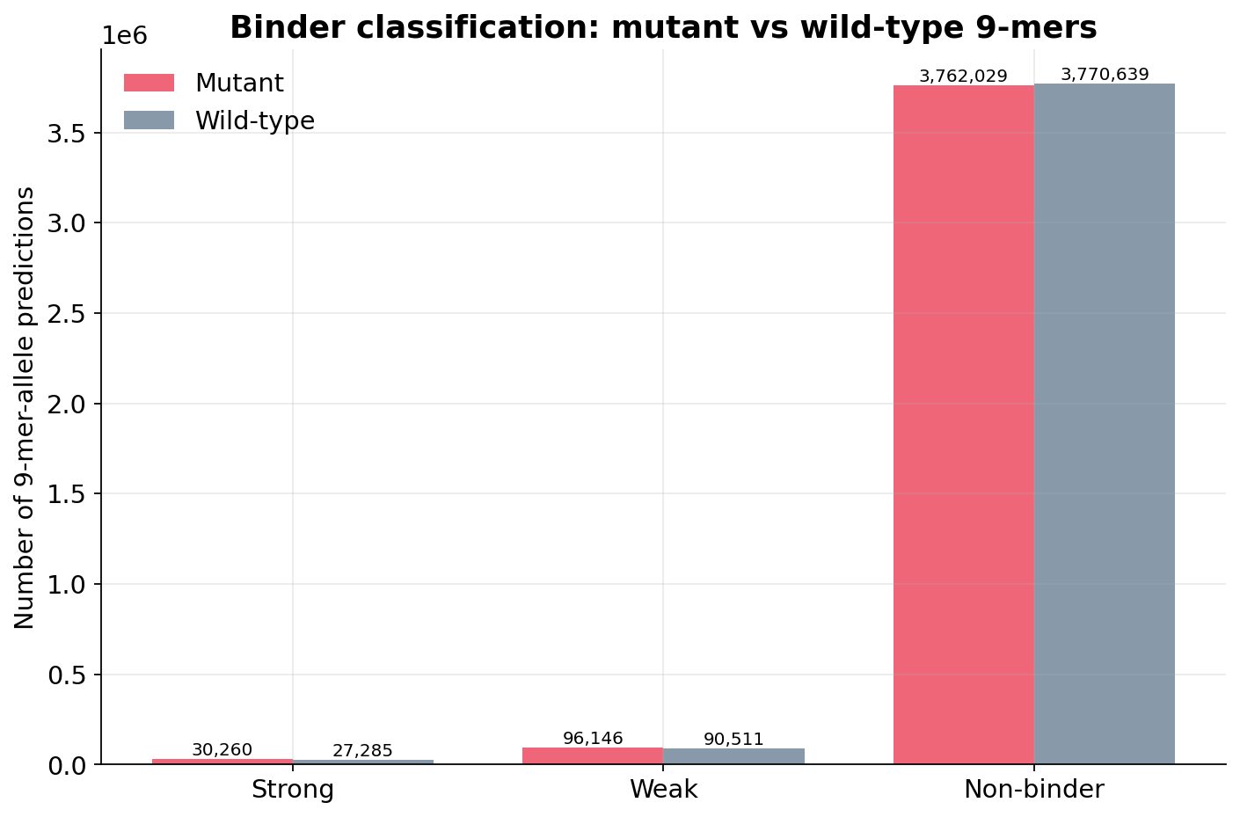
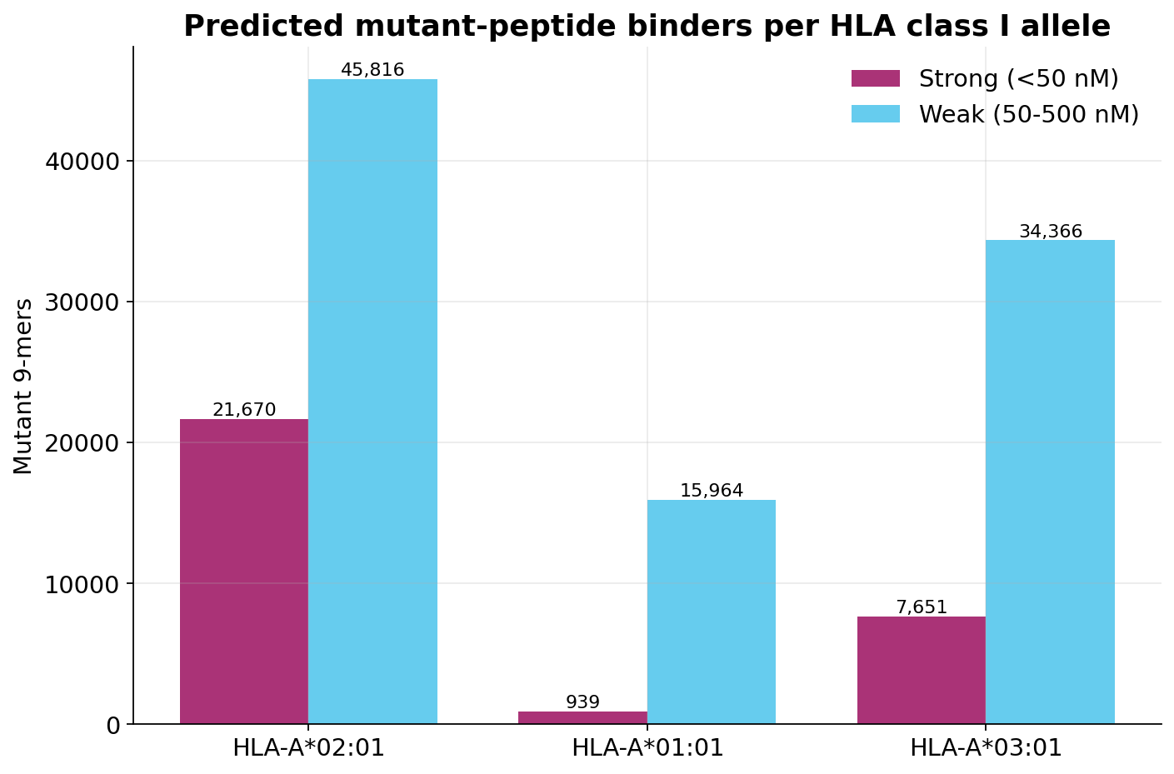
Predicted binders by class & allele
30,260 strong-binding mutant 9-mer–allele pairs; HLA-A*02:01 yields the most, then A*03:01, then A*01:01.
Notes:
Class I and class II reported separately (different pathways).

Slide 18
Binding ≠ immunogenicity (Section 13)
MHC binding / presentation
Immunogenicity
Peptide is predicted to be displayed by an HLA molecule.
Predicted here with MHCflurry.
A strong binder is NOT automatically immunogenic.
Presented peptide can stimulate a T-cell response.
Requires a dedicated predictor (e.g. PRIME).
Reported as NA unless that tool is run — never fabricated.
Binding and immunogenicity are kept in separate columns of deliverable 04.
Notes:
Key conceptual point examiners look for. Predictions are prioritisation features, not experimental validation (Rule 8).

Slide 19
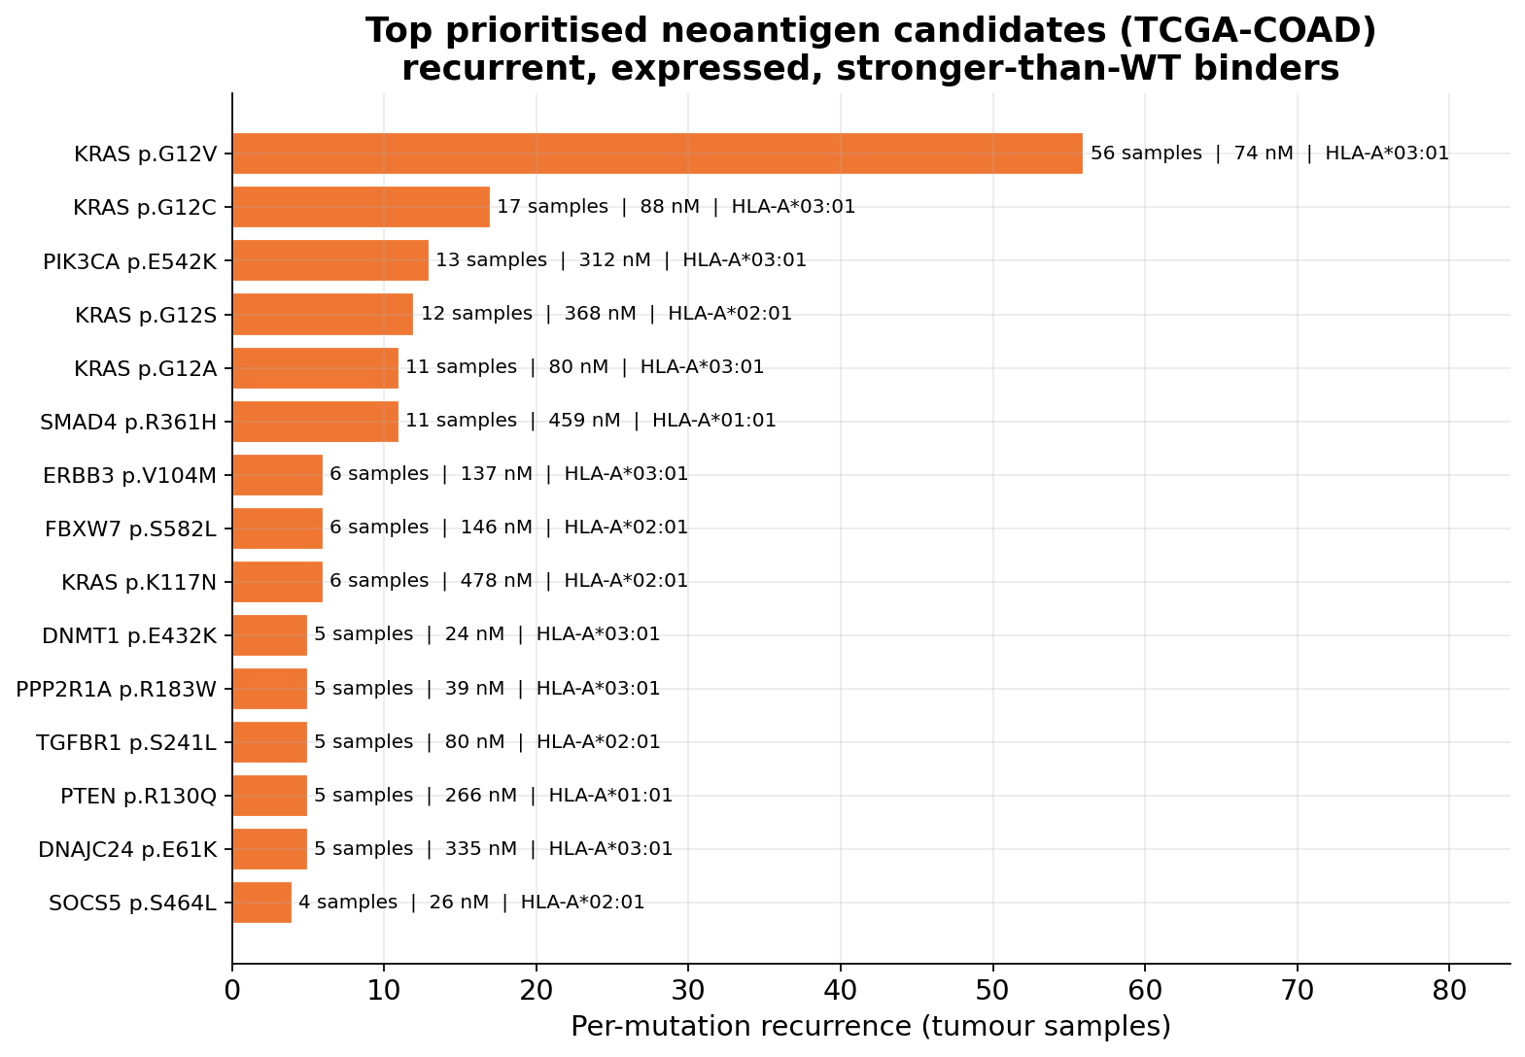
Prioritised neoantigen candidates (Section 14)
Notes:
The data-driven shortlist rediscovers the known colorectal neoantigen landscape — a strong sanity check.

Slide 20
Major findings
1,536
30,260
54%
prioritised candidates (966 genes)
strong mutant binders
mutant > wild-type binding
• Drivers recovered at expected frequency (TP53, KRAS, PIK3CA).
• Top candidates are canonical CRC neoantigens: KRAS G12V/C/S/A, PIK3CA E542K, SMAD4 R361H.
• KRAS G12x recovered on HLA-A*03:01 — a documented, clinically pursued neoantigen.
Notes:
Tie the numbers to biology.

Slide 21
One challenge · one conclusion
Technical challenge
Biological conclusion
Scale: pairing WT vs mutant across ~16M peptide–allele rows.
Correct per-mutation (not per-gene) recurrence.
Tooling: running MHCflurry over 2.46M unique 9-mers reproducibly.
A recurrence- and expression-aware pipeline independently rediscovers the colorectal neoantigen landscape.
KRAS G12x on HLA-A*03:01 emerges as a top shared-neoantigen candidate.
Notes:
These map to the two required presentation points.

Slide 22
Limitations & reproducibility
Mutation and expression cohorts are both TCGA-COAD but not identical samples (cancer-level median used).
Analysis restricted to missense SNVs; in-frame indels / frameshifts are an extension.
RSEM→TPM is a documented per-million rescaling; native GDC TPM is an alternative.
Class-II binding and immunogenicity are NA unless NetMHCIIpan / PRIME are run.
Predictions are prioritisation features, not experimental validation (Rule 8).
Reproducible by design
7 numbered scripts (01–07)
4 tab-delimited deliverables
README + software versions
Access dates + GRCh38 only
Missing values = NA, never 0
No manual table edits
Notes:
Cover Part V rules compliance.

Slide 23
Thank you
Questions & discussion
Project 130 · TCGA-COAD neoantigen pipeline · mutations → expression → peptides → HLA → candidates

