Slide 1
Embracing the Digital Transformation in Banking Domain
03/03/2023

Slide 2
TEXT LAYOUT 1
Agenda
Data Science Lifecycle​
Project Overview​
Data
Analysis
Modeling
Model Evaluation
Recommendations

Slide 3
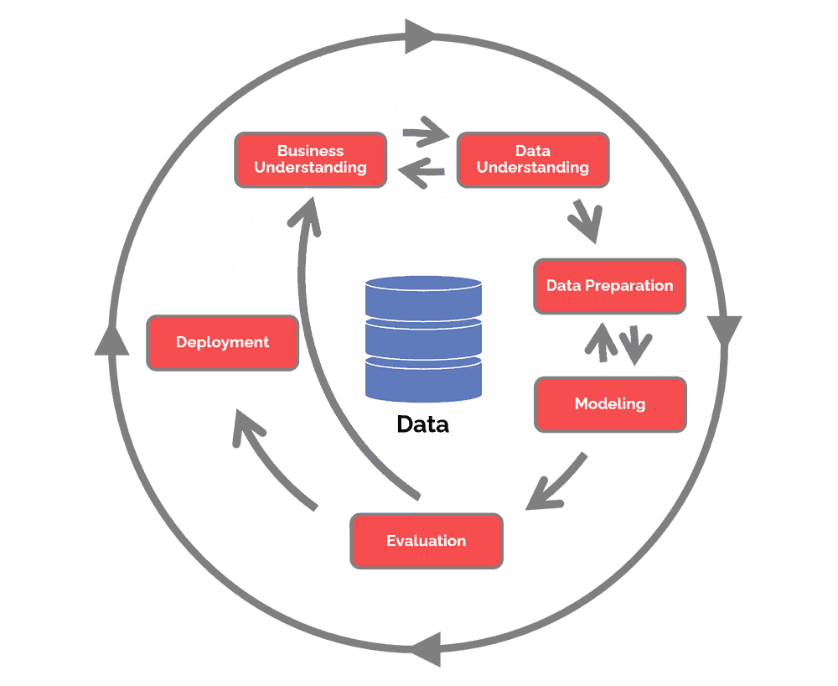
Data Science Lifecycle
The data science lifecycle includes the following:
- Business Understanding
- Data Understanding
- Data Preparation
- Modeling
- Evaluation
- Deployment

Slide 4
Project Overview
Business Problem : The bank aims to improve the current process in which potential borrowers apply for a home loan. The current process involves loan officers having to manually process home loan applications. This process takes 2 to 3 days to process, upon which the applicant will receive communication on whether or not they have been granted the loan for the requested amount.
Business Objective : To improve the process, Standard Bank wants to make use of machine learning to reduce the amount of time taking to assess the creditworthiness of an applicant by implementing a model that will predict if the potential borrower will default on his/her loan or not, and do this such that they receive a response immediately after completing their application.
Hypothesis:: Based on historical data we can use machine learning to predict the loan status of a potential borrower such that the time taken for them to receive their respective statuses is reduced significantly.

Slide 5
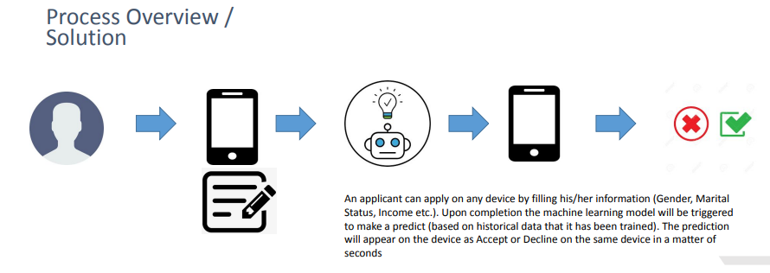
TEXT LAYOUT 1
Process Overview / Solution

Slide 6
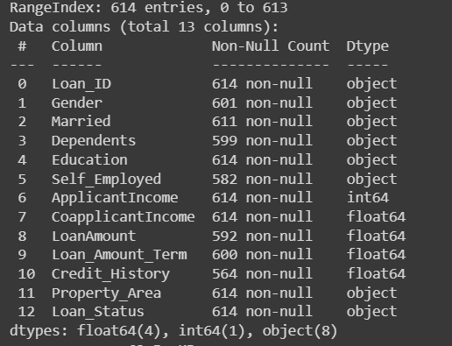
Data
The number of records – 614
The number of columns – 13
The number of numerical columns – 5
The number of categorical columns – 8
Target/Loan Status – Y (422) vs N (192)

Slide 7
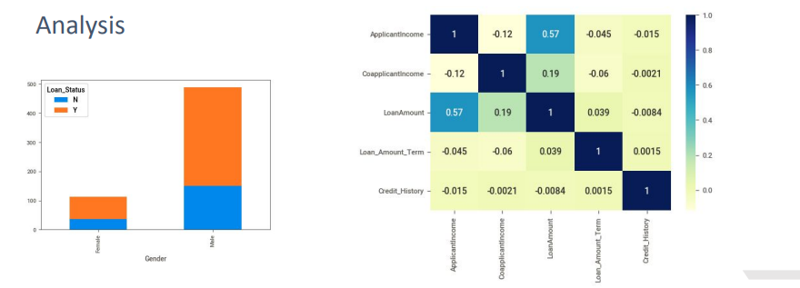
TEXT LAYOUT 1
Analysis

Slide 8
One machine learning model trained and AutoML used as well. Bespoke model required preprocessing. AutoML did not, Results fairly similar.
Modeling
1. AutoML with auto-sklearn
Train-Test Split.
Train the model.
Predict.
Find the accuracy and print the confusion matrix.
2. BespokeML with sklearn
Impute missing values.
Train the model.
Predict.
Find the accuracy and print the confusion matrix.

Slide 9
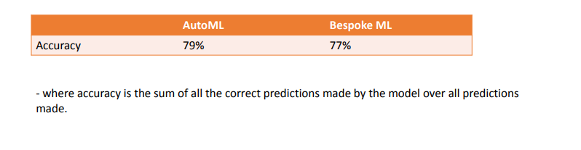
TEXT LAYOUT 1
Model Evaluation
Based on confusion matrix compare the both models ad find the suitable one and recommend to the client.

Slide 10
Recommendations
Based on Accuracy, we can say AutoML Performed a little bit more than conventional.
We understand/know exactly what went in, how it went in and what algorithm
was used to achieve the business objective
Less time training (works in our favour if we train and predict in real time –
maybe not applicable in this use case)
But it doesn’t mean always automation is preferable. Its depends on features, results required.
AutoML is best used as a base model.

