Slide 1
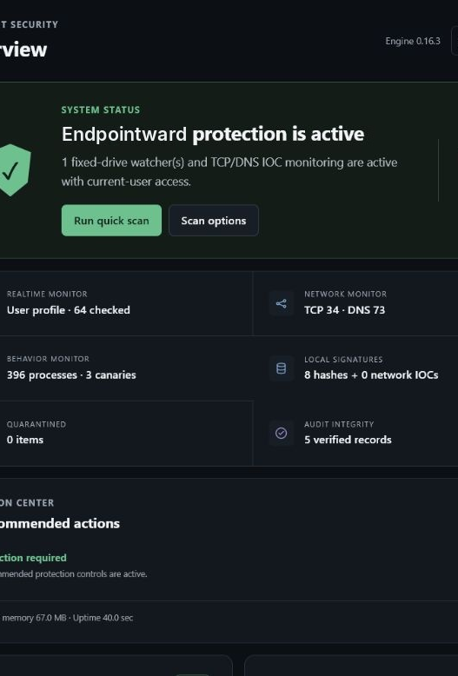
ENDPOINTWARD
Security stays local.
Fleet control stays ours.
Management briefing • Endpoint v0.16.3 • HQ v0.4.2
Open-source, offline-first Windows protection with optional on-premises operations.

Slide 2
WHY THIS MATTERS
Fragile state turns endpoint security into an operational risk
01
Connectivity changes
02
Upgrades overwrite context
03
Administration needs guardrails
Sleep, hibernate, network changes, and server outages can leave a client appearing offline.
Settings, identity, logs, quarantine, and enrollment must survive Setup unless migration intentionally changes them.
Critical changes and uninstall need controlled authorization without exposing a remote shell.
The solution must stay protective while disconnected, reconnect cleanly, preserve history through upgrades, and make every sensitive action explicit.
ENDPOINTWARD MANAGEMENT BRIEF
02

Slide 3
SOLUTION ARCHITECTURE
Two computers, one controlled operating model
WINDOWS ENDPOINT
ON-PREMISES HQ
Local protection continues without HQ
Visibility and control remain inside the organization
CERTIFICATE-PINNED HTTPS →
Scanning • behavioral monitoring • encrypted quarantine • local threat intelligence
Approved enrollment • health telemetry • alerts • allowlisted response • signed updates
LAN discovery and explicit firewall rules make the server findable across separate PCs.
ENDPOINTWARD MANAGEMENT BRIEF
03

Slide 4
CLIENT EXPERIENCE
The endpoint makes local security posture clear
What the user sees
Active protection and security score
File, network, behavior, signature, quarantine, and audit health in one place.
Actionable, not noisy
The action center prioritizes attention while normal protection remains unobtrusive.
ENDPOINTWARD MANAGEMENT BRIEF
04

Slide 5
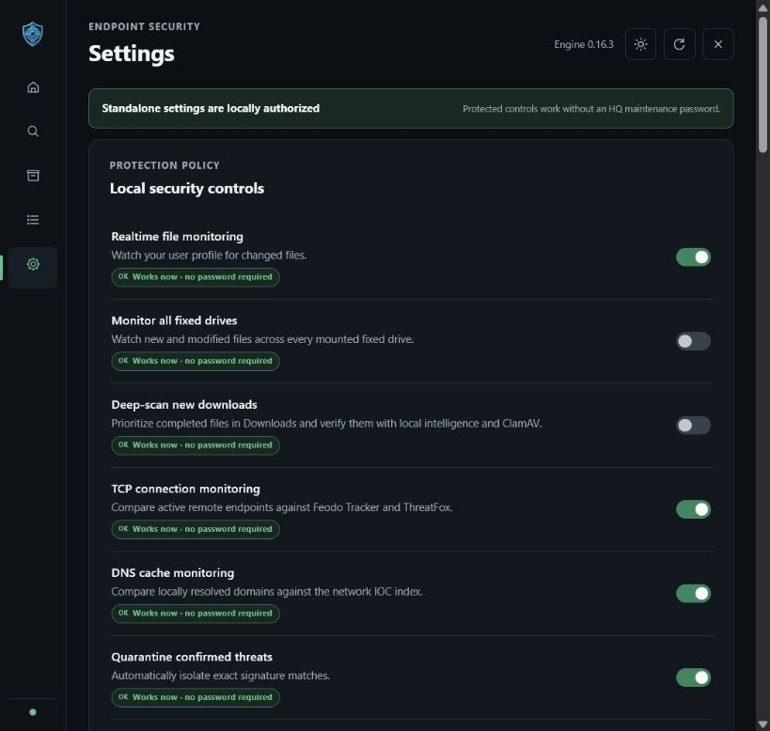
POLICY TRANSPARENCY
Sensitive settings show when authorization is required
Visible status
Works now • password required • HQ offline • compatibility checking • upgrade required
Managed endpoints can request an administrator-approved password within a strict 20-second window.
Standalone endpoints remain locally authorized. Managed endpoints enforce HQ policy for critical operations.
ENDPOINTWARD MANAGEMENT BRIEF
05

Slide 6
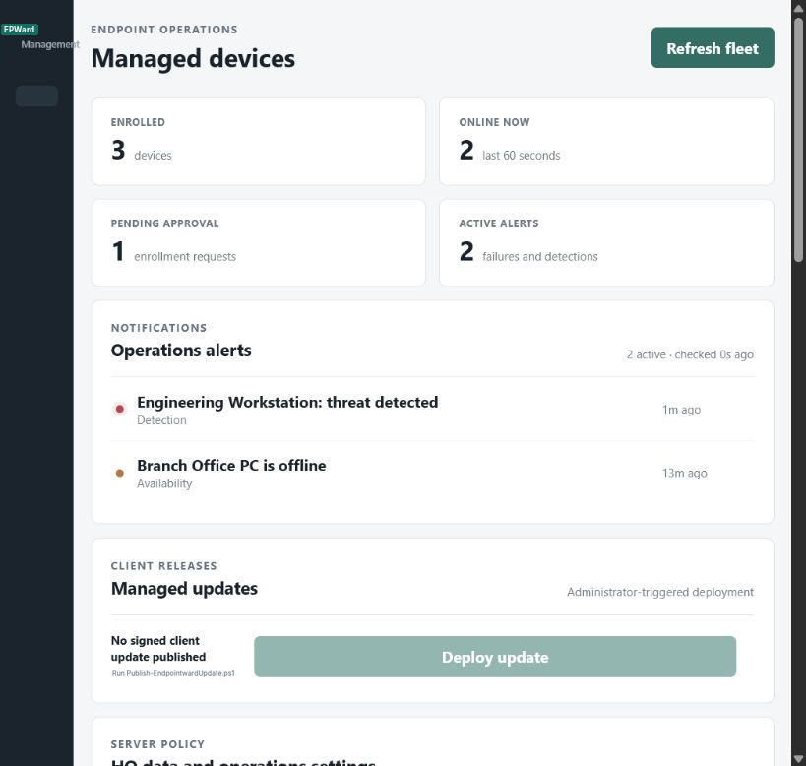
SERVER EXPERIENCE
HQ turns endpoint signals into an operations queue
One operational view
Enrollment, online state, pending approval, and active alerts are immediately visible.
Response remains bounded
HQ queues approved scans, repair, database updates, and signed client updates. There is no arbitrary remote shell API.
ENDPOINTWARD MANAGEMENT BRIEF
06

Slide 7
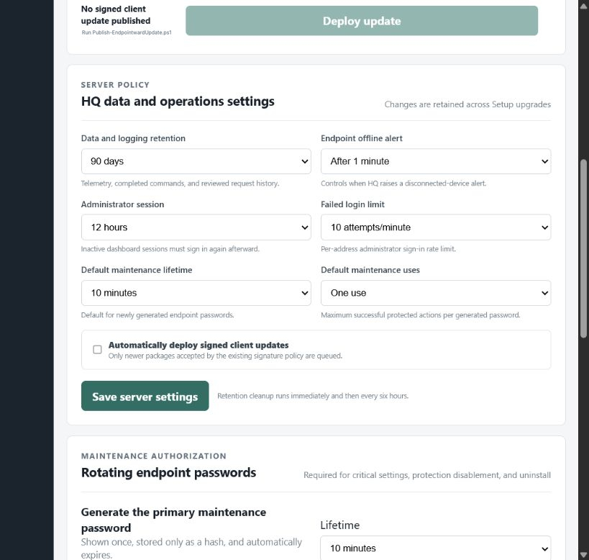
SERVER GOVERNANCE
HQ policy is discrete and retained across upgrades
30 / 90 / 365
day operational data retention
Also configurable
Offline-alert delay
Administrator session lifetime
Failed-login limit
Maintenance lifetime and uses
Signed-update auto-deployment
ENDPOINTWARD MANAGEMENT BRIEF
07

Slide 8
RESILIENCE BY DESIGN
Clients reconnect and Setup preserves state
1
2
3
4
Detect change
Reconnect safely
Back up before Setup
Migrate intentionally
Wake, network, server, and process changes trigger health checks.
Bounded retries re-resolve HQ and resume telemetry.
Restricted backups retain identity, settings, logs, quarantine, and databases.
Existing values change only through explicit schema migrations.
Result: a laptop can sleep or move networks, and an operator can run Setup, without silently resetting the security relationship.
ENDPOINTWARD MANAGEMENT BRIEF
08

Slide 9
TRUST MODEL
Security controls constrain administrative power
LOCAL
NETWORK
ADMINISTRATION
Encrypted credentials
AES-256-GCM quarantine
Tamper-evident audit chain
Loopback-only dashboard
HTTPS management
Certificate pinning
Explicit firewall rules
Revocable device tokens
Rotating passwords
One-time client approvals
Rate-limited attempts
Allowlisted commands only
Important boundary: Endpointward is actively developed user-mode security. Keep Defender, Windows Firewall, SmartScreen, UAC, Secure Boot, and BitLocker enabled.
ENDPOINTWARD MANAGEMENT BRIEF
09

Slide 10
STRATEGIC VALUE
Open source improves control and flexibility
Apache 2.0
No mandatory cloud
Auditable stack
Portable operations
Personal, internal, hosted, modified, and commercial use with notices.
Protection works without HQ. Management remains self-hosted and optional.
JavaScript, PowerShell, C#, HTML, CSS, SQLite, and documented Windows integration.
Separate client and HQ installers support local labs and managed fleets.
Current installers are reproducible but unsigned; production distribution should follow the code-signing policy.
ENDPOINTWARD MANAGEMENT BRIEF
10

Slide 11
DECISION
Approve a controlled 30-day pilot
Start small, preserve optionality, and measure operational behavior before wider adoption.
Pilot scope
Measure
Exit gate
1 HQ server
5 representative endpoints
IT-managed enrollment
Reconnect after sleep/network changes
Alert and approval workflow
State retention through Setup
Review evidence, code-signing readiness, support ownership, and policy before scale.
Recommended next action: nominate an IT owner and pilot device group.
ENDPOINTWARD • MANAGEMENT DECISION
11

