Slide 1
Operating Systems
Linked Topics (studied earlier)
Instruction Set Architecture
Structure of Computers
Hardware support for Operating System functions
Interfaces with applications

Slide 2
Overview of Operating System
Introduction and Overview
Operating System Structures

Slide 3

Introduction
Definitions
Computer Systems Organization and Architecture
Operating Systems Structure
Dual Mode of Operation
Concept of Process and its Management
Memory and Storage Management
Protection and Security of Systems
Various Computing Environments

Slide 4
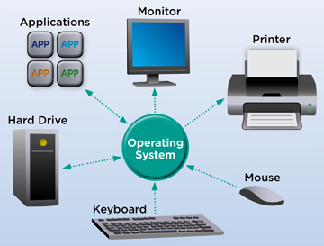

Slide 5
Introduction to Operating System Concepts
What is an OS?
An interface between the user of the computer and the hardware that forms the computer
Coordination and Abstraction
A program that manages and controls the hardware
It provides an environment for application programs
Acts as an intermediary between a computer user and the hardware
Operating systems vary in their design according to their purpose of use

Slide 6
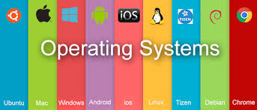

Slide 7
Introduction to Operating System Concepts
Some operating systems are designed to optimize utilization of hardware
Others are designed to support activities including games, business applications, etc.
Due to the complexity and the large size
OS is consciously designed to be modular with a layered architecture
Role of an OS?
Control and coordinate the use of resources among various application programs

Slide 8
Computer System Structure
Computer system consists of four components
Hardware comprises of the basic computing resources for the system
Includes CPU, memory, I/O devices, etc.
Application programs define the ways the resources are used to solve users’ computing problems
Word processors, compilers, web browsers, etc.
Operating system controls the resources and coordinates its use to provide an environment in which various programs can do useful work
Users make use of the computing system

Slide 9
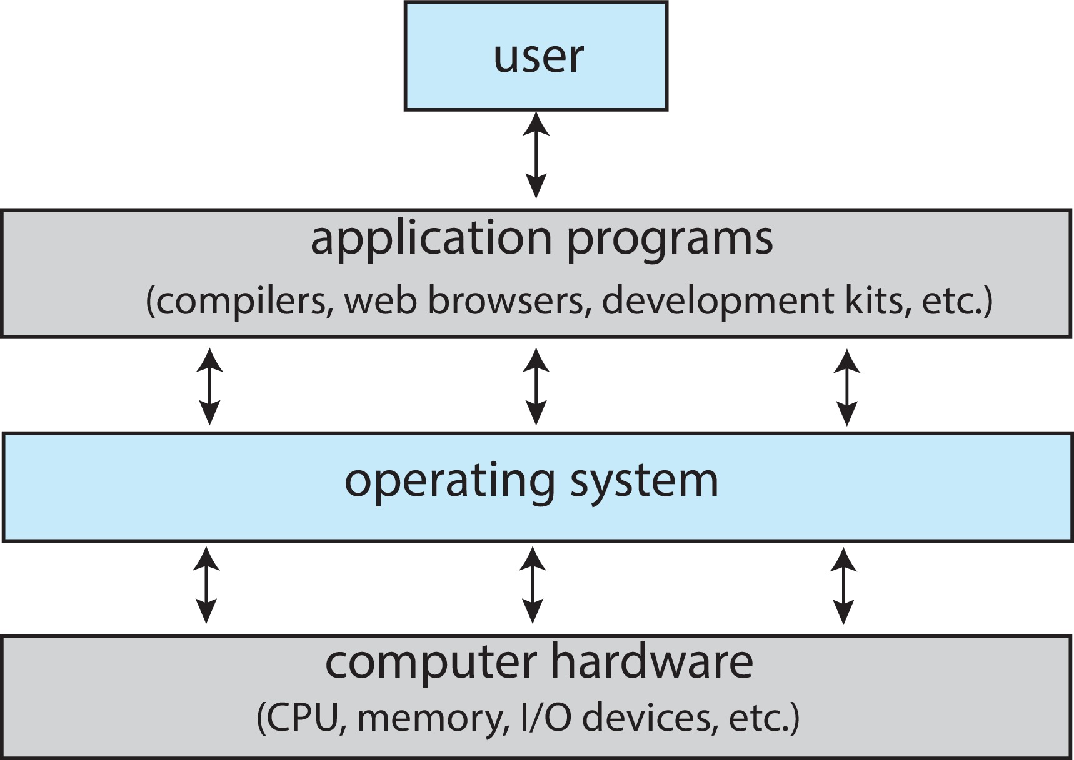
Abstract view of the Components of a Computer System

Slide 10
Introduction to Operating System Concepts
User View
Varies according to the interface used
Operating system for a PC is optimized for
Ease of use and performance
Improving single user experience
Little effort is made for efficient resource utilization
Some users interact with mobile devices
Connected to networks through wireless technologies
Touch screen interface is common in these devices

Slide 11
Introduction to Operating System Concepts
Mobile computers – smart phones and tablets
OS is designed for individual usability
Performance per unit of battery life is also important
Embedded computers
Have little or no user view
OS may be designed to run without user intervention
System View
Views the operating system as a resource allocator
CPU time Memory space
File-storage space I/O devices etc.

Slide 12
Introduction to Operating System Concepts
OS acts as the manager of resources
Conflicting requests may also be generated
Manage and allocate resources efficiently and fairly
OS is a control program that controls and manages the execution of user programs
Prevent errors and improper use of computer
Operation and control of I/O devices

Slide 13
Operating System Definition
“One program that is running at all times on the computer with everything else being system programs and application programs”
The Kernel
The one program that the vendor ships
Resource allocator and control program
Operating system for mobile devices may also include middleware
A set of software frameworks that provide additional services to application developers

Slide 14
Computer System Organization
Computer system consists of
One or more CPUs
Memory and memory controller
Device controllers
A bus connects the components with the shared memory
How the system operates?
Interrupts
Storage structure
I/O structure
Interrupts
Devices interact with the system through interrupts
Actions on the occurrence of an interrupt

Slide 15
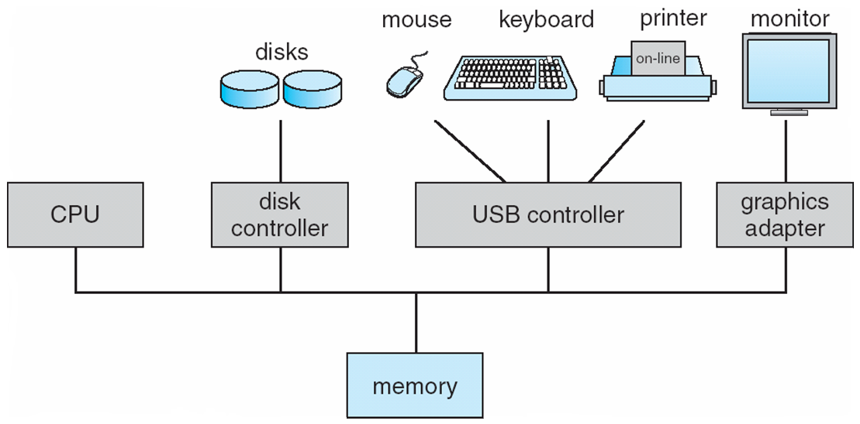
A Modern Computer System

Slide 16
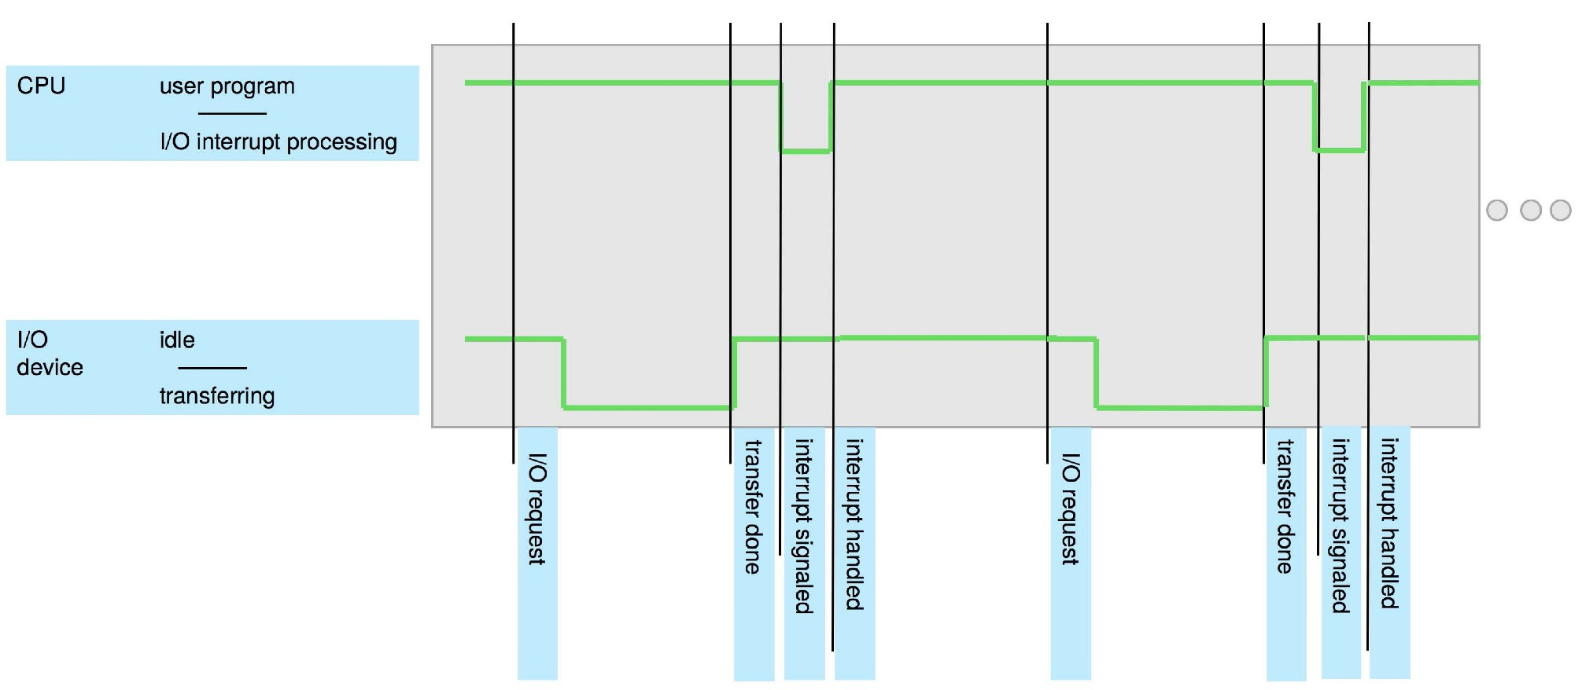
Interrupt Timeline

Slide 17
Computer System Organization
Interrupts cause a transfer to take place to the relevant interrupt service routine (ISR)
Methods of transfer varies
Saving the address of the interrupted instruction and the state of the processor is required
Registers, runtime stack or fixed memory addresses
Implementation
Interrupt request line is used to generate interrupt
Jump to interrupt handler routine
Maskable and nonmaskable interrupts
Interrupts at different levels of priority

Slide 18
Interrupt-driven I/O cycle

Slide 19
Computer System Organization
Storage structure
All programs are loaded into main memory (implemented in DRAMs) for execution
Bootstrap program is saved on EEPROM
Initializes all aspects of computer system
Loads OS kernel into memory
OS starts execution and waits for an event to occur
Units of storage
Bit and bytes
Kilobyte, Megabyte and Gigabyte
Terabyte and Petabyte
Main memory has program and data accessed by the CPU for execution directly

