Slide 1
Computer System Organization
Storage structure
All programs are loaded into main memory (implemented in DRAMs) for execution
Bootstrap program is saved on EEPROM
Initializes all aspects of computer system
Loads OS kernel into memory
OS starts execution and waits for an event to occur
Units of storage
Bit and bytes
Kilobyte, Megabyte and Gigabyte
Terabyte and Petabyte
Main memory has program and data accessed by the CPU for execution directly

Slide 2
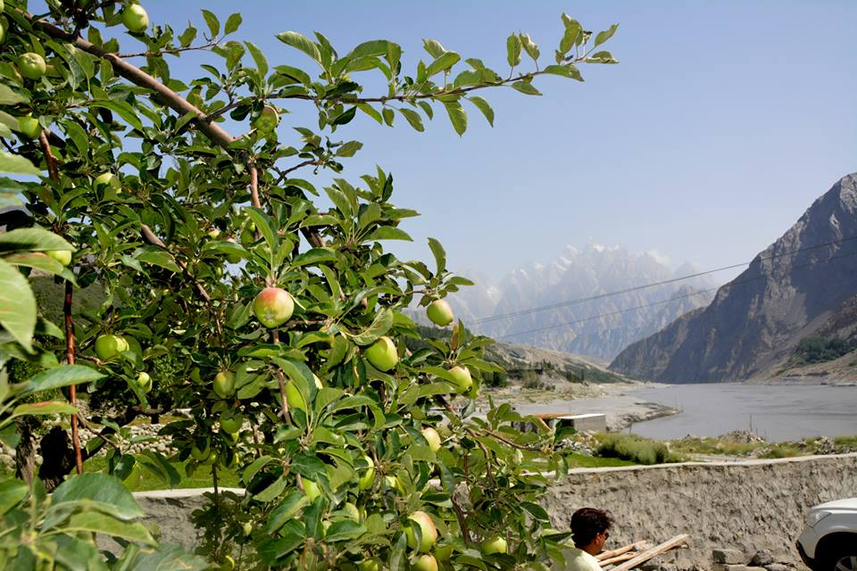
Storage Structure
Volatile and too small to contain all information
Secondary storage is the extension of main memory
Stores large quantities of information permanently
Storage system is organized in a hierarchy
Varies in speed, capacity, cost and volatility
Higher to lower levels
Decrease in speed
Increase in size
Decrease in cost
More persistence (non-volatile)

Slide 3
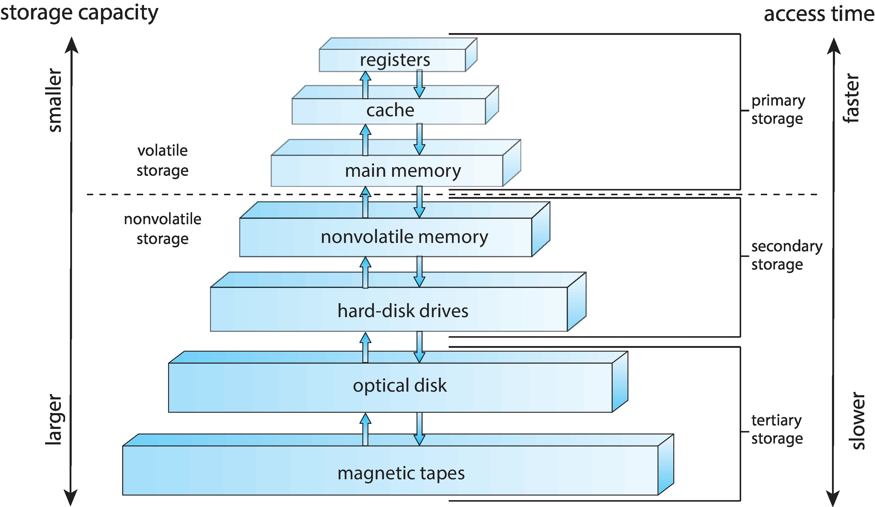
Storage Device Hierarchy

Slide 4
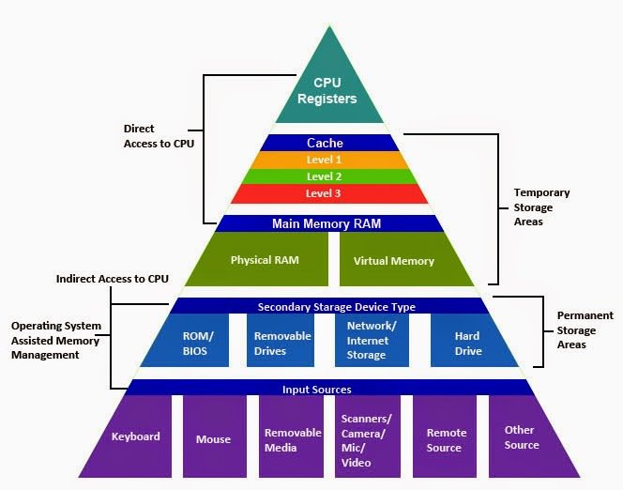
Storage-Device Hierarchy

Slide 5
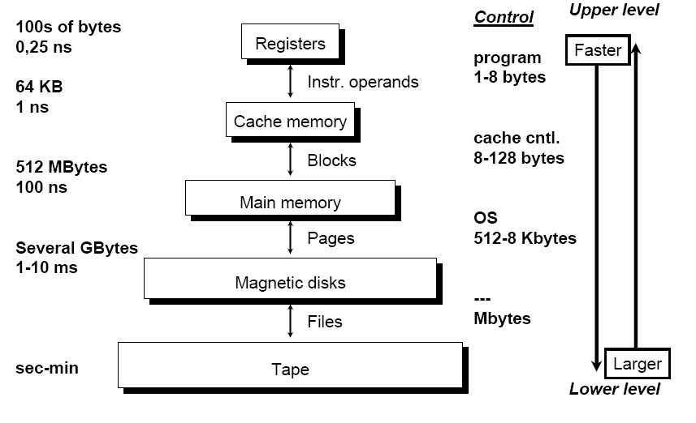
Storage-Device Hierarchy

Slide 6
I/O Structure
A large part of OS code is dedicated to managing I/O
Interrupt driven I/O is slow with high overheads
Direct memory access (DMA)
Used for large data movement
Very little CPU intervention
Device controller (DMA controller) performs most of the transfer functions

Slide 7
Computer System Architecture
Organized in a number of ways
Categorized according to the number of general purpose processors used
Single processor systems
One main CPU with special purpose proc.
Used only for specific device operations
Multiprocessor systems
Consists of two or more processors
Multicore processors
Clustered systems
Multiple CPUs from two or more individual systems or nodes

Slide 8
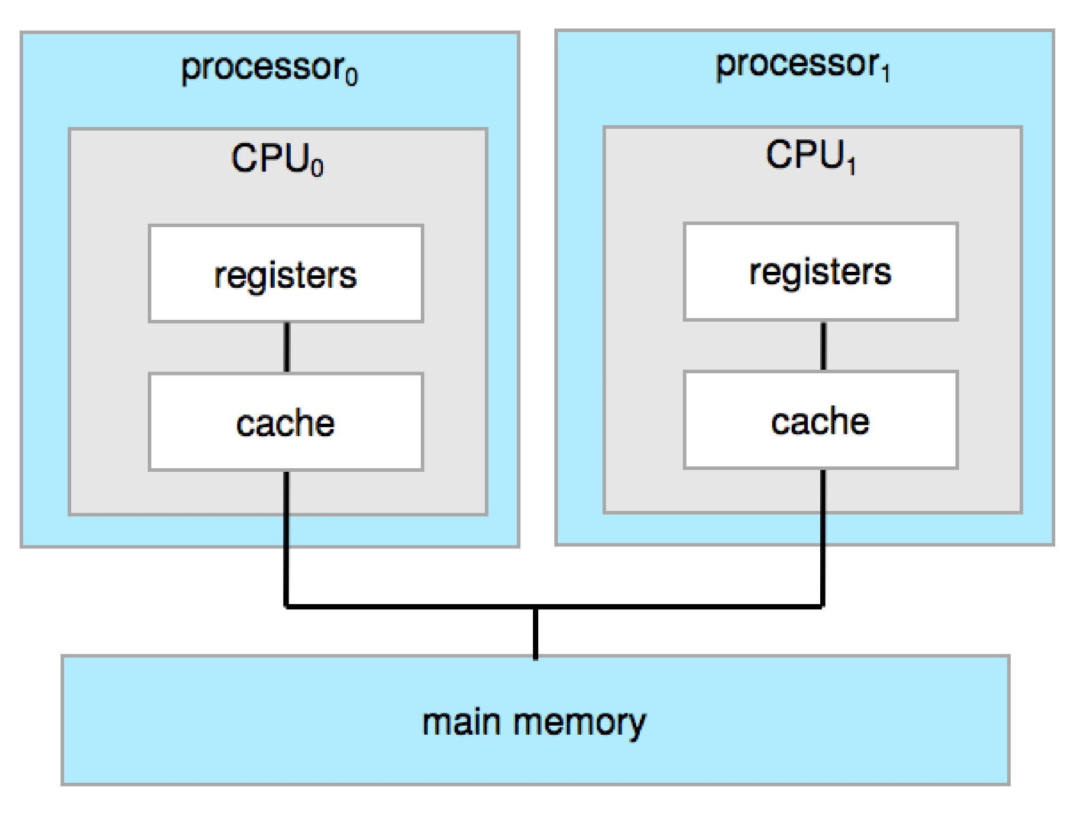
Symmetric Multiprocessor Architecture

Slide 9
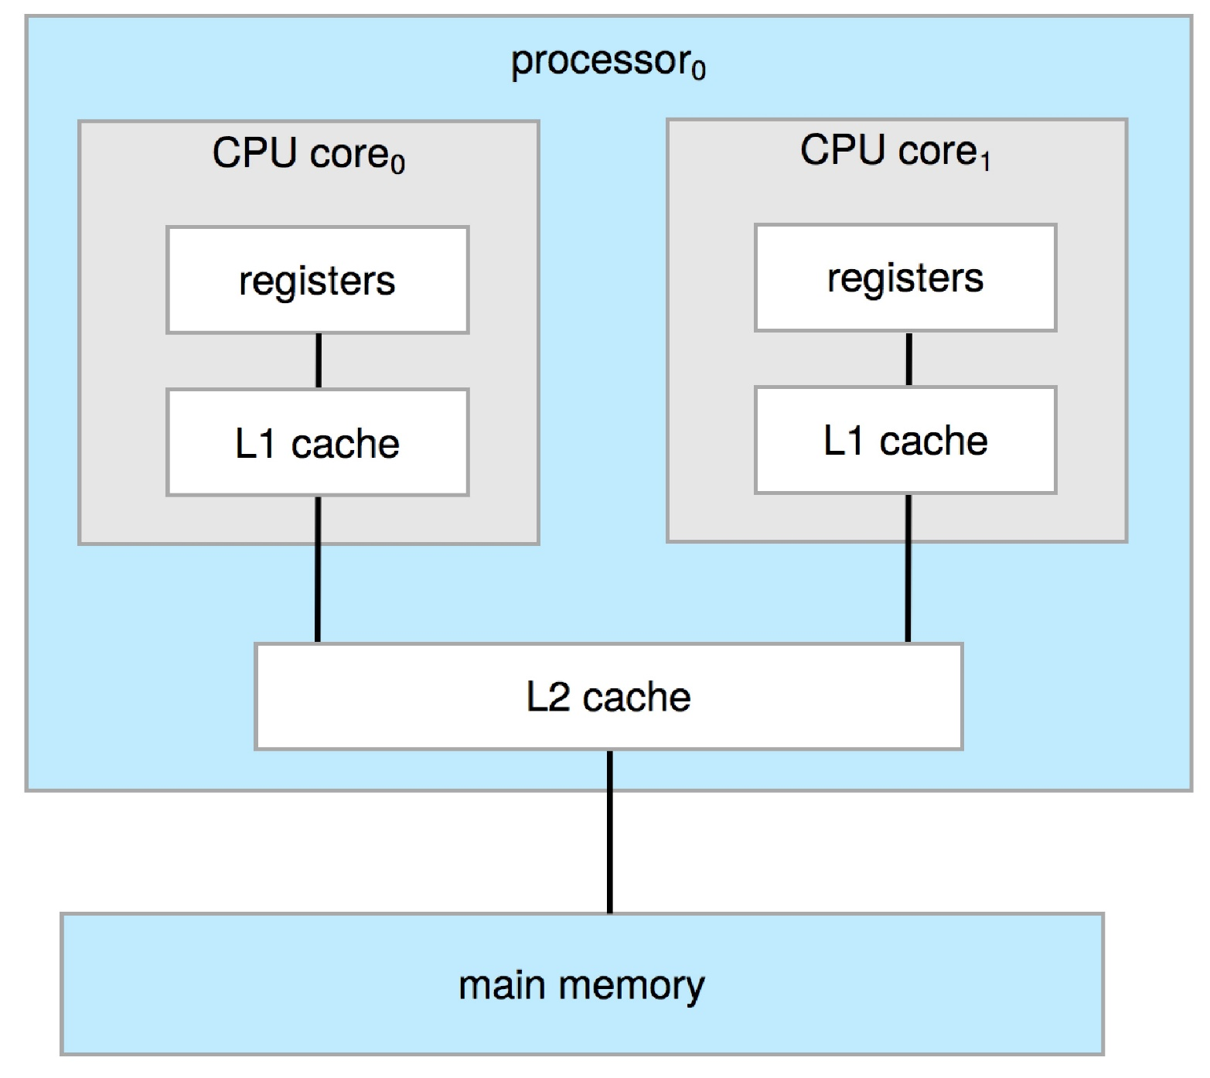
A Dual-Core Design

Slide 10
Operating System Operations
Bootstrap program locates the OS kernel and loads into memory
Once the kernel is loaded, it starts providing services to its users
A trap or an exception
A software-generated interrupt caused by a special request from a user program or caused by an error
Multiprogramming and Multitasking
In multiprogramming, a number of user programs are sharing all the resources of the system
Increases CPU utilization

Slide 11
Operating System Operations
Several programs are resident in memory at the same time
Multitasking is a logical extension to multiprogramming
Switching between processes take place more frequently
Memory management is required to have several programs in memory at the same time
Which process should be executed next?
CPU scheduling

Slide 12
Dual Mode and Multimode Operation
How to achieve the objective of protection?
Distinguish between the execution of OS code and user-defined code
User mode and kernel mode of operation
Supervisor, system or privileged mode
Mode bit present in hardware
Dual mode helps achieve the following
Protection of one user from another
Protection of system from users
Privileged instructions are needed
System calls allow users to gain access to OS services
Treated by the hardware as a software interrupt

Slide 13
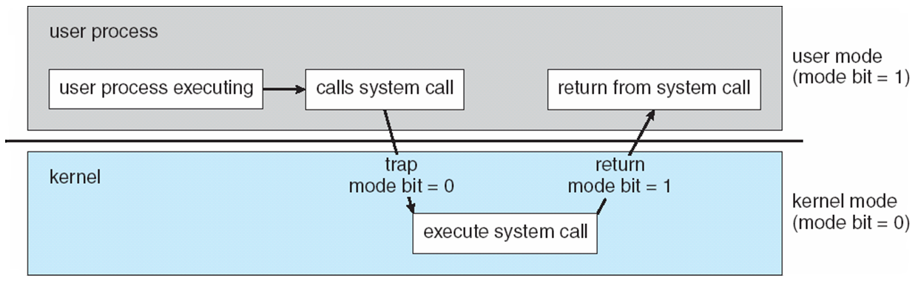
Transition from User to Kernel Mode

Slide 14
Dual Mode and Multimode Operation
The concept can be extended beyond two modes of operation
CPUs that support virtualization have a VMM mode
A mode when VMM (Virtual Machine Manager) is in control of the system
More privileges than the user but less privileges than the kernel
Some CPUs support four privilege levels
Initial control is in the OS
User program runs in user mode
Any OS function can be requested by the user through system call

Slide 15
Timer
How does the OS maintain control by not allowing processes getting stuck in an infinite loop?
Use a timer that is set to interrupt the CPU after a specific period of time
Period may be fixed or variable
Implementation of the variable timer
A fixed rate clock and a counter
Instructions that modify the counter are privileged

Slide 16
Resource Management
Operating System acts as a resource manager
Process Management
A program in execution is a process
Program is passive and process is active entity
Process is a unit of work in a system
Process needs resources for execution
Resources are allocated before/during execution
Program counter specifies the next instruction address of a process
Single-threaded and multi-threaded process
Processes execute concurrently on a single processor or multiple processors

Slide 17
Process Management
OS process management activities
Scheduling processes and threads on the CPUs
Creation and deletion of user and system processes
Suspending and resuming processes
Providing mechanisms for process synchronization
Providing mechanisms for process communication

Slide 18
Memory Management
CPU accesses main memory directly
Programs and data must reside in main memory for execution
Several programs are in main memory at the same time for efficient utilization of CPU
Memory management schemes are used to allocate and reclaim it
OS memory management activities
Keeping track of which part of memory is used by which process
Deciding which processes (or parts) and data to move into and out of the memory
Allocating and de-allocating memory space as needed

Slide 19
File-System Management
OS provides a uniform, logical view of information storage to make the computer system convenient for users
A file is a logical storage unit consisting of a collection of related information
Files are organized into directories and stored on
Magnetic disk, optical disc, magnetic tape, etc.
OS file management activities
Creating and deleting files
Creating and deleting directories
Supporting primitives for manipulating files and directories
Mapping files onto mass (secondary) storage
Backing up files on stable storage media

Slide 20
Mass-Storage Management
Secondary storage is backup of main memory
Everything is in secondary storage until it is loaded in main memory
OS mass-storage management activities
Free space management Storage allocation
Disk scheduling Partitioning
Mounting and unmounting Protection
Speed of this subsystem is important for efficiency
Tertiary storage devices provide low cost, low speed and large capacity backups
Not crucial for system performance

Slide 21
Cache Management
Caching is an important principle of computer systems
When an information is used, it is kept in a faster storage system on a temporary basis
The cache
Information is first checked in cache before accessing the next level of memory
Caching may be implemented in hardware or in software
Hardware controlled cache are outside the scope of OS
Cache management techniques are required for software controlled cache
Selection of cache size and replacement policy

Slide 22
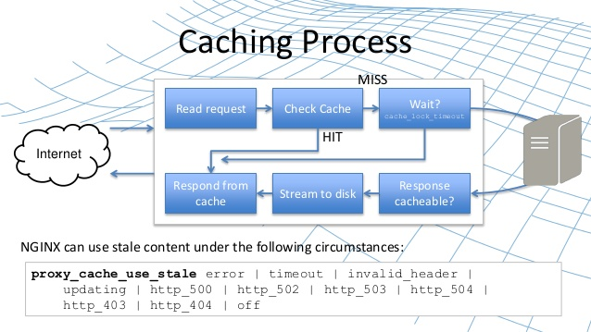

Slide 23
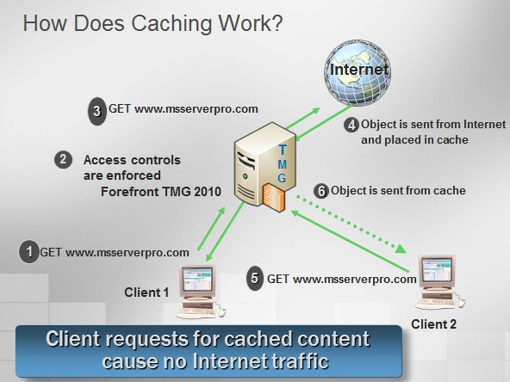

Slide 24
Caching
Performance between the levels of storage
Movement of information between levels is implicit or explicit
Transfer between disk and memory – explicit
Controlled by the OS
Transfer between hardware cache and CPU registers
Controlled by the hardware
Same data may appear at different levels in a hierarchical storage structure
When and how is an update at one level propagated to other levels
Cache coherency problem arises in a multiprocessor environment with multiple caches

Slide 25
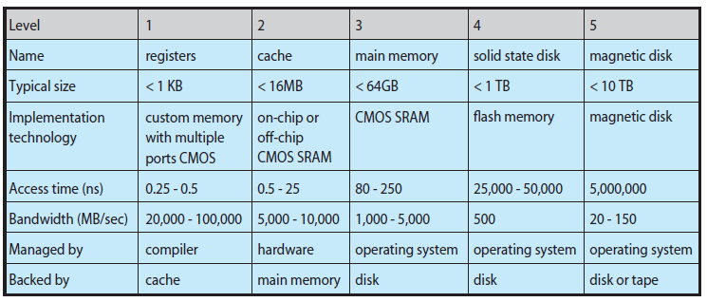
Performance of Various Levels of Storage

Slide 26
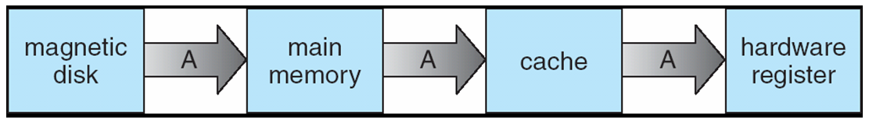
Migration of Integer A from Disk to Register If A is modified in Register, when and how is it propagated to the other levels of memory hierarchy?
The issue of coherence

Slide 27
Input-Output System Management
OS should hide the details of hardware characteristics from user and application programs
OS components that handle I/O subsystem
A memory management component that includes
Buffering, caching, etc.
A general device-driver interface
Drivers for specific hardware devices
How interrupt handlers and device drivers form the I/O subsystem?
How the I/O subsystem interfaces to other system components?

Slide 28
Protection and Security
Protection is a mechanism for controlling the accesses of processes or users to the resources defined by the computer system
OS provides means to enforce it
Protection can improve reliability
Security is a mechanism to defend a system from internal and external attacks
Includes attacks from viruses
Some systems place some of the larger functionalities in additional software
List of user names and IDs maintained by the OS
Authorization and authentication system uses them to identify and authenticate users
Privilege escalation may be done by the OS

Slide 29
Virtualization
A technology that allows to abstract the hardware of a single computer into several different execution environments
A user can switch between these virtual environments
Virtualization allows an OS to run as application within other operating systems
It is a member of a class of software that includes emulation
Emulation is used when source CPU type is different from target CPU type
Involves simulating computer hardware in software
Emulated code runs much slower than the native code

Slide 30
Virtualization
An operating system compiled for a particular CPU architecture runs within another OS also native to that CPU
VMware application is the Virtual Machine Manager (VMM)
Multiple virtual machines allow many users to run tasks designed for a single user
Use of virtualization is growing

Slide 31
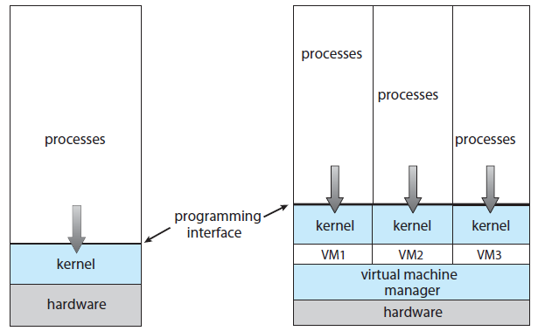
A computer running a single OS and three virtual machines

Slide 32
Distributed Systems
A collection of physically separate, possibly heterogeneous computer systems networked to provide access to resources that the system maintains
Increases computation speed, reliability, functionality and data availability
Some systems hide the details of the network and remote resources
Others explicitly expose the local and remote resources
Networks vary in protocols, distance between nodes and the transport media
Network operating system and distributed operating system

Slide 33
Computing Environments
How operating systems are used in a variety of computing environments?
Traditional Computing
Does not exist in the form that was there a decade ago
Networked computers, portals, wireless connections, etc.
Mobile Computing
Refers to computing on handheld smart phones and tablet computers
There is a large growth in the range of applications in mobile devices
Memory capacity and power consumption are limited
Apple iOS and Google Android

Slide 34
Computing Environments
Client-Server Computing
Most of today’s systems act as server systems to satisfy requests generated by client systems
User workstations are powerful
Servers are both compute servers and file servers
Compute servers provide an interface for the client to request an action to be performed by the server
File servers provide with a file-system interface

Slide 35
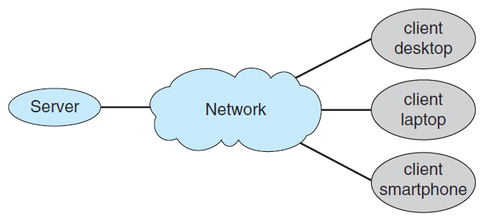
General Structure of a Client-Server System

Slide 36
Computing Environments
Peer-to-Peer Computing
Server bottleneck of client-server is resolved
All nodes are peers
Each node can act both as a client and as a server
How to determine the available services?
A node joining the network registers its service in a lookup service
Nodes which need a service contacts the lookup service
Discovery protocol is used to determine who can provide service
Broadcast a request

Slide 37
Computing Environments
Cloud Computing
A type of computing that delivers computing, storage and even applications as a service across a network
A logical extension to virtualization
Types of cloud computing
Public cloud
Available to anyone willing to pay for the services
Private cloud
Run by a company for its own use
Hybrid cloud
Include both public and private cloud components

Slide 38
Computing Environments
SaaS – Software as a service
One or more applications available via the Internet
PaaS – Platform as a service
A software stack ready for applications for use via the Internet
IaaS – Infrastructure as a service
Storage servers available on the Internet
Combination of several types may also exist
Cloud management tools are used to manage the resources and provide interfaces to cloud components

Slide 39
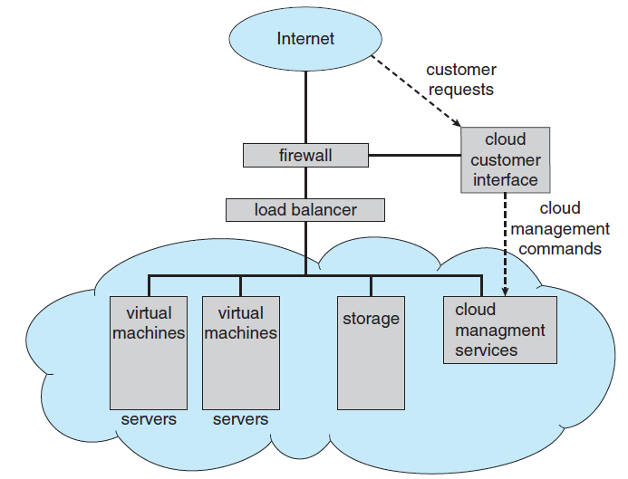
Public Cloud Computing providing IaaS

