Slide 1
Overview of Operating System
Introduction and Overview
Operating System Structures

Slide 2

Computing Environments
Real-time Embedded Systems
Most prevalent form of computers
Computers found everywhere
Systems they run on are usually primitive
OS provides limited features
Limited to little or no user interface
Vary considerably in their capabilities
Embedded systems run real-time operating system (RTOS)
Rigid time requirements are imposed on execution of certain functions
System fails if the time constraints are not met

Slide 3
Operating System Structures
OS Services
Interface for users
Components and their interconnections

Slide 4

Operating System Structures
OS services
Interface of user and OS
OS functions provided through system calls
Types of System calls
Structure of OS
Defining goals of OS
Modularity and Layered approach
Mechanisms and policies
Microkernel and Monolithic OS

Slide 5
Operating System Structures
View an OS from several vintage points
Services offered by the OS
Interfaces made available to users and programmers
Its components and their interconnections
Viewpoints of users, programmers and OS designers

Slide 6
Operating-System Services
Identify common class of services among all OS
Set of services provided for the convenience of user
User Interface (UI)
Options are
Command-line Interface (CLI)
Graphical User Interface (GUI)
Touchscreen Interface
Program Execution
The system must be able to load a program and execute it, terminating normally or abnormally
I/O operations
OS must provide means to perform I/O

Slide 7
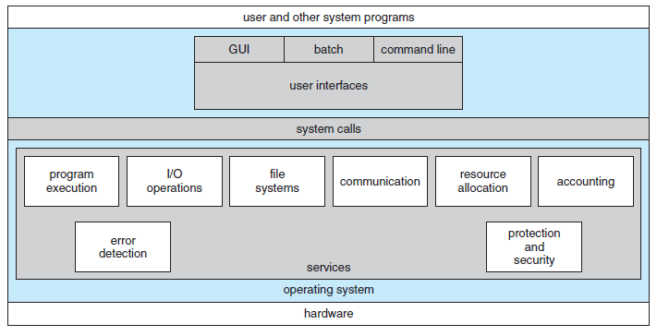
A View of Operating System Services

Slide 8
Operating-System Services
File-system manipulation
File management and access control management features should be provided
Communications
Processes need to communicate with one another
This can be implemented through message passing or shared memory
Error detection
Detect errors and take appropriate action to ensure correct and consistent computing
Set of services for efficient working of system
Resource allocation
Efficient allocation of resources without error and deadlocks

Slide 9
Operating-System Services
Accounting
For record-keeping, usage statistics and future planning
Protection and Security
Processes should not interfere with each other or with the OS processes
Protection ensures that all accesses to system resources are controlled
Security ensures that only authorized and authenticated users access the system and its resources
Defend all I/O devices from external threats and invalid attempts

Slide 10
User Operating-System Interface
There are three approaches for users to interface with the OS
Command Line Interface (CLI) or
Command Interpreter
Two approaches that use Graphical User Interface (GUI)
Command Interpreter
Allows users to directly enter commands to be performed by the OS
A number of interpreters may be available to choose from
Shells: Bourne shell, Cshell of Unix
How are commands implemented?
There are two ways to implement it

Slide 11
User Operating-System Interface
Command interpreter itself contains the code to execute the command
Size is determined from the number of commands
Commands are implemented through system programs
Interpreter only identifies which program to load into memory
Command Interpreter program is small and it does not need to change when new commands are added in the system
Graphical User Interface using touchscreen or mouse as the pointer
Both CLI or GUI are personal preferences

Slide 12
System Calls
System calls provide an interface to the services made available by the OS
How are system calls used?
APIs hide the details of all the operation sequence
Invokes the functions on behalf of the application programmer
Provides portability between different systems
Windows API, POSIX-API, Java API
System call interface (SCI)
Run-time support system for most programming languages
Serves as the link to the system calls made available by the OS

Slide 13
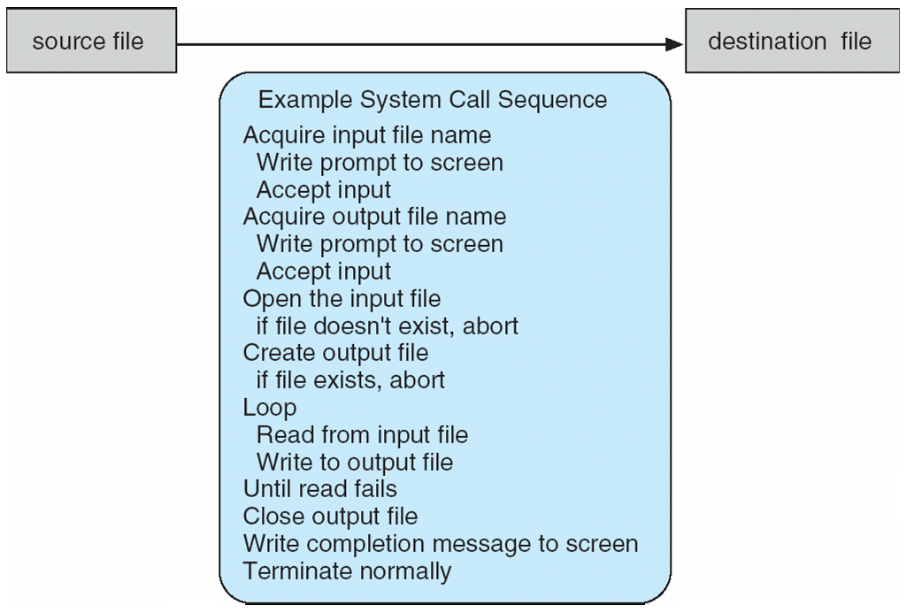
Example of how System Calls are used
Copy from one file to another
Notes:
13

Slide 14
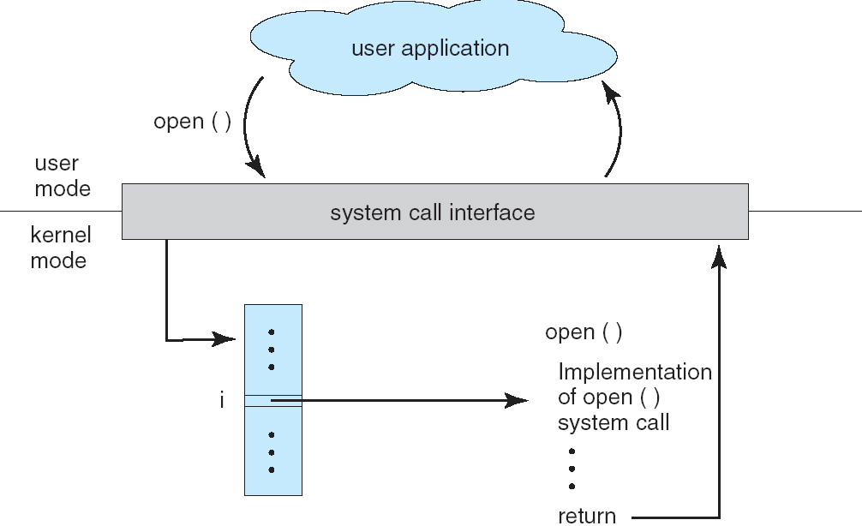
API – System Call – OS Relationship
The handling of a user application invoking the open() system call
Notes:
14

Slide 15
System Calls
Why API instead of system call?
Program portability
Handling of system calls in the RTE
Many system calls need parameters to be passed to the OS – three approaches are used
Pass parameters in registers
Registers are fewer in number
Place the parameters in a block or table in memory
Place the address of the block in register
Push the parameters onto the stack by the calling program
Popped off by the OS routine

Slide 16
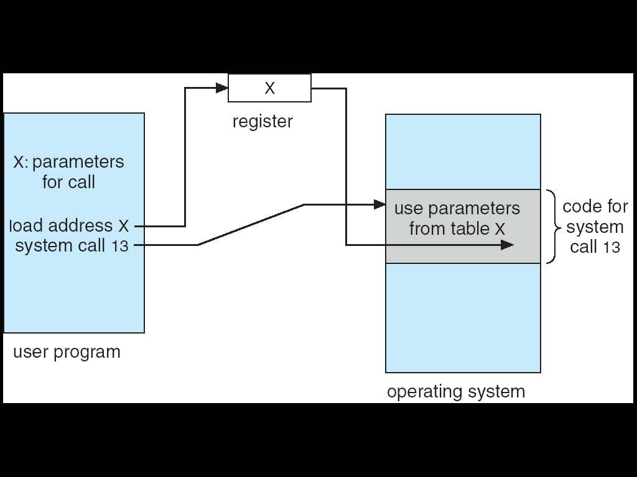
Parameter Passing as a Table
Notes:
16

Slide 17
Types of System Calls
Systems calls are grouped into six categories
Process control
File management
Device management
Information maintenance
Communications
Protection
Process Control
end, abort load, execute
wait event, signal event
allocate and free memory
create process, terminate process
get process attributes, set process attributes
wait for time

Slide 18
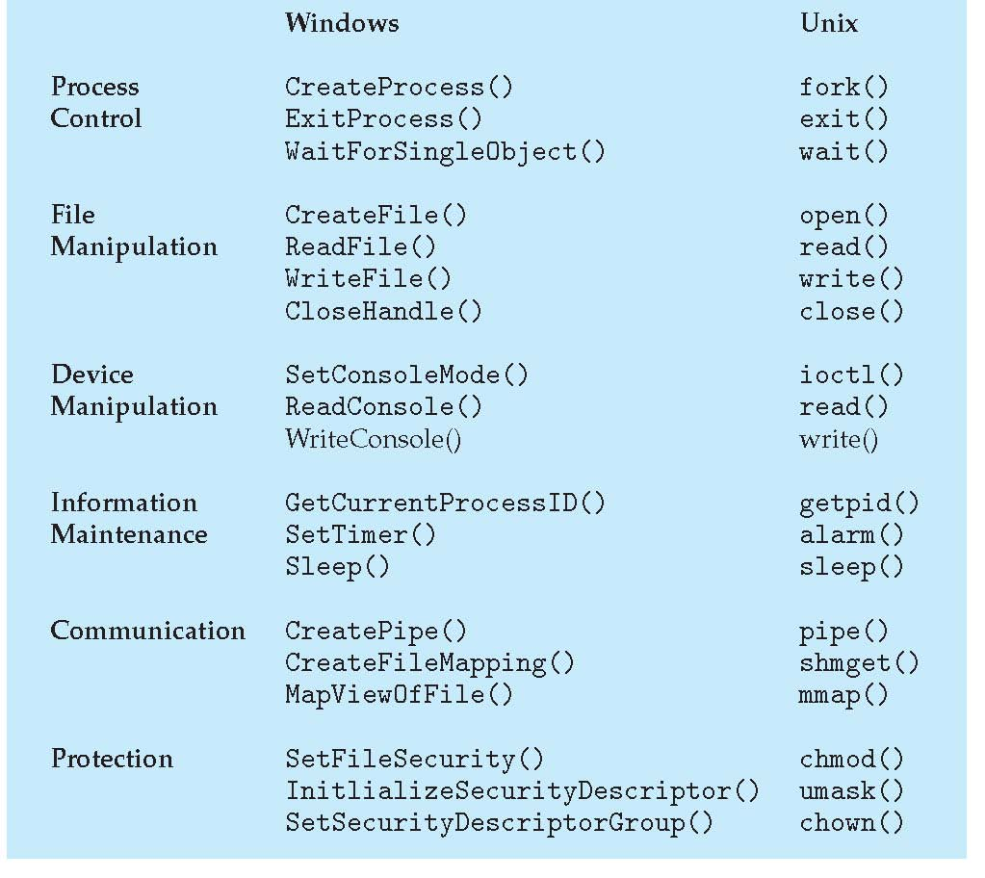
Examples of Windows and Unix System Calls

Slide 19
System Calls for Process Control
end, abort
A running process may need to end normally (end) or abnormally (abort)
Abnormal termination provides the error code
load, execute
A process may want to load another process for execution
Where does control return as the new process terminates?
Depends on whether the existing process is lost, saved or allowed to continue execution concurrently
If the return is to the existing process, memory image of the process should be saved

Slide 20
System Calls for Process Control
create process, terminate process
New processes may be created by an existing process
set process attributes, get process attributes
This provides the ability to control and set the attributes of a new process or to determine the attributes of an existing process
wait for time
Wait for a certain amount of time for a process to terminate
wait event, signal event
Wait for a specific event or the process itself signals completion
Other system calls are available for debugging, getting memory dump, profiling, etc.

Slide 21
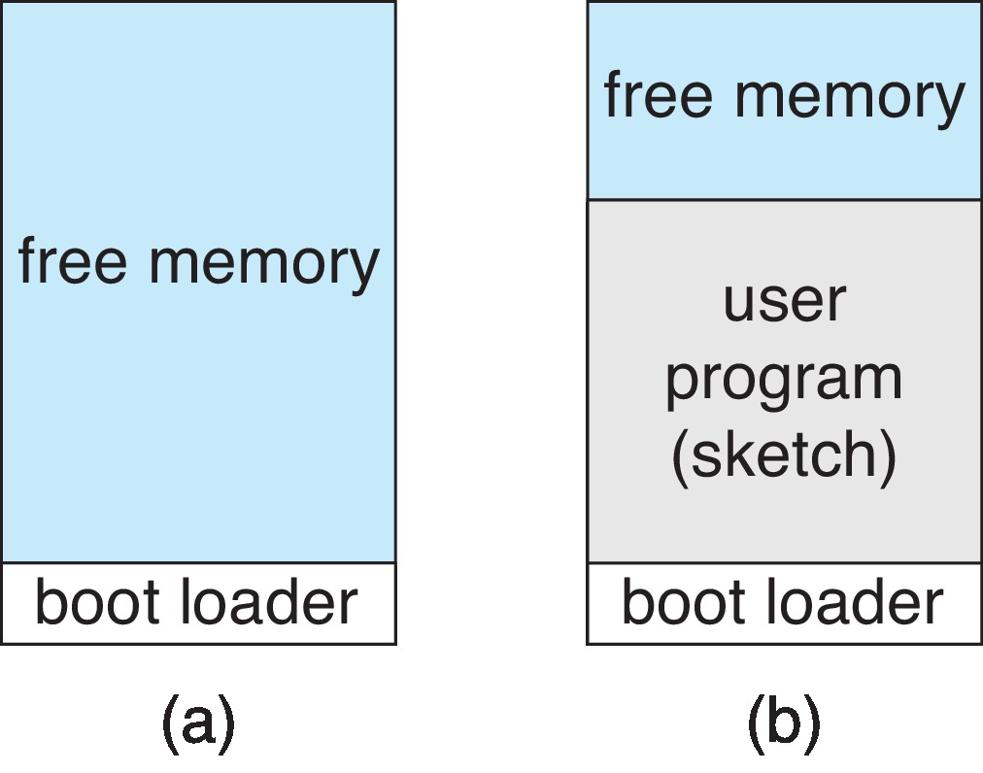
Single-tasking in Arduino
system startup running a program
Notes:
21

Slide 22
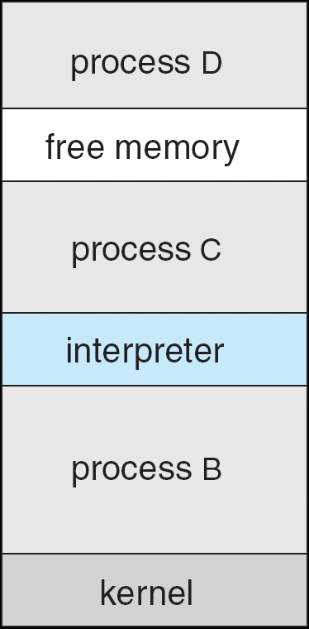
FreeBSD Running Multiple Programs
Notes:
22

Slide 23
File Management System Calls
create file, delete file
Requires the name of the file and its attributes
open, close
After creation, file should be opened for specific operations
read, write, reposition
Operations that can be performed on open file
get file attributes, set file attributes
Get attributes of a file and possibly set them if desired
Attributes are name, type, protection codes, accounting information, etc.
Some systems provide more file management functions and system calls

Slide 24
Device Management System Calls
Resources controlled by the OS are treated as devices
Physical and virtual devices
request device, release device
If there are multiple users of various devices, processes require to request for devices before making use of it and release it after using it
read, write, reposition
Operations that can be performed on the devices that are allocated
Get device attributes, set device attributes
Logically attach or detach devices

Slide 25
Information Maintenance System Calls
System calls that are used only to transfer information between user and OS programs
get time or date, set time or date
get system data, set system data
get process, file or device attributes
set process, file or device attributes
OS maintains information to respond to the calls that are relevant

Slide 26
Communication System Calls
Interprocess communication models
Message-passing model
Processes exchange messages to transfer information directly or indirectly
Requires the name of the processes
Shared-memory model
For exchange of information through common, shared memory areas
create, delete communication connection
A connection is established before messages are exchanged between processes
send, receive messages
transfer status information
attach or detach remote devices

Slide 27
Protection Related System Calls
Protection provides a mechanism for controlling access to resources provided by a computer system
Set_permission and get_permission
Manipulates permission settings of resources such as files and disks
Allow_user and deny_user
Whether users be allowed or not allowed access to certain resources

Slide 28
System Services
Provide a convenient environment for program development and execution – system utilities
Varies from simple to complex ones
Divided into a number of categories
File management
Programs that manipulate files and directories
Status information
Programs that format and print the output from the status information system calls
Registry may be supported that store and retrieve configuration information
File modification
Several text editors may be available with various options like search or transformations

Slide 29
A View of Operating System Services

Slide 30
System Services
Programming language support
Compilers, assemblers, debuggers and interpreters for common programming languages
Program loading and execution
Used for loading and execution of programs
Communications
Provide mechanism for creating virtual connections among processes, users and computer systems
Other programs are supplied: perform common operations: web browsers, spreadsheets, etc.

Slide 31
Why are applications OS Specific?
Each OS provides a unique set of system calls
An application can be made to run on multiple OS through one of three ways:
Application can be written in an interpreted language that has an interpreter available for multiple OS
Python or Ruby
Features are limited
Performance suffers
Application is written in a language that includes virtual machine running the application
Java and JVM

Slide 32
Why are applications OS Specific?
Suffers from similar disadvantages as in the first approach
Application developer can use a standard language or API which generates binaries in a machine- and OS-specific language
POSIX API and its set of standards
Developing cross platform application is a challenging task
Other challenges exist at the lower levels of the system

Slide 33
Operating-System Design and Implementation
Design Goals
Define goals and specifications
Affected by the choice of hardware and the type of system
General purpose or specific
Next level requirements: user and system goals
User goals
System should be convenient to use
It should be reliable, safe and fast
How to achieve these objectives?
System goals
System should be easy to design, implement and maintain - It should be flexible, reliable, error free and efficient

Slide 34
Mechanisms and Policies
An important principle of OS design is to separate policy from mechanism
Mechanisms determine how to do something
Policies determine what will be done
This is important for flexibility
Policies are likely to change over time and place
A general mechanism insensitive to policy changes is desirable
Microkernel-based OS separate mechanisms from policies
Implements basic set of primitive building blocks that are totally policy free

Slide 35
Implementation
All current generation OS is implemented in a high-level language
Easier to write, understand and debug
Portability is achieved
May suffer from reduced speed and increased storage requirements
Performance improvement measures can be used to offset the disadvantage
Bottleneck routines can be identified and replaced with assembly language equivalents
Bottleneck is identified through programs that measure system behavior
Traces can be run to achieve the objectives

Slide 36
Operating System Structure
Design the system by defining small components or modules
Each module is a well-defined portion of the system with carefully defined interfaces and functions
Monolithic Structure
Simplest structure has no structure
Monolithic structure
Original UNIX operating system had limited structuring
Consists of two separable parts
The kernel and system programs

Slide 37
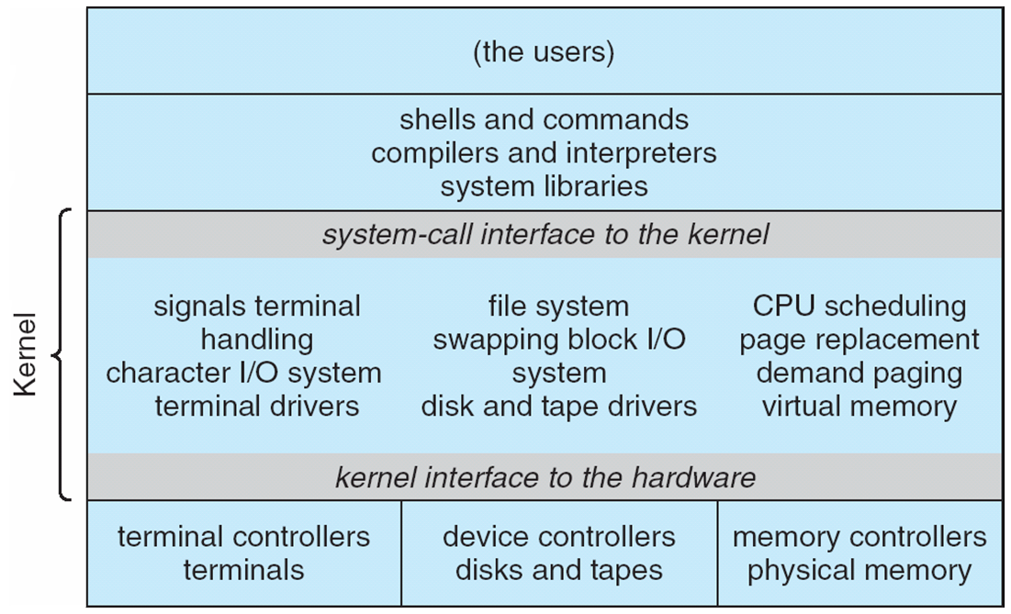
Traditional UNIX System Structure
Notes:
37

Slide 38
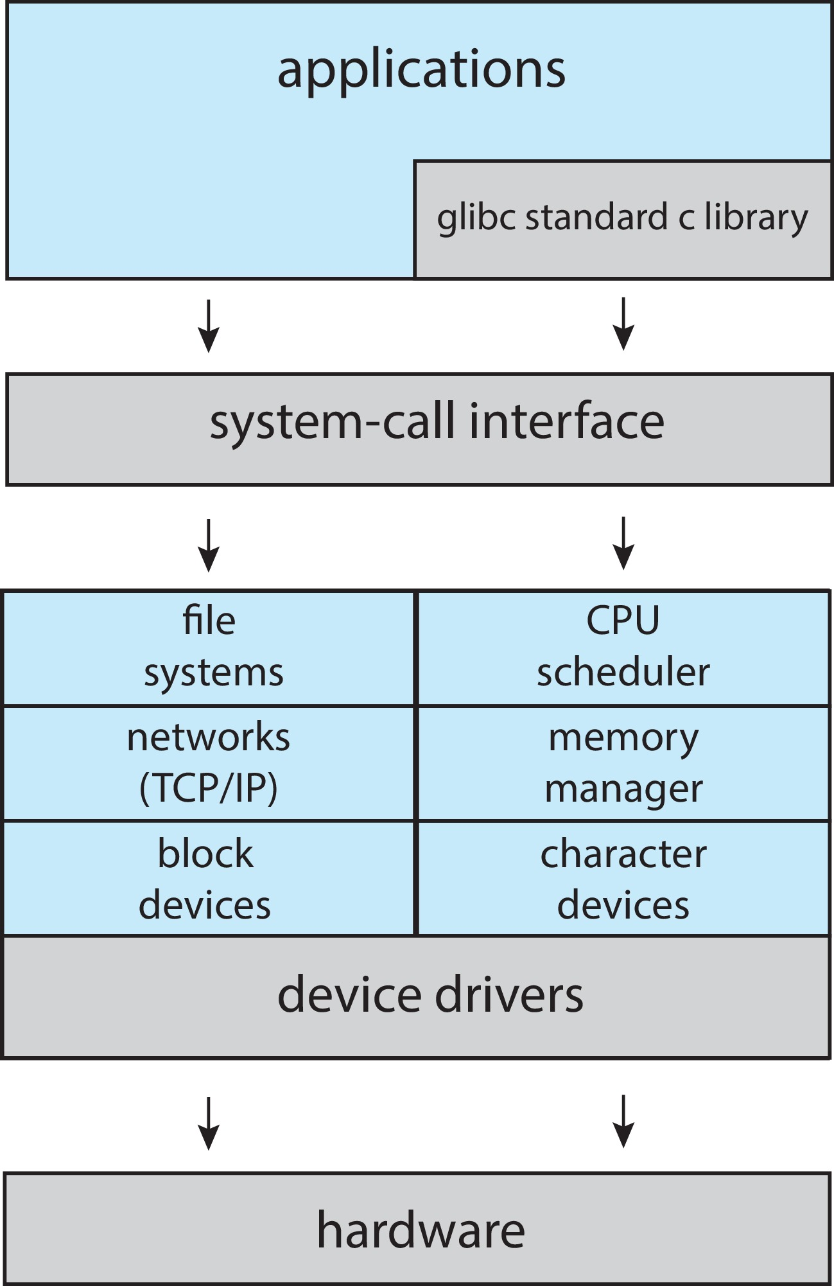
Linux System Struct-ure
Notes:
38

Slide 39
Layered Approach
Monolithic approach is a tightly coupled system
A loosely coupled system is divided into separate smaller components
Changes in one component affects only that component
Modular system can be designed using a number of approaches
Layered approach
OS is broken into a number of layers or levels
Bottom layer is the hardware and the highest layer is the user interface
An OS layer is an implementation of an abstract object made up of data and the operations that can manipulate those data

Slide 40
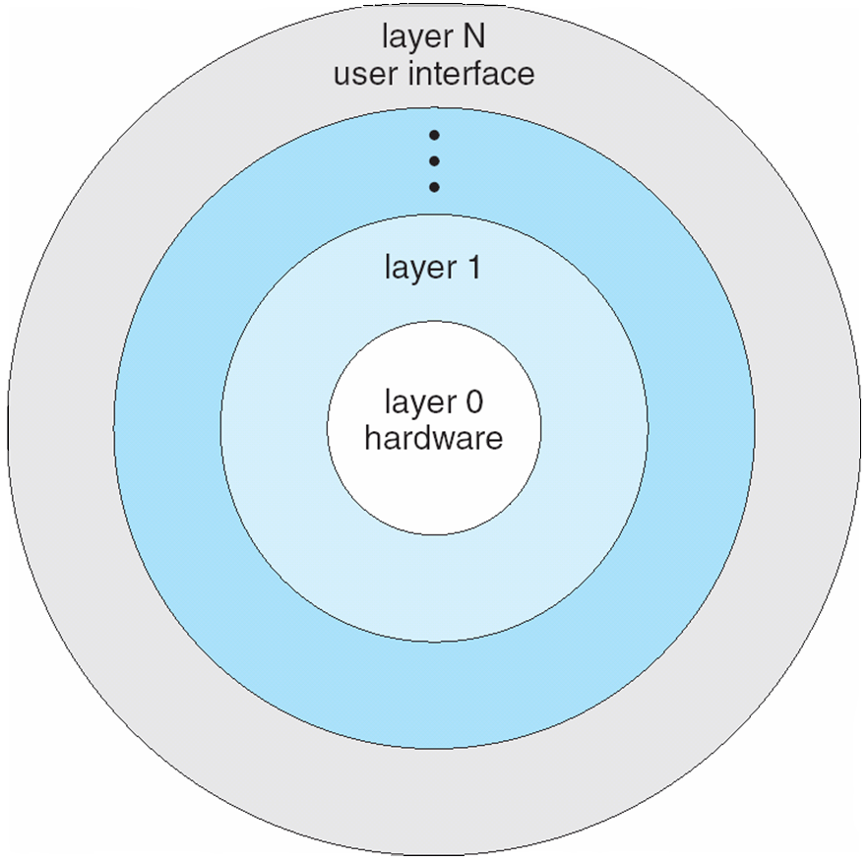
Layered Operating System
Notes:
40

Slide 41
Layered Approach
Advantages of layered approach
Simplicity of construction and debugging
Simplifies system verification
Problems with layered approach
How to appropriately define the layers
Some layers may not be completely self- contained violating the basic principle of layered approach
Less efficient in terms of performance
Recent developments
Fewer layers with more functionality have been designed to overcome the above problems

Slide 42
Microkernels
This method structures the kernel by removing all nonessential components and implements them as system and user-level programs
Results in smaller kernel
Microkernel provides minimal process and memory management and some communication facility
Communication is through message passing
Benefits of microkernel approach
Ease of extending the OS
Easier to port
It provides more security and reliability
Examples are Tru64 UNIX and QNX
This approach suffers from performance losses

Slide 43
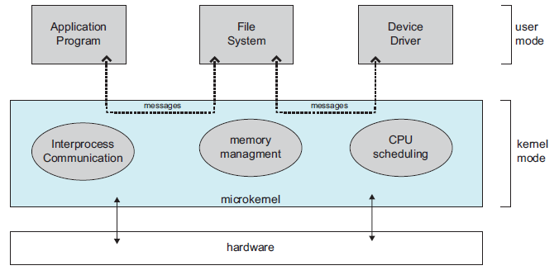
Architecture of a Typical Microkernel

Slide 44

Modules
Current methodology is to use loadable kernel modules (LKMs)
Kernel has a set of core components
Links dynamically with additional services during boot time or during run time
Linux uses LKMs for dev. drivers and file system
Current implementations of UNIX uses this methodology
Solaris, Mac OS X, Windows, etc.
Hybrid Systems
Most of the operating systems are a hybrid of the previously mentioned structures
They address the issues of performance, security and usability

Slide 45
Hybrid Systems
Linux and Windows are primarily monolithic
New functionalities can be added to Linux kernel dynamically
Windows also support LKMs and has some behavior of microkernel systems
Operating Systems for mobile devices
iOS
Android
Reading Assignment

Slide 46
Process Management
Part 2
Processes
Threads
Process Synchronization
CPU Scheduling
Deadlocks

Slide 47
Process Management
A process is a program in execution
Needs resources to accomplish its task
System consists of a collection of processes executing concurrently
OS processes and user processes
Processes may be of single thread or may have multiple threads
The threads may run in parallel on systems with multiple hardware processing cores
Scheduling of threads on cores
Several CPU schedulers are available to programmers

Slide 48
Process Concept
Definitions
States of a process
Process Control Block
Threads of a process
Scheduling and schedulers
Scheduling queues
Operations on processes
Process creation and termination
Communication between processes
IPC using shared memory and message passing

Slide 49
Process Concept
All activities including OS programs and user programs are termed as processes
Job and process are terms used interchangeably
A process comprises of
A program code or text section
Program counter content and content of processor registers
Process stack and a data section
It may also contain a heap that is dynamically allocated at run time
Two processes may be associated with the same program but are considered to be separate processes

Slide 50
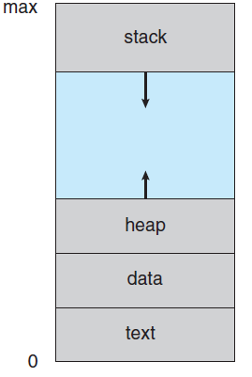
Process in Memory

Slide 51
Process State
Processes change states as they execute
New: The process is being created
Running: Instructions are being executed
Only one process can be running on a single core processor in system at any instant
Waiting: The process is waiting for some event to occur
Ready: The process is waiting to be assigned to the processor
Many processes may be ready and waiting
Terminated: The process has completed execution

Slide 52
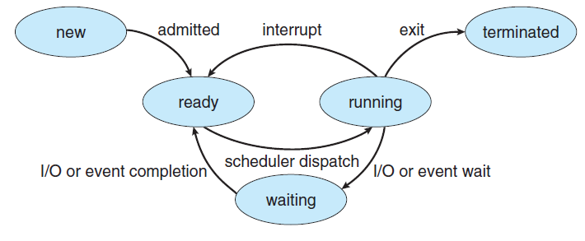
Diagram of Process State

Slide 53
Process Control Block
Each process in the system is represented by a task control or a process control block (PCB)
PCB serves as the repository for information that may vary from process to process
Includes the following information
Process state
Program counter
CPU registers
Number and type depends on the processor architecture
CPU scheduling information
Contains scheduling parameters
Memory management information
Accounting information
I/O status information

Slide 54
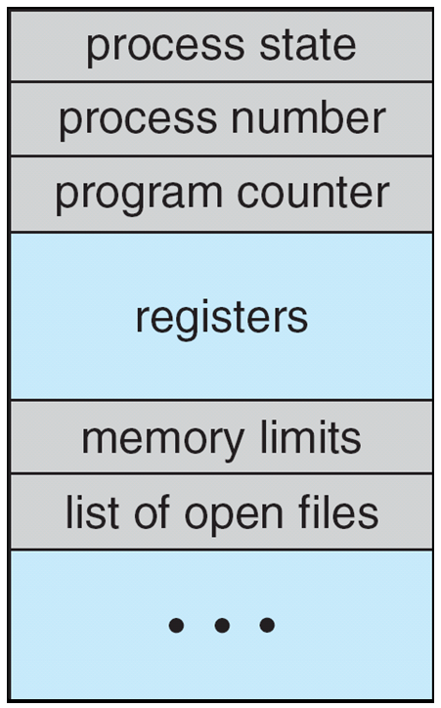
Process Control Block (PCB)

