Slide 1
Process Management
Part 2
Processes
Threads
Process Synchronization
CPU Scheduling
Deadlocks

Slide 2

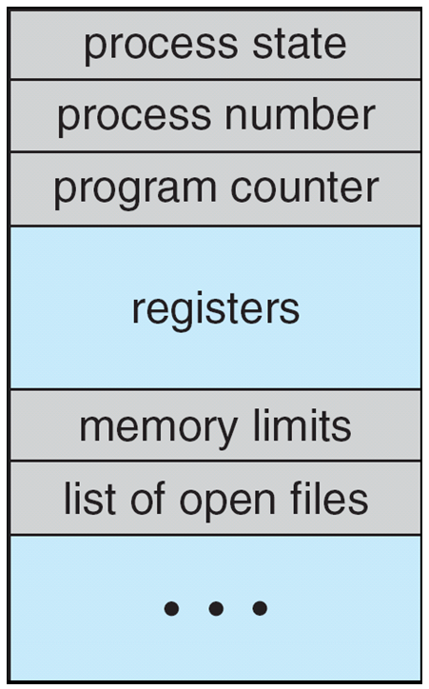
Process Control Block (PCB)

Slide 3
Threads
The process model implies that a process performs a single thread of execution
A single thread of instructions is being executed
Allows the process to execute only one task at a time
Current generation OS allow a process to perform multiple threads of execution at a time
Perform more than one task at a time
Feature is beneficial for multicore systems
PCB is expanded to include information about each thread

Slide 4
Process Scheduling
Objective of multiprogramming
Maximize CPU utilization
Objective of time sharing
Switch a CPU core among processes
Process scheduler
Selects an available process for execution on a core
Each CPU core can run one process at a time
Multicore systems can run multiple processes at a time
Degree of multiprogramming
Number of processes currently in memory
Most processes are either I/O bound or CPU bound

Slide 5
Process Scheduling
I/O bound process
Process spends most of the time performing I/O than doing computation
CPU bound process
Process spends most of its time doing computation
Scheduling Queues
Ready queue consists of all processes that enter the system and reside in main memory
Generally stored as a linked list
Ready queue header and pointer field of each PCB
System includes other queues too
Wait queue contains a list of processes waiting for an event to occur

Slide 6
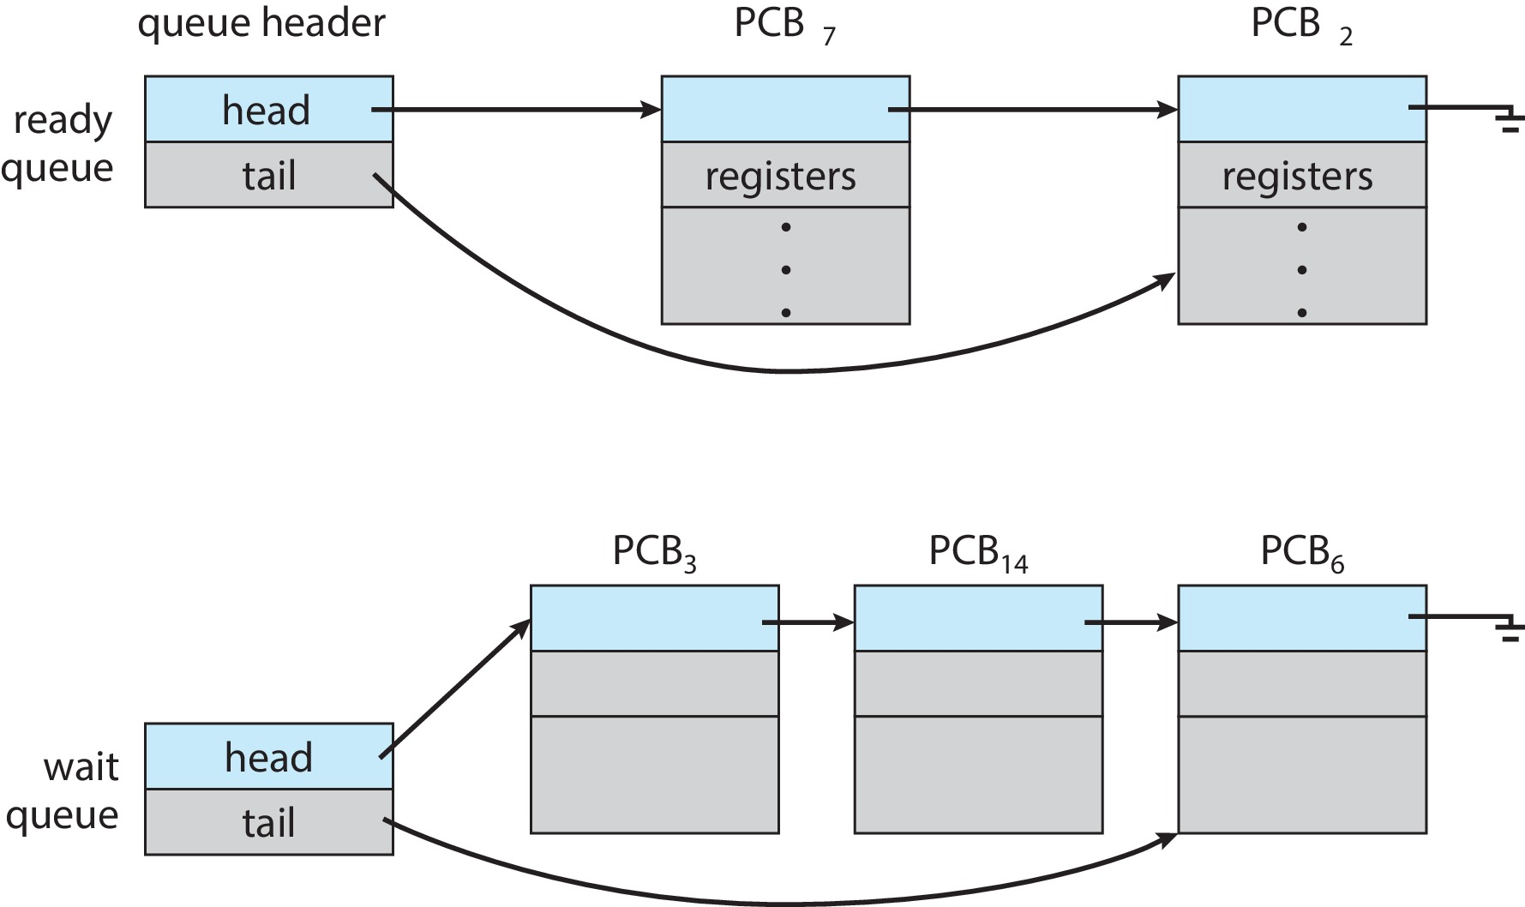
Ready Queue and Wait Queue

Slide 7
Scheduling Queues
A queuing diagram represents process scheduling
A new process is placed in a ready queue
It waits until it is selected for execution or is dispatched
One of several events may occur while the process is in execution
Process issues an I/O request and is placed in an I/O wait queue
Process creates a child process and waits for the child’s termination
Process eventually goes back to ready queue
Process is interrupted and put in ready queue
Process continues with this cycle until it terminates and releases all its resources

Slide 8
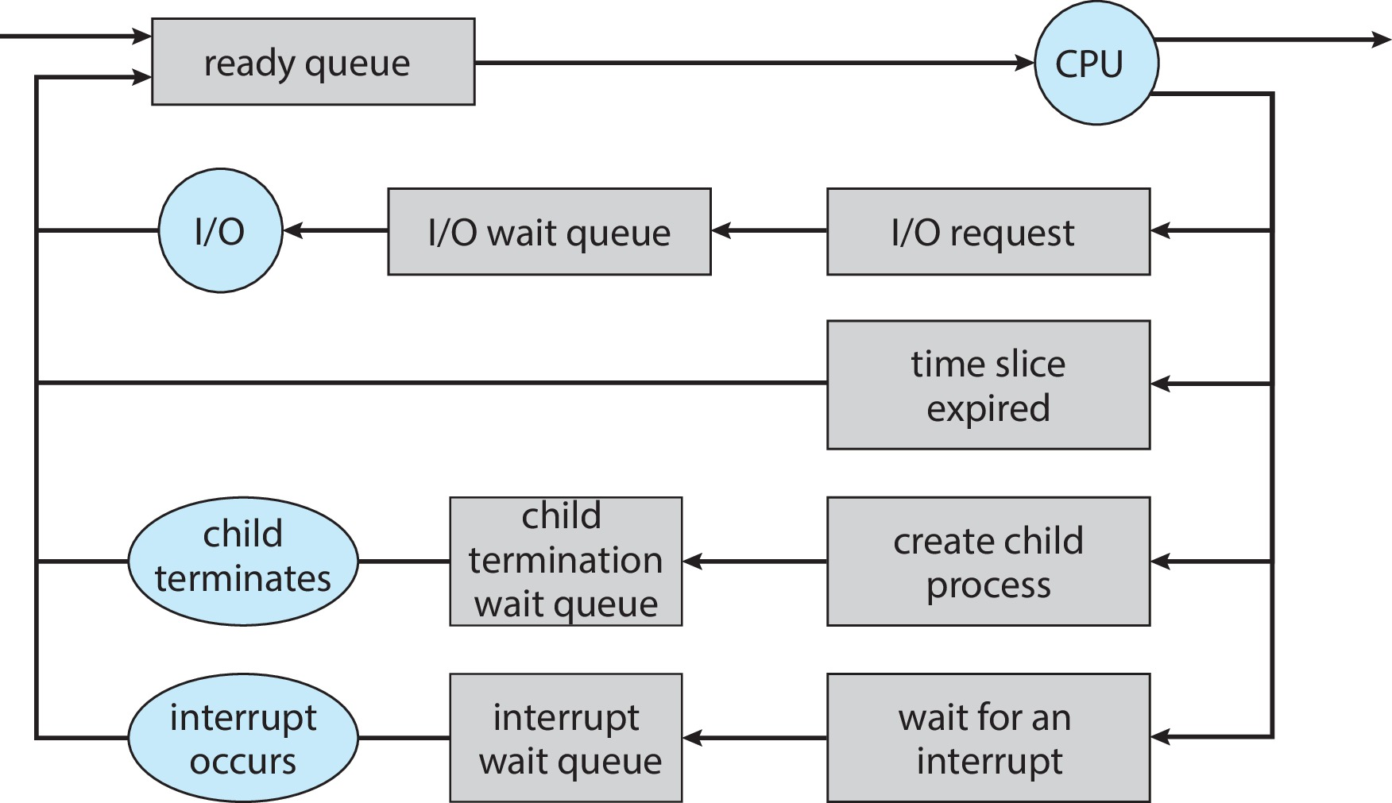
Queuing-diagram representation of Process Scheduling

Slide 9
CPU Scheduling
CPU scheduler
Selects from among the ready processes and allocate the CPU core to one of them
Executes frequently
Swapping
An intermediate form of scheduling
Supported by some OS to balance the number of processes in memory
Used for reducing the degree of multiprogramming
Remove a process from memory
Necessary only when memory has been overcommitted

Slide 10
Context Switch
When the CPU is interrupted, it saves the state of the current process and restores the state later to resume
Save and restore operation takes place in kernel mode
Switching the CPU to another process requires state saving and restoring state of another process
Context switch time is overhead
It is dependant on hardware support
Some processors provide multiple sets of registers
Context switch involves only the change of a pointer

Slide 11
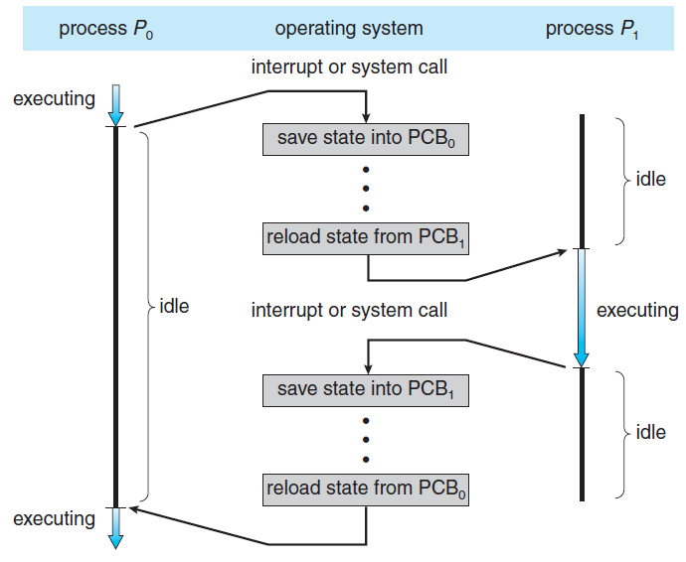
CPU Switch From Process to Process

Slide 12
Operations on Processes
Most systems provide a mechanism for process creation and termination
Process Creation
A process may create new processes through a create-process system call
Parent and child processes form a tree of processes
Process identifier (pid) uniquely identify processes in a system
When a process creates a child process, it may get its resources
Directly from the OS or it may be allocated a subset of resources of the parent process
Initialization data is also passed on to the child process

Slide 13
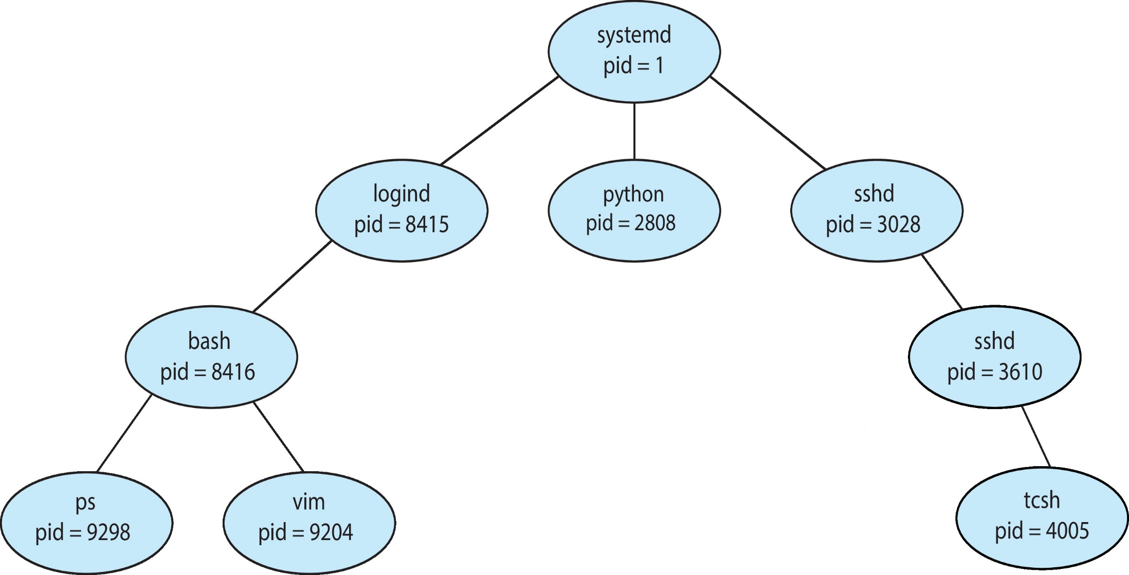
A tree of processes on a typical Linux system

Slide 14
Operations on Processes
Two possibilities exist in terms of execution when a process creates another process
The parent continues to execute concurrently with the child processes
The parent waits until some or all of its children have terminated
In terms of address space of the new process
The child process is an exact duplicate of the parent process
The child process has a new program loaded into it
Illustrate the differences between the above through UNIX OS
Process creation in Windows
Reading assignment

Slide 15
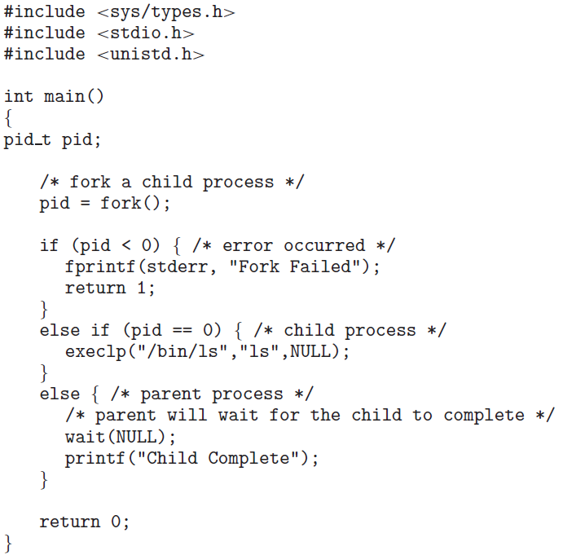
C Program Forking Separate Process

Slide 16
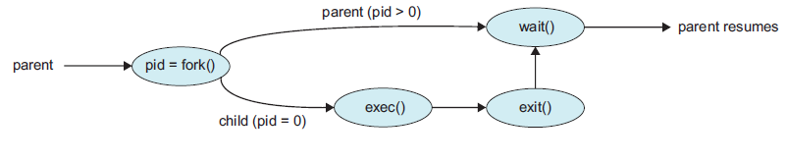
Process Creation

Slide 17
Operations on Processes
Process Termination
A process terminates when it finishes executing its final statement – exit()
All resources of the process are deallocated and it may return a status value to its parent process
Termination can also be caused by another process through a system call
Only the parent process can terminate
Reasons for termination can be
The child process has exceeded the usage of some of its resources
The task assigned to child is no longer required
The parent is exiting and the OS does not allow the child to continue
Cascading termination may take place

Slide 18
Interprocess Communication
Processes executing concurrently in a system are either independent or cooperating
Independent processes cannot affect or be affected by other executing processes in system
Cooperating processes can affect and be affected by other processes
Why cooperating processes?
Information sharing can be done by allowing concurrent access to same set of information
Computation speedup can be achieved by breaking a task into subtasks that execute in parallel
Modularity is achieved by constructing the system in a modular fashion

Slide 19
Interprocess Communication
Two models exist for IPC
Shared memory model
A region of memory is created that is shared by cooperating processes
Allows maximum speed and convenience of communication
Message passing model
Messages are exchanged between cooperating processes
Useful for exchange of smaller amount of data and is easier to implement
Both models are common in operating systems

Slide 20
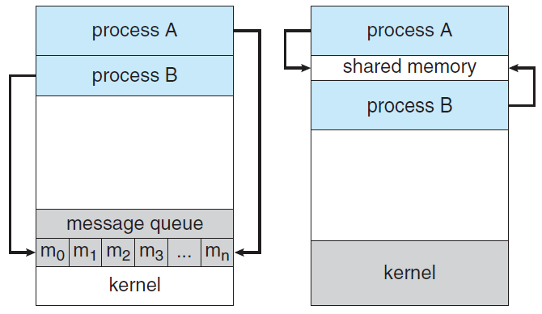
Communications Models
Message Passing
Shared Memory

Slide 21
IPC in Shared-Memory Systems
Communicating processes need to establish a region of shared memory
Resides in the address space of the creating process
Producer-consumer problem for cooperating processes
Producer process provides information
Consumer process consumes information
One solution to the problem
Use shared memory
Producer places the produced item in the buffer
Consumer removes the item from buffer
Buffer may be bounded or unbounded

Slide 22
IPC in Shared-memory systems
#define BUFFER_SIZE 10 Solution is correct,
typedef struct { but can use only
. . . BUFFER_SIZE – 1
} item; elements
item buffer[BUFFER_SIZE];
int in = 0;
int out = 0;
Code for producer and consumer processes
Solution does not address the problem of both processes accessing the buffer concurrently

Slide 23
Producer Process in Shared-Memory Systems
item next_produced;
while (true) {
/* produce an item in next produced */
while (((in + 1) % BUFFER_SIZE) == out)
; /* do nothing */
buffer[in] = next_produced;
in = (in + 1) % BUFFER_SIZE;
}

Slide 24
Consumer Process in Shared-Memory Systems
item next_consumed; while (true) { while (in == out)
; /* do nothing */ next_consumed = buffer[out];
out = (out + 1) % BUFFER_SIZE; /* consume the item in next consumed */
}

Slide 25
IPC in Message-Passing Systems
Processes communicate and synchronize without sharing the same address space
Provides at least two operations
send(message); receive(message)
Messages may be fixed or variable in size
A communication link must exist between processes
Methods for logically implementing a link and the send/receive operations
Direct or indirect communication
Synchronous or asynchronous communication
Automatic or explicit buffering

Slide 26
IPC in Message-Passing Systems
Naming
Processes must be able to refer to each other
Direct communication
Each process must explicitly name the recipient or the sender
send (P, message); receive (Q, message)
Communication link properties
Link is established automatically
A link is associated with exactly two processes
There exists exactly one link between each pair of processes
There is symmetry in addressing

Slide 27
IPC in Message-Passing Systems
Asymmetric addressing
Only sender names the recipient
Disadvantage of both schemes
Limited modularity of the resulting process definitions
Indirect communication
Messages are sent to and received from mailboxes or ports
send(A,message) receive(A,message)
Communication link properties
A link is established between a pair of processes only if the pair has a shared mailbox

Slide 28
IPC in Message-Passing Systems
A link is associated with more than two processes
A number of different links may exist between each pair of communicating processes
Synchronization
Message passing can be either blocking or nonblocking
Also known as synchronous or asynchronous
Blocking send
The sending process is blocked until the message is received by the receiving process

Slide 29
IPC in Message-Passing Systems
Nonblocking send
The sending process sends the message and resumes the operation
Blocking receive
The receiver blocks until a message is available
Nonblocking receive
The receiver retrieves either a valid message or a null

Slide 30
CPU Scheduling
Algorithms for CPU Scheduling
Evaluation of Various Scheduling Algorithms
Multiprocessor or Multicore Scheduling
Real-time Scheduling Algorithms

Slide 31
Overview of Contents
CPU scheduling algorithms
FCFS
SJF
Priority
Round-Robin
Preemptive and non-preemptive algorithms
Multilevel queue algorithms
Multilevel feedback-queue algorithms
Thread scheduling
Multiple-processor scheduling
Real-time CPU scheduling
Performance of scheduling algorithms

Slide 32
Introduction
CPU scheduling is the basis of multiprogrammed OS
Computer becomes more productive by switching the CPU among processes
The problem of selecting a particular CPU scheduling algorithms from among a number of algorithms
Process scheduling and thread scheduling

Slide 33
Some Basic Definitions and Concepts
In a single process environment, CPU is idle when the process is waiting for an I/O request
Multiprogramming helps use this time productively
Another process can run on the CPU in case a running process waits for such events
Fundamental OS function
CPU-I/O Burst Cycle
Process execution consists of a cycle of CPU execution and I/O wait
CPU burst and I/O burst
Duration of CPU burst and their frequency curve
Exponential or hyper-exponential

Slide 34
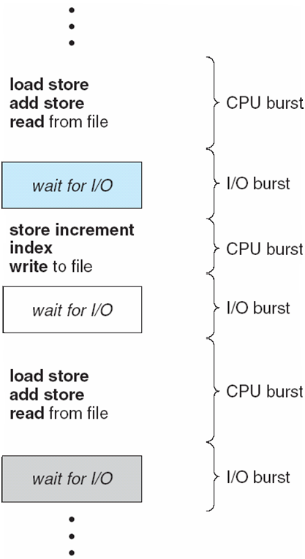
Alternating Sequence of CPU and I/O Bursts
Notes:
34

Slide 35
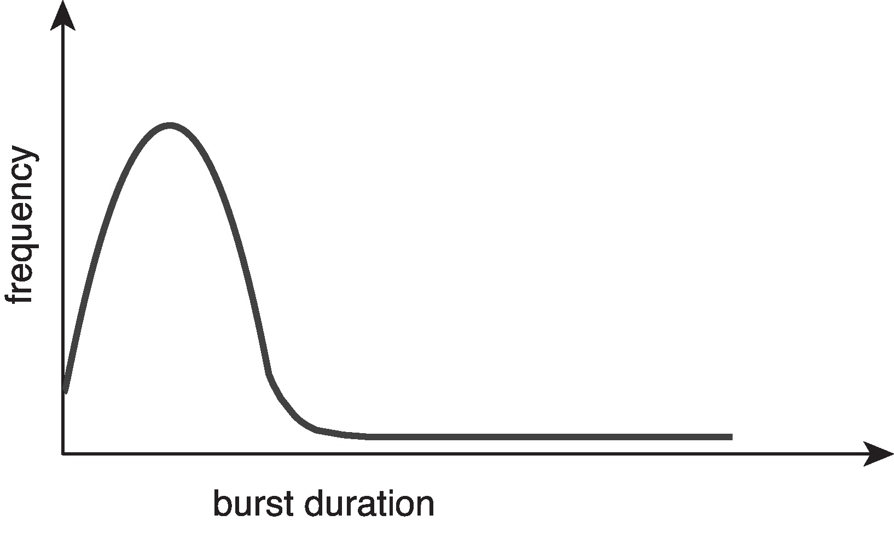
Histogram of CPU-burst Durations
Notes:
35

Slide 36
Basic Concepts
Consists of a large number of short CPU bursts and a small number of long CPU bursts
I/O bound and CPU bound processes
CPU Scheduler
Selects a process from the processes in memory that are ready to execute and allocates the CPU to the process
Ready queue can be either
A FIFO queue
A priority queue
A tree
An unordered linked list
Records in the queue are PCBs

Slide 37
Basic Concepts
Preemptive and Non-Preemptive Scheduling
CPU scheduling decision is taken when any of the following occurs
A process switches from running to wait state
A process switches from running to ready state
A process switches from wait state to ready state
A process terminates
For cases 1 and 4, there is no choice in terms of scheduling – a new process must be selected
For cases 2 and 3, there are choices
When scheduling takes place only under 1 and 4, the scheduling is referred to as non-preemptive or cooperative scheduling
For other cases, it is said to be preemptive

Slide 38
Preemptive Scheduling
Non-Preemptive scheduling
If the CPU is allocated to a process, it is released only if the process terminates or switches to wait state
Preemptive scheduling
OS can interrupt a process to release CPU
Incurs a cost for access to shared data
A mechanism is needed to coordinate access to shared data
Preemption affects the design of OS kernel with respect to the processing of a system call
Wait for a system call to complete before preempting the process
Poor kernel execution model for real- time computing
Disabling interrupts is another solution

