Slide 1

CPU Scheduling
Algorithms for CPU Scheduling
Evaluation of Various Scheduling Algorithms
Multiprocessor or Multicore Scheduling
Real-time Scheduling Algorithms

Slide 2
Dispatcher
Another component of CPU scheduling
Dispatcher is the module that gives control of the CPU to the process selected by the CPU-scheduler
Functions of the dispatcher
Switching context
Switching to user mode
Jumping to proper location in the user program to restart that program
A frequently used module
Should be as fast as possible
Dispatch latency is the time taken by the dispatcher to stop one process and start another

Slide 3
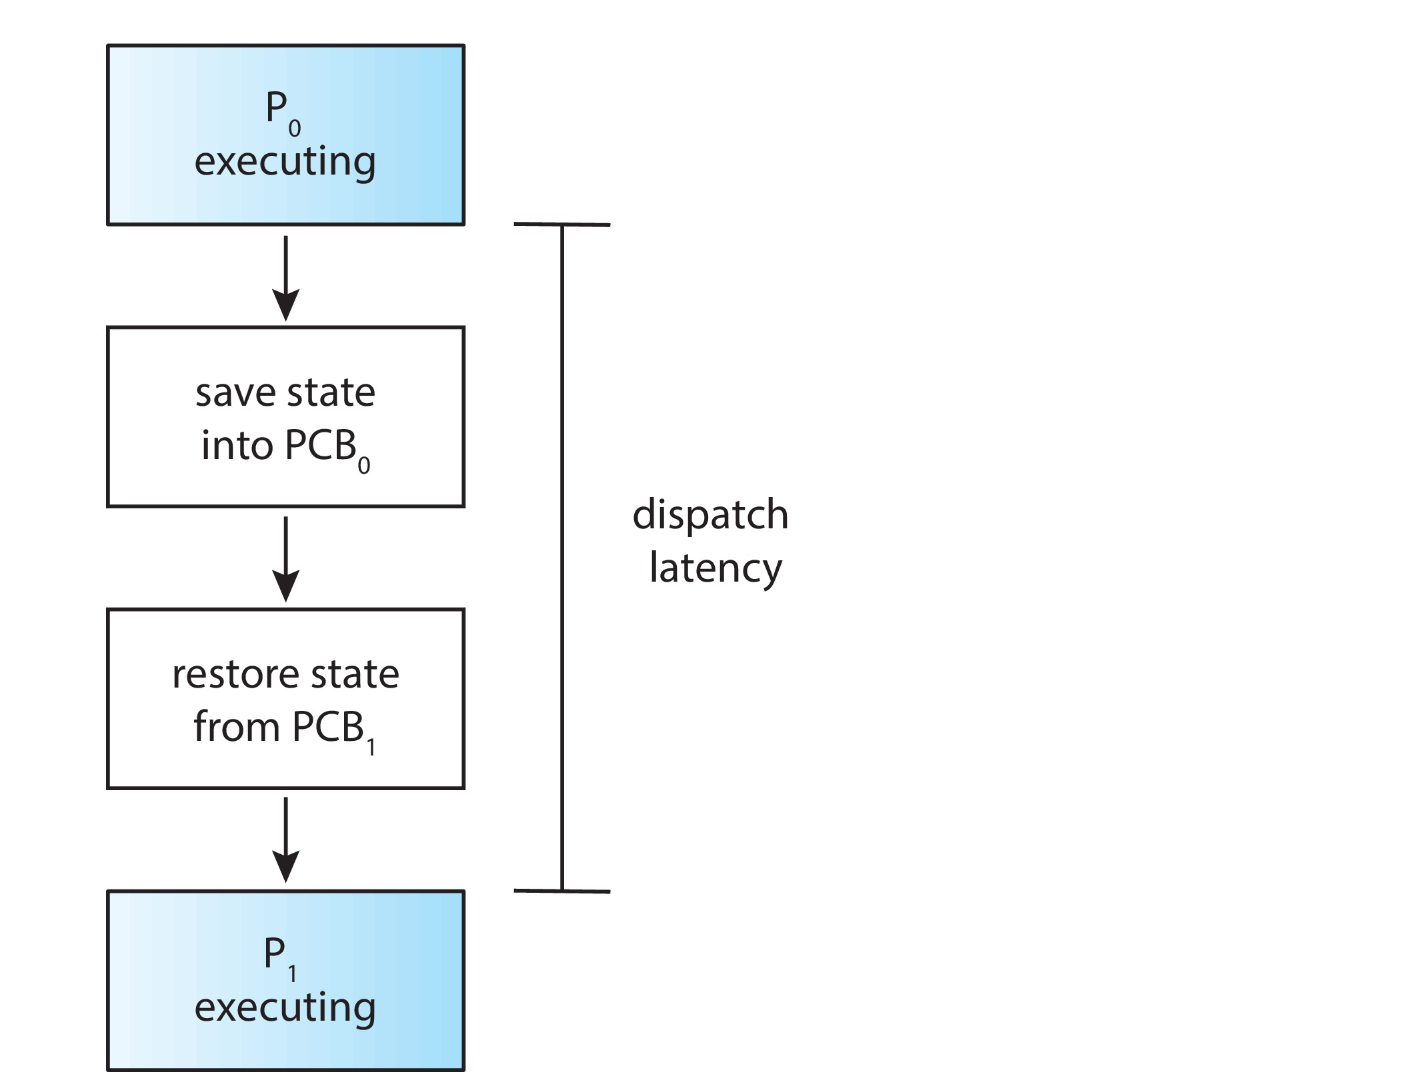
The Role of Dispatcher
How many context switches take place per second?
vmstat 1 3
Output is:
----------cpu---------
24
225
339

Slide 4
Scheduling Criteria
Different scheduling algorithms have different properties
Many criteria are used to perform comparison between different algorithms
Criteria for comparison
CPU utilization
Keep the CPU as busy as possible
CPU utilization ranges from 40% to 90%
Throughput
Number of processes completed per unit time
A measure of the amount of work being done

Slide 5
Scheduling Criteria
Turnaround time
The interval from the time of submission of a process to the time of completion
Includes both computation and wait times
Waiting time
Sum of time periods spent waiting in the ready queue
Scheduling algorithm affects only this time of a process
Response time
Time from the submission of a request until the first response is produced

Slide 6
Scheduling Criteria
Desirable characteristics
Maximize CPU utilization and throughput
Minimize turnaround time, waiting time and response time
For interactive systems, it is more important to minimize the variance in the response time
Have reasonable and predictable response time
Scheduling Algorithms
Which of the processes in the ready queue is to be allocated the CPU
Scheduling algorithms are discussed in the context of a single core

Slide 7
Scheduling Algorithms
First-Come, First-Served Scheduling
The simplest scheduling algorithm
Implementation is managed by a FIFO queue
PCB of a ready process is linked to the tail of the ready queue
When CPU is free, it is allocated to the process at the head of the queue
Average waiting time of this algorithm is long
Gantt chart is a bar chart that illustrates a particular schedule
Example using Process Burst time
Gantt chart P₁ 24
P₂ 3
P₃ 3

Slide 8
First-Come, First-Served (FCFS) Scheduling
P₁
P₂
P₃
0
24
27
30
Average waiting time
Waiting time of each process
Change the order of arrival
P2, P3, P1
Notes:
8

Slide 9
FCFS Scheduling
Average waiting time of FCFS is high and may vary substantially
In case of many I/O bound processes and one CPU bound process, there is a convoy effect seen in FCFS scheduling
Results in low CPU and device utilization
FCFS scheduling algorithm is non-preemptive
This algorithm is not suitable for interactive systems
No scheduling takes place until the process has completed its CPU burst

Slide 10
Shortest-Job-First Scheduling
Associates with each process the length of the process’s next CPU burst
Process with the smallest next CPU burst is allocated the CPU
FCFS is used to break a tie
Shortest-next-CPU-burst algorithm
SJF scheduling for the following processes
Process Burst time
P1 6
P2 8
P3 7
P4 3

Slide 11
SJF Scheduling
P₄
P₁
P₃
P₂
0
3
9
16
24
Waiting time for each process
Average waiting time
Average waiting time using FCFS
Notes:
11

Slide 12
SJF Scheduling
This is an optimal scheduling algorithm
Gives the minimum average waiting time for a set of processes
Problem is to estimate the length of the next CPU request
One approach is to try to approximate SJF scheduling
Prediction algorithms that predict next CPU burst using past statistics can be useful for CPU scheduling
This can be predicted as an exponential average of the measured lengths of the previous CPU bursts
Let t_{n} be the nth CPU burst and Ƭ_{n+1} be the predicted value for the next CPU burst

Slide 13
SJF Scheduling
Then for α, 0 ≤ α ≤ 1
Ƭ_{n+1} = α t_{n} + (1 – α) Ƭ_{n}
t_{n} contains the most recent information and Ƭ_{n} stores the past history
The parameter α controls the relative weight of recent and past history in our prediction
Most commonly used value of α is ½
SJF algorithm can be either preemptive or non-preemptive
A newly arrived process may have a shorter duration next CPU burst than what is left of the currently executing process
Preempt the currently executing process
Shortest-remaining-time-first-scheduling

Slide 14
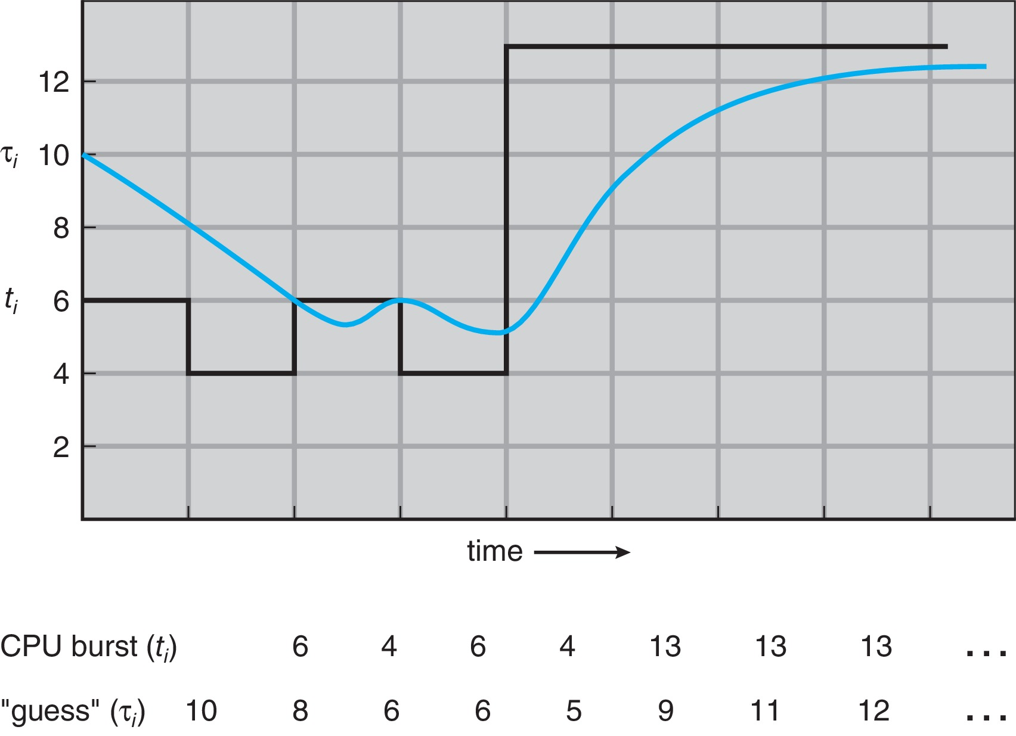
Prediction of the Length of the Next CPU Burst
Notes:
14

Slide 15
Preemptive SJF Scheduling
Process Arrival Burst
Time Time
P1 0 8
P2 1 4
P3 2 9
P4 3 5
Average waiting time for both
Preemptive SJF
Non-preemptive SJF

Slide 16
Priority Scheduling
SJF is a special case of priority scheduling algorithm
Priority (p) is the inverse of the predicted next CPU burst
Priorities are generally indicated by a fixed range of numbers
0 is the highest priority and n is the lowest priority
Priorities can be defined internally or externally
Internal priority is determined using some measurable quantity to compute the priority
External priorities are determined by criteria outside the control of the OS
Priority scheduling can be either preemptive or non-preemptive

Slide 17
Example of Priority Scheduling
Process Burst Time Priority
P1 10 3
P2 1 1
P3 2 4
P4 1 5
P5 5 2
P2
P5
P1
P3
P4
Find the average waiting time

Slide 18
Priority Scheduling
Preemptive priority scheduling algorithm allows a newly arrived higher priority process to preempt a currently running lower priority process
A non-preemptive priority scheduling algorithm will put the new process at the head of the ready queue
Problem with priority scheduling algorithm
Indefinite blocking or starvation
A low priority process may have to wait indefinitely
Aging can be used to solve this problem
Technique of gradually increasing the priority of processes that wait in the system for a long time

Slide 19
Round-Robin Scheduling
This algorithm is designed for time-sharing systems
Time quantum or time slice is defined
Generally between 10 to 100msec interval
Ready queue is treated as a circular queue
Each process in the ready queue is allocated a time quantum
Ready queue is a FIFO queue
A timer is set to interrupt at the end of every time quantum
Average waiting time of RR is long
This scheduling algorithm is preemptive

Slide 20
Example of RR with Time Quantum = 4
Process Burst Time
P₁ 24
P₂ 3
P₃ 3
P₁
P₂
P₃
P₁
P₁
P₁
P₁
P₁
0
4
7
10
14
18
22
26
30
Notes:
20

Slide 21
Round-Robin Scheduling
Every process is allocated only a single time quantum in a row
If there are n processes in the ready queue and the time quantum is q
Each process gets 1/n of CPU time in chunks of at most q time units
Each process must wait for (n – 1) x q time units until the next time quantum
Performance of RR algorithm depends on the size of the time quantum
For very large time quantum
RR policy is very close to FCFS policy
For very small time quantum
A large number of context switches occur

Slide 22
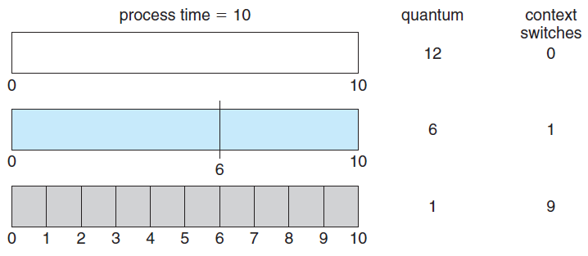
Time Quantum and Context Switch Time
Notes:
22

Slide 23
Round-Robin Scheduling
Consider the effect of context switching on the performance of RR scheduling
Time quantum should be large with respect to context switching time
Context switching time should be a small fraction of quantum
Turnaround time depends on the time quantum
Does not necessarily improve with the increase in time quantum
Average turnaround time improves if most of the processes finish their next CPU burst in a single time quantum
A rule of thumb
80 percent of the CPU bursts should be shorter than the time quantum

Slide 24
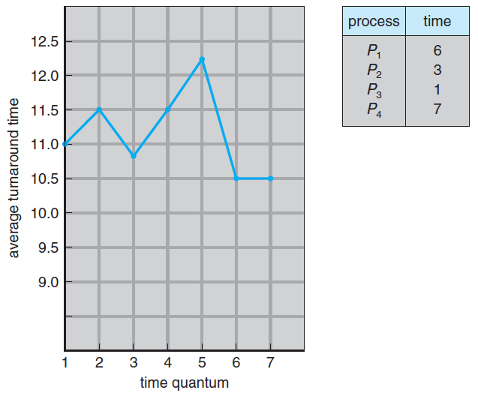
Turnaround Time Varies With The Time Quantum
Notes:
24

Slide 25
Multilevel Queue Scheduling
Scheduling algorithms created for systems where processes can be classified into different groups
Each group may have a different response time requirements and scheduling needs
Foreground (interactive) and background (batch) processes
Ready queue is partitioned into several separate queues
Each queue has its own scheduling algorithm
Scheduling is also required among the queues
Fixed-priority preemptive scheduling
Processes are permanently assigned to a particular queue
Low scheduling overhead but not flexible

Slide 26
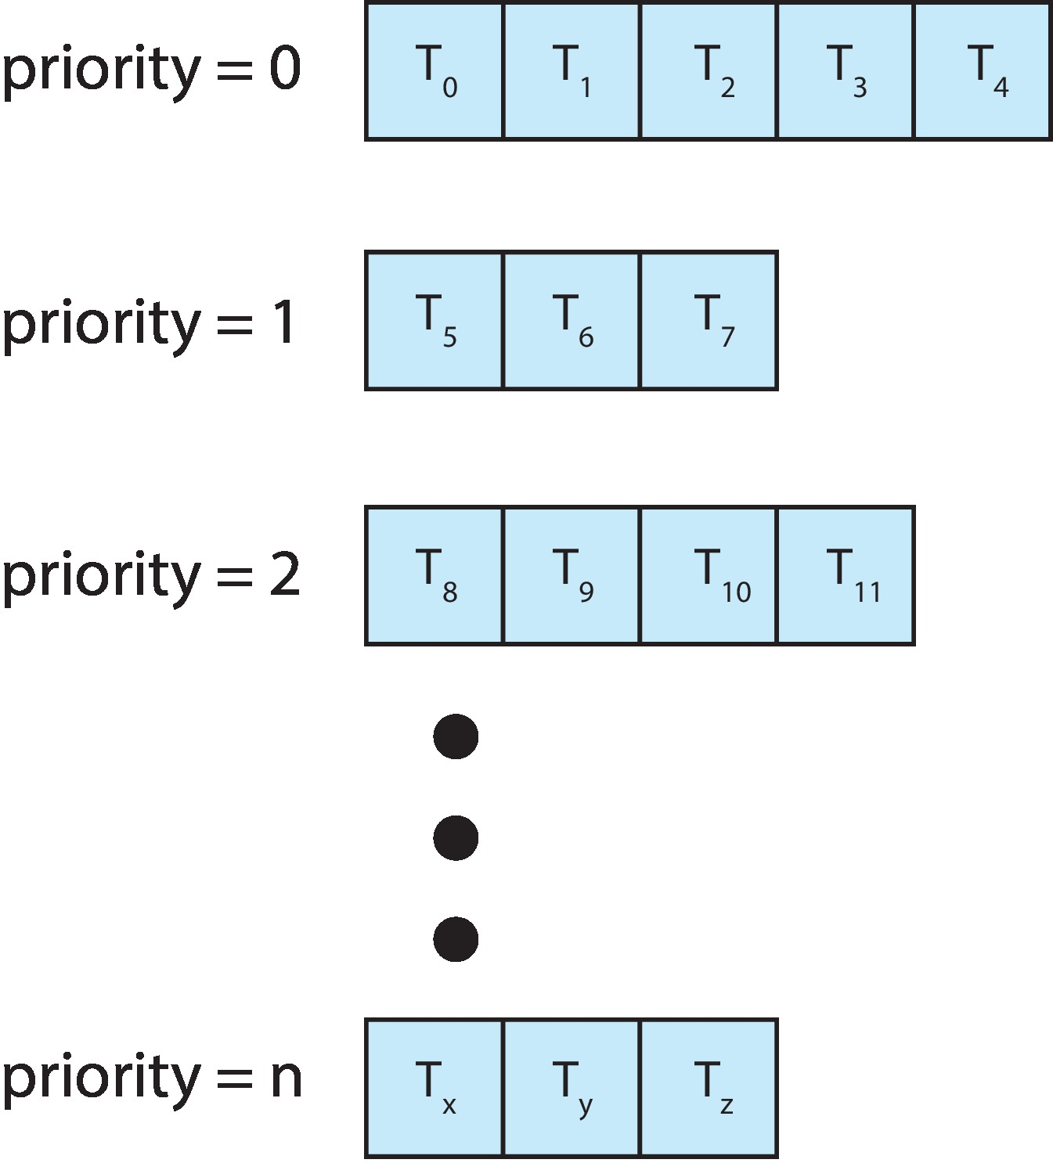
Separate Queues for each Priority
Notes:
26

Slide 27
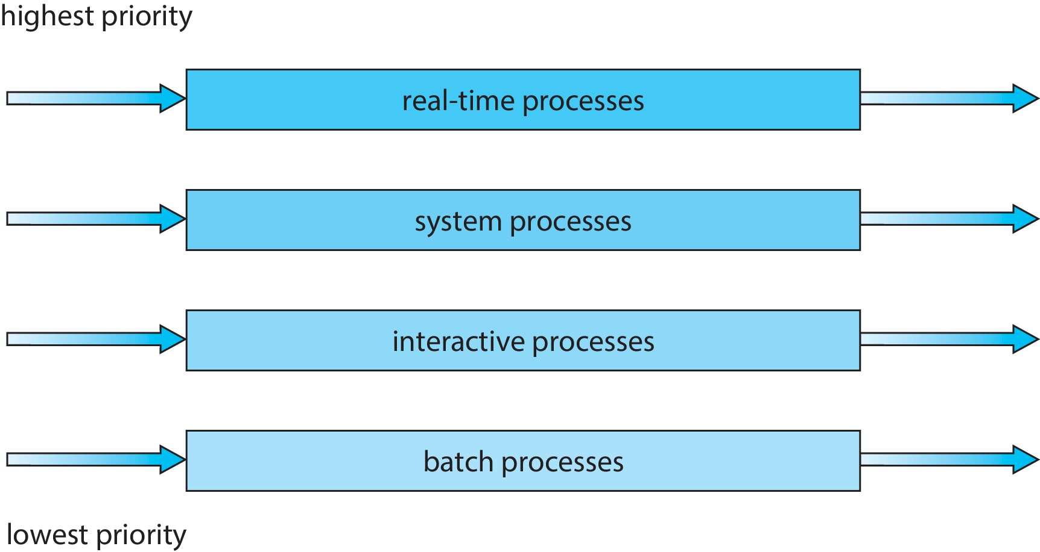
Multilevel Queue Scheduling
Notes:
27

Slide 28
Multilevel Feedback-Queue Scheduling
This algorithm allows a process to move between queues
Processes are separated on the basis of CPU bursts
Processes that have longer CPU bursts are moved to a lower priority queue
Aging can be used to prevent starvation
This scheduler is defined by the following parameters
The number of queues
The scheduling algorithm for each queue
Method used to determine when to upgrade a process to a higher priority queue

Slide 29
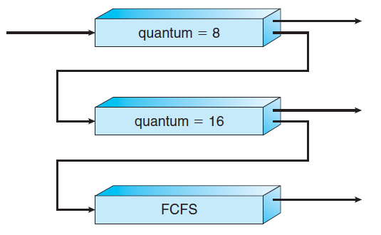
Multilevel Feedback Queues
Notes:
29

Slide 30
Multilevel Feedback-Queue Scheduling
Method used to determine when to demote a process
Method used to determine the queue for a process
This is the most general CPU-scheduling algorithm
Can be configured to match a specific system
This is also the most complex algorithm
Defining the scheduler requires some means to determine the parameters

Slide 31
Thread Scheduling
In systems that support user and kernel-level threads, kernel-level threads are scheduled by the OS
Kernel-level threads instead of processes are scheduled
User-level threads are managed by a thread library
To run on the CPU, the user-level thread must be mapped on an associated kernel- level thread
Other sub-topics shall be discussed later

Slide 32
Multi-Processor Scheduling
Load sharing is possible if multiple processors are available
Scheduling problem becomes more complex
The term multiprocessor applies to all the following architectures:
1. Multicore CPUs
2. Multithreaded cores
3. NUMA systems
4. Heterogeneous multiprocessing
Processors are identical in the first three cases
Multiple-Processor Scheduling Approaches
Two scheduling approaches are used
Asymmetric Multiprocessing
Symmetric Multiprocessing (SMP)

Slide 33
Multi-Processor Scheduling
Asymmetric Multiprocessing
All scheduling decisions are handled by a single processor
The master server
Scheduling is simple: Access to system data structure is done by a single processor
Master server becomes the potential bottleneck
Symmetric Multiprocessing (SMP)
Each processor is self-scheduling
Two possible strategies
1.All threads are in a common ready queue
Shared ready queue suffer from race condition
2.Each processor has its own private queue of threads
Workload balancing is required

Slide 34
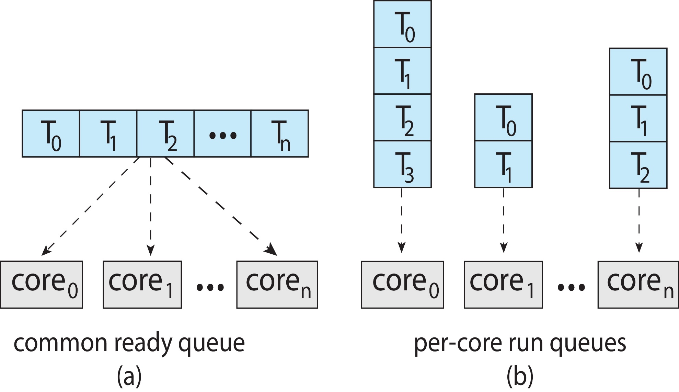
Organization of Ready Queues

