Slide 1

CPU Scheduling
Algorithms for CPU Scheduling
Evaluation of Various Scheduling Algorithms

Slide 2
Multi-Processor Scheduling
Multicore Processors
Each core appears to be a separate logical CPU
Memory stall occur due to
Cache miss OR
Access to relatively slow memory
Multithreaded cores are used to alleviate the problem
Chip multithreading (CMT)
Each hardware thread appears as a logical CPU that can run a software thread
Intel uses the term hyper-threading
Also called simultaneous multithreading (SMT)
Two ways to multithread a processing core
Coarse grained and fine grained multithreading

Slide 3
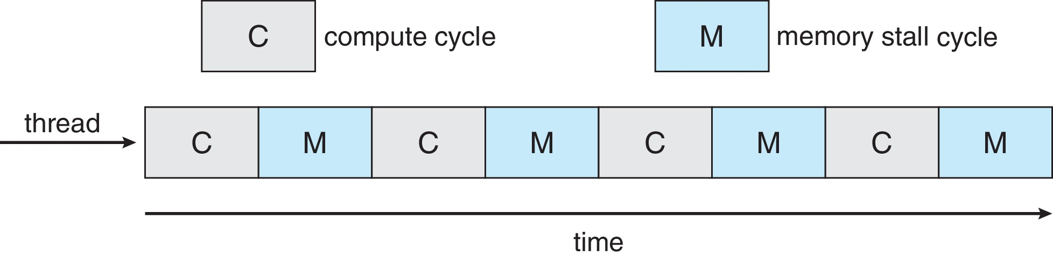
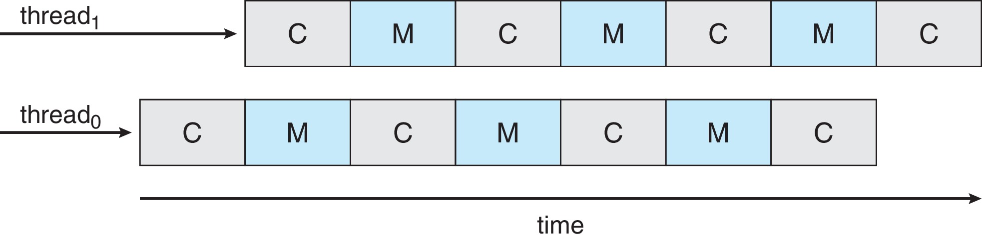
Memory Stall
Multithreaded Multicore System

Slide 4
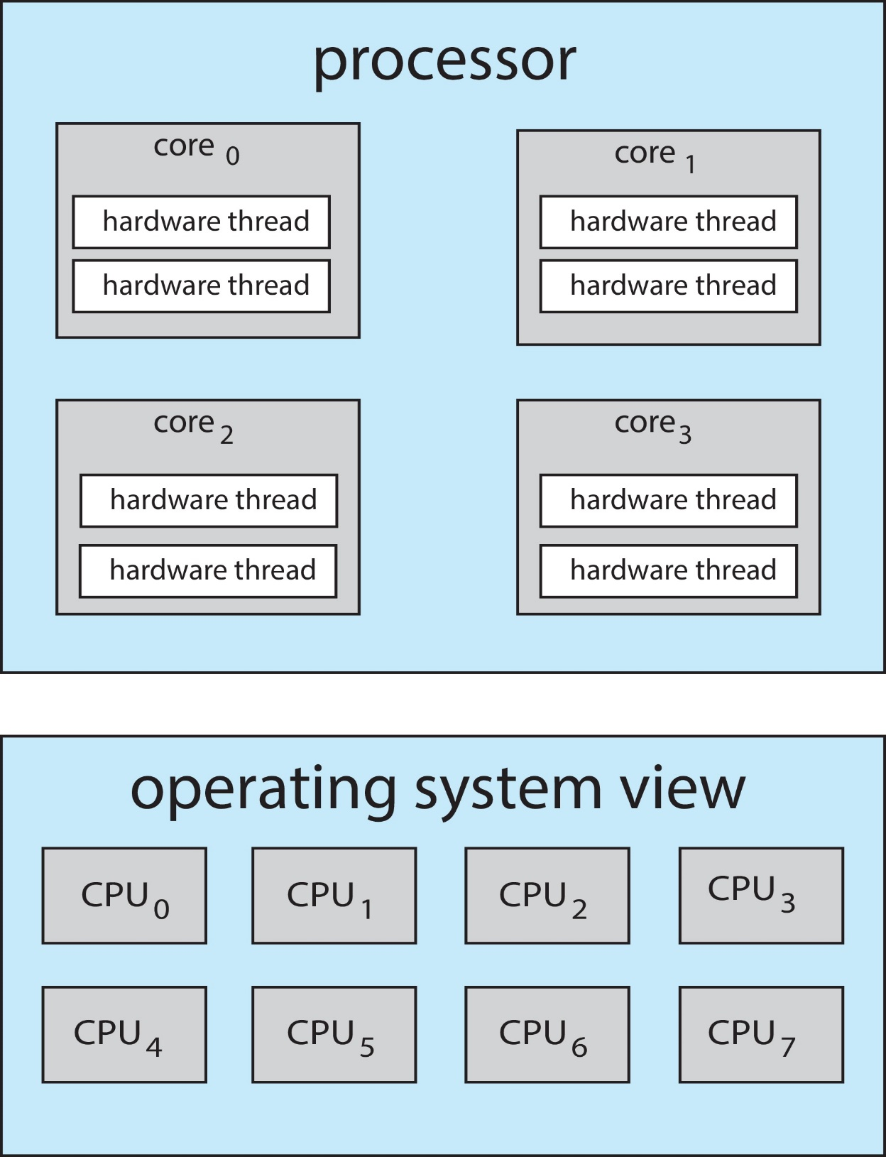
C H I P MUL T I THREAD I NG

Slide 5
Multi-Processor Scheduling
Coarse grained multithreading
A thread executes on a core until a long latency event occurs
Memory stall occurs
Cost of switching between threads is high
Fine grained multithreading
Switches between threads at the boundary of an instruction cycle
Cost of switching between threads is small
Two different levels of scheduling are reqd.
Scheduling decision made by the OS Any scheduling algorithm can be used
Each core decides which hardware thread to run
May use simple RR algorithm

Slide 6
Multi-Processor Scheduling
The two levels are not mutually exclusive
Other options may also be followed by OS
Load Balancing
Keep the workload evenly distributed across all processors in an SMP system
Necessary in those systems where each processor has its own private ready queue
Not necessary where there is a common ready queue
Two general approaches to load balancing
Push migration
A specific task periodically checks the load on each processor

Slide 7
Multi-Processor Scheduling
Evenly distributes the load by moving or pushing processes in case of imbalance
Schedules on idle or less busy processors
Pushes a process to an idle processor
Pull Migration
An idle processor pulls a waiting task from a busy processor
The two approaches need not be mutually exclusive
The idea of load balance may have different meanings

Slide 8
Real-Time CPU Scheduling
Soft real-time systems
Provide no guarantee as to when a critical real-time process will be scheduled
The process will be given preference
Hard real-time systems
These systems have stricter requirements
A task must be serviced by its deadline
Minimizing Latency
Real time systems are event-driven
The system must respond as soon as possible when the event occurs
Event latency:
Amount of time that elapses when an event occurs to when it is serviced

Slide 9
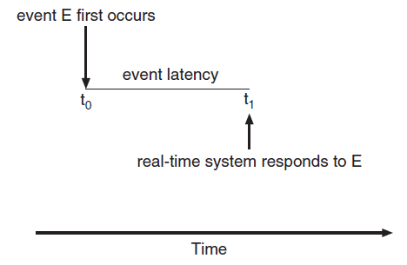
Event Latency

Slide 10
Real-Time Scheduling
Different events have different latency requirements
Two types of latencies affect the performance of the system
1. Interrupt latency
2. Dispatch latency
Interrupt latency
Refers to the time from the arrival of the interrupt at the CPU to the start of the routine that services the interrupt
Minimize the latency to ensure that real-time tasks receive immediate attention

Slide 11
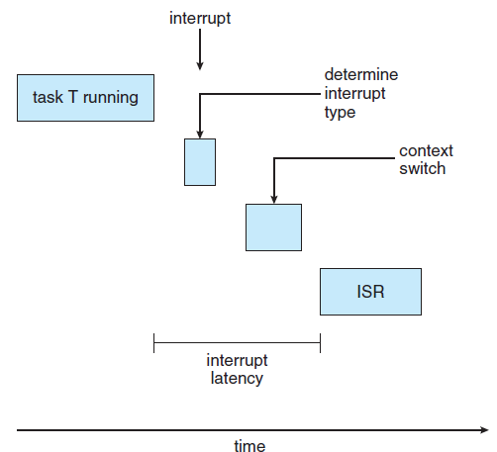
Interrupt Latency

Slide 12
Real-Time Scheduling
Dispatch latency
The amount of time required for the scheduling dispatcher to stop one process and start another
Provide preemptive kernels to keep this latency low
Conflict phase has two components
Preemption of any process running in the kernel
Release of resources by a low priority process needed by a high priority process
If preemption is enabled this latency is low

Slide 13
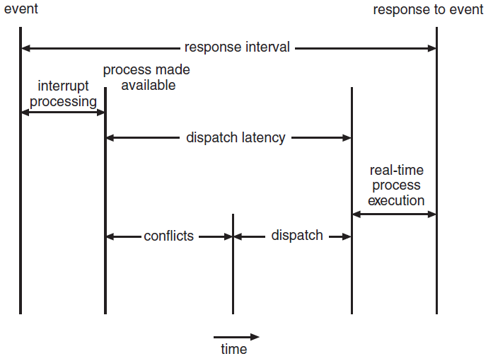
Dispatch Latency

Slide 14
Real-Time Priority-Based Scheduling
Real-time schedulers must support priority-based algorithms with preemption
All operating systems support preemptive, priority-based scheduling algorithms
Priority-based preemptive schedulers only guarantee soft real-time functionality
Additional scheduling features are required to support hard real-time requirements
Processes that are to be scheduled are considered to be periodic
A periodic process requires CPU at constant intervals or periods of p

Slide 15
Real-Time Priority-Based Scheduling
It has fixed processing time t
It has a deadline d by which it should be serviced by the CPU
The relationship can be expressed as
0 ≤ t ≤ d ≤ p
The rate of periodic task is 1/p
A process would have to announce its deadline requirements to the scheduler
Admission-control algorithm
A scheduler either
Admits a process guaranteeing that the process will complete in time OR
Rejects the process if it cannot guarantee the requirements

Slide 16
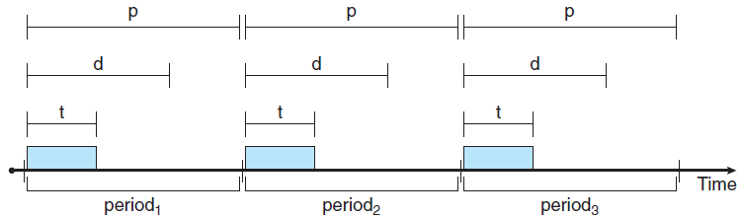
Periodic Task

Slide 17
Rate-Monotonic Scheduling
Schedules periodic tasks using a static priority policy with preemption
Each periodic task is assigned a priority
Inversely based on its period
Assumes that the processing time of a periodic process is the same for each CPU burst
Priority-based scheduling vs Rate-monotonic scheduling
This scheduling algorithm is optimal
CPU utilization is bounded
Operating System Examples
Read about at least one of the operating systems that are discussed in the text

Slide 18

Scheduling when P2 has higher priority than P1
Priority-based scheduling
Two processes P1 and P2
P1 has a period p1 of 50 and P2 has a period p2 of 100
Processing time t1 = 20 and t2 =35
If P2 has higher priority, P1 would miss its deadline

Slide 19
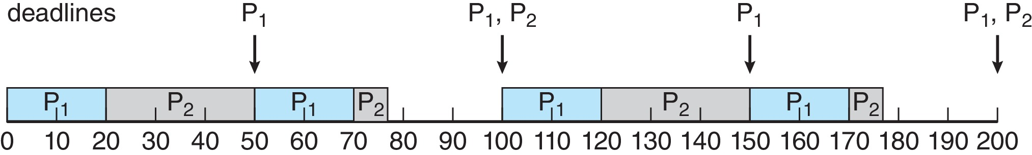
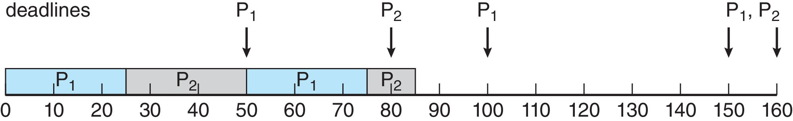
Rate-Monotonic Scheduling

Slide 20
Algorithm Evaluation
Define the criteria that can be used to select an algorithm
CPU utilization, response time or throughput
Maximize CPU utilization under the constraint that the maximum response time is 1 second
Maximize throughput such that the turnaround time is linearly proportional to total execution time
Deterministic Modeling
Analytic evaluation uses the given algorithm and the system workload to produce a formula or number that evaluates the performance of the algorithm for that workload
One type of analytic evaluation is deterministic modeling

Slide 21
Deterministic Modeling
Takes a predetermined workload and defines the performance of each algorithm for that workload
Evaluate all algorithms using the given workload
Deterministic modeling is simple and fast
Requires exact numbers for inputs and the answers apply only to those cases
Main purpose is to describe algorithms and provide examples
May help in the selection of a particular algorithm for static systems
On many systems, there is no static set of processes to use for deterministic modeling
Deterministic algorithm indicates trends

Slide 22
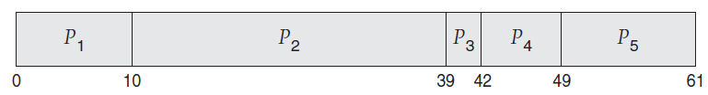
Deterministic Modeling
Process Burst Time
P1 10
P2 29
P3 3
P4 7
P5 12
Use FCFS, SJF and RR algorithms to calculate the average waiting time for comparison
FCFS Average waiting time = 28 mSec
Notes:
22

Slide 23
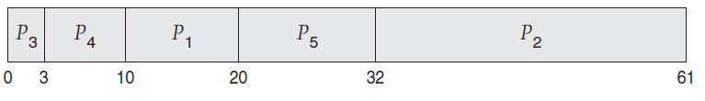
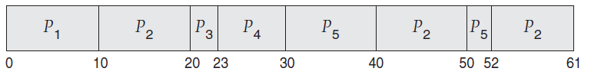
Deterministic Modeling
Non-preemptive SJF Average Waiting time = 13 mSec
RR Average Waiting time = 23 mSec
Notes:
23

Slide 24
Queuing Models
The computer system can be described as a network of servers where each server has a queue of waiting processes
Queueing network analysis
It is possible to compute utilization, average queue length, average wait time by knowing the arrival rates and service rates
Let n be the average long-term queue length
Let W be the average waiting time in the queue
Let λ be the average arrival rate for new processes in queue
For a steady state of the system
Number of processes leaving the queue must equal the number of processes that arrive
n = λ x W Little’s formula

Slide 25
Queuing Models
Little’s formula is valid for any scheduling algorithm and arrival distribution
Queueing analysis can be useful in comparing scheduling algorithms
Limitations
Classes of algorithms and distributions that can be handled are limited
It may be necessary to make a number of independent assumptions which may not be accurate
These are only approximations of the actual systems

Slide 26
Simulations
Simulations are used to get a more accurate evaluation of scheduling algorithms
Program a model of the computer system
As the simulation executes, statistics are gathered giving the algorithm performance
A random number generator is programmed to generate processes, CPU burst times, arrivals, departures, etc. according to probability distributions
Distribution may be defined mathematically or empirically
Distribution-driven simulation may be inaccurate
Trace tapes can be used instead
Simulations are expensive and involves large resources, time, and expertise

Slide 27
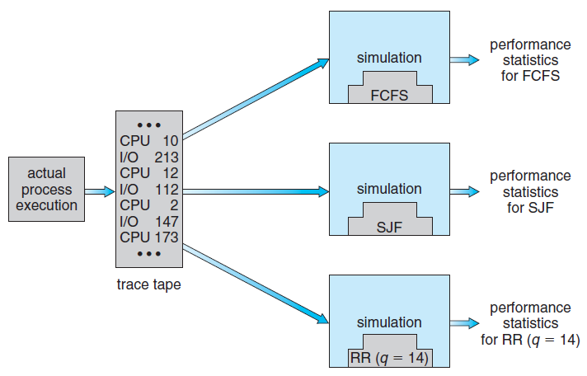
Evaluation of CPU schedulers by Simulation
Notes:
27

Slide 28
Implementation
A real operating environment gives the most accurate results
Major difficulty is the high cost
A constantly changing operating system is not liked by users
Environment in which algorithm is used may change
Interactive and non-interactive processes
Most flexible scheduling algorithms allow to incorporate change so that they can be tuned for a particular application
Use APIs that modify the priority of a process or a thread
Summary

Slide 29
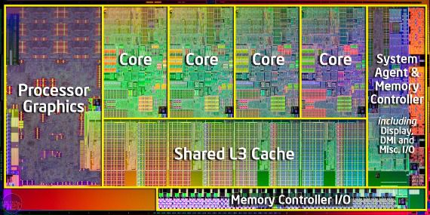
Threads and Concurrency Chapter 4
Basic components of a Thread
Strategies for Implicit threading
Multithreaded Models and Libraries

Slide 30
Multithreaded Programming
Single and multithreaded processes
Multicore programming
Advantages of multithreading
Multithreading models
Thread libraries
Implicit Threading

Slide 31
Overview
A process may contain multiple threads of control
A thread is a basic unit of CPU utilization, consisting of
A thread ID A program counter
A register set A stack
It shares all other and OS resources with the threads of the same process
A multithreaded process can perform more than one task
Difference between the traditional single threaded and multi-threaded processes
Motivation for multithreaded processes
Most of today’s applications are multithreaded

Slide 32
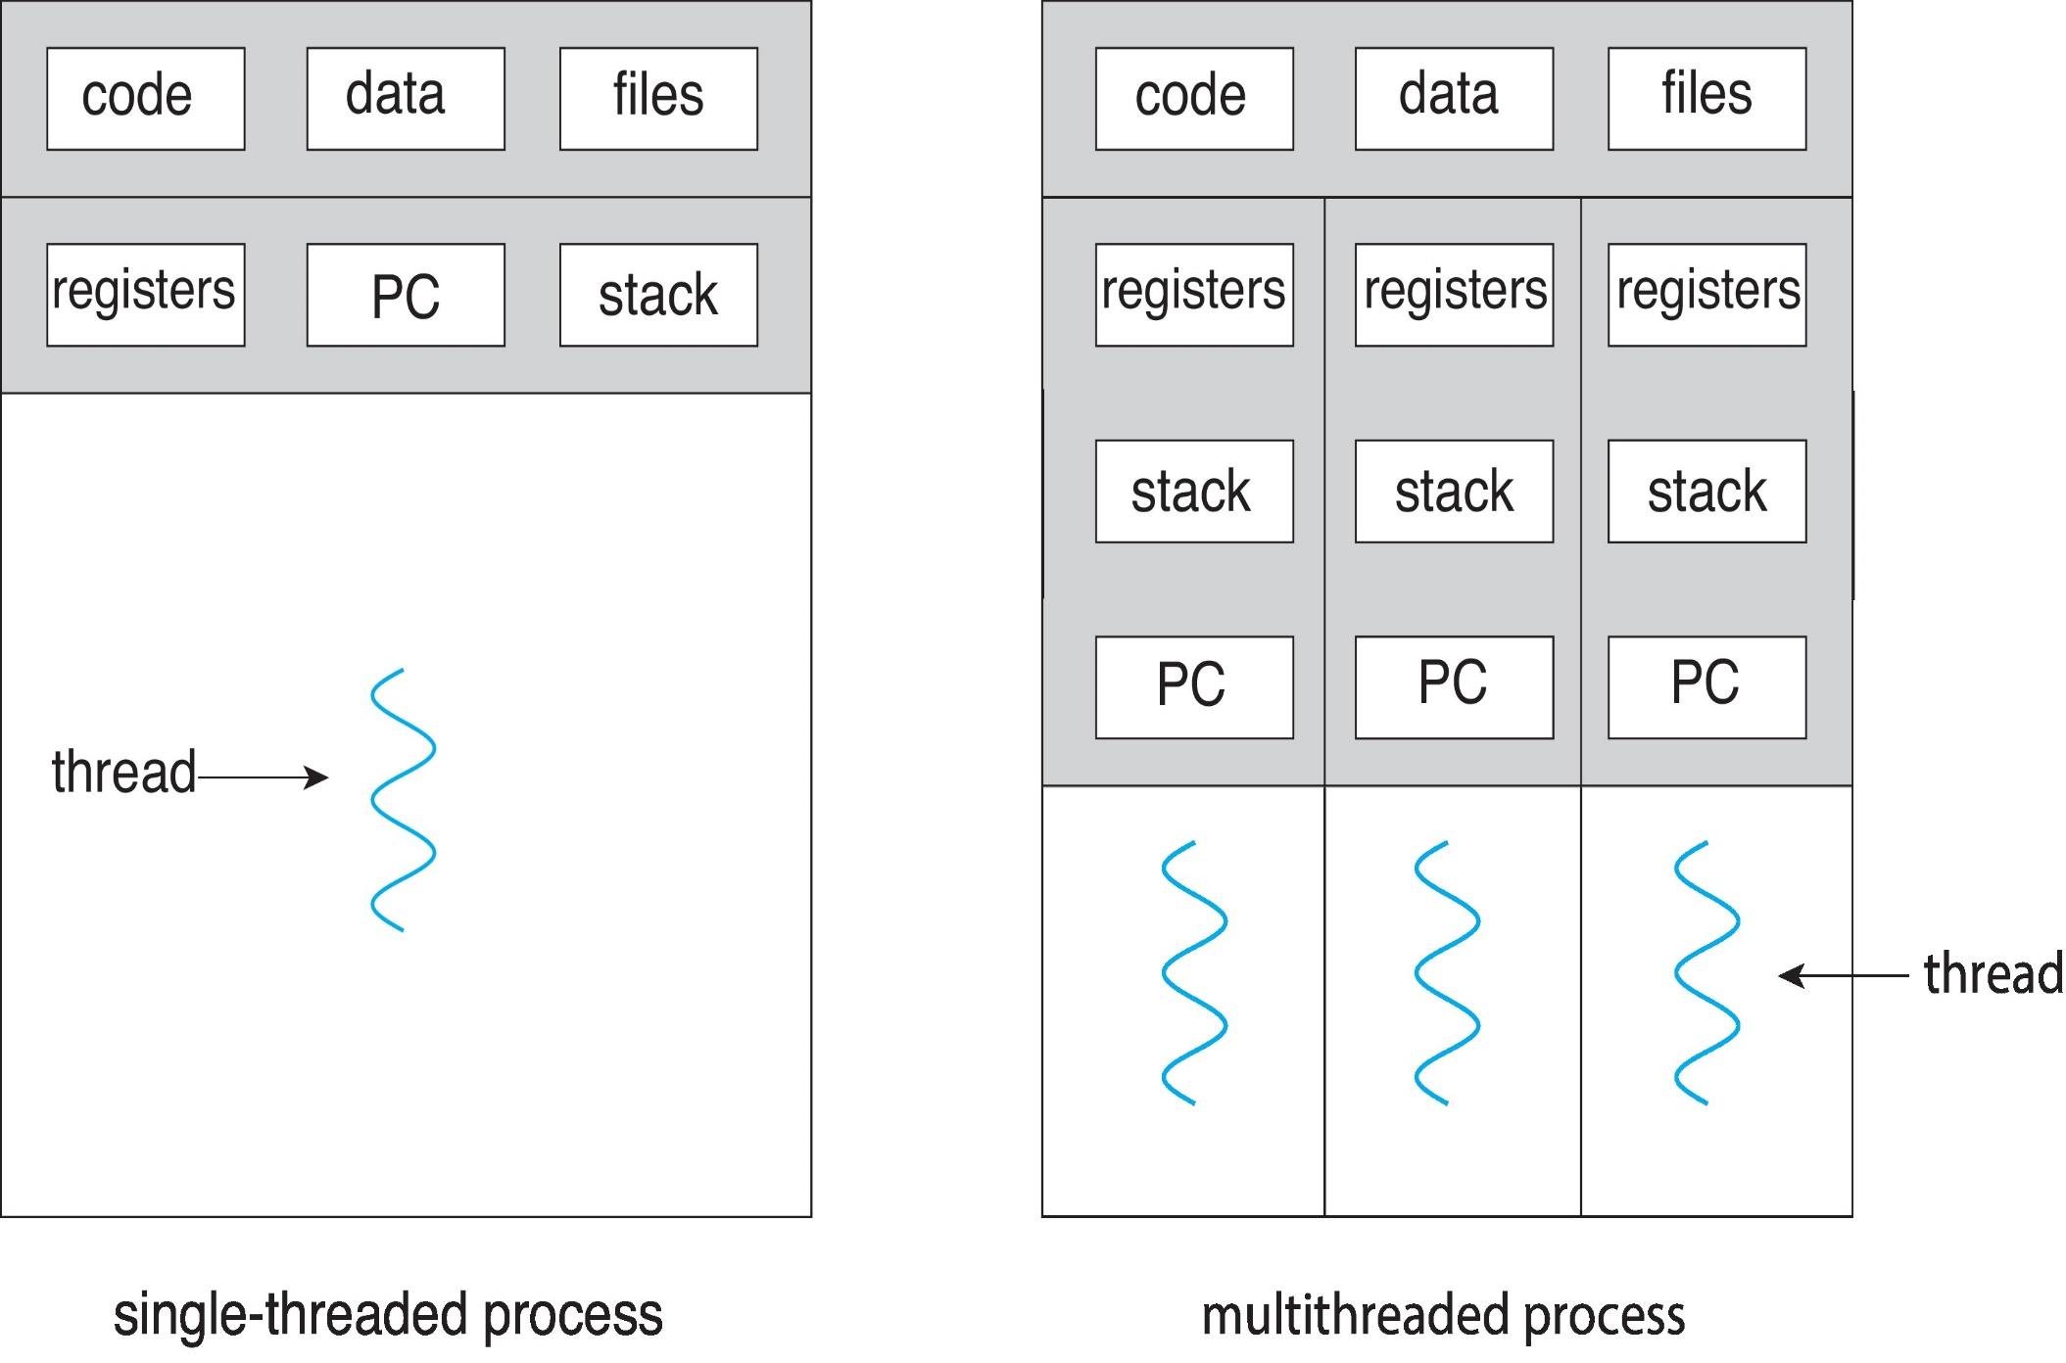
Single and Multithreaded Processes
Notes:
32

Slide 33
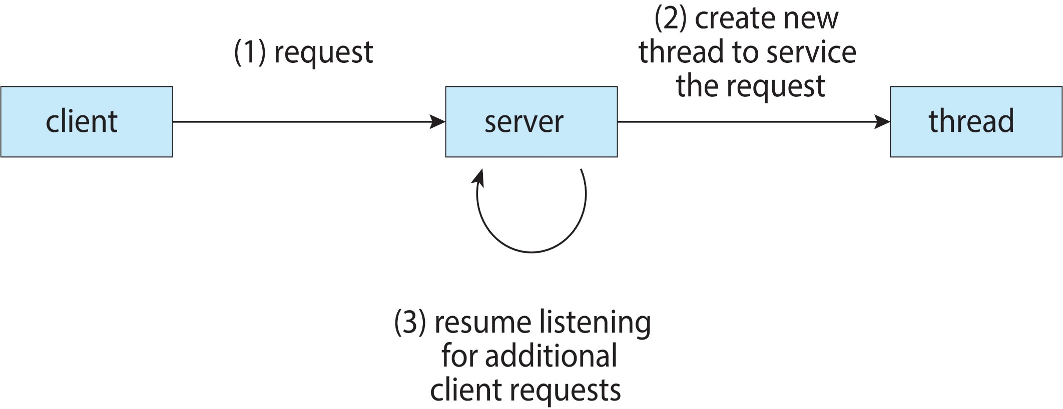
Multithreaded Server Architecture

Slide 34
Benefits of Multithreaded Programming
Responsiveness
Improves response time of interactive programs
Resource sharing
Threads in the same process share memory and other resources
Applications may have several different threads of activity within the same address space
Economy
More economical to create and context- switch threads in terms of time and resource
Scalability – Multithreading is more beneficial in a multiprocessor architecture
Threads of the same process can run in parallel increasing concurrency

Slide 35
Multicore Programming
Multiple computing cores are now placed on a single chip
Multiprocessor systems
Multithreaded programming is an efficient use of multiple cores
Concurrency and parallelism
Systems may be concurrent or parallel or both
A system is parallel if it can perform more than one task simultaneously
A concurrent system supports more than one task by allowing all the tasks to make progress
It is possible to have concurrency without parallelism
Multicore processors may also be multithreaded

Slide 36
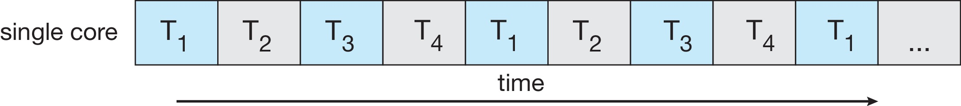
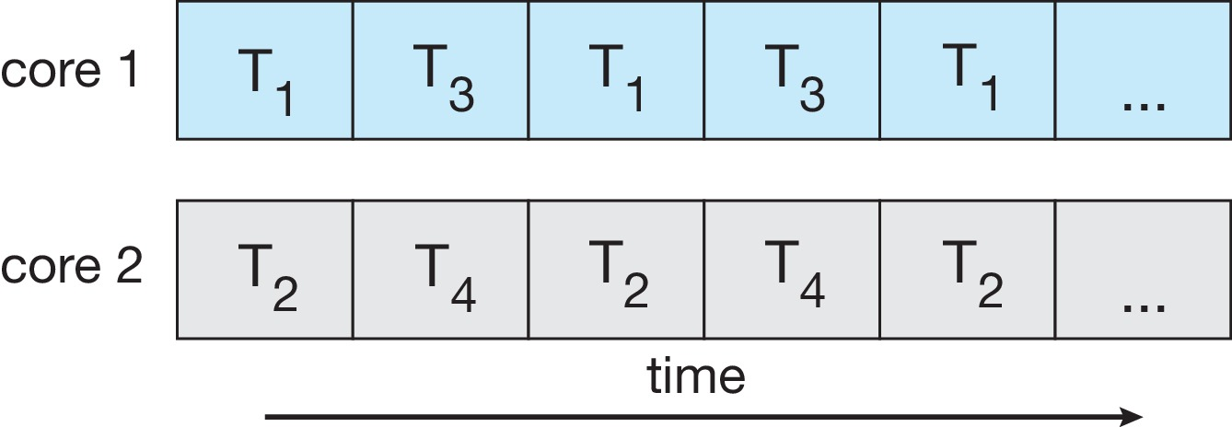
Concurrency vs Parallelism
Concurrent execution on a single core system
Parallel execution on a multicore system

Slide 37
Concurrency vs Parallelism
Concurrent execution on a single core system
Parallel execution on a multicore system

Slide 38
Multicore Programming
Programming Challenges
Programmers are facing the challenge to modify existing programs or design new programs that are multithreaded
OS designers must write scheduling algorithms that exploit multiple cores
Five areas present challenges for multicore systems
Identifying tasks
Examine applications to find parts that can be divided into separate concurrent tasks
Balance
Tasks must perform equal work of equal value

Slide 39
Multicore Programming
Programming Challenges
Programmers are facing the challenge to modify existing programs or design new programs that are multithreaded
OS designers must write scheduling algorithms that exploit multiple cores
Five areas present challenges for multicore systems
Identifying tasks
Examine applications to find parts that can be divided into separate concurrent tasks
Balance
Tasks must perform equal work of equal value

Slide 40
Multicore Programming
Data splitting
Data to be manipulated by tasks must also be partitioned to run on separate cores
Data dependency
Data accessed by tasks must be examined for dependencies between two or more tasks
Synchronization is necessary to accommodate data dependency
Testing and debugging
It is more difficult to test and debug multithreaded concurrent programs
Parallel programming should be increasingly emphasized

