Slide 1
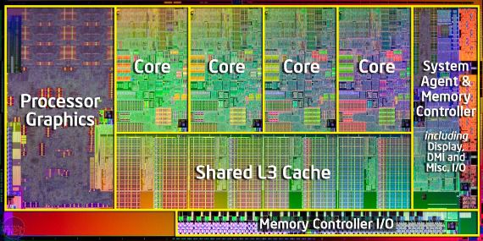
Threads and Concurrency Chapter 4
Basic components of a Thread
Strategies for Implicit threading
Multithreaded Models and Libraries

Slide 2
Multicore Programming
Programming Challenges
Programmers are facing the challenge to modify existing programs or design new programs that are multithreaded
OS designers must write scheduling algorithms that exploit multiple cores
Five areas present challenges for multicore systems
Identifying tasks
Examine applications to find parts that can be divided into separate concurrent tasks
Balance
Tasks must perform equal work of equal value

Slide 3
Multicore Programming
Data splitting
Data to be manipulated by tasks must also be partitioned to run on separate cores
Data dependency
Data accessed by tasks must be examined for dependencies between two or more tasks
Synchronization is necessary to accommodate data dependency
Testing and debugging
It is more difficult to test and debug multithreaded concurrent programs
Parallel programming should be increasingly emphasized

Slide 4
Multicore Programming
Types of Parallelism
Data parallelism Task parallelism
Data parallelism
Focuses on distributing subsets of the same data across multiple computing cores and performing the same operation on each core
Distribution of data among multiple cores
Task parallelism
Distributing tasks across multiple cores
Each thread performs a unique operation
Different threads may be operating on the same or different data
Distribution of tasks across multiple cores
Applications may use a hybrid of the above two strategies

Slide 5
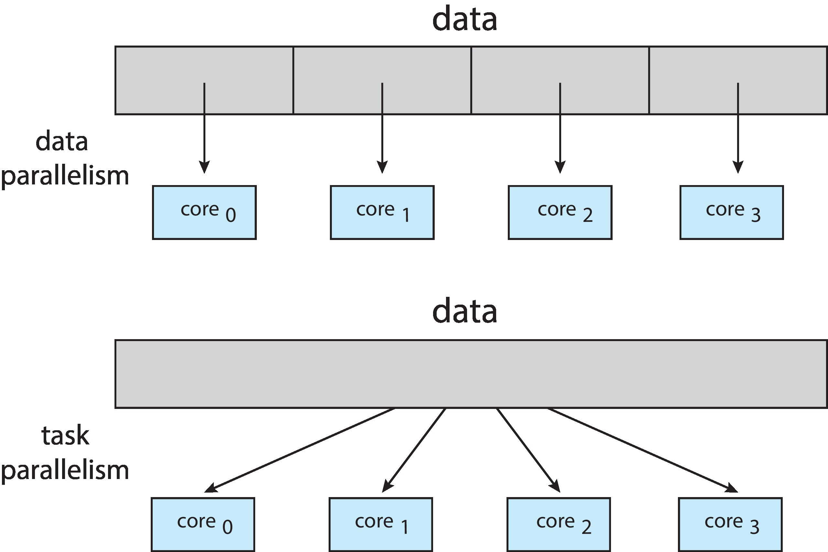
Data and Task Parallelism

Slide 6
Multithreading Models
Support for threads may be at the user level or kernel level
User threads are managed without kernel support
There must exist a relationship between user and kernel threads
Many-to-One Model
Maps many user-level threads to one kernel thread
Thread management is done by the thread library in user space
Entire process blocks if a thread makes a blocking system call
Multiple threads are unable to run in parallel in multiprocessors

Slide 7
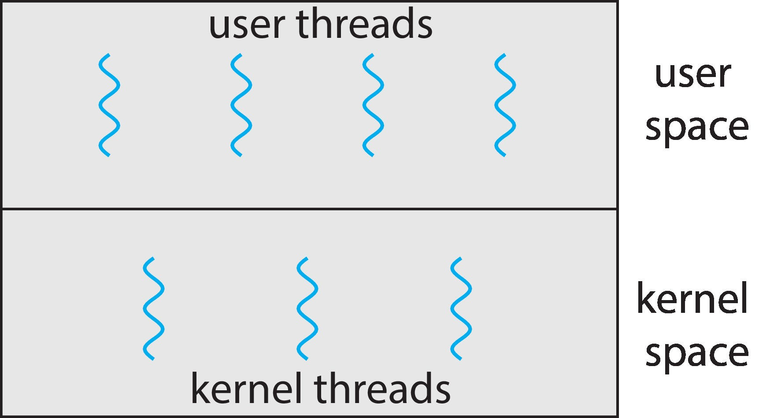
User and Kernel Level Threads
Notes:
7

Slide 8
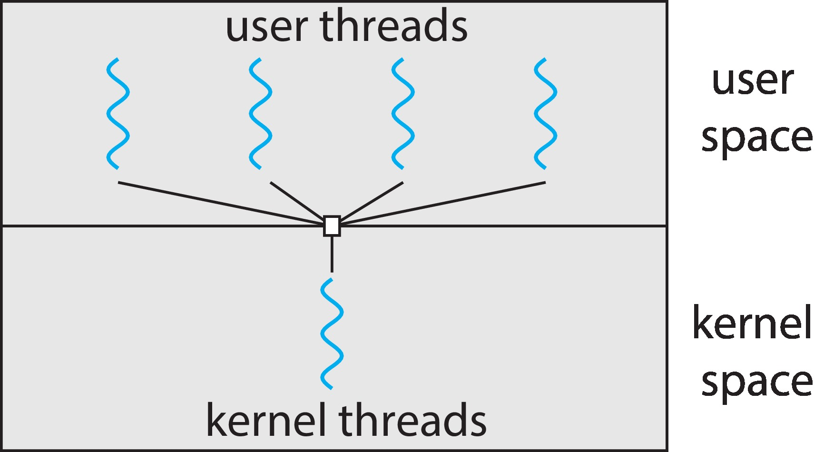
Many-to-One Model
Notes:
8

Slide 9
Multithreading Models
One-to-One Model
Maps each user thread to one kernel thread
Allows more concurrency than many-to-one model
Allows another thread to run in case of a blocking system call
Allows parallel execution in multiprocessors
Creating a user level thread requires creating a kernel-level thread
Number of threads are restricted
Many-to-Many Model
Multiplexes many user-level threads on a smaller or equal number of kernel-level threads

Slide 10
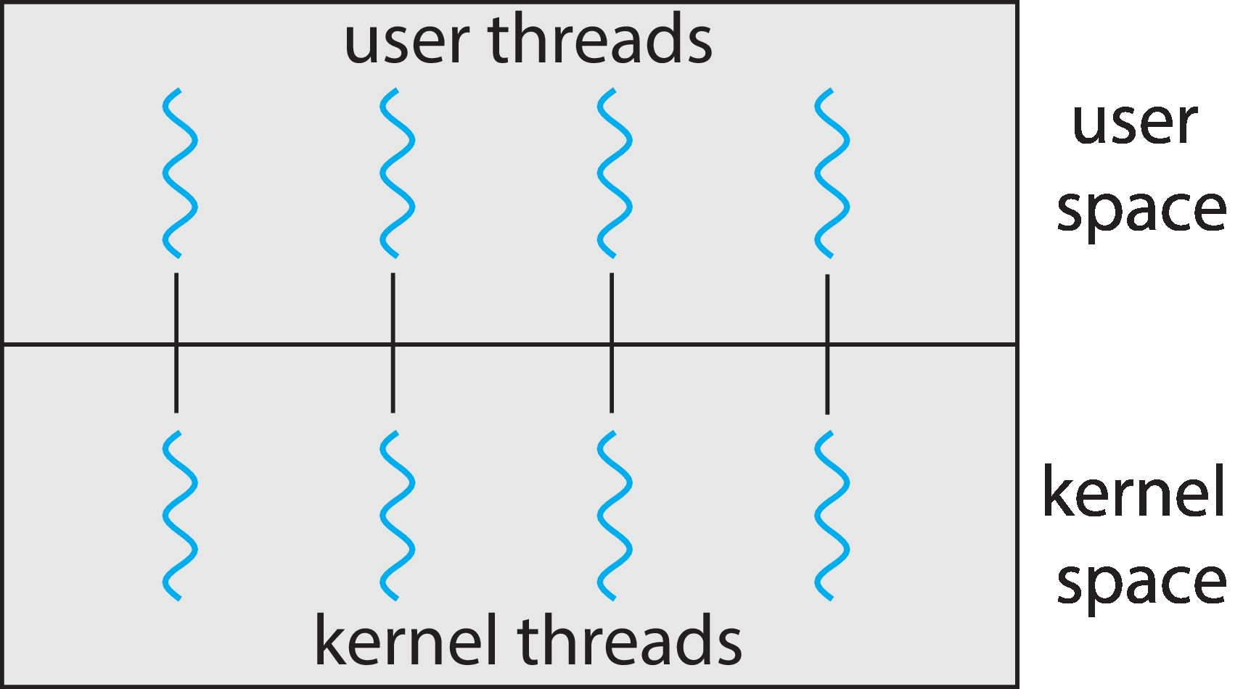
One-to-one Model
Notes:
10

Slide 11
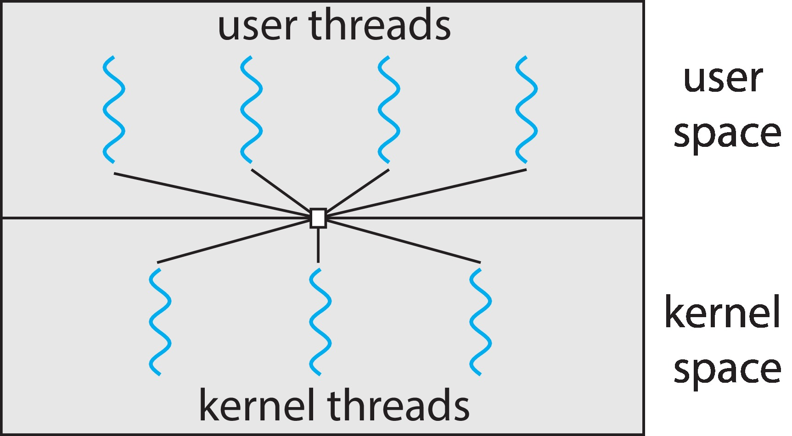
Many-to-Many Model
Notes:
11

Slide 12
Multithreading Models
Shortcomings of the previous two models are not there
Developers can create as many user threads as necessary
Kernel threads can run in parallel in multiprocessors
In case of a blocking system call, kernel can schedule another thread
One variation is the two-level model
A variant of many-to-many model
Allows a user-level thread to be bound to a kernel thread

Slide 13
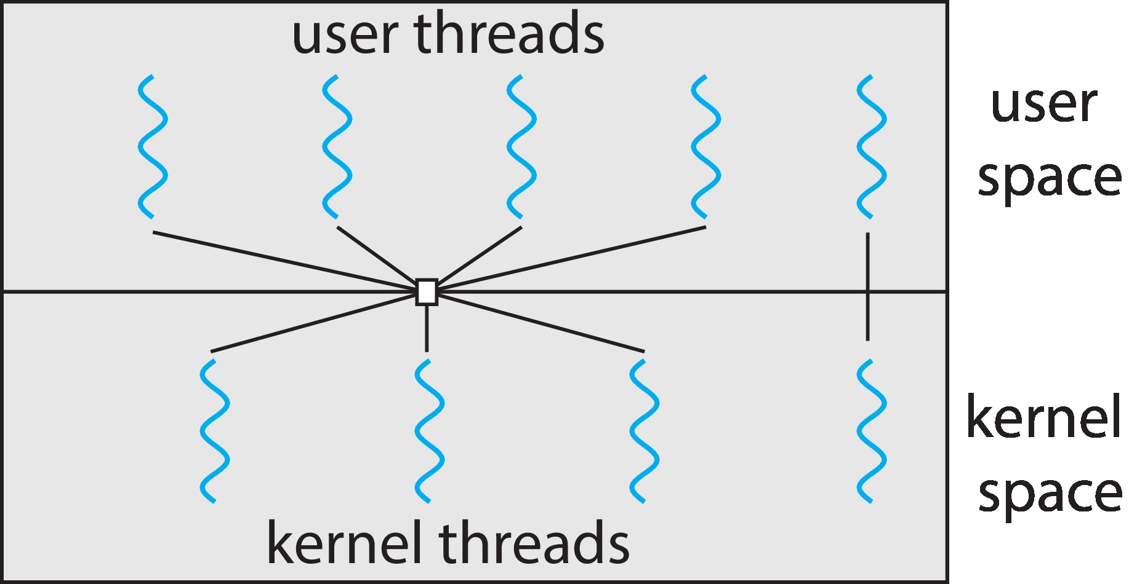
Two-level Model
Notes:
13

Slide 14
Thread Libraries
Provides the programmer an API for creating and managing threads
There are two approaches for implementing thread library
Provide a library in user space without any kernel support
Local function call in user space
Implement a kernel-level library supported directly by the OS
Invoking a library function results in a system call to the kernel
Three commonly used thread libraries
POSIX Pthreads, Win32 and Java

Slide 15
Memory Management Chapter 9
Part 4
Memory Management Strategies
Virtual Memory Management

Slide 16
Memory Management
All programs and data must be in main memory before execution
Partially or completely
Several processes are in main memory to
Improve CPU utilization
Improve speed of response to the users
Memory management schemes help achieve these objectives
Hardware specifications/ design determine the selection option for a particular memory management scheme

Slide 17
Memory Management
All programs and data must be in main memory before execution
Partially or completely
Several processes are in main memory to
Improve CPU utilization
Improve speed of response to the users
Memory management schemes help achieve these objectives
Hardware specifications/ design determine the selection option for a particular memory management scheme

Slide 18

Memory Management Strategies
Ways to manage memory
Hardware support
Logical and Physical address Space
Memory allocation to processes
Contiguous memory allocation
Fragmented memory allocation
Paging
Hardware support for paging
Shared fragments
Hierarchical and hashed paging, inverted PT
Swapping
Example of Intel 32 and 64 bit architectures

Slide 19
Introduction
Share memory among a number of processes
Various ways of organizing memory hardware
A number of ways exist to manage memory
From bare machine approach to paging techniques
Each approach have their advantages and disadvantages
Hardware support is required to support a management technique
Integration of hardware and operating system

Slide 20
Background
Memory is central to the operation of computer systems
CPU fetches instructions from memory using address in the program counter
Decode the instruction
May require operand fetch from memory
Execute the operation
Result may be stored back in memory
Memory sees a stream of addresses
Techniques for managing memory
Basic hardware issues
Binding of symbolic to physical addresses
Distinguish between logical and physical address
Dynamic linking and shared libraries

Slide 21
Basic Hardware
CPU accesses all data and instructions directly only from the main memory and registers
Access to registers, instruction decoding and operations of simple instructions can be performed within a cycle of CPU
Main memory is accessed via a bus transaction taking many CPU clock cycles
This may require the CPU to stall
Solution is to add a fast memory, a cache, between the CPU and main memory
Correct operation of OS requires its protection from user processes
User processes must also be protected from each other
This protection is provided through hardware

Slide 22
Basic Hardware
Each process should be allowed to access only its legal addresses
Use two registers
Base and limit registers
Base register holds the smallest legal physical memory address for that process
Limit register specifies the size of the range
Every generated address is compared to determine its legality
An attempt to violate the legality results in a trap to the OS-treats it as a fatal error
Base and limit registers can be loaded only by OS using privileged instructions executed in kernel mode

Slide 23
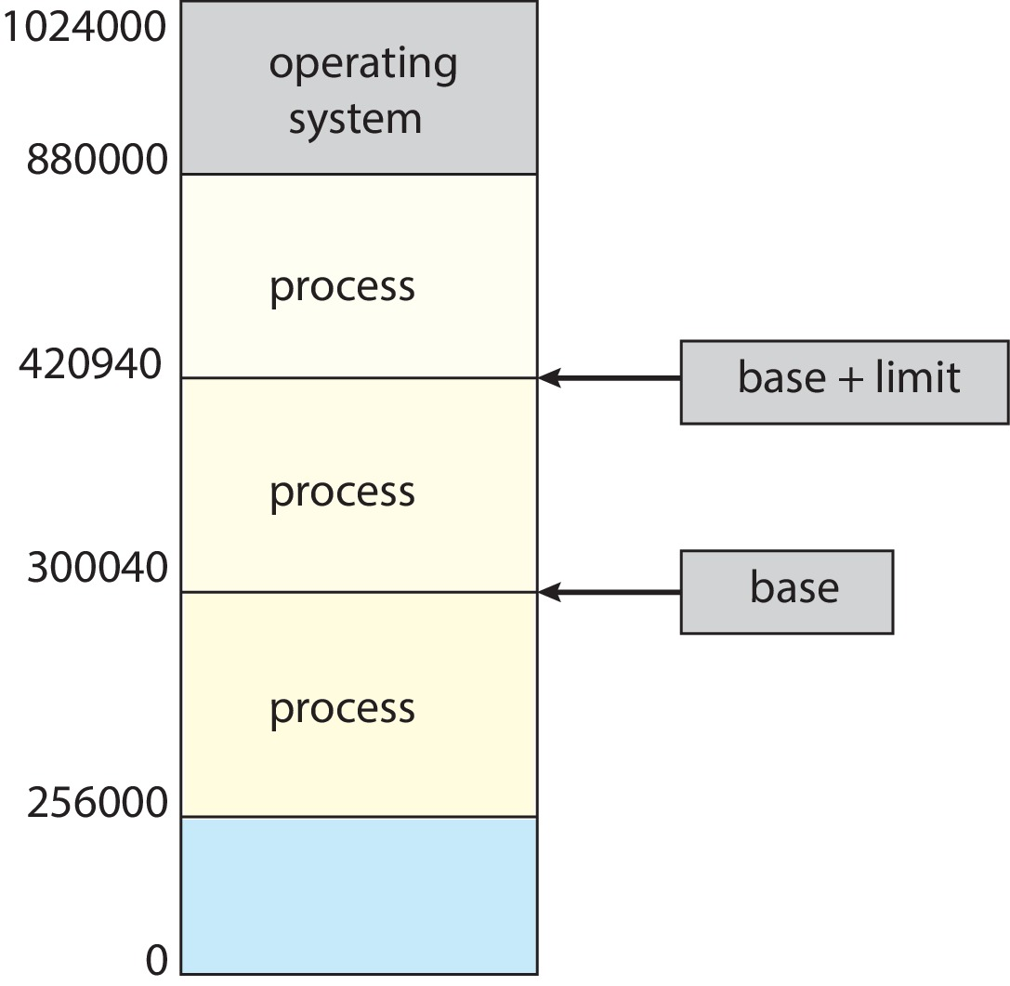
Base and Limit Registers
Notes:
23

Slide 24
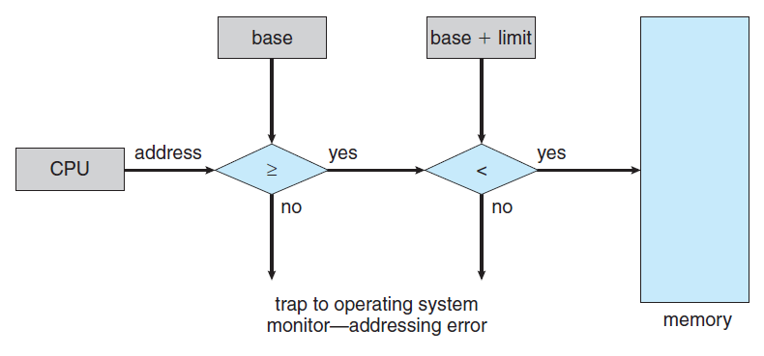
HW address protection with base and limit registers

Slide 25
Address Binding
Programs reside on a disk as a binary executable file
To execute, the program is loaded in any part of memory within the context of a process
A program goes though several steps before being executed
Addresses are represented in different ways during these steps
Addresses in source program are symbolic
Compiler binds the symbolic addresses in the source program to relocatable addresses
Linker or loader binds the relocatable addresses to absolute addresses
Each binding is a mapping from one address space to another

Slide 26
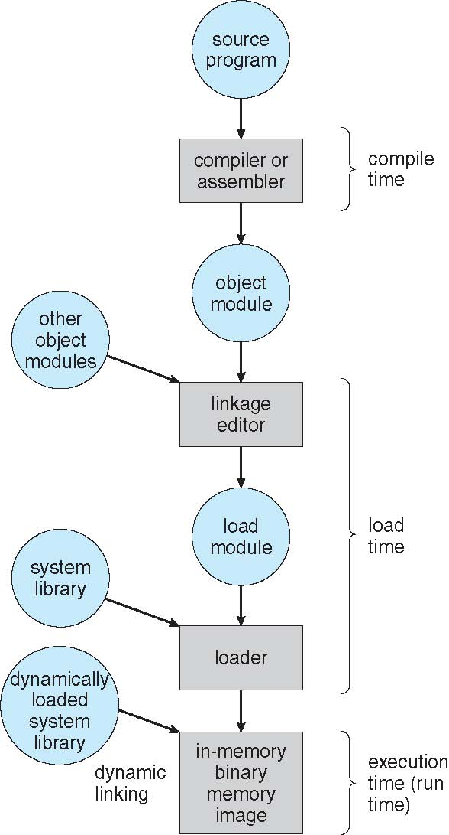
Multistep Processing of a User Program

Slide 27
Address Binding
Binding of instructions and data to memory addresses can be done in any of the steps
Binding at compile time
Absolute code is generated at compile time if it is known where the process will reside in memory
If starting address changes, it becomes necessary to recompile the programs
Binding at load time
If the address is not known at compile time, the compiler generates relocatable code
Final binding is done at load time
If starting address changes, reload the code
Binding at execution time
If the process can be moved during execution, binding is delayed until run time
Most general purpose OS use this method

Slide 28
Logical Versus Physical Address Space
Address generated by the CPU is referred to as a logical address
Address seen by the memory unit is referred to as a physical address
Compile and load-time address bindings generate identical logical and physical addresses
Execution-time address-binding scheme results in different logical and physical addresses
Logical address is also referred to as virtual address
Logical and physical address spaces
Memory management unit (MMU) does run-time mapping from virtual to physical addresses
Generalization of base-register scheme
Base register is called relocation register

Slide 29
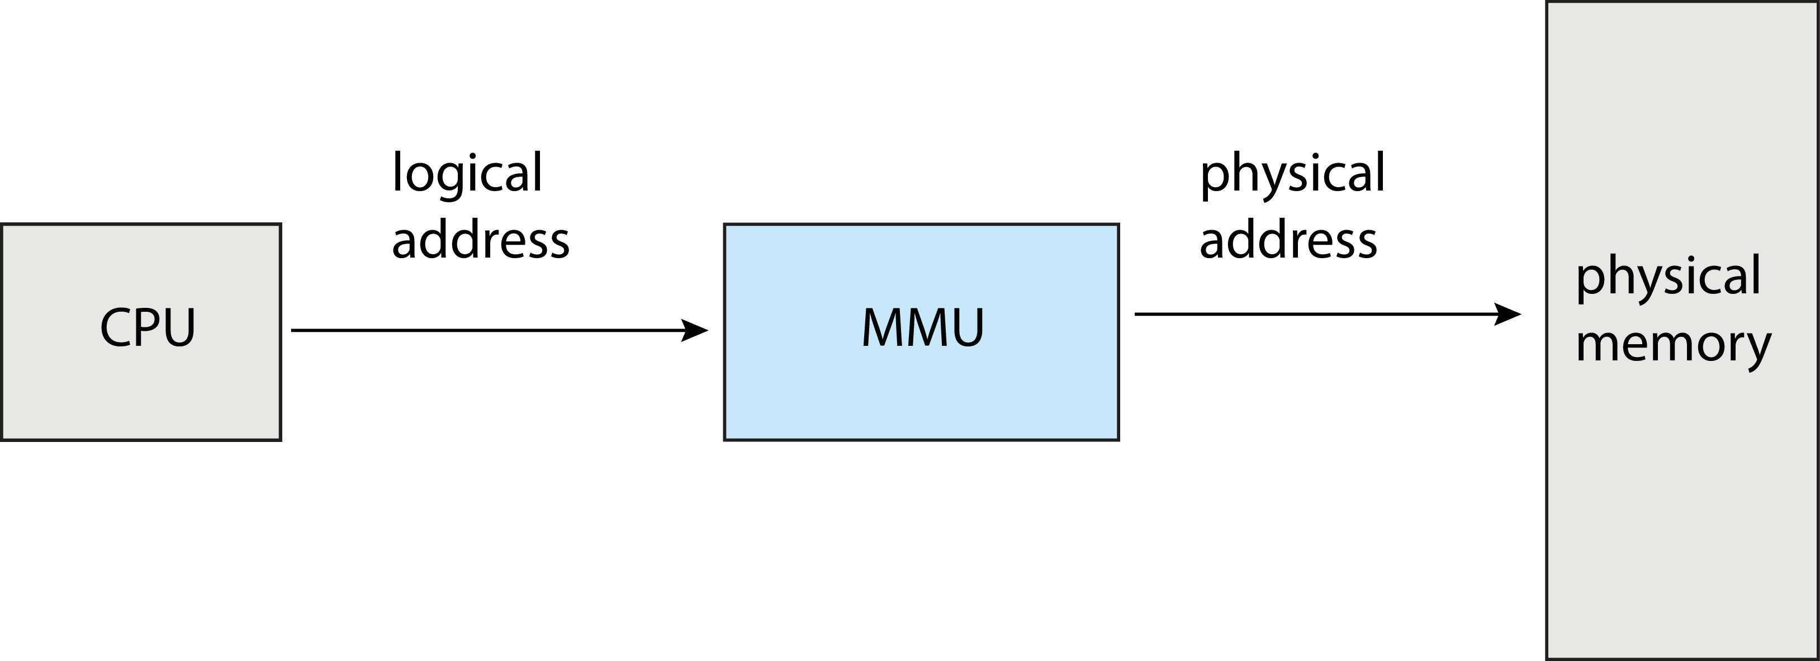
Logical Versus Physical Address Space

Slide 30
Logical Versus Physical Address Space
Relocation register contents are added to every address generated by the CPU
User program never sees the real physical addresses
Deals with logical addresses only
Hardware is required to do the mapping
Two address ranges are involved
Logical address space
Range is 0 to max
Physical address space
Range is R+0 to R+max for a base value of R
The concept of logical address space that is bound to a separate physical address space is central to proper memory management

Slide 31
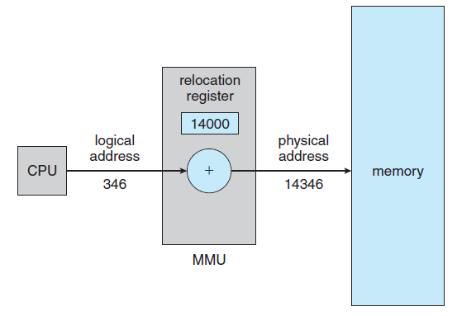
Dynamic relocation using a relocation register

Slide 32
Dynamic Loading
Size of a process in execution is limited to the size of the physical memory
Dynamic loading allows better memory- space utilization
A routine is loaded only when it is referenced
An unused routine is never loaded
Useful for applications that has a large code to handle infrequently occurring cases
Dynamic loading does not require special support from the operating system
Users are responsible to design their programs accordingly
OS may provide support in the form of library routines to implement dynamic loading

Slide 33
Dynamic Linking and Shared Libraries
Similar to the concept of dynamic loading
Linking is postponed till the execution time
Used for linking system libraries
Without this facility, each program would have to include a copy of its language library in the executable image
Wastage of disk and memory space
Another advantage: Libraries can be shared among multiple users
Only one copy of library is in memory
Also known as shared libraries
Can also be extended to updates and new versions
Dynamic linking requires help from the OS

Slide 34
Contiguous Memory Allocation
A method of allocating memory to OS and user processes
Memory is divided into two partitions
Operating system
User processes
OS is kept in the higher or lower memory
Available memory is allocated to the processes through contiguous memory allocation
Memory Protection
Protection among processes can be provided through a relocation register and a limit register
Relocation register contains the smallest physical address of that process
Limit register contains the range of logical addresses
Notes:
Linux and Windows place OS in higher memory. Some OS place it in lower memory

Slide 35
Contiguous Memory Allocation
MMU maps the logical address dynamically
Mapped address is sent to memory
Dispatcher loads the relocation and limit registers with the correct address as part of context-switch
Protection of processes from each other
This scheme provides an effective way to change the OS size dynamically
A desirable flexibility
Transient OS code
It is loaded into memory when needed and may be removed in case of other memory requirements
Notes:
Device drivers that are not always needed are example transient code

Slide 36
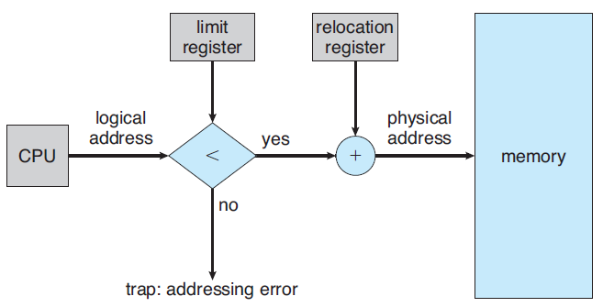
Hardware Support for Relocation and Limit Registers
Notes:
36

Slide 37
Memory Allocation
Variable partitioning scheme
The simplest method to allocate memory
Assign variably sized partitions to processes
Each partition may contain exactly one process
The operating system maintains a table of free memory spaces (called holes) and memory spaces that are occupied
An arriving process is allocated a part/full of hole according to its memory needs
If the hole is too large, it is split into two parts and allocated to the process
At any time, there is a list of available block sizes and an input queue of processe

Slide 38
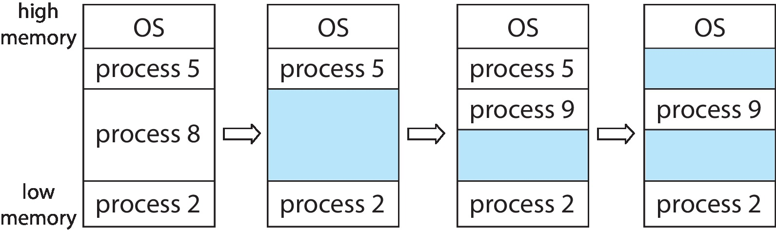
Variable Partition

Slide 39
Memory Allocation
Allocation is done to processes till the partitions are available
Set of holes of variable sizes are scattered throughout the memory
System needs to match the need and availability
Dynamic storage allocation problem
How to satisfy a request of size n from a list of free holes?
Solutions
First fit:
Allocate the first hole that is big enough
Search can start from the beginning or where the last search ended

Slide 40
Memory Allocation
Best fit:
Allocate the smallest hole that is big enough
Search the entire list unless sorted by size
Produces the smallest leftover hole
Worst fit:
Allocate the largest hole
Produces the largest leftover hole
Search the entire list unless it is sorted by size
Simulation results
First and best fit are better than worst fit in terms of decreasing time and storage utilization
First fit is generally faster than best fit

