Slide 1
ANALYSIS OF VARIANCE (ANOVA)
OSAMA BIN AJAZ
Lecturer
Dept. of Sciences & Humanities
FAST-NUCES, Main Campus,
Shah Latif Town, Karachi
One-Way ANOVA

Slide 2
Introduction
ANOVA is a tool to test equality of more than two means simultaneously.
OR
It is a tool for analyzing how the mean value of a quantitative response variable is related to one or more categorical explanatory factors.
F-test is used to determine the significance difference among three or means.
It was developed by Sir R. A. Fisher, an English Statistician.
One-Way ANOVA

Slide 3
Examples
To determine significant differences for mean time of solving a computer problem by four groups of students, using C, C #, C++ and Python.
To determine significant differences for Software Effort among different phases of SDLC.
To determine significant differences for software metrics such as: Defect metric, process metric, KSLOC, FPs, etc.
To determine interaction effect of testing technique, software type, expertise level etc.
One-Way ANOVA

Slide 4

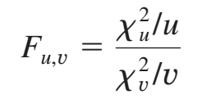
F-test (Definition – I)
If are two independent chi-square random variables with u and υ degrees of freedom, respectively, then the ratio:
follows the F distribution with u numerator degrees of freedom and υ denominator degrees of freedom.
One-Way ANOVA

Slide 5
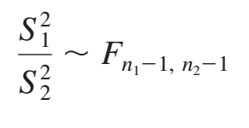

F-test (Definition – II)
Consider two independent normal populations with common variance σ² . If random samples of sizes n1 & n2 are drawn from these populations then:
where are two sample variances.
(Note: the larger of the variances is placed in the numerator of the F formula)
One-Way ANOVA

Slide 6
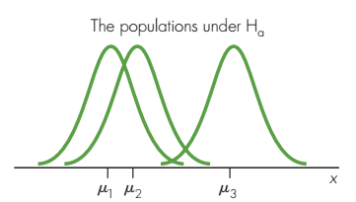
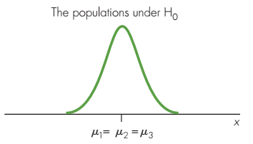
Assumptions & Conditions for F-test
The samples are independent random samples.
The distribution of the response variable is a normal curve within each population.
The different populations may have different means.
All populations have the same standard deviation, σ.
One-Way ANOVA

Slide 7
Sensitivity of F-statistic
The F-statistic is sensitive to differences among a set of sample means.
The greater the variation among the sample means, the larger is the value of the test statistic.
The smaller the variation among the observed means, the smaller the value of the test statistic.
One-Way ANOVA

Slide 8
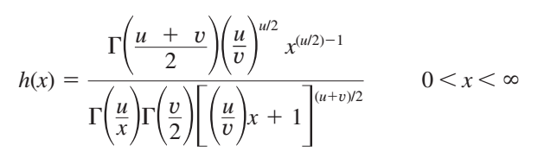
F-distribution
If x is an F random variable with u numerator and υ denominator degrees of freedom, then the PDF of x is:
One-Way ANOVA

Slide 9
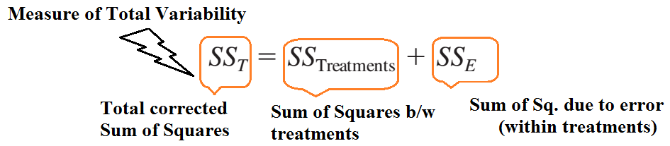
Why the procedure is called ANOVA?
The name Analysis of Variance is derived from a partitioning of total variability into its component parts.
One-Way ANOVA

Slide 10
One-Way ANOVA
Random samples of size n are selected from each of k populations. The k diﬀerent populations are classiﬁed on the basis of a single criterion such as diﬀerent treatments or groups.
It is assumed that the k populations are independent and normally distributed with means µ1, µ2, … µk and common variance σ².
One-Way ANOVA
Notes:
In one-way there is only one independent variable.

Slide 11




Model for One-way ANOVA
µ is the Grand Mean of all µi,
The represents random error (within group variation).
is the effect of i^{th} treatment with constraint
One-Way ANOVA

Slide 12
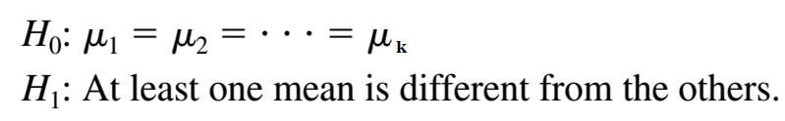
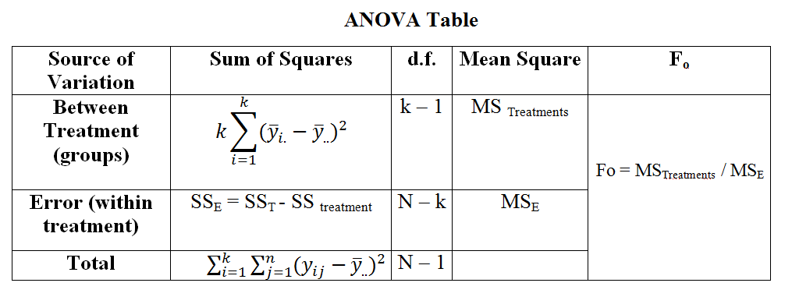
Summary procedure of ANOVA
α: 0.05, 0.01, or 0.10
One-Way ANOVA

Slide 14
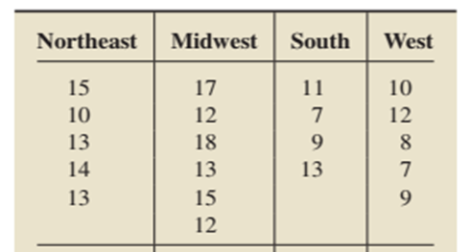

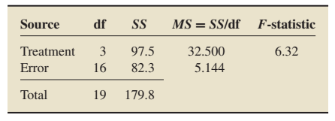
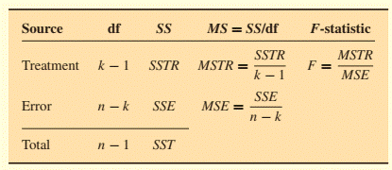
Example # 01: Residential energy consumption and expenditures data for 4 US regions
Suppose a researcher want to decide whether a difference exists in mean annual energy consumption by households among the four U.S. regions.
Notes:
the data are displayed to the nearest 10 million BTU.
Grand total = 238 & [sum of sq. of all obs→859+1295+420+438=3012]
SSTR=[ 65^2/5 + … + 46^2/5 – CF = (2929.7-238^2/2)=97.5 ]
Reject Ho.

Slide 15
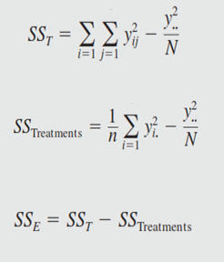

Slide 16
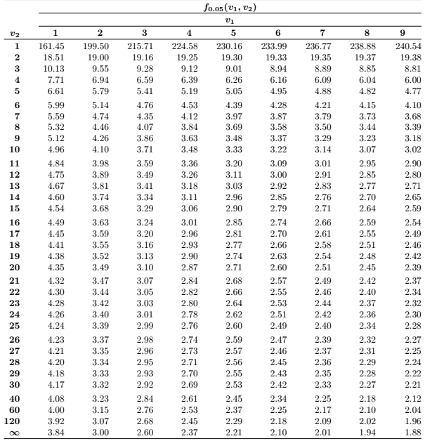
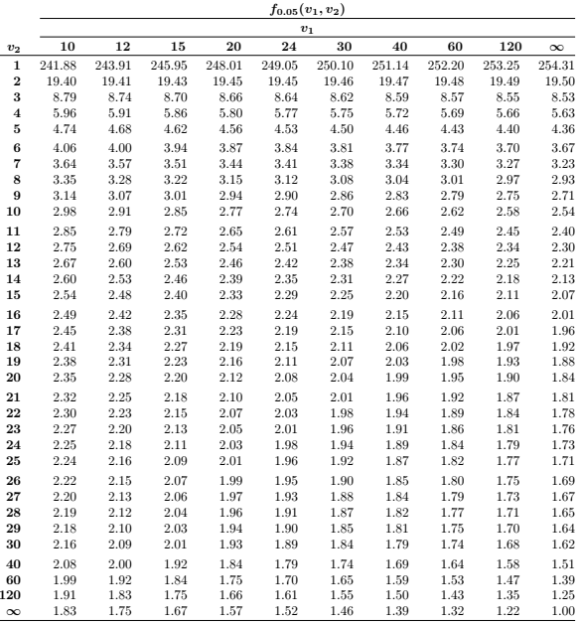

Slide 17
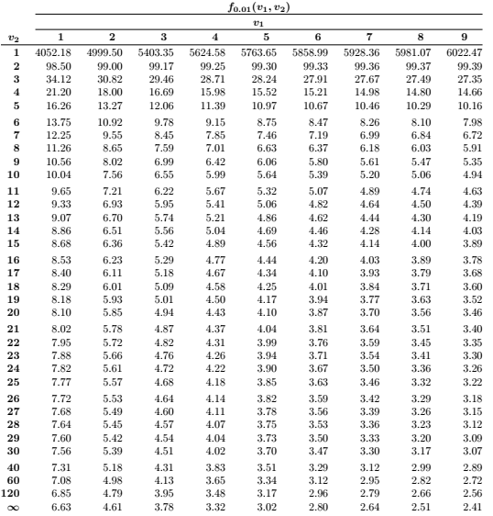
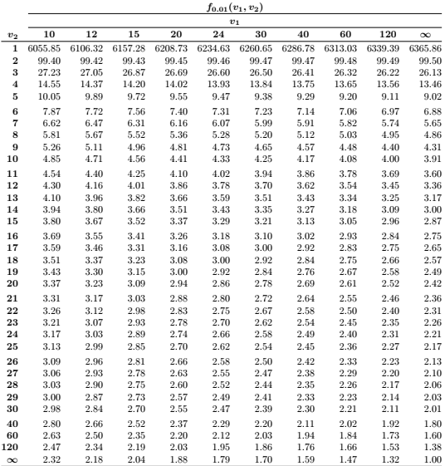

Slide 19
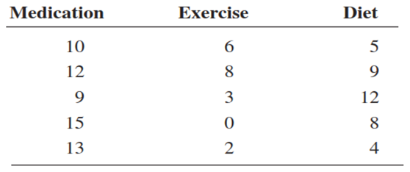
Example # 1
A researcher wishes to try three different techniques to lower the blood pressure of individuals diagnosed with high blood pressure. The subjects are randomly assigned to three groups; the first group takes medication, the second group exercises, and the third group follows a special diet. After four weeks, the reduction in each person’s blood pressure is recorded. At α = 0.05, test the claim that there is no difference among the means. The data follow.
One-Way ANOVA
Notes:
59 + 19 + 38 = 116 & Grand Mean=7.733
Sum (Each obs.)^2=1162
59^2 + 19^2 + 38^2=5286
SST=264.933 & SS(treatment)=160.133 & SSE=104.799

Slide 20

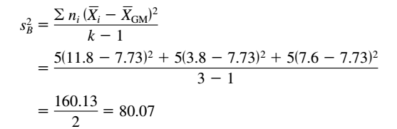
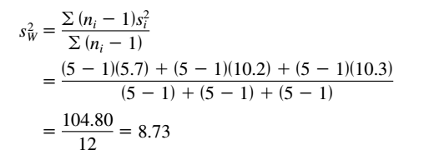

Solution (Example 01)
Find Grand Mean (GM) as:
Find b/w group variance as:
Find within group variance as:
F-test as:
One-Way ANOVA

Slide 21
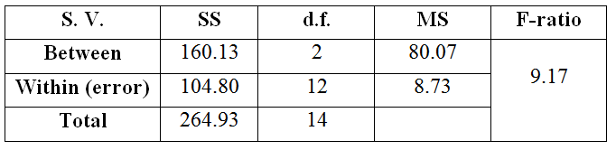
Solution (Example 01, Contd.)
Decision: the decision is to reject Ho as :
There is enough evidence to reject the claim and conclude that at least one mean is different from the others.
One-Way ANOVA

Slide 22
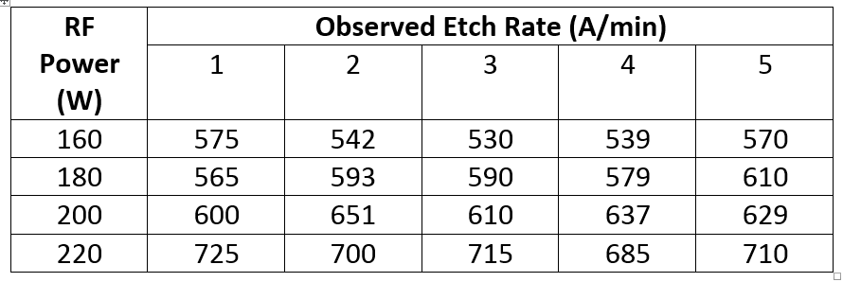
Example # 02 [Plasma Etching Experiment]
Recall that the engineer is interested in determining if the RF power setting affects the etch rate, and she has run a completely randomized experiment with four levels of RF power and ﬁve replicates.

Slide 23
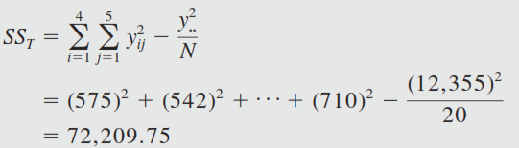
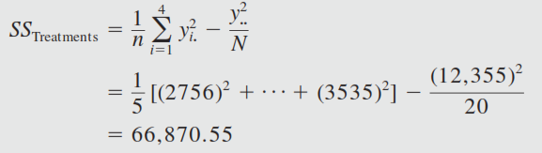

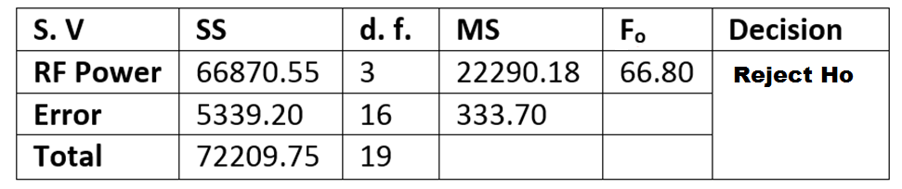
Solution (Example 02)
One-Way ANOVA

Slide 24
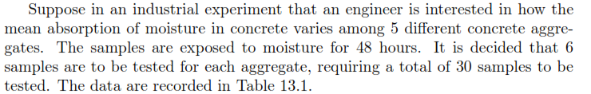
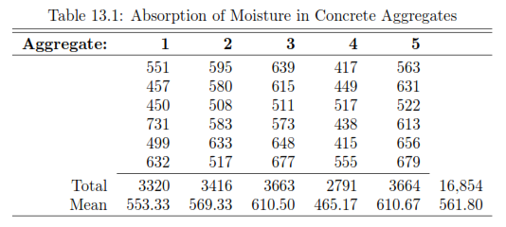
Example # 03
One-Way ANOVA

Slide 25

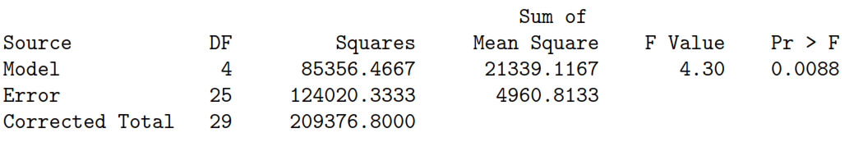
Solution (Example 04)
One-Way ANOVA

Slide 26
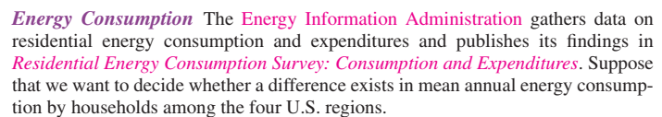
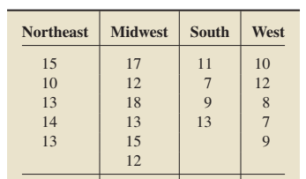
Example # 05
Notes:
GrandMean=11.9, SSTR=97.5 SSE = 82.3 MSE= 5.144, MSTR= 32.5; F=6.32

Slide 27


Solution (Example # 05)
SSTR = SS _{Treatments}
Notes:
GrandMean=11.9, SSTR=97.5 SSE = 82.3 MSE= 5.144, MSTR= 32.5; F=6.32
Reject Ho.

Slide 28
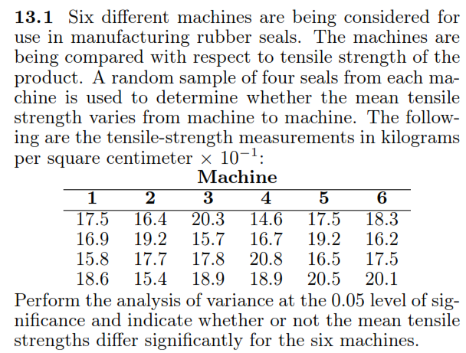
Practice Questions
Q1)
One-Way ANOVA

Slide 29
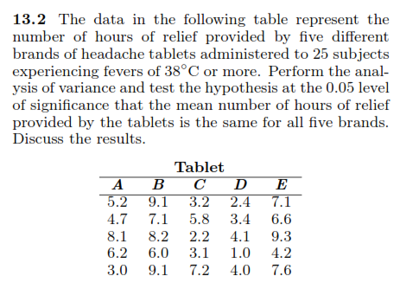
Q2)
One-Way ANOVA

Slide 30
