Slide 1
Discrete & Continuous Random Variables (Probability distributions, PMF, PDF, CDF, JPDF,JPMF)
Instructor
Osama Bin Ajaz
Lecturer, S & H Dept.,
FAST-NU, Main Campus, Karachi
osama.ajaz@nu.edu.pk

Slide 2
Brief Content (Sessional – II)
Random Variables, Joint and marginal distributions.
Mathematical Expectation
Binomial & Multinomial distributions
Poisson, hypergeometric, geometric, and discrete uniform distributions.
Normal, Standard Normal, Exponential, Uniform and Chi-Sq. distributions.
Introduction to Hypothesis testing

Slide 3
Random Variable
Two balls are drawn in succession without replacement from an urn containing 4 red balls and 3 black balls. The possible outcomes and the values y of the random variable Y , where Y is the number of red balls, are:
Suppose an experiment consists of tossing a coin two times & we are interested in the number of Heads (X):
Notes:
S = { RR, RB, BR, BB} -> y = { 0, 1, 2}

Slide 4
Discrete & Continuous Random Variable
A random variable is called a discrete random variable if its set of possible outcomes is countable.
When a random variable can take on values on a continuous scale, it is called a continuous random variable

Slide 5
Discrete Probability Distribution
Tossing a coin 3 times and X = No. of heads
A shipment of 20 similar laptop computers to a retail outlet contains 3 that are defective. If a school makes a random purchase of 2 of these computers, find the probability distribution for the number of defectives.
Notes:
Tabular, formula and graphical forms. (3) X = No. of defective = {0, 1, 2}

Slide 6
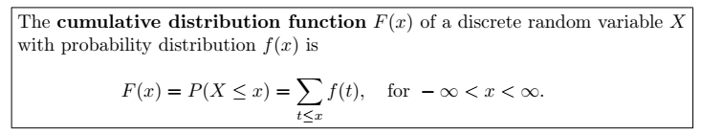
Cumulative Distribution Function
Suppose a coin is tossed 3 times and X = No. of heads.

Slide 7
Example # 01
Consider the following pmf: f(x) = (x/6), x = 1, 2, 3, zero elsewhere
Find distribution function and its graph.
Calculate P(1.5 < x ≤ 4.5)
Notes:
(ii) P(1.5 < x ≤ 4.5) = 5/6

Slide 8
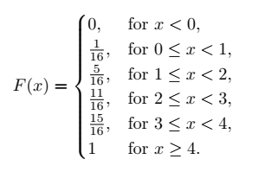
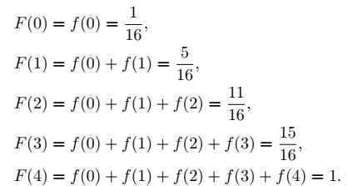
Example # 02
Find P (x = 2) = f(2)
Notes:
f(2) = F(2) – F(1) = 3/8

Slide 9
Example # 03 & 04
(3) Consider the following functions
(i) f(x) = (x +2) / 5 for x = 1, 2, 3, 4, 5.
(ii) f(x) = (4Cx) / (2^5), for x = 0, 1, 2, 3, and 4.
and check whether the functions can serve as a pmf ?
(4) A coin is biased so that a head occurs 3 times of tail. If the coin is tossed 3 times, find the probability distribution for the number of heads and also find P (1 ≤ x ≤ 3).

