Slide 1
Discrete & Continuous Random Variables (Probability distributions, PMF, PDF, CDF, JPDF,JPMF)
Instructor
Osama Bin Ajaz
Lecturer, S & H Dept.,
FAST-NU, Main Campus, Karachi
osama.ajaz@nu.edu.pk

Slide 2
Example # 04: Biased coin
A coin is biased so that a head occurs 3 times of tail. If the coin is tossed 3 times, find the probability distribution for the number of heads and also find P (1 ≤ x ≤ 3).
Notes:
x = 0 (1/64), 1 (9/64), 2 (27/64), 3 (27/64) & P (1 ≤ x ≤ 3). = 63/64

Slide 3
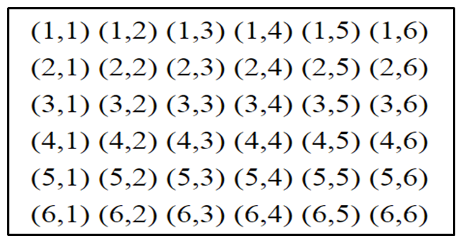
Example # 05: PMF for the sum of points on two dice
If two dice are rolled once, find the
(a) PMF of the sum of points on two dice.
(b) CDF

Slide 4
Example # 06: Tossing coin until Head appears
A fair coin is tossed until a “Head” appears for the first time. Find
(a) p. m. f
(b) distribution function
(c) F(4)
Notes:
F(4) = 15/16

Slide 5
Example # 07
The distribution function for a discrete random variable x is given as:
F(x) = 1 – (1/2)^(x+1), for x = 0, 1, 2, …..
Find:
P (X = 3)
P (7 ≤ x < 10)
Probability Mass Function.
Notes:
P(3) = F(3) – F(2) = 1/ 16
(b) F(9) – F(6) = 7/2^10
(c) f(x) = F(x) – F(x-1) = (1/2)^(x+1) for x = 0, 1, 2, …

Slide 6
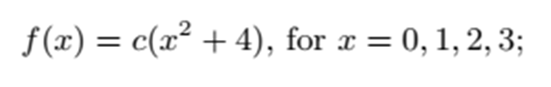
Example # 08
Find the value of c so that the following function can serve as a probability distribution of the discrete random variable X:
Notes:
C = 1/30

