Slide 1
Learn OpenGL

Slide 2
建议
1. 结合代码演示
2. Git的使用 3. Cmake工程化
4. C++学习
5. Ray tracing 6. 会不会开娱乐化的模块(唱歌，跳舞，美食，书评，基金…)

Slide 3
目录
CONTENTS
1
Assimp介绍
3
Assimp使用
2
Assimp 数据结构

Slide 4
1
Assimp介绍

Slide 5
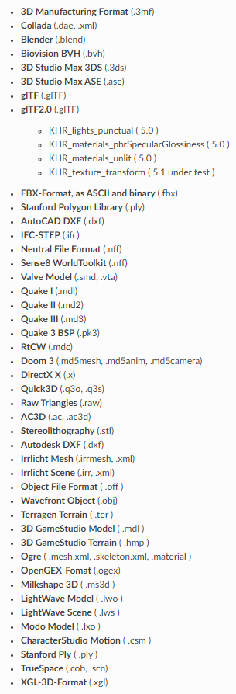
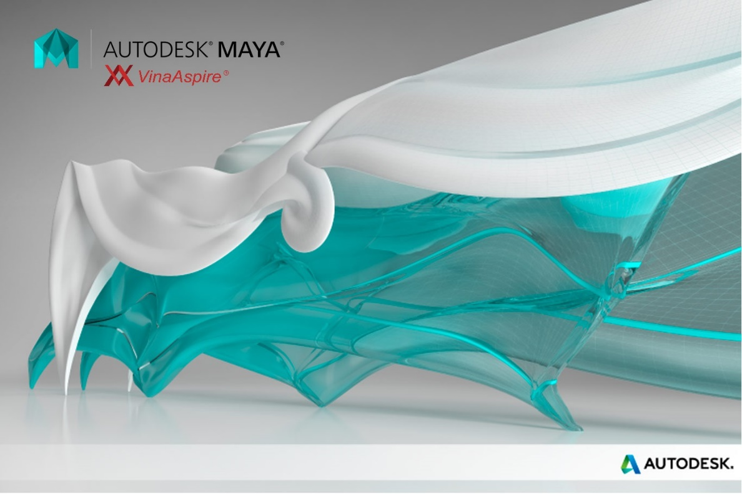


Assimp介绍

Slide 6
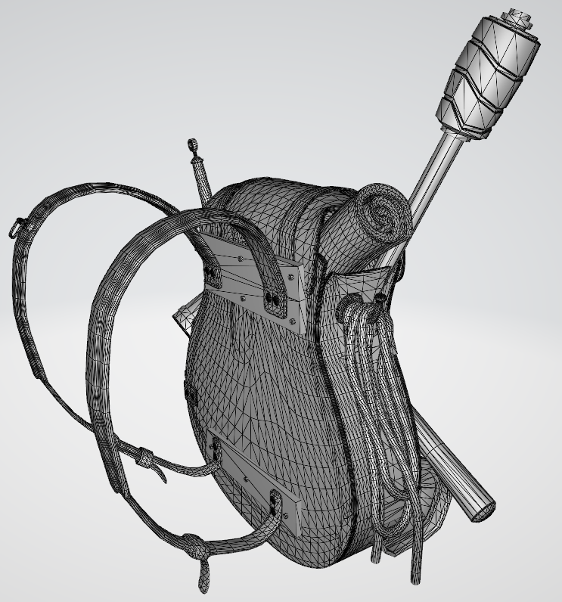
Assimp介绍
自定义 加载器
引用 三方库

Slide 7
Assimp介绍
文档：https://assimp-docs.readthedocs.io/en/v5.1.0/index.html
源码：https://github.com/assimp/assimp
Vertex/Index Buffer
Assimp 数据结构
Textures

Slide 8
2
Assimp数据结构

Slide 9
Assimp数据结构
aiMesh mVertices[] mNormals[]
mTextureCoords[] mFaces[] mMaterialIndex[]
aiScene mNumMeshes=3 mNumMaterials=2
aiFace unsigned int mIndices[]
aiMaterial Textures

Slide 10
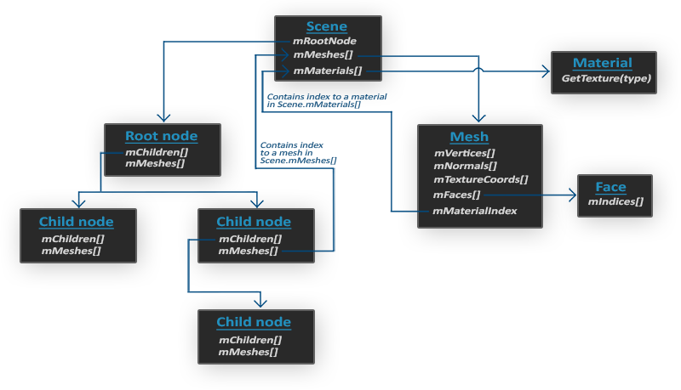
Assimp数据结构

Slide 11
3
Assimp使用

Slide 12
Assimp使用
导入模型
void Entity::AddMeshNode(const std::string& strPath, std::shared_ptr<RenderState>& spRenderState)
{
Assimp::Importer importer;
const aiScene* scene = importer.ReadFile(strPath, aiProcess_Triangulate | aiProcess_GenSmoothNormals
| aiProcess_FlipUVs | aiProcess_CalcTangentSpace);
if (!scene || scene->mFlags & AI_SCENE_FLAGS_INCOMPLETE || !scene->mRootNode)
{
std::cout << "Error::ASSIMP::" << importer.GetErrorString() << std::endl;
return;
}
ProcessMeshNode(scene->mRootNode, scene, strPath, spRenderState);
}
void Entity::ProcessMeshNode(aiNode* node, const aiScene* scene, const std::string& strPath,
std::shared_ptr<RenderState>& spRenderState)
{
for (int i = 0; i < node->mNumMeshes; i++)
{
aiMesh* mesh = scene->mMeshes[node->mMeshes[i]];
auto spMeshNode = std::make_shared<MeshNode>();
spMeshNode->SetRenderState(spRenderState);
spMeshNode->ProcessMesh(mesh, scene, strPath);
m_listNode.push_back(spMeshNode);
}
for (int i = 0; i < node->mNumChildren; i++)
{
ProcessMeshNode(node->mChildren[i], scene, strPath, spRenderState);
}
}

Slide 13
Assimp使用
网格处理
std::vector<Vertex> vecVertices;
for (unsigned int i = 0; i < pMesh->mNumVertices; i++)
{
Vertex vertex;
vertex.Position = glm::vec3(pMesh->mVertices[i].x, pMesh->mVertices[i].y, pMesh->mVertices[i].z);
if (pMesh->HasNormals())
{
vertex.Normal = glm::vec3(pMesh->mNormals[i].x, pMesh->mNormals[i].y, pMesh->mNormals[i].z);
}
if (pMesh->mTextureCoords[0])
{
vertex.TexCoords = glm::vec2(pMesh->mTextureCoords[0][i].x, pMesh->mTextureCoords[0][i].y);
vertex.Tangent = glm::vec3(pMesh->mTangents[i].x, pMesh->mTangents[i].y, pMesh->mTangents[i].z);
vertex.Bitangent = glm::vec3(pMesh->mBitangents[i].x, pMesh->mBitangents[i].y, pMesh->mBitangents[i].z);
}
vecVertices.emplace_back(vertex);
}
SetVertexs(vecVertices);
std::vector<unsigned int> vecIndices;
for (unsigned int i = 0; i < pMesh->mNumFaces; i++)
{
aiFace aiFace = pMesh->mFaces[i];
for (unsigned j = 0; j < aiFace.mNumIndices; j++)
{
vecIndices.emplace_back(aiFace.mIndices[j]);
}
}
SetIndexs(vecIndices);

Slide 14
Assimp使用
材质处理
std::string sDirectory = strPath.substr(0, strPath.find_last_of('/'));
auto& spTexture = m_spRenderState->GetTexture();
aiMaterial* aiMaterial = pScene->mMaterials[pMesh->mMaterialIndex];
LoadMaterialTextures(spTexture, aiMaterial, aiTextureType_DIFFUSE, TextureType::DIFFUSE, sDirectory);
LoadMaterialTextures(spTexture, aiMaterial, aiTextureType_SPECULAR, TextureType::SPECULAR, sDirectory);
LoadMaterialTextures(spTexture, aiMaterial, aiTextureType_HEIGHT, TextureType::NORMAL, sDirectory);
LoadMaterialTextures(spTexture, aiMaterial, aiTextureType_AMBIENT, TextureType::HEIGHT, sDirectory);
void MeshNode::LoadMaterialTextures(std::shared_ptr<Texture>&spTexture, aiMaterial* aiMat,
aiTextureType aiTexture, TextureType eTextureType, const std::string& strPath)
{
for (unsigned int i = 0; i < aiMat->GetTextureCount(aiTexture); i++)
{
aiString path;
aiMat->GetTexture(aiTexture, i,&path);
std::string sPath = strPath + "/" + path.C_Str();
bool skip(false);
for (unsigned int j = 0; j < spTexture->GetTexures().size(); j++)
{
if (std::strcmp(spTexture->GetTexures()[j].sPath.data(), sPath.c_str()) == 0)
{
skip = true;
break;
}
}
if (!skip)
{
spTexture->AddTexture(sPath.c_str(), eTextureType, true);
}
}
}

Slide 15
谢谢大家
THANK YOU FOR WATCHING

