Slide 1
从零开始写引擎

Slide 2
目录
CONTENTS
1
ECS系统
3
Scene序列化/反序列化
2
Scene的构建

Slide 3
1
ECS系统

Slide 4
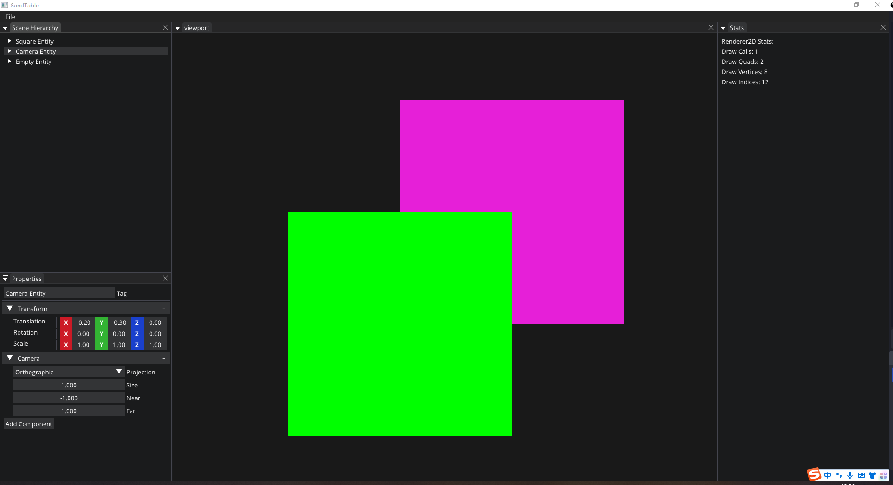
ECS系统

Slide 5
ECS系统
组合
继承

Slide 6
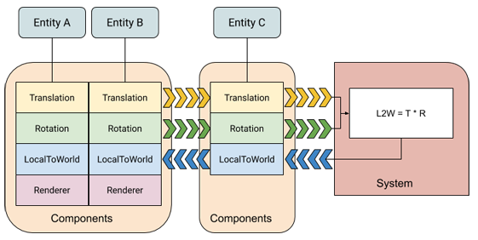
ECS系统
Entity Component System (ECS)
Entity：一个实体可以既没有行为也没有数据；然而，它却决定了哪些数据可以拼凑在一起。
Componet：实体相关联的数据
System：将组件数据从当前状态转换为下一个状态的逻辑。
http://entity-systems.wikidot.com/
https://docs.unity3d.com/Packages/com.unity.entities@0.17/manual/index.html

Slide 7

ECS系统
struct position
{
float x;
float y;
};
struct velocity
{
float dx;
float dy;
};
void update(entt::registry& registry)
{
auto view = registry.view<const position, velocity>();
// use a callback
view.each([](const auto& pos, auto& vel) { /* ... */ });
// use an extended callback
view.each([](const auto entity, const auto& pos, auto& vel) { /* ... */ });
// use a range-for
for (auto [entity, pos, vel] : view.each())
{
// ...
}
// use forward iterators and get only the components of interest
for (auto entity : view)
{
auto& vel = view.get<velocity>(entity);
// ...
}
}
int main()
{
entt::registry registry;
for (auto i = 0u; i < 10u; ++i)
{
const auto entity = registry.create();
registry.emplace<position>(entity, i * 1.f, i * 1.f);
if (i % 2 == 0) { registry.emplace<velocity>(entity, i * .1f, i * .1f); }
}
update(registry);
}
https://github.com/skypjack/entt

Slide 8
2
Scene的构建

Slide 9
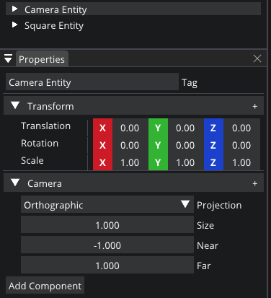
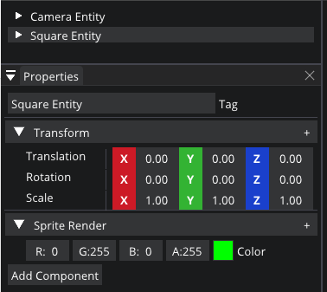
Scene的构建

Slide 10
Scene的构建
struct TransformComponent
{
glm::vec3 Translation = glm::vec3(0.f);
glm::vec3 Rotation = glm::vec3(0.f);
glm::vec3 Scale = glm::vec3(1.f);
TransformComponent() = default;
TransformComponent(const TransformComponent&) = default;
TransformComponent& operator =(const TransformComponent&) = default;
TransformComponent(const glm::vec3 & translation, const glm::vec3 & rotation, const glm::vec3 & scale) :
Translation(translation),
Rotation(rotation),
Scale(scale)
{}
};
struct CameraComponent
{
Ref<SandTable::Camera> OrthoCamera = CreateRef<OrthoGraphicCamera>();
Ref<SandTable::Camera> PerspecCamera = CreateRef<PerspectiveGraphicCamera>();
bool Primary = true;
bool FixedAspectRatio = false;
ProjectionType Projection = ProjectionType::Orthographic;
CameraComponent() = default;
CameraComponent(const CameraComponent&) = default;
CameraComponent& operator =(const CameraComponent&) = default;
CameraComponent(const Ref<SandTable::Camera>& spCamera, bool bPrimary = true, bool bFixedAspectRatio = false)
:OrthoCamera(spCamera), Primary(bPrimary), FixedAspectRatio(bFixedAspectRatio)
{}
};
struct TagComponent
{
std::string Tag = "Entity";
TagComponent() = default;
TagComponent(const TagComponent&) = default;
TagComponent& operator =(const TagComponent&) = default;
TagComponent(const std::string& sTag) :Tag(sTag)
{}
};

Slide 11
Scene的构建
struct TransformComponent
{
glm::vec3 Translation = glm::vec3(0.f);
glm::vec3 Rotation = glm::vec3(0.f);
glm::vec3 Scale = glm::vec3(1.f);
TransformComponent() = default;
TransformComponent(const TransformComponent&) = default;
TransformComponent& operator =(const TransformComponent&) = default;
TransformComponent(const glm::vec3 & translation, const glm::vec3 & rotation, const glm::vec3 & scale) :
Translation(translation),
Rotation(rotation),
Scale(scale)
{}
};
struct SpriteRenderComponent
{
glm::vec4 Color{ 1.f };
SpriteRenderComponent() = default;
SpriteRenderComponent(const SpriteRenderComponent&) = default;
SpriteRenderComponent& operator =(const SpriteRenderComponent&) = default;
SpriteRenderComponent(const glm::vec4& vec4Color) :Color(vec4Color)
{}
operator glm::vec4& () { return Color; }
operator const glm::vec4& ()const { return Color; }
};
struct TagComponent
{
std::string Tag = "Entity";
TagComponent() = default;
TagComponent(const TagComponent&) = default;
TagComponent& operator =(const TagComponent&) = default;
TagComponent(const std::string& sTag) :Tag(sTag)
{}
};

Slide 12
3
Scene序列化/反序列化

Slide 13
Scene序列化/反序列化
YAML通常以.yml为后缀，是一种直观的能够被电脑识别的数据序列化格式，语法简单，适合做配置文件，比 JSON和xml格式要方便很多，并且容易被阅读。
基本语法
基本语法
对象：键值对的集合，又称为映射（mapping）/哈希（hashes）/字典（dictionary）；
数组：一组按次序排列的值，又称为序列（sequence）/列表（list）；
标量（scalars）：单个的、不可再分的值；
大小写敏感；
使用缩进表示层级关系；
缩进不允许使用tab，只允许空格
缩进的空格数不重要，只要相同层级的元素左对齐即可
'#'表示注释；
https://github.com/jbeder/yaml-cpp
https://github.com/jbeder/yaml-cpp/wiki/How-To-Emit-YAML

Slide 14
Scene序列化/反序列化
bool SceneSerializer::DeSerialize(const std::string& sFilePath)
{
std::ifstream stream(sFilePath);
std::stringstream sStream;
sStream << stream.rdbuf();
YAML::Node data = YAML::Load(sStream.str());
std::string sSceneName = data["Scene"].as<std::string>();
auto entities = data["Entities"];
for (auto entity : entities)
{
uint64_t uuid = entity["Entity"].as<uint64_t>();
std::string sName;
auto tagComponent = entity["TagComponent"];
if (tagComponent)
sName = tagComponent["Tag"].as<std::string>();
Ref<Entity> deserializedEntity = m_spScene->CreateEntity(sName);
auto transformComponent = entity["TransformComponent"];
if (transformComponent)
{
}
auto cameraComponent = entity["CameraComponent"];
if (cameraComponent)
{
}
auto spriteRenderComponent = entity["SpriteRenderComponent"];
if (spriteRenderComponent)
{
}
}
return true;
}
void SceneSerializer::Serialize(const std::string& sFilePath)
{
YAML::Emitter out;
out << YAML::BeginMap;
out << YAML::Key << "Scene" << YAML::Value << "Untitled";
out << YAML::Key << "Entities" << YAML::Value << YAML::BeginSeq;
auto spRegistry = m_spScene->Registry();
spRegistry->each([&](auto entityID)
{
Entity entity(spRegistry, entityID);
SerializeEntity(out, entity);
});
out << YAML::EndSeq;
out << YAML::EndMap;
std::ofstream fout(sFilePath);
fout << out.c_str();
}

Slide 15
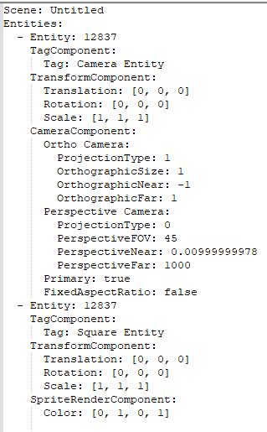
Scene序列化/反序列化
void SceneSerializer::Serialize(const std::string& sFilePath)
{
YAML::Emitter out;
out << YAML::BeginMap;
out << YAML::Key << "Scene" << YAML::Value << "Untitled";
out << YAML::Key << "Entities" << YAML::Value << YAML::BeginSeq;
auto spRegistry = m_spScene->Registry();
spRegistry->each([&](auto entityID)
{
Entity entity(spRegistry, entityID);
SerializeEntity(out, entity);
});
out << YAML::EndSeq;
out << YAML::EndMap;
std::ofstream fout(sFilePath);
fout << out.c_str();
}

Slide 16
谢谢大家
THANK YOU FOR WATCHING

