Slide 1
从零开始写引擎

Slide 2
目录
CONTENTS
1
物理系统
2
场景搭建

Slide 3
1
物理系统

Slide 4
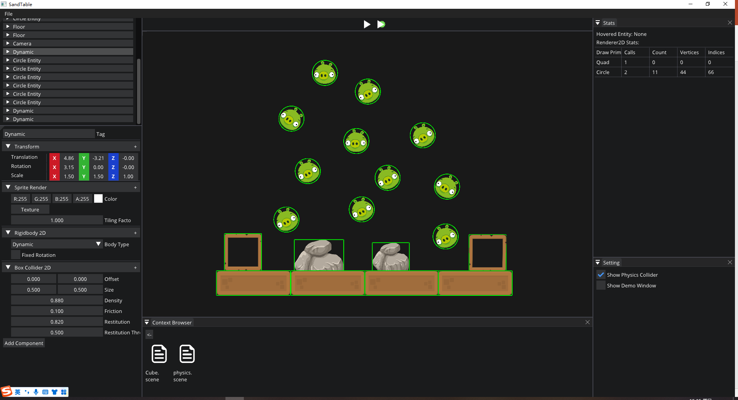
物理系统

Slide 5
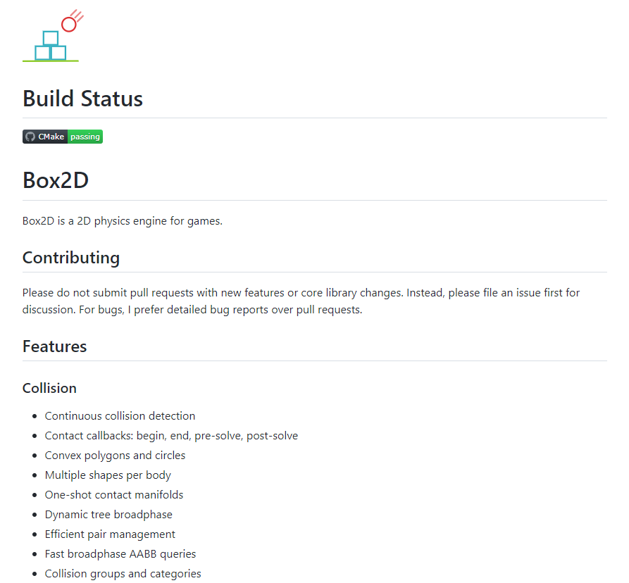
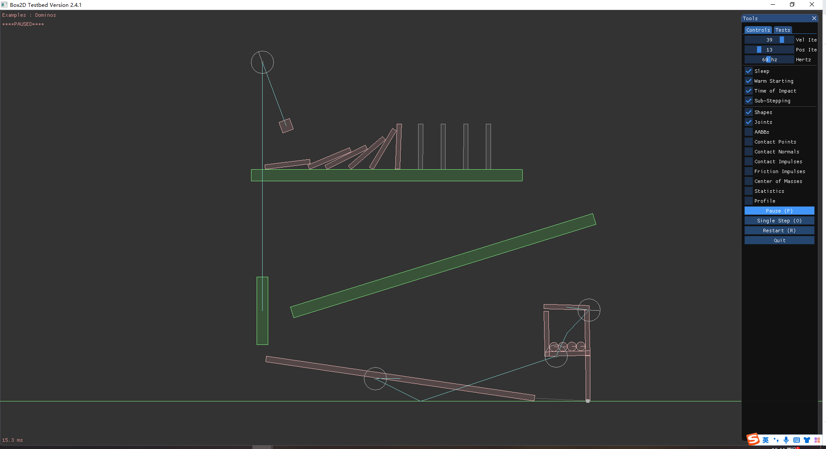
物理系统
从游戏引擎的角度来看，物理系统是一个程序动画系统。Box2D 是一个用于游戏的 2D 刚体模拟库，使对象能够以逼真的方式移动，从而使游戏世界更具交互性。
https://github.com/erincatto/box2d
https://box2d.org/documentation/index.html

Slide 6
物理系统
从游戏引擎的角度来看，物理系统是一个程序动画系统。Box2D 是一个用于游戏的 2D 刚体模拟库，使对象能够以逼真的方式移动，从而使游戏世界更具交互性。
PhysicsSystem2D::PhysicsSystem2D()
{
m_spPhysicsWorld = CreateRef<b2World>(b2Vec2(0.f, -9.8f));
}
PhysicsSystem2D::~PhysicsSystem2D()
{
m_spPhysicsWorld->DestroyBody(m_pBody);
}
void PhysicsSystem2D::CreateBody(RigidBody2DComponent& rigidBody2D, const TransformComponent& transform)
{
b2BodyDef bodyDef;
bodyDef.type = RigidBodyTypeToBox2D(rigidBody2D.Type);
bodyDef.position.Set(transform.Translation.x, transform.Translation.y);
bodyDef.angle = transform.Rotation.z;
m_pBody = m_spPhysicsWorld->CreateBody(&bodyDef);
m_pBody->SetFixedRotation(bodyDef.fixedRotation);
rigidBody2D.RuntimeBody = m_pBody;
}
https://github.com/erincatto/box2d
https://box2d.org/documentation/index.html

Slide 7
物理系统
从游戏引擎的角度来看，物理系统是一个程序动画系统。Box2D 是一个用于游戏的 2D 刚体模拟库，使对象能够以逼真的方式移动，从而使游戏世界更具交互性。
void PhysicsSystem2D::CreatePolygonShape(BoxCollider2DComponent& boxCollider2D, const TransformComponent& transform)
{
b2PolygonShape polygonShape;
polygonShape.SetAsBox(boxCollider2D.Size.x * transform.Scale.x, boxCollider2D.Size.y * transform.Scale.y);
b2FixtureDef fixtureDef;
fixtureDef.shape = &polygonShape;
fixtureDef.density = boxCollider2D.Density;
fixtureDef.friction = boxCollider2D.Friction;
fixtureDef.restitution = boxCollider2D.Restitution;
fixtureDef.restitutionThreshold = boxCollider2D.RestitutionThreshold;
m_pBody->CreateFixture(&fixtureDef);
}
void PhysicsSystem2D::CreateCircleShape(CircleCollider2DComponent& circleCollider2D, const TransformComponent& transform)
{
b2CircleShape circleShape;
circleShape.m_p.Set(circleCollider2D.Offset.x, circleCollider2D.Offset.y);
circleShape.m_radius = circleCollider2D.Radius * transform.Scale.x;
b2FixtureDef fixtureDef;
fixtureDef.shape = &circleShape;
fixtureDef.density = circleCollider2D.Density;
fixtureDef.friction = circleCollider2D.Friction;
fixtureDef.restitution = circleCollider2D.Restitution;
fixtureDef.restitutionThreshold = circleCollider2D.RestitutionThreshold;
m_pBody->CreateFixture(&fixtureDef);
}
https://github.com/erincatto/box2d
https://box2d.org/documentation/index.html

Slide 8
物理系统
从游戏引擎的角度来看，物理系统是一个程序动画系统。Box2D 是一个用于游戏的 2D 刚体模拟库，使对象能够以逼真的方式移动，从而使游戏世界更具交互性。
void PhysicsSystem2D::OnUpdate(const TimeStep& timeStep)
{
m_spPhysicsWorld->Step(timeStep, uiVelocityIterations, uiPositionIterations);
}
void PhysicsSystem2D::UpdateSystem(RigidBody2DComponent& rigidBody2D, TransformComponent& transform)
{
b2Body* pB2Body = (b2Body*)rigidBody2D.RuntimeBody;
transform.Translation.x = pB2Body->GetPosition().x;
transform.Translation.y = pB2Body->GetPosition().y;
transform.Rotation.z = pB2Body->GetAngle();
}
https://github.com/erincatto/box2d
https://box2d.org/documentation/index.html

Slide 9

物理系统
如果 ：
如果 ：

Slide 10
物理系统
void main()
{
vec4 texColor = texture(u_Textures[int(v_TexIndex)], Input.TexCoord);
if(texColor.a < 0.00001)
discard;
// Calculate distance and fill circle with white
float distance = 1.0 - length(Input.LocalPosition);
float circle = smoothstep(0.0, Input.Fade, distance);
circle *= smoothstep(Input.Thickness + Input.Fade, Input.Thickness, distance);
if (circle == 0.0)
discard;
// Set output color
o_Color = texColor * Input.Color;
o_Color.a *= circle;
o_EntityID = int(v_EntityID);
}

Slide 11
2
场景搭建

Slide 12
场景搭建

Slide 13
谢谢大家
THANK YOU FOR WATCHING

