Slide 1
从零开始写引擎

Slide 2
目录
CONTENTS
1
物理系统
2
场景搭建

Slide 3
1
物理系统

Slide 4
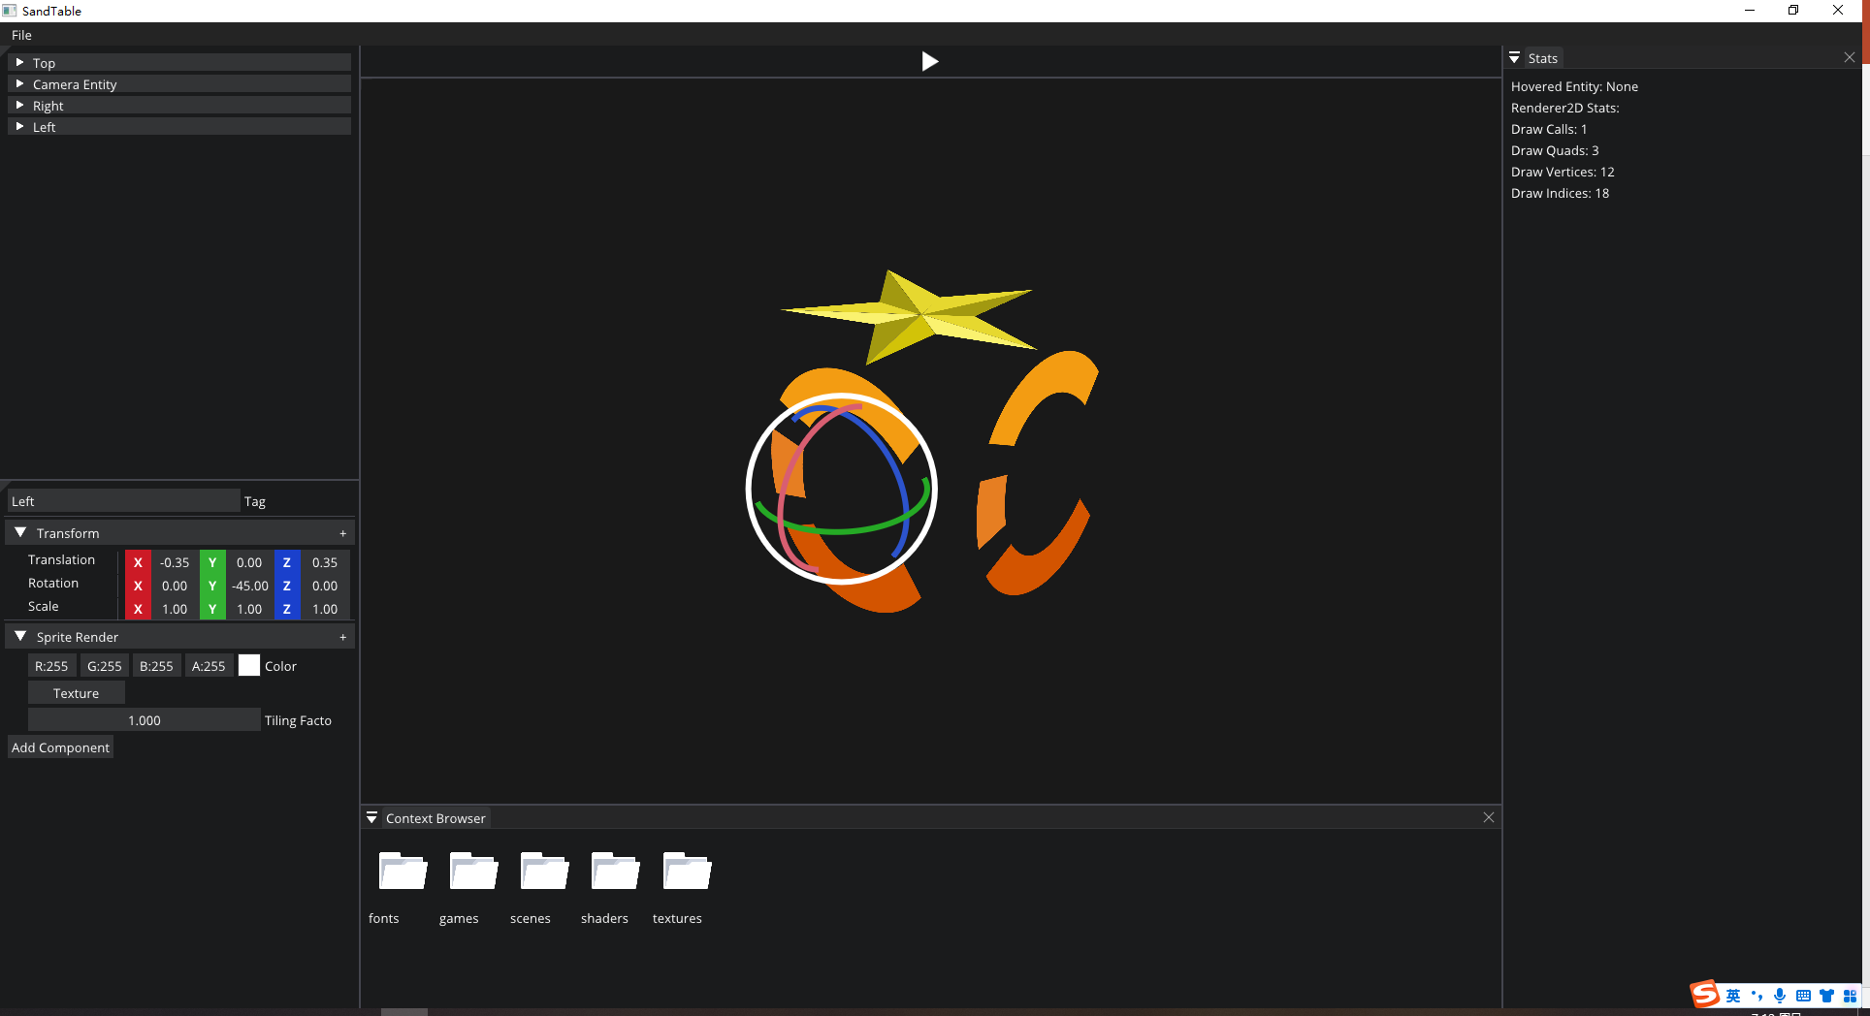
物理系统

Slide 5
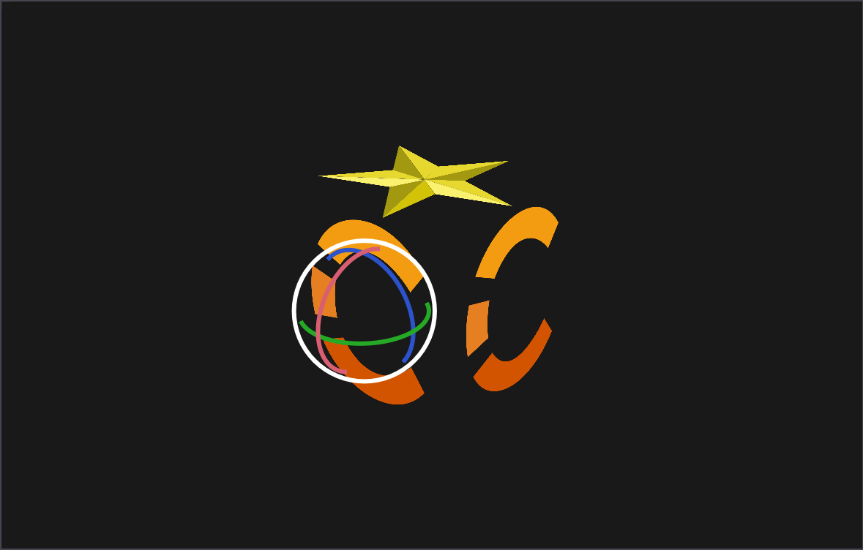
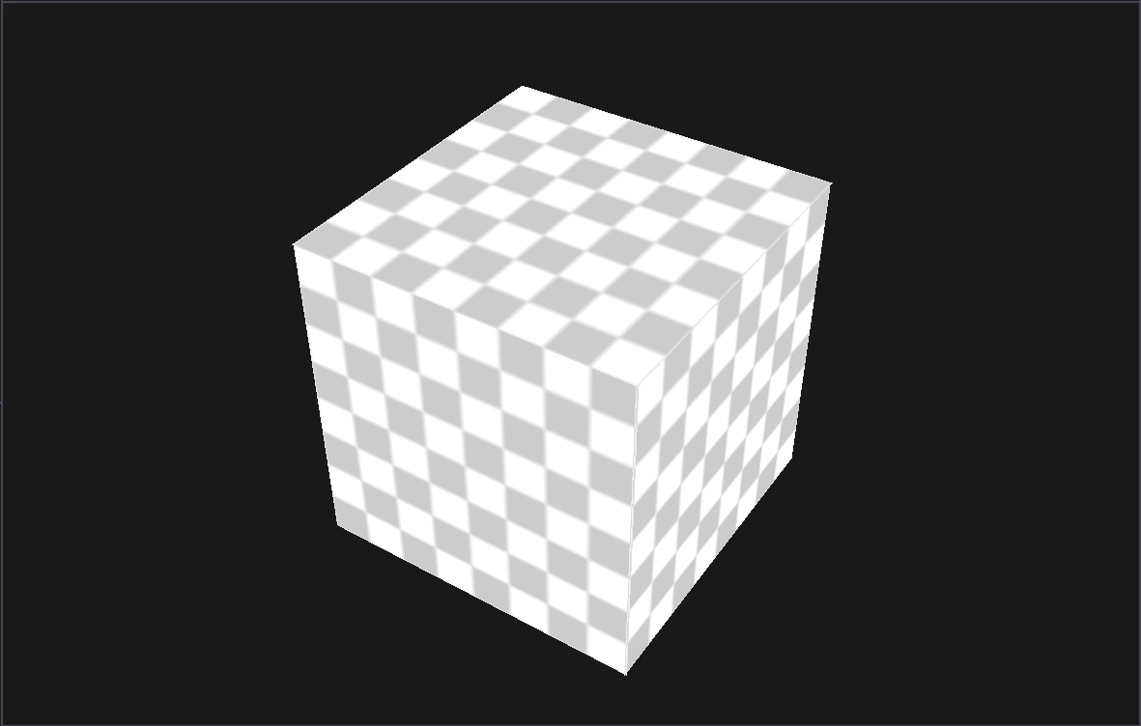
实体交互
2
0
1
-1

Slide 6
实体交互
2
1
0
-1

Slide 7
实体交互
2
#version 450 core
layout(location = 0) out vec4 o_Color;
layout(location = 1) out int o_EntityID;
layout (binding = 0) uniform sampler2D u_Textures[32];
struct VertexOutput
{
vec4 Color;
vec2 TexCoord;
float TilingFactor;
};
layout (location = 0) in VertexOutput Input;
layout (location = 3) in flat float v_TexIndex;
layout (location = 4) in flat float v_EntityID;
void main()
{
vec4 texColor = texture(u_Textures[int(v_TexIndex)], Input.TexCoord * Input.TilingFactor);
if(texColor.a < 0.00001)
discard;
o_Color = texColor * Input.Color;
o_EntityID = int(v_EntityID);
}
0
1
-1
int OpenGLFrameBuffer::ReadPixel(unsigned int uiIndex, unsigned int uiX, unsigned int uiY) const
{
glReadBuffer(GL_COLOR_ATTACHMENT0 + uiIndex);
int uiPixelData;
glReadPixels(uiX, uiY, 1, 1, GL_RED_INTEGER, GL_INT, &uiPixelData);
return uiPixelData;
}

Slide 8
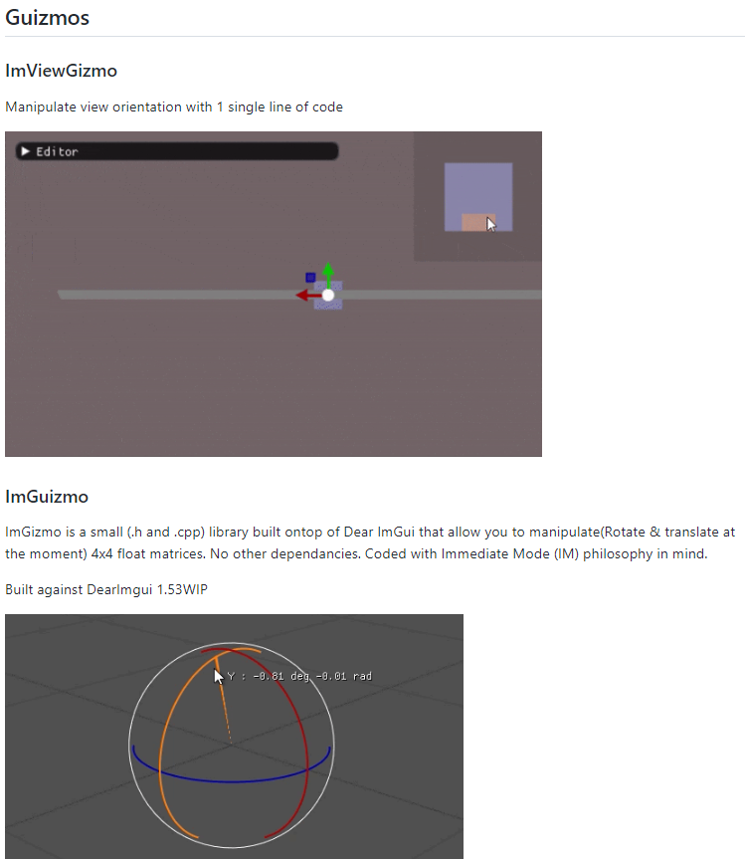
实体交互
https://github.com/CedricGuillemet/ImGuizmo

Slide 9
实体交互
const glm::mat4& cameraProjection = m_spEditCamera->GetProjectionMatrix();
const glm::mat4& cameraView = m_spEditCamera->GetViewMatrix();
// Entity transform
auto& transformComponent = spSelectedEntity->GetComponent<TransformComponent>();
glm::mat4 transform = transformComponent.GetTransform();
//snapping
bool snap = Input::IsKeyPressed(Key::LeftControl);
float snapValue = 0.5f;
if (static_cast<ImGuizmo::OPERATION>(m_iGizmoType) == ImGuizmo::OPERATION::ROTATE)
{
snapValue = 45.f;
}
glm::vec3 snapValues(snapValue);
ImGuizmo::Manipulate(glm::value_ptr(cameraView), glm::value_ptr(cameraProjection),
static_cast<ImGuizmo::OPERATION>(m_iGizmoType), ImGuizmo::LOCAL, glm::value_ptr(transform),
nullptr, snap ? glm::value_ptr(snapValues) : nullptr);
if (ImGuizmo::IsUsing())
{
glm::vec3 translation, rotation, scale;
MathUtils::DecomposeTransform(transform, translation, rotation, scale);
glm::vec3 deltaRotation = rotation - transformComponent.Rotation;
transformComponent.Translation = translation;
transformComponent.Rotation += deltaRotation;
transformComponent.Scale = scale;
}

Slide 10
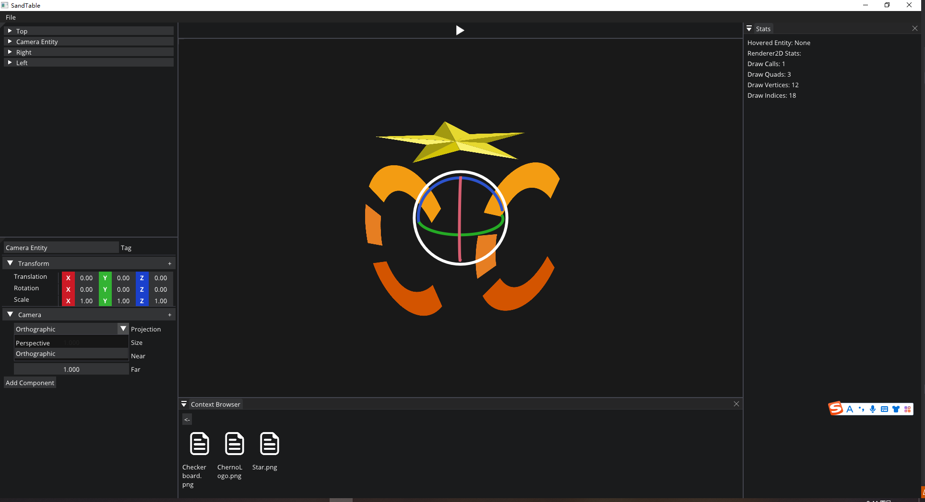
实体交互
Edit Camera

Slide 11
2
资源加载

Slide 12
资源加载

Slide 13
资源加载
ImGui::Button("Texture", ImVec2(100.f, 0.0f));
if (ImGui::BeginDragDropTarget())
{
if (const ImGuiPayload* payload = ImGui::AcceptDragDropPayload("CONTENT_BROWSER_ITEM"))
{
const wchar_t* path = (const wchar_t*)payload->Data;
auto texturePath = std::filesystem::path(sAssetsDirector) / path;
component.spTexture = Texture2D::Create(texturePath.string());
}
ImGui::EndDragDropTarget();
}
void Render2D::DrawSprite(const glm::mat4& mat4Transform, const SpriteRenderComponent& spriteRenderComponent, int iEntityID)
{
if (spriteRenderComponent.spTexture != nullptr)
{
DrawQuad(mat4Transform, spriteRenderComponent.spTexture, spriteRenderComponent.TilingFactor, spriteRenderComponent.Color, iEntityID);
}
else
{
DrawQuad(mat4Transform, spriteRenderComponent.Color, iEntityID);
}
}

Slide 14
资源加载
if (ImGui::BeginDragDropTarget())
{
if (const ImGuiPayload* payload = ImGui::AcceptDragDropPayload("CONTENT_BROWSER_ITEM"))
{
const wchar_t* path = (const wchar_t*)payload->Data;
OpenScene(std::filesystem::path(sAssetsDirector) / path);
}
ImGui::EndDragDropTarget();
}
void SandBoxEditorLayer::OpenScene(const std::filesystem::path& path)
{
m_spScene = CreateRef<Scene>();
m_spScene->OnViewPortResize(m_vec2RenderViewPortSize.x, m_vec2RenderViewPortSize.y);
m_spSceneHierarchyPanel->SetSelectedScene(m_spScene);
m_spSceneSerializer->SetSelectedScene(m_spScene);
m_spSceneSerializer->DeSerialize(path.string());
}

Slide 15
谢谢大家
THANK YOU FOR WATCHING

