Slide 1
从零开始写引擎

Slide 2
目录
CONTENTS
1
2D渲染器
2
可视化性能分析

Slide 3
1
2D渲染器

Slide 4
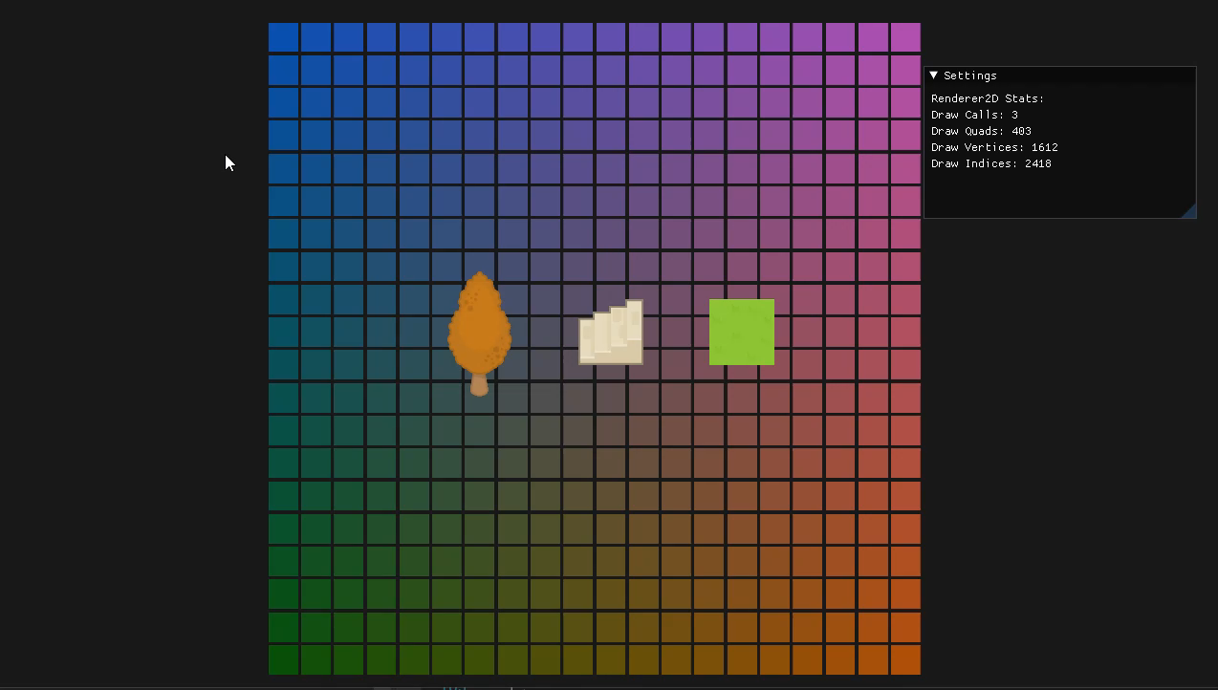
2D渲染器
2D粒子系统
Sub Texture
批处理绘制

Slide 5
2
批处理绘制

Slide 6

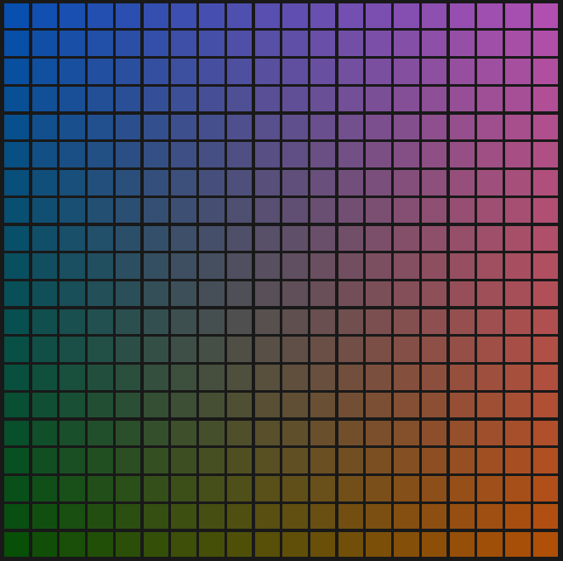

批处理绘制

Slide 7
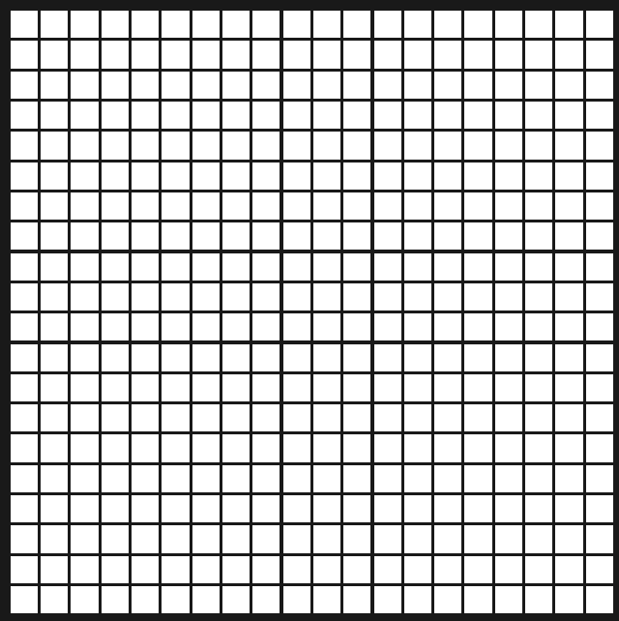
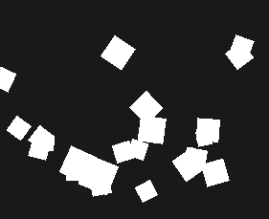
批处理绘制

Slide 8
批处理绘制
struct Render2DStroge
{
unsigned int QuadIndexCount = 0;
const unsigned int MaxQuads = 10000;
const unsigned int MaxVertices = MaxQuads * 4;
const unsigned int MaxIndices = MaxQuads * 6;
Ref<VertexArray> VertexArray;
std::vector<Vertex> Vertex;
std::array<glm::vec4, 4> VertexPosition;
Ref<Buffer> VertexBuffer;
Ref<Shader> Shader;
std::unordered_map<unsigned int, Ref<Texture>> TextureSlots;
Ref<Texture> WhiteTexture;
std::array<glm::vec2, 4> TextureCoord;
};

Slide 9
批处理绘制
#version 420 core
layout (location = 0) in vec3 a_Position;
layout (location = 1) in vec4 a_Color;
layout (location = 2) in vec2 a_TexCoord;
layout (location = 3) in float a_TexIndex;
layout (location = 4) in float a_TilingFactor;
uniform mat4 ViewProjection;
out VS_OUT {
vec4 v_Color;
vec2 v_TexCoord;
float v_TexIndex;
float v_TilingFactor;
} vs_out;
void main()
{
gl_Position = ViewProjection * vec4(a_Position, 1.0);
vs_out.v_Color = a_Color;
vs_out.v_TexCoord = a_TexCoord;
vs_out.v_TexIndex = a_TexIndex;
vs_out.v_TilingFactor = a_TilingFactor;
}
struct Render2DStroge
{
unsigned int QuadIndexCount = 0;
const unsigned int MaxQuads = 10000;
const unsigned int MaxVertices = MaxQuads * 4;
const unsigned int MaxIndices = MaxQuads * 6;
Ref<VertexArray> VertexArray;
std::vector<Vertex> Vertex;
std::array<glm::vec4, 4> VertexPosition;
Ref<Buffer> VertexBuffer;
Ref<Shader> Shader;
std::unordered_map<unsigned int, Ref<Texture>> TextureSlots;
Ref<Texture> WhiteTexture;
std::array<glm::vec2, 4> TextureCoord;
};

Slide 10
批处理绘制
struct Render2DStroge
{
unsigned int QuadIndexCount = 0;
const unsigned int MaxQuads = 10000;
const unsigned int MaxVertices = MaxQuads * 4;
const unsigned int MaxIndices = MaxQuads * 6;
Ref<VertexArray> VertexArray;
std::vector<Vertex> Vertex;
std::array<glm::vec4, 4> VertexPosition;
Ref<Buffer> VertexBuffer;
Ref<Shader> Shader;
std::unordered_map<unsigned int, Ref<Texture>> TextureSlots;
Ref<Texture> WhiteTexture;
std::array<glm::vec2, 4> TextureCoord;
};
#version 420 core
out vec4 FragColor;
uniform sampler2D u_Textures[32];
in VS_OUT {
vec4 v_Color;
vec2 v_TexCoord;
float v_TexIndex;
float v_TilingFactor;
} fs_in;
void main()
{
vec4 texColor=texture(u_Textures[int(fs_in.v_TexIndex)], fs_in.v_TexCoord * fs_in.v_TilingFactor);
if(texColor.a < 0.1)
discard;
FragColor = texColor * fs_in.v_Color;
}

Slide 11
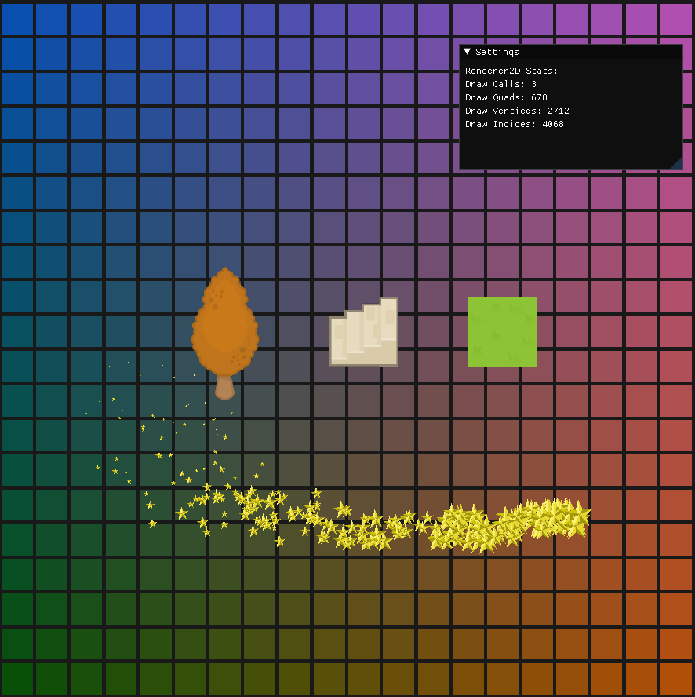
批处理绘制
struct Statistics
{
unsigned int DrawCalls;
unsigned int QuadCount;
unsigned int GetTotalVertexCount() { return QuadCount * 4; }
unsigned int GetTotalIndexCount() { return QuadCount * 6; }
};

Slide 12
3
Sub Texture

Slide 13

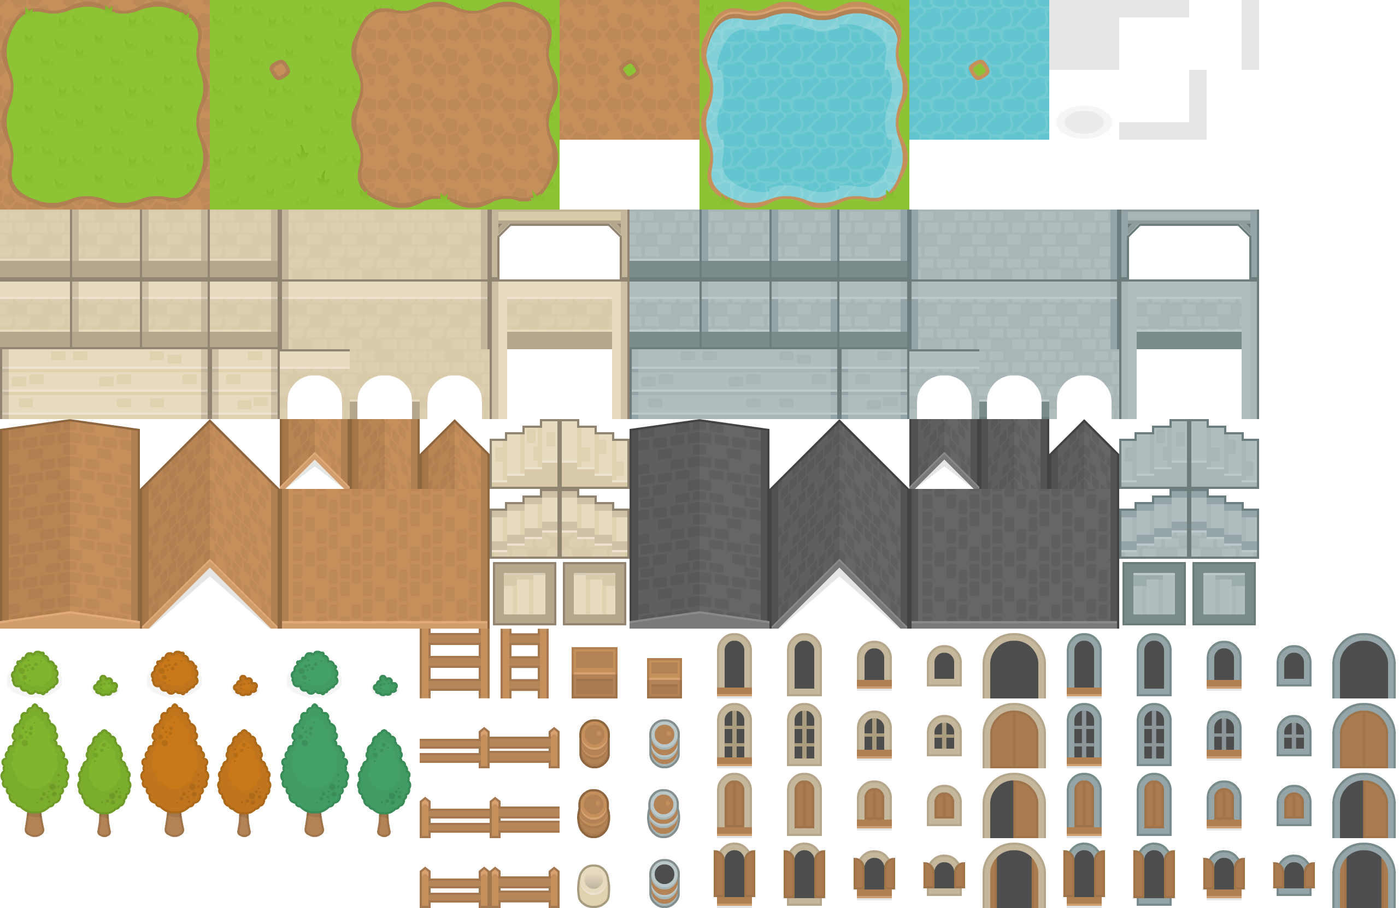


Sub Texture
https://kenney.nl/assets

Slide 14
Sub Texture
SubTexture2D::SubTexture2D(const Ref<Texture>& spTexture, const glm::vec2& vec2Coords,const glm::vec2& vec2TileSize, const glm::vec2& vec2Offset):
m_spTexture(spTexture)
{
float fXMin = vec2Coords.x * vec2TileSize.x / m_spTexture->GetWidth();
float fYMin = vec2Coords.y * vec2TileSize.y / m_spTexture->GetHeight();
float fXMax = (vec2Coords.x + vec2Offset.x) * vec2TileSize.x / m_spTexture->GetWidth();
float fYMax = (vec2Coords.y + vec2Offset.y) * vec2TileSize.y / m_spTexture->GetHeight();
m_arrTexCoord[0] = glm::vec2(fXMin, fYMin);
m_arrTexCoord[1] = glm::vec2(fXMax, fYMin);
m_arrTexCoord[2] = glm::vec2(fXMax, fYMax);
m_arrTexCoord[3] = glm::vec2(fXMin, fYMax);
}
Offset
TileSize
Coords

Slide 15
4
2D粒子系统

Slide 16
2D粒子系统

Slide 17
2D粒子系统

Slide 18
5
可视化性能分析

Slide 19
可视化性能分析

Slide 20
可视化性能分析

Slide 21
谢谢大家
THANK YOU FOR WATCHING

